Slide 1
Maryland Ecological Forecasting
Utilizing NASA Earth Observations to Monitor and Strengthen the Survivorship of Maryland’s Sea Turtles
Chris Long (Project Lead)
Erica Scaduto
Kiersten Newtoff

Slide 2
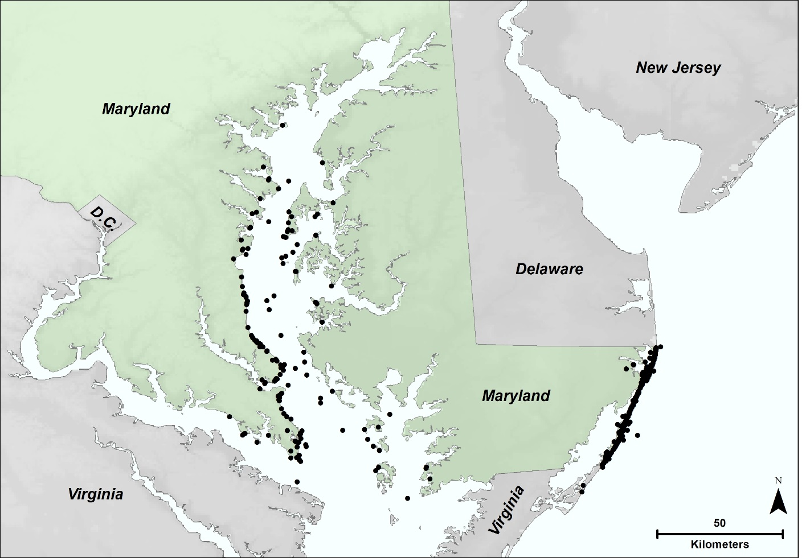
Study Region
Atlantic and Chesapeake Bay coast of Maryland
569 sea turtle strandings since 1991
All strandings are reported to Maryland Department of Natural Resources
Sea Turtle Stranding (1991-2014)
Source: Maryland Department of Natural Resources
Notes:
For this study, we focused on Maryland’s coastline which touches the Atlantic Ocean and Chesapeake Bay. Since 1991, there have been 569 sea turtle strandings which are marked here with black dots. Sea turtle strandings refer to dead sea turtles that have either washed up on shore or were identified from boat. Strandings include green sea turtles, loggerheads, kemp’s ridley, but 80% were loggerheads and are the focus of our study. The cause of the strandings are sometimes easy to determine such as a boat strike, but other times environmental variables such as temperature of algae activity can cause death. Any time a turtle is recovered, it gets reported to our partners, the Maryland Department of Natural Resources, for recovery and testing.

Slide 3
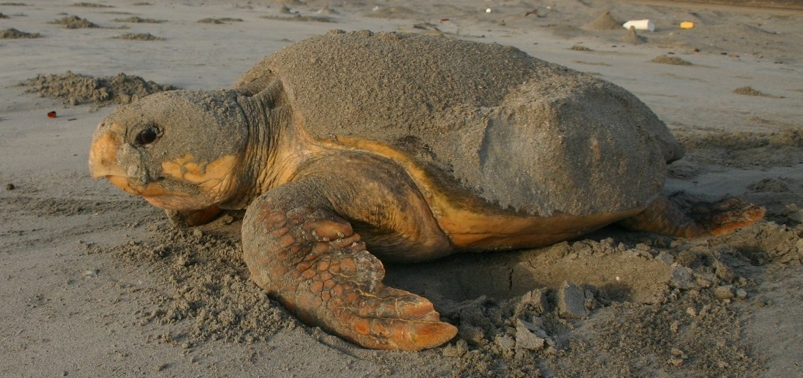
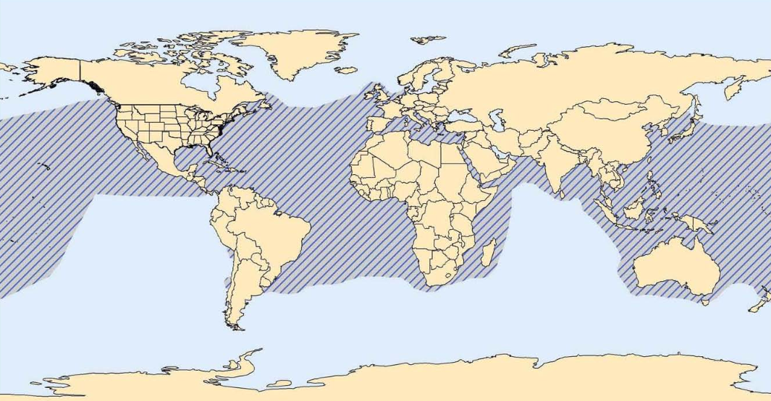
Study Species
Loggerhead sea turtle (Caretta caretta)
Threatened in U.S.
Endangered worldwide
Worldwide distribution
Nests subtropical to warm temperate climates
Blair Witherington
National Marine Fisheries Service, Office of Protected Resources
Notes:
Due to the high prevalence of stranding, we focused our research on the loggerhead sea turtle, Caretta caretta. In the United States they are listed as threatened on the Endangered Species List. Their worldwide distribution is Endangered on the IUCN Red list. Although they can be found across the globe, their nesting is limited to warm temperate climates and the subtropics due to the need for warmer temperatures for hatchlings. At the moment, nesting events are quite rare along Maryland’s coasts.
Turtle image source: https://www.flickr.com/photos/myfwc/15224181729/in/photolist-ptMfSG-pciMYD-pciUPT
Distribution image source: http://www.nmfs.noaa.gov/pr/pdfs/rangemaps/loggerhead_turtle.pdf

Slide 4
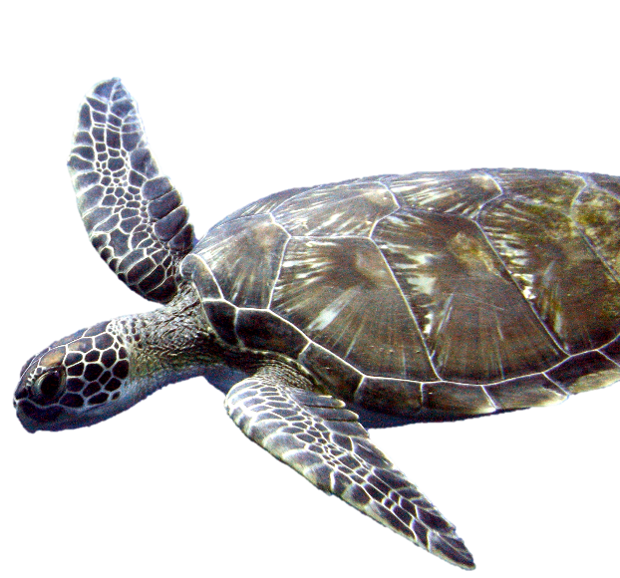
Objectives
Matt Kleffer
Analyze correlations between loggerhead strandings and chlorophyll-a and sea surface temperature
Stranding
Nesting
Identify optimal nesting locations along Atlantic Coast
Climate Change
Predict changes in nest site use and availability
Notes:
Overall, our objectives for this study focus on three major topics: stranding, nesting, and climate change. For stranding, our goal is to determine if there is a relationship between sea surface temperatures, chlorophyll a, and sea turtle strandings to better aid the DNR in recovery. We also want to identify the best nesting locations for loggerheads along the Maryland Atlantic coastline. The most suitable locations can be protected by wildlife personnel. Finally, we want to see how loggerhead nesting will be affected by climate change. In particular, we want to generate an idea of when nesting may move northward and also to account for sea level rise in identifying the beaches that need to be conserved.
Image: https://www.flickr.com/photos/mattkieffer/5287428193/in/photolist-94esc4-kHp2XC-cFvwL1-8qDP7G-jdbqM3-ehDM8y-bpytkw-dskgub-9A1NoD-or4kzn-5n59LX-nZRToJ-ohaMxN-7fji-aZX74r-4Uk5be-666WTD-paP35u-b4TnDv-7JzePt-9tfMjB-9tiJhN-9tiJCJ-smA95B-4UpnoJ-mZ3SWr-mZ5H6G-mZ3SpX-mZ3T4c-fq2qSf-fq2gNY-fq2eh1-bBv2j4-5m7doh-aCZYKs-7vriAM-4UpnmY-6F7VEy-nPPfAv-5rF57M-4Uk59D-7o6mWZ-5rF54T-qyhReF-9AHJGq-fpLVXH-fpLT8n-mZ3THi-fpLQQk-bUnkHQ

Slide 5
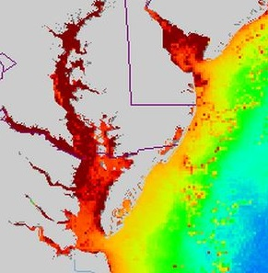
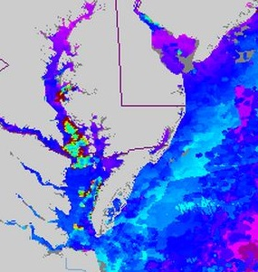
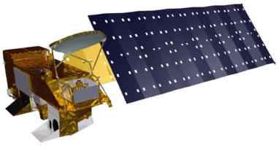

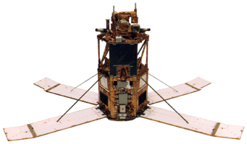
Stranding: Data Acquisition
Satellite | Sensor | Years | Parameter
Aqua | MODIS | 2003-2014 | Chlorophyll-a
OrbView 2 | SeaWiFS | 1998-2002 | Chlorophyll-a
Terra | MODIS | 2000-2014 | Sea Surface Temperature
NOAA-17 NOAA-18 | AVHRR | 1991-1999 | Sea Surface Temperature
Source: NOAA CoastWatch Program and NASA’s Goddard Space Flight Center, Ocean Color Web
Chlorophyll-a
Aqua
OrbView-2
Terra
Sea Surface Temperature
Notes:
To further understand loggerhead strandings, locational information on sea turtle strandings were obtained from the Maryland Department of Natural Resources, which included GPS coordinates and additional data including species, morphology, possible cause of death, among others.
Additionally, chlorophyll-a and sea surface temperature (SST) datasets were obtained as 8-day composites from SeaWIFS, Aqua Moderate Resolution Imaging Spectroradiometer (MODIS), and Advanced Very High Resolution Radiometer (AVHRR) using the NOAA CoastWatch Program’s Environmental Research Division’s Data Access Program (ERDDAP). These oceanic datasets were gathered based on sea turtle stranding dates, specifically in the peak months of May to October from 1991 to present. (should I talk about the different algorithms used for chla and sst detection?)

Slide 6
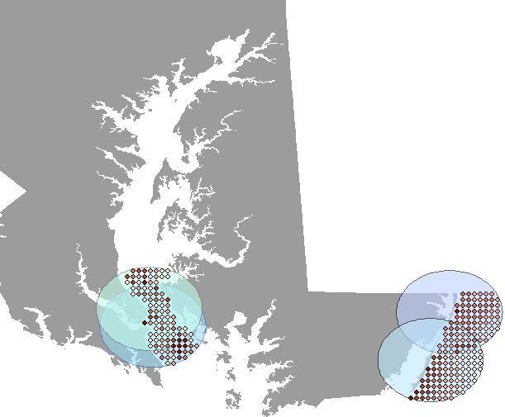
Stranding: Methodology
Examine SST and Chl-a within 20km of stranding
Average 8-day composites from 1-4 weeks prior to the stranding date
Calculate Pearson’s r correlation relationship between stranding and oceanic variables
Notes:
After data acquisition, data processing was done mainly through scripting custom functions with Python programming in order to automate the process. Once, the ESRI ASCII formatted datasets were rasterized for chlorophyll-a and sea surface temperature, they were converted to point vector format to easily intersect the oceanic data to the region of interest. Then for each unique stranding a 20-km buffer zone was created and intersected to calculate the average value of chlorophyll and sea surface temperature within the greatest likely area of death. The 8-day composites from 1-4 weeks prior to the stranding date were used dependent on decomposition rate. Lastly, data analysis and visualization were done through libraries such as scipy and seaborn to determine the relationship between stranding and the oceanic variables.

Slide 7
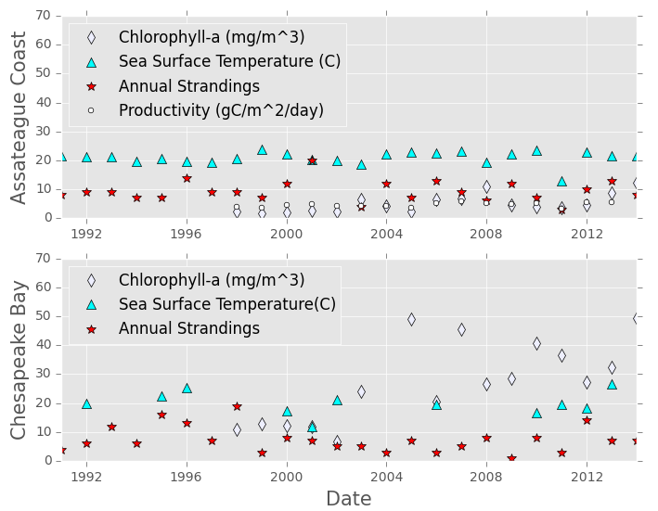
Stranding: Preliminary Results
Parameter | Pearson’s r Correlation | P
Chl-a | -0.2634 | 0.31
SST | 0.0807 | 0.71
Productivity | 0.1166 | 0.67
Parameter | Pearson’s r Correlation | P
Chl-a | -0.2648 | 0.30
SST | 0.2234 | 0.51
Notes:
The graph illustrates a comparison between the annual average chlorophyll-a concentrations, sea surface temperatures, and stranding counts for two distinct regions, Assateague Coastline (top) and Chesapeake Bay (bottom). The annual averages of exposed sea surface temperature range from about 11.95℃ in 2001 to 26.6℃ in 2013. While, exposure to chlorophyll-a range from 1.67mg/m³ in 1999 to 49.25 mg/m³ in 2014. Sea turtles are exposed to a higher range of chlorophyll and SST values, whereas the Assateague coastline exhibit a more steady trend. However, overall after undergoing the Pearson’s r correlation test there were no statistically significant relationship between sea turtle stranding and the oceanic variables.
Errors and uncertainties:
High discrepancies between 1998-2002 and 2003-2014 levels may be attributed to differences in resolution between the Aqua and SeaWiFS sensors, respectively. There were predominantly higher numbers of pixels missing near the coastal areas in the SeaWiFS datasets and can attribute to the lower levels of chlorophyll during those years.
With the lack of in situ measurements corresponding to the strand date, there are uncertainties in regards to chlorophyll-a and sea surface temperature values and are highly dependent upon the sensor’s resolution and algorithm used for detection. In addition, exposure is based on assumption of 14 days prior to stranding date, which is not consistently accurate among individual sea turtles.

Slide 8
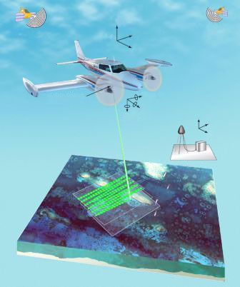
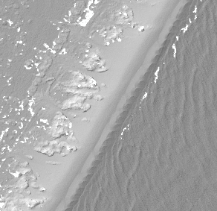
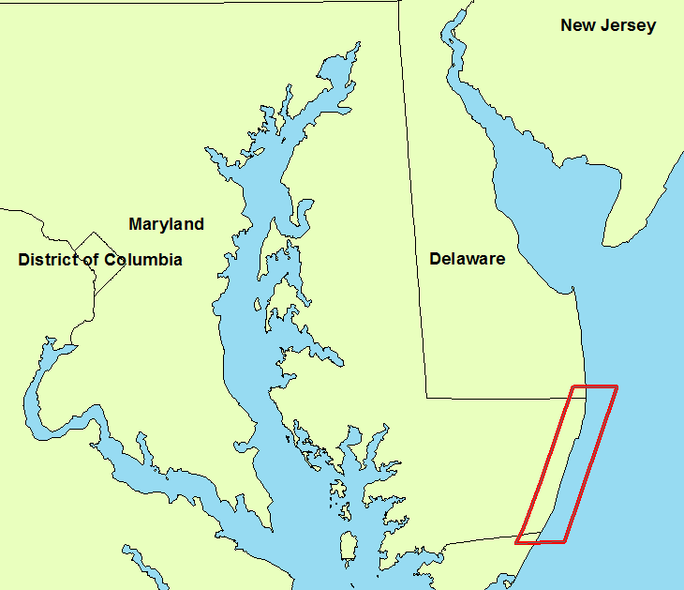
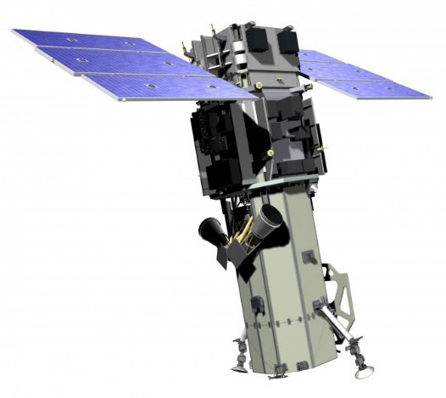
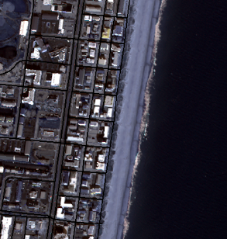
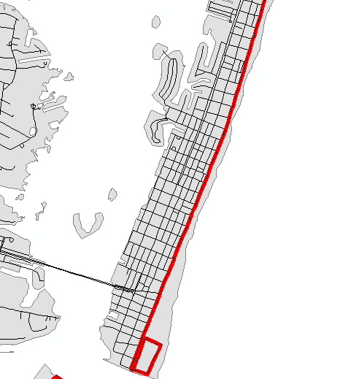
Nesting: Data Acquisition
Data Acquisition
USGS LiDAR
Shoreline Flight
LiDAR-Derived DEM
MD Atlantic Coastline
Worldview 2
US Census Bureau TIGER/Line (roads)
Coastal Imagery
Notes:
http://www.geo-matching.com/products/id1919-worldview-2.html
http://soundwaves.usgs.gov/2007/09/meetings2.html
LiDAR-derived DEM was obtained from the USGS survey of the NE Atlantic coast following Hurricane Sandy (November 2012). This was used to create subsequent topographic layers in next slide
WV2 imagery was obtained for the study area (coast only) and used for shoreline delineation, digitization of coastal development boundary.
TIGER line files for roads in MD obtained from USCB, used for development distance and development boundary steps.

Slide 9
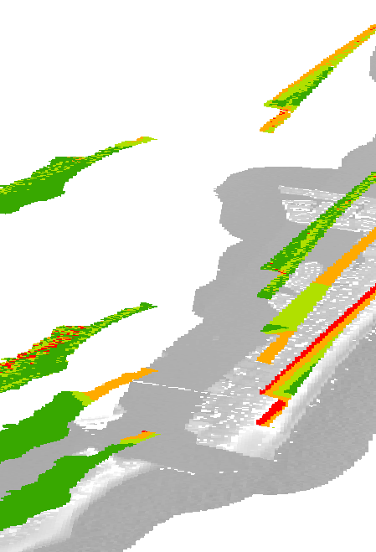
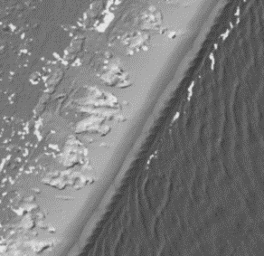
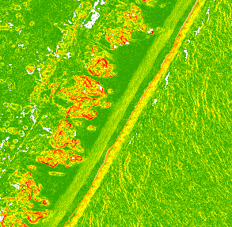
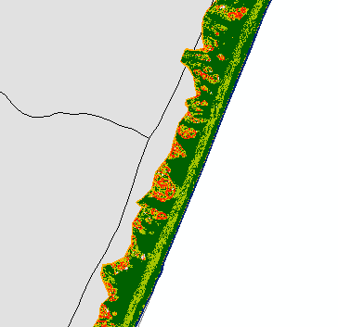
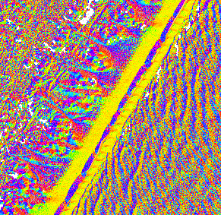
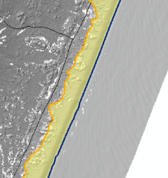
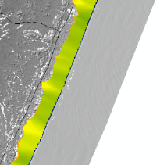
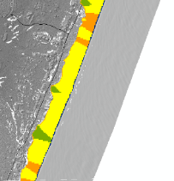
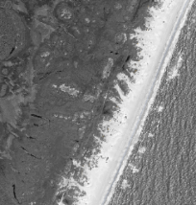
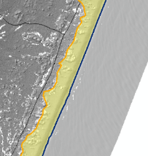
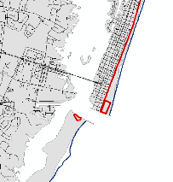
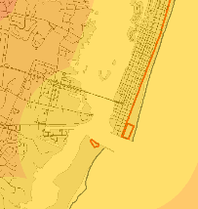
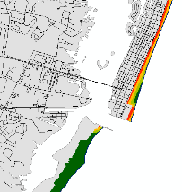
Nesting: Methodology
Beach Zone Digitization
Slope
DEM
DEM
Slope
Suitability
Overall Nesting Suitability
Slope &
Aspect
Beach Width
Slope Suitability
Beach
Zone
Beach
Width
Suitability
+
Beach Width Suitability
Imagery
+
Distance to Development
Distance to
Development Suitability
Beach
Zone
TIGER
Roads
Dev.
Boundary
Distance
to Dev.
Suitability
Notes:
Original DEM was used to create slope, aspect layers to aid in ID of beach zone (also used imagery in this step).
Slope suitability was determined from DEM, clipped to beach, reclassed (LH prefer lower slopes)
Beach width determined by overlaying grid/points on beach zone, calculating distance, reclassifying resulting raster (from point → raster step, resampling used, 4-classes of width [wider beaches better])
Distance to development suitability determined by using TIGER road (and some imagery) to find furthest shore-side dev. boundary, used as index of human activity which can negatively affect STs. Calculated distance layer, clipped and reclassified to beach zone for suitability (farther from dev. the better). Also included campgrounds/possible high-traffic areas of AINS.
Multiplied / collated 3 suitability layers together to make overall suitability (was a 64-class layer, reclassified to 4-class for simplicity. THIS MAY CHANGE)

Slide 10
Nesting: Results
Best nesting site locations
Notes:
Cool results!

Slide 11
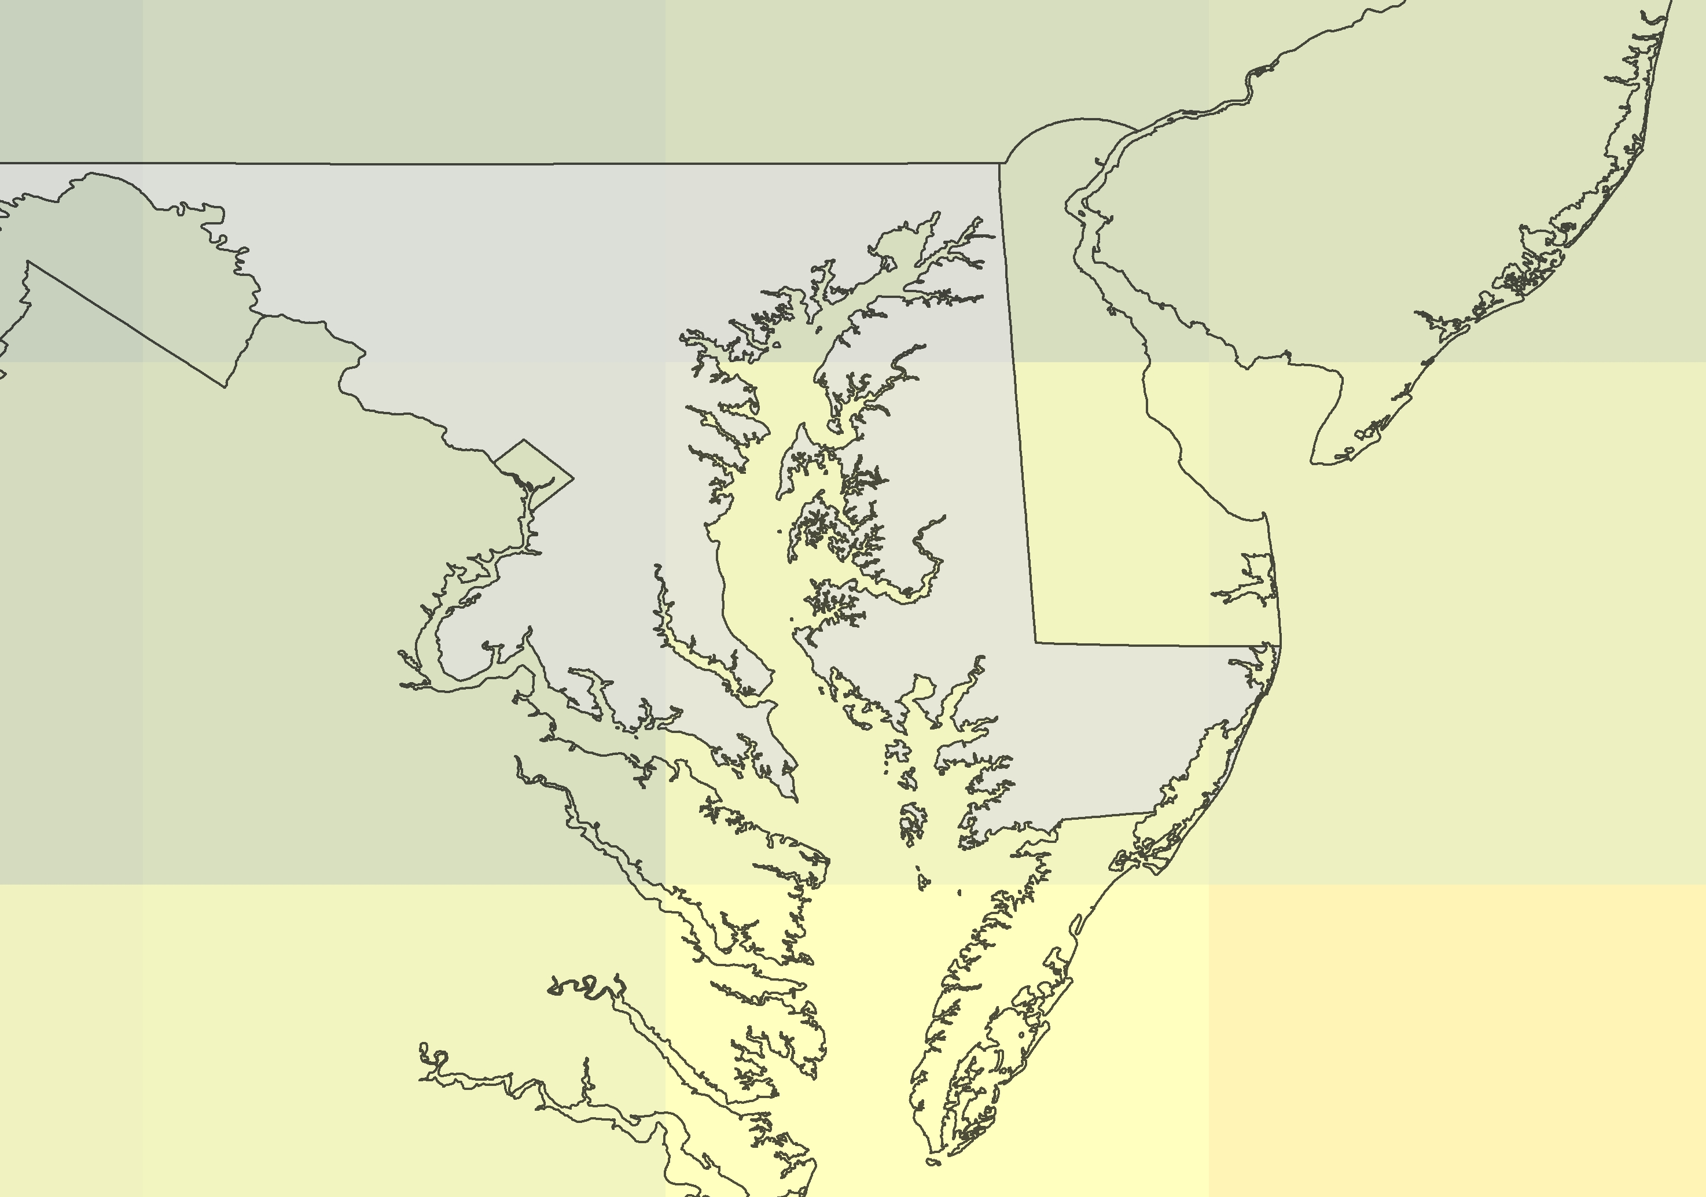
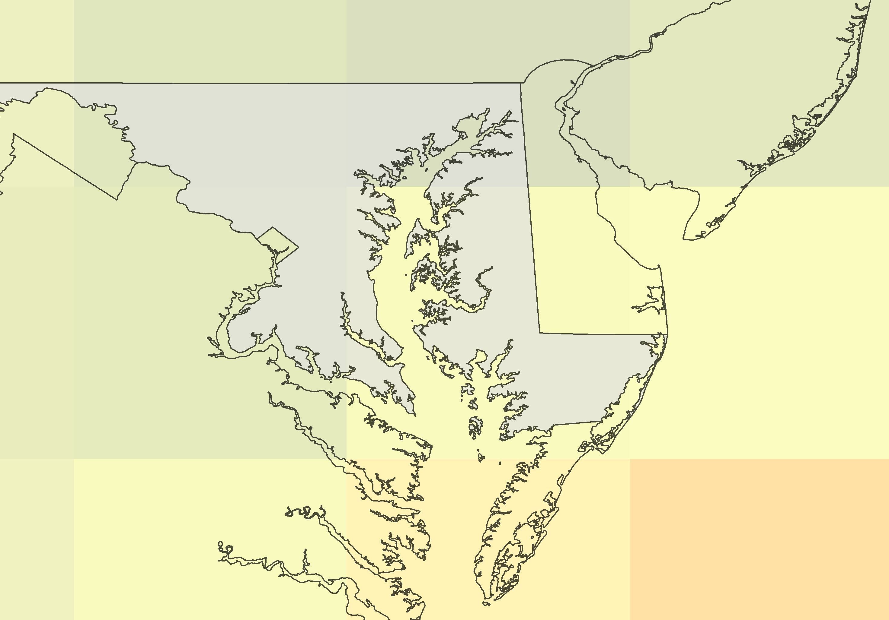
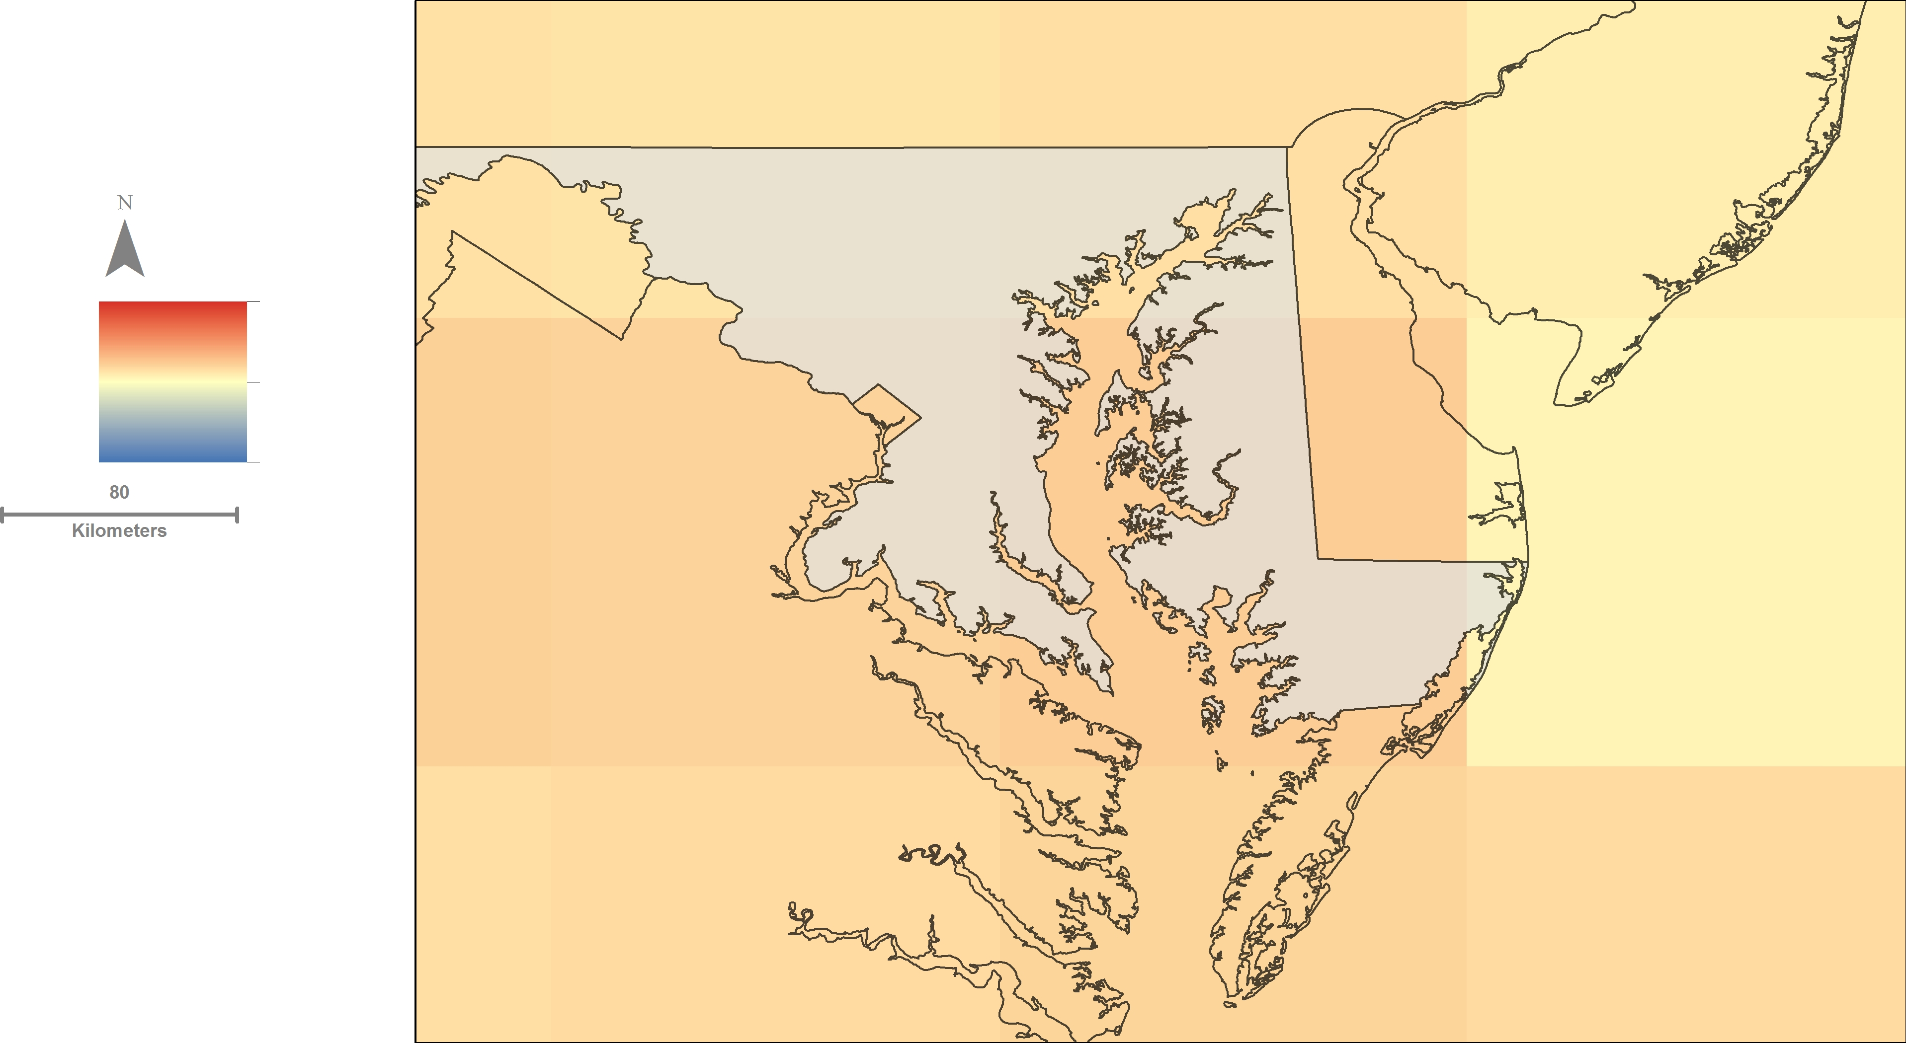
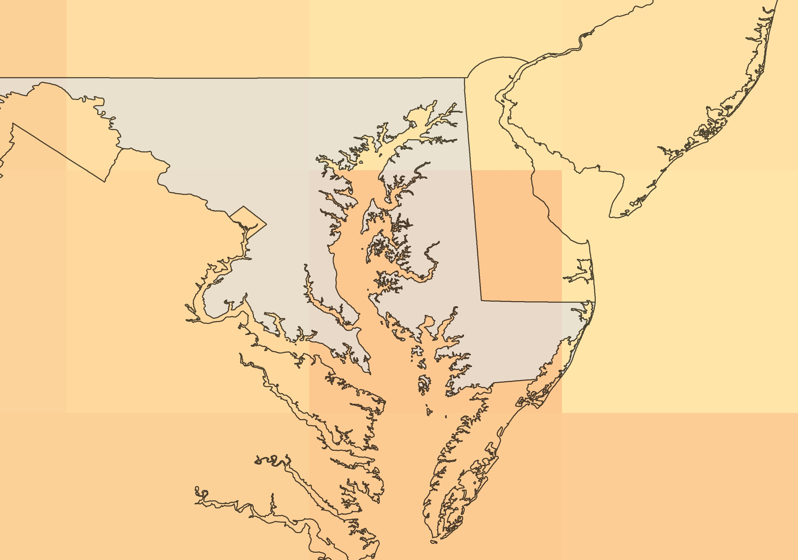
Climate Change
Community Climate System Model 3
International Panel on Climate Change 4
31.8°C
Levels remain constant since 2000
B1: declining pop., greener tech
19.1°C
A1B: declining pop., lower fossil fuel use
A2: increasing pop., same fossil fuel use
Notes:
The number of nesting sites in Maryland is very limited, so we investigated how future climate change will affect nest site distribution in Maryland. We used the Community Climate System Model 3 which are derived from the 4th Assessment from the International Panel on Climate Change. We analyzed four different scenarios, one in which greenhouse gas emissions are halted at the year 2000. Then we examined a low emissions scenario based on a declining population and a huge push in green technology. The medium scenario also has a declining population and has a balanced use of fossil fuels and green technology. We also looked at worst case scenario with an increasing population with relatively the same fossil fuel use per capita. We are looking for when the temperature regime on coastal Maryland is similar to that of Florida and Georgia which hosts the largest loggerhead nesting grounds in the United States. We also used the climate models to estimate sea level rise which will affect nesting sites.

Slide 12
Climate Change - Results
Time scale of future nest sites, etc.
Sea level rise and nesting results
Notes:
Cool results!

Slide 13
Conclusions
Really awesome conclusions!
Notes:
Cool conclusions!

Slide 14
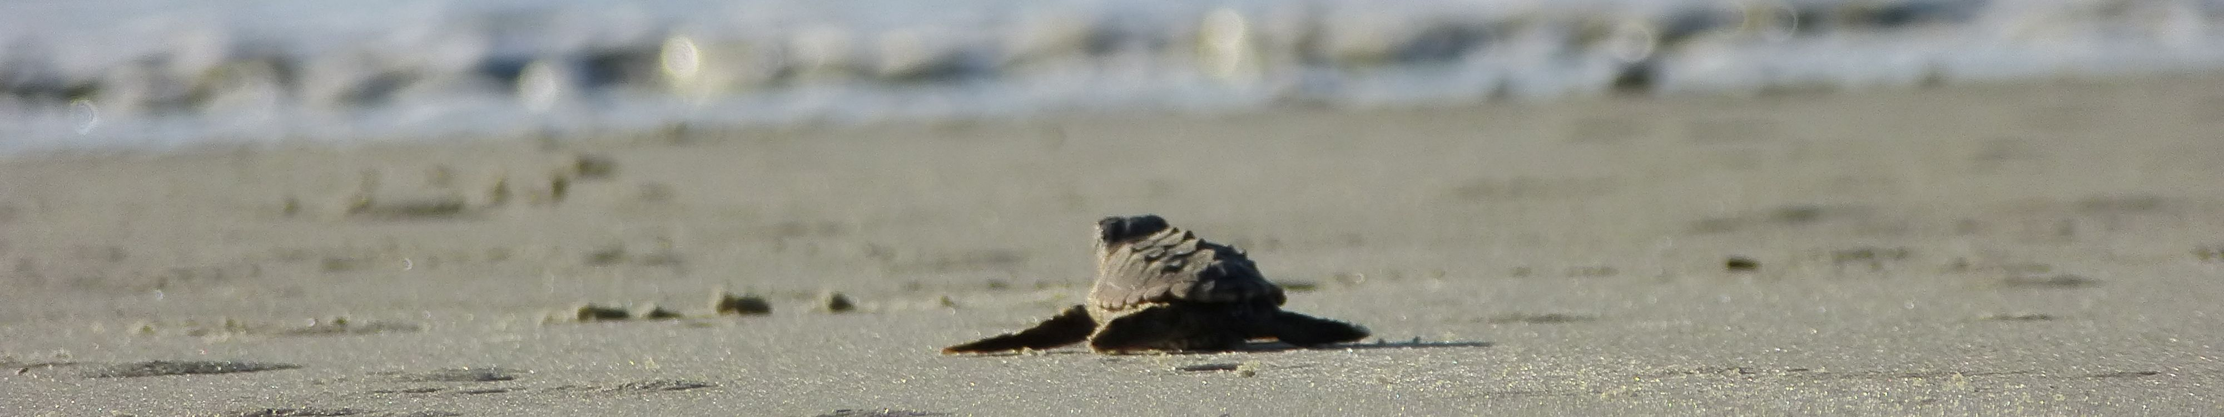
Advisor
Dr. John Bolten, NASA Goddard Space Flight Center
Partners
Cindy Driscoll, Maryland Department of Natural Resources
Amanda Weschler, Maryland Department of Natural Resources
Others
Gary Strand, National Climate and Atmosphere Research
Becky Skiba
Notes:
We would like to thank our science advisor Dr. John Bolten for all of his assistance as well as Gary Strand who helped us immensely with the climatological modeling. Thank you to Cindy and Amanda of the MD DNR for their help in this project and supplying us with datasets. Thank you.

