Slide 1
DEVELOP National Program
Northwest US Agriculture II
[LaRC]
Spring 2015
Final Imagery

Slide 2
Checklist for Each Image:
Image is derived from NASA sensor data
  Not from an outside source
  Not a photograph of the team/issue
Preferably, At least one image provided is derived from recent data (2014-2015)
  This is mandatory for inclusion in any highlight to NASA HQ
Some kind of processing has taken place
  Not a raw image or a photograph
The team actually created the image
  Not from some other source/world wide web/etc.
High-resolution (over 300 dpi)
Saved as a JPEG or TIFF
Also:
While there are three slides, you can have more imagery. Minimum of one, max of ten.
The “best” image should have a SVG version, saved as a separate file, that will be used on the DEVELOP website and brochures

Slide 3
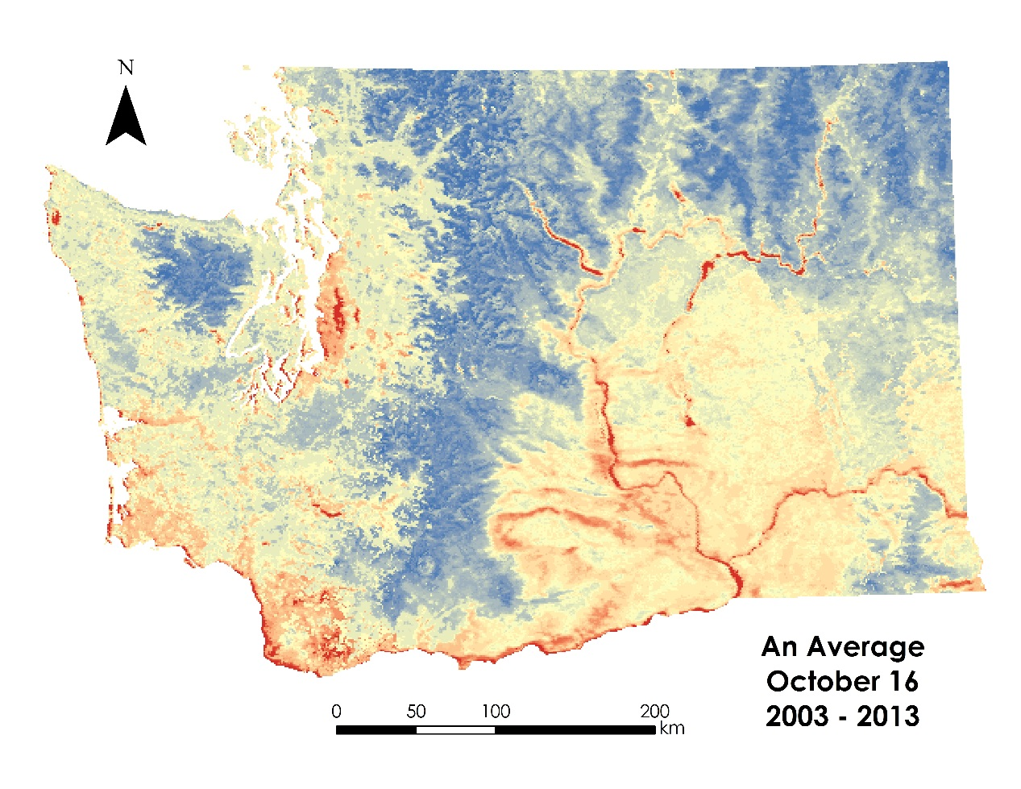
LaRC
Northwest US Agriculture II
Caption: Map of 24 hour accumulated chill units for an average October 16 between 2003 and 2013 in Washington State derived from Aqua MODIS Land Surface Temperature data. Accumulated chill units enumerate the number of hours an area spends between 1.4°C and 12.4°C. This chill time is vital to the health of apple trees and as climate fluctuations continue, knowing ranges in chill time can be beneficial in deciding where to cultivate different varieties of apples based on the specific chill requirements of each variety.

Slide 4
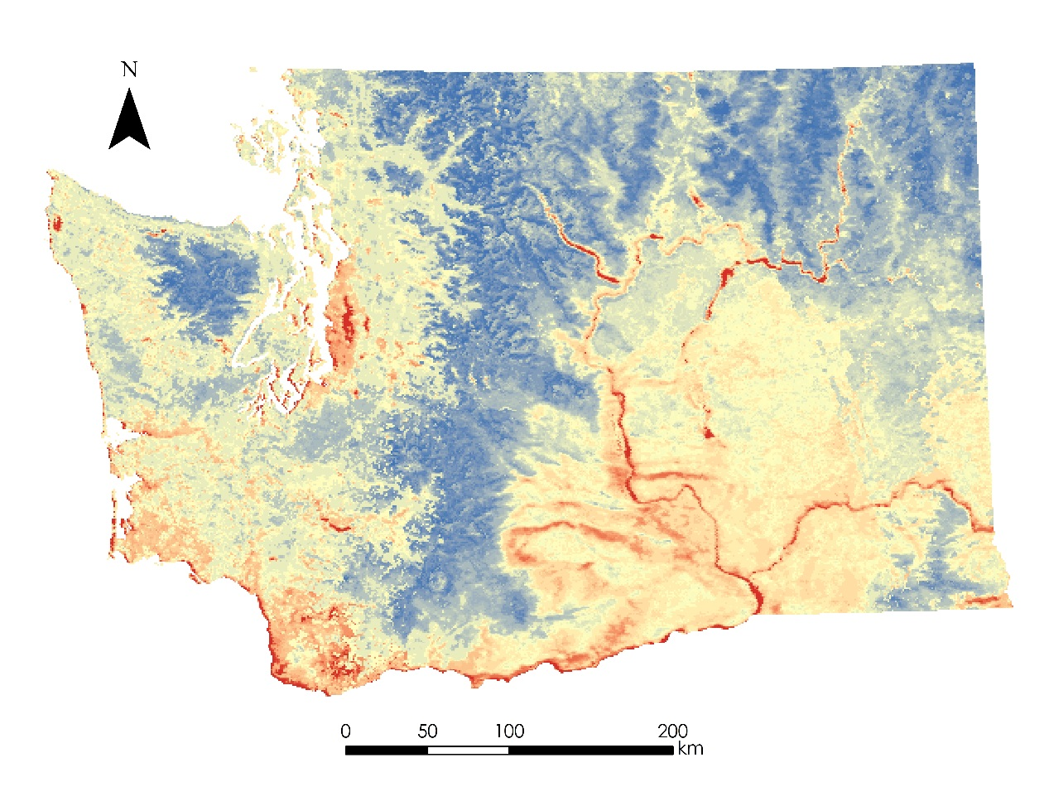
LaRC
Northwest US Agriculture II
Caption: Map of 24 hour accumulated chill units for an average October 16 between 2003 and 2013 in Washington State derived from Aqua MODIS Land Surface Temperature data. Accumulated chill units enumerate the number of hours an area spends between 1.4°C and 12.4°C. This chill time is vital to the health of apple trees and as climate fluctuations continue, knowing ranges in chill time can be beneficial in deciding where to cultivate different varieties of apples based on the specific chill requirements of each variety.

Slide 5
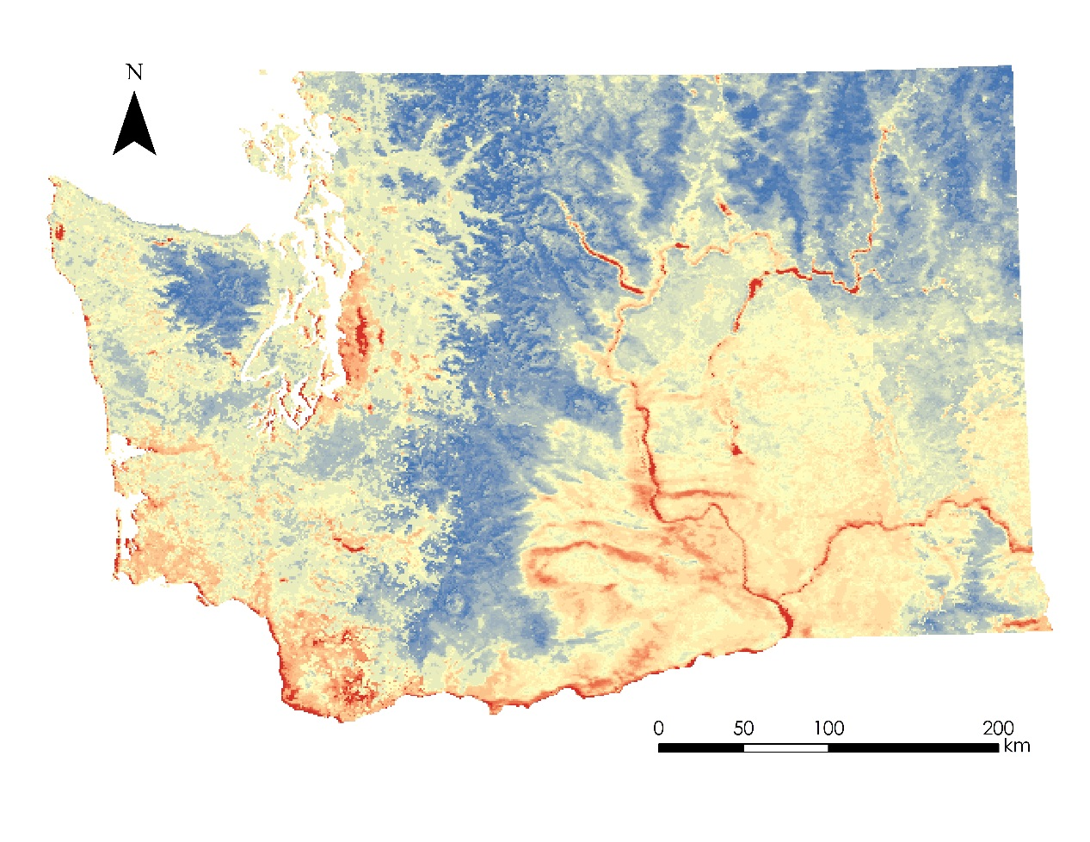
LaRC
Northwest US Agriculture II
Caption: Map of 24 hour accumulated chill units for an average October 16 between 2003 and 2013 in Washington State derived from Aqua MODIS Land Surface Temperature data. Accumulated chill units enumerate the number of hours an area spends between 1.4°C and 12.4°C. This chill time is vital to the health of apple trees and as climate fluctuations continue, knowing ranges in chill time can be beneficial in deciding where to cultivate different varieties of apples based on the specific chill requirements of each variety.

Slide 6
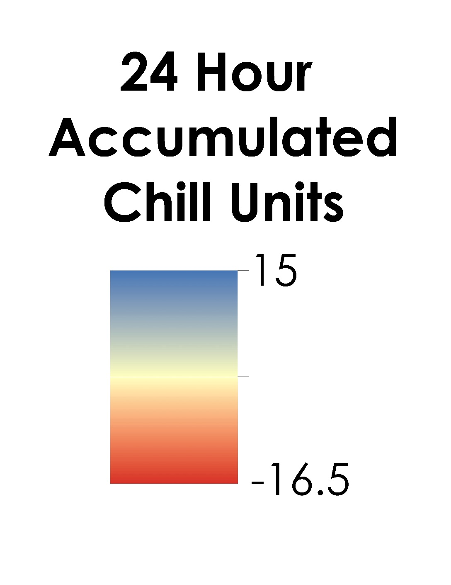
LaRC
Northwest US Agriculture II
Caption: Map of 24 hour accumulated chill units for an average October 16 between 2003 and 2013 in Washington State derived from Aqua MODIS Land Surface Temperature data. Accumulated chill units enumerate the number of hours an area spends between 1.4°C and 12.4°C. This chill time is vital to the health of apple trees and as climate fluctuations continue, knowing ranges in chill time can be beneficial in deciding where to cultivate different varieties of apples based on the specific chill requirements of each variety.

