Slide 1
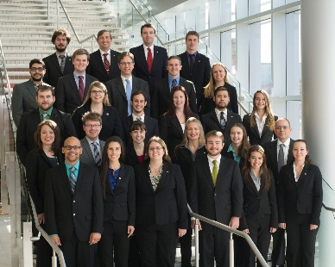
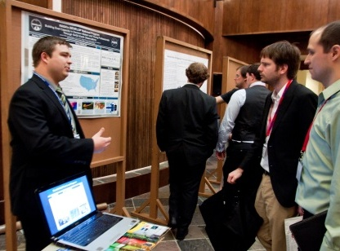
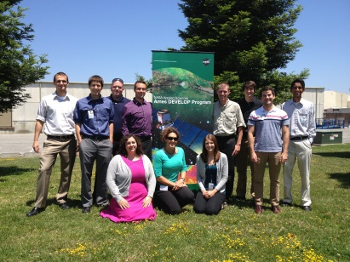
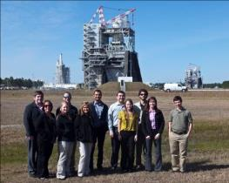
DEVELOP National Program
Event Location
Event Name
Date of Presentation

Slide 2
NASA Organization
NASA Administrator
Associate Administrator
Mission Directorates
Human Exploration and Operations
Space Technology
Mission Support
Aeronautics Research
Science
Joint Agency Satellite Div.
Heliophysics Division
Earth Science Division
Planetary Science Div.
Astrophysics Division
Applied Sciences Program
Capacity Building Program
DEVELOP National Program

Slide 3
NASA Applied Sciences Program
“Discovering Innovative & Practical Applications
of NASA Earth Science”
The Applied Sciences Program (ASP) serves as a bridge between the data and knowledge generated by NASA Earth Science and the information and decision-making needs of public and private organizations. The goal of the program is to discover and demonstrate innovative uses and practical benefits of NASA Earth science data, scientific knowledge, and technology.
Ecological
Forecasting
Water
Resources
Agriculture
Health &
Air Quality
Climate
Disasters
Energy
Oceans
Weather
Applied Sciences Program Website: www.nasa.gov/applied-sciences

Slide 4
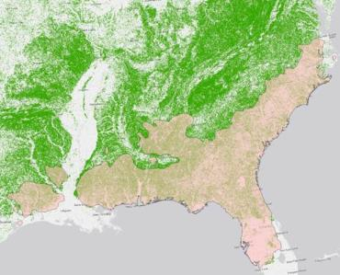
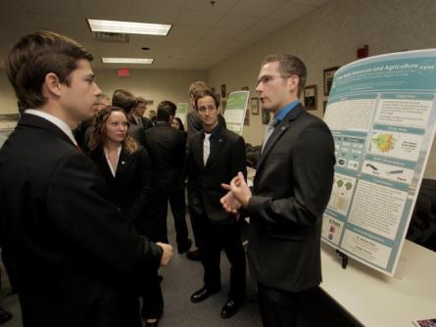
Applied Sciences’ Capacity Building
SERVIR Coordination Office (MSFC): Building international capacity with hubs in East Africa, Hindu Kush-Himalaya, Mesoamerica
Applied Remote Sensing Training, ARSET (GSFC): Online and hands on basic/advanced training to build domestic skills
DEVELOP (LaRC National Office): Dual workforce and local partner capacity building using collaborative feasibility projects

Slide 5
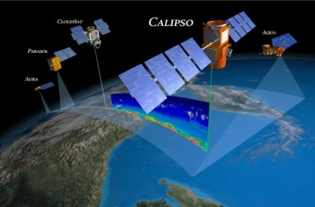
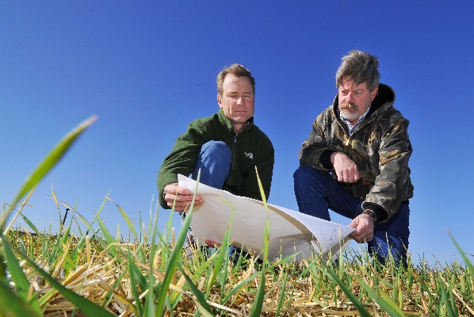
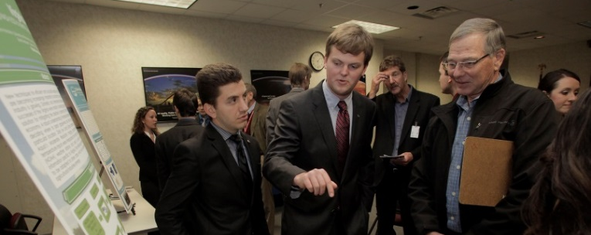
What is DEVELOP?
Measurements
and Predictions
Communities
DEVELOP bridges the gap between NASA Earth Science and society, building capacity in both its participants and end-user organizations to better prepare them to handle the environmental challenges that face society.
DEVELOP is a dual-capacity building program:
Partners & Participants

Slide 6
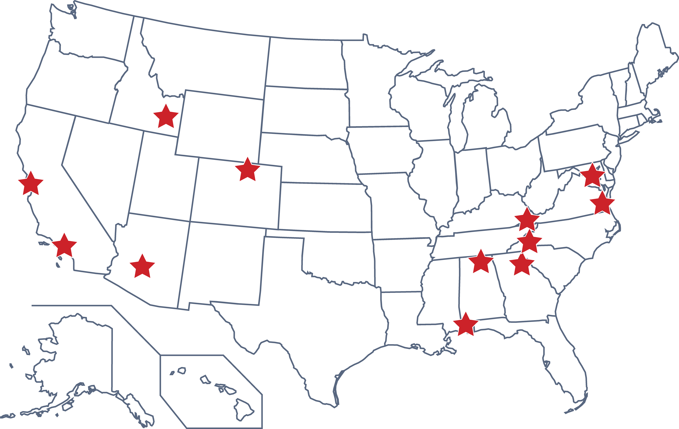
DEVELOP Node Locations
NASA Centers
Ames Research Center – Moffett Field, CA
Goddard Space Flight Center – Greenbelt, MD
Jet Propulsion Laboratory – Pasadena, CA
Langley Research Center – Hampton, VA
Marshall Space Flight Center – Huntsville, AL
Regional Locations
BLM at Idaho State University – Pocatello, ID
Maricopa County Department of Public Health
and Arizona State University – Tempe, AZ
Mobile County Health Department – Mobile, AL
NOAA National Centers for Environmental Information – Asheville, NC
University of Georgia – Athens, GA
USGS at Colorado State University – Fort Collins, CO
Wise County Clerk of Court’s Office – Wise, VA

Slide 7
DEVELOP’s Mission, Vision & Core Values
MISSION
CORE VALUES
Integrating NASA Earth observations
with society to foster future innovation and cultivate the professionals of tomorrow by addressing diverse environmental issues today.
COLLABORATION
INNOVATION
VISION
PASSION
Shaping the future by integrating Earth observations into global decision making.
DISCOVERY

Slide 8
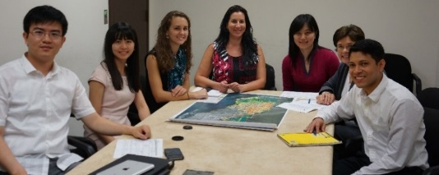
Project Characteristics
>
350+ Participants Conducting 80+ Projects Per Year
Highlight the applications and capabilities of NASA Earth observations
Address community concerns relating to decision-making for real-world environmental issues
Partner with organizations who can benefit from using NASA Earth observations to enhance decision making by providing decision support tools
Align with at least one of the nine NASA Applied Sciences Program’s National Application Areas
Incorporate teams with diverse academic backgrounds
Rapid Feasibility & Implementation: 10 Weeks

Slide 9
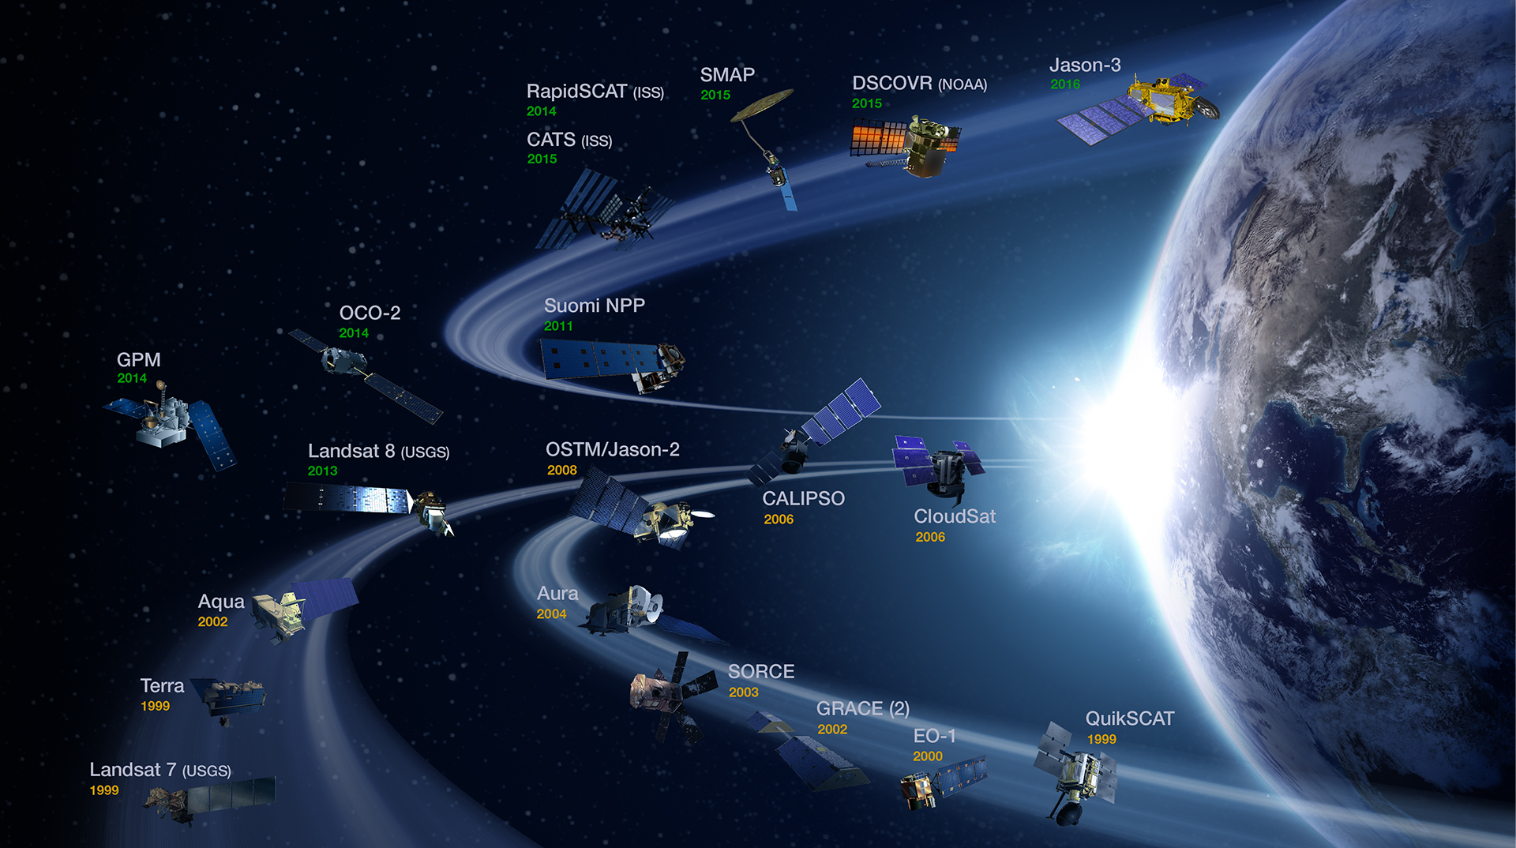
NASA Earth Observations
NASA Earth observations include a coordinated series of 17 polar-orbiting and low
inclination satellites for long-term global observations.

Slide 10
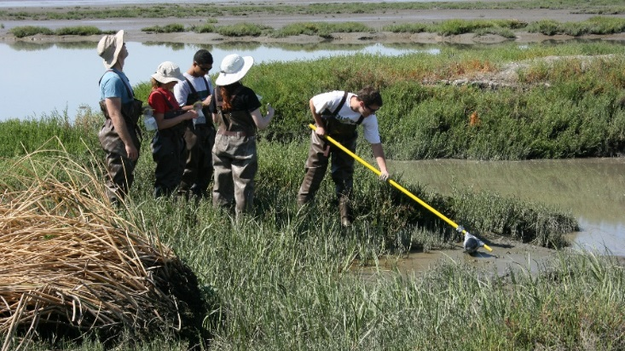
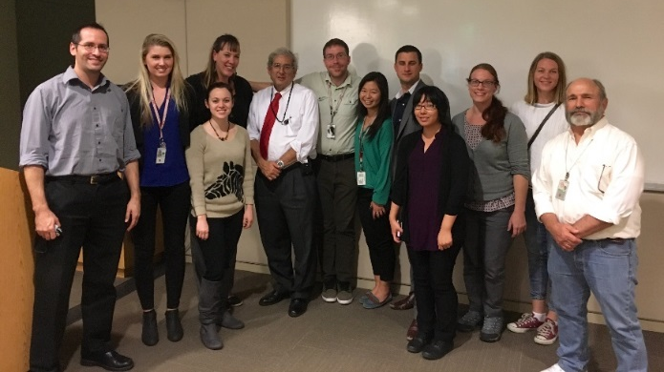
Who Participates in DEVELOP?
Participants
Recent Graduates
Military
Personnel
Students
Transitioning Professionals
Decision Makers
State & Local Govt.
Federal
Agencies
NGOs
International
Notes:
Christie
-DEVELOP encourages people with a variety of backgrounds to apply. We frequently see recent graduates, military personnel, students, and those transitioning in their career participate in the program.
-There is also a mix of organizations DEVELOP partners with to conduct projects, such as state & local government, federal agencies, NGOs, and international organizations. Currently, many projects are partnering with various National Parks in honor of the National Park Service’s 100th anniversary.
-DEVELOP offers scientific & professional development opportunities, such as working with GIS & Remote Sensing and working in a group environment. There are numerous opportunities to develop technical skills as well as presentation and communication skills. While working on DEVELOP projects, participants also have the chance to network with partners, science advisors, and their fellow DEVELOPers.
Scientific/Professional Development:
Experience using NASA Earth observations
GIS and remote sensing
Working in a group environment
Management and leadership skills
Personal Development:
Presentation and communication skills
Personality typing and working with diverse groups (How NASA Builds Teams)
Professional Networking:
NASA scientists and managers
Partner organizations
Peers – teams, center, and national

Slide 11
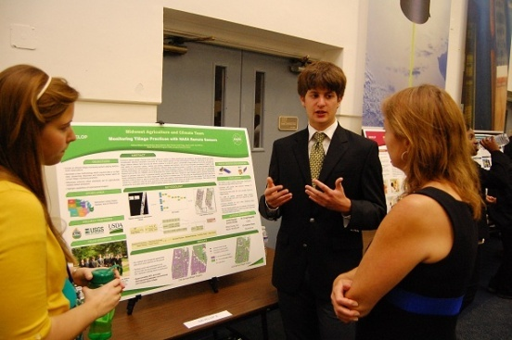
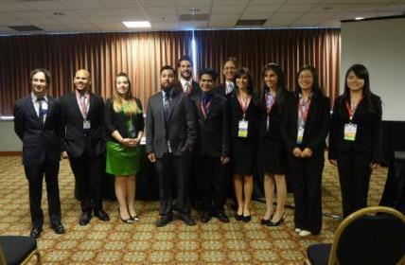
Participant Eligibility
Age 18+ with a minimum GPA of 3.0 GPA
Current students, recent graduates, early career professionals, transitioning career professionals, US Military service members & veterans
Interdisciplinary backgrounds (majority from STEM fields), no experience is required but a strong interest in GIS, remote sensing, and science is important
US Citizens & Foreign Nationals*
* US citizenship required to apply to DEVELOP locations at NASA Centers. Foreign nationals must be currently enrolled or recently graduated an accredited U.S. school. Acceptances are conditional upon proof of a visa or approved CPT/OPT that will allow them to legally work within the U.S.
Three 10-week terms per year
Spring, Summer, and Fall
Participants must reapply each term

Slide 12
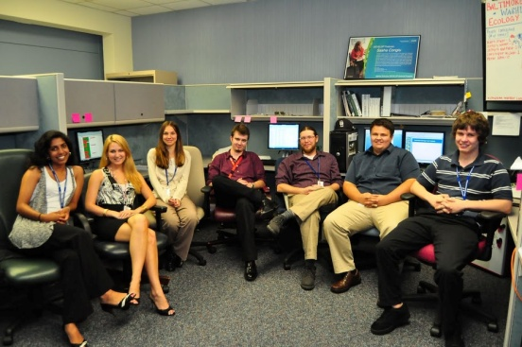
Dual-Capacity Building
Participants
Young Professionals, Students &
Transitioning Professionals
End-Users
Local, State, Regional, Federal, Academic, International, and NGOs
Scientific/Professional Development
Personal Development
Professional Networking
Enhanced decision support through use of NASA Earth observations
Increased exposure to NASA Earth Science technologies and capabilities
Opportunities for networking with the NASA community
Notes:
Scientific/Professional Development:
Experience using NASA Earth observations
GIS and remote sensing
Working in a group environment
Management and leadership skills
Personal Development:
Presentation and communication skills
Personality typing and working with diverse groups (How NASA Builds Teams)
Professional Networking:
NASA scientists and managers
Partner organizations
Peers – teams, center, and national

Slide 13
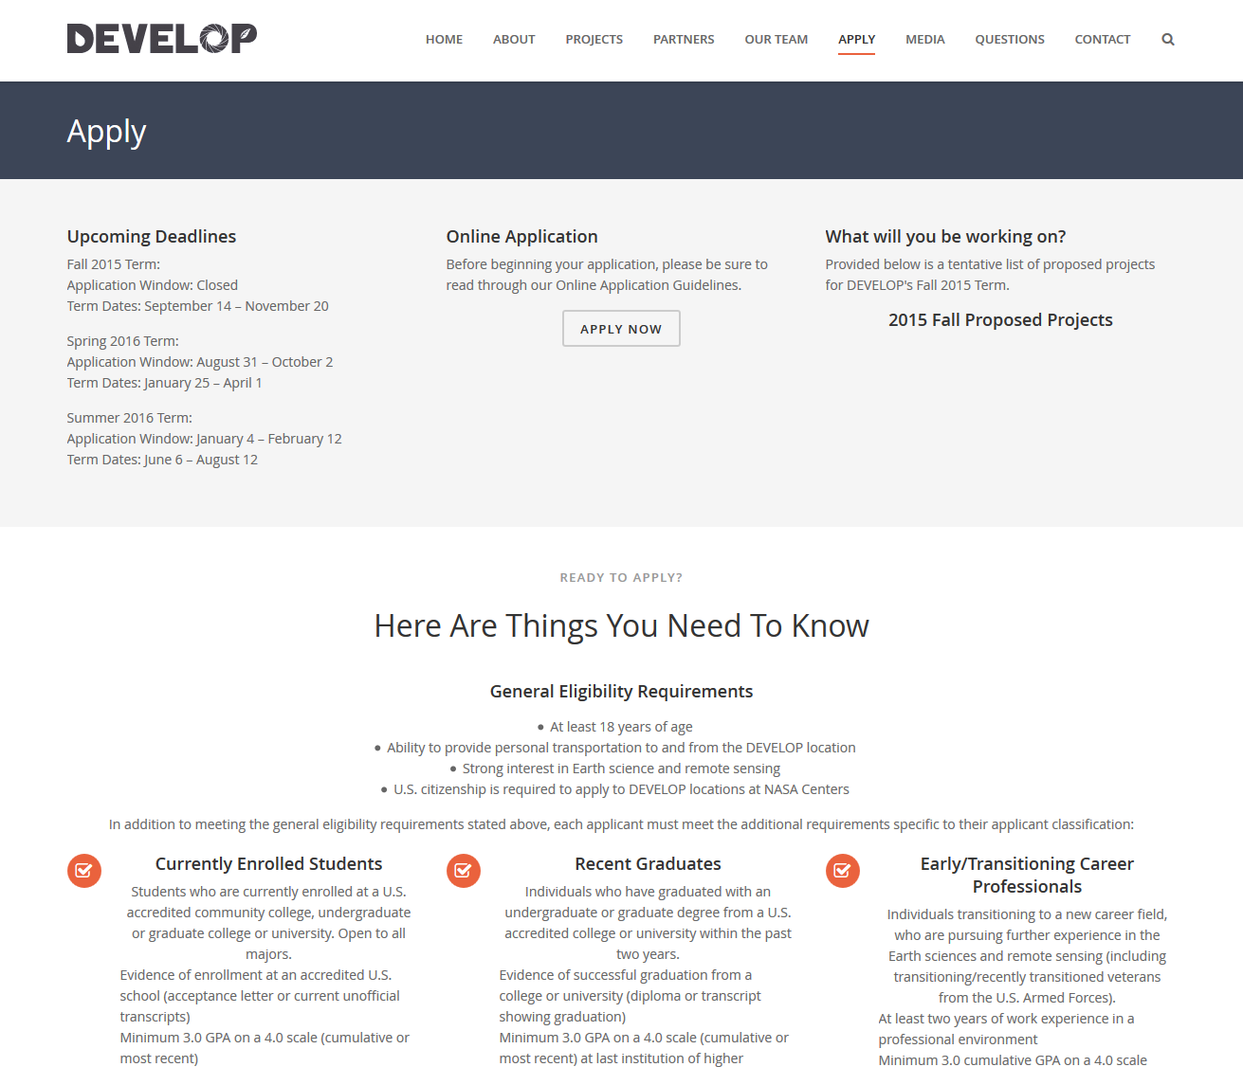
Application Process
Entirely online
Through the DEVELOP website under the “Apply” tab
Create account, can save progress and return later
Application only open during a specific window
Summer 2017 Term
Application Window: January 9th – February 17th
Term Dates: June 5th – August 11th

Slide 14
Spring 2017 Portfolio
Mississippi River Basin Disasters II (MSFC)
Philippines Disasters (NCEI)
Southern Appalachia Disasters (UGA)
Glacier National Park Climate II (LaRC)
Missouri River Climate II (NCEI)
Santa Monica Mountains Climate (JPL)
Intermountain West Eco (ID)
New York Eco (GSFC)
Alabama Ag (MSFC)
Arizona Ag (JPL)
Chesapeake Bay Ag (GSFC)
Phoenix Health & AQ (AZ)
Nez Perce-Clearwater NF Energy (FC)
Wyoming Cross-Cutting
Arizona Water (FC)
Chesapeake Bay Water (LaRC)
Chile Water (ARC)
Lake Erie Water (ARC)
Mississippi Sound Water (LaRC-JPL)
Southeastern Arizona Water II (MCHD)
Southeastern Idaho Water II (ID)

Slide 15
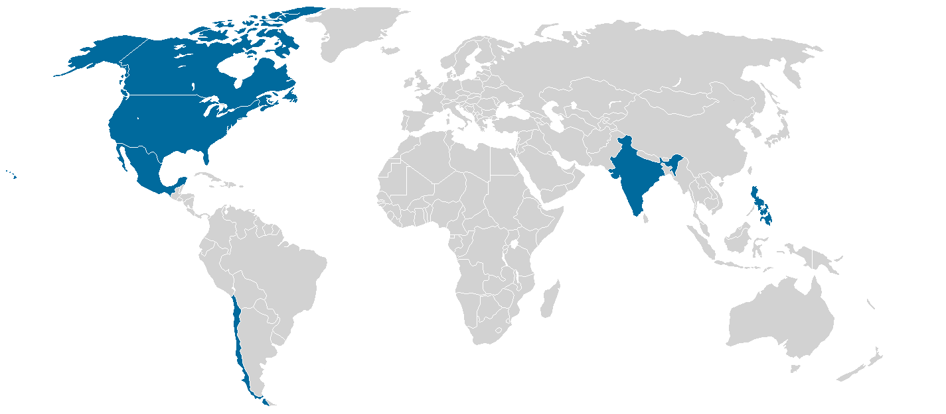
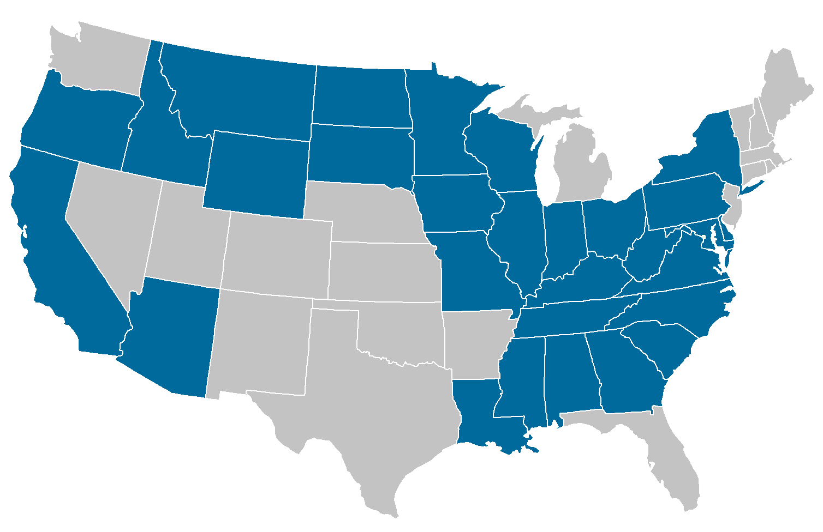
Spring 2017 Stats
23
Projects
30 States & 6 Countries Impacted
87% Domestic 13% International
1st TERM (17)
Application Areas Addressed
Partner Total by Type
57
Partners
2nd TERM (6)

Slide 16
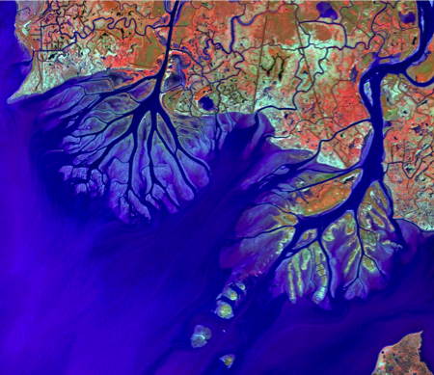
Louisiana Ecological Forecasting
NASA Jet Propulsion Laboratory
Community Concerns
Land subsidence and sea level rise
Rapid growth of Wax Lake Delta
Partners
Naval Research Laboratory
Louisiana Universities Marine Consortium
Partner Needs
Better understand the accretion process at Wax Lake to help guide coastal managers
Assess land loss reduction and preserve future of the Louisiana Coastline
Notes:
Example Project

Slide 17
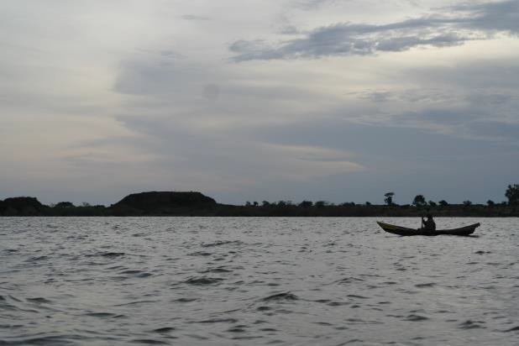
Africa Great Lakes Weather
Wise County Clerk of Court’s Office
Community Concerns
5,000 people/ year killed in great lakes due to sever storms
No early warning system for local residents
Partners
Tanzania Meteorological Agency
Partner Needs
Determine the historical record of storms
Assess environmental impacts before and after storm events
Find correlations and create storm impact index
Notes:
Example Project

Slide 18
Your Project
Feel free to use this slide to showcase your own project which you worked on through DEVELOP. You can also change the two examples before this if you like.

Slide 19
Participant Opportunities
Common Majors
Common Software & Programming Languages
Geography
Environmental Science
Computer Science
Remote Sensing
GIS
Biology
Engineering
Chemistry
Meteorology
Physics
Accounting
Economics
Mathematics
Public Policy
Communications
ESRI ArcGIS
ERDAS IMAGINE
ENVI/IDL
Python
MATLAB
R
Microsoft Office Suite
Summer Term 2017
June 5th – August 11th
Apply Online:
January 9th – February 17th
Fall Term 2017
September 11th – November 17th
Apply Online:
May 22nd – June 30th

Slide 20
Find DEVELOP on Social Media!
Facebook: www.facebook.com/developnationalprogram
Twitter: http://twitter.com/#!/nasa_develop
LinkedIn: https://www.linkedin.com/groups/4343498
YouTube: www.youtube.com/user/NASADEVELOP
Google+: https://plus.google.com/u/0/+NASADEVELOP

Slide 21
THANK YOU!
Questions?
NASA-DL-DEVELOP@mail.NASA.gov
Notes:
Replace with your contact information! Hand out business cards if appropriate.
(Can include Communications Team email: DEVELOP.Communications@gmail.com)

Slide 22
Reference slides to follow!

Slide 23
Application Process
International students must communicate with their advisor throughout the application process!
International students on F-1 visas graduating in either May or December 2017 are eligible for summer 2017 or fall 2017 terms
Must notify international student advisor for approval
Must start either Curricular Practical Training (CPT) or Optional Practical Training (OPT)
International students on J-1 visas have more strict guidance
Remember to anticipate time for letters of recommendations

Slide 24
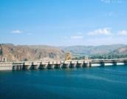
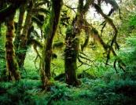
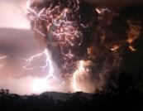
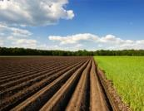
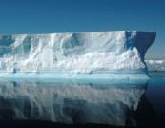
Fall 2016 Portfolio
Climate
Navajo Nation Climate III
Rocky Mountain National Park Climate
Glacier National Park Climate
Levant & Central America Climate II
Water Resources
North Carolina Water
Southeastern Idaho Water
Western US Water II
Southeastern Arizona Water
Lake Victoria Water III
Atlanta Water III
Grand Canyon Water
Northern Great Plains Water II
Ecological Forecasting
Elkhorn Slough Eco Forecasting II Kenya Eco Forecasting
Southern Arizona Eco Forecasting Everglades Eco Forecasting II
Eastern India Eco Forecasting
Disasters
Ethiopia Disasters
Mississippi River Basin Disasters
Health & Air Quality
Maricopa Health & Air Quality II
Agriculture
Costa Rica Ag II

Slide 25
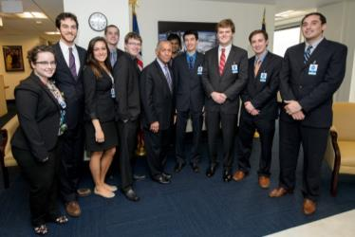
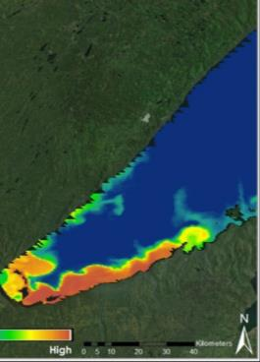
FY2016 Project Stats
Fall 2015
105 Participants working on
26 Projects with
63 Partners & End-Users
Spring 2016
107 Participants working on
26 Projects with
56 Partners & End-Users
Summer 2016
116 Participants working on
30 Projects with
71 Partners & End-Users

