Slide 1
BRIDGEPORT URBAN DEVELOPMENT
Leveraging NASA Earth Observations and Sociodemographic Data to Assess Urban Heat Vulnerability and Inform Cool Corridors in Bridgeport, Connecticut
Silas Kirsch
John Hocknell
Maggie Roseto
Char Tomlinson
Massachusetts – Boston | Spring 2024
Notes:
Good Afternoon everyone, this presentation will focus on the Bridgeport Urban Development project conducted for the Spring 2024 Term at the Boston Node. The members of this project include Silas Kirsch (project lead), John Hocknell, Maggie Roseto, and Char Tomlinson.

Slide 2
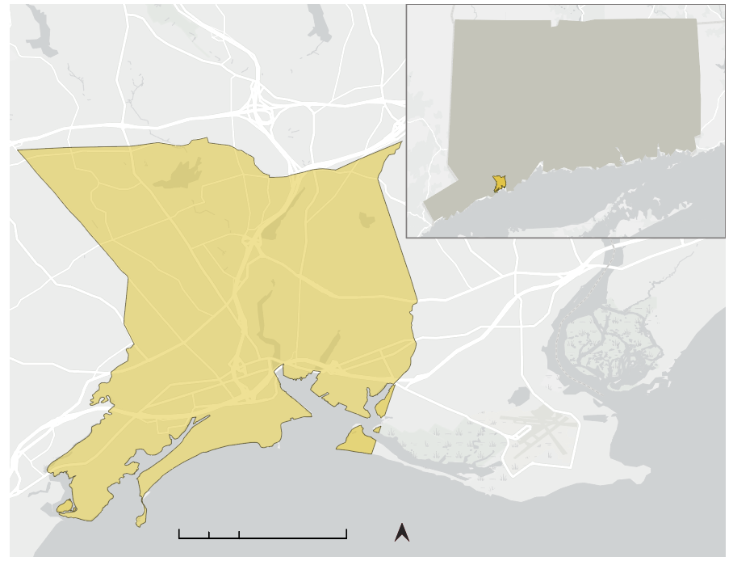
Bridgeport, Connecticut
Study Area
Study Area
Connecticut
Located in Fairfield County
Population: 149K (2022)
Climate: Humid Subtropical
Focus on the East Side neighborhood
GBRC, TomTom, Garmin, SafeGraph, USGS, USFWS EPA, NPS
Bridgeport
Study Period
2013 - 2023
June 01 - September 30
10
20
50 miles
GBRC, TomTom, Garmin, SafeGraph, GeoTechnologies Inc, METI/NASA. USGS, EPA, NPS, USDA, USFWS
Notes:
Our study area is Bridgeport, a port city located in the southwest of Connecticut in Fairfield County. With a population of 149 thousand reported in 2022, it is Connecticut’s most populous city and historically has been a major manufacturing and industrial hub. This has contributed to the density of buildings and impervious surfaces as well as the lack of tree canopy and green space, particularly in neighborhoods like the East Side. These factors intensify heat within urban areas and are compounded by climate change, resulting in increased risks and burdens faced by disadvantaged communities. Our study analyzes urban heat in Bridgeport, with a focus on the East Side, from 2013 to 2023 during the summer (June through September).
-------------------------------- Image Credit --------------------------------
Study Area Map created by team

Slide 3
Partner: Groundwork Bridgeport
Mission: promoting civic and youth engagement and the sharing of knowledge to rebuild post-industrial and blighted areas of Bridgeport.
Image Credit: Groundwork Bridgeport
Notes:
For this project, our Partner is Groundwork Bridgeport, which is a community based nonprofit organization focused on sustainable regeneration of blighted areas into areas that empower the community. Our point of contact is Christina Smith, the Executive Director of Groundwork Bridgeport and a long-time Bridgeport resident.
Groundwork Bridgeport engages and supports community stakeholders as they seek to make their neighborhoods greener, healthier, and more livable. They are particularly committed to cultivating future leaders through their Youth Engagement efforts and increasing civic engagement in turn.
Our work this term is in support of Groundwork Bridgeport’s proposed “Cool Corridors” Project, which seeks to redress the harms of urban heat. “The urban heat assessment and vulnerability map packages created will help Groundwork Bridgeport identify areas of varying urban heat and their intersection with social and environmental vulnerability” (Workplan). The insights from our products will inform where Groundwork Bridgeport will locate cooling interventions as a part of the Cool Corridor project.
-------------------------------- Image Credit --------------------------------
Image Credit: Christina Smith, Groundwork Bridgeport (Used with Permission)

Slide 4
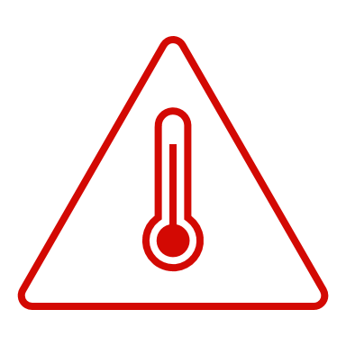
Community Concerns
Urban Heat Intensity
Heat Relief in Public Spaces
Elevated Heat Exposure
Individual Sensitivity
Notes:
The four main community concerns that are shaping this project are:
Urban Heat Intensity
Urban areas typically experience higher temperatures due to high concentrations of asphalt and limited green space. Natural spaces such as trees, vegetation, and soil help regulate temperature by absorbing heat. The built environment does not typically offer these same benefits, reflecting and retaining much of that heat, raising urban temperatures compared to the surrounding areas. Rising global temperatures due to anthropogenic climate change have recently been seen to exacerbate this effect.
Elevated Heat Exposure
Another concern of neighbors on the East Side is their heightened exposure to this heat. As we will discuss further, someone may be exposed to the aforementioned intensified heat as a result of how several factors.
1. Commute: the East Side has lower rates of private car ownership than Bridgeport and Fairfield County. Similarly, their are higher incidences of people commuting via bicycle, walking, and public transportation, and they face higher exposure as a result.
Individual Sensitivity
There are additional factors for each individual that make them most vulnerable. For example, age, health care coverage, comorbidities, and disability status will impact someone’s vulnerability to heat. Additionally, factors related to the age of a building will also affect one's heat vulnerability. For example, older buildings are less likely to have AC, double-pane windows, and sufficient insulation, rendering heat effects inescapable for some. Many of these factors are connected to income and poverty, and we factored them into our social vulnerability index which we will explore more later.
Heat Relief in Public Spaces
Presently, the East Side of Bridgeport has limited green space and tree canopy as compared to more affluent sections of Bridgeport and Fairfield County. The neighborhood was largely built out by the early 20th century for worker housing: green space was not included in these plans and this issue persists in these inherited landscapes. In their place, building and road materials that retain and radiate heat were sited. This makes the intensity of radiative heating more extreme in the area; for this reason, the East Side residents who tend to use the public space for commuting and are seeking more relief from this extreme heat. Natural vegetation and soil intake radiation and release cooling water through evapotranspiration. Additionally, the tree canopies provide valuable shade which is why the East Side community is advocating for these assets.
-------------------------------- Image Credit --------------------------------
Icons: Microsoft Office

Slide 5
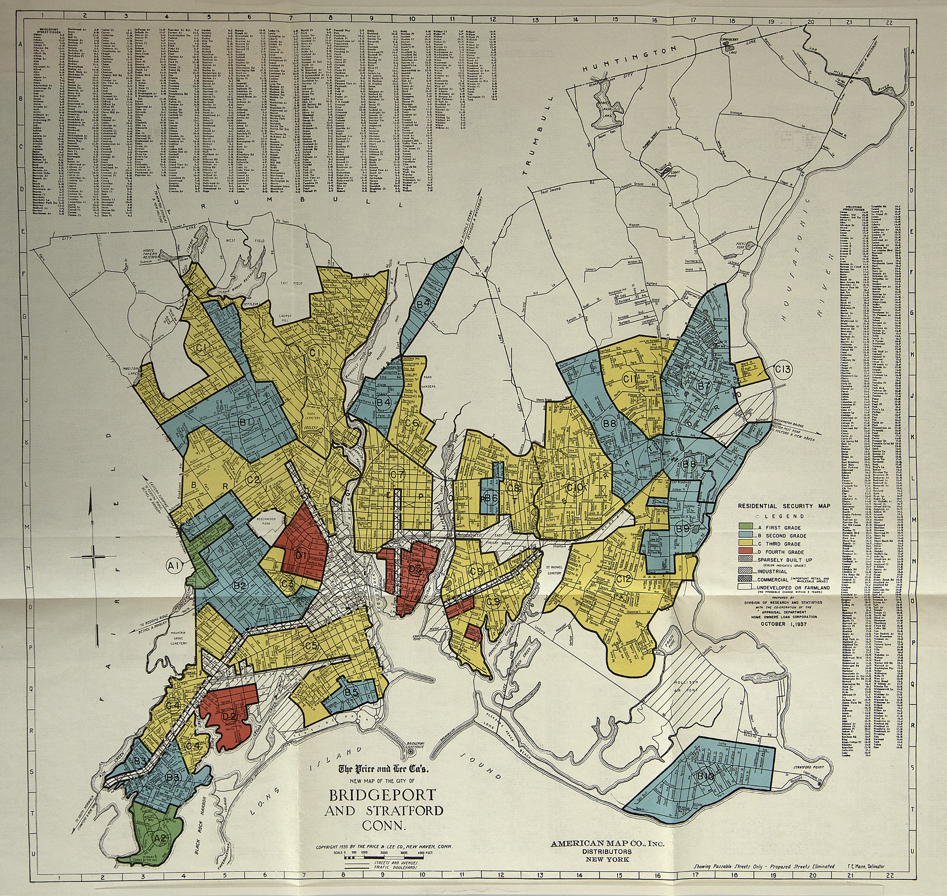
Environmental Injustice in Bridgeport
Redlining
Deindustrialization and
Urban Renewal
Inequitable Distribution
of Greenspace
Image Credit: Mapping Inequality
Icons: "City"--Chalwat Kinkaew (The Noun Project), "Industry"--Wartina Anggraeni (The Noun Project), "Sustainable Urban"--Uyun (The Noun Project)
Notes:
Fairfield County is home to some of the nation’s wealthiest and poorest neighborhoods. Today’s geography of wealth and access to resources is tied to the historic redlining of neighborhoods done by the HOLC, which marked entire communities of color as being too risky for investment. The city saw further disinvestment during the 1970s, when industry started relocating from Bridgeport, leaving residents with little opportunity and causing urban blight. Urban renewal projects, from the clearance of blighted areas to the construction of highways, drastically altered the cityscape and its communities. Due in no small part to all of these public policies, Bridgeport and its East Side community are burdened with a disproportionately hotter environment than the rest of Fairfield County due to the inequitable distribution of green space, tree canopy, and other cooling strategies.
-------------------------------- Image Credit --------------------------------
Image Credit: Mapping Inequality, public domain image
Image Source: https://dsl.richmond.edu/panorama/redlining/data/CT-Bridgeportand%20Fairfield#cityData (Public Domain)
Icon Credit: "City"--Chalwat Kinkaew, The Noun Project
Image Source: https://thenounproject.com/icon/city-5579760/ licensed by CC BY 3.0 DEED
Icon Credit: "Industry"--Wartina Anggraeni, The Noun Project
Image Source: https://thenounproject.com/icon/sustainable-urban-6443563/ licensed by CC BY 3.0 DEED
Icon Credit: "Sustainable Urban"--Uyun, The Noun Project
Image Source: https://thenounproject.com/icon/industry-6499202/ licensed by CC BY 3.0 DEED

Slide 6
Objectives
Urban Heat Assessment​
Use Earth observations to map urban heat disparities in Bridgeport by analyzing 10-year land surface temperature averages and comparing them to the average temperature in the neighboring city of Fairfield.​
Urban Heat Vulnerability​
Identify areas where land surface temperature is extremely high and where Bridgeport residents are most vulnerable to the harms of extreme heat, as indicated by health, socioeconomic, and lifestyle factors. ​
Urban Heat Intervention Model
Locate optimal spots for Groundwork Bridgeport to implement cooling strategies through SOlar and LongWave Environmental Irradiance Geometry (SOLWEIG) modeling.
Icons: "Urban Heat Island"--Softscape (The Noun Project), "Urban Heat Island"--Creative Mania (The Noun Project), "Eco City" -- Softscape (The Noun Project)
Notes:
In order to provide the partners with the information necessary to implement cooling corridors we first created an Urban Heat Assessment showing Land Surface Temperature. We then created a Social Vulnerability Index to investigate with the heat assessment to make a heat vulnerability map. Finally, we used 3D modeling techniques to demonstrate outdoor thermal comfort and determine specific locations for cooling methods.
Urban Heat Assessment
Use earth observation data to map urban heat disparities in Bridgeport, Connecticut by analyzing 10 year temperature averages and comparing them to the average temperature in the neighboring city of Fairfield.
Urban Heat Vulnerability
Identify areas where land surface temperature is extremely high and where Bridgeport resident's are most vulnerable to the harms of extreme heat, as indicated by socioeconomic factors.
Urban Heat Intervention Model
Locate the optimal spot for Groundwork Bridgeport to deploy their Cool Corridors Intervention through SOLWEIG (SOlar and LongWave Environmental Irradiance Geometry) modeling that will show where their infrastructure should be placed.
-------------------------------- Image Credit --------------------------------
Icon Credit: "Urban Heat Island"--Softscape, The Noun Project
Image Source: https://thenounproject.com/icon/urban-heat-island-5088161/ licensed by CC BY 3.0 DEED
Icon Credit: "Urban Heat Island"--Creative Mania, The Noun Project
Image Source: https://thenounproject.com/icon/urban-heat-island-1030202/ licensed by CC BY 3.0 DEED
Icon Credit: "Eco City" -- Softscape, The Noun Project
Image Source: https://thenounproject.com/icon/eco-city-5088168/ licensed by CC BY 3.0 DEED

Slide 7
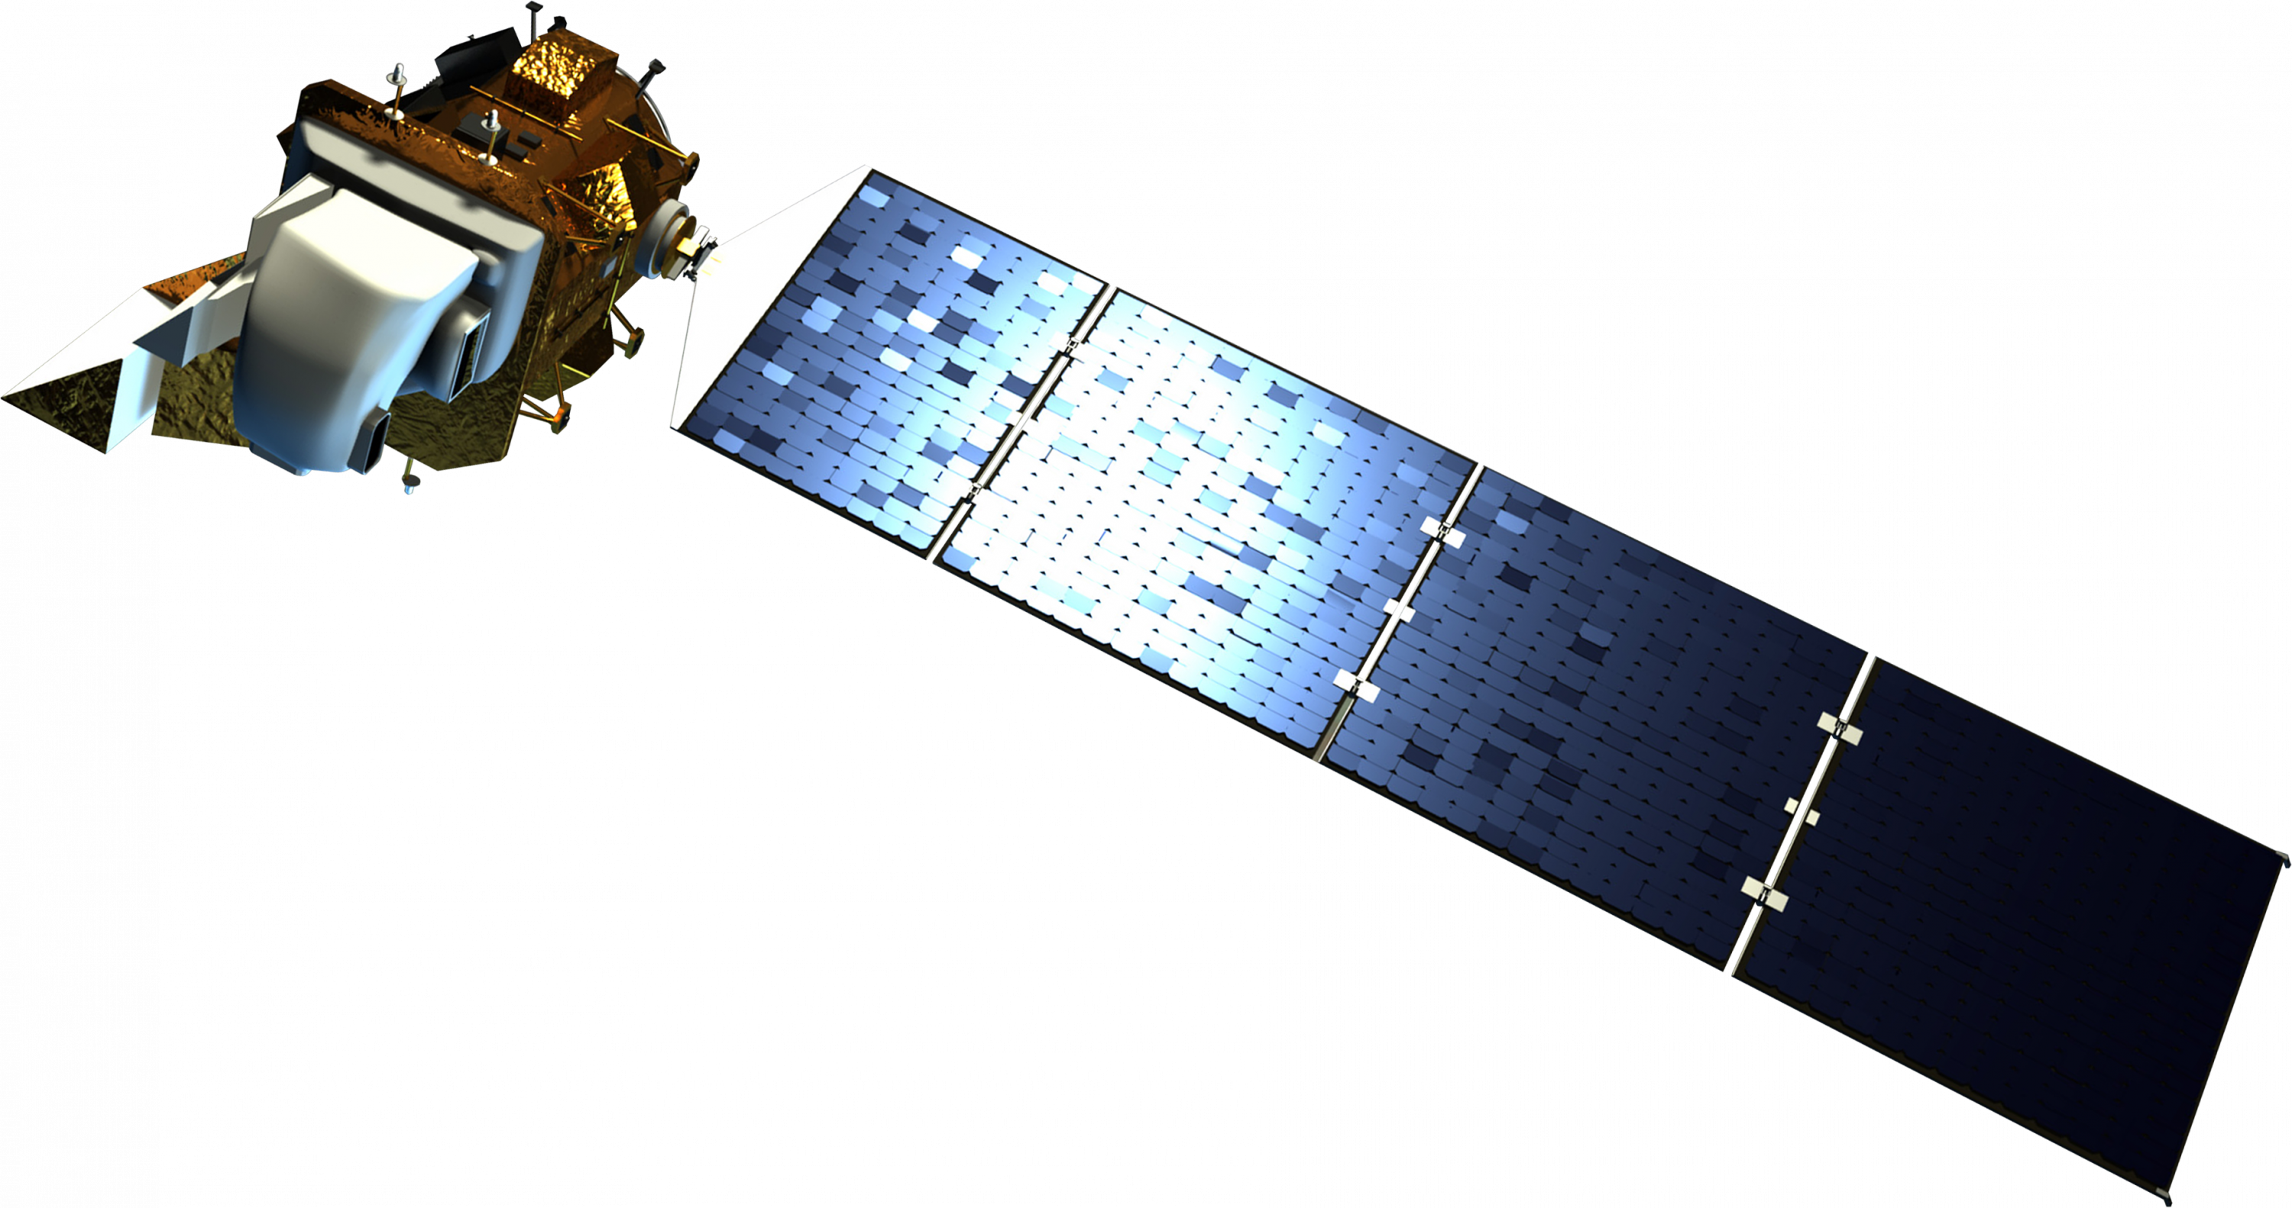
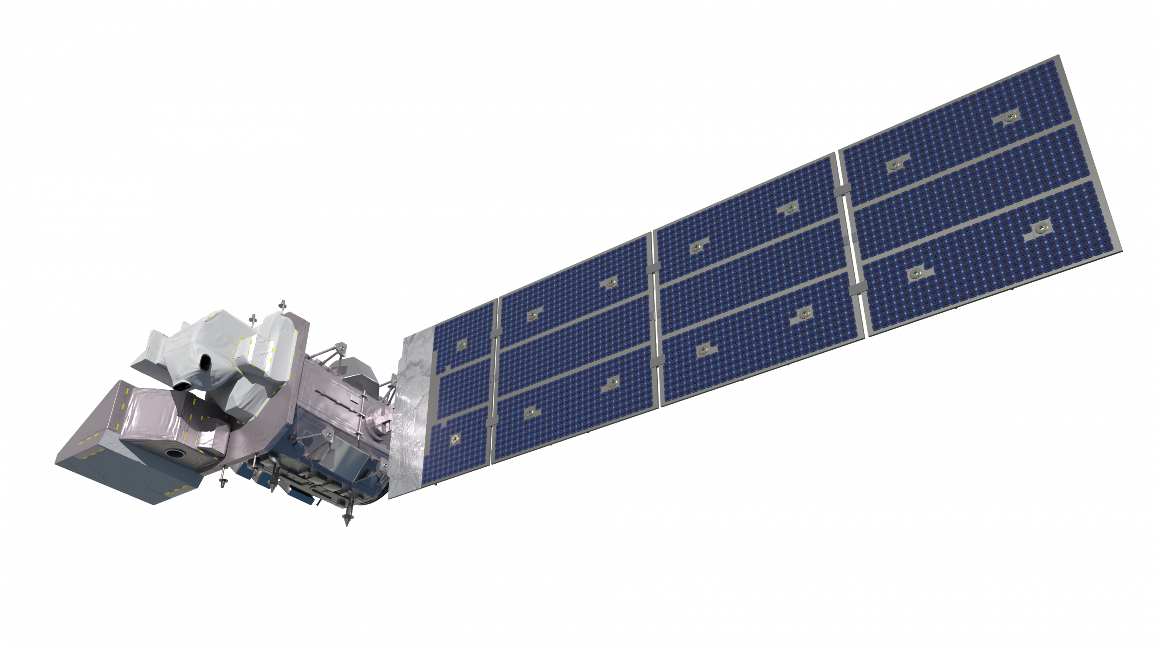
Earth Observations
Landsat 8 TIRS
Lidar
Landsat 9 TIRS-2
Image Credit: NASA
Notes:
To produce Land Surface Temperature maps, we use Landsat imagery which is downloaded with a spatial resolution of 30m. TIRS is used for its ability to capture thermal Infrared data. These two NASA observations informed our project. In addition, we used LiDAR imagery to inform our 3D model of outdoor thermal comfort.
-------------------------------- Image Credit --------------------------------
Left Image Credit: Landsat 8 Rendering
Image Source: https://science.nasa.gov/get-involved/toolkits/spacecraft-icons
Right Image Credit: Landsat 9 Spacecraft Rendering
Image Source: https://science.nasa.gov/get-involved/toolkits/spacecraft-icons
Middle Image Credit: Before-and-After LIDAR Images from 2014 King Fire in El Dorado National Forest NASA ID: PIA19360
Image Source: http://images-assets.nasa.gov/image/PIA19360/PIA19360~orig.jpg
Bottom Image Credit: Earth Observations, Earth observation taken by the Expedition 42 crew aboard the ISS, NASA ID: iss042e013697
Image Source: https://images.nasa.gov/details/iss042e013697

Slide 8
Methods
Urban Heat Difference Map
Land Surface
Temperature
Map
Heat Vulnerability
Assessment Package
3D Model of Outdoor Thermal Comfort
Social Vulnerability Index
Notes:
As mentioned before, this project uses land surface temperature data from Landsat to determine the urban heat difference between Bridgeport city and our reference area of Fairfield City. This information was combined with our own Social Vulnerability Index to create a heat vulnerability assessment package, showcasing where residents are most vulnerable to extreme heat. Finally, this information along with our partners recommendation allowed us to create a 3D model of thermal comfort, informing our partners cooling interventions. We can now go into more detail of each of these products...

Slide 9
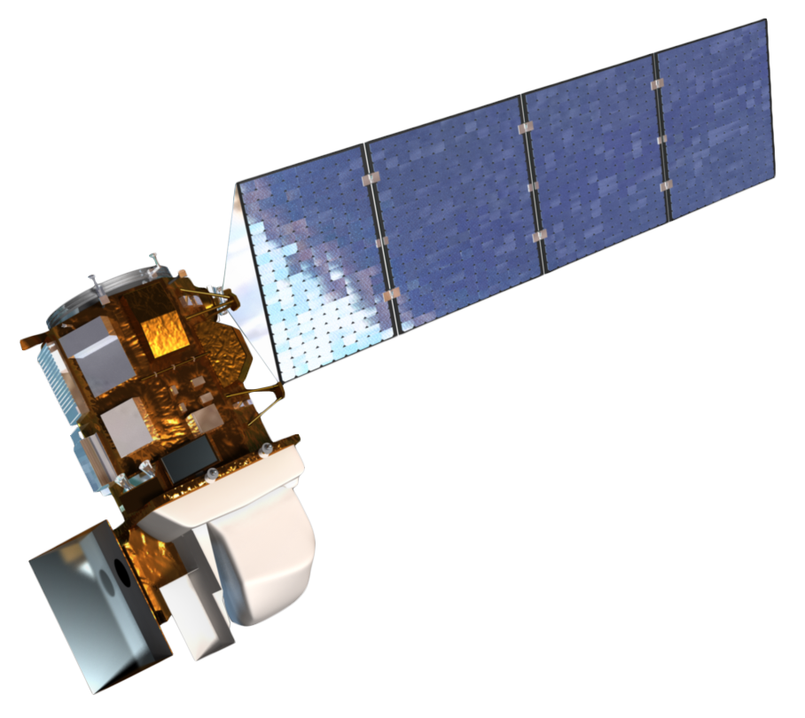
Urban Heat Assessment
Data Acquisition
Processing
Analysis
Result
Calculate Median LST for every Pixel
Calculate LST by Census
Block Group
Average Land Surface Temperature Map
Cloud Mask & Mosaic
Landsat 8 TIRS
Landsat 9 TIRS-2
Clip by Study Area
Calculate Median LST for Reference Area
Subtract Reference LST from every Pixel
Urban Heat Difference Image Map
Image Credit: NASA
Notes:
Our first objective was the urban heat assessment. We used Landsat 8 TIRS and Landsat 9 TIRS-2 images from our study period for all of Fairfield County, providing more insight into the differences in heat distribution between Bridgeport and its surrounding area. We processed and analyzed these images using Google Earth Engine (GEE) with code provided by our science advisor, Dr. Kenton Ross – NASA Langley Research Center, that we adapted for our project. The images available for our study area and period were clipped to a polygon of Fairfield County which excludes the Long Island Sound. We then performed cloud masking to ensure the quality of our data and then mosaiced images taken on the same day. For our analysis, we first calculated the median land surface temperature (LST) at every pixel for the entire collection of images over our study period, which produced a raster image of the mean LST. We used this raster and census geography polygons to calculate the mean LST for each census block group in Bridgeport. Our next step calculated the median LST over an entire reference area. We chose the town of Fairfield as our reference area, which has more green space than Bridgeport and is more affluent. We then subtracted the median LST of the town of Fairfield from the LST at every pixel in the county, resulting in an LST difference image.
-------------------------------- Image Credit --------------------------------
Left Image Credit: Landsat 8 Rendering
Image Source: https://science.nasa.gov/wp-content/uploads/2023/05/landsat8_ldcm.png
Right Image Credit: Landsat 9 Spacecraft Rendering
Image Source: https://science.nasa.gov/wp-content/uploads/2023/05/landsat9.png

Slide 10
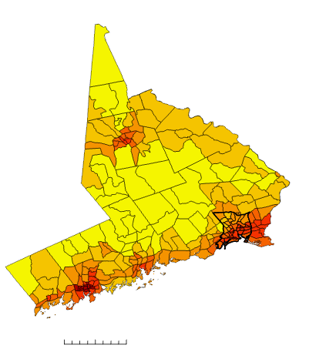
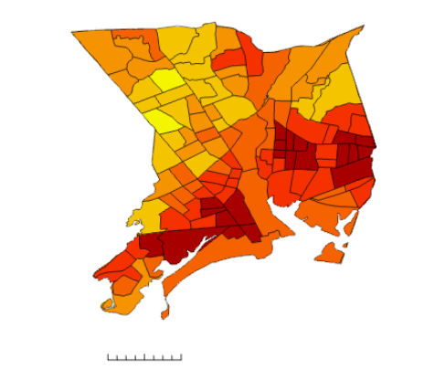
Land Surface Temperature Results
Temperature Distribution for Fairfield County Block Groups
Temperature Distribution for Bridgeport City Block Groups
Block Groups
Block Groups
Average Temp °F
Average Temp °F
65.346-69.569
71.146-74.033
69.570-73.793
74.034-76.922
73.794-78.016
76.923-79.811
78.017-82.240
79.812-82.700
0
5
10 miles
82.241-86.464
0
0.75
1.5 miles
82.701-85.589
86.465-90.687
85.590-88.478
10 miles
0
1.5 miles
1.5 miles
1.5 miles
Notes:
These maps demonstrate the average land surface temperature per census tract (Fairfield County) and block group (Bridgeport City). This map is a zonal mean of a spatial median. As you can see here along the coast, there are much higher temperatures at the county level. This area is more developed raising surface temperatures whereas this lighter yellow color here is more forested area and therefore cooler. In addition, this map shows a zoomed in version of the distribution of temperature for Bridgeport.
-------------------------------- Image Credit --------------------------------
Maps created by team

Slide 11
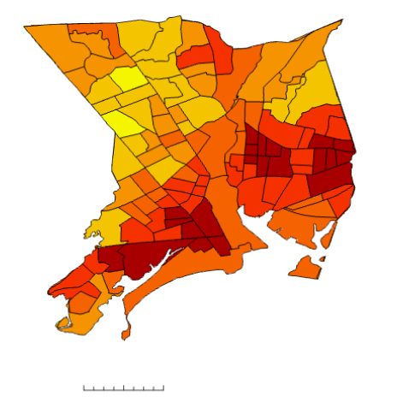
Heat Difference Results
Temperature Difference between Bridgeport and Fairfield City Block Groups
Block Groups
Temp Difference °F
-1.796-0.238
0.239-2.273
2.274-4.308
4.309-6.342
6.343-8.377
0
0.75
1.5 miles
8.738-10.412
Notes:
To create this map, we calculated the difference between Fairfield the town and each block group for Bridgeport . This tells us how much hotter Bridgeport is relative to its neighbor Fairfield town. It is evident from this map that many areas of the city are much hotter with these darker red block groups being between 8-10 degrees hotter
-------------------------------- Image Credit --------------------------------
Maps created by team

Slide 12
Principal Component Analysis and Social Vulnerability Index
Data Acquisition
Processing
Analysis
Results
Socioeconomic Factors
Consult with Partners to Select Urban Heat
Vulnerability Factors
Create Bivariate map with Urban Heat Assessment
Identification of Areas with High Heat
Vulnerability and High Exposure
Complete Vulnerability Principal Component Analysis in R
US Census 2021 ACS 5-Year Survey
Notes:
The social vulnerability index (SVI) is a tool that considers factors that may affect an individual's susceptibility to extreme heat, which when paired with the Land Surface Temperature analysis will contribute to a multi-dimensional, more complete understanding of heat vulnerability. In our initial discussion with our partner, we brought up the types of factors that they found to be significant in defining social vulnerability. From there, we searched available datasets and selected specific factors and sent them for final approval with our partner. The light blue is the data sources we pulled data from. With our finalized list of factors, we began to perform a Principal Component Analysis, a statistical processing method that simplifies large datasets but retains their ability to represent variation. To do this, we used an existing R Script from a past DEVELOP project called UHEAT for processing census data.
The results gave us unique values for each block group that represented the composite of each vulnerability category as one. These values were extracted and visualized in ArcGIS, showing the heat vulnerability of every block group in the Fairfield County. Then, a bivariate map was created that showed the vulnerability of each block group polygon along with the average temperature. We used a simple classification to show the spectrum from low to high vulnerability. With the bivariate map, one could see the areas that were facing the most extreme heat exposure and stood to be affected negatively the most. Identifying areas of extreme vulnerability was the necessary precursor of our next analysis.
We set out with a goal of implementing a combination of census data, as well as health data for the PCA; however, due to the importance of analysis being on the Block Group Level, we were unable to include health data because it only is exported in tract level through the EPA.
Data collection and partner input--> Vulnerability index creation, (Stats+UHA)--> urban heat vulnerability map

Slide 13
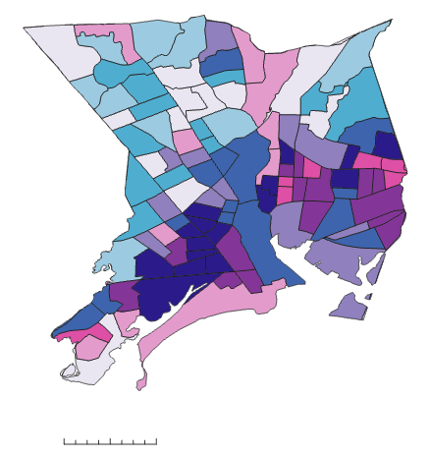
Heat Vulnerability Map
Bivariate Choropleth map of Temperature Distribution and Heat Vulnerability for Bridgeport Block Groups
Block Groups
Land Surface Temperature
Heat Vulnerability Score
High
Low
0
1.5 miles
High
0.75
Low
Notes:
In this map, we put all the results together. The Dark blue means high vulnerability and high land surface temperature. The very light purple means low vulnerability and low land surface temperature. Given that the dark blue block groups experience extreme heat exposure and are very vulnerable to the adverse effects of extreme heat as indicated by our SVI, this is roughly the area we are suggesting our partner target their intervention. For this reason, it is also where our SOLWEIG model will focus.
-------------------------------- Image Credit --------------------------------
Maps created by team

Slide 14
Outdoor Thermal Comfort (SOLWEIG Modeling)
Data Acquisition
Processing
Analysis
Results
USGS LIDAR Point Cloud
Create surface model
Create additional inputs via UMEP plugin
Run model to calculate mean radiant temperature
Outdoor thermal comfort maps
USGS Elevation Data
Clip to each AOI
NOAA
Landcover
Meteorological Data
Notes:
SOlar and LongWave Environmental Irradiance Geometry model (SOLWEIG) The final objective of this project was to create a 3D Model of Outdoor Thermal Comfort using the SOLWEIG Model. This model is run through a plugin on QGIS. In essence, this output is a model of mean radiate temperature of the area we chose, showing how temperature will be felt on the ground via the human experience. To begin processing the model, we downloaded lidar point cloud, DEM, and NOAA land cover data. We then used the point cloud to create a digital surface model. All of the datasets were clipped to the area of interest determined from the urban heat vulnerability assessment, and via the partners wishes. Next we created the variables listed above as they are all additional inputs for the model, using the UMEP pre-processor plugin. Finally we inputted these layers and datasets into the SOLWEIG model to output outdoor thermal comfort, a 3D model.

Slide 15
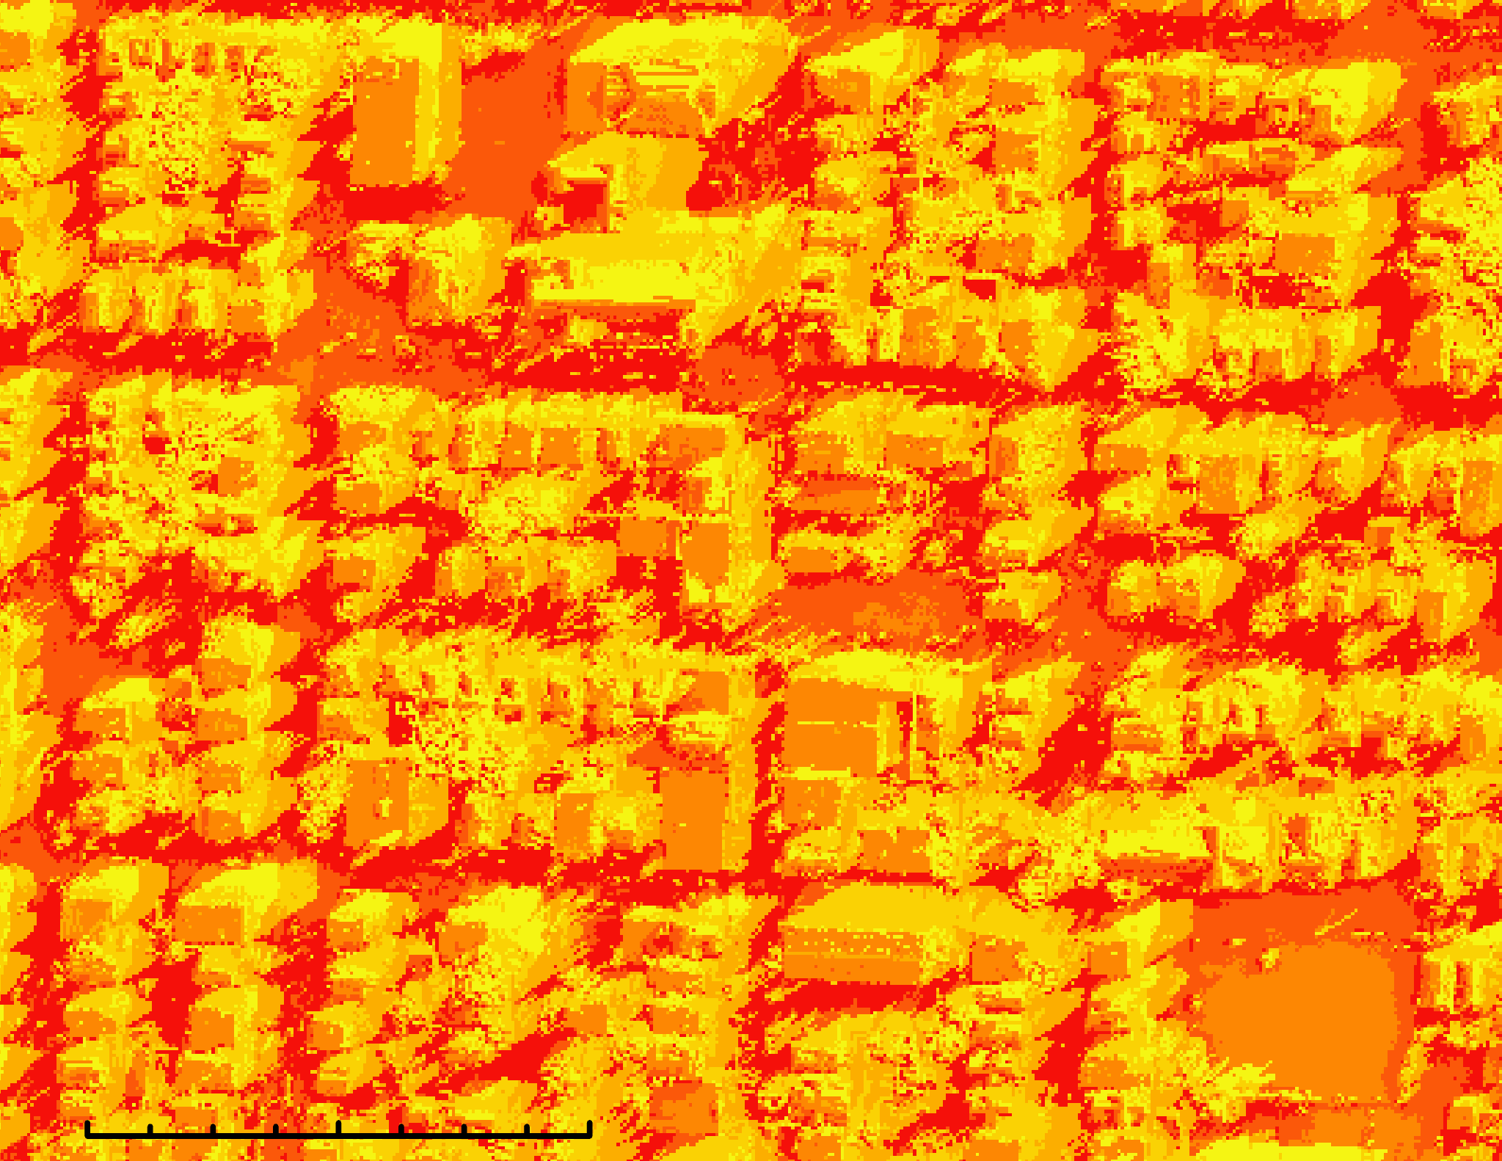
SOLWEIG Output
Mean Radiant Temperature in the East Bridgeport on 07/30/2022 at 14:30
Temperature °F
89.1 – 98.4
Ogden St
98.4 – 100.0
100.0 – 148.2
148.2 – 152.7
152.7 – 154.6
E Main St
154.6 – 157.3
Parking Lot
0
250
500 feet
Notes:
The SOLWEIG model is able to show us radiant temperature from 6 directions, the four cardinal directions as well as upward and downward. Using the previously mentioned inputs and recent meteorological data, this image models how heat may have been experienced on the ground on July 30, 2022. As you can see the red here is where there is the most felt heat, up to 157 degrees Fahrenheit for some pixels. Impervious surfaces, such as asphalt and parking lots, are significant contributors to the intensity of heat. Yellow areas represent cooler temperatures and are most often non-impervious surfaces like vegetation. Shadows also contribute to cooler areas, which is why the northern sides of buildings in this image are typically cooler.
-------------------------------- Image Credit --------------------------------
Maps created by team

Slide 16
Errors & Uncertainties
Urban Heat Assessment​
Land surface temperature does not account for how heat is felt or experienced
Coarse Landsat temporal resolution (revisit time ~ 16 days)
Social Vulnerability​
Could not include all factors relevant to social vulnerability. Social data at block level are desired.
Adapted existing code base
SOLWEIG
Due to availability of data, model inputs are taken from different dates
Highly computer intensive, making it difficult to produce on a large scale
Notes:
Urban Heat Assessment
The way that heat is felt and experienced depends upon numerous factors. Land surface temperature is just one way to approximate and measure heat and does not fully account for how we experience it.
We utilized the Landsat imagery available for our study area and period. However, Landsat imagery is taken periodically, not continuously, so the images used to perform our analysis do not capture the entire story. Our partner was most interested in the extreme heat and the hottest days in Bridgeport, but Landsat imagery does not necessarily align with such events at the time they happened.
Social Vulnerability
It was difficult to find social data that was relevant to our partners' demands and at a high spatial resolution. For this reason, we could not included factors like asthma rates and heat-related hospitalizations or access to AC.
We adapted the existing UHEAT code base. There were unique challenges we faced as we sought to use the tool without exactly following each step of the process. There were many errors in R caused by these adaptations and given that we were using the UHEAT methods that dictated interpretations without using the complete UHEAT inputs, it took additional effort to ensure our findings were veritable.
SOLWEIG
Due to the availability of data, the required inputs for the outdoor thermal comfort model are not taken from the same date, with some being years apart. This causes discrepancies, especially in areas where there have been drastic changes in land cover, tree canopy, or the built environment.
-------------------------------- Image Credit --------------------------------
Icons: Microsoft Office

Slide 17
Conclusions
Bridgeport is about 10 F hotter than Fairfield City on average during Summer months.
Socio-demographic and socio-economic factors contribute to higher likelihood of heat related hardships
Cooling interventions such as adding vegetation could help address heat concerns at high heat vulnerability regions.
Notes:
After conducting this study, we can conclude that Bridgeport is hotter than Fairfield city. We also can conclude that different socio-demographic variables are related to increased vulnerability to heat risk.
Lastly, we can conclude that cooling interventions should be considered in the East Side of Bridgeport, particularly in areas where heat vulnerability and heat exposure are highest.
-------------------------------- Image Credit --------------------------------
Icons: Microsoft Office

Slide 18
Feasibility Assessment
Landsat Earth observations can be used to identify hot areas
Thermal Comfort Modeling is valuable for determining cooling interventions
Notes:
From this study, we can conclude it is possible to use NASA Earth observations, to identify hotter areas. In addition, this has been corroborated with other literature. The high spatial resolution of the modeling provides more information to felt heat that can be valuable for determining where it may be beneficial to implement cool corridors.
-------------------------------- Image Credit --------------------------------
Icons: Microsoft Office

Slide 19
Future Recommendations
Modeling tree canopy interventions to determine effectiveness in neighborhoods vulnerable to heat
Conducting a multi-purpose study of green infrastructure to assess cooling and flood relief
Incorporate more in-situ temperature data for social vulnerability
Notes:
With further resources, we would recommend to expand on this study by completing a tree canopy model to understand how the implementation of tree canopy can provide cooling. In addition, our partner expressed concern about flooding within Bridgeport, we recommend a holistic study of the benefits of green infrastructure that is holistic, and includes both flooding and cooling to address a more multi-dimensional use for the city. Finally, our partner has expressed interest in using volunteers to collect more data from households in the East Side about their experiences with extreme heat. This would result in the best possible dataset to use for determining social vulnerability to heat.

Slide 20
We would like to thank our wonderful science advisors and lead:
Dr. Kenton Ross - NASA Langley Research Center
Dr. Xia Cai - NASA Langley Research Center
Madison Arndt – DEVELOP Massachusetts – Boston Lead
We would also like to thank our partners for this project:
Christina Smith - Groundwork Bridgeport
Andrei Harwell - Yale Urban Design Lab
Notes:
Thank you to our Science advisors, our lead, and our partners for making this study possible!

