Slide 1
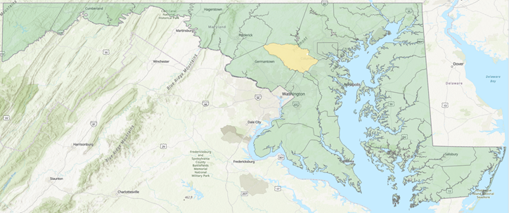
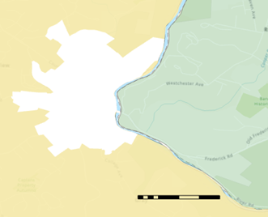
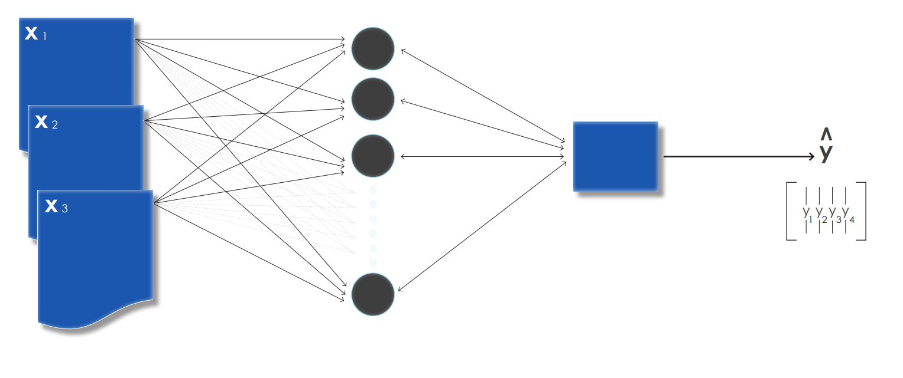
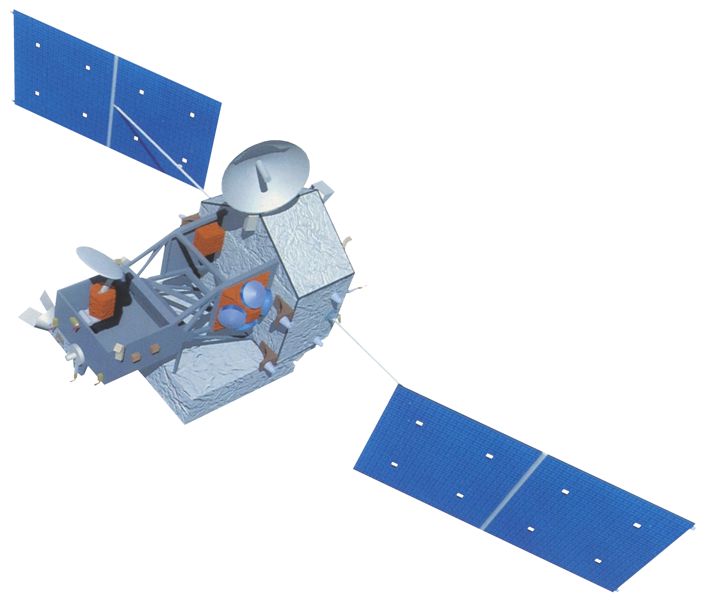
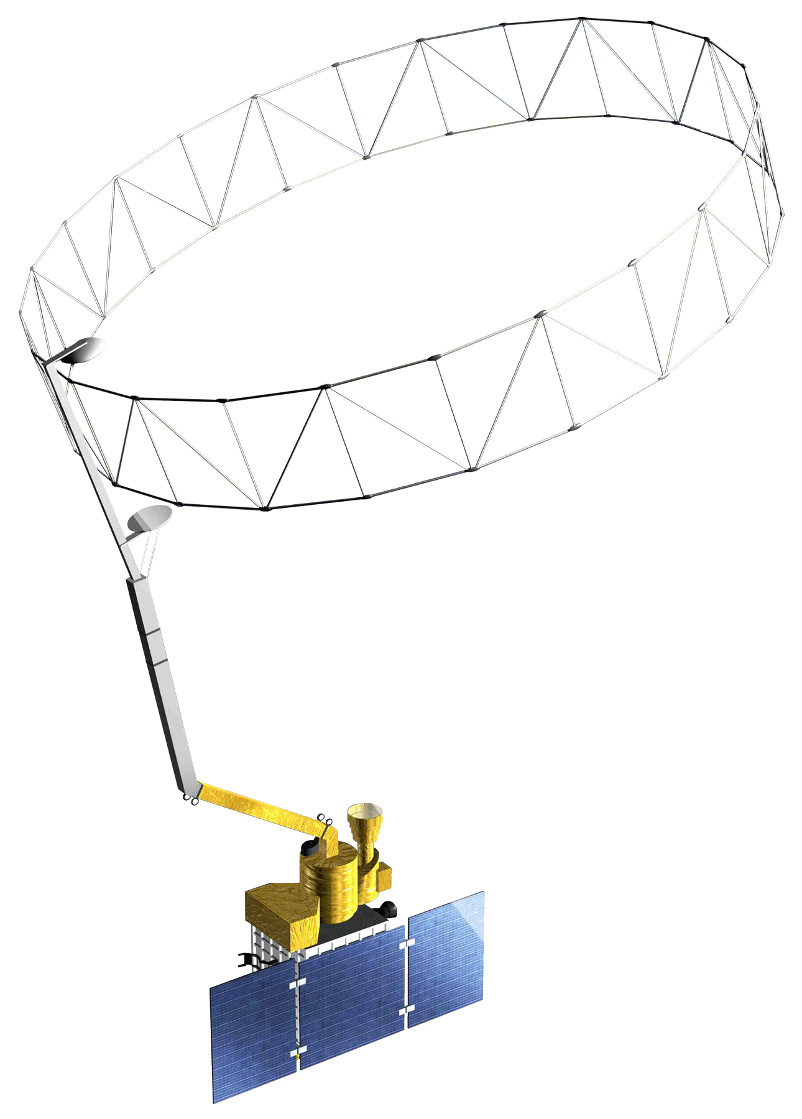
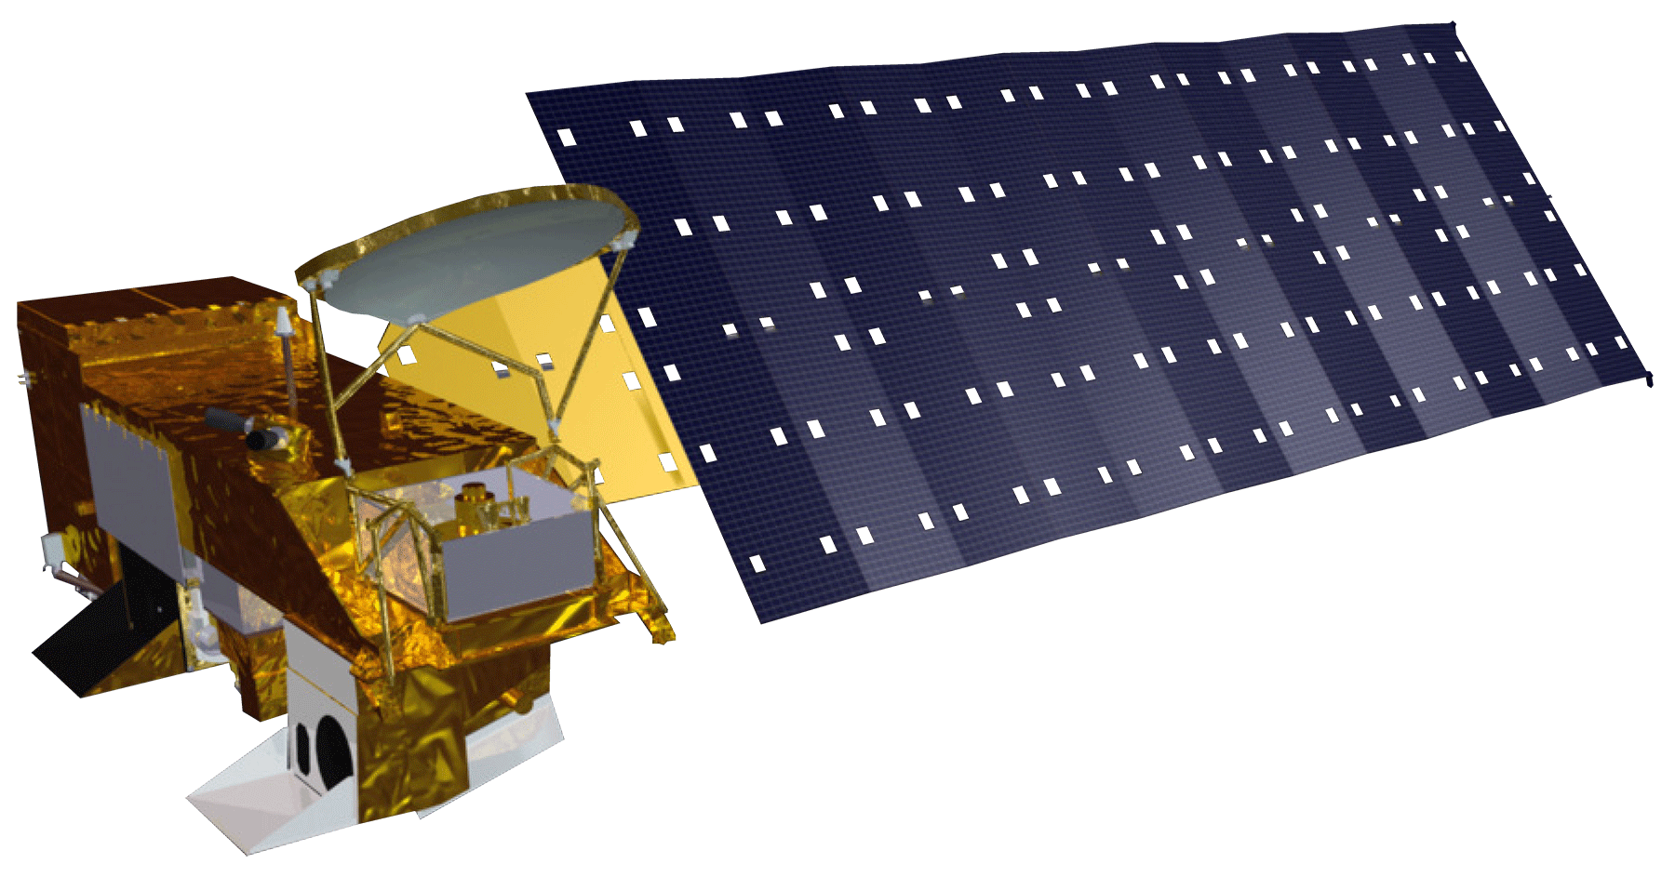
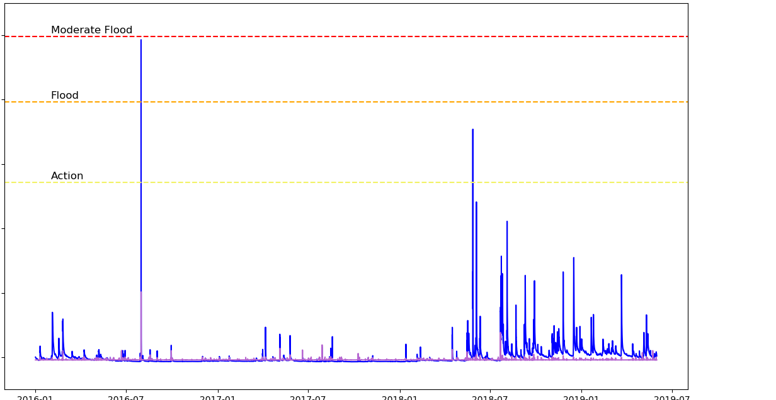
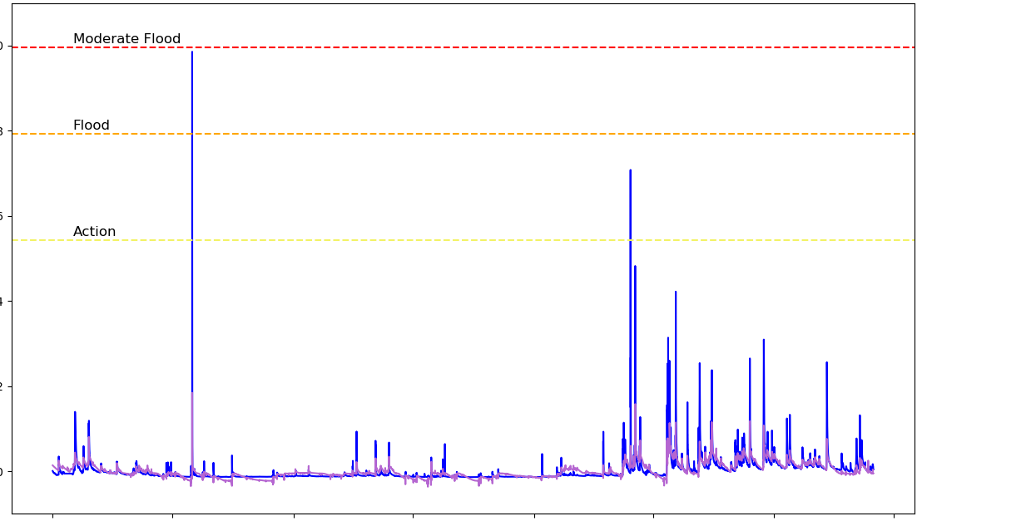
Applying NASA Resources to a Statistical Flood Risk Model to Improve Early Warning Systems and Public Safety
Abstract
Study Area
As flooding events in the United States grow in frequency and intensity, the use of technological advancements and applied science is increasingly necessary for effective flood monitoring and warning systems. Governments are exploring new ways of using science and technology to solve public safety and environmental problems. The NASA DEVELOP Ellicott City Disasters project investigated two extreme flood events in 2016 and 2018 within Ellicott City, Maryland. The project supported the efforts of the Howard County Office of Emergency Management (OEM) and represents the first step in improving early warning system capabilities using open data and NASA Earth observations. The resultant flood model (“Flood Learning Model Environment” or FLuME) evaluated the statistical significance of features engineered from NASA resources such as North American Land Data Assimilation System (NLDAS) and Soil Moisture Active Passive (SMAP), and utilized stream gauge data from the Department of Homeland Security, OEM, and the United States Geological Survey. The project products included data visualizations and a model framework for exploring factors influencing flood severity. The model was trained on two years of discharge data and was subsequently used to hindcast the May 2018 flood of Ellicott City. This exploratory analysis informs OEM decision-making processes and will help the county effectively allocate monitoring technology within the Patapsco watershed, thereby increasing public safety and reducing risk.
Ellicott City
Maryland
Miles
0 .08.32 .48 .64
Howard County
Miles
0 10 20 40 60 80
Methodology
INPUT LAYER (Features)
VISIBLE
HIDDEN LAYER
OUTPUT LAYER
VISIBLE
PREDICTED VALUE
X₁
Precipitation (NLDAS)
X₂
ŷ
Objectives
Soil Moisture (NLDAS)
Downstream Discharge
X₃
y₁
y₂
Apply NASA Earth observations to examine flood events in Ellicott City
Model factors that contribute to flood events
Provide feedback to inform monitoring technology and resource allocation across space, with a focus on ground-level data collection
Identify other datasets necessary for accurate flood modeling at a scale useful for decision-making
Upstream Discharge (Various Sources)
y₃
y₄
Earth Observations
Results
Measured discharge is visualized alongside modeled, or predicted, discharge for a Patapsco River gauge 2.3 miles southeast of downtown Ellicott City in Catonsville, Maryland. This gauge was selected for its superior data quality. Modeled discharge is achieved using various inputs. The left plot utilizes only precipitation, while the right one additionally includes soil moisture and upstream discharge. As seen in the comparison of measured and modeled data points in the right plot, incorporating soil moisture and upstream discharge increases the accuracy of the model’s prediction. This is confirmed in the sum of the root mean squared error (RMSE) for each plot: the left plot has RMSE 22.1 and the right one has 9.7.
Aqua
AMSR-E
TRMM
TMI
SMAP
L-band radiometer
Ellicott City Disasters
Measured and Predicted Discharge: Precipitation as Model Input
Measured and Predicted Discharge: Precipitation, Upstream Discharge, and Soil Moisture as Model Inputs
1.0
Moderate Flood
Error: 22.1
1.0
Moderate Flood
Error: 9.7
0.8
Flood
Measured
Modeled
0.8
Flood
Measured
Modeled
0.6
0.6
Action
Normalized Discharge
Action
Normalized Discharge
0.4
0.4
0.2
0.2
0.0
2016-01
2016-07
2017-01
2017-07
2018-01
2018-07
2019-01
2019-07
0.0
2016-01
2016-07
2017-01
2017-07
2018-01
2018-07
2019-01
2019-07
Conclusions
Dates
Project Partners
Dates
While machine learning methods are useful for modeling discharge using various flood-predicting variables, further work is needed to interpret each variable’s importance.
No single variable (precipitation, soil moisture, or upstream discharge) is sufficient to model past flood events, but analysis of multiple variables enhances flood estimation.
Additional data points, particularly ones representing extreme weather events, are necessary for adequate prediction of future floods.
Howard County Government, Office of Emergency Management (OEM)
National Oceanic and Atmospheric Administration (NOAA), National Weather Service (NWS), Baltimore-Washington Weather Forecast Office
Howard County Government, Stormwater Management Division
Acknowledgements
Team Members
This research was made possible by Dr. John Bolten and Dr. Sujay Kumar, our Science Advisors, Victor Lenske, Center Lead, and the GSFC New York Eco II DEVELOP team; Brian Cleary, Howard County Government Stormwater Management Division Project Manager; Mike Hinson, Howard County Government Office of Emergency Management Acting Emergency Management Director; and Christopher Strong, Baltimore-Washington Weather Forecast Office of NOAA-NWS Warning Coordination Meteorologist.
Terra Edenhart-Pepe
Project Lead
Julio Peredo
Caroline Resor
Callum Wayman
Maryland – Goddard | Summer 2019

