Slide 1
NASA DEVELOP National Program
DEVELOP Resources
What’s Available?

Slide 2
DEVELOPedia
DEVELOPedia is an internal wiki intended to serve three purposes:
Enhance project workflow
Capture lessons learned and make them available to future project teams
Record data required for operational metrics
DEVELOPedia is a collaborative effort whose utility is directly related to the efforts of previous DEVELOP participants.
DEVELOPedia is a living document, constantly adapting to meet the needs of the NASA DEVELOP National Program and the people that make the program great (That’s you!)
http://www.devpedia.developexchange.com
POC – Jordan Vaa
Training Resources Homepage
http://www.devpedia.developexchange.com/dp/index.php?title=Training_Resources_Homepage
Geospatial Programs and Methods
Remote Sensing
Code and Programming Tutorials
Technical Skill Development
Professional Development: EdX Classes, Coursera Classes, Alison Classes

Slide 3
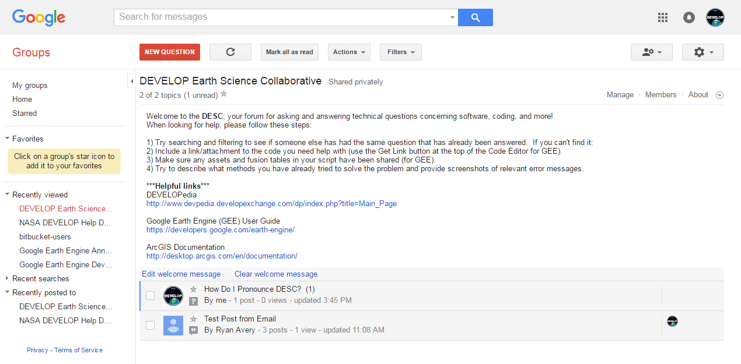
The DEVELOP Earth Science Collaborative
A forum for software, geospatial, and coding questions
Can email forum directly like a regular email address
Moderated by the Geoinformatics Team
Copy link, go join, and bookmark the DESC on your favorite browser!
https://groups.google.com/d/forum/developesc

Slide 4
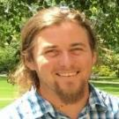
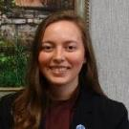
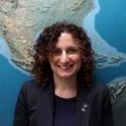
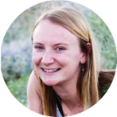
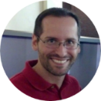
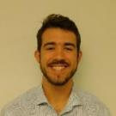
FY18 Fellows Class
Fellow Elements are here to assist teams, feel free to reach out to them with questions!
Project Coordination
DEVELOP.ProjectCoordination@gmail.com
Communications
DEVELOP.Communication@gmail.com
Geoinformatics & IT
DEVELOP.Geoinformatics@gmail.com
Impact Analysis
DEVELOP.ImpactAnalysis@gmail.com
Amanda Clayton
Virginia – Langley
PC Senior Fellow
Jordan Vaa
Virginia – Langley
IT Senior Fellow
Georgina Crepps
Virginia – Langley
IA Senior Fellow
Austin Counts
Virginia – Wise
Comm Fellow
Mercedes Bartkovich
Alabama – Marshall
PC Fellow
Leah Kucera Idaho – Pocatello
Comm Fellow
Daniel Carver Colorado – Fort Collins
Geo Fellow
Brooke Colley
Virginia – Wise
IA Fellow
Sara Lubkin
Maryland – Goddard
PC Fellow
Jonathan O’Brien
North Carolina – Asheville
Comm Fellow
Kate Cavanaugh
California – JPL
Geo Fellow
Liz Dyer
Arizona – Tempe
IA Fellow
Nick Rousseau
California – JPL
PC Fellow
Austin Stone
Georgia – Athens
Comm Fellow
John Dilger
California – Ames
Geo Fellow
Danielle Quick
Alabama – Mobile
IA Fellow

Slide 5
National POCs
DEVELOP
NPO
Mike Ruiz
Lindsay Rogers
Karen Allsbrook
Lauren Childs-Gleason
Dr. Kenton Ross
Jennifer Tindell
Senior Fellows
Georgina Crepps
Amanda Clayton
Jordan Vaa
DEVELOP
Fellows
Mercedes Bartkovich (MSFC)
Daniel Carver (CO)
Kate Cavanaugh (JPL)
Brooke Colley (VA)
Austin Counts (VA)
John Dilger (ARC)
Liz Dyer (AZ)
Leah Kucera (ID)
Sara Lubkin (GSFC)
Jonathan O’Brien (NC)
Danielle Quick (AL)
Nick Rousseau (JPL)
Austin Stone (GA)
DEVELOP Node Leadership
Arizona - Tempe
Lance Watkins (CL)
Liz Dyer (ACL)
California – Ames
Jenna Williams (CL)
John Dilger (ACL)
California – JPL
Erika Higa (CL)
Kate Cavanaugh (ACL)
Colorado – Fort Collins
Timothy Mayer (CL)
Dan Carver (ACL)
Georgia – Athens
Caren Remillard (CL)
Sean Cameron (ACL)
Idaho – Pocatello
Brandon Crawford (Acting CL)
Leah Kucera (ACL)
Maryland – Goddard
Victor Lenske (CL)
Sara Lubkin (ACL)
North Carolina – NCEI
Alec Courtright (CL)
Jonathan O’Brien (ACL)
Virginia – Langley
Emily Gotschalk (CL)
Virginia – Wise
Eric White (CL)
Brooke Colley (ACL)
Austin Counts (ACL)
Alabama – Marshall
Maggi Klug (CL)
Helen Baldwin (ACL)
Alabama – Mobile
Farnaz Bayat (CL)
Danielle Quick (ACL)

Slide 6
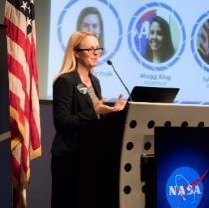
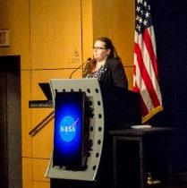
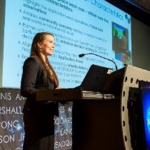
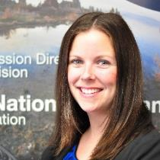
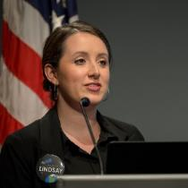
Questions?
Lauren Childs-Gleason: Lauren.M.Childs@nasa.gov, 757-864-4204
Georgina Crepps: Georgina.S.Crepps@nasa.gov, 757-864-5548
Amanda Clayton: Amanda.L.Clayton@nasa.gov, 757-864-5552
Jordan Vaa: Jordan.S.Vaa@nasa.gov, 757-864-4554
Karen Allsbrook: Karen.N.Allsbrook@nasa.gov, 757-864-1276
Lindsay Rogers: Lindsay.M.Rogers@nasa.gov, 757-864-7283
Deadlines, conferences, telecons, Fellow class, CL position competition, publications, international activities, partner engagement, project hand-offs, graphic design support, print materials, recruiting, VPS, Wise County
Impact Analysis Team-related items, tracking metrics, indicators, socioeconomic impact analysis, PSI, participant surveys, alumni survey, using the national telecon line
Project Coordination Team-related items, publications, deliverables, deadlines, webinars, DEVELOPedia project pages
IT Team-related items, DEVELOPedia, DEVELOP website, DEVELOP Exchange, software, hardware, software release authority
Contracts, payroll, status reports/invoices, schedule adjustments, online application system, travel, employment verifications, SSAI
Communications Team-related items, social media, newsletter, recruiting, military engagement, outreach activities, Ambassador Corps, media requests
Topics Not Listed Here: ANYONE! We love answering questions and will direct you to the right person if we can’t answer ☺

Slide 7
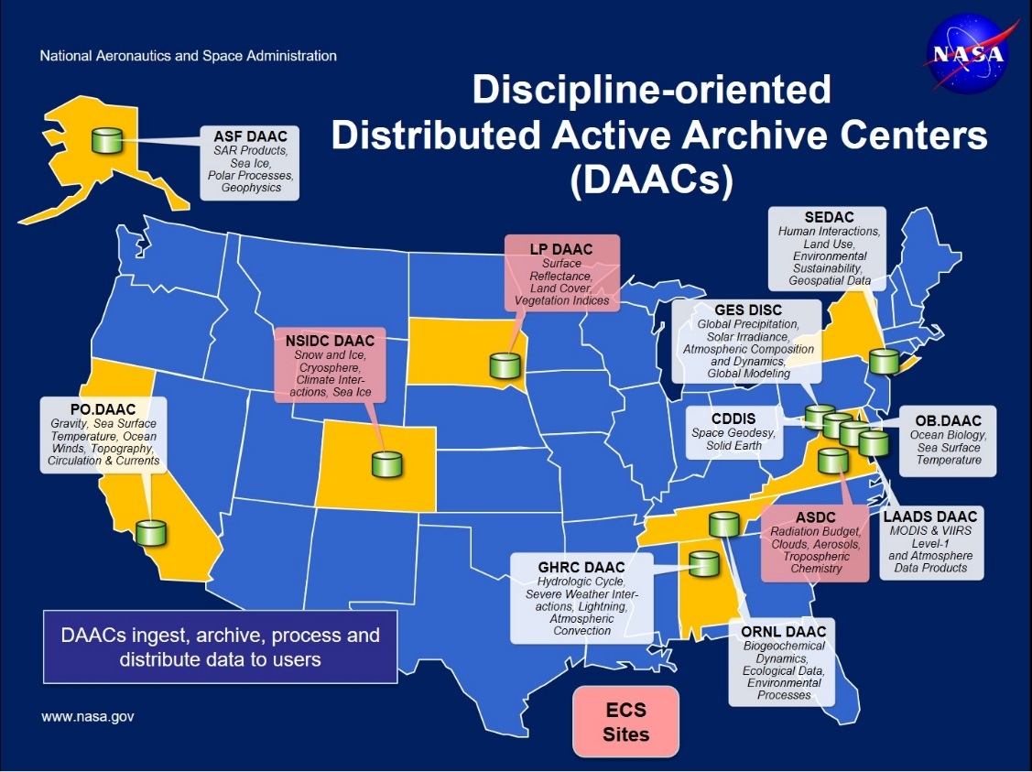
NASA Data Centers
Earth Observing System Data and Information System (EOSDIS) is designed as a distributed system, with major facilities at Distributed Active Archive Centers (DAACs) located throughout the United States. These institutions are custodians of EOS mission data and ensure that data will be easily accessible to users. The EOSDIS DAACs process, archive, document, and distribute data from NASA's past and current Earth-observing satellites and field measurement programs. Acting in concert, the DAACs provide reliable, robust services to users whose needs may cross the traditional boundaries of a science discipline, while continuing to support the particular needs of users within the discipline communities. User services include:
Assistance in selecting and obtaining data
Access to data-handling and visualization tools
Notification of data-related news
Technical support and referrals
EOSDIS Distributed Active Archive Centers (DAACs)
https://earthdata.nasa.gov/about/daacs
Earth Data Search
https://search.earthdata.nasa.gov/search

Slide 8
ARSET Trainings
https://arset.gsfc.nasa.gov/
Through ARSET trainings, you can learn how to:
Use NASA data for environmental management
Search and access NASA resources relevant to your needs
Visualize, interpret, and apply remote sensing data and imagery
Remote Sensing Fundamentals: These webinars are available for viewing at any time. They provide basic information about the fundamentals of remote sensing, and are often a prerequisite for other ARSET trainings. https://arset.gsfc.nasa.gov/webinars/fundamentals-remote-sensing
Session 1: Fundamentals of Remote Sensing
Session 2A: Satellites, Sensors, Data and Tools for Land Management and Wildfire Applications
Session 2B: Satellites, Sensors, and Earth Systems Models for Water Resources Management
Session 2C: Fundamentals of Aquatic Remote Sensing

Slide 9
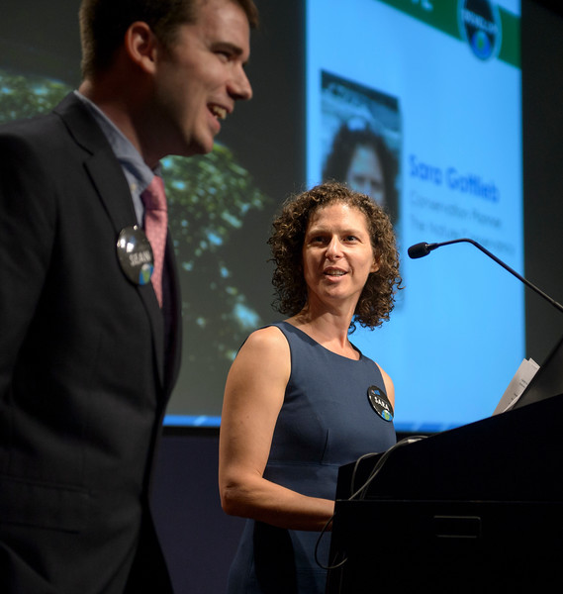
Thank You!
Ask lots of Questions!

