Slide 1
BIG CYPRESS WATER RESOURCES
Using Earth Observations to Assess Water Quality in Big Cypress Reservation, FL
Dominic Fantauzzo
Gustavo Rosas
Nathan Hewitt
Sarah Swiersz
Pop-Up Project | Summer 2024
Notes:
----------Speaker Notes------------------------
This is the Summer 2024 Florida Gulf Coast University Pop-Up Project's virtual presentation, titled "Big Cypress Water Resources: Using Earth Observations to Assess Water Quality Characteristics to Determine Operational Best Practices in Big Cypress Preserve, FL".
The team members for this project are: Dominic Fantauzzo, Gustavo Rosas, Nathan Hewitt, and Sarah Swiersz.

Slide 2
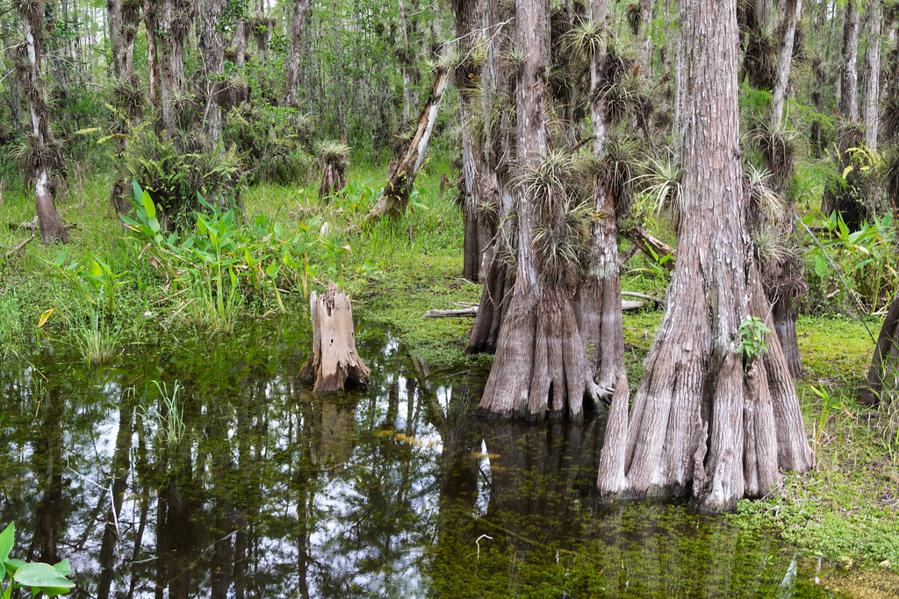
OUTLINE
Project Context
Community Concerns
Partner
Study Area & Period
Project Objectives
Earth Observations
Methodology
Results
Uncertainties
Feasibility & Partner Implementation
Conclusions
Acknowledgements
Image Credit: dconvertini
Notes:
----------Speaker Notes------------------------
Today, we will share key information about the project issue, design, execution, and outcomes.
We will provide an overview of the issue the study addresses, including the project partners, study area, and study period.
Then, we will explain the methods and tools we employed in our analyses.
Finally, we will share the findings of our study, including a discussion of the project's outcomes, limitations, and opportunities for further work.
----------Image Information Below----------
Taxodium ascendens Big Cypress National Preserve, Florida, USA
Image Credit: dconvertini, licensed under CC BY-SA 2.0
Image Source: https://openverse.org/image/546d5d8b-f2e5-4b2d-bffa-a5f933a380bc?q=big%20cypress%20preserve

Slide 3
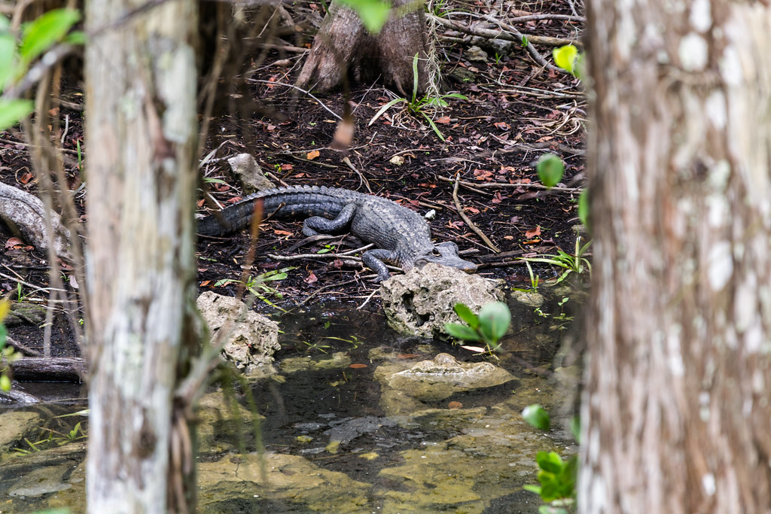
PROJECT CONTEXT
Land development has worsened water quality around Big Cypress National Preserve
Excess nutrients from runoff have caused intense harmful algal blooms (HABs)
HABs can harm people and ecosystems
Minimizing HABs is essential for a healthier environment
Image Credit: dconvertini
Notes:
----------Speaker Notes------------------------
The area of particular interest includes the Big Cypress National Preserve and the Big Cypress Reservation, where land development has worsened water quality conditions.
Runoff from land development and agriculture contribute nutrients that promote the growth of harmful algal blooms—referred to as "HABs".
Harmful algal blooms threaten ecological function and pose human health risks.
This project assesses the feasibility of using Earth observations for assessing water quality in South Florida.
----------Image Information Below----------
Big Cypress National Preserve, Florida, USA
Image Credit: dconvertini, licensed under CC BY-SA 2.0
Image Source: https://openverse.org/image/3c77551c-310f-40f7-a966-47559898d38c?q=big%20cypress%20preserve

Slide 4
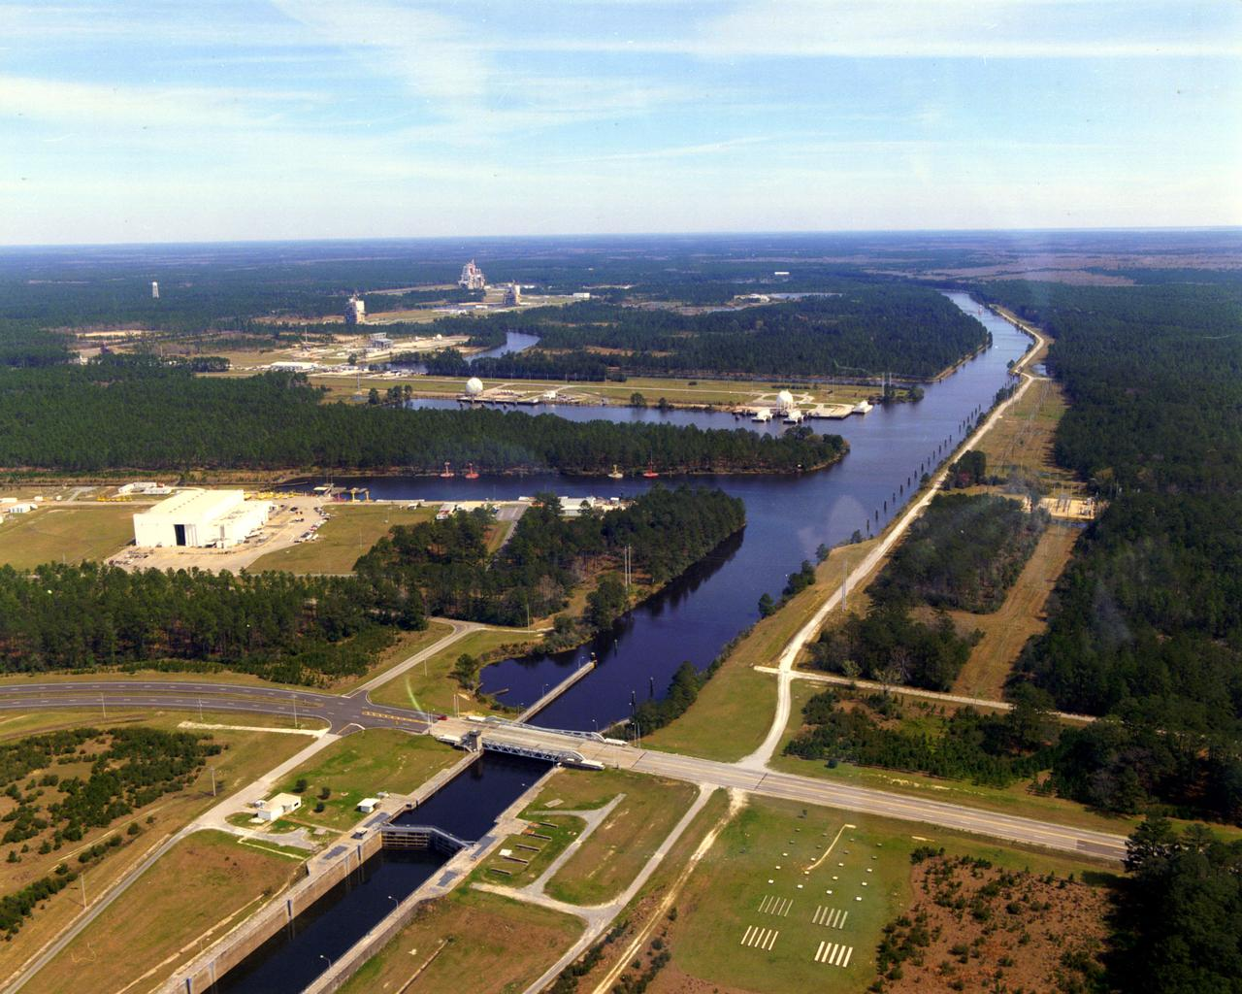
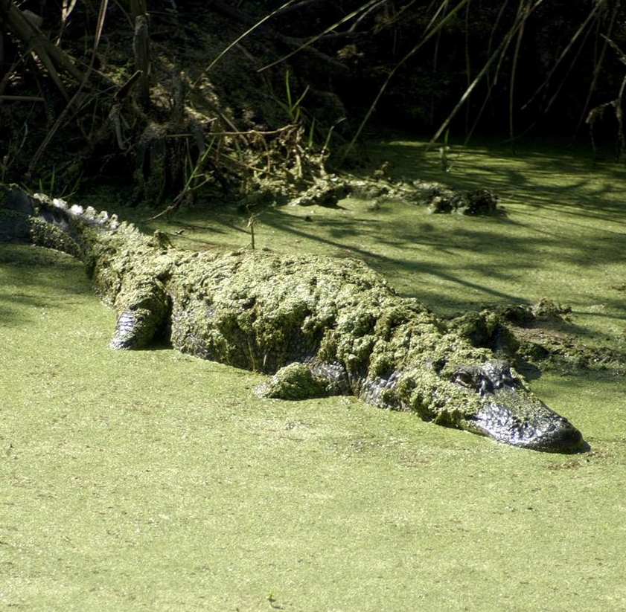
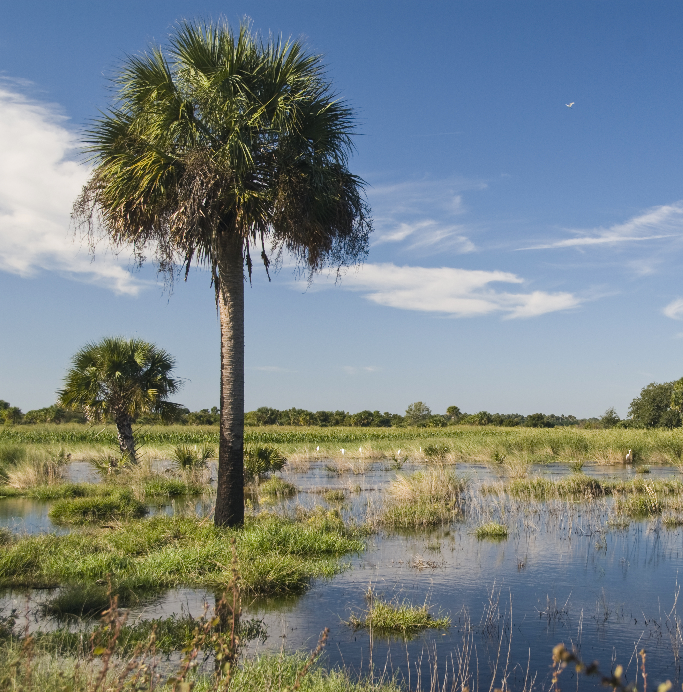
COMMUNITY CONCERNS
Canal Management and Operational Best Practices
Water Quality and Cyanobacteria Blooms
Land Conservation
Image Credit: NASA, USDA
Notes:
----------Speaker Notes------------------------
The Seminole Tribe is facing significant water quality issues throughout the Big Cypress Reservation, largely driven by drainage from surrounding basins.
Canals within the Reservation struggle with high levels of nutrients due to runoff from waterbodies upstream. This runoff contributes to the growth of algal blooms within the reservation.
Runoff is increasing toxic conditions for fish and wildlife, which impact human heath and recreation.
----------Image Information Below----------
[Left Image]
Image Credit: NASA
Image Source: https://images.nasa.gov/details/SSC-20010425-S046-6
[Middle Image]
Image Credit: NASA
Image Source: https://images.nasa.gov/details/KSC-02pd0358
[Right Image]
Image Credit: USDA, licensed under CC BY 2.0 DEED
Image Source: https://commons.wikimedia.org/wiki/File:Florida_Wetlands_%2819114335522%29.jpg
Image Adaptation: Image was cropped from original form.

Slide 5
PARTNER
Increase the accessibility of Earth observations (EO) for Indigenous organizations
Seminole Tribe of Florida
Environmental Resource Management Department
Inform decision-making processes with larger-scale and more current datasets
Work towards early bloom detection and implement actions to minimize harmful impacts
Notes:
----------Speaker Notes------------------------
We are partnered with the Seminole Tribe of Florida Environmental Resources Management Department.
The Seminole Tribe has spent many years building up their infrastructure management capacity, practices, and procedures.
Their current management approach uses GIS and on ground water sampling.
They are interested in incorporating EO to enhance their ability to detect and predict high nutrient loads in order to develop a better understanding of source and in/out flows.
Ultimately, the Tribe hopes a better understanding can inform management decisions—such as canal operations, wetland conservation, etc.—in the preserve.

Slide 6
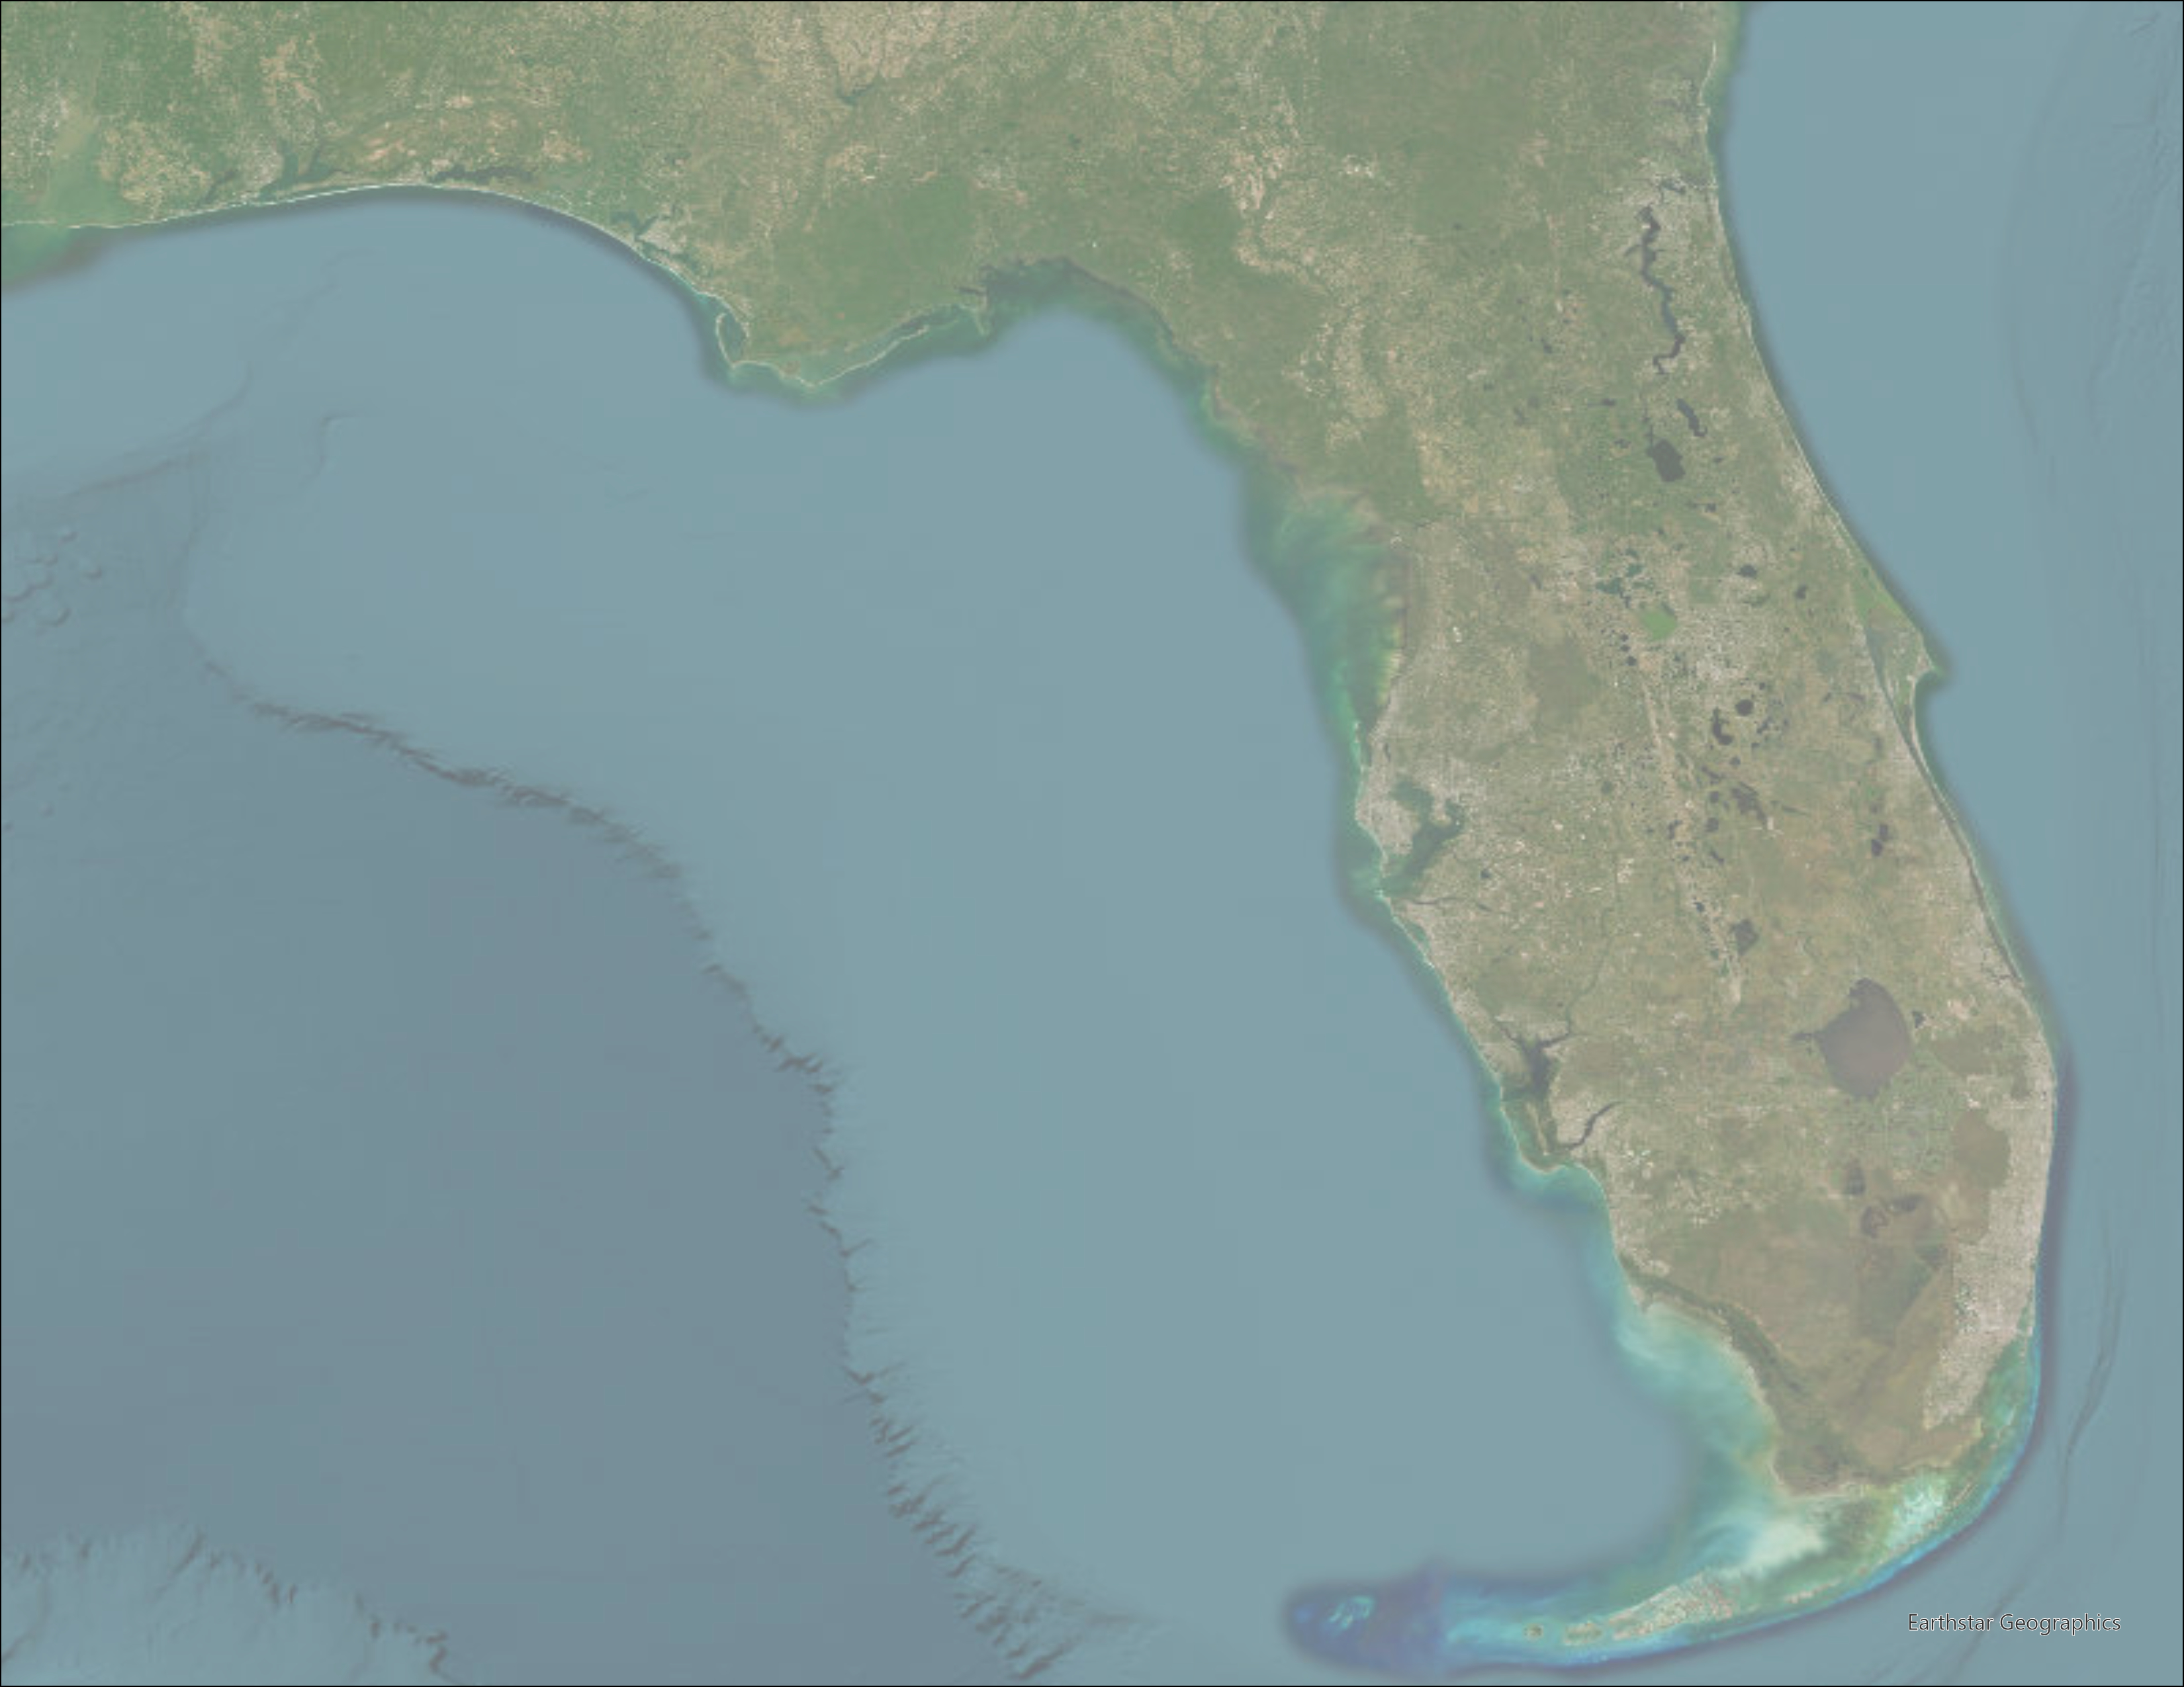
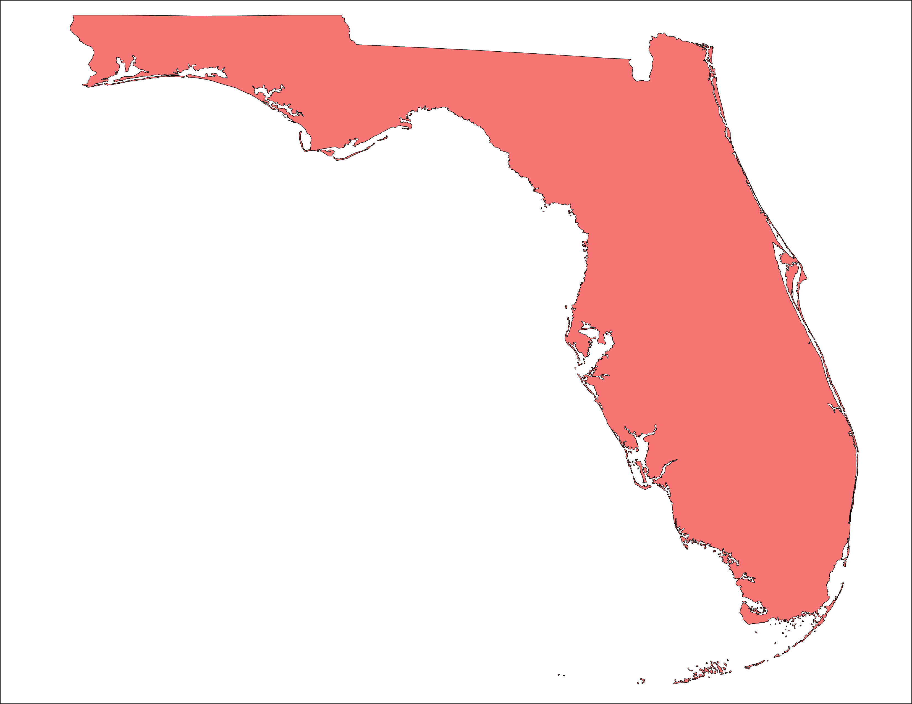
STUDY AREA & PERIOD
2013 to 2024 timeframe
Dynamic
hydrology with wet and dry seasons
Big Cypress Reservation
The Reservation is influenced by surrounding basins which flow into
the National Preserve
Big Cypress National Preserve
Surrounding Sub-Basins
Florida
0
75
150
300 Kilometers
Earthstar Geographics
Basemap Credit: ESRI, Earthstar Geographics
Notes:
----------Speaker Notes------------
The Big Cypress Reservation is in the heart of South Florida, north of the Big Cypress National Preserve.
Canals within the reservation are connected to surrounding sub-basins, transporting water southward.
This is especially pronounced during South Florida's wet season, which spans from June to October.
The water quality within these canals is dependent on the health of surrounding sub-basins.
----------Basemap Credits------------
Basemap courtesy of ESRI and Earthstar Geographics

Slide 7
PROJECT OBJECTIVES
Identify areas vulnerable to algal blooms
Report on GIS and EO methods for future use
Assess water quality utilizing EO
Inform partner of findings and implications
Notes:
----------Speaker Notes------------------------
The project determines the feasibility of using remote sensing techniques for assessing water quality within the reservation, with the goal of identifying areas that are particularly vulnerable to harmful algal blooms.
Detecting algal blooms with earth observations would allow the Seminole Tribe to gain a better understanding of water quality within the canal, informing management practices.
----------Image Information Below----------
Image Credit: Microsoft Office

Slide 8
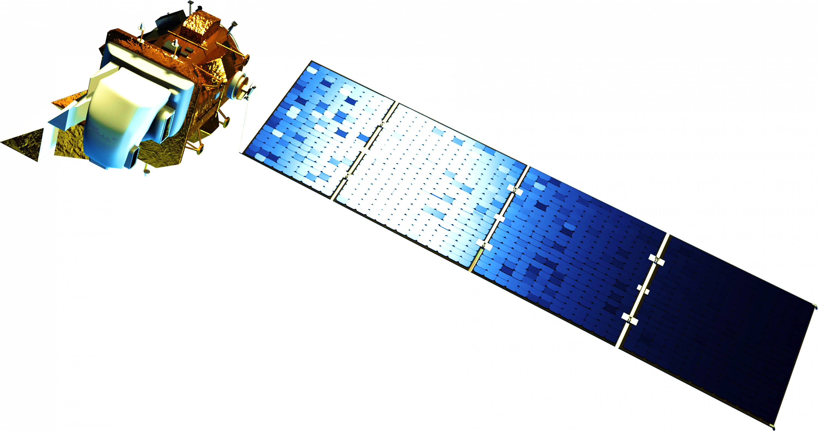
EARTH OBSERVATIONS
Also Including:
Maxar WorldView-3
Sentinel-2 MSI
Landsat 9
OLI-2 & TIRS-2
Landsat 8 OLI & TIRS
Image Credit: NASA, Rama, SkywalkerPL
Notes:
-------Speaker Notes-------
We acquired data from multiple earth observation platforms.
We used Landsat 8 and Landsat 9 to measure land surface temperature and turbidity. We used Seninel-2 to measure turbidity and derive several indices measuring the presence of algae.
We used Maxar WorldView-3 to understand the opportunities of enhanced spatial resolution for detecting algae.
-------Image Credits-------
[Model of Landsat 8]
Image Credit: NASA
Image Source: https://science.nasa.gov/wp-content/uploads/2023/05/landsat8_ldcm.png
[Model of Landsat 9]
Image Credit: NASA
Image Source: https://science.nasa.gov/wp-content/uploads/2023/05/landsat9.png
[Model of Sentinel-2]
Image Credit: Rama, licensed under CC BY-SA 2.0 FR DEED
Image Source: https://commons.wikimedia.org/wiki/File:Sentinel_2-IMG_5873-white_%28crop%29.jpg
[Model of Sentinel-3]
Image Credit: SkywalkerPL, licensed under CC BY 4.0 DEED
Image Source: https://commons.wikimedia.org/wiki/File:Sentinel-3_spacecraft_model.svg
[Earth Background]
Image Credit: NASA
Image Source: images-assets.nasa.gov/image/iss042e013697/iss042e013697~orig.jpg

Slide 9
METHODOLOGY
Data Acquisition:
Data Processing:
Data Analysis:
End Products:
Landsat 8
OLI/TIRS
Land Surface Temperature
NDTI
Cloud Filtering and Masking
Index Calculation
Time Series
Correlation Matrix
Trend Analysis
Regression
JupyterLab
Time series of harmful algal blooms
Landsat 9
OLI-2/TIRS-2
Tech Paper on methodologies and
applications of these findings
Sentinel-2
MSI
NDTI, NDCI, FAI and CDOM
One-page flyer
DBHydro
Water Quality
Nitrogen
Phosphorus
Turbidity
Notes:
-------Speaker Notes-------
After analyzing Landsat 8 & 9 imagery within the study area, we determined that the coarser spatial resolution, less frequent imagery, and lack of red edge bands for Landsat 8 & 9 made Sentinel 2 the best choice for observing algal blooms.
Using the harmonized Sentinel-2 imagery collection on Google Earth Engine, geemap, and JupyterLab, we created indices that were ideal for observing algae.
We used normalized difference turbidity index (NDTI), colored dissolved organic matter (CDOM), normalized difference chlorophyll index (NDCI), and floating algae index (FAI). Water quality data was also downloaded from DBHYDRO and transformed in Excel to give us usable water sample data for nitrogen, phosphorus, and turbidity at a number of stations within BCR. Index values at each station were compared with water sample data, allowing us to test the correlation between various water sample measurements and indices. Using these indices, we created end products.
We also acquired imagery from Maxar WorldView-3. Limited imagery prevented us from using Maxar imagery in correlations. However, we were able to inspect indices and visually evaluate its effectiveness for detecting algal blooms.

Slide 10
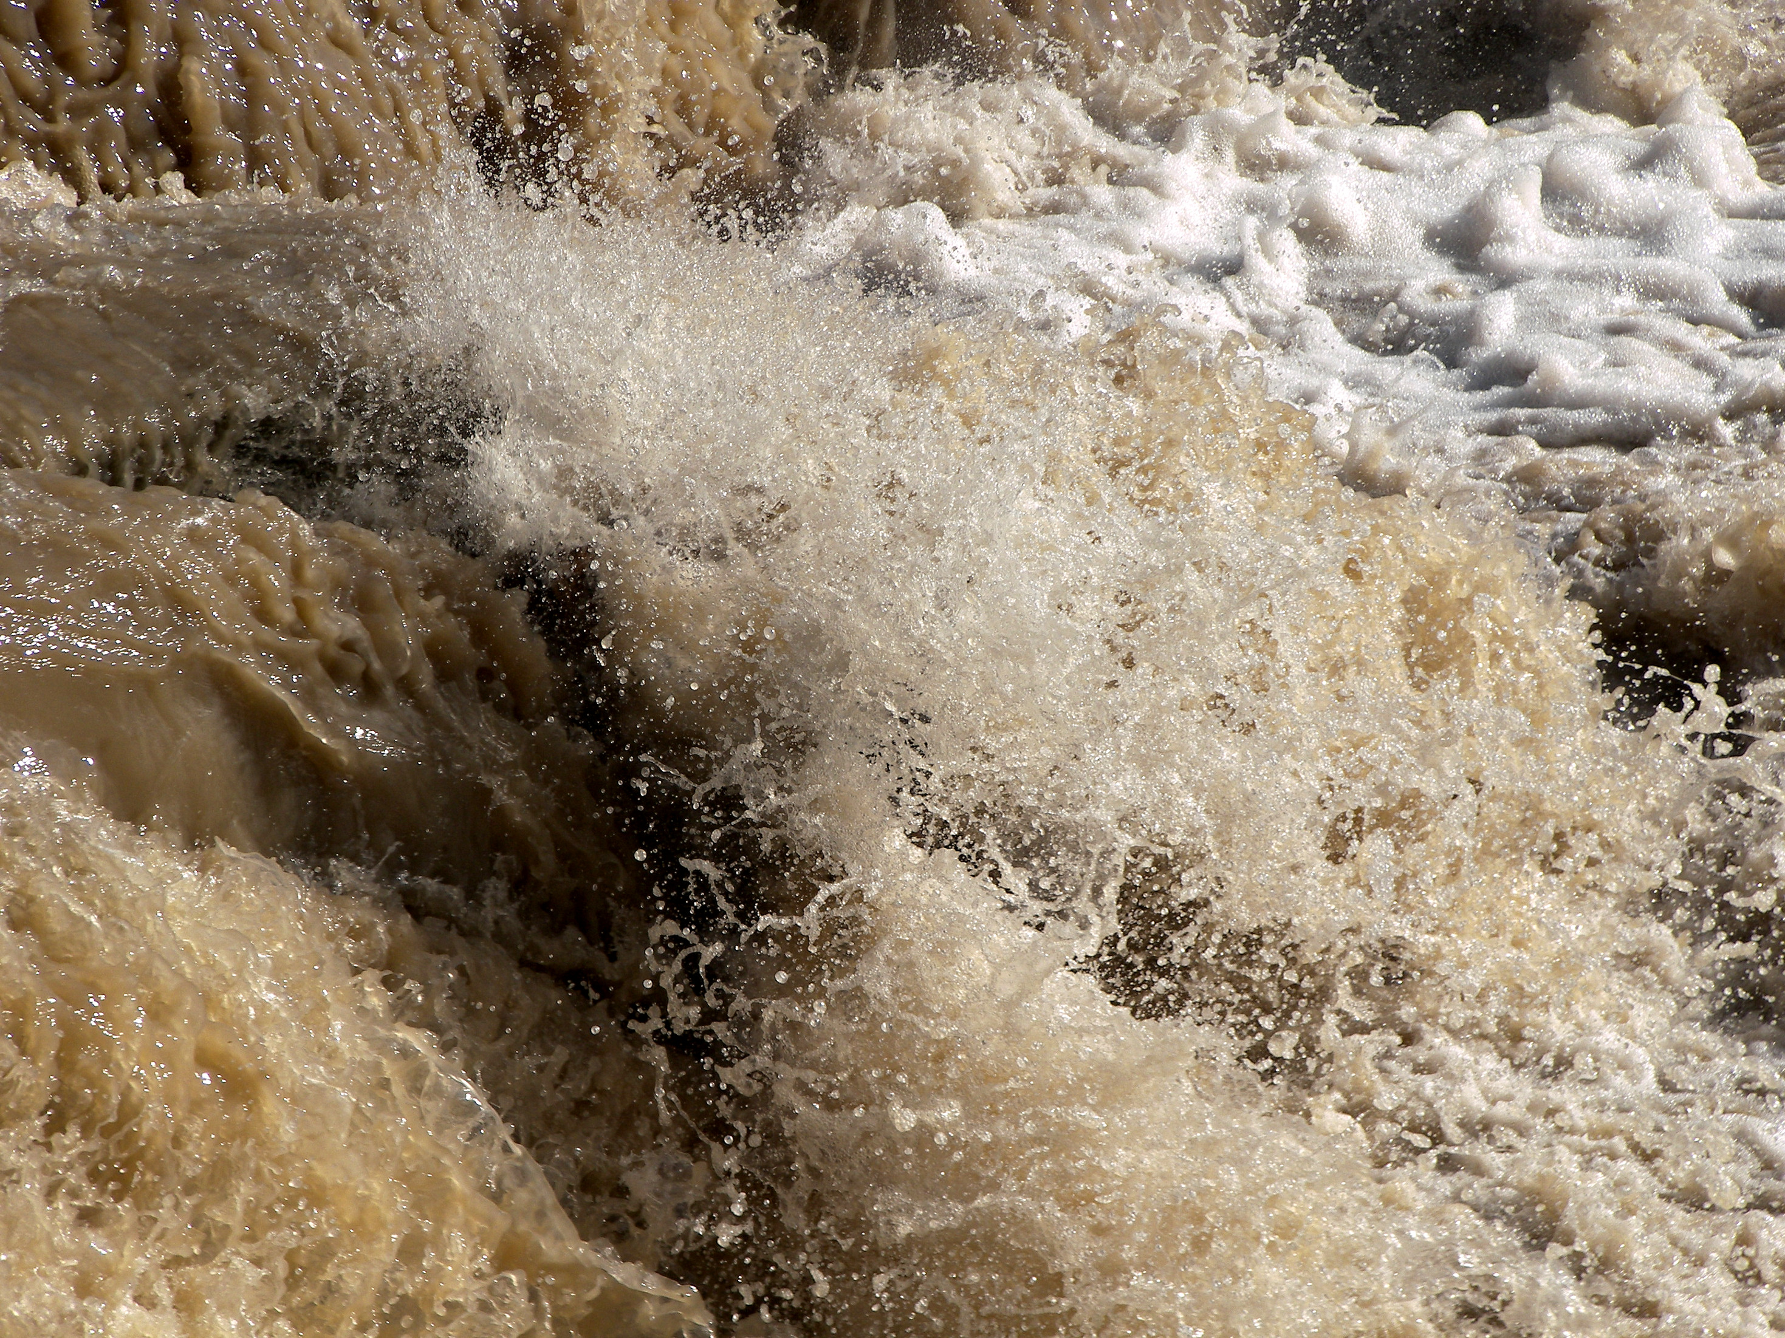
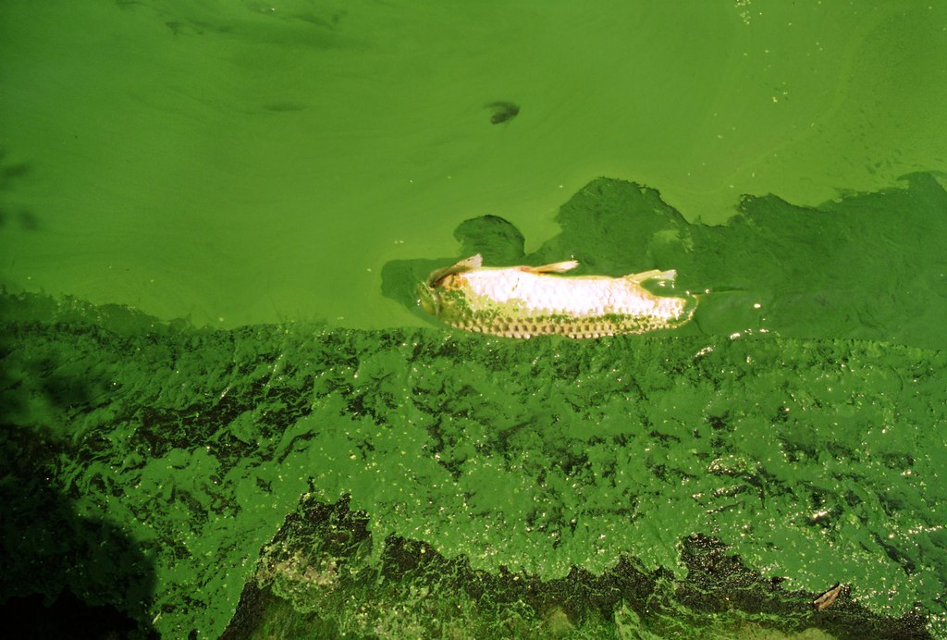
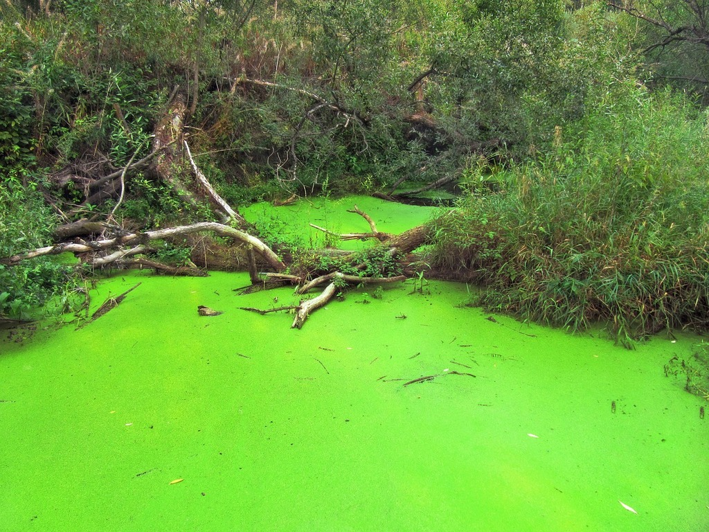
INDICES & MEASUREMENTS
Water Quality Parameters
Turbidity
Phosphorus
Nitrogen
In Situ
Measurements
(Red – Green)
(Red + Green)
(Red Edge – Red)​
(Red Edge + Red)
NIR - (Red + (SWIR - RED) * Constant
(Green – Red Edge)​​
(Green + Red Edge)
NDTI
NDCI
FAI
CDOM
Earth Observation Indices
Image Credit: Larry D. Moore, Greenpeace China, Robert A. Rohde / Berkeley Earth, Willem van Aken
Notes:
-------Speaker Notes-------
Phosphorus and Nitrogen measurements are a proxy for algae as they contribute to faster algae growth, resulting in algal blooms.
Turbidity, a measure of water opacity, also influences algae growth by affecting the penetration of sunlight.
The reservation contained several sites with Turbidity, Phosphorus, and Nitrogen measurements sufficient for analysis.
We aimed to correlate these measurements with several established indices for detecting algal blooms.
Correlating water sample measurements with our indices would demonstrate the feasibility of using earth observations to monitor algal blooms.
Even in narrow canals!
For the best chance at finding a correlation, we choose indices that identify algal blooms in different ways. Let's explore.
-------Image Credits-------
[Turbid, Running Water]
Image Credit: Larry D. Moore, licensed under CC BY 4.0 DEED
Image Source: https://commons.wikimedia.org/wiki/File:Runoff_torbidity.jpg
[Algae on Pond]
Image Credit: Licensed under PDM 1.0 DEED
Image Source: https://picryl.com/media/pond-green-alga-algae-nature-landscapes-41fffa
[Floating Fish]
Image Credit: Greenpeace China, licensed under CC BY 2.0 DEED
Image Source: https://www.flickr.com/photos/48722974@N07/4598769539

Slide 11
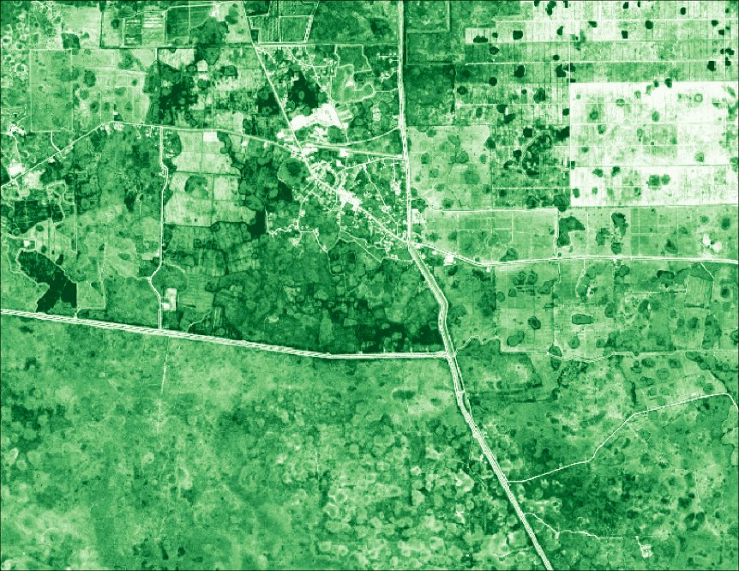
NDCI
Sensitive to changes in chlorophyll-a concentration
Normalized Difference Chlorophyll Index
Normalized difference minimizes negative effects of atmospheric conditions
Correlates with algal biomass, providing information about bloom intensity
Notes:
-------Speaker Notes-------
NDCI looks at chlorophyll-a and utilizes the Red Edge and Red bands to observe chlorophyll-a, which is a pigment found in algae.
It uses normalized difference to minimizes negative effects of atmospheric conditions.

Slide 12
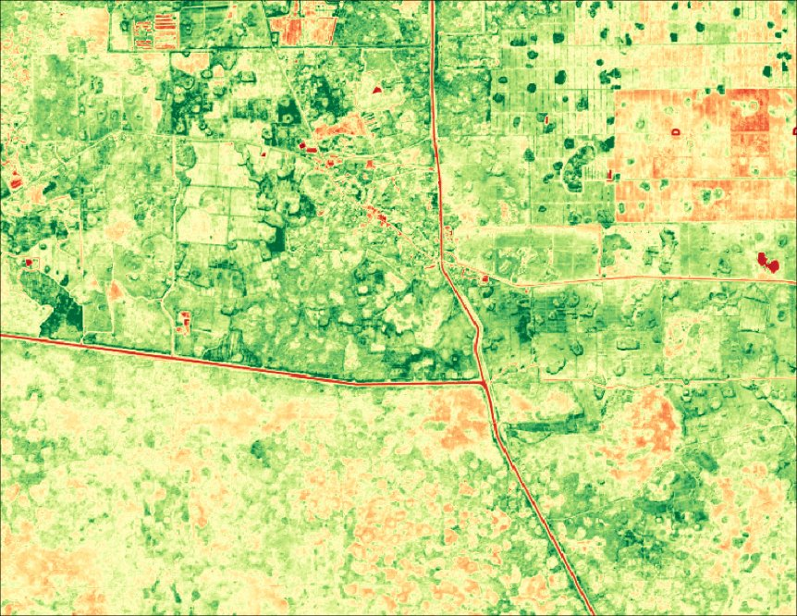
FAI
Sensitive to spectral characteristics of algal blooms in NIR & SWIR regions
Floating Algal Index
Baseline subtraction reduces the influence of aerosols
Designed to distinguish floating algae from other constituents
Notes:
-------Speaker Notes-------
FAI is specifically designed to measure floating algae. Unlike NDCI, FAI uses the spectral characteristics of algae in the NIR and SWIR band.
FAI also uses a different approach to correct for aerosols, giving us different approaches to reach the same goal: measuring algae!

Slide 13
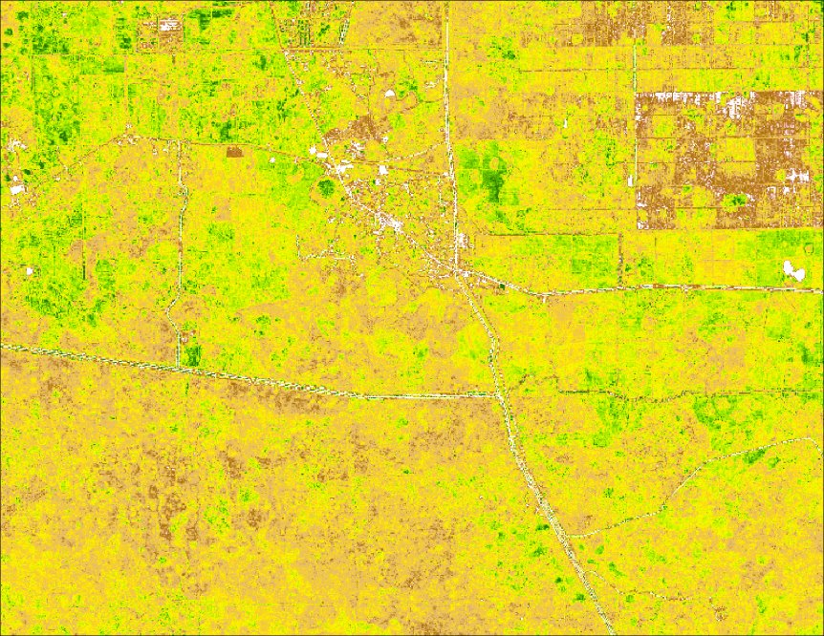
CDOM
High levels can indicate nutrient-rich waters, which facilitate algal growth
Color Dissolved Organic Matter
Distinct spectral signature reflecting in the red region
Formula varies with water body classification
Notes:
-------Speaker Notes-------
Lastly, CDOM is not a direct measurement of algae but a proxy that allows us to measure nutrient rich waters with high biological activity.
Although not a direct measurement, CDOM is often correlated with algal blooms as nutrient-rich waters facilitate algal growth. CDOM is sensitive to reflection in the red region, giving us yet another way to examine algae.

Slide 14
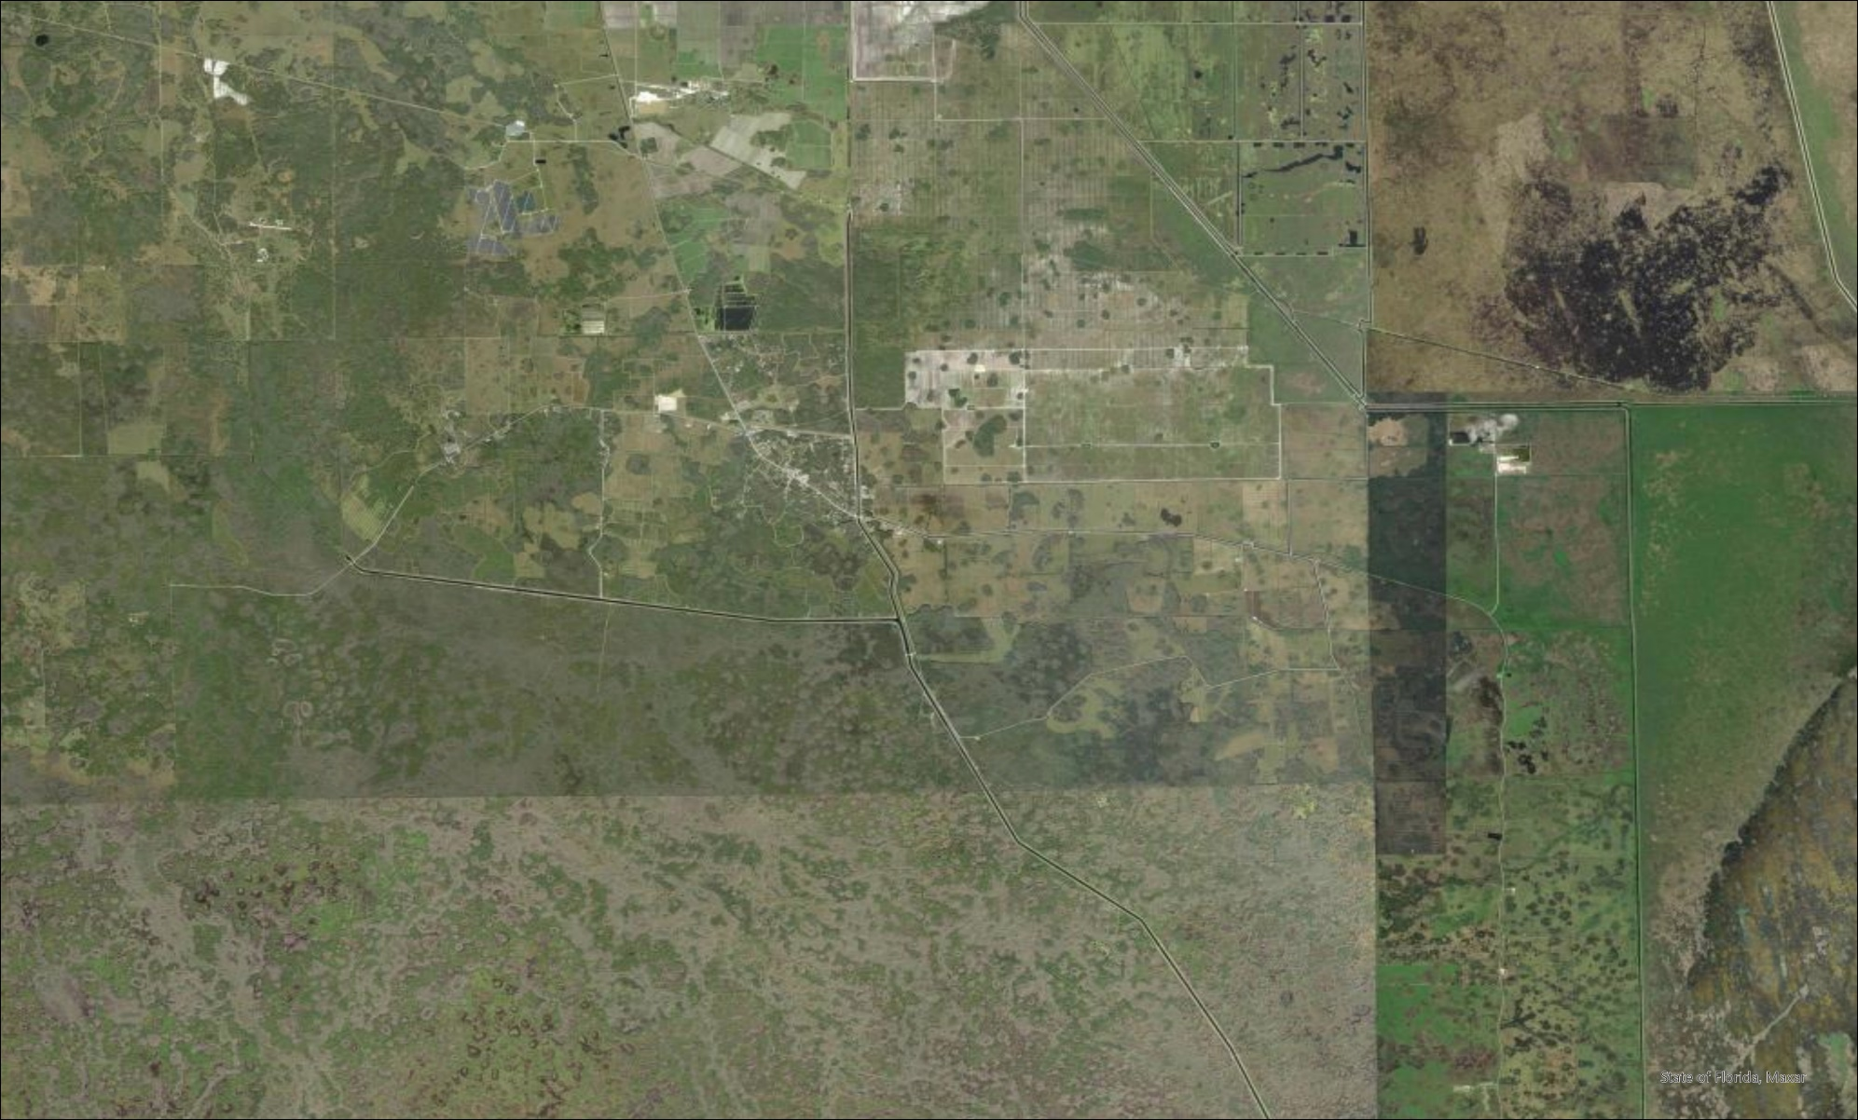
RESULTS
Garcia Farm Pond
G354C
G353B
G353C
USSO & L3BRS
PC17A
West Feeder
S190
Legend
Sampling Gauges
Big Cypress Reservation
1.75
7 Kilometers
0
3.5
Canals
Basemap Credit: ESRI, Earthstar Geographics
Notes:
-------Speaker Notes-------
We combined these indices with in situ phosphate, nitrogen, and turbidity measurements from these 8 stations in the BCR canal system.
We created gauges at optimal locations near these 8 stations.

Slide 15
RESULTS
USSO Station Sentinel-2: July 2019
NDCI
NDCI Value
High
Low
0
0.1
0.2 Kilometers
True Color
Notes:
-------Speaker Notes-------
Here you can see the canal at the USSO station, as observed by Sentinel-2.
The red line delineates the outline of the canal when viewed with high resolution imagery.
The gauge at this station was compromised of a subset of the pixels within the red canal outline.
Only pixels that remained dark throughout the year, demonstrating consistent water levels, were used to calculate indices.
This particular gauge is for the USSO station.
The same process was repeated for all 8 stations.
We used these gauges to calculate the mean pixel value for each index.
Once combined, we performed a correlation between our indices and water sample measurements.

Slide 16
RESULTS
Index
CDOM | -0.1 | 0.31 | -0.18 | -0.13 | -0.33 | 0.22 | -0.11 | -0.007 | 0.0086
FAI | -0.21 | 0.17 | -0.14 | -0.039 | 0.24 | 0.13 | 0.069 | -0.11 | 0.043
NDCI | -0.01 | 0.23 | 0.082 | 0.28 | 0.52 | -0.28 | 0.081 | -0.027 | -0.03
NDTI | 0.11 | -0.036 | -0.003 | No data | No data | No data | No data | No Data | 0.0007
Station | USSO | S190 | L3BRS | G353B | G353C | G354C | PC17A | West Feeder | All Same-Day
Nitrogen
Phosphate
Turbidity
Largest R² by Station and Index
Notes:
-------Speaker Notes-------
The above table shows the correlation results for all 8 stations, as well as a master correlation, combining all 8 stations.
The left side indicates the index being tested while the color indicates the in situ measurement the index is being correlated with.
As phosphorus and nitrogen are similar proxies for algae, we are displaying the highest correlation value that was achieved for each station and index.
The correlations yielded lackluster results that were not consistent across stations.
We were not able to find a strong correlation between our indices and phosphate and nitrogen measurements.
However, at certain stations we noticed potential associations between our indices and in situ measurements.

Slide 17
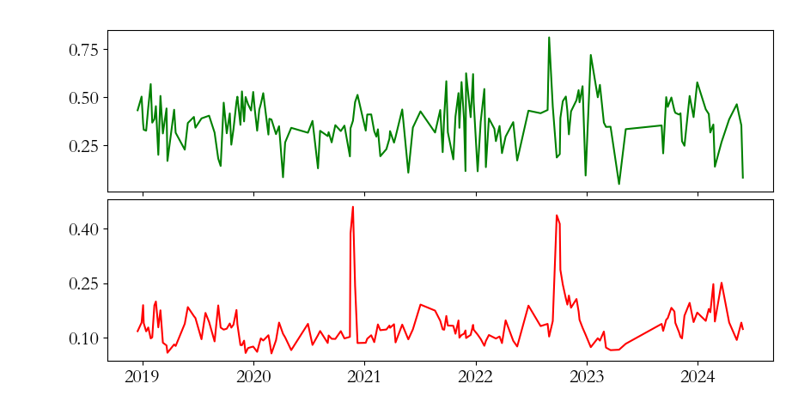
RESULTS
Sentinel 2 NDCI & In Situ Total Phosphate Concentration (USSO Site)
0.75
NDCI Seasonal Component
C
0.1
NDCI
0.50
0.0
0.25
-0.1
Total Phosphate (mg/l)
0.40
TP Seasonal Component
0.05
0.25
0.00
0.10
2019
2020
2021
2022
2023
2024
Jan
June
Dec
Date
Notes:
-------Speaker Notes-------
The times series of Sentinel-2 NDCI and water sample Total Phosphate for the USSO station is portrayed here.
The USSO station displayed a potential association between our indices and these water sample measurements.
While the relationship is inconsistent, we observed similar seasonal trends.
Due to this inconsistency, it was not feasible to derive a strong correlation between NDCI and Total Phosphate.
However, the seasonal decomposition shows a potential association between NDCI and Total Phosphate.
A number of uncertainties prevented us from achieving a strong correlation, but we believe the indices themselves are capable of detecting algal blooms.

Slide 18
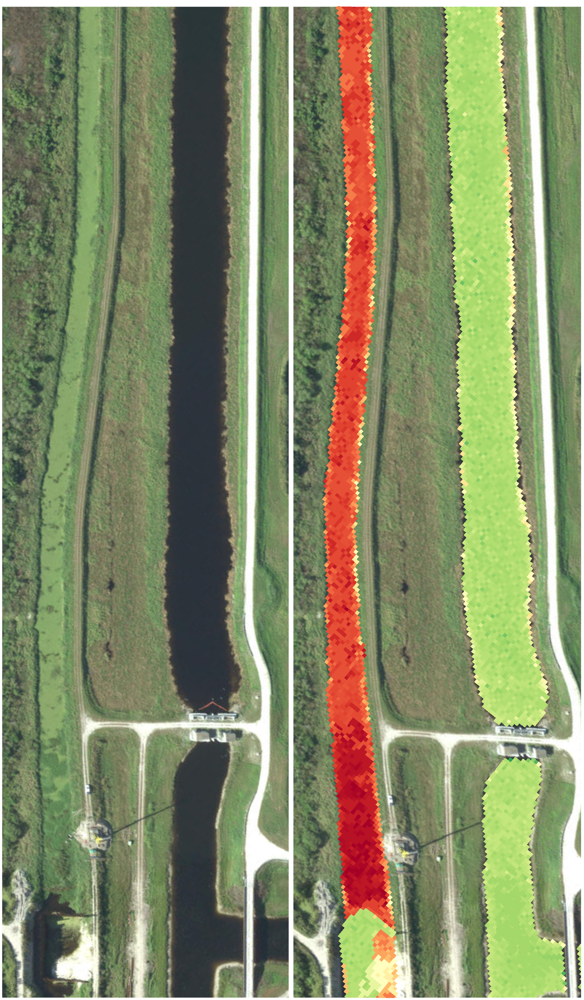
RESULTS
Approximation of Maxar
Sentinel-2: July 15, 2019
True Color
NDCI
True Color
NDCI
USSO Station: True color imagery shows algal blooms, NDCI measures and emphasizes them.
This is not Maxar imagery but a depiction of what Maxar would look like
NDCI Value
High
Low
0
0.1
0.2 Kilometers
Basemap Credit: ESRI, Earthstar Geographics
Notes:
-------Speaker Notes-------
We received a limited number of images from Maxar, while not enough to correlate, we were able to examine the potential of higher resolution imagery.
Higher resolution imagery (like Maxar WorldView-3) may be able to more accurately measure algal blooms.
Using higher resolution imagery could result in improved correlations with water samples, validating the use of indices to monitor algal blooms.
Here, on the left, you can see the potential impact of higher spatial resolution.

Slide 19
UNCERTAINTIES
Flow Rates
Spatial Resolution
Canals have varied flow rates throughout days
Time lags between in-person and satellite measurements could capture different water compositions
Florida canals are narrow: it can be difficult to obtain clean pixels
Land interference can occur on larger pixels
Temporal Resolution
Varied Water Levels
Daily imagery not available
Delay to process imagery to corrected levels
Low water levels can lead to ground reflectance
Misrepresentation of pixel values
Notes:
-------Speaker Notes-------
The uncertainties of the project manifested in four main ways.
Water flows through canals at various rates.
Time lag between water sample collection and satellite imagery collection may capture different water compositions of a canal.
Because Sentinel-2 imagery is not daily, we had fewer dates that aligned with water sampling.
Some dates that did align couldn't be used due to cloud cover, especially in the summer.
Even at the best locations, the canals within BCR are narrow relative to the spatial resolution of Sentinel-2. This challenge is even more pronounced with other satellite platforms.
Where we could observe canals with Sentinel-2, low water levels further constrained available data.

Slide 20
FEASIBILITY & PARTNER IMPLEMENTATION
Can use NASA EO in larger bodies of water near canals to serve as a proxy or indicator
Seminole Tribe of Florida
Environmental Resource Management Department
Narrowed scope of EO to focus on Sentinel-2 and commercial data for monitoring algal blooms
Found potential for utilizing
Sentinel-2 for monitoring algal blooms.
Notes:
----------Speaker Notes------------------------
Through this study, we found that utilizing NASA EO data is challenging when looking at nutrient pollution in narrow canal waterbodies.
Due to its spatial resolution and red edge band, Sentinel 2 may be able to detect algal blooms within canals.
The methods and algorithms could be refined for certain canals and parameters associated with Southwest Florida, which may give a better correlation for water samples.

Slide 21
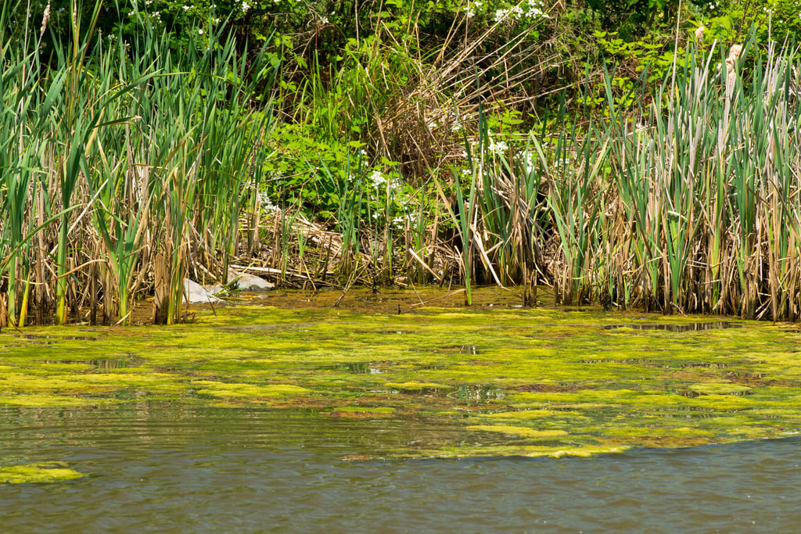
CONCLUSIONS
The spatial resolution of Landsat 8 & 9 is too coarse to accurately estimate indices for narrow canals
Spectral indices can identify blooms and generate reflectance values to compare to in situ datasets
Maxar WorldView-3 shows promise to use for the BCR canal system due to high spatial resolution but has temporal limitations.
Image Credit: Eric Vance
Notes:
----------Speaker Notes------------------------
While we were not able to validate Sentinel-2 indices with a strong correlation.
We were able to use visual analysis and seasonal decomposition to determine that Sentinel-2 has potential for monitoring algal blooms in the BCR canal system.
We were also able to show the potential benefits of higher resolution imagery.
----------Image Information Below----------
Image Credit: Eric Vance, PDM 1.0 Deed, Public Domain Image from the EPA
Image Source: https://renopenrose.getarchive.net/media/water-algae-2-412-dsp-2-algae_053jpg-815ebe

Slide 22
Fellow
Ella Haugen, Virginia - Langley
Partner
Dr. Jed Redwine, The Seminole Tribe of Florida Environmental Resource Management Department
CSDA
This work utilized data made available through the NASA Commercial Smallsat Data Acquisition (CSDA) Program.
Science Advisors
Dr. Rachel Rotz, Florida Gulf Coast University
Dr. Ahmed Elshall, Florida Gulf Coast University
Dhruvkumar Bhatt, Florida Gulf Coast University
Dr. Barry Rosen, Florida Gulf Coast University
Dr. Kenton Ross, NASA Langley Research Center
This material contains modified Copernicus Sentinel data (2016, 2017, 2018, 2019, 2020, 2021, 2022, 2023, 2024), processed by ESA.
This work utilized data made available through the NASA Commercial Smallsat Data Acquisition (CSDA) Program.
Notes:
-------Speaker Notes-------
Our project would not be complete without mentioning the incredible people that helped along the way.
We would like to acknowledge the person who probably had the most communication and help with us on the day-to-day issues, our Fellow Ella Haugen. Our partner on this project, who helped define our vision, gave insights to certain study areas, and assisted with in situ data, Dr. Jed Redwine with The Seminole Tribe of Florida Environmental Resource Management Department.
We would also like to thank the science advisors who helped with our technical issues and understanding of the project, Dr. Rachel Rotz, Dr. Ahmed Elshall, Dhruvkumar Bhatt, and Dr. Barry Rosen with Florida Gulf Coast University and Dr. Kenton Ross with NASA Langley Research Center.

