Slide 1
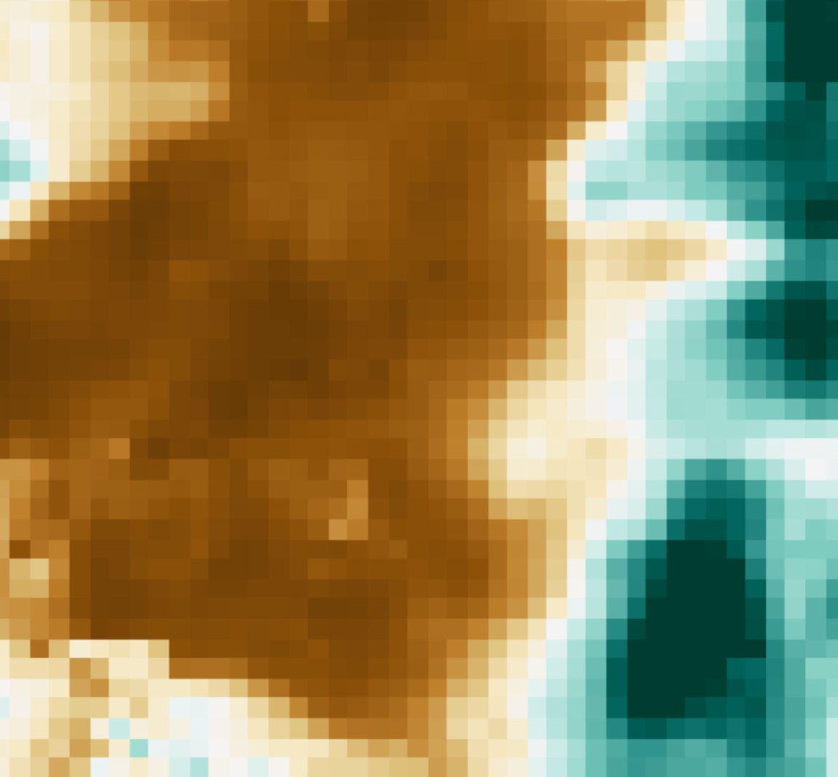
KANSAS AGRICULTURE & FOOD SECURITY
Modeling Soil Drydown Parameters for Drought Mitigation in Cropland and Rangeland of Kansas Using NASA Earth Observations
Danika Mosher
Max Dunsker
Krishna Tiwari
North Carolina – NCEI | Summer 2019
Notes:
Hello, we are the DEVELOP team hosted at the NOAA’s National Center for Environmental Information. Our project for the Summer 2019 revolved around helping our partners in Kansas fill the gaps in their in situ soil moisture measurements with remote sensing data from NASA Earth observations. Using data from NASA’s Soil Moisture Active Passive (SMAP) sensor, we have produced a spatially comprehensive early warning system to determine the severity of drought in different counties based upon the day of the year and date of the last rainfall event for our partners in Kansas.

Slide 2



PRESENTATION OUTLINE
Part I: Background
  Community Concern
  Partners
  Study Area
  Study Period
Part II: Project
  Datasets Used
  Objectives
  Methodology
  Results
  Conclusions
  Errors & Uncertainties, Future Work
Part III: Acknowledgments
Max Dunsker
Danika Mosher
Krishna Tiwari
Notes:
Team members introduce themselves along with their educational institution.
This presentation will be divided into three main parts: background, to understand why NASA DEVELOP pursued this project with our partners; the details of the project, to understand what we have done during this project; and acknowledgments, to thank everyone who has helped us get to this point.

Slide 3
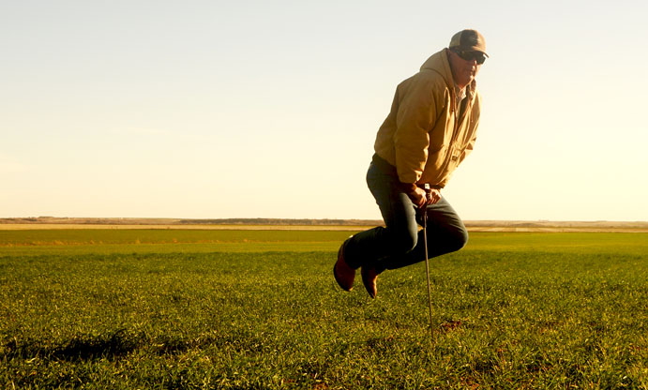
PART I: COMMUNITY CONCERN
Agricultural production is a major source of income and employment
Drought threatens agricultural production
The exponential decay of soil moisture, soil drydown, is a costly consequence of drought.
Farmer failing to insert a soil probe into dry soil.
Image Credit: US Department of Agriculture (USDA)
Notes:
Agricultural production is a major source of income and employment within the state of Kansas. In 2016, its agricultural exports amounted to $4.5 billion, making it the 9th largest by a state that year. However, drought threatens this massive agricultural production throughout the state. Soil moisture is a piece of drought that largely contributes to agricultural productions. Soil moisture, also known as soil drydown, constitutes water storage and field capacity of the soil. Therefore, the exponential decay of soil moisture, soil drydown, is a costly consequence of drought. The picture to the right depicts a farmer failing to insert a soil probe into dry soil, due to drought conditions and soil moisture throughout the area.
---------------------------------------------
Image Source: USDA Flickr
Image Credit: https://www.flickr.com/photos/usdagov/8466250624/in/photolist-dU8Kmm-bmbti4-bmbsWx-8iQMyP-xRLuF9-xxpcyh-xAWnUr-wE4ESP-DnteFa-QK2rUi-NVKjCL-NwozZ1-igZwtD-ig1Zak-xSCxyg-xA8q1D-xA8bcX-2d7xdUz-2d7xcNM-2d7xbR6-NVKjPs-N1RR6x-NVKjis-NwozuU-NYYNM6-Nwovrd-es3eG9-NRdDna-NYYGU4-N1RGLX-ejoFxJ (public domain)

Slide 4
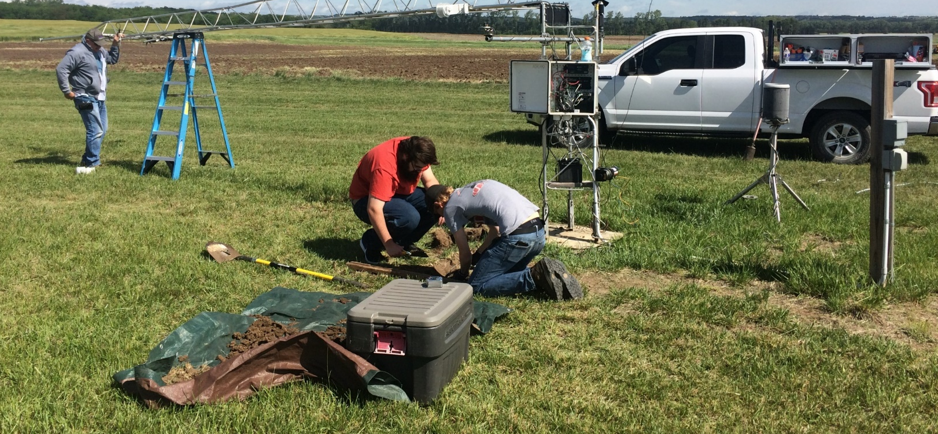
PART I: PARTNERS
Kansas State University (KSU), Department of Agronomy
Western Regional Climate Center, Desert Research Institute
Kansas Office of the State Climatologist
Kansas Water Office
KSU researchers inserting a soil probe at a Mesonet Station
Image Credit: KSU
Notes:
Our stakeholders or partners in Kansas include Kansas State University, specifically the Department of Agronomy, the Western Regional Climate Center at the Desert Research Institute, Kansas Office of the State Climatologist, and Kansas Water Office. The Kansas Office of the State Climatologist actively communicates data to the Kansas Water Office and then to agricultural producers in Kansas. Below is a picture showing Kansas State University researchers inserting a soil probe at a Mesonet Station.
---------------------------------------------
Image Source: Andres Patrignani, Kansas State University
Image Credit: Sent via Slack; Permission from partner

Slide 5
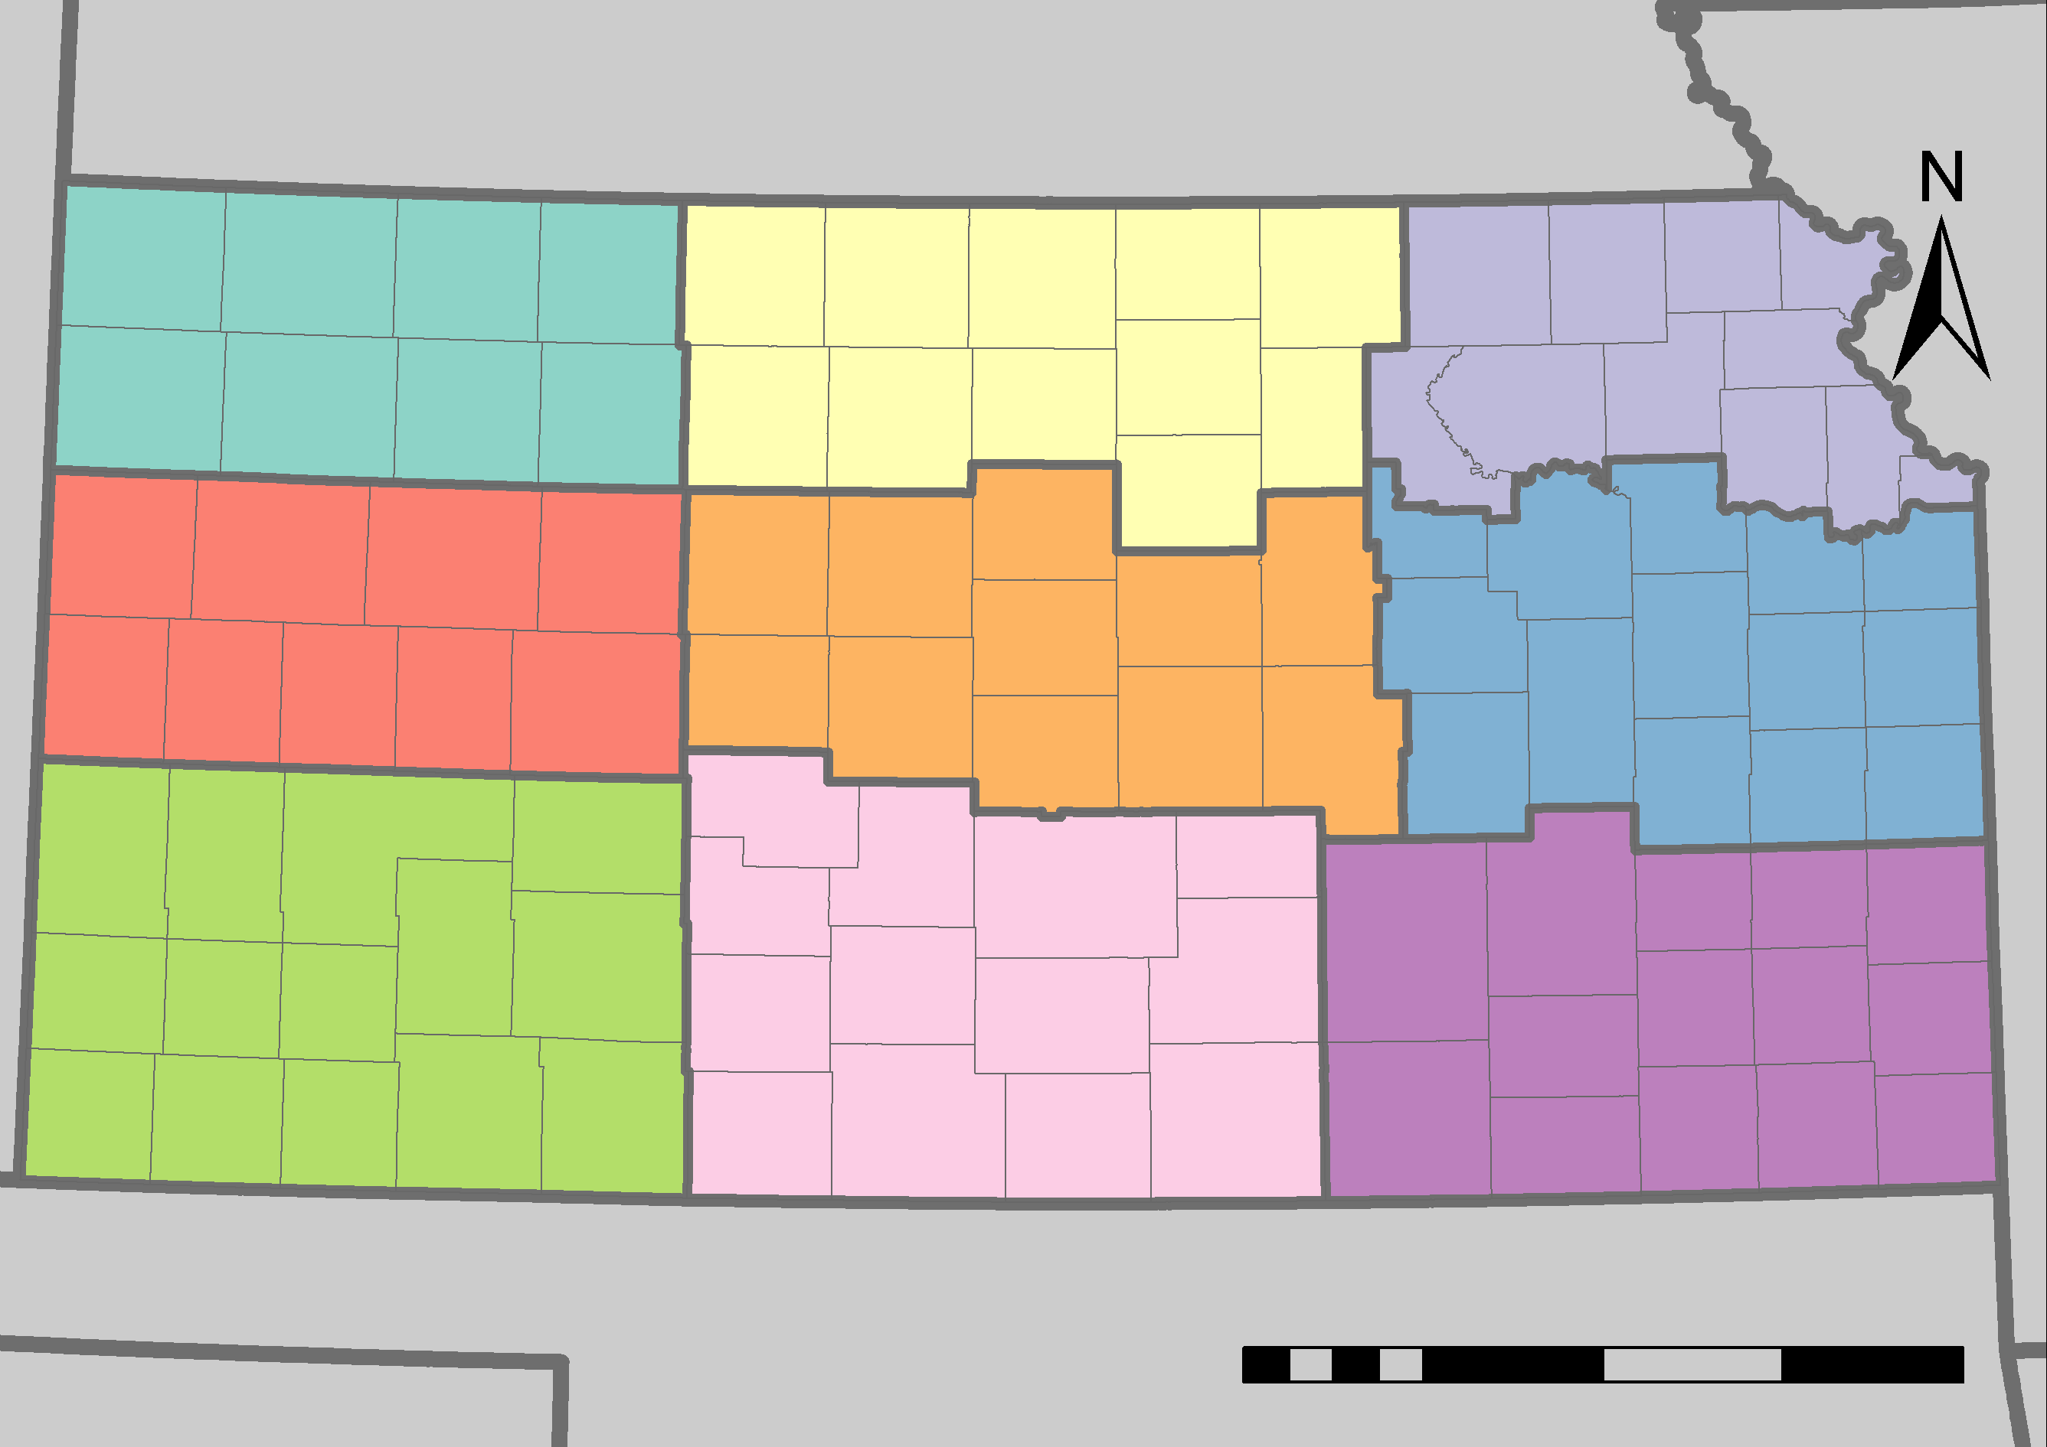
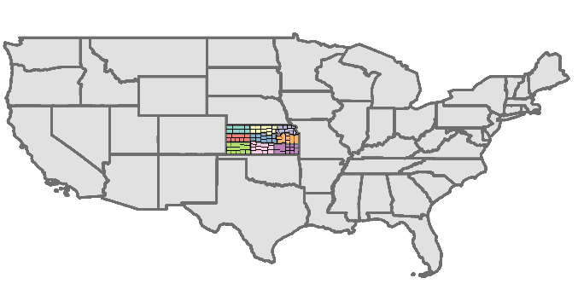
PART I: STUDY AREA
County Boundaries
NEBRASKA
1
2
3
Climatological Divisions
State Boundaries
4
5
6
KANSAS
7
8
9
OKLAHOMA
0 60 240
km
Notes:
Our study area is comprised of Kansas State itself. Here we have a graph of Kansas State with the county boundaries, the 9 agro-climatological divisions, as well as the state boundaries. We included the 9 agro-climatological divisions because we initially studied soil moisture characteristics within these regions, as well as analyzed sub-county level characteristics.
----------------------------------------------------
Image Source: Cartography by DEVELOPer Max Dunsker
Image Credit:
Shapefile of US States:
U.S. Bureau of the Census. TIGER/Line: U.S. States. Washington, D.C.: Bureau of the Census, 2018.
Shapefile of Kansas Counties:
U.S. Bureau of the Census. TIGER/Line: Kansas Counties. Washington, D.C.: Bureau of the Census, 2018. Shapefile of Kansas Climatological Divisions:
Vose, Russell S.; Applequist, Scott; Squires, Mike; Durre, Imke; Menne, Matthew J.; Williams, Claude N., Jr.; Fenimore, Chris; Gleason, Karin; Arndt, Derek (2014): NOAA's Gridded Climate Divisional Dataset (CLIMDIV). Kansas Climatological Divisions. NOAA National Climatic Data Center. doi:10.7289/V5M32STR, June 2, 2019.

Slide 6
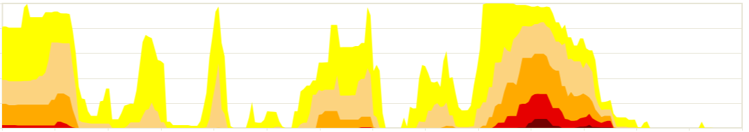
PART I: STUDY PERIOD
USDM Classification
Abnormally Dry
Moderate Drought
Severe Drought
Extreme Drought
Exceptional Drought
Time Series of Kansas Percent Area In Drought
Image Credit: National Drought Mitigation Center (USDM)
100%
2018
80%
60%
40%
20%
0%
1/1/2015
1/1/2016
1/1/2017
1/1/2018
1/1/2019
We are observing root zone soil moisture (RZSM) using NASA’s Soil Moisture Active Passive (SMAP) sensor for all pixels in Kansas between March 31, 2015 and July 19, 2019
Notes:
Our study period was from March 31, 2015 to July 19, 2019. We observed root zone soil moisture using NASA’s Soil Moisture Active Passive sensor for all pixels throughout Kansas. Above is a time series of Kansas Percent Area In Drought, courtesy of the National Drought Mitigation Center. Although Kansas has had a particularly wet summer and past year, one can see within the past few years Kansas is still subject to cycles of severe drought. Here, we have 2018 highlighted, in which case 60 percent of Kansas is in severe drought and 80 percent of Kansas is in moderate drought. So, even with plenty of moisture this past year Kansas, Kansas has still experienced these cycles of drought over the past few years.
---------------------------------------------------
Image Source: United States Drought Monitor, National Drought Mitigation Center
Image Credit: https://droughtmonitor.unl.edu/Data/Timeseries.aspx (public domain)

Slide 7

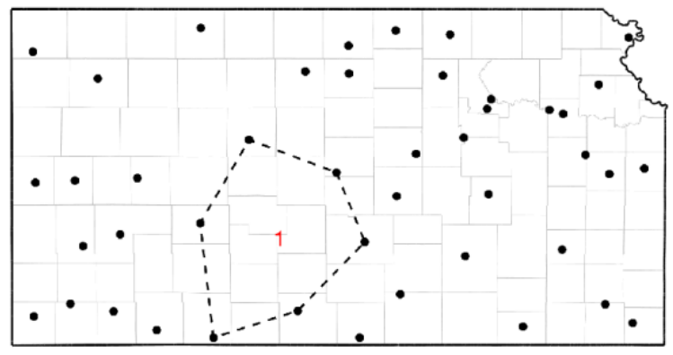

PART II: DATASETS USED
Soil Moisture Active Passive (SMAP) sensor L-band Radiometer
  Root Zone Soil Moisture Analysis Update, Level 4 Product (SPL4SMAU)
  The spatial resolution is 9 km by 9 km
Kansas Mesonet
  Gathered in situ measurements of soil moisture at 5cm, 10cm, 20cm, and 50cm
  88 sites, with 41 measuring soil moisture
Image Credit: Chip Redmond
Evaporative Demand Drought Index (EDDI)
  EDDI data represent the anomaly of evaporative demand for each pixel in the contiguous U.S.
  The spatial resolution is 12 km by 12km
Notes:
Datasets used include Soil Moisture Active Passive, known as SMAP, sensor L-Band Radiometer. We used a modeled product which measures root zone soil moisture from 0 to 100 centimeters. This data was a level 4 product, and the spatial resolution of SMAP is 9 kilometers by 9 kilometers. In addition to SMAP, we also derived data from the Kansas Mesonet. The Kansas Mesonet constitutes physical stations throughout Kansas that record in situ measurements of soil moisture from 5 centimeters (cm), 10cm, 20cm, and 50 cm. There are actually 81 Mesonet stations throughout Kansas, however only 41 measure soil moisture. The graph to the right illustrate the location of these 41 mesonet stations that measure soil moisture. As one can see, there are large spatial gaps within these stations, where remote sensing can provide more spatially comprehensive data regarding soil moisture. Finally, we used the Evaporative Demand Drought Index, known as EDDI. Evaporative demand constitutes the thirst of the atmosphere, relating to atmospheric conditions. Specifically, EDDI data represents the anomaly of evaporative demand for each pixel in the contiguous U.S. The spatial resolution of EDDI is 12 km by 12 km.
----------------------------------------------
Image Source: NASA Website
Image Credit: https://www.nasa.gov/audience/forstudents/5-8/features/symbols-of-nasa.html (Public Domain)
Image Source: Christopher Redmond
Image Credit: https://www.dropbox.com/s/b1rpt2obqti8fsv/christopher_redmond.pdf?dl=0 (Permission from partner)
Image Source: Drought.gov
Image Credit: https://www.drought.gov/drought/data-maps-tools/snow-drought (Public Domain)

Slide 8
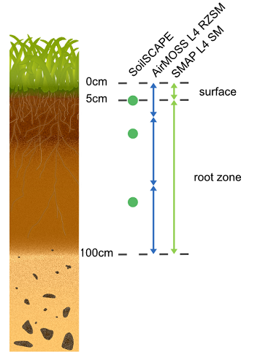
PART II: OBJECTIVES
Enhance understanding of soil characteristics for drought mitigation planning
Produce a statewide map atlas of soil moisture capacity using SMAP imagery
Develop an exponential model to estimate the worst-case decay of root zone soil moisture
Utilize remote sensing and in situ data to calculate model parameters
Analyze the relationship between soil moisture and drought indices
Soil Moisture Visualizer
Image Credit: Oak Ridge National Laboratory
Distributed Active Archive Center
Notes:
A visualization of the SMAP root zone soil moisture product is shown to the right. SMAP measures the first 5cm of surface soil moisture and then models the soil moisture between 0cm and 100cm with remote sensing data, soil characteristics, and in situ validation.
To serve each of our partners, we pursued three different objectives.
For the Kansas Water Office, we sought to enhance the understanding of soil characteristics so water managers could better plan for drought mitigation. To accomplish this objective, we created an atlas of the state with images of soil moisture content maximum and minimum, as well as storage capacity for each of Kansas’ 105 counties.
We worked with researchers from Kansas State University to develop a model which predicts soil drydown in the worst case scenario, assuming no precipitation and normal evaporative demand. We incorporated measurements from their in situ station in the creation of the exponential decay constant, integrating in situ and remote sensing data for our model.
Finally, in partnership with the Desert Research Institute, we used the EDDI product, from the National Integrated Drought Information System, as a proxy for atmospheric drought and SMAP data as a proxy for agricultural drought to gain insight into the relationship between both phenomena.
-------------------------------------------------------
Image Source: Dr. Jessica Welch/ Oak Ridge National Laboratory Distributed Active Archive Center
Image Credit: https://daac.ornl.gov/soilmoisture/guide.html (provided consent via email, also in public domain)

Slide 9

PART II: METHODOLOGY - CHARACTERIZING
Minimum Soil Moisture Content
Maximum Soil Moisture Content
Soil Water Storage Capacity
0 200 km
0 30 60
m³/m³
0 30 60
m³/m³
0 20 40
m³/m³
Notes:
The first step in enhancing the understanding of soil characteristics was to go through the SMAP period of record, from March 31, 2015 to June 30, 2019, to find the maximum and minimum values of soil moisture, presented here. As you can see, the driest part of Kansas coincides with the largest gap with the Mesonet dataset, in south central Kansas. Then we found the soil water storage capacity by subtracting the minimum from the maximum, to measure the amount of water each pixel can possibly hold during a rainfall event, shown on the rightmost map.
All the units in the project are measured using volume of water over volume of soil, in meters cubed over meters cubed.
----------------------------------------------
Image Source: Max Dunsker
Image Credit: Created by DEVELOPer
Shapefile of Kansas:
U.S. Bureau of the Census. TIGER/Line: U.S. States. Washington, D.C.: Bureau of the Census, 2018.
Shapefile of Kansas Counties:
U.S. Bureau of the Census. TIGER/Line: Kansas Counties. Washington, D.C.: Bureau of the Census, 2018.
Imagery:
SMAP data 2015 (NASA). Dataset: SMAP L4 km EASE-Grid Surface and Root Zone Soil Moisture Analysis Update (SPL4SMAU), Version 3. Retrieved from NSIDC DAAC 26 June 2019. doi: http://dx.doi.org/10.5067/20ULJH6EZKFJ

Slide 10
PART II: METHODOLOGY - FORECASTING
Incorporate
in situ measurements
Execute the Exponential Decay Model
Use measurements from the Mesonet data to model the exponential decay constant.
Forecast soil moisture using current soil moisture, minimum soil moisture, and the exponential decay constant with inputs selected by the user.
Notes:
The first step in calculating model forecast was calculating the exponential decay constant. Using Mesonet data from 41 stations, we identified 237 periods of drydown to find the rate at which soil drying down. Then, assuming low evaporative demand in the winter and high evaporative demand in the summer, we derived the exponential decay constant.
Using the exponential decay constant, along with current soil moisture (measured by SMAP) and minimum soil moisture (gathered from SMAP) for each pixel, we forecasted the soil moisture to a user selected date, assuming no precipitation.

Slide 11
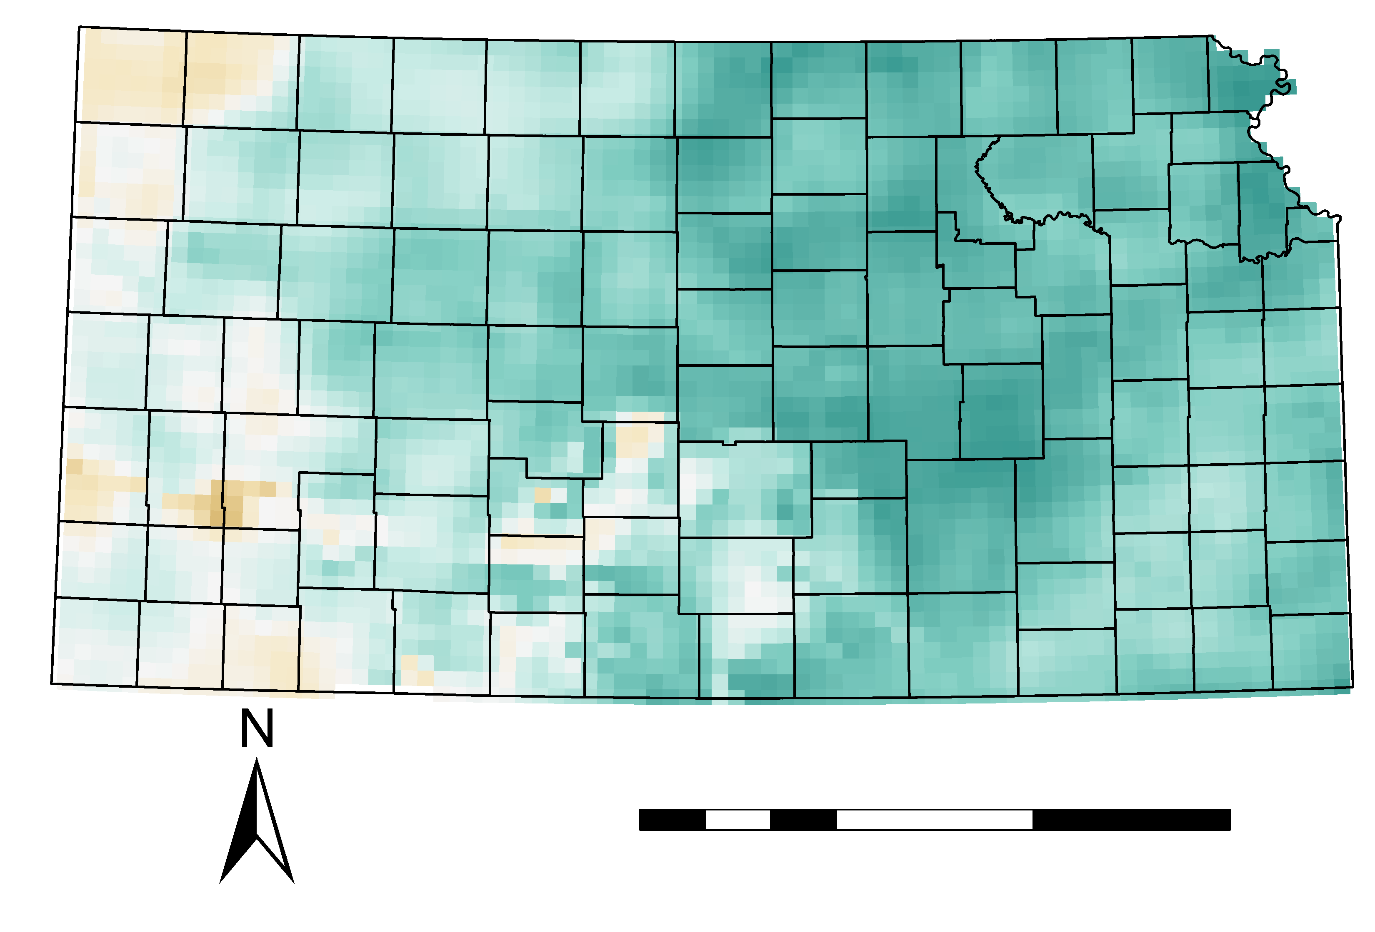
PART II: METHODOLOGY - MODELING
Relative Saturation of Soil on July 1, 2019
Calculate current relative saturation of soil using the soil moisture characteristics from SMAP
100%
50%
0%
0 100 300 km
Find the difference between selected relative saturation and current relative saturation
Model the days until or since each pixel reaches a selected percent relative saturation
Notes:
We also worked with Kansas State University to model the relative soil moisture, based on the maximum and minimum measurements from the SMAP period of record. To find the relative soil moisture, we took SMAP imagery from a user selected day, subtracted the minimum soil moisture, and divided by the storage capacity. A map of relative soil moisture for July 1, 2019 is presented to the right.
After finding the current relative saturation, we found the difference between that percentage and the percentage relative saturation selected by the model user. Using that difference, we modeled the days until or since each pixel in Kansas reached the selected percentage of relative saturation.
----------------------------------------------
Image Source: Max Dunsker
Image Credit: Created by DEVELOPer
Shapefile of Kansas:
U.S. Bureau of the Census. TIGER/Line: U.S. States. Washington, D.C.: Bureau of the Census, 2018.
Shapefile of Kansas Counties:
U.S. Bureau of the Census. TIGER/Line: Kansas Counties. Washington, D.C.: Bureau of the Census, 2018.
Imagery:
SMAP data 2019 (NASA). Dataset: SMAP L4 km EASE-Grid Surface and Root Zone Soil Moisture Analysis Update (SPL4SMAU), Version 3. Retrieved from NSIDC DAAC 26 June 2019. doi: http://dx.doi.org/10.5067/20ULJH6EZKFJ

Slide 12
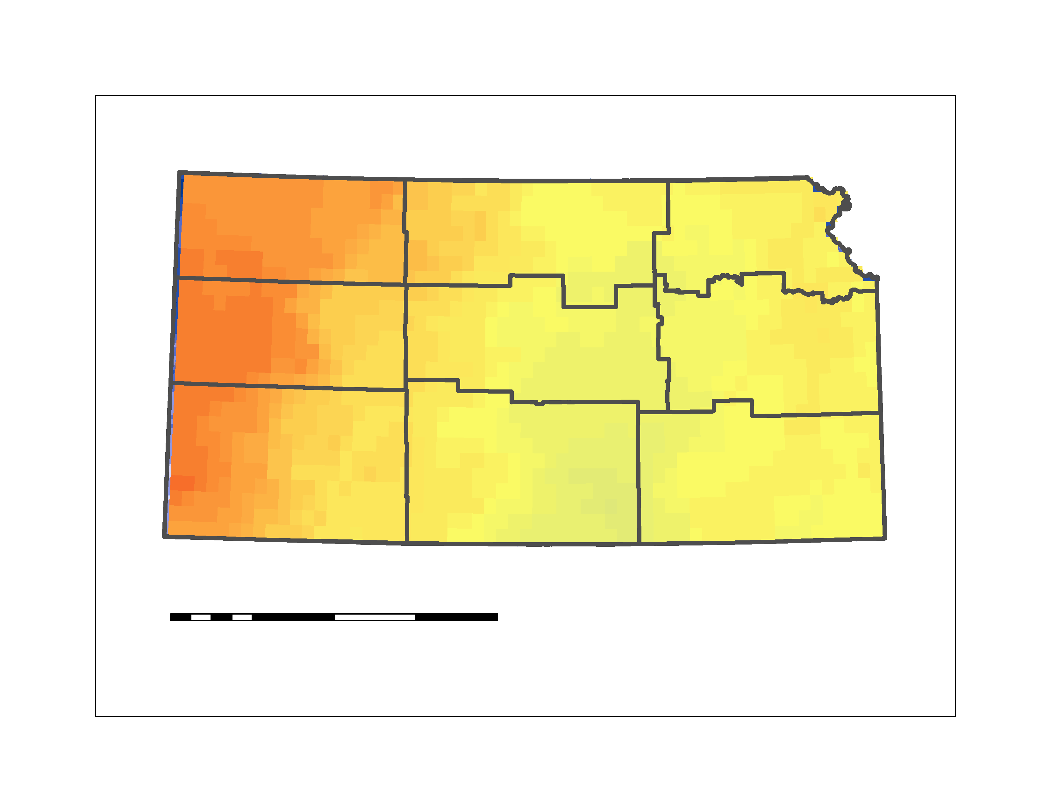
PART II: METHODOLOGY - EDDI ANALYSIS
Acquire one week timescale EDDI for each observation in the study period March 31, 2015 to present
Using the 88 Mesonet Stations as a sample, find the SMAP and EDDI values for each point for each observation in the study period
One Week Timescale EDDI for July 1,2019
For each SMAP value, calculate its percentile rank among all SMAP observations at that pixel
0 150 300 km
-2 0 2
Notes:
A map of one week timescale EDDI for July 1, 2019, where EDDI compiles the evaporative demand anomaly for the prior week, is shown in the bottom left. Values in red represent abnormally high evaporative demand, while values in yellow show normal evaporative demand. Values in blue would represent an abnormally low evaporative demand for that pixel.
Our first step in comparing EDDI and SMAP was gathering one week timescale EDDI for everyday in the SMAP period of record. Then, using all 88 Mesonet stations as a sample, we gathered the SMAP and EDDI values for each observation of the values at each point. Then, to make SMAP more comparable to the EDDI value, which is an anomaly, we found the percentile rank for each SMAP observation at that pixel.
----------------------------------------------
Image Source: Max Dunsker
Image Credit: Made by DEVELOPer
Shapefile of Kansas:
U.S. Bureau of the Census. TIGER/Line: U.S. States. Washington, D.C.: Bureau of the Census, 2018.
Shapefile of Kansas Climatological Divisions:
Vose, Russell S.; Applequist, Scott; Squires, Mike; Durre, Imke; Menne, Matthew J.; Williams, Claude N., Jr.; Fenimore, Chris; Gleason, Karin; Arndt, Derek (2014): NOAA's Gridded Climate Divisional Dataset (CLIMDIV). Kansas Climatological Divisions. NOAA National Climatic Data Center. doi:10.7289/V5M32STR, June 2, 2019.
Imagery:
Hobbins, M.T., A. Wood, D. McEvoy, J. Huntington, C. Morton, M. Anderson, and C. Hain (2016), The Evaporative Demand Drought
Index: Part I - Linking drought evolution to variations in evaporative demand. Journal of Hydrometeorology, 17: 1745–
1761, doi:10.1175/JHM-D-15-0121.1.
McEvoy, D., J. Huntington, M.T. Hobbins, A. Wood, C. Morton, M. Anderson, and C. Hain C (2016), The Evaporative Demand Drought Index: Part II - CONUS-wide assessment against common drought indicators. Journal of Hydrometeorology, 17: 1763–1779, doi:10.1175/JHM-D-15-0122.1.

Slide 13
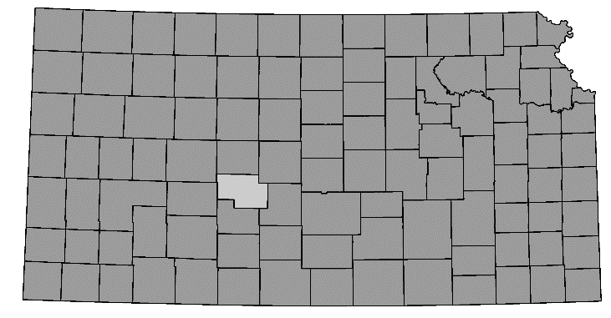
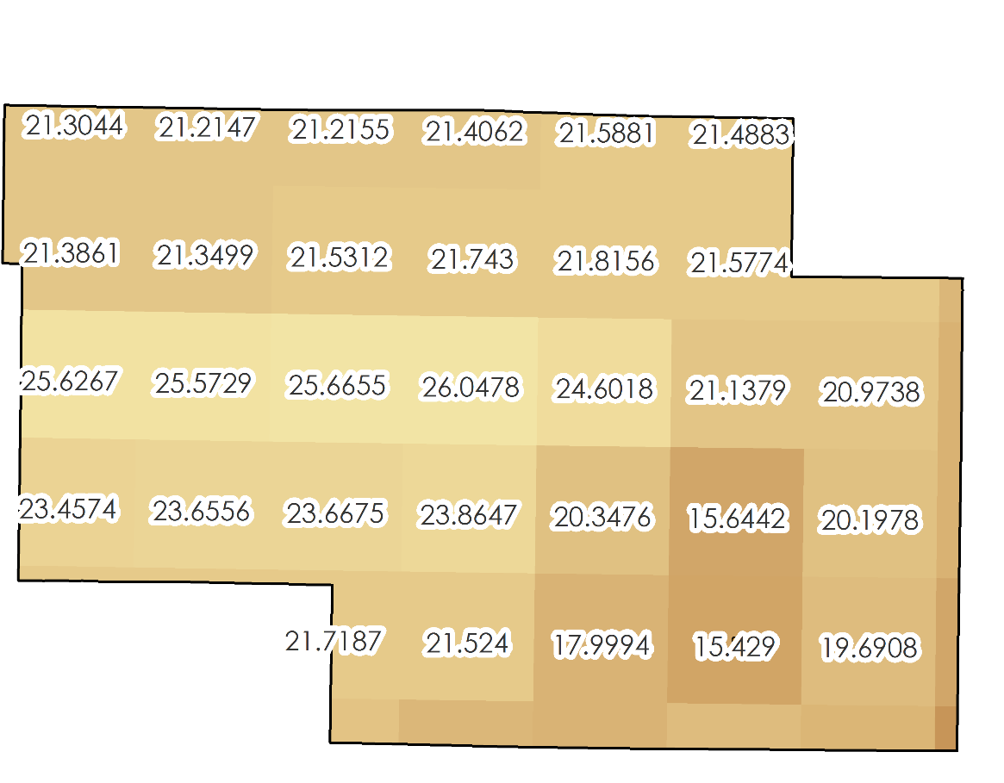
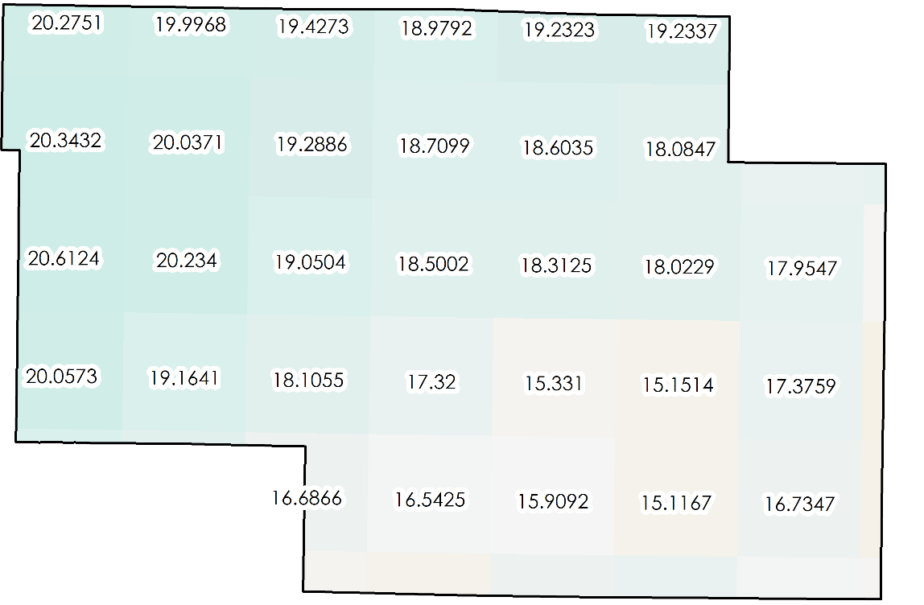
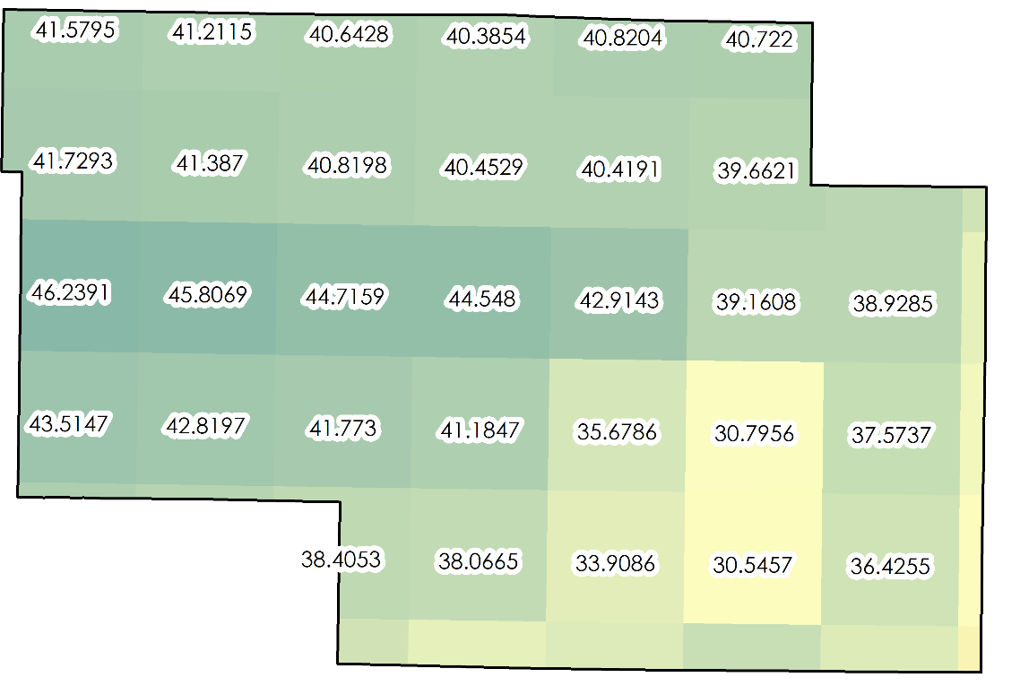

PART II: RESULTS - MAP ATLAS
Map of Pawnee County, Maximum Soil Moisture
Map of Pawnee County, Soil Moisture Capacity
Map of Pawnee County, Minimum Soil Moisture
For each county in Kansas, create a map of its maximum and minimum soil moisture content, as well as its storage capacity for the Kansas Water Office
40
m³/m³
0
60
m³/m³
0
0 15 30 km
Notes:
One unique aspect about our project is not only do we collaborate with our partners, but when generating our results we have to consider its comprehension and usability for our partners. For example when working with the Kansas Water Office, they have yet to include soil moisture in their water resources. Since they interface with agricultural producers and farmers, they are able to disseminate soil characteristics such as minimum and maximum soil moisture and overall storage capacity on a sub-county level like with Pawnee County, which doesn’t have a Mesonet station.
-------------------------------
Image Source: Max Dunsker
Image Credit: Made by DEVELOPer
Shapefile of US States:
U.S. Bureau of the Census. TIGER/Line: U.S. States. Washington, D.C.: Bureau of the Census, 2018.
Shapefile of Kansas Counties:
U.S. Bureau of the Census. TIGER/Line: Kansas Counties. Washington, D.C.: Bureau of the Census, 2018.

Slide 14
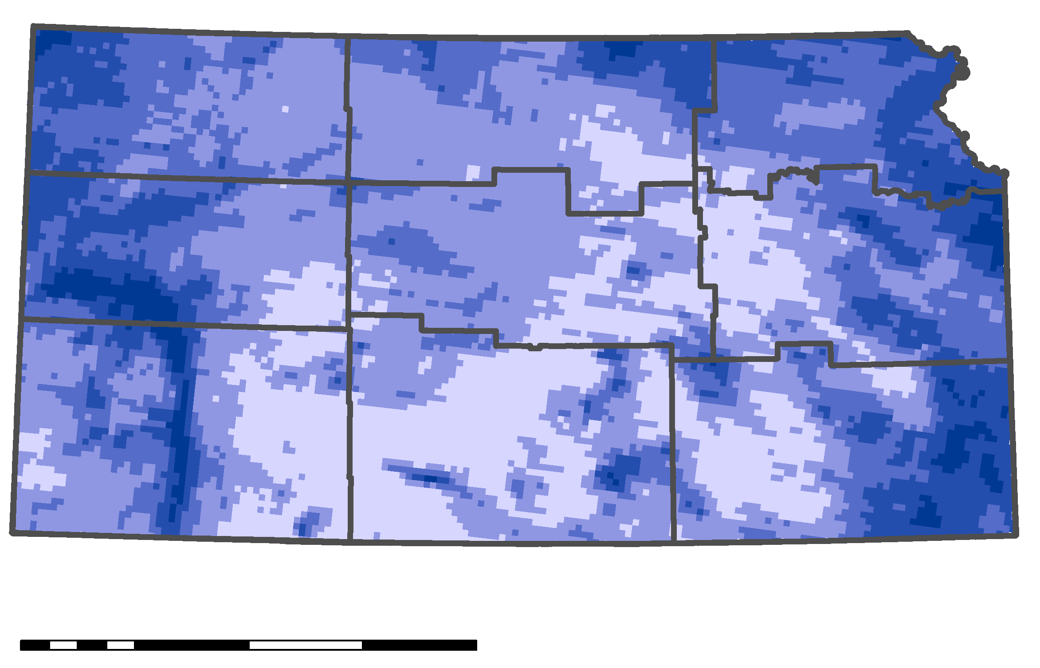
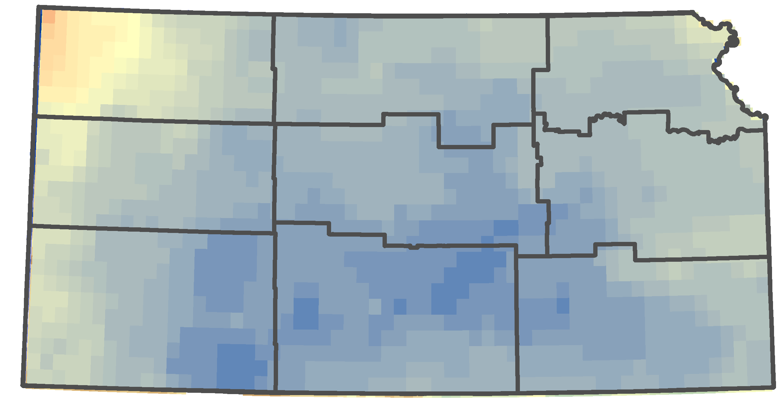
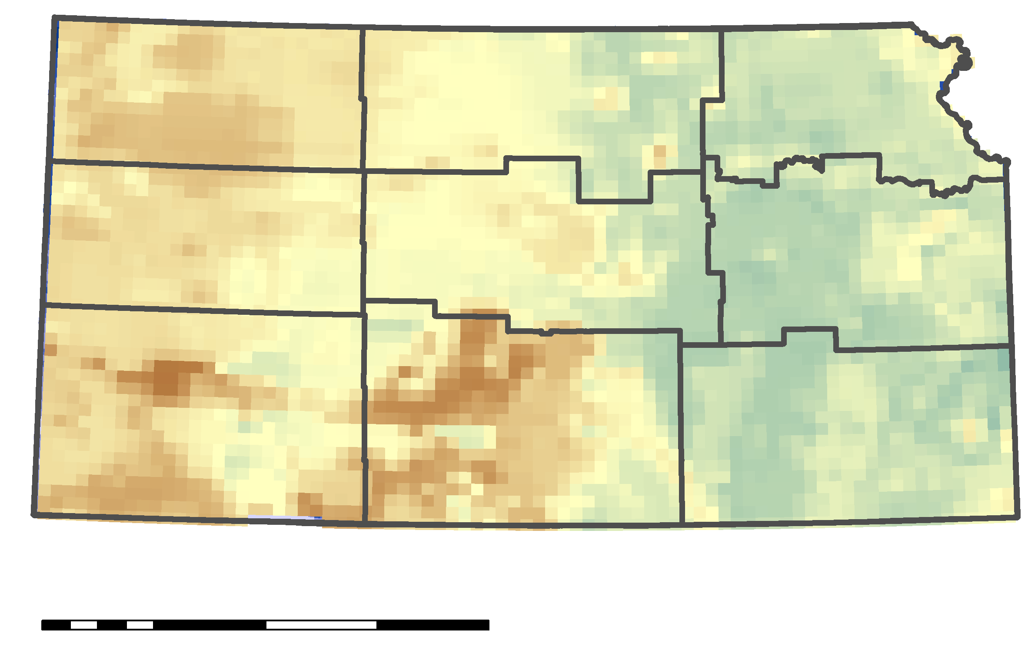
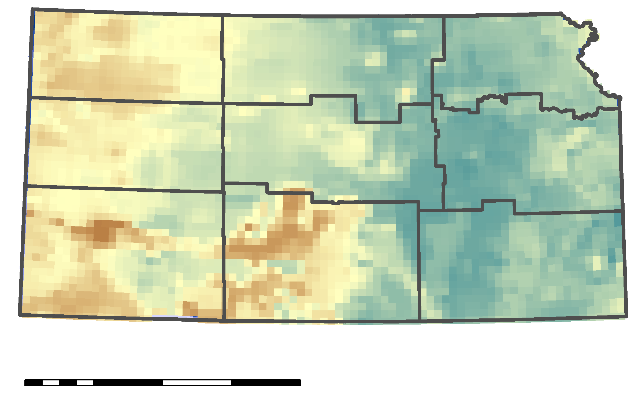
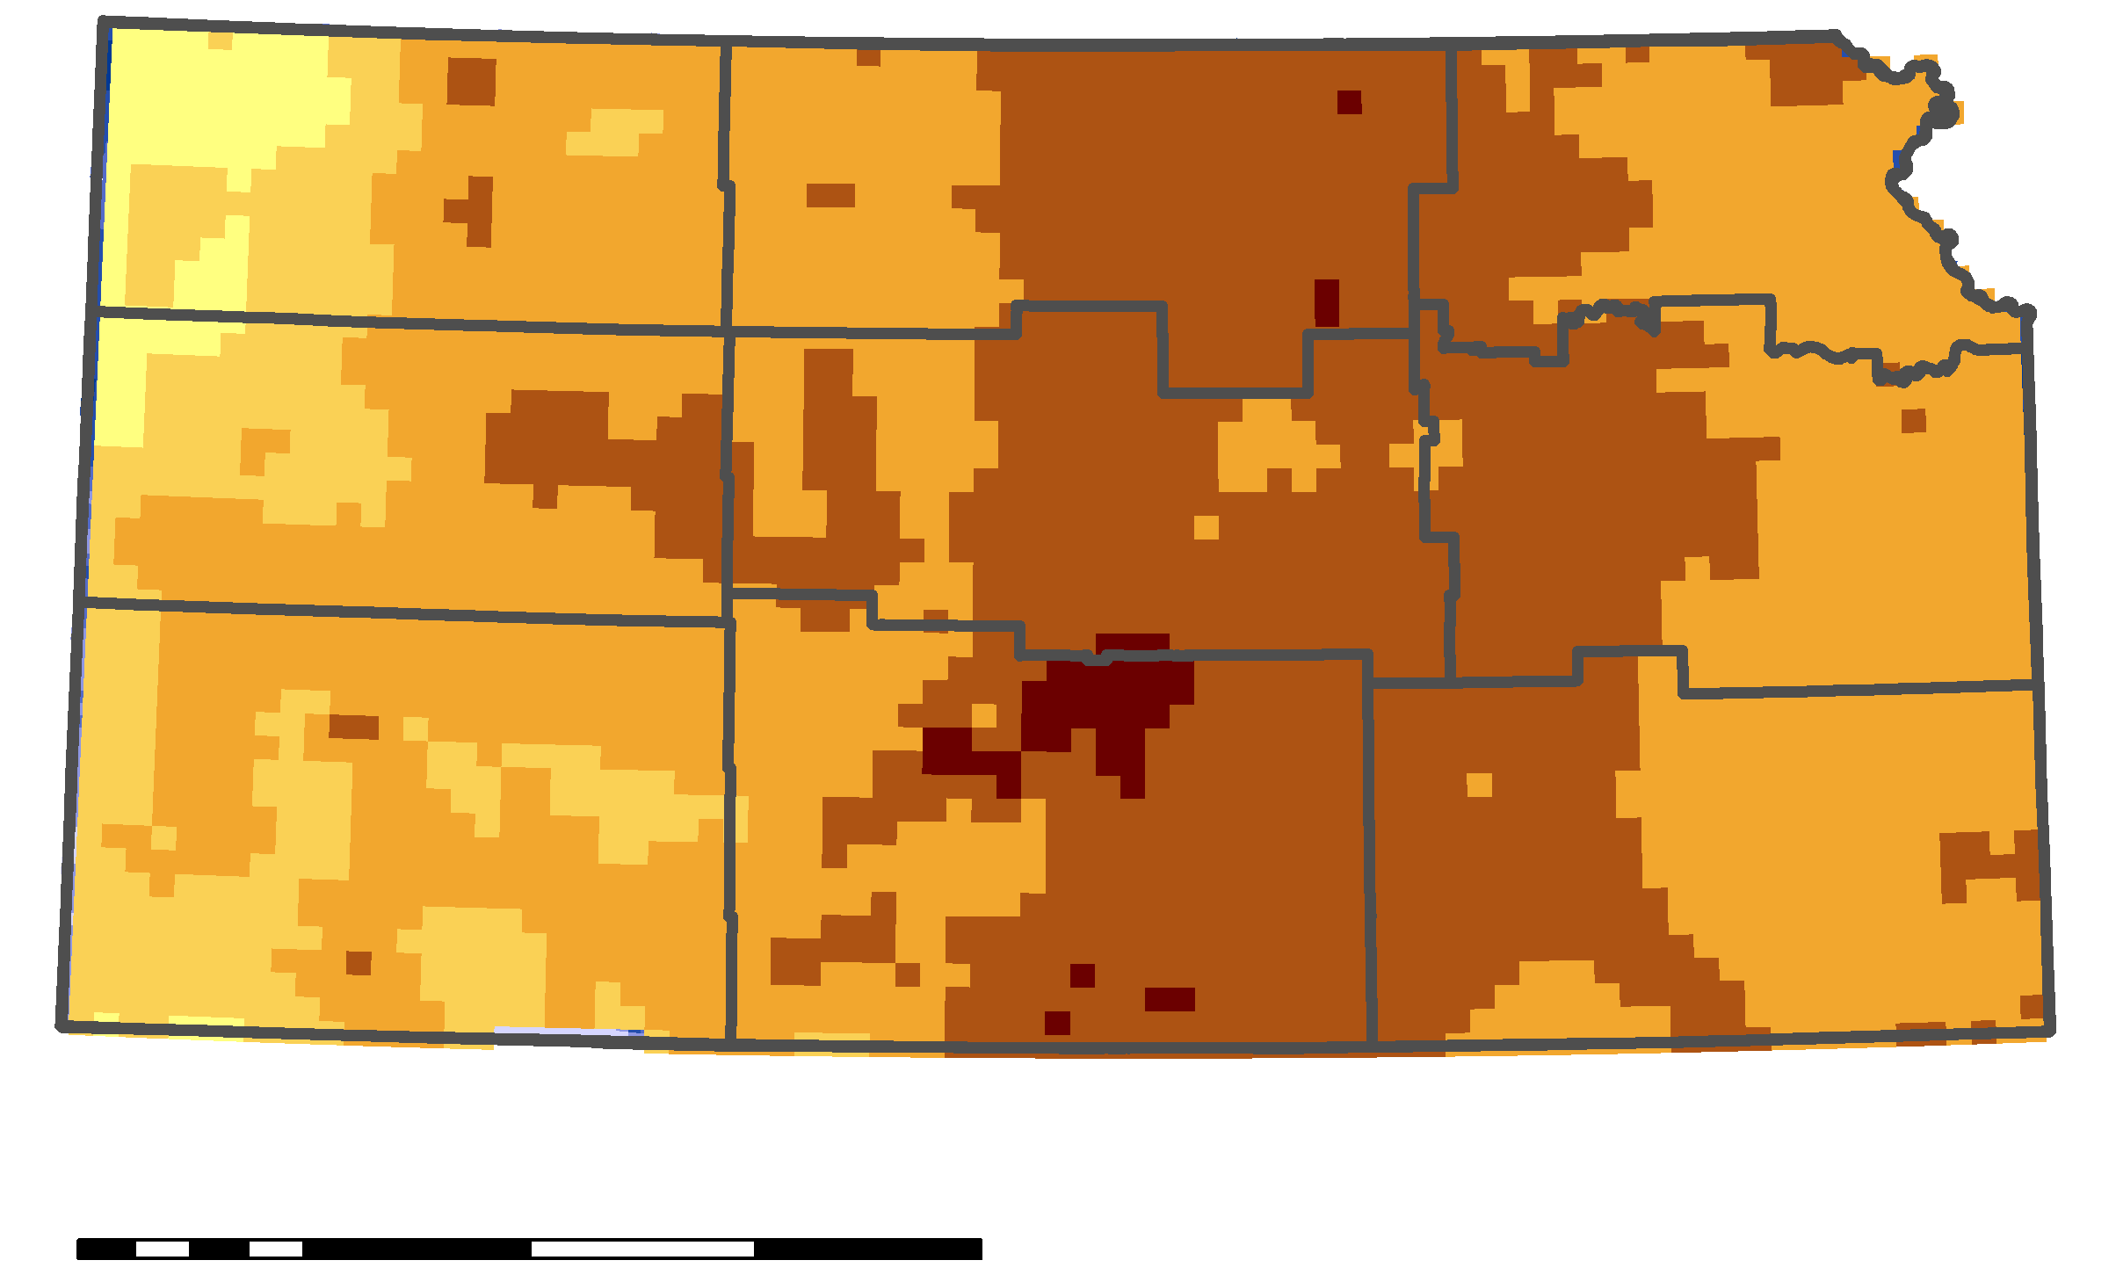
PART II: RESULTS, FORECASTED RZSM
One Week Timescale EDDI for July 13, 2019
Precipitation for 2 weeks before July 22, 2019
SMAP Modeled RZSM for July 19, 2019
SMAP Actual RZSM for July 19, 2019
Percent Difference for July 19, 2019 Forecast
0 150 300 km
-2 0 2
1 .5 1 2 4 (in)
A percent difference map of the forecasted soil moisture and actual soil moisture.
0 75 150 300 km
0 6 12 18 24 30 (%)
0 50
(m³/m³)
Notes:
When looking at forecasted rootzone soil moisture, we wanted to see how our model performs when looking at worst case scenario of no precipitation. We wanted to look at a date that was recent but also where most of Kansas wasn’t experiencing rainfall. We decided for our start date to be July 8th because if you look on the right-hand side map illustrating cumulative precipitation over the next two weeks, most of central Kansas experienced less than 0.1 inches of rain. So we obtained rootzone soil moisture measurements derived from SMAP for July 19th, since that was the most recent data available at the time, and compared it with the modeled rootzone soil moisture by creating a percent difference map. Our model overpredicted soil drydown, but that’s okay since our model assumes high evaporative demand due to wanting to look at worst case scenario. However, when compared to the evaporative demand anomaly from EDDI for this time period, it’s actually low rather than the assumed high anomaly in the model. These results are useful to highlight areas to look at in instances wherethe projected worst case scenario comes true.
----------------------------------------------
Image Source: Max Dunsker
Image Credit: Made by DEVELOPer
Shapefile of Kansas:
U.S. Bureau of the Census. TIGER/Line: U.S. States. Washington, D.C.: Bureau of the Census, 2018.
Shapefile of Kansas Climatological Divisions:
Vose, Russell S.; Applequist, Scott; Squires, Mike; Durre, Imke; Menne, Matthew J.; Williams, Claude N., Jr.; Fenimore, Chris; Gleason, Karin; Arndt, Derek (2014): NOAA's Gridded Climate Divisional Dataset (CLIMDIV). Kansas Climatological Divisions. NOAA National Climatic Data Center. doi:10.7289/V5M32STR, June 2, 2019.
Imagery:
Hobbins, M.T., A. Wood, D. McEvoy, J. Huntington, C. Morton, M. Anderson, and C. Hain (2016), The Evaporative Demand Drought
Index: Part I - Linking drought evolution to variations in evaporative demand. Journal of Hydrometeorology, 17: 1745–
1761, doi:10.1175/JHM-D-15-0121.1.
McEvoy, D., J. Huntington, M.T. Hobbins, A. Wood, C. Morton, M. Anderson, and C. Hain C (2016), The Evaporative Demand Drought Index: Part II - CONUS-wide assessment against common drought indicators. Journal of Hydrometeorology, 17: 1763–1779, doi:10.1175/JHM-D-15-0122.1.

Slide 15
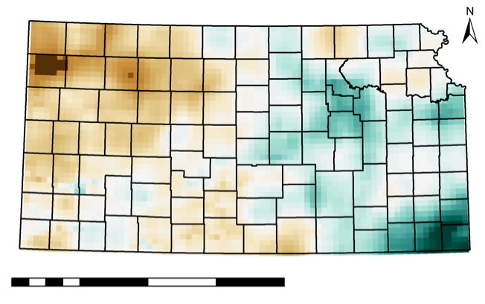

PART II: RESULTS - RELATIVE SATURATION
Pixels in blue are above 25% relative saturation; the darker the pixel, the more days until it reaches 25% relative saturation
25% Relative Saturation Model for July 1, 2019
Pixels in brown are below 25% relative saturation; the darker the pixel, the more days since it reached 25% relative saturation
0 50 200 400 km
-30 _{Days} 30
Notes:
Our model is designed to where our partners are able to change inputs based on their definition of worst case scenario. They are able to choose the soil moisture for the starting day they want to look at and the threshold of percent relative saturation, such as 25 percent or 50 percent. So for example when looking at July 1st, the white color indicate areas that are at 25 percent relative saturation for that date. The blue are areas that will reach 25 percent relative saturation and the brown are areas that have reached relative saturation. In this case, within the southeast corner in Labette and Cherokee counties, they have areas that will reach 25 percent relative saturation in 30 days from July 1st. In the northwest in Sherman County, there’s an area that reached 25 percent relative saturation 30 days before July 1st.
----------------------------------------------
Image Source: Max Dunsker
Image Credit: Made by DEVELOPer
Shapefile of US States:
U.S. Bureau of the Census. TIGER/Line: U.S. States. Washington, D.C.: Bureau of the Census, 2018.
Shapefile of Kansas Counties:
U.S. Bureau of the Census. TIGER/Line: Kansas Counties. Washington, D.C.: Bureau of the Census, 2018.

Slide 16
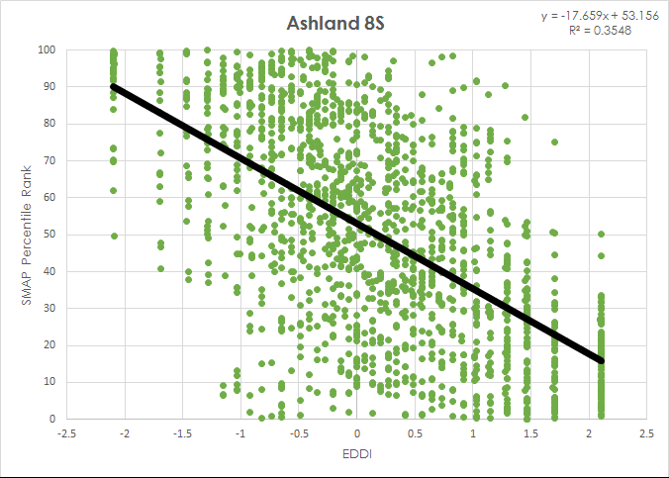
PART II: RESULTS - EDDI ANALYSIS
Our preliminary analysis of the relationship between SMAP and EDDI shows a negative trend, where high evaporative demand anomalies are present with low root zone soil moisture.
Notes:
We incorporated EDDI into our analysis by using it as a proxy for atmospheric drought and SMAP percentile ranking as a representative for agricultural drought to observe the relationship between the two. The areas observed were based on the 88 Mesonet stations. This is a preliminary observation since it includes numbers throughout the year rather than just the season, so an anomaly value for July may be the same for January. Overall there is a negative trend, meaning higher evaporative demand is seen with lower soil moisture.
----------------------------------------------
Image Source: Danika Mosher
Image Credit: Made by DEVELOPer

Slide 17
PART II: CONCLUSION
Remote sensing enhances information available for drought planning.
Remote sensing produces spatially comprehensive forecasts of soil moisture when modeled with empirically measured decay parameters.
Modeled outputs showed sub-county variations in estimated days to a selected relative soil saturation.
Evaporative Demand Drought Index is inversely related to RZSM percentiles.
The model shortens the timescale on which flash drought can be identified to less than 2 weeks.
Notes:
We were able to see through our project that remotely sensed data is effective in filling in the gaps from in situ observations, such as with Pawnee county that doesn’t have a station. From there we are able to derive soil characteristics that can be relayed to agricultural producers and farmers. When the data is incorporated with in situ measurements, it is possible to create a model as a user driven forecast tool to observe worst case scenario of no precipitation to prepare with drought mitigation planning. We’ve also been able to see an overall inverse relationship between EDDI and rootzone soil moisture percentiles from SMAP. Overall, one novel aspect about this project is the ability to look at drought instances on a much shorter timescale than months ahead, making it capable to identify flash drought.

Slide 18
PART II: ERRORS & UNCERTAINTIES, FUTURE WORK
The SPL4SMAU product models RZSM soil moisture, current Level-4 products are not modeled using contemporaneous observations.
Exponential decay constant should be calculated for each pixel using evaporative demand data.
Model does not include soil type as an input.
EDDI comparison is pixel to point and other EDDI timescales can be tested to improve accuracy.
Spatially comprehensive model is based on 41 in situ sites with mostly silt loam soil.
Notes:
One drawback with using SMAP is that it is currently not ingesting data, but is still generating a modeled output. It also began in 2015, so this limits derived soil characteristics within these past few years. As for EDDI, future work needs to observe the relationship with SMAP on a seasonal basis and on a pixel by pixel scale than just the Mesonet stations. As for our model, we do not have actual values for evaporative demand but rather a proxy based on the Mesonet drydown measurements and the day of the year. The model also does not include soil type; however, SMAP does, causing a discrepancy between in situ measurements and the model, especially since most of the stations are in silt loam soil. And of course, more tests need to be done to see how the model performs based on different initial conditions.

Slide 19
Thank you to our Center Lead, Andrew Shannon, our Science Advisor, Jessica Blunden for their support.
Thank you to our partners:
  Andres Patrignani, Kansas State University
  Christopher Redmond, Kansas State University
  Mary Knapp, Kansas Office of the State Climatologist
  Dan McEvoy, Desert Research Institute
  Diane Knowles, Kansas Water Office
Thank you to the DEVELOP National Program Office, Fellows, and Center Leads for their contributions and encouragement.
Thank you to NIDIS, NC Space Grant, and CISESS for their support
Notes:
Read through the slide, no additional speakers notes.

