Slide 1
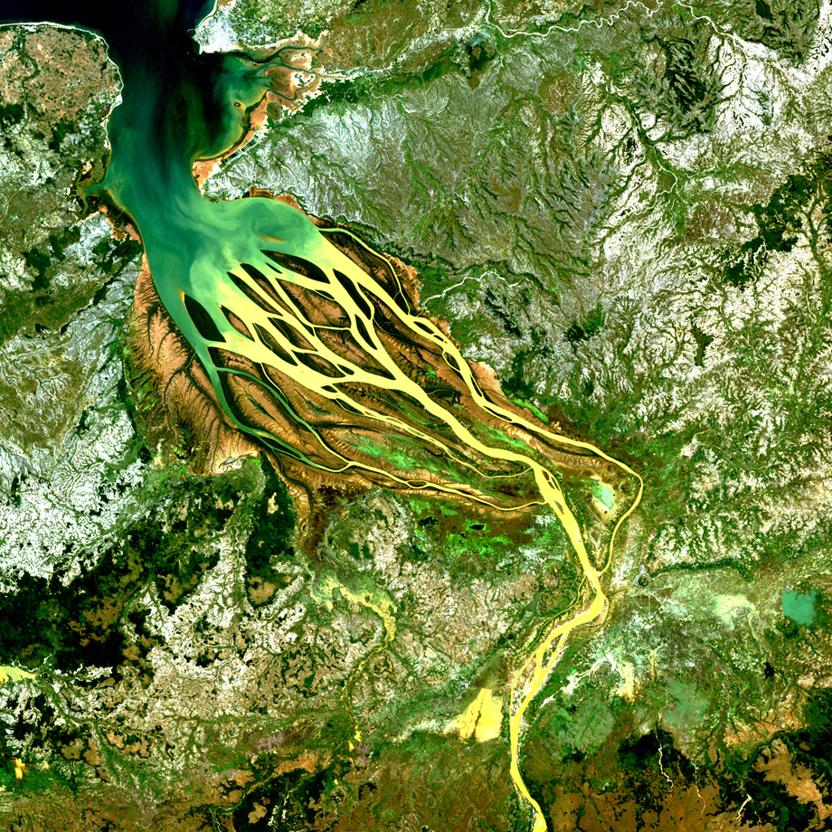
2019 Fall Term
DEVELOP
Proposal Bootcamp
Part 3
Notes:
Your project Website Image should be placed behind the hexagon grid. An example image has been placed in this position for your reference. Delete the example image, insert your image, right click your image and select the “Send to Back” option. Position and adjust the size of your image so that it lines up with the provided margin rulers.

Slide 2
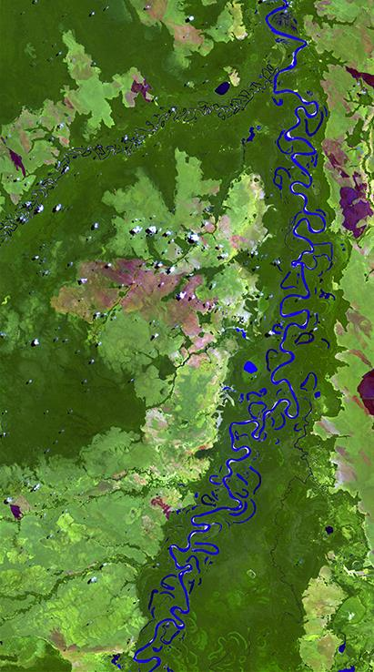
Proposal Writing
Template
Best Practices
Things NPO Looks For
Partner Forms
PSI
Resources
NPO Wish List
POCs

Slide 3
Proposal Considerations
Responding to HQ, NPO, and/or partner requests
Meeting DEVELOP metrics & node targets
App Area requirements (e.g. Eco proposal approval depends on a forecasting/prediction piece to the project)
Usage of underutilized & new sensors
“Relevant” – topics in the media, current data usage (2018-2019 data must be used)
Collect project ideas from a wide variety of sources – if you are ever having trouble, call NPO as there are typically some project ideas needing a home
DEVELOP only conducts projects that last 1-3 terms (10 to 30 weeks, i.e., always less than one year). This is a gap in ASP project activities that DEVELOP uniquely fills.
Continuation projects: 1 Term (65%), 2 Terms (25%), 3 Terms (10%)
Need a compelling reason during proposal phase for why a project should continue into a 2nd or 3rd term
Clearly lay out phased approach for a project in the first proposal
Partner engagement is critical for multi-term project approval – a third term should have a robust handoff plan so consider providing a training and tutorials.
International projects: if a proposal has an international study area, an international checklist must be completed. NPO will review and approve/reject for proposal submission.

Slide 4
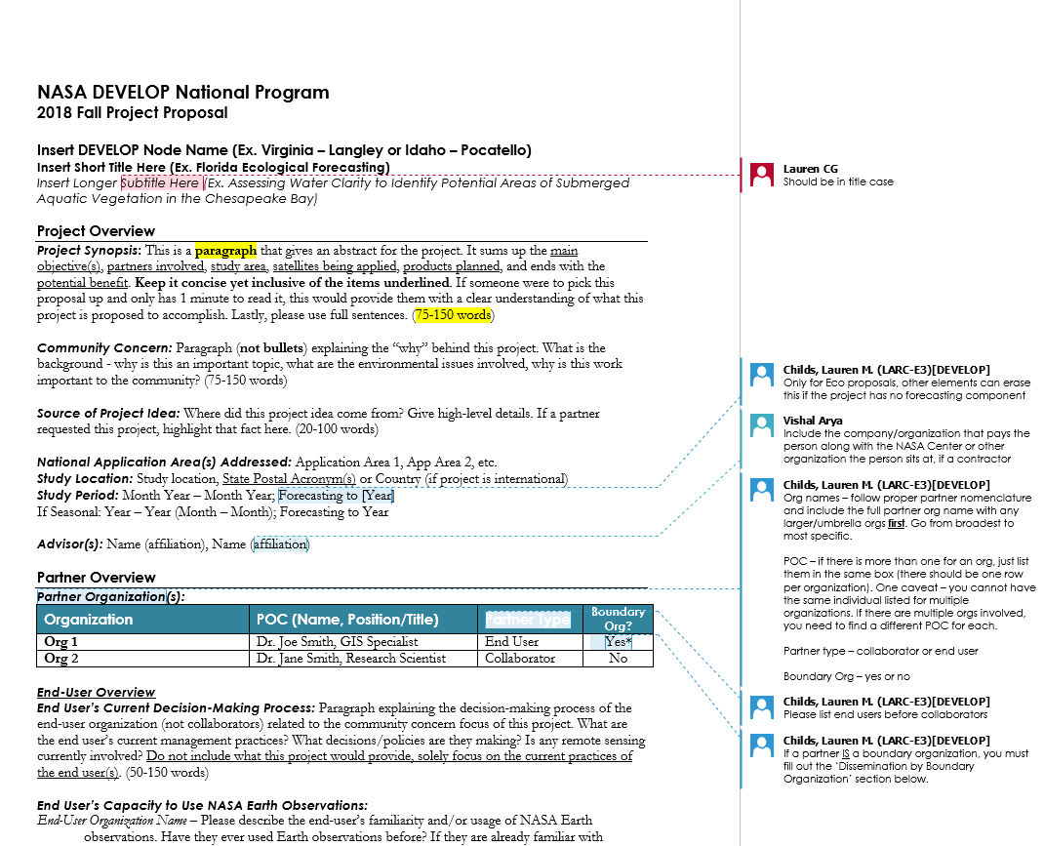
Proposal Template
6 Sections:
Project Overview: synopsis, community concern, source of idea, app areas, study area & period, advisors
Partner Overview: partner names, decision, EO experience, collaborator contributions, boundary orgs, communication plan, transition plan, letters of support (if any)
Earth Observation Overview: EO, ancillary datasets, modeling, software
DST & End Product Overview: end products, benefits
Timeline & Related Work: timeline, multi-term objectives, previous terms, related work,
Notes & References: notes, references
Notes:
Comments provide guidance
Word counts are included

Slide 5
Proposal – Titles
Short title:
Study area + the primary app area
Ex. South Carolina Disasters
Common Mistakes:
In place of app area, a proposal has something specific – ex. South Carolina Hurricanes --- stick to the ASP application areas!
Subtitle:
The subtitle should be a short description of the project to provide the reader more insight into the project – include things like EO being used, where the project is taking place, and the decision being made
Common Mistakes:
Not writing in title case (first letter of each word capitalized)
Too generic: “Utilizing NASA Earth Observations to…”
Not emphasizing the applied nature of the project: “Utilizing Earth Observations to Better Understand…” --- speak to the decision the project aims to impact, not understanding things!
It’s long and complicated --- keep it simple but informative

Slide 6
Proposal – Project Overview
Synopsis: This is a paragraph that gives an abstract for the project. It sums up the main objective(s), partners involved, study area, satellites being applied, products planned, and ends with the potential benefit. Keep it concise yet inclusive of the items underlined. If someone were to pick this proposal up and only has 1 minute to read it, this would provide them with a clear understanding of what this project is proposed to accomplish. No need to spell out satellite/sensor names – NASA HQ knows what they mean. Lastly, please use full sentences. (75-150 words)
Community Concern: Paragraph (not bullets) explaining the “why” behind this project. What is the background - why is this an important topic, what are the environmental issues involved, why is this work important to the community? (75-150 words)
Source of Project Idea: Where did this project idea come from? Give high-level details. If a partner requested this project, highlight that fact here. (20-100 words)
National App Area: List – Application Area 1, App Area 2, etc.
Study Location: Study location, State Postal Acronym(s) or Country (if international)
Study Period: Month Year – Month Year; Forecasting to [Year]
Advisors: Name (affiliation), Name (affiliation)

Slide 7
Proposal – Partner Overview
Partner Organizations: Org names – follow proper partner nomenclature and include the full partner org name with any larger/umbrella orgs first. Lead with the primary end user.
End user’s Decision: Paragraph explaining the decision-making process of the end user organization (not collaborators) related to the community concern focus of this project. What are the end user’s current management practices? What decisions/policies are they making? Is any remote sensing currently involved? Do not include what this project would provide, solely focus on the current practices of the end user(s). (50-150 words)
End user’s EO Experience: Please describe the end user’s familiarity and/or usage of NASA Earth observations. Have they ever used Earth observations before? If they are already familiar with and/or use NASA Earth observations, how does this project build their capacity? (10-100 words per end user. Please include a separate paragraph for each partner defined as an end user).
Collaborator Support: Please describe how any collaborators are supporting and involved with the project. (10-75 words)
Boundary Orgs: Please describe the organization’s capacity to transition and disseminate project results and methodologies to other groups. Describe the community they would share the DEVELOP project with here. If you know specific groups they would be sending results/products to, please include exact organization names; however, do not list those groups as partners above unless the team will be directly in contact with them. (50-100 words)
Communication Plan: Describe the communication plan for during the term – how and how often will the team communicate with the partners? Who will be the main POC for this communication? (25-100 words)
Transition Plan: Discuss the transition approach to the end user – how will you hand off your decision support tool(s)? How and when will the tool(s) be used and/or implemented by the partner? Will software release be required, and if so how does that work into the timeline? (25-100 words)
Letter of Support: Author, Author’s Title, Organization. Do not put the letter in this document, submit it to the Project Coordination Team through email with proposals or as soon after as you have the letter. Erase this section if no letter(s) of support are available.

Slide 8
Proposal – EO Overview
Earth Observations: Please list each Instrument on an individual line, even if the parameter and use are the same Ex. Landsat 5 TM, Landsat 7 ETM+, and Landsat 8 OLI should all be in separate rows.
Ancillary Datasets: List any non-satellite/airborne datasets you might use for this study, e.g., field surveys, in situ measurements, available modeled data (even if it is modeled using satellite data), etc. For published datasets, list the original source for Creator Organization (i.e. person/organization who actually created the dataset) followed by the formal dataset name. Do not list where the data came from or who provided it, if different from the creator.
Modeling: This section is for highlighting any model that will be run by the team during the term to assist in project deliverables. For an Eco Forecasting project, this is required! Some kind of forecasting needs to be taking place. Any model data not being run by the team should be included under ancillary datasets.
Software & Scripting: List the software (ERDAS IMAGINE, Esri ArcGIS, ENVI, IDL, R, QGIS, MATLAB, etc.) you will use and for what data.

Slide 9
Proposal – DST & EP Overview
End Products: List the end products that the team will create and hand off to the partners. Each should be on a separate line and include how the partner will use it, what datasets/analyses are involved, and if software release is required. If an Eco project, one must include forecasting.
End-user Benefit: What will be the benefits of your project’s end products to the end user(s)? How will this impact their decision-making process? Will it save them time/money/etc.? This should be concise and well thought out. If the end user has written a letter of support, incorporate any applicable quotes regarding the potential benefit and any outcomes or you can also reach out to them to write this section or contribute a quote. (50-100 words)

Slide 10
Proposal – Timeline & Related Work
Project Timeline: 1 Term: [Year Term] OR [#2-3] Terms: [Year Term] to [Year Term]
Multi-Term Objectives: Only complete if it’s a multi-term project. For each term write a descriptive paragraph that outlines the specific goals/objectives (or accomplishments) for the first term of this project, and how they set the stage for subsequent terms. Include details related to partner interaction. (75-100 words)
Previous Terms: Year Term (Team Location) - Project Short Title. This is for a) 2nd or 3rd terms of continuing projects, or b) One term projects that are a continuation of another term but aren’t easily identified as such because the focus has changed (geographic location/partner/ASP app area/etc.). When the continuation term is so different for a follow-on term that it is determined best to be considered as a new first term project. When this happens, please include the previous term(s) here for tracking clarity.
Related Work: Term Completed (Node Acronym) - Project Title: Project Subtitle. Projects in DEVELOP’s portfolio that are similar and can support the new team, give merit to methods being used, etc. Max # of related projects: 5, 2-3 is sufficient. Look on DEVELOPedia. There will be related work!

Slide 11
Proposal – Notes & References
Notes: Anything else you deem important to share. Often empty and that is ok! If you have ideas for looking at additional topics, EO, or datasets that aren’t fully developed enough to include in your main proposal list them here.
Ex. The California Department of Fish and Wildlife has artificial drinker systems that have rain gauges that transmit via satellite. Also, they might be able to contribute some personnel time if on-the-ground validation is needed.
References: List out any relevant content or websites; however, please note that citations should not be included in the text in the body of the proposal. Keep this list to a handful of key references. Use APA format.

Slide 12
General Tips for a Seamless Review
Write clearly & concisely
No vague or “empty” sentences
Be consistent with your EO throughout
Ex. If you write that your project will use Terra ASTER data in the Project Synopsis, make sure Terra ASTER is listed in the both EO table AND is associated with a specific end product in the Datasets & Analyses section of the End Products table.
Research official partner organization names
Make sure the end user, collaborator, and boundary organization sections are competed for all partners
If you’re submitting a proposal for a 2nd or 3rd term project OR resubmitting a proposal idea for a subsequent term, build on the proposal FD or NPOs comments/edits
Delete all comments
NASA Earth observations NOT NASA Earth Observations
proper noun
proper noun
common noun
proper noun
proper noun

Slide 13
Proposal Submission & Nomenclature
Email
Amanda.L.Clayton@nasa.gov
DEVELOP.ProjectCoordination@gmail.com
File Nomenclature
YearTerm_NodeAcronym_ProjectShortTitle_Proposal
Ex. 2020pring_GA_EasternIndiaEcoII_Proposal
Node Acronyms:
ARC, AZ, CO, GA, GSFC, ID, JPL, LaRC, MA, MSFC, NC
App Area Shorthand:
Ag, Disasters, Eco, Energy, HealthAQ, TI, Urban, Water

Slide 14
Things NPO Looks For
The correct template is used and sections aren’t missing
We look for responses to be roughly within word counts provided – concise, fluff free, and responsive to each prompt
If the project fills a gap: study areas in gap states, underutilized sensors, less common app areas
Multiple term projects should have significant partner involvement and a third term project should be focused on the hand off and the partner being able to use and replicate the methodologies/results
End products should be well thought out and titles should be short but descriptive
If software release is involved, we look for a very descriptive and well thought out transition plan and timeline
What is the decision? Is it actionable? When we see a title talking about improving understanding of a phenomenon and weak write up in the decision section, we question whether it is truly “applied science” – so clearly communicate the decision that could potentially be impacted
Partner names & satellite/instrument names are written correctly

Slide 15
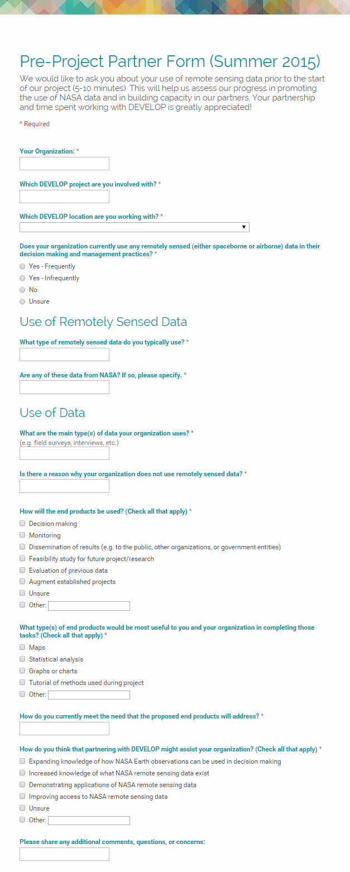
Partner Forms (Pre/Post)
Pre-Project Partner Forms are sent out before the term to gather information about partner needs and expectations. Post-Project Partner Forms are sent after the completion of the term to collect information regarding the perceptions of success of collaborating with DEVELOP.
Were the project results and methodologies useful?
Was the experience a good one?
Is the partner using the results or methodologies in their decision-making process?
Timeline: Center Leads send out the Pre-Project survey link a couple weeks before the beginning of the term for new projects. The Post-Project survey link will be sent to partners at the end of the term. In case of a project that has multiple terms, the survey goes out following the project’s final term.
Please communicate to your partners that DEVELOP will stay in touch and send a brief form at the end of the project’s final term.

Slide 16
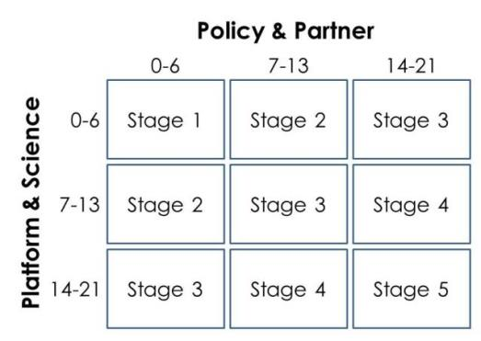
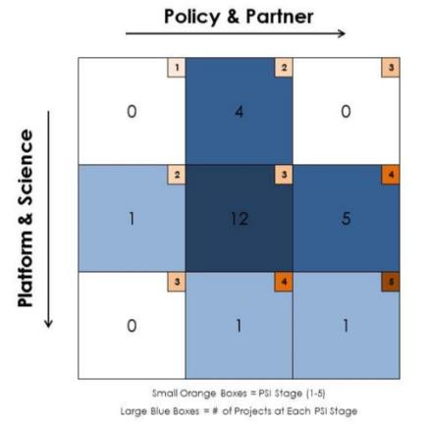
Project Strength Index (PSI)
DEVELOP projects have consistently improved and matured over the Program’s last 15+ years. A means of assessing project progression and comparing project success has, to date, been subjective. The PSI provides DEVELOP a means of objectively evaluating projects and tracking progress.
A series of questions are answered earning a total of 21 points in two sections: 1. Policy & Partner and 2. Platform & Science. The score for each category is then placed on the index to receive the project’s current stage (1 to 5).
PSI Part I: Initial set of questions answered by CLs about projects during each interim about the preceding term.
PSI Part II: ~4-6 month follow-up, questions answered by CLs to assess additional project characteristics such as publishing, conference presentations, and partner use of end products.
Stage 1: Basic Research
Stage 2: Application Concept Complete
Stage 3: Application Demonstration Successful
Stage 4: Application Verified / End-User Engaged
Stage 5: Transition to End-User / Decision Enhanced

