Slide 1
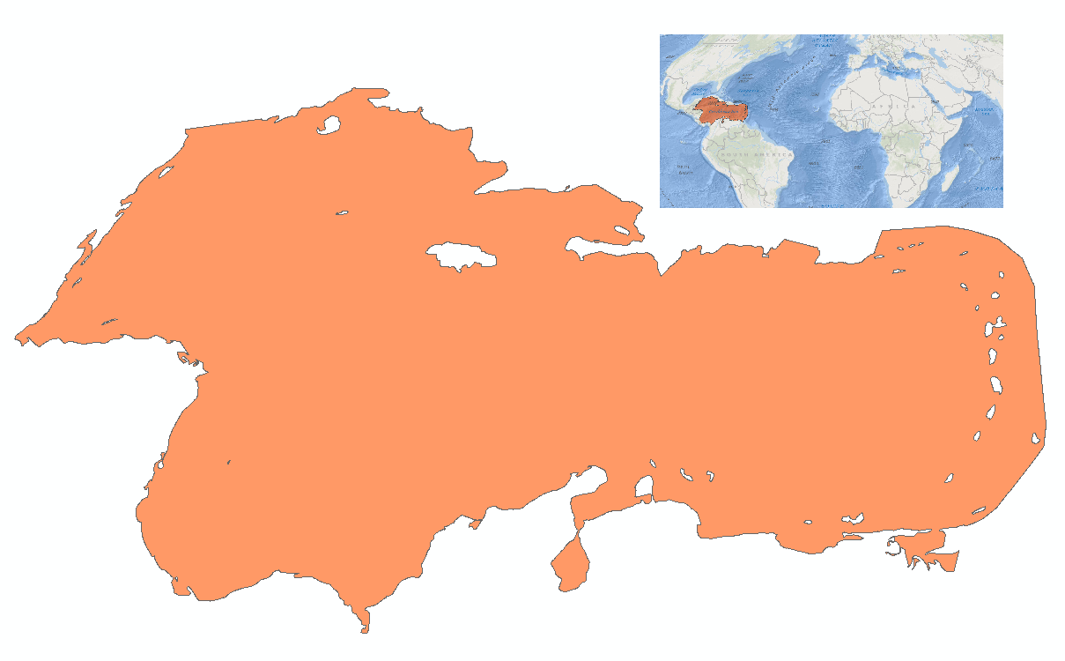
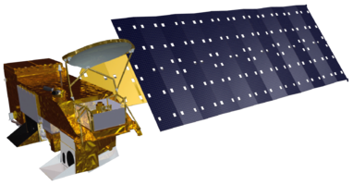
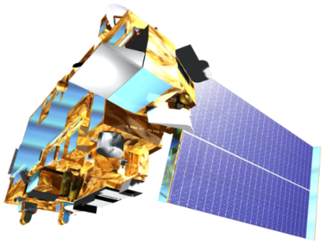
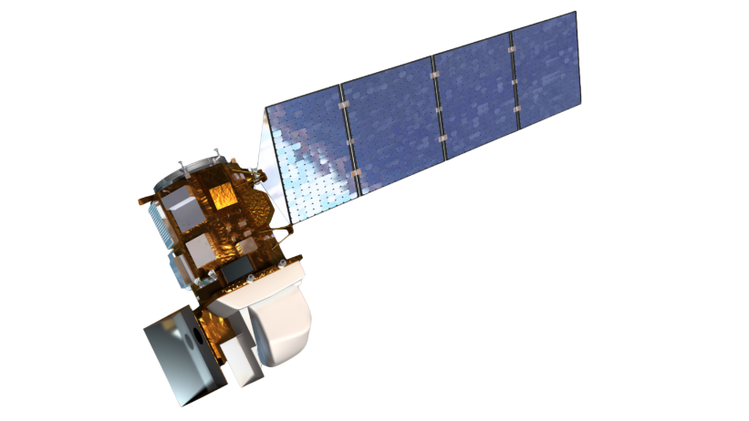
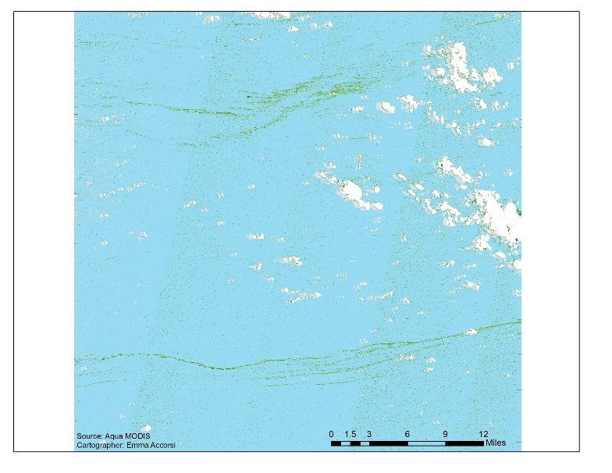
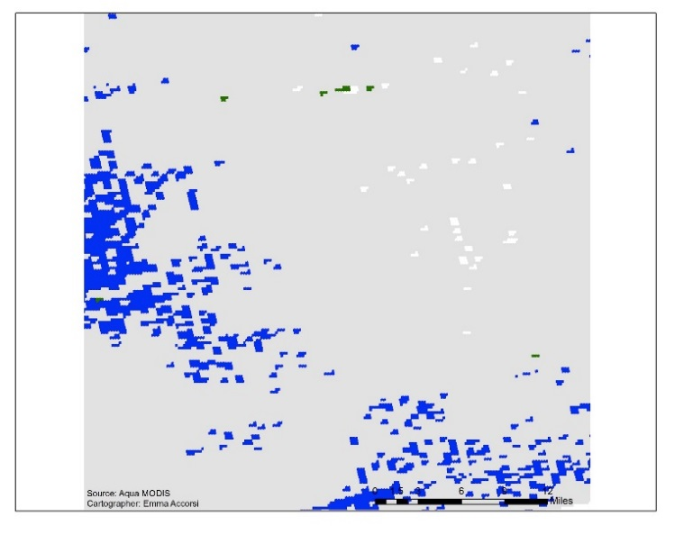
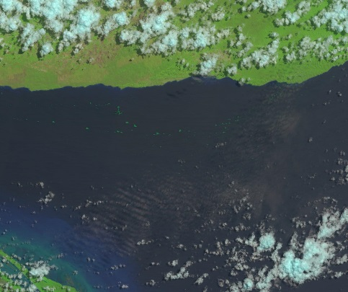
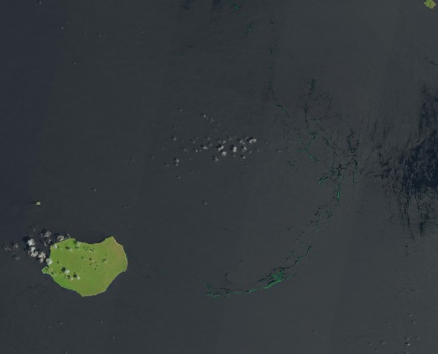
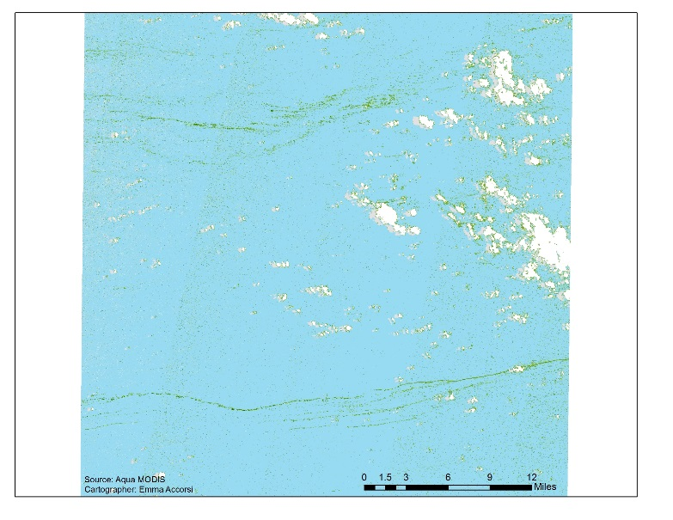
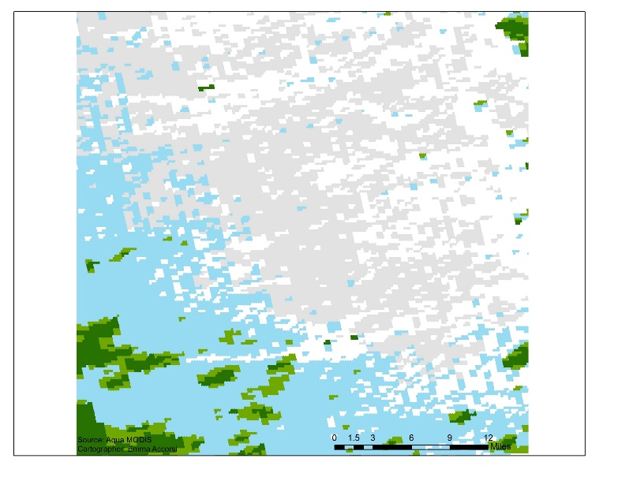
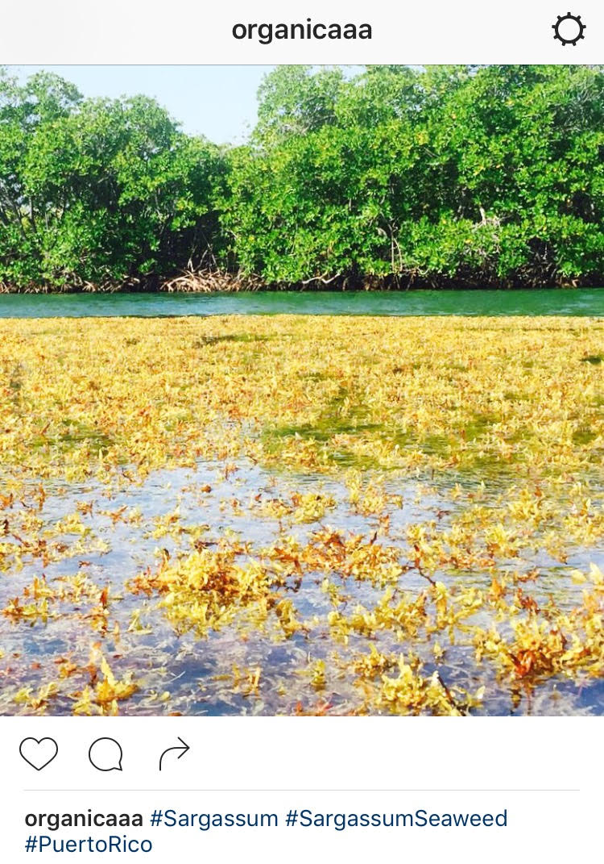
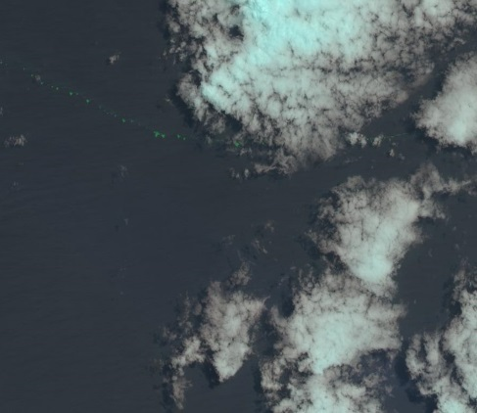
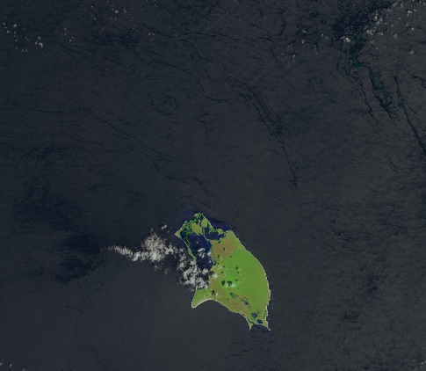
Investigating Inundation Events: A Study of Remote Sensing Techniques and Novel Data Sources for Sargassum Detection and Quantification in the Caribbean Sea
Abstract
In 2015, Caribbean nations were overwhelmed by an unprecedented quantity of Sargassum that washed ashore. This issue prompted international discussion to better understand the origin, distribution, and movement of Sargassum, a free-floating brown seaweed with ecological, environmental, and economic importance. In the open ocean, Sargassum mats serve a vital ecological function. However, when large quantities appear onshore without warning, Sargassum threatens local tourist industries and near-shore ecosystems. As part of the international response, this project investigated the proliferation of this seaweed using NASA Earth observations for detection of Sargassum and available nutrients across the region. The NASA DEVELOP National Program
Caribbean Oceans team at the NASA Ames Research Center compared Landsat 8 Operational Land Imager (OLI) imagery to Aqua Moderate Resolution Imaging Spectroradiometer (MODIS) imagery across a number of indices for the identification of Sargassum. The presence of Sargassum was then compared to ground truth data points from Sea Education Association (SEA) cruises and social media platforms, as well as various oceanic variables, to determine the ideal pelagic environment for Sargassum growth. As part of the international effort to better understand the life cycle of Sargassum in the Caribbean, the results of this project will assist local economies and help promote sustainable management practices.
Objectives
Earth Observations
Study Area
I) Compare Sargassum indices to in situ data to allow for better determination of Sargassum quantity from satellite imagery.
Investigate the relative performance of indices derived from different sensors on common patterns of Sargassum distribution
II) Assess the accuracy of Instagram as a novel source of ground truth data
Aqua MODIS
Terra MODIS
Caribbean Sea
Methodology
Landsat 8 OLI
Identification of Observable Sargassum in Landsat Scenes with Instagram Points and SEA Cruise Data
Results II
II. a) Partial atmospheric correction of imagery in SeaDAS to remove Rayleigh scattering
Landsat 8 Classifications
MODIS Aqua Classifications
Normalized
Difference in
Vegetation Index
(NDVI)
Figure 3.
Figure 4.
seadas.gsfc.nasa.gov
II. b) Selection of typical patterns of pelagic Sargassum distribution
Caribbean Oceans II
Figure 5.
Figure 6.
I. Verification of Instagram Sightings via Landsat 8 imagery
Floating
Algal Index
(FAI)
Sargassum Mats
Bright Windrow
The number of pixels classified as Sargassum varied based on the sensor and the index used. The NDVI, commonly used in land-based classifications, was able to identify Sargassum in both Landsat (Fig. 3) and MODIS (Fig. 4) imagery, but misidentified more pixels than other indices. The FAI also identified only half as much Sargassum using Landsat (Fig. 5) relative to MODIS (Fig. 6).
Under Clouds
Faint Windrow
Conclusions
II. c) Classification and pixel-by-pixel comparison of indices by distribution pattern and sensor
The Floating Algal Index (FAI) is finely tuned for Sargassum identification across different sensors
Instagram is a good source of ground truth for hypothesis generation
Results I
Acknowledgements
Juan Torres-Pérez – Bay Area Environmental Research Institute
Sherry Palacios – Bay Area Environmental Research Institute
Chippie Kislik – DEVELOP NASA Ames Research Center Center Lead
Vickie Ly – DEVELOP NASA Ames Research Center Assistant Center Lead
Erica Scaduto – Caribbean Oceans I Team Member
Any opinions, findings, and conclusions or recommendations expressed in this material are those of the author(s) and do not necessarily reflect the views of the National Aeronautics and Space Administration. This material is based upon work supported by NASA through contract NNL11AA00B and cooperative agreement NNX14AB60A. This material is based upon work supported by NASA through contract NNL11AA00B and cooperative agreement NNX14AB60A.
Figure 1. The database the team created from #sargassum and #sargassum seaweed shows the positive trend in reliability of Instagram-based number of posts.
Figure 2. The trend in the number of days between the posting and Landsat 8 flyover is likely influenced by a majority of land-based posts.
Team Members
Project Partners
Dr. Porfirio Alvarez Torres, CiiMar-GoMC
Fréderique Fardin, SPAW-RAC
Dr. Amy Siuda, Dr. Jeff Schell and Dr. Deb Goodwin, SEA
Dr. Sergio Cerdeira, CONABIO
Dr. Roy A. Armstrong, UPR
Jordan Ped
Team Lead
Emma Accorsi
María López-Peña
NASA Ames Research Center – Summer 2016

