Slide 1
Indonesia Agriculture
Identifying Current Areas of Palm Oil Production and Modeling a Risk Map for Future Expansion in Central Kalimantan, Indonesia
Kyle Peterson (Project Lead)
Michael Riedman
Abigail Childs
Notes:
Hello! Thank you for attending our presentation today.
My name is Kyle Peterson, and I’m the Project Lead on the Indonesia Agriculture project. I have a B.S. in Geographical Sciences from University of Missouri
Hi, my name is Michael Riedman, I have a Master’s in GIS from University of Maryland, Baltimore County, and a B.S. in Environmental Science from University of Maryland, College Park
Hi, my name is Abby Childs, I have a Masters in International Affairs from Columbia University’s School of International and Public Affairs and a B.A. in Environmental Studies from Bates College.
Our project couples NASA earth observations with in situ data to predict locations of current palm oil production and model a risk map for future expansion of palm oil plantations in Central Kalimantan, Indonesia.

Slide 2
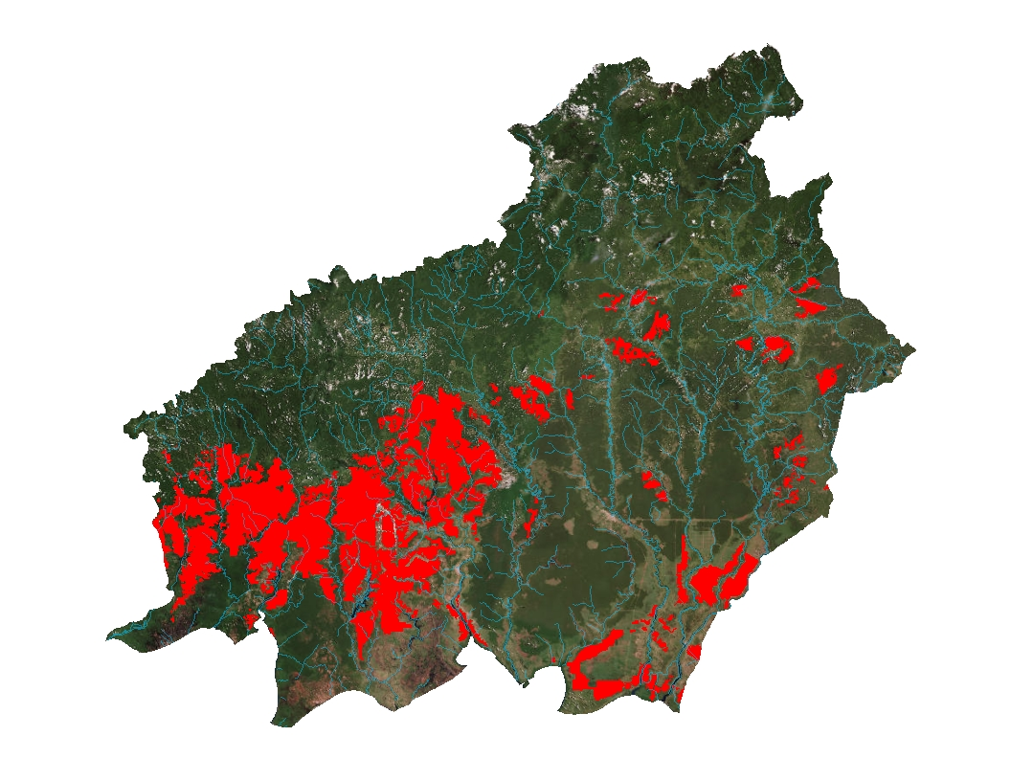
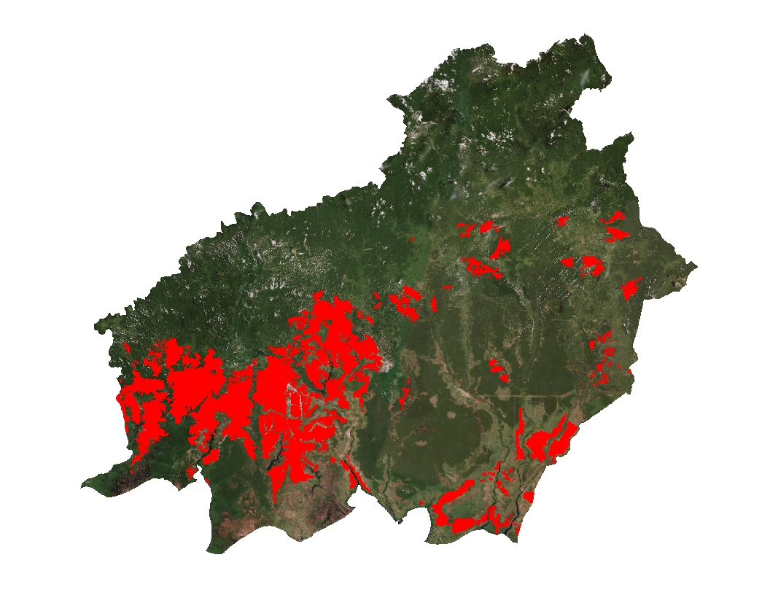
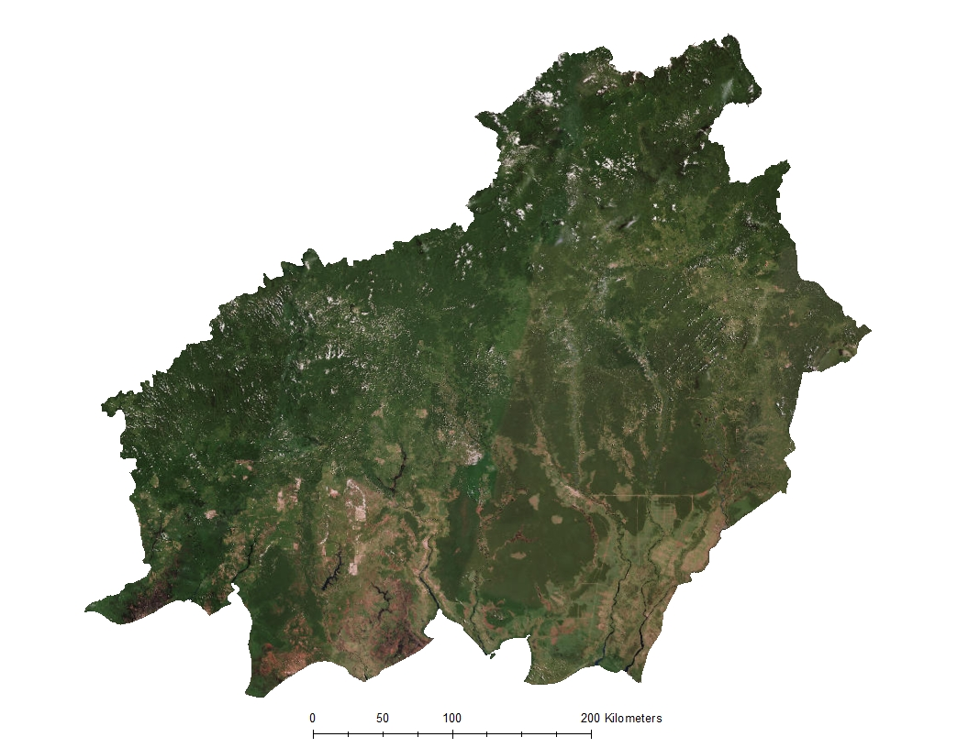
Study Area
Central Kalimantan,
Indonesia
Plantation Locations
Water
Notes:
Located in Southeast Asia, on the island of Borneo, the third largest island in the world, Central Kalimantan is a remote province that is home to natural rainforests, peatlands, and many endangered species, such as Sumatran tigers, orangutans, pygmy elephants, and Sumatran rhinoceros.
*CLICK
Central Kalimantan has been marked as a region for the government-backed expansion of palm oil due to its underdevelopment and availability of large plots of land that can be converted into palm oil plantations.
*CLICK
Currently, most plantations are located near waterways since water systems offer access to plantations in the most remote regions of the province where roads do no exist.
Also existing in Central Kalimantan are areas that have been designated by the government of Indonesia as land to be protected; these protected areas are on rainforest, peatlands, and areas that contain endangered species.
Citation:
ESRI Basemap: World Imagery provides one meter or better satellite and aerial imagery in many parts of the world and lower resolution satellite imagery worldwide. The map includes 15m TerraColor imagery at small and mid-scales (591M down to 72k) and 2.5m SPOT Imagery (288k to 72k) for the world, and USGS 15m Landsat imagery for Antarctica. The map features 0.3m resolution imagery in the continental United States and 0.6m resolution imagery in parts of Western Europe from Digital Globe. Recent 1m USDA NAIP imagery is available in select states of the US. In other parts of the world, 1 meter resolution imagery is available from GeoEye IKONOS, Getmapping, AeroGRID, IGN Spain, and IGP Portugal. Additionally, imagery at different resolutions has been contributed by the GIS User Community. For more information on this map, including the terms of use, visit us online at http://goto.arcgisonline.com/maps/World_Imagery

Slide 3
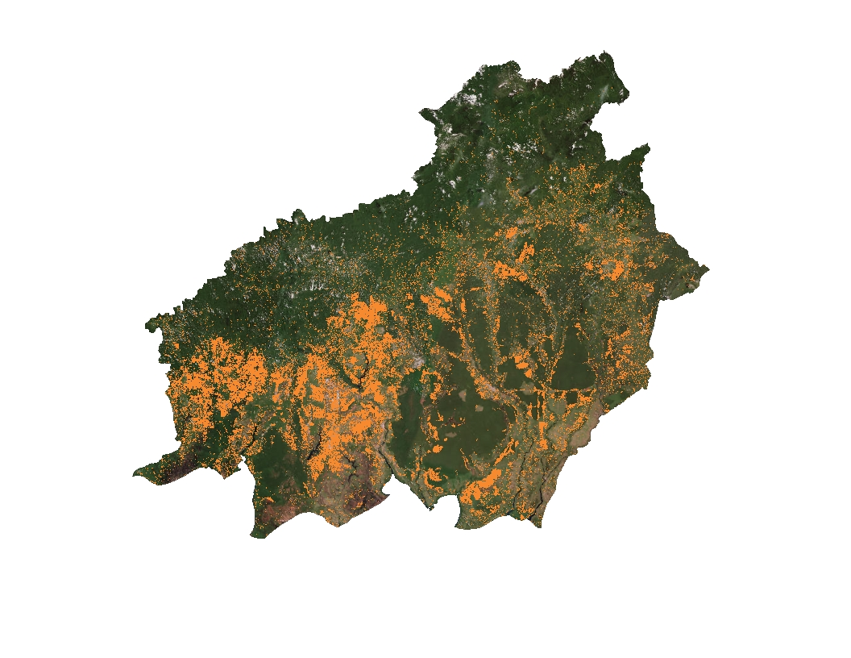
Study Period
January 2000 – January 2016
Palm oil plantations expanded by 120,000-140,000 ha/yr since 2000
Loss of Forest, 2000-2014
Image Credit: Hansen/UMD/Google/USGS/NASA
Notes:
Our project had a 16 year study period from January 2000 – January 2016.
*CLICK
This image shows areas of forest loss in Central Kalimantan between 2000-2014, collected over 14 years using Landsat imagery
There was considerable forest loss in this region over that 14 year period, particularly in the southwest portion of the province. Most of this loss is estimated to have come from the increase in palm oil plantations- palm oil plantations in Central Kalimantan have increase by 120,000 – 140,000 hectares per year since 2000.
Citation
Yayu Ramdhani and R. Kiki Taufik, Land Suitability Analysis for Sustainable Oil-palm Plantations in Kalimantan using Fuzzy Weighted Linear Combination on Multi Criteria- Spatial Decision Support System
Hansen/UMD/Google/USGS/NASA ->Forest loss data: http://earthenginepartners.appspot.com/science-2013-global-forest/download_v1.2.html
ESRI Basemap :World Imagery provides one meter or better satellite and aerial imagery in many parts of the world and lower resolution satellite imagery worldwide. The map includes 15m TerraColor imagery at small and mid-scales (591M down to 72k) and 2.5m SPOT Imagery (288k to 72k) for the world, and USGS 15m Landsat imagery for Antarctica. The map features 0.3m resolution imagery in the continental United States and 0.6m resolution imagery in parts of Western Europe from Digital Globe. Recent 1m USDA NAIP imagery is available in select states of the US. In other parts of the world, 1 meter resolution imagery is available from GeoEye IKONOS, Getmapping, AeroGRID, IGN Spain, and IGP Portugal. Additionally, imagery at different resolutions has been contributed by the GIS User Community. For more information on this map, including the terms of use, visit us online at http://goto.arcgisonline.com/maps/World_Imagery

Slide 4
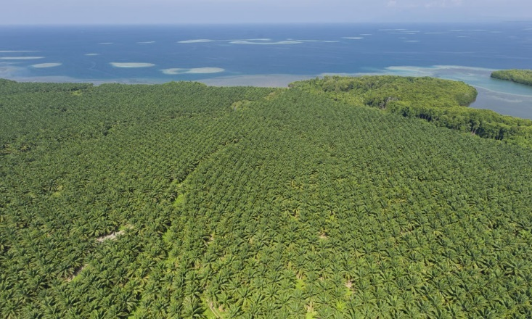

Objectives
Identify current palm oil plantations in Central Kalimantan, Indonesia using Maxent
Generate a risk assessment map of future palm oil plantations based on identified plantations
Enhance World Wildlife Fund’s ability to combat deforestation using NASA Earth observations
Image Credit: World Wildlife Fund
Don’t destroy my home!!!
Image Credit: Flickr (Restless Mind)
Notes:
There were two primary objectives in this project
The first objective was to create a model that identifies the location of current palm oil plantations in Central Kalimantan, based on in situ data provided by WWF and data obtained from NASA satellites.
*CLICK
2. The second objective was to create a risk assessment map of potential future palm oil plantations based on the output of palm oil plantations from the first objective
Both objectives used Maxent to model the presence of palm oil plantations in Central Kalimantan
*CLICK
Both outcomes will be used by WWF to combat deforestation in the province and protect rainforest, peatlands, and biodiversity.
*CLICK
(Orangutan bubble)
Image Link:
http://www.worldwildlife.org/photos/sustainably-produced-palm-oil
https://www.flickr.com/photos/restless_mind/2318914518/sizes/l

Slide 5
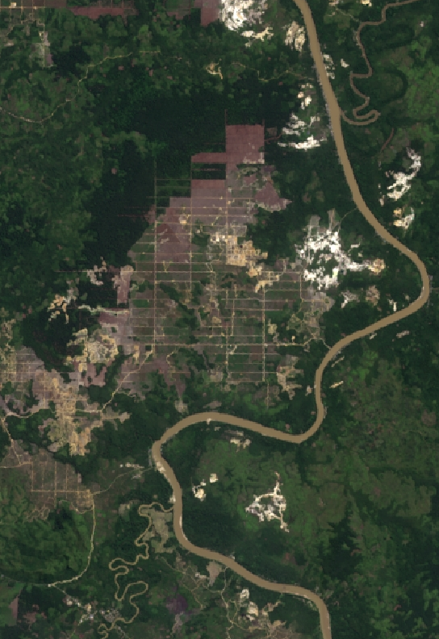
Community Concerns
Illegal deforestation
CO₂ emissions
Rainforest and biodiversity loss
Image Credit: Landsat 8
Notes:
Illegal deforestation of conservation areas in Central Kalimantan for the purpose of palm oil plantations is against the expressed purpose of conserving areas. Moreover, reduction of natural forests and peatlands causes a significant release of CO₂ emissions, making Indonesia one of the largest contributors to climate change in the world.
Rainforest and biodiversity loss caused by the creation of palm oil plantations will have a long and continuing impact of the species that rely on natural forests for their survival and can push these species to the brink of extinction in the near future.

Slide 6
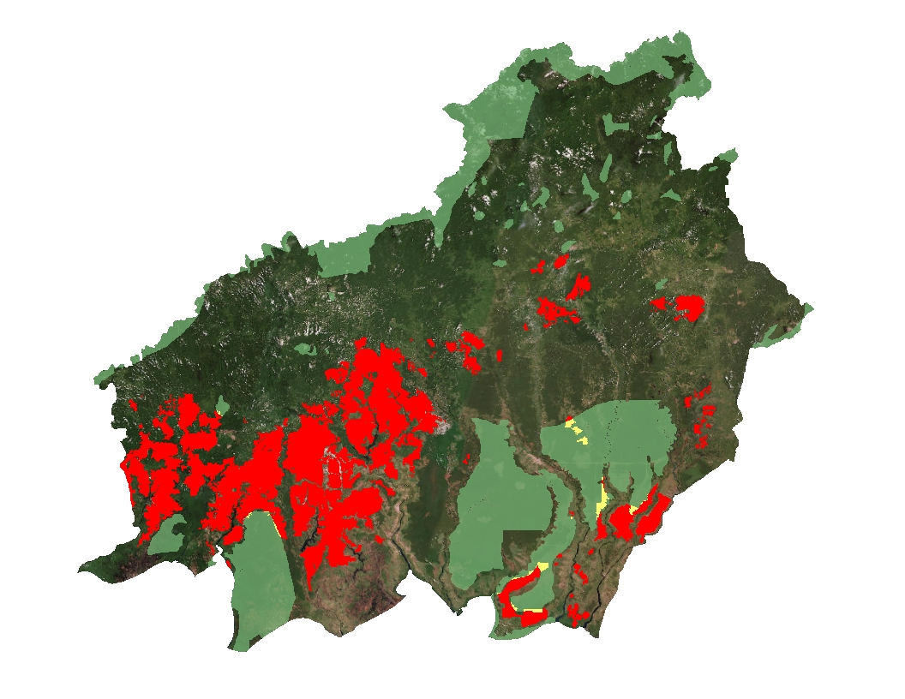
Current Plantations
Palm oil plantations exist in both conserved and non-conserved areas
Indonesia has set a goal to expand palm oil plantations by two million ha by 2020
Conservation Areas
Plantation Locations
Plantations inside conservation areas
Data from: World Wildlife Fund and Global Forest Watch
Notes:
Data we have gathered indicate that the presence of palm oil plantations in Central Kalimantan, Indonesia occurs in both conserved and non-conserved areas, with most palm oil plantations existing in non-conserved areas, as indicated by the figure.
Global demand for palm oil has doubled over the last decade and is expected to double again before 2050. (http://wwf.panda.org/what_we_do/footprint/agriculture/palm_oil/)
Indonesia has the goal of becoming the worlds largest palm oil exporter and will need to convert two million hectares of land in order to achieve this goal. (Ramdhani/Taufik 2006 - Land Suitability Analysis for Sustainable Oil-palm Plantations in Kalimantan using Fuzzy Weighted Linear Combination on Multi Criteria- Spatial Decision Support System). To reach this goal the government of Indonesia is actively attempting to convert land into palm oil plantations.
Areas with roads and existing plantations are likely increase their plantation sizes in the near future since these areas have existing infrastructure making the relative cost of growth and expansion inexpensive.
Citations: Data layers obtained from Global Forest Watch (http://data.globalforestwatch.org/datasets/baae47df61ed4a73a6f54f00cb4207e0_5) and provided by World Wildlife Fund
ESRI Basemap: World Imagery provides one meter or better satellite and aerial imagery in many parts of the world and lower resolution satellite imagery worldwide. The map includes 15m TerraColor imagery at small and mid-scales (591M down to 72k) and 2.5m SPOT Imagery (288k to 72k) for the world, and USGS 15m Landsat imagery for Antarctica. The map features 0.3m resolution imagery in the continental United States and 0.6m resolution imagery in parts of Western Europe from Digital Globe. Recent 1m USDA NAIP imagery is available in select states of the US. In other parts of the world, 1 meter resolution imagery is available from GeoEye IKONOS, Getmapping, AeroGRID, IGN Spain, and IGP Portugal. Additionally, imagery at different resolutions has been contributed by the GIS User Community. For more information on this map, including the terms of use, visit us online at http://goto.arcgisonline.com/maps/World_Imagery

Slide 7
Methodology
Known Palm Oil Plantations
NASA Earth Observations
Relative Humidity
EVI
Maxent
Max Ave. Temp
NDVI
Environmental Variables
Min Ave. Temp
Elevation
Precipitation
Slope
Ancillary Data
Distance to Mills
Population
Protected Areas
Distance to Cities
Peatlands
Accessibility
Distance to Roads
Soil Type
Pre-existing plantations
Distance to Water
Palm Oil Concessions
Notes:
Using a combination of NASA Earth Observations and ancillary data. Maxent requires that all raster data are uniform; meaning that rasters must have the same projection, cell size, and extent to be entered into the model. A combination of geoprocessing procedures in Python and ArcGIS were used to make all input rasters uniform.
*CLICK
An example of the NASA Earth Observation data is slope, illustrating the z-value gradient of each raster cell
*CLICK
An example of a vector layer are roads, which were weighted and added to the model
*CLICK
An ancillary dataset we used was the location of peatlands, weighted by the depth of the peat.
*CLICK
We then combined our variables, from both NASA Earth Observation and Ancillary datasets to create a set of environmental variables
*CLICK
We then added known palm oil plantations, provided by WWF, as the training data for Maxent. The known locations information is used as the input into Maxent; the environmental variables are tested against the training data to predict areas where other palm oil plantations may exist.
*CLICK
We entered the data in and ran the data in TerrSet using Maxent
*CLICK
And created the resulting map (TO BE CREATED)

Slide 8
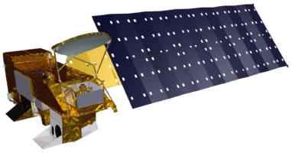
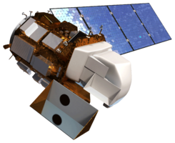
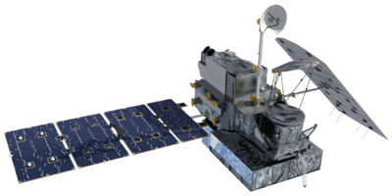
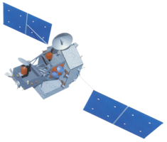
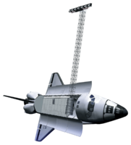
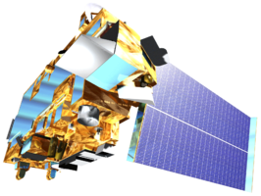
NASA Earth Observations
Aqua: Relative Humidity
Landsat 8: Imagery
GPM: Precipitation
TRMM: Precipitation
SRTM: Elevation
Terra: Land Surface Temperature
Aqua MODIS
Landsat 8 OLI
GPM GMI
TRMM TMI
SRTM IFSAR
Terra MODIS
Images: NASA
Notes:
We used several of NASA’s satellites to serve as inputs into the Maxent model of palm oil plantations. Each satellite provided valuable input data to help model plantation locations based on earth and environmental features.

Slide 9
Risk Map
Future growth of palm oil plantations will likely occur in XXX areas
Notes:
Using the results of modeling known palm oil plantations, we modeled areas most at risk for future palm oil plantations in Central Kalimantan.
The results show that the areas most at risk for palm oil plantations are those located in I DON’T KNOW WHERE.
This map is helpful since it shows expected future palm oil plantations in both conserved areas and areas that are marked for development.
(Image 1: highlight plantations in conserved areas)
(Image 2: highlight plantations in areas not marked for conservation)
WWF can use this map to show local government officials the conserved areas most at risk for future deforestation and help to better target resources.
This map can also be used by the government to better direct palm growers to prime palm oil plantation land that is not in conserved areas

Slide 10
Analysis
Statistics on robustness of results
Notes:
Compare training data to actual data
Use image classification in ENVI to check against our results

Slide 11
Conclusions

Slide 12
Errors & Uncertainties
Notes:
Data issues, resolution issues.

Slide 13
Future Work
Expand scope of work to Kalimantan
Notes:
Future work can expand on our project and extrapolate our findings to the entire island of Kalimantan, Indonesia. By using our results to model current locations of palm oil plantations in Kalimantan, WWF and other NGOs can better target their resources over a wider range, thus curbing deforestation of conserved areas and reducing biodiversity loss.

Slide 14
Advisors
Dr. Naikoa Aguilar-Amuchastegui, WWF (Science Advisor)
Aakash Ahamed, USRA/GSFC (Science Advisor)
Partners
World Wildlife Fund
DEVELOP Staff
Sean McCartney, SSAI/GSFC (DEVELOP Center Lead)
Notes:
We would like to acknowledge both Dr. Naikoa Aguilar-Amuchastegui and Aakash Ahamed for their advice and guidance over the course of this project.
We would also like to thank World Wildlife Fund for partnering with NASA DEVELOP to bring this project to life and for advising us throughout the project.
Lastly, we would like to thank Sean McCartney at DEVELOP his help and guidance throughout the course of this project.

