Slide 1
North Carolina Water Resources
Utilizing NASA Earth Observations to Monitor Harmful Algal Blooms in the Albemarle and Pamlico Sounds of North Carolina
Chad Smith (Project Lead)
Jelly Riedel
Keith Benjamin
Daniel Wozniak
Matthew Carter

Slide 2
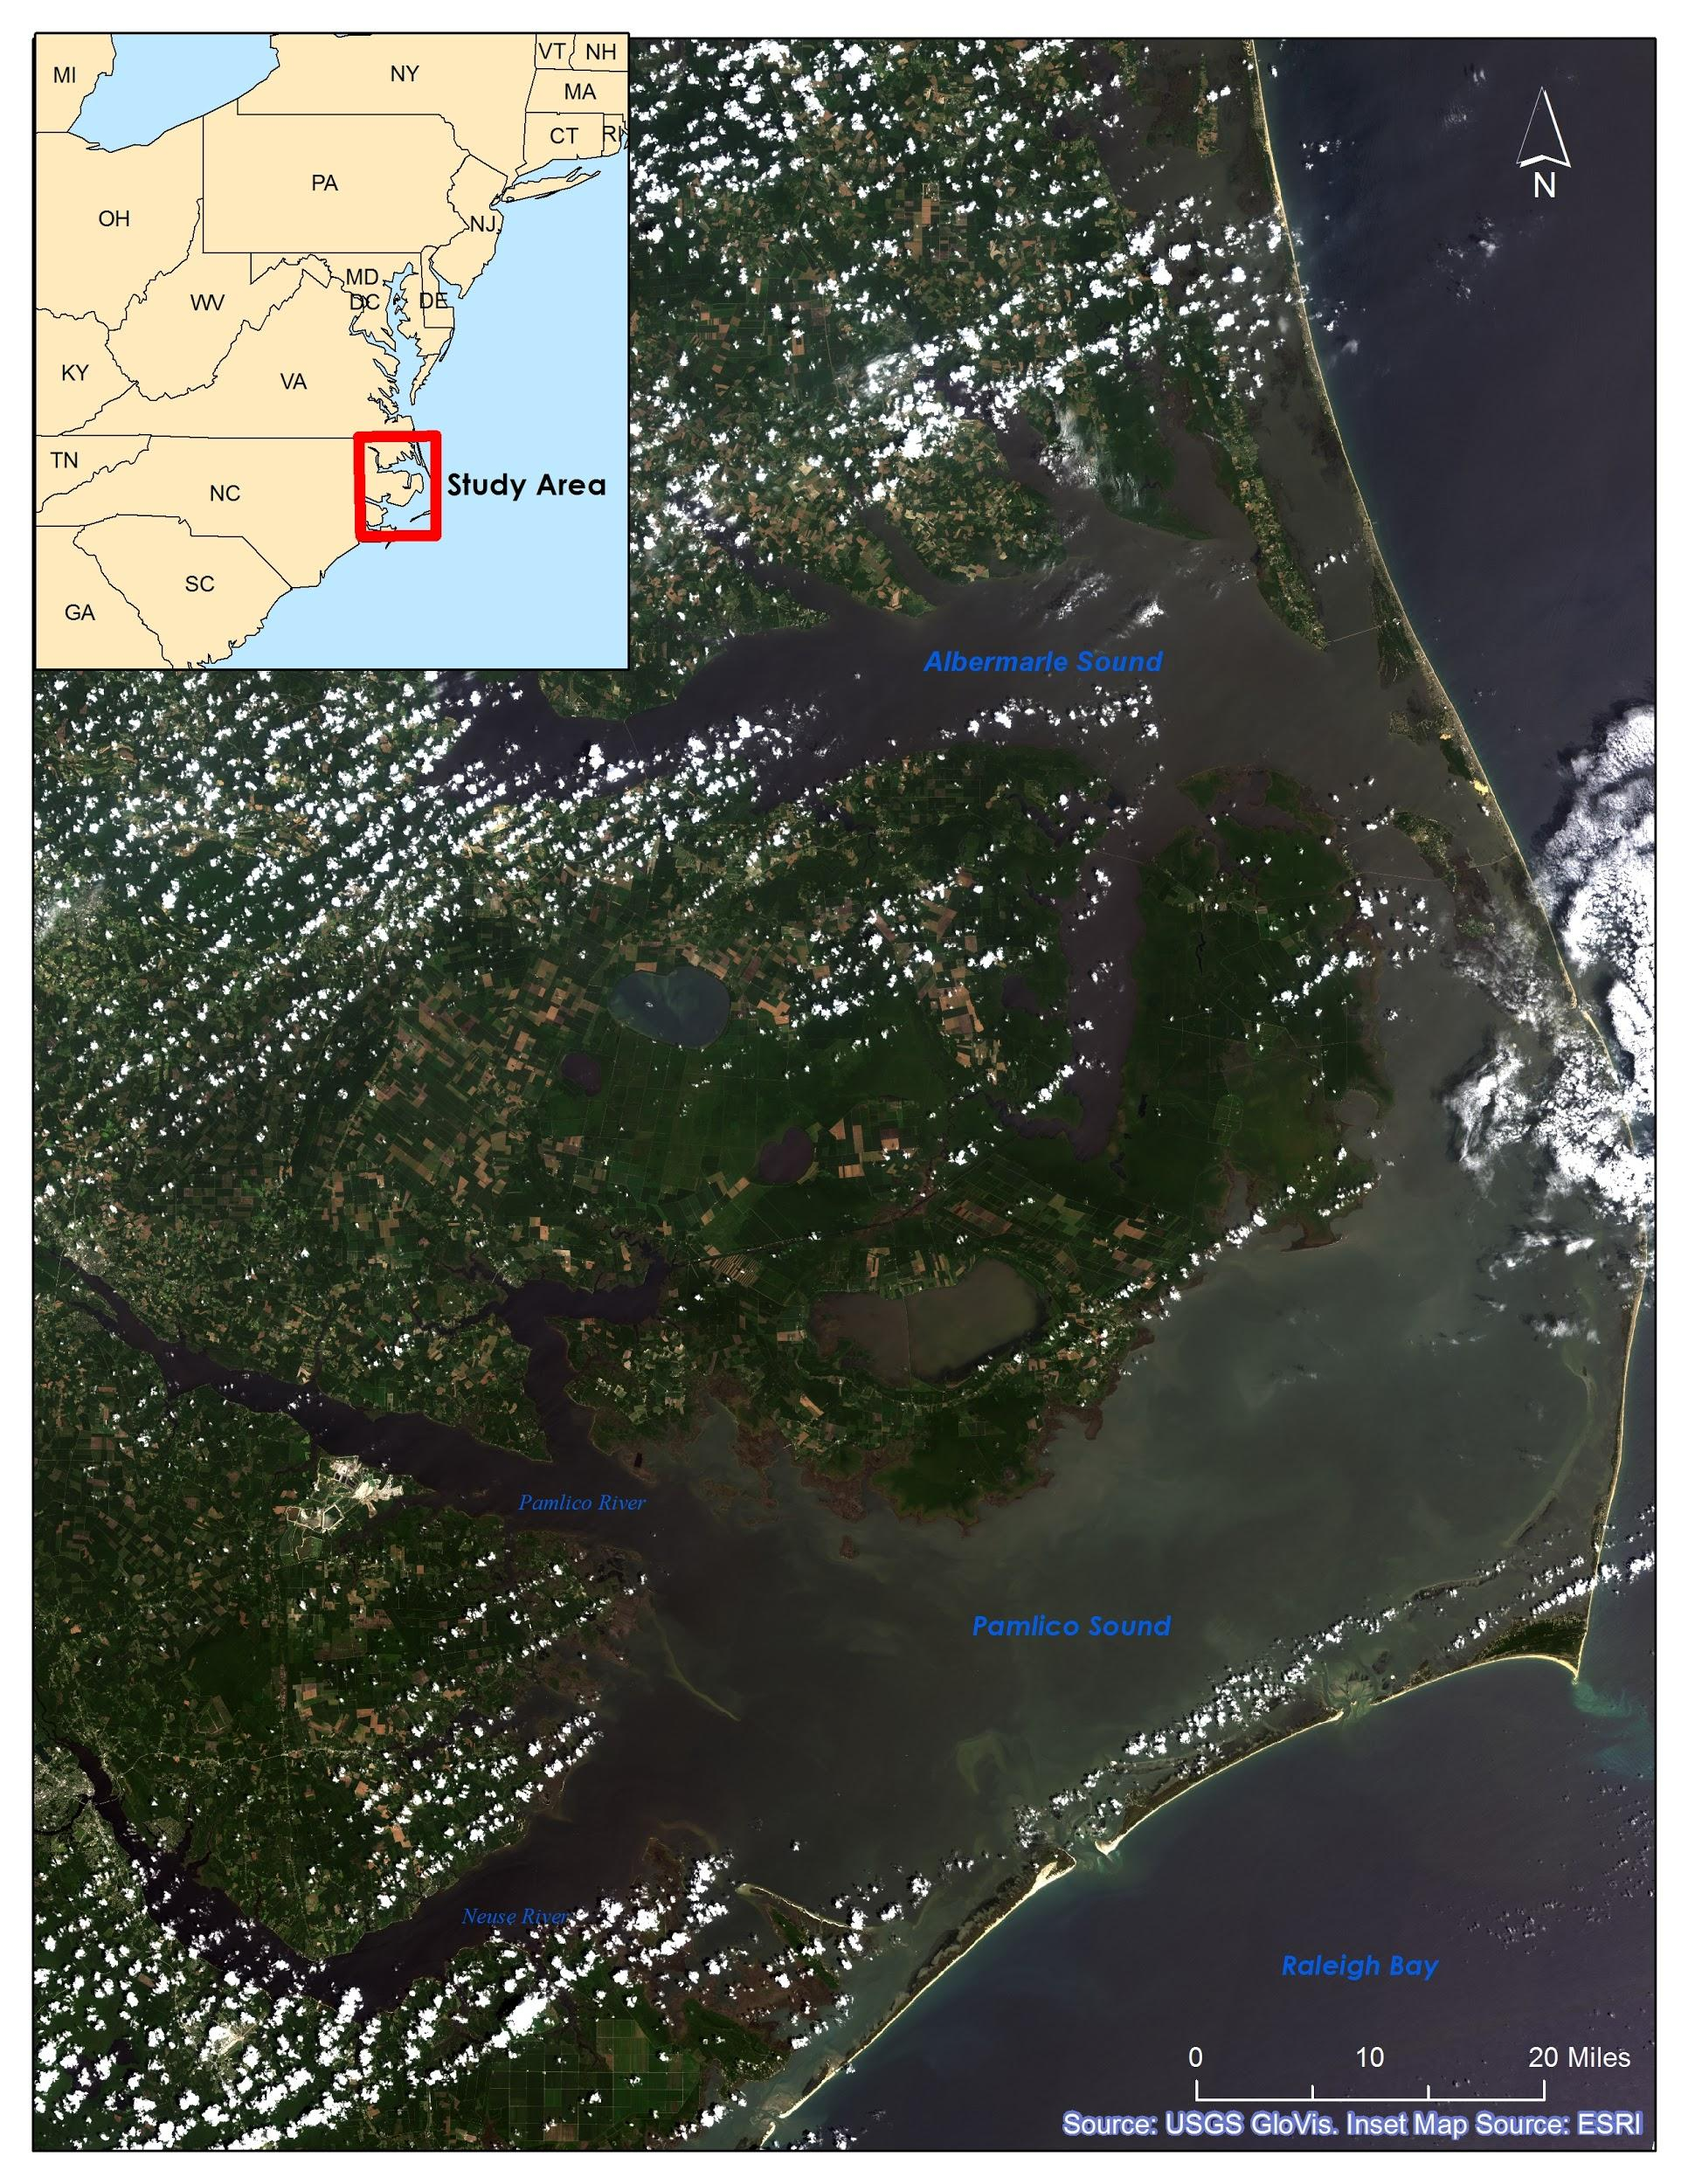
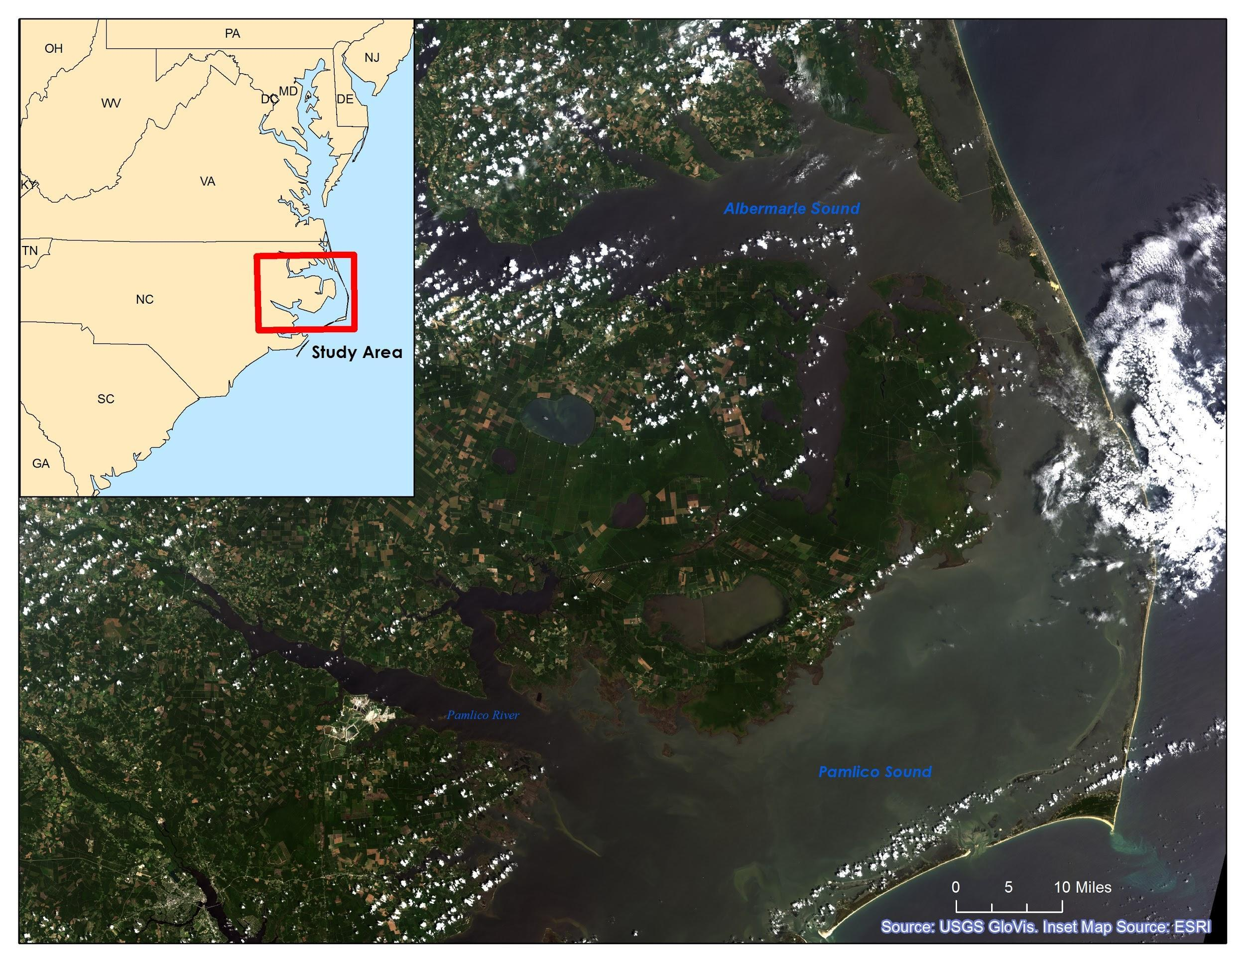
Community Concerns
Why are the Albemarle and Pamlico Sounds so important?
The Albemarle-Pamlico National Estuarine Complex is the 2nd largest estuary in the United States
Contains 99% of the Atlantic coast’s submerged aquatic vegetation outside of Florida
Supports one of the nation’s richest fisheries
Valuable for its appeal to recreational sportsmen and tourists
Notes:
I think this map looks too dark. We can replace it with a lighter image. I can mess with the symbology in the raster to make it appear lighter.

Slide 3
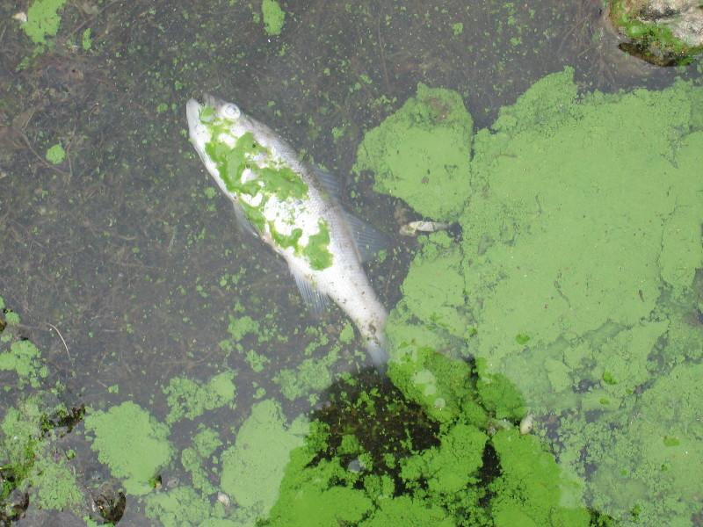
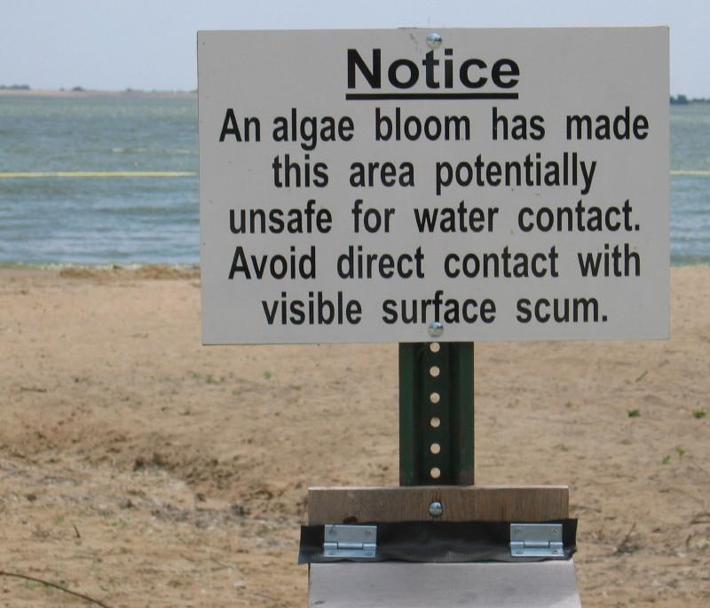
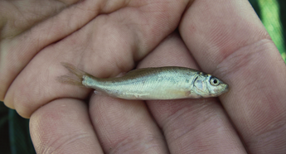
Community Concerns
Dangers of Harmful Algal Blooms (HABs):
Production of various toxins in concentrations lethal to wildlife and domestic animals
Adverse human health effects
Hypoxic zones
Reduced light availability in water column for submerged aquatic vegetation
Source: USGS
Source: USGS
Source: USGS

Slide 4
Project Partners
Dr. Michelle Mooreman, Biologist
USGS North Carolina Water Science Center
Jim Hawhee
Dean Carpenter
Dr. Bill Crowell, Director
Albemarle-Pamlico National Estuary Partnership (APNEP)

Slide 5
Project Objectives
Create a 10 year time-series representation of HAB extent from 2004 to 2014 using Chl-a as a proxy for algae
Compare MODIS-derived HAB maps with in situ water sample data provided by USGS North Carolina Water Science Center
Provide end-users with informational maps displaying HAB spatial extent on a large scale

Slide 6
Project Methodology
NASA Earth Observations:
Data Acquisition:
Landsat 8 OLI
Landsat 7 ETM+
Landsat 1-5 MSS
USGS Glovis
Source: NASA
Aqua MODIS
Level 2 Data
GSFC Ocean Color
SeaDAS
Source: NASA
In situ Data:
USGS Water Sample Data & Station Locations
USGS North Carolina Water Science Center & NWQMC
Source: USGS

Slide 7
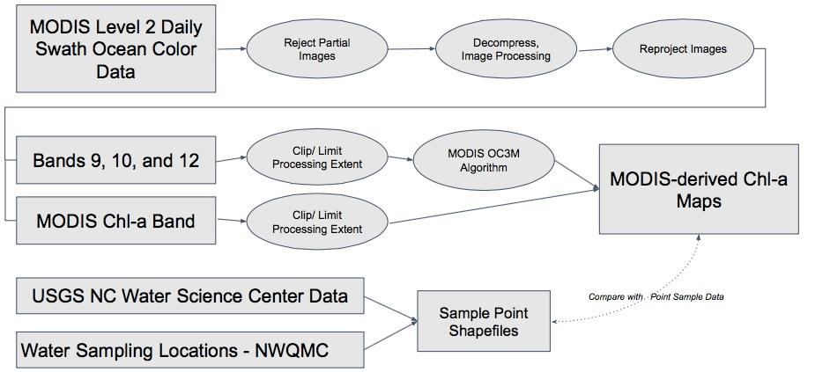
Project Methodology

Slide 8
Results
Results- our chl-a maps did/did not appear to match water sample data in a non-qualitative analysis of accuracy
Discussion
Uncertainty/Error Analysis- many different algorithms to determine chl-a from MODIS

Slide 9
Conclusions
Conclusions
Benefits of Research- large extent of HAB monitoring and a historical record of HAB behavior
Any Future Work (if applicable)- regression analysis to actually validate the model. Also to investigate relationships between chl-a concentration and other water quality factors (dissolved O2, N, P, etc)

Slide 10
Acknowledgements
Advisors- Dr. Kenton Ross
Partners-
Others -thanks Jeff
This material is based upon work supported by NASA through contract NNL11AA00B and cooperative agreement NNX14AB60A.

