Slide 1
Colorado Agriculture
Mapping Forest Species Composition at the Colorado State Forest using Landsat for Integrative Spatial Modeling
Brian Woodward
Sarah Carroll
Eric Rounds
Nicholas Kotlinski

Slide 2
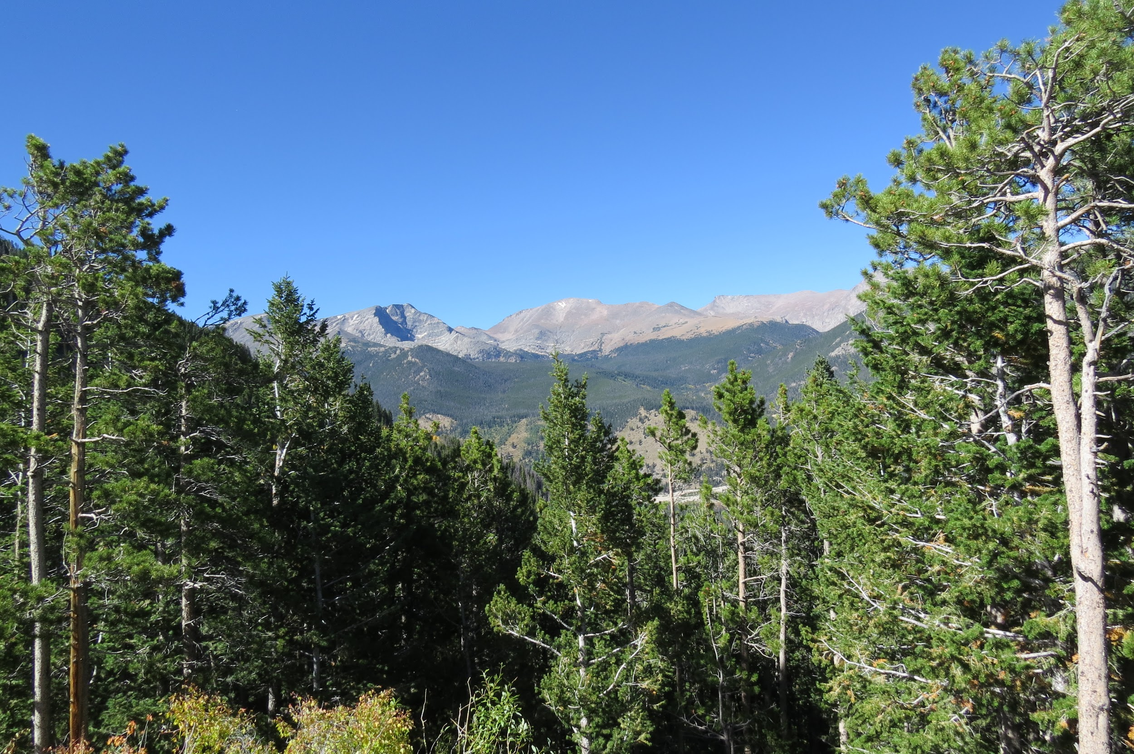
Community Concerns
Meeting Colorado State Forest natural resource, wildlife, and recreational management objectives
Tracking dynamics of forest health (beetle kill, wildfire, and harvests)
BANR - Assessing potential inventory of biofuel feedstocks
Image Credit: Sarah Carroll
Notes:
Park Management is actively managed for timber, recreation, wildlife, and grazing. An accurate and up-to-date map of species composition is needed to manage for this diverse range of objectives. A map of species composition can Additionally, communities in the Rocky Mountains are concerned about potential severe fires, aesthetics, and falling dead trees as a result of the recent mountain pine beetle epidemic.
Beetle Kill outbreak in Colorado has left many acres of dead trees. In 2014 alone, over 800,000 trees in the state were impacted by insect or disease activity. Understanding how forests will recover and predicting future at risk areas for outbreak could be improved and aided with baseline species composition maps. Recovery trajectories can be predicted by pre-outbreak composition
BANR- A map of species composition could be used by BANR to map live and dead biomass as they assess the location and quantity of potential feedstock for biofuel

Slide 3
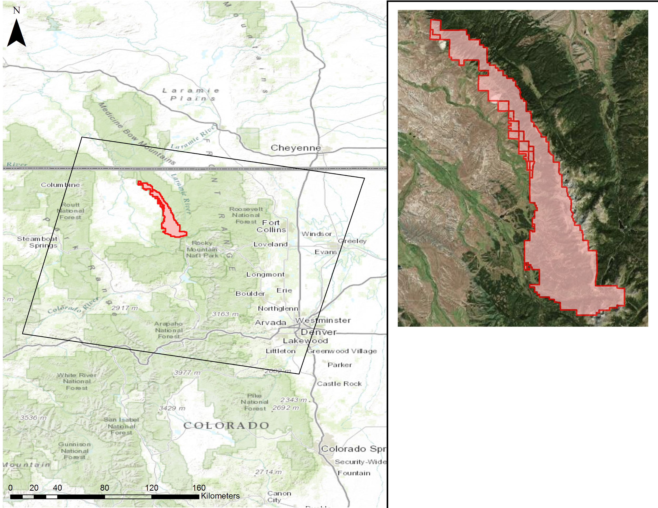
Study Area & Time Period
Location
Colorado State Forest
Time Periods
2014 – Post-Beetle Kill
2002 – Pre-Beetle Kill
Focal Species
Lodgepole Pine
Subalpine Fir
Engelmann Spruce
Aspen
Notes:
The study area focuses on the Colorado State Forest in north-central Colorado, which stretches across 70,000 acres through Jackson and Larimer counties. The area was established as a state park in 1970 and is now actively managed by Colorado Parks and Wildlife, Colorado State Forest Service and other partners. Elevation in the park ranges from approximately 2500 to nearly 4000 meters and more than seventy percent of the acreage is covered with coniferous forests ( Colorado Parks & Wildlife). The montane forests are dominated by Lodgepole pine (Pinus contorta), and fir-spruce communities in the subalpine zone including Douglas fir (Pseudotsuga menziesii), Engelmann Spruce (Picea engelmannii), subalpine fir (Abies lasiocarpa) , and aspen (Populus tremula) ( Wiken et al., 2011).
World Imagery Basemap Source: ESRI, Digital Globe
World Topo Basemap Source: ESRI

Slide 4
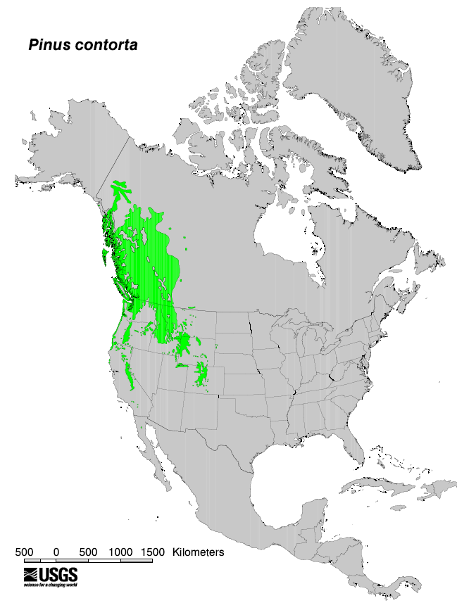
Objectives
Refine species composition maps for use by our project partners
Employ a novel zero-inflated (ZI) regression tree model to identify the location and extent of tree species composition within the Colorado State Forest
USGS, Pinus contorta Species Distribution Map
Notes:
The main objective of the project is the creation of a species composition map for use by our project partners in Colorado State Forest. This is novel because while previous projects and published works have integrated free medium-resolution imagery with other types of high resolution, and often expensive, sensors such as LIDAR, this project aims to utilize only freely available satellite imagery in combination with reference data to map tree species composition within the study area.
To aid in this project, we aim to utilize a novel zero-inflated model developed by researchers at the University of Montana to help enhance the reference data and imagery to accurately predict species distribution by canopy cover. This model is still being developed and our use of it provides an additional case study to test its feasibility and accuracy in temperate mountain environments.
Image: USGS, Pinus Contortus Species Distribution Map, http://esp.cr.usgs.gov/data/little/

Slide 5
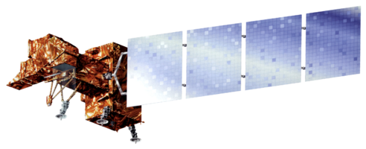
Data Acquisition
Platform | Data Product | Resolution | Source
Landsat 8 | OLI, TIRS | 30m | USGS Earth Explorer
Landsat 7 | ETM+ | 30m | USGS Earth Explorer
Landsat 5 | TM | 30m | USGS Earth Explorer
SRTM | Digital Elevation Model | 30m | USGS Earth Explorer
NAIP | Aerial Imagery | 1m | USDA
Reference Data | 2014-2015 Field-plot data | Excluded harvested plots
Notes:
In order to replicate the data used by Savage/Lawrence we gathered Landsat data for four different summer dates, with two scenes acquired for 2002(July & August) and two for 2014 (July & September). Also, SRTM data was downloaded from USGS Earth Explorer, providing us with a 30m DEM that we then used to create aspect and slope rasters .

Slide 6
STACK A (2014)
STACK B (2002)
Model Image Stack Band Number | Landsat (Year - Band) / Raster Data Set OLI
1 | July 2014 - Blue
2 | July 2014 - Green
3 | July 2014 - Red
4 | July 2014 - NIR
5 | July 2014 - MIR1
6 | July 2014 - MIR2
7 | July 2014 - TIR1 (Thermal)
8 | July 2014 - TIR2 (Thermal)
9 | September 2014 - Blue
10 | September 2014 - Green
11 | September 2014 - Red
12 | September 2014 - NIR
13 | September 2014 - MIR1
14 | September 2014 - MIR2
15 | September 2014 - TIR1 (Thermal)
16 | September 2014 - TIR2 (Thermal)
17 | SRTM DEM (30m)
18 | Slope
19 | Aspect
20 | NAIP Texture Mean
21 | NAIP Texture Minimum
Model Image Stack Band Number | Landsat (Year - Band) / Raster Data Set July (TM ) / August (ETM+)
1 | July 2002 - Blue
2 | July 2002 - Green
3 | July 2002 - Red
4 | July 2002 - NIR
5 | July 2002 - MIR1
6 | July 2002 - MIR2
7 | July 2002 - Thermal
8 | August 2002 - Blue
9 | August 2002 - Green
10 | August 2002- Red
11 | August 2002- NIR
12 | August 2002 - MIR1
13 | August 2002 - MIR2
14 | August 2002 - Thermal
15 | SRTM DEM (30m)
16 | Slope
17 | Aspect
18 | NAIP Texture Mean
19 | NAIP Texture Minimum
Notes:
Here are the two most recent image stacks used to run through the second step of the model. The two stacks were used to capture any differences between pre- and post-beetle outbreak on species identification in the model. Combinations based on specifications from Savage et al. (2015)

Slide 7
Step 1 Model Input & Purpose
Image Credit: Elizabeth Reiling, BANR
Step 1 runs statistics on all possible combinations of reference data
Selected Reference Data:
Only Non-Harvested Plots
All Trees (Live + Dead Combined)
Live Trees Only
Dead Trees Only
Reference data:
percent canopy cover (PCC) by species using field-plot data
Notes:
First, we run step 1 of the model. The statistical results of step 1 provides both an indicator of dataset reliability, but also a way to choose the model that fits the data the best. Based on this information you choose your model for the step 2 map output. In this case we used Savage et al’s (2015) model selection which was already written into the R code. Because the two study areas were similar in species composition and environmental factors we felt that changing the model was unnecessary. Moreover, Savage et al had great results and we attempted to reproduce their accuracy by using the same model. However, we did run several variations in the data [as seen on the slide].

Slide 8
Step 1 Model Output
Ten-fold cross validation model and Wilcoxon’s signed-rank test
Notes:
The Resulting output is a spreadsheet of statistical from a Wilcoxons signed-rank test and 10-fold cross validation for each model to test how accurately our model is performing in its predictions. So each model is run 10 times, and each time, a random 25% of the data is excluded. This effectively creates 10 sub-samples in our dataset where each subsample is used once for validation, and all of the observations in the data set are used as training data for the model and statistical validation. The average of the 10 outputs can then be used as a single estimation for our desired statistics. In this case, it is the combination of the SVM.RF model from Savage 2015 was performed. The Wilcoxon’s signed-rank test, which is a test used for paired data sets with some assumptions, but no assumptions of normality or distristribution. So all parameters for this model are determined and added by the training data we input.
In this case the statistics we are most focused on are the confidence interval width, and the RMSE (This model uses a 95% confidence interval).
So when selecting a model that performed well, we are looking for a reasonable confidence interval size, (the smaller value the better), and then we want to look across and make sure the root-mean-square-error (RMSE) is also a reasonably small value in the context of our data. Since we are predicting percent canopy cover from 10-100, nearly 10% error is not outstandingly bad. The RMSE statistic supplements the mean difference used to create the CI

Slide 9
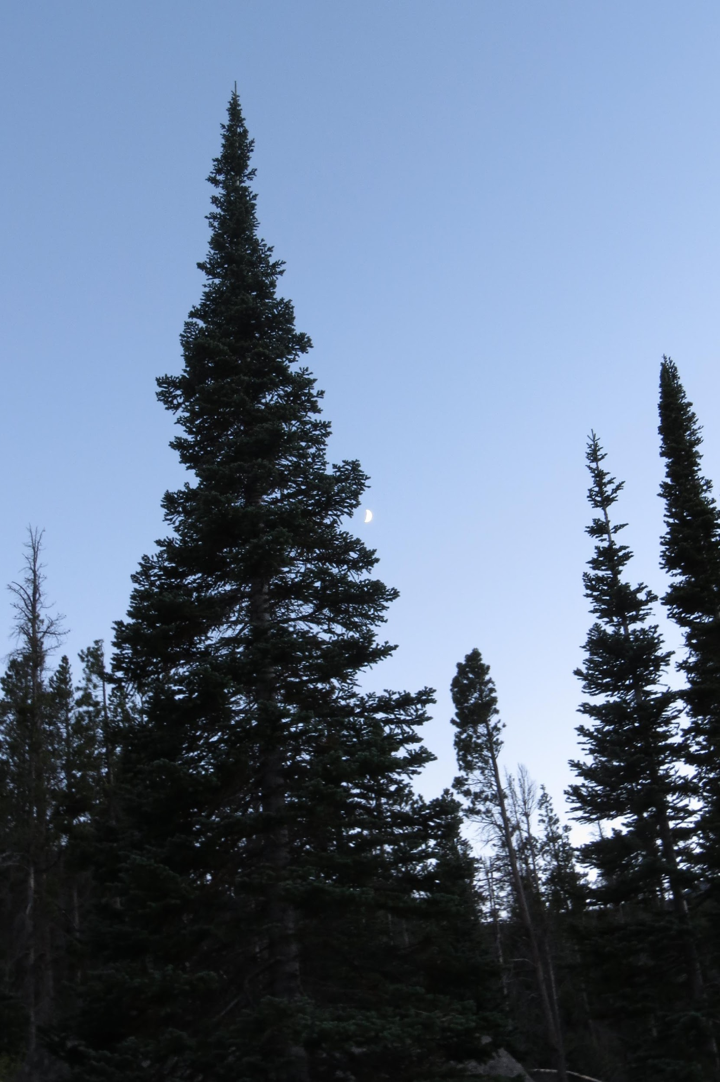
Step 2 Model Input and Processing
Model Inputs:
Image stack
One reference data spreadsheet per model run
Percent canopy cover map outputs:
All trees (live and dead) [4]
Live trees only [4]
Dead trees [1]
Dead lodgepole (2014 only) [1]
# - denotes output maps and corresponding
reference data sheets
Image Credit: Sarah Carroll
Notes:
Each run of model 2 requires two data files: the compiled image stack and a single species reference sheet for each run through the model.
For our purposes we have decided to test the accuracy of a variety of data combinations. 1. A collection of all live and dead trees for each species 2. We also took all dead trees out of the previous dataset to run only live trees of each species 3. We compiled all dead trees into a single species type to attempt to unconfuse the model between live and dead 4. Because lodgepole makes up such a large percentage of forest cover in the study area, and dead lodgepole in particular, we created an individual species composed of dead lodgepole to further parse out dead trees from live.

Slide 10
Methodology & Step 2 Workflow
Reference data:
percent canopy cover (PCC) by species using field-plot data
Imagery: multi-band composite image from Landsat scenes and DEM
Preprocessing
Model Processes Inputs
Outputs
Input
reference data
for target
species
Step 1: Model (GLM) binary classification of study area for tree species
Presence = 1
Absence = 0
Output = BIN
Binary map
Create Combination map from BIN*CON with raster calculator
Output =
Presence
Data Only
Step 2: Regression model (SVM) of study areas
with Continuous Response
Output = CON
Continuous
Map
Final Output:
Continuous map
of each
target species
Notes:
At this point in our workflow, we have collected and organized reference data, and have compiled our multi-image and elevation derived data composites. Presumably we have selected the best model and reference data combination from step 1 as well. Now we run step 2 of the model which runs as follows [quickly go through slide].

Slide 11
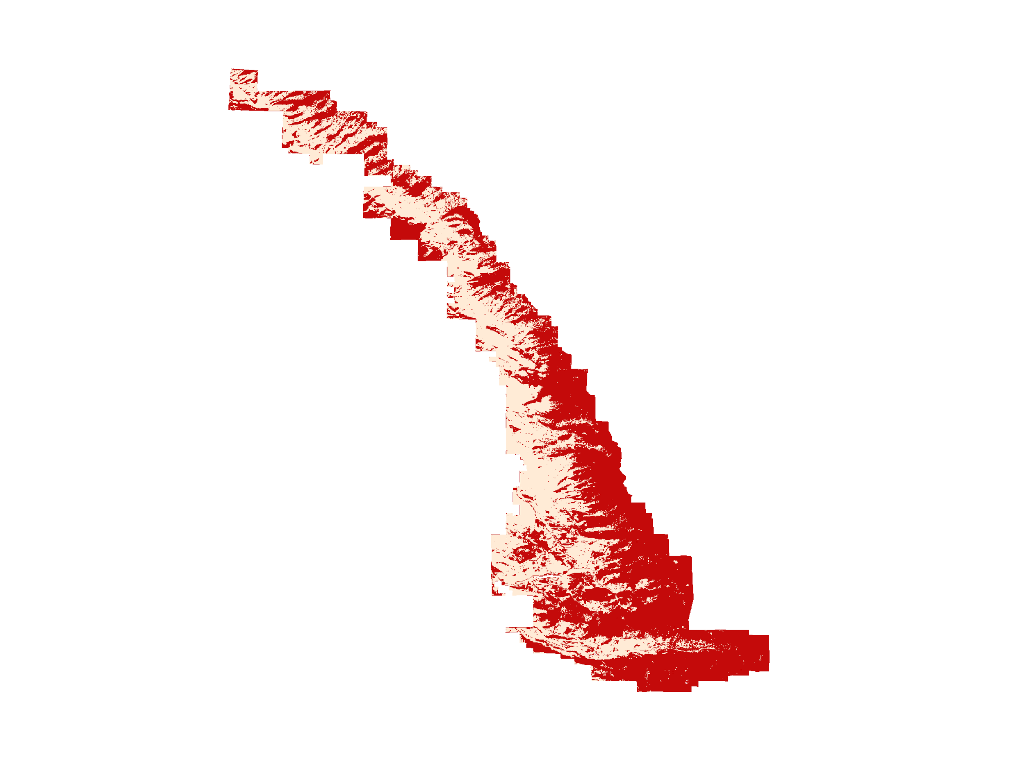
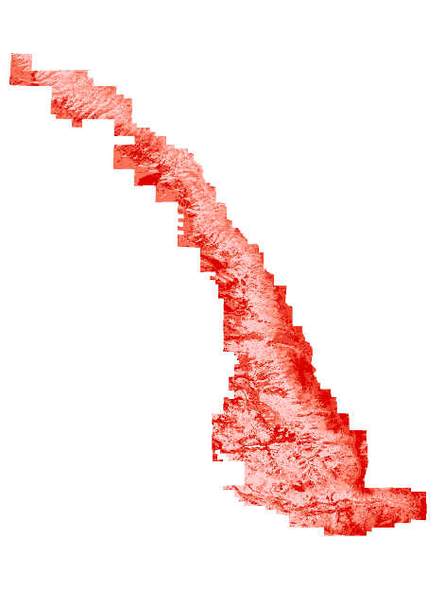
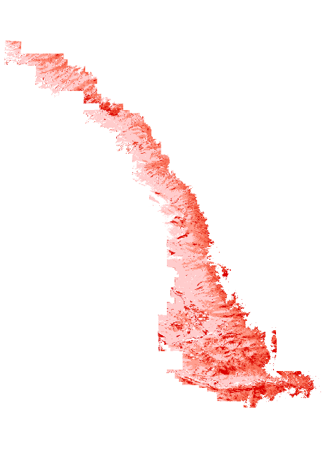
Step 2 Model Output Post-Processing
Binary (BIN)
Continuous (CON)
Combination
(BIN*CON + Forest Mask)
Notes:
The step 2 model binary and continuous output for each species were loaded into arcmap and the binary and continuous rasters were combined using raster calculator and the resulting raster was clipped to a forest/non-forest mask for a final raster output of percent canopy coverage by species

Slide 12
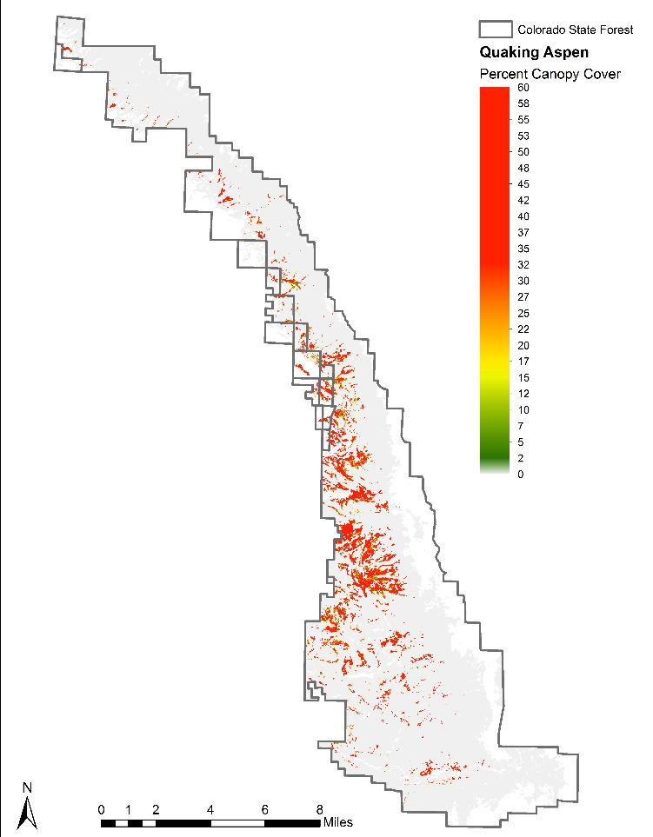
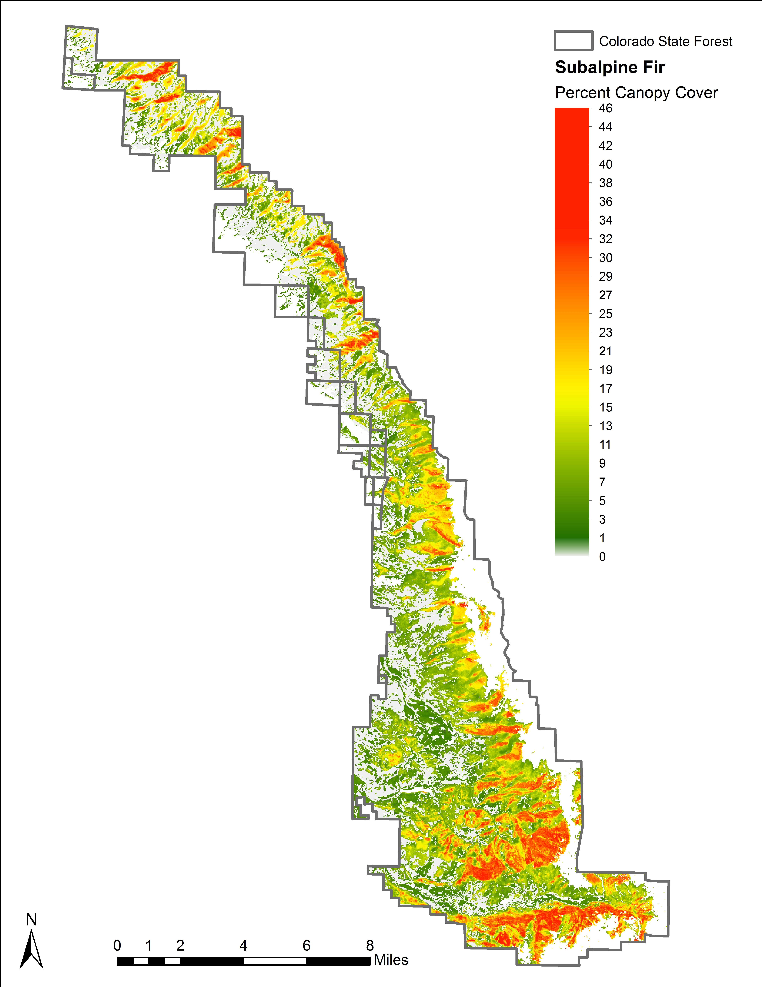
Results
Notes:
Here we have the final map outputs for 2014 for Aspen and Subalpine Fir with percent canopy cover shown as a color ramp. (1) The maps are of continuous output of species canopy cover percentage throughout the entire study area which shows the highest percent cover to the lowest. Here, subalpine fir shows a maximum cover of 46%, which is in line with maximum percentage for fir from Savage et al. (2015) (43%). You can see that the prediction for Aspen shows that Aspen only appears when the canopy cover is over ~30%. For Fir we have a far greater range of predicted canopy cover, but the maximum percent canopy cover of 45% is present in locations where we would expect to encounter Fir.

Slide 13
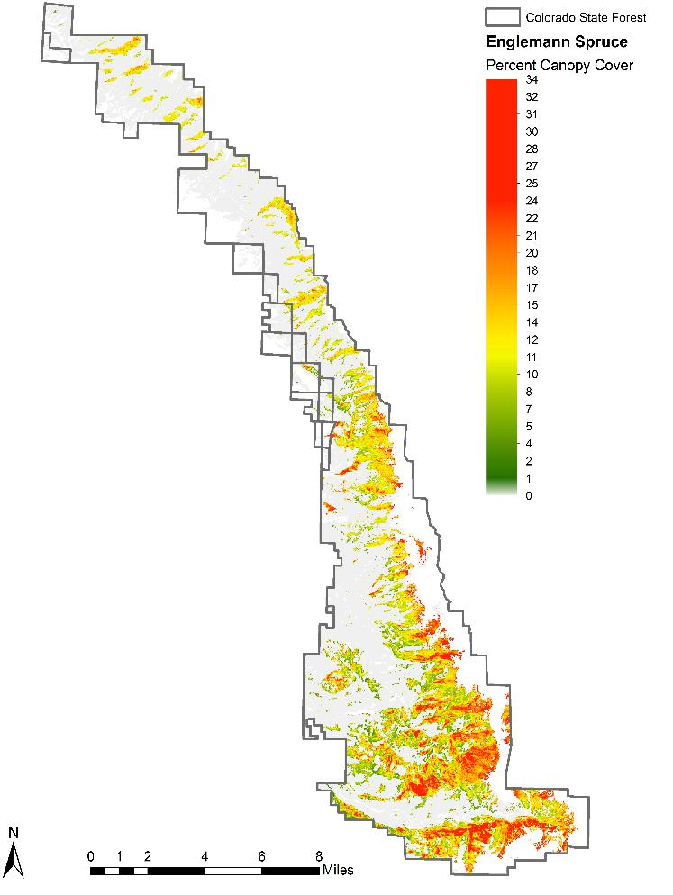
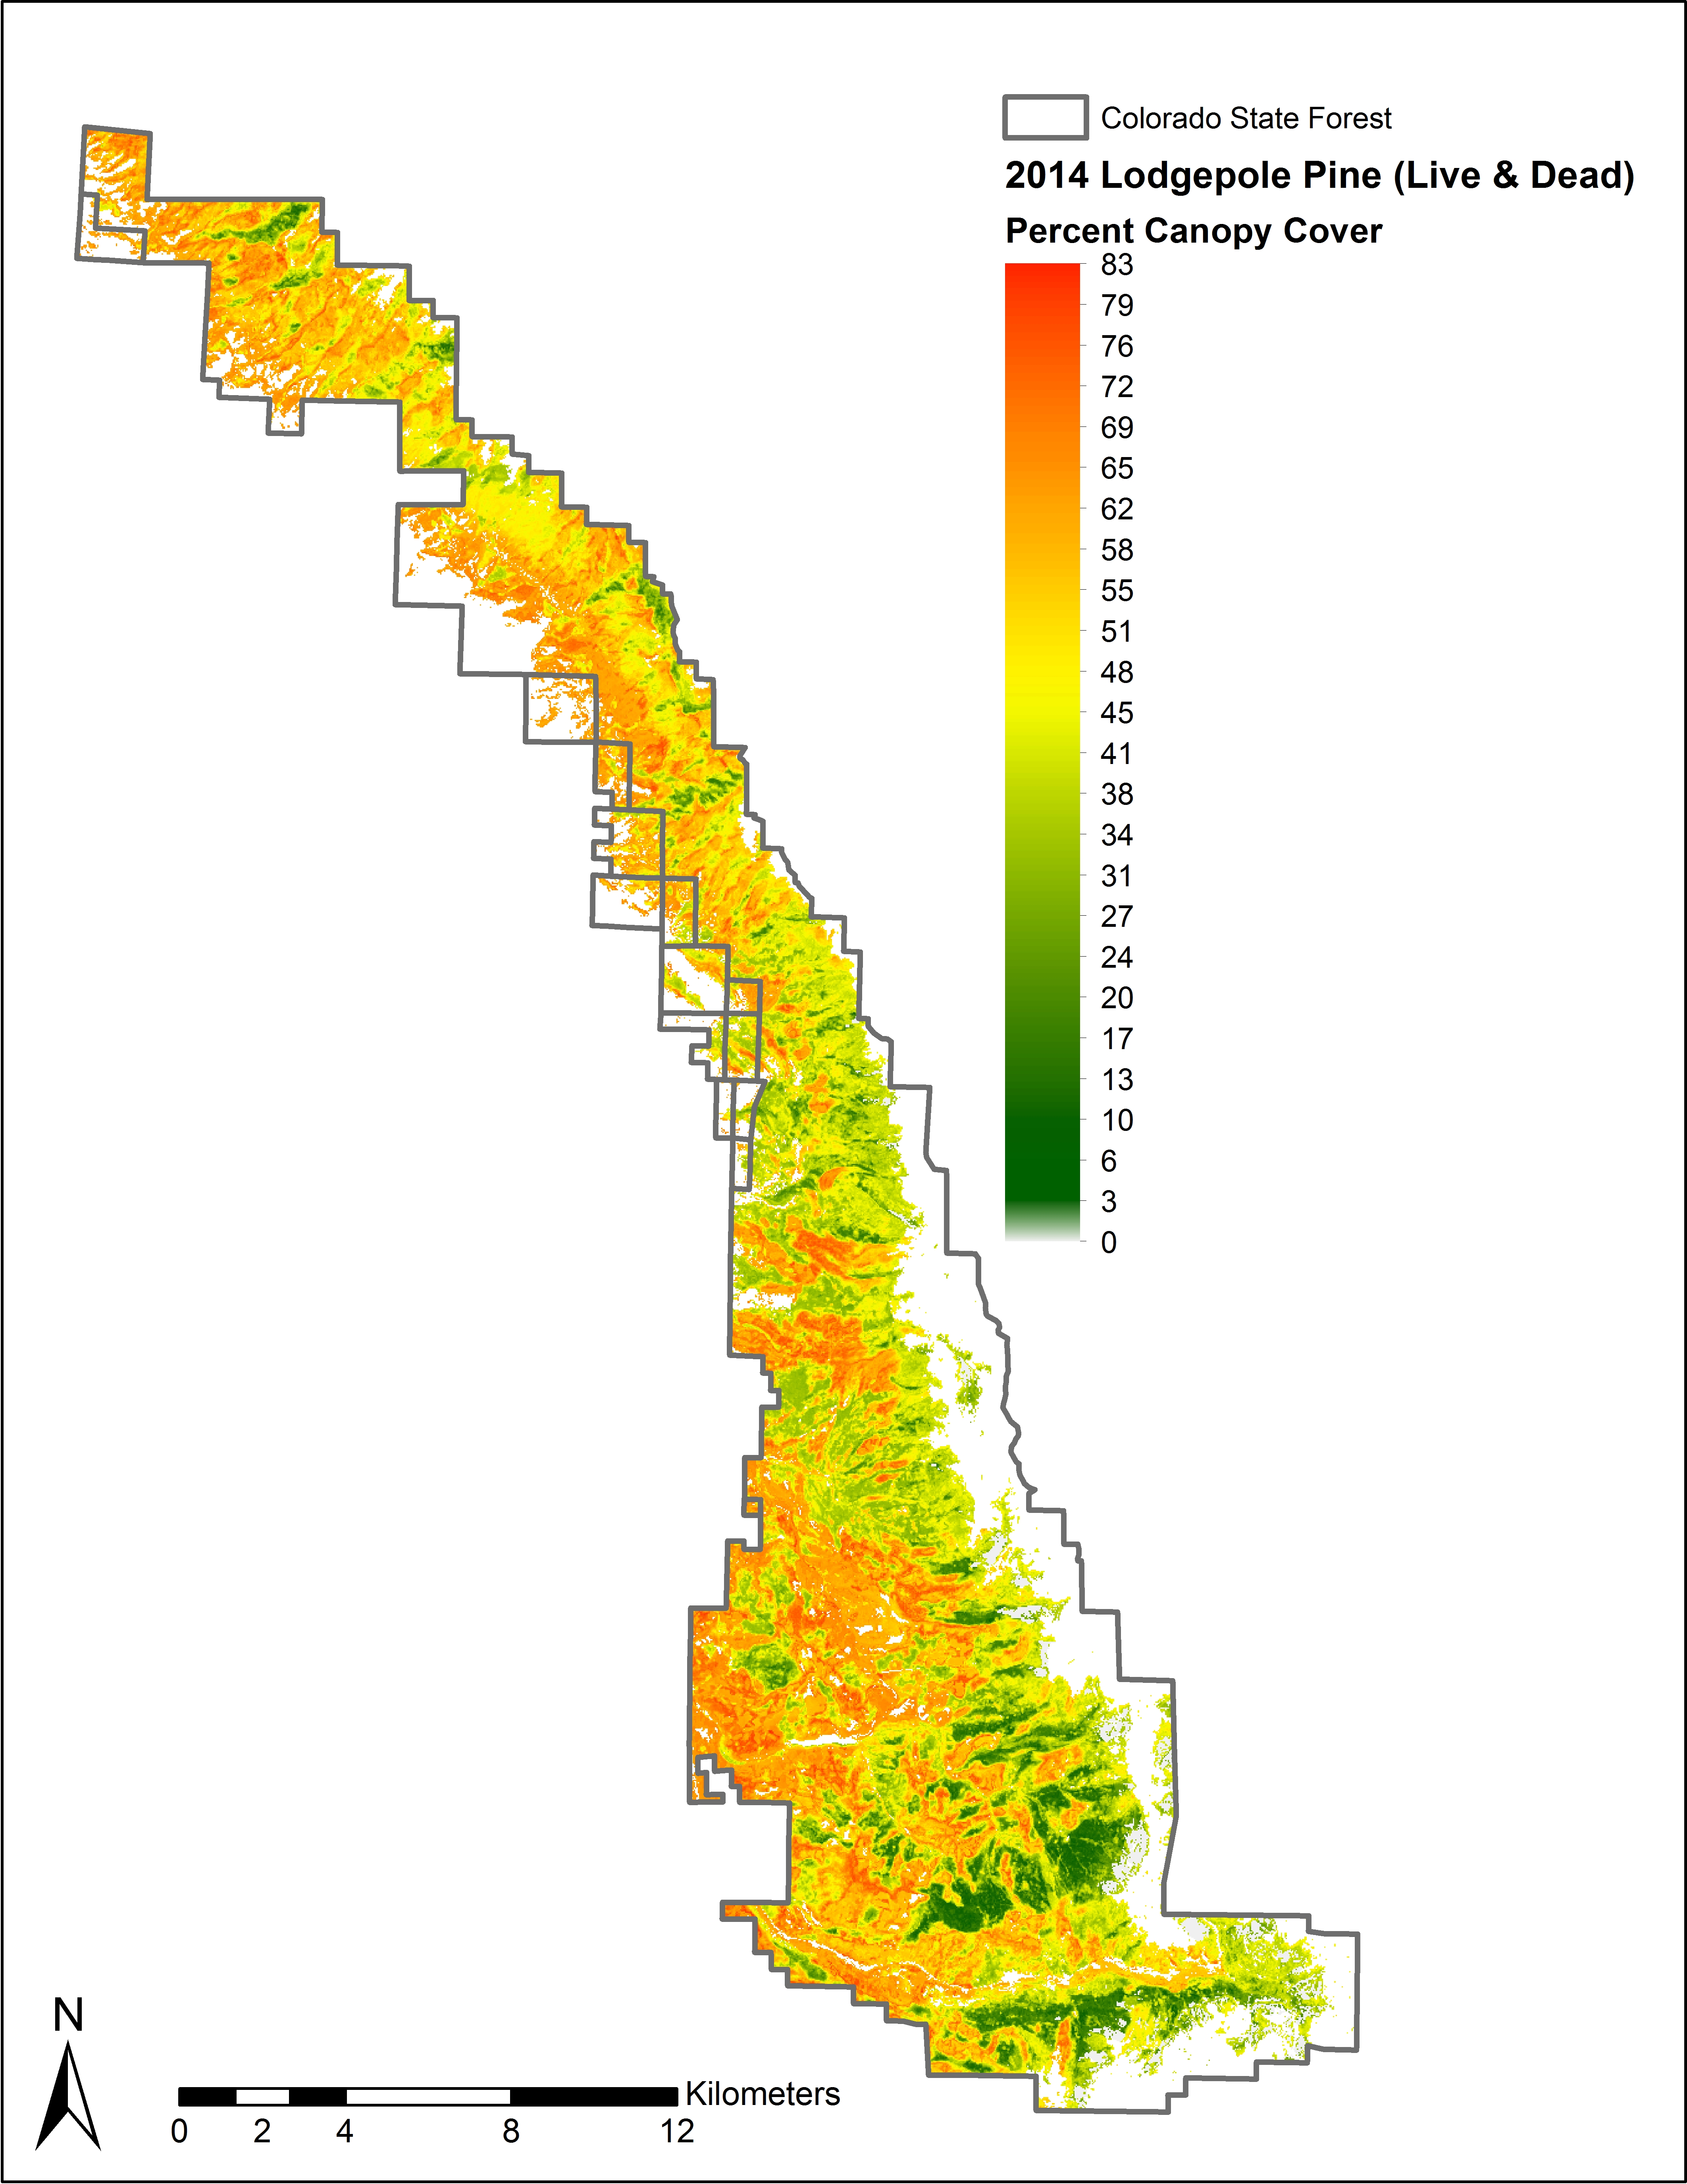
Results
Notes:
Here are our other two focal species, Englemann Spruce, with a percent canopy cover maximum of 34%, and Lodgepole Pine at 55%. Again, these continuous cover maps highlight total possible coverage of species within the study area, but also accurately highlight the most likely maximum canopy coverage to spatially specific locations that we would expect to find these species.

Slide 14
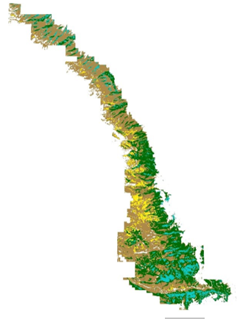
Results
Notes:
We also chose to visualize only the highest percentage of canopy cover of each species to create a simple to understand species composition map of the study area, since species are often most identifiable based on geographic location. While some species overlap based on the continuous map, here the species location is based on which species possess the highest percent canopy cover for a given pixel; giving forest managers with a detailed, yet easy to use species composition map.

Slide 15
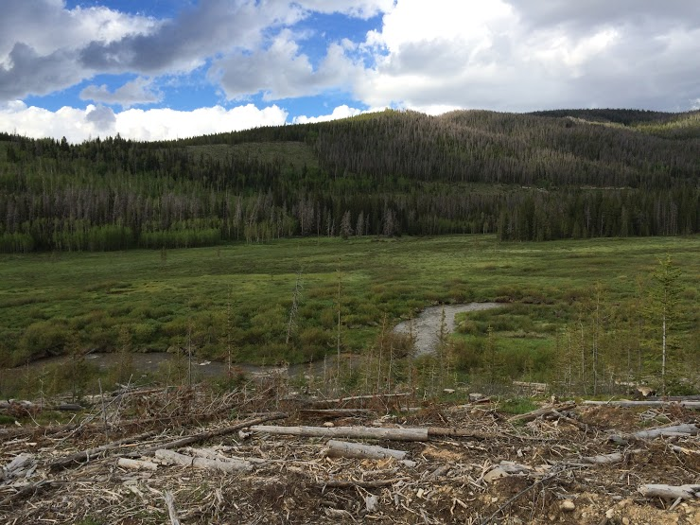
Errors & Uncertainties
Inaccuracies using medium-scale resolution imagery
Small sample of reference data
Dead trees in study area may
confuse model
Potential for improved results
from other statistical models
Image Credit: Eric Rounds
Notes:
Some final thoughts on possible errors and real uncertainties, include:
1. Inaccuracies in species identification using medium-scale resolution imagery – this is something the model and field reference data was meant to address, but limitations still exist
2. Small sample of reference data for model training may be insufficient (67 plots versus +300 plots) – Savage et al., which we modeled our research off of utilized far more reference data, and had a sample available for accuracy verification, which this study didn’t have. In addition a small sample size means that model outputs have lower accuracy.
3. High volume of dead trees in study area may confuse the training data and spectral signatures affecting species prediction
4. Potential of using other statistical models on output unknown – since the model was given to us with Savage et al.’s best fit statistics

Slide 16
Conclusions
The model provided improved percent canopy cover estimates at the pixel level for the four focal species at the Colorado State Forest
For any given pixel the percent canopy cover estimates by species were between 9-15% different from the average
Final products delivered
Four independent maps of percent canopy cover by species
A generalized species composition map based on dominant species cover in a given pixel
Species | Confidence Interval Width
Lodgepole Pine | ± 9 %
Subalpine Fir | ± 9 %
Engelmann Spruce | ± 11 %
Aspen | ± 15 %
Notes:
The project outputs show that not only did the model adequately map species distribution, but more importantly, it provided improved percent canopy cover estimates at the pixel level for the four focal species at the Colorado State Forest, which had not been previously attempted.
Our confidence interval, which was our primary accuracy assessment at this time, proved to be within an acceptable range for use by forest managers: between ~9 – 15% from the average at the pixel level.
As you saw in the previous slides, we are please to be able to provide independent species canopy cover maps, as well as a generalized species composition map based on dominant species, to our project partners.

Slide 17
Acknowledgements
Advisors
Dr. Paul Evangelista, Colorado State University (CSU), Natural Resource Ecology Laboratory (NREL)
Partners
Tony Vorster, Bioenergy Alliance Network of the Rockies (BANR)
John Twitchell, Colorado State Forest Service (CSFS)
Others
Shannon Savage, Montana State University (MSU)
Notes:
We would like to thank our science advisor and project partners, as well as the researchers at Montana State University for their support of this project.

