Slide 1
Southern Idaho
Health & Air Quality
Monitoring Atmospheric Mixing Heights Post-Wildfire Through the Use of NASA Earth Observations
Ella Griffith, Ashwini Badgujar, Sean Cusick, Dan Giltz
Idaho – Pocatello
Notes:
Project and team member introductions
Team-created project image

Slide 2
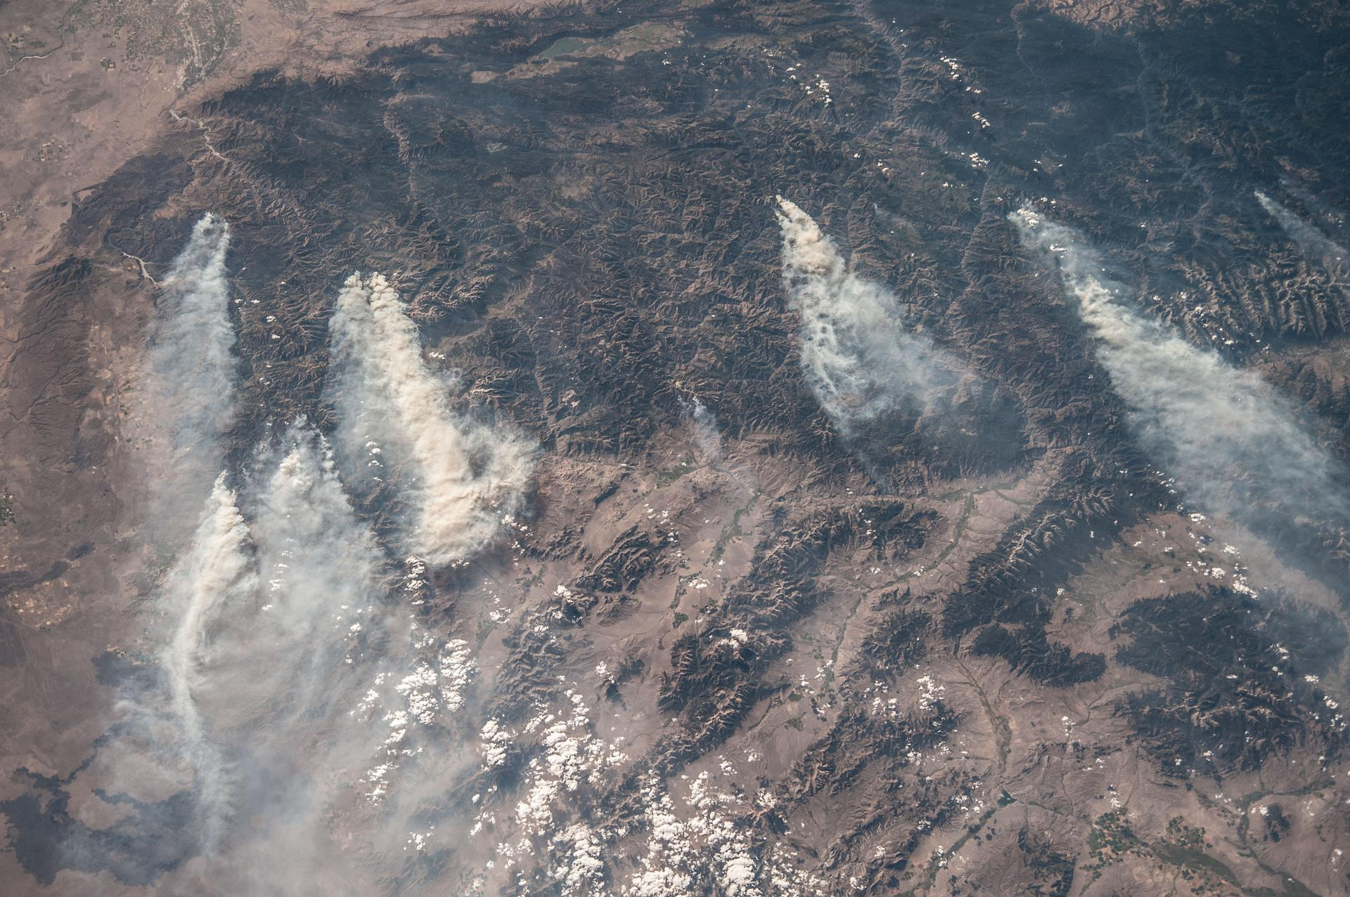
Project Overview
30 mi
N
Image Credit: NASA
50-mile smoke plumes blowing from west to east during wildfires in central Idaho in 2013, image taken aboard the International Space Station
Notes:
Across the United States, wildfires have disrupted communities and ecosystems alike. Smoke pollution from these wildfires, however, can have equally as devastating an impact on human and environmental health. Current methods to evaluate and predict smoke pollution are under-researched, but satellite imagery can provide more continuous and accurate coverage than current in situ methods. Using data from CALIPSO Vertical Feature Mask Granules, this project created a software tool that automates the process of calculating a value for the maximum height to which smoke plumes will rise into the atmosphere. The difference between the maximum height and the surface elevation is also referred to as the mixing height. As the smoke spreads through the mixing height, a larger mixing height will results in a smaller the surface concentration.
------------------------------Image Information Below ------------------------------
Image Credit: NASA/Fyodor Yurchikhin, Central Idaho Wildfires (NASA, International Space Station, 08/18/13)
Image Source: https://images.nasa.gov/details-iss036e032853 (

Slide 3
Project Partners
NOAA's National Weather Service Fire Weather Program
Bureau of Land Management Interagency Fire Center
National Park Service
Notes:
The team worked with the NWS, BLM and NPS. The NWS is looking to standardize the method in which smoke mixing heights are calculated and will be using the team's results to aid in the decision making process. The BLM and NPS are looking for more insight into which mixing height estimation method is most accurate in order to authorize prescribed burns. These deliberate fires are vital in reducing the fuel load of wildfires but the smoke poses the same risk to the public as wildfire smoke.

Slide 4
Background & Community Concern
Wildfire events have increased in frequency
Prescribed burning helps reduce fuel loads and
minimize fire danger, but is also a source of smoke
Atmospheric smoke is known to have adverse effects
on human respiratory and cardiovascular health
Notes:
1. Wildfire events have increased in frequency:
This is particularly true in the western U.S. where the number of wildfires has increased dramatically since 1950.
2. Prescribed burning helps reduce fuel loads and minimize fire danger, but is also a source of smoke
Land managers must base their go/no go decisions for prescribed burns on current smoke dispersal prediction methods while considering the consequences in areas that
may be located far from the actual burned area.
3. Atmospheric smoke is known to have adverse effects on human respiratory and cardiovascular health:
These health related issues place an additional burden on the already overwhelmed healthcare system in the United States.
Icons from ppt

Slide 5
Scientific Problem
No standardized method for predicting smoke dispersal
Lack of research in this area results in inconsistencies in forecasting between agencies and across state lines
The only relevant publication to date investigated four common calculations approaches
Fearon, Brown, & Curcio (2015)
Notes:
1. No standardized method for predicting smoke dispersal:
In the past, these have been based on atmospheric soundings.
2. Lack of research on this area results in inconsistencies in forecasting between agencies and across state lines:
Currently, different methods are used by different agencies and may even differ for the same fire if it crosses state lines.
3. The only relevant publication to date investigated four common calculations approaches:
Due to the high variation in the results of the different methods, a more reliable and consistent approach is needed.
------------------------------Image Information Below ------------------------------
•Image Credit: Matt Fearon
•Image Source: Fearon, M. G., T. J. Brown, & G. M. Curcio (2015). Establishing a national standard method for operational mixing height determination. J. Operational Meteor., 3 (15), 172-189. http://dx.doi.org/10.15191/nwajom.2015.0315.

Slide 6
Scientific Problem
Method of Mixing Height Estimation
Inconsistency & Errors
Stull
Excludes dynamic processes such as advection and turbulent flow
Holzworth
Assumes a dry atmosphere
Bulk Richardson
Excludes advection contributions such as heat & water vapor
Turbulent Kinetic Energy
Relies on predication models and
possible over estimation
Notes:
Without launching a balloon sonde directly into a smoke plume, there is not reliable way to obtain observed smoke mixing heights. The team focuses on common methodologies for mixing height estimations as shown above. The Stull and Holzworth methods use soundings to trace an air parcels trajectory as it is lifted through the atmosphere, but the Stull method excludes dynamic processes such as advection and turbulent flow and the Holzworth method assumes a dry atmosphere. The Bulk Richardson number method compares the ratio between buoyancy versus the wind shear and is used to determine if turbulent winds will result in upward vertical motion. The Turbulent Kinetic Energy method looks at how the kinetic energy of the environment changes over time. For this project the team used another form of the equation which looks at how buoyancy, advection and pressure gradients change the kinetic energy.

Slide 7
Project Objectives
ANALYZE
VALIDATE
AUTOMATE
Use CALIPSO Lidar data to calculate observed mixing heights of historic wildfires
Compare observed data with mixing height estimation from different prediction methods
Provide project partners with a tutorial on how to better estimate mixing heights for future wildfire events
Notes:
1. This project had three main objectives: First, the team worked to produce observed mixing height data by processing and analyzing CALIPSO aerosol data across smoke plumes from historic wildfires. Since there is very little verified mixing height data, these observations are very valuable to the project partners.
2. Second, the team aimed to compare these observations with past mixing height estimations from the National Weather Service to validate the accuracy of the predictions. This will help determine a uniform mixing height estimation method in the future.
3. Finally, this project provided our partners with a tutorial on our methods, and a script that automated the process of finding the mixing height from any CALIPSO data import.

Slide 8
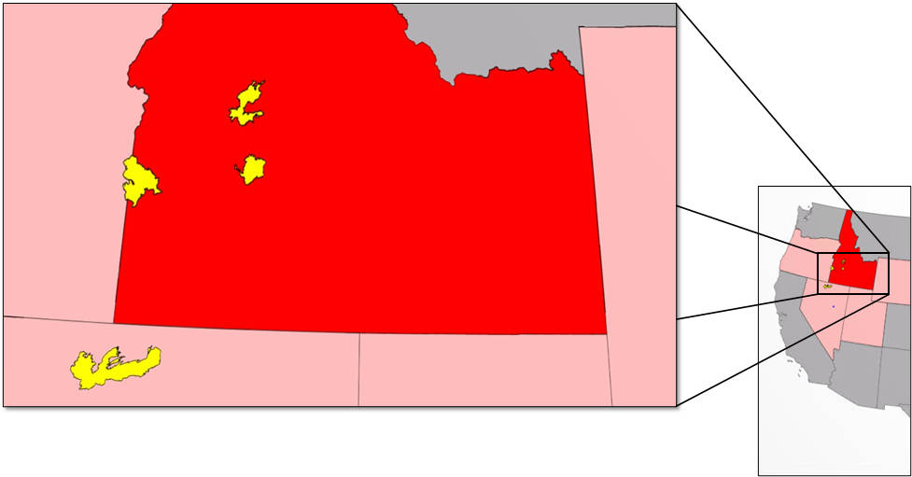
Study Area & Study Period
Southern Idaho Region
Areas of Interest
Primary Area (Idaho)
Secondary Area
Western U.S.
Megafire Burn Scars
N
120 Kilometers
Data were extracted from smoke plumes of wildfires that occurred from 2013 - 2020
Western
United States
Notes:
1. Southern Idaho is located in the intermountain western United States.
2. The semi-arid climate results in dry vegetation shared by surrounding states to the west, south, and east.
3. These conditions create a region prone to large wildfire events.
4. We chose to focus on this area because of the high density of records for large fires.

Slide 9
NASA Satellites & Sensors
CALIOP CALIPSO
Aqua MODIS
Vertical and horizontal distribution of cloud and aerosol layers
Terra MODIS
Active fire boundary and smoke imagery
Suomi NPP VIIRS
Active fire boundary and smoke imagery
Historic fire approximation
Image Credit: NASA
Notes:
CALIPSO, CALIOP LiDAR vertical feature masks data was used in order to determine land, aeorosol and cloud features. Terra MODIS , Aqua MODIS and VIIRS were used to identify fire boundary, smoke plume trajectory, and whether the CALIPSO instrument was sampling the smoke plume during a particular overflight. I will say more about this last point in the next chart.
Images: NASA

Slide 10
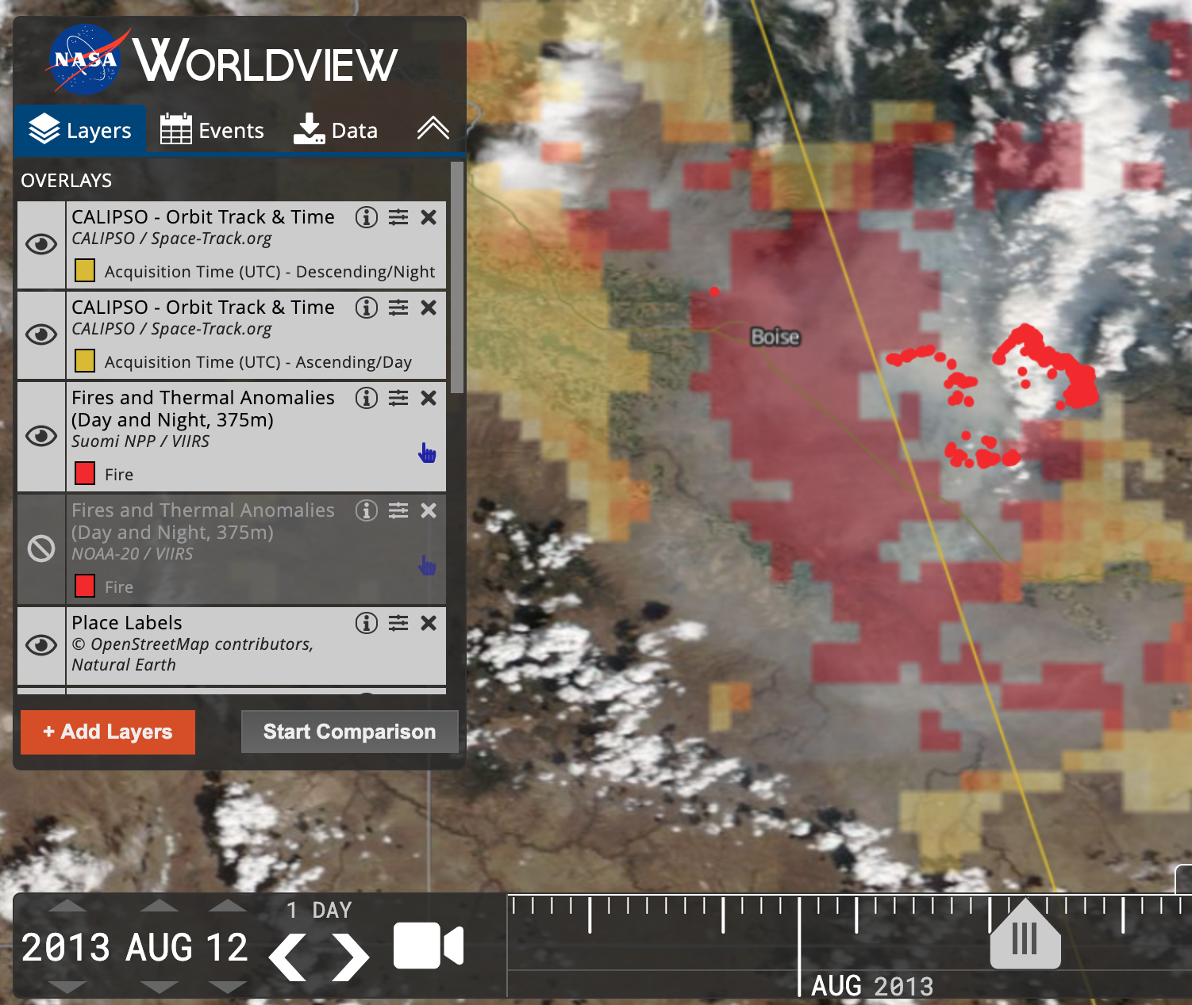
Methodology
Data Acquistion
Identified fires of interest located in the Southern Idaho region
Viewed fire using 2D imagery in NASA Worldview
Download corresponding CALIPSO Vertical Feature Mask HDF file data product
Elk Complex – August 12th, 2013. The map highlights the fire scar using VIIRS, the air quality and smoke plume using MODIS, and overlaps CALIPSO's flight path for accuracy.
Notes:
Smoke pollution is not stationary, and CALIPSO has a sparse temporal resolution, only making a pass once every sixteen days. To overcome this inconsistent sampling, the team used 2D passive sensor data to view the intersection of CALIPSO’s flight path with smoke pollution over the duration of each wildfire of interest to improve data accuracy. The team then used the NASA Worldview visual as a guide to download CALIPSO Vertical Feature Mask data product from NASA's Earth Data Website.
------------------------------Image Information Below ------------------------------
Image Credit: Image created by the ID DEVELOP team during the 2020 Fall Term using NASA Worldview Map, data layers selected by team member
Image Citation: https://worldview.earthdata.nasa.gov/?v=-118.1497602302469,41.81923670284256,-112.85728138086623,44.45723239100738&t=2013-08-12-T20%3A38%3A42Z&l=OrbitTracks_Calipso_Descending,OrbitTracks_Calipso_Ascending,VIIRS_SNPP_Thermal_Anomalies_375m_All,VIIRS_NOAA20_Thermal_Anomalies_375m_All,Reference_Labels,Reference_Features,VIIRS_SNPP_AOT_Deep_Blue_Best_Estimate(opacity=0.41,min=0.2,squash=true),Coastlines(hidden),VIIRS_NOAA20_CorrectedReflectance_TrueColor(hidden),VIIRS_SNPP_CorrectedReflectance_TrueColor(hidden),MODIS_Aqua_CorrectedReflectance_TrueColor(hidden),MODIS_Terra_CorrectedReflectance_TrueColor (public domain)

Slide 11
Methodology
Data Processing
Latitude | Longitude | Mixing Height Altitude
42.1385 | -115.543 | 2.68
42.1414 | -115.544 | 2.68
42.1444 | -115.546 | 2.68
42.1474 | -115.547 | 2.68
42.1533 | -115.548 | 2.68
42.1563 | -115.549 | 2.68
42.1592 | -115.55 | 2.68
Python script extracts features of relevance to find continuous aerosols
Maximum altitude at which the aerosol ends is recorded as the mixing height
Mixing Height observations are recorded and exported to CSV with corresponding latitude and longitude
Notes:
In order to estimate mixing height from CALIPSO’s Vertical Feature Mask data, the team had to unpack each data block to determine atmospheric features. The features that were of interest to the team were surface, aerosol, latitude, longitude and altitude. These features are then assigned to a numeric value for processing and better access. The python code works to calculate the mixing height value for the aerosol with respect to surface. Once the mixing height value for aerosol was calculated, it was recorded in the form of CSV file.

Slide 12
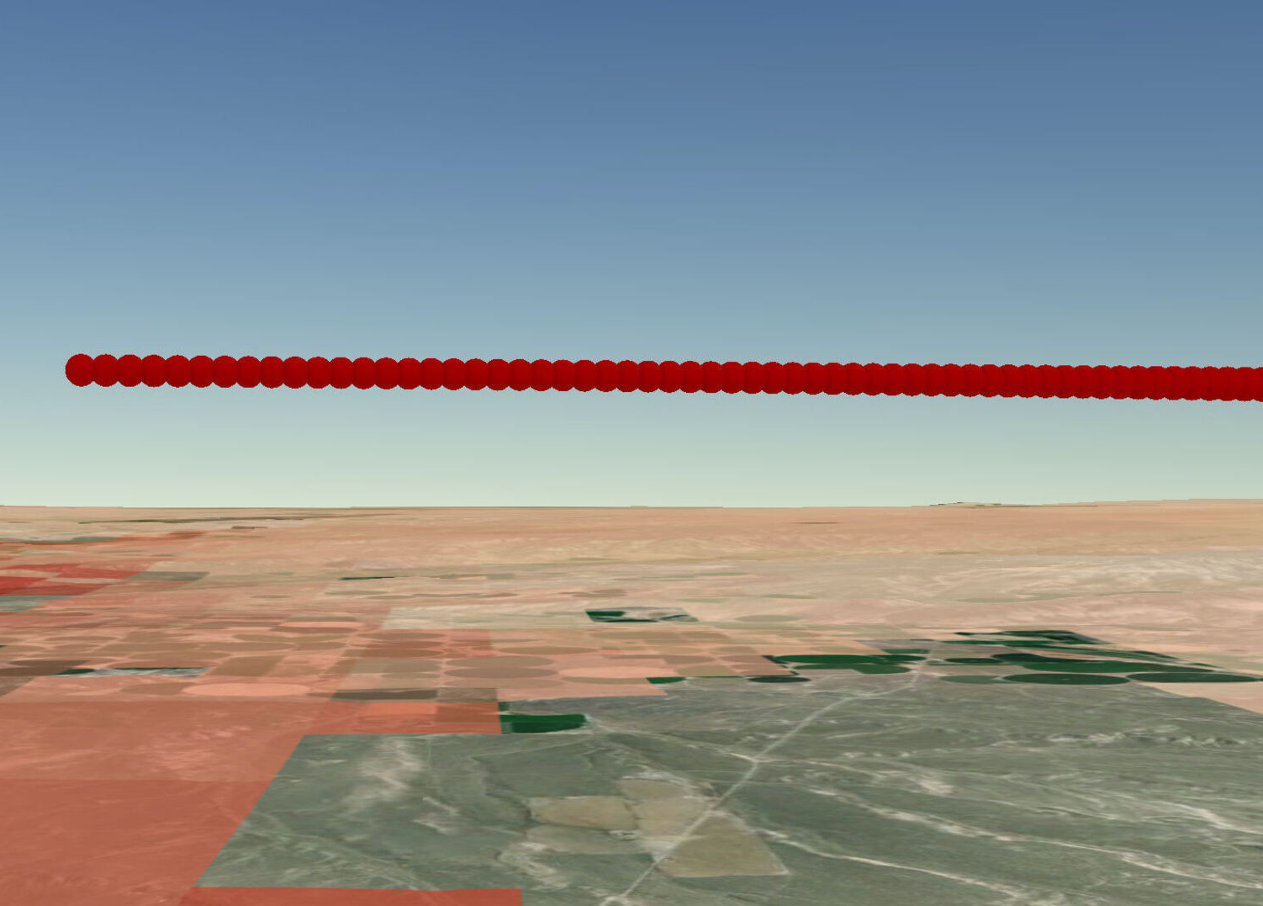
Methodology
Data Analysis
Visualized Mixing Height layer from CALIPSO transect
Attempted to back-calculate mixing heights from model-based soundings
Compared the spatial and temporal differences of model-based soundings with the CALIPSO pass
Mixing Height Layer
Idaho
Notes:
Observed mixing height data could then be displayed on a map using the corresponding latitude and longitude points. In the image, mixing Height is displayed with a red sphere for each latitude and longitude data point. The base map is overlaid with Terra & Aqua MAIAC Land Aerosol Optical Depth (AOD) Daily 1km which depicts the air quality.
The team was hoping to compare these observations to back-calculated mixing height estimations made with one of the four main mixing height models used by the NWS. We ended up just comparing the location of the soundings that the estimations are based off of with the location of the mixing height observation to determine the accuracy for future comparison.
Identified usable mixing height layers

Slide 13
Results
Atmospheric Profile From Elk Complex Fire (2013)
8
7
6
Surface/subsurface
5
Attenuated data
4
Altitude (km)
Tropospheric aerosol
3
2
1
0
42.25
42.50
42.75
Latitude (degrees north)
Notes:
The team was able to successfully develop a software tool that found the features of interest from the vertical feature mask granule can be plotted. This verified the location of attenuated data, cloud interference, surface and aerosol location. The areas where the blue aerosols, continuous from the red surface, end representations the altitude of the mixing height. The CALIPSO pass does not always indicate where there are continuous aerosols if the transect does not cross a smoke plume. The team was able to refine our methodology when selecting CALIPSO passes.

Slide 14
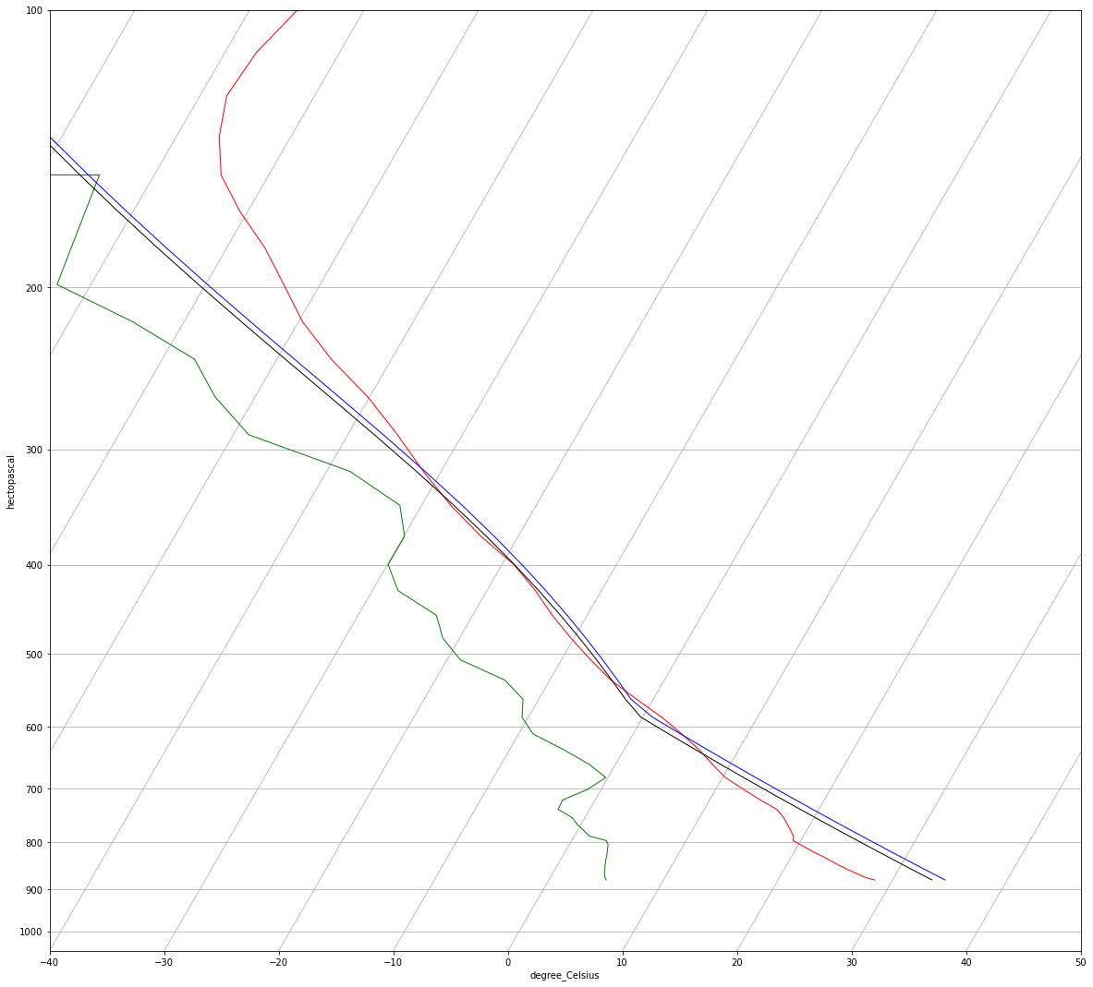
Results
Sounding and parcel paths of the Stull and Holzworth method of the Elk Complex Fire (2013)
100
Air Temp
200
Air Dewpoint
300
Stull Parcel Temp
Hectopascal
400
Holzworth Parcel
Temp
500
600
700
800
900
1000
-40
-30
-20
-10
0
10
20
30
40
50
Degrees Celsius
Notes:
One major obstacle in achieveing the validation objective of this project was that mixing height predictions are difficult to calculate given the complexity of atmospheric inputs. Translating atmosphernic sounding data into python data frames has proven difficult, as the data and python were not programmed to be directly compatible. In addition, the bulk Richardson and the turbulent kinetic energy method require additional imputes and more data to successfully calculate and the team was unable to get the code working.

Slide 15
Results
Primary Area (Idaho)
Secondary Area
Western U.S.
Mixing Height layer
Wildfire Burn Scar
Megafire Burn Scars
Observed Mixing Height
Modeled Sounding Location
N
120 Kilometers
Notes:
The mixing layer observation calculated from CALIPSO data does not align spatially or temporally with model-based soundings.
First, it should be noted that this image is from our BEST result.
Often, when acquiring CALIPSO imagery, it seemed that the track of the pass would encompass the area of the fire, but that was not always the case, as demonstrated here with the fragmented green line. Gaps in the line represent attenuated data.
Temporally, we don’t know what time of day the modeled sounding represents, making it difficult to compare those results with the output from our code.
In any case, both points are far away from the source of the smoke and more work needs to be done to resolve these issues.

Slide 16
Conclusions
Mixing height altitude can be calculated from CALIPSO VFM Granules
Spatial and temporal thresholds must be determined to reconcile differences between soundings and CALIPSO passes
CALIPSO LiDAR data can be used to validate the accuracy of mixing height models
Notes:
The team developed software tool that took inputs of CALIPSO LiDAR Vertical Feature Mask data, and extract mixing height observations. We had hoped to conclude which mixing height estimation methodology is most accurate based on comparisons with observed mixing height data. However, we were not able to back-calculate the mixing height predictions and spatial and temporal thresholds must be determined to reconcile differences between soundings and CALIPSO passes. This project will be continuing for a second term, and once those reconciliations are made, these mixing height observations can be used to validate the accuracy of mixing height models.

Slide 17
Future Work
Use methodologies in different ecosystems,
climates, and varying wildfire characteristics
Investigate a radiance calculated observed
mixing height
Determine how much mixing heights vary over
the course of a day
Notes:
1. The team hopes a second term can apply the methodologies of mixing height estimations to over fires in different ecosystems. During this term, the team chose grassland wildfires from arid regions for a consistent smoke plume composition and fire intensity. More research is needed to verify the accuracy of various methodologies with different fires in different ecosystems.
2. In addition the team hopes more research can be done into intensity derived mixing heights. With sparse passes, mixing height observations from CALIPSO are not practical for daily mixing height forecasts.
3. Lastly we hope another term can explore how mixing heights vary over the course of a day. The team only look at a wildfire’s mixing height once; more research is needed to determine how long an estimation is valid for.

Slide 18
NASA DEVELOP Advisors:
Keith Weber, Idaho State University, GIS Training and Research Center
Dr. Kenton Ross, NASA Langley Research Center
Dr. Travis Toth, NASA Science Directorate
Brandy Nisbet-Wilcox, Idaho NASA DEVELOP Fellow
Project Partners:
Robyn Heffernan, Predictive Services Meteorologist
Heath Hockenberry, Fire Weather Program Manager
Larry Van Bussum, National Fire Weather Operations Coordinator
Mark Fitch, Smoke Management Specialist
Dave Mueller, Hazardous Fuels Reduction Specialist
Notes:
The team would like to thank the following individuals for all their support, instruction, and feedback on this project:

