Slide 1
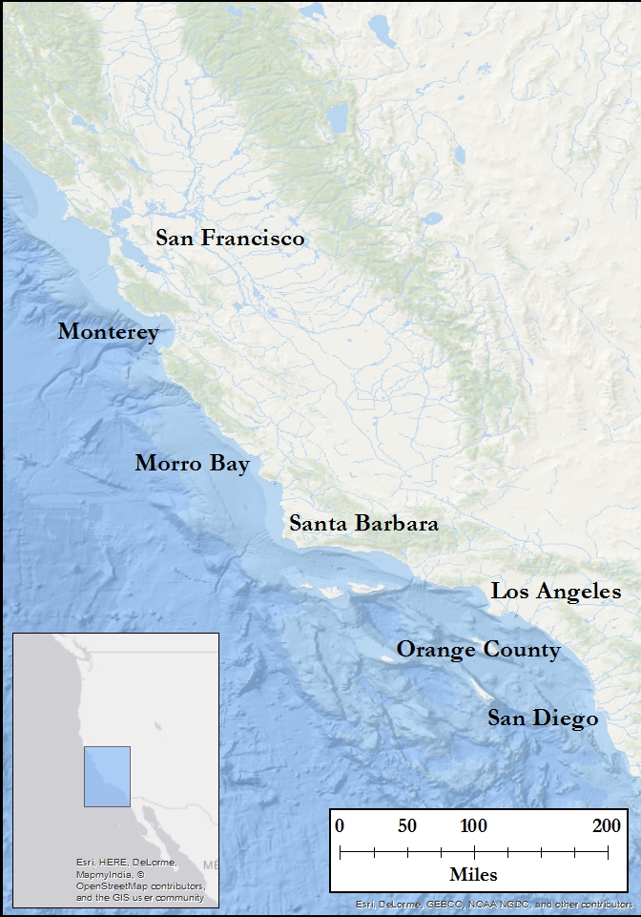
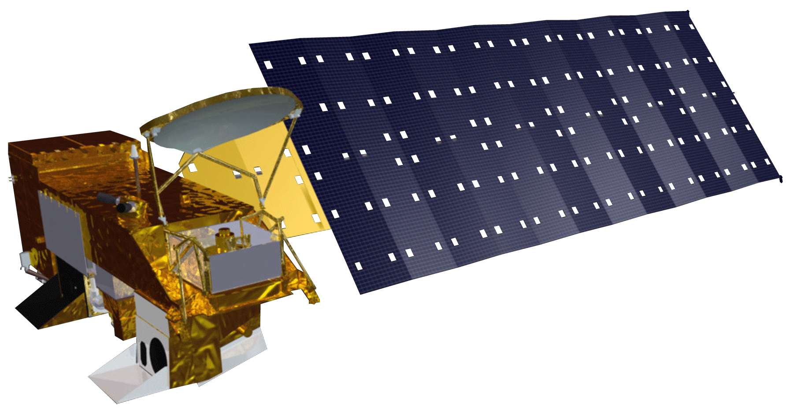
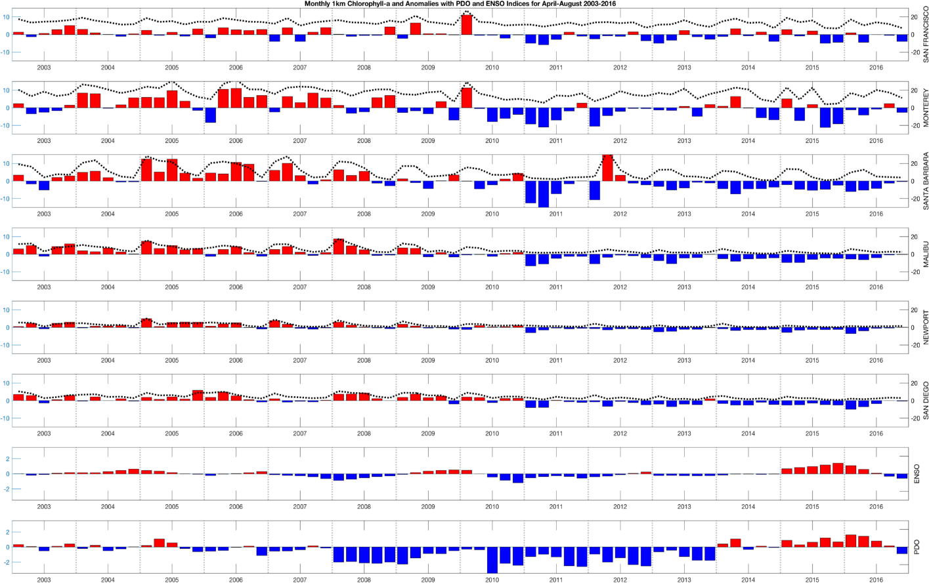
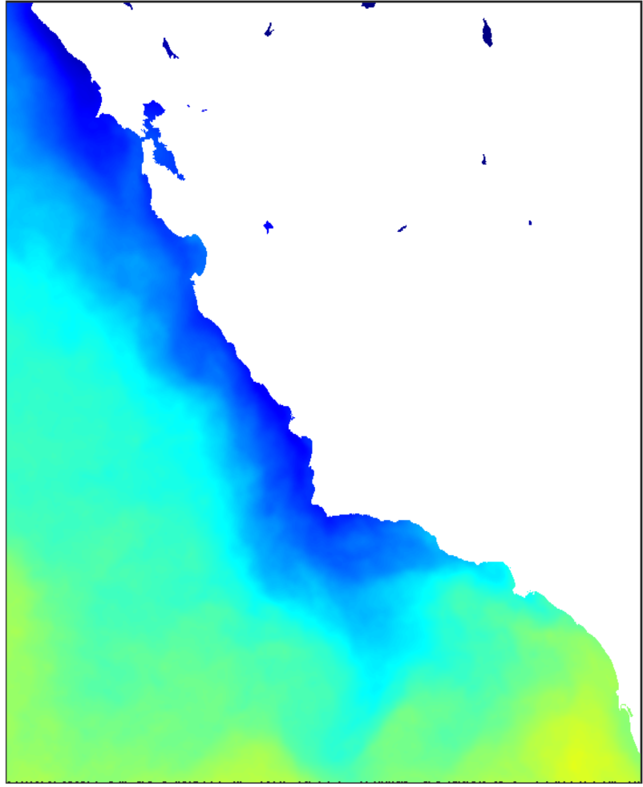
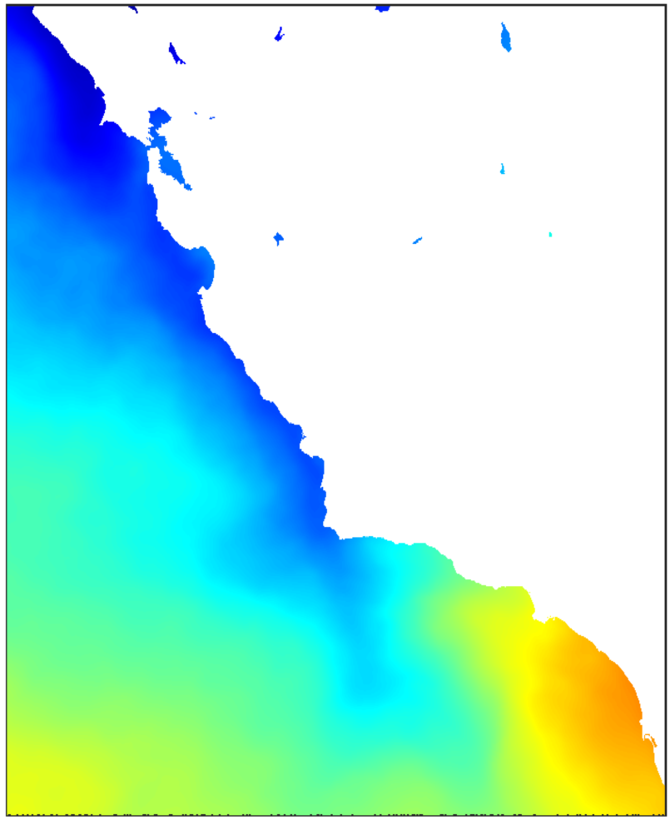
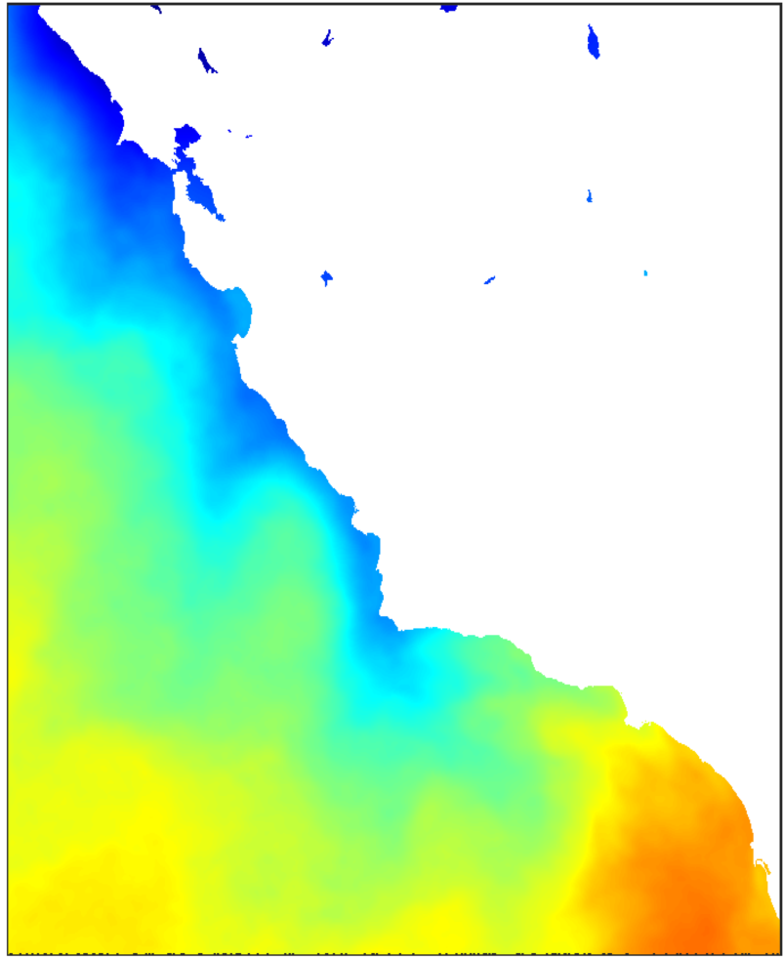
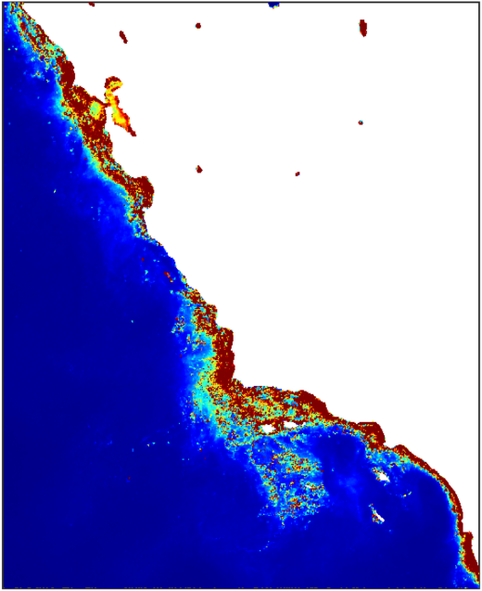
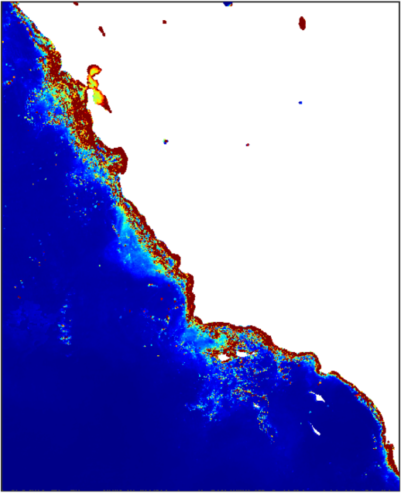
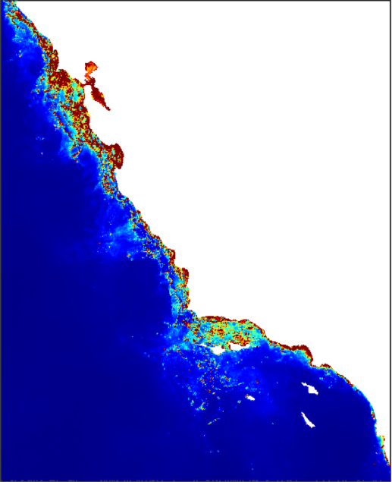
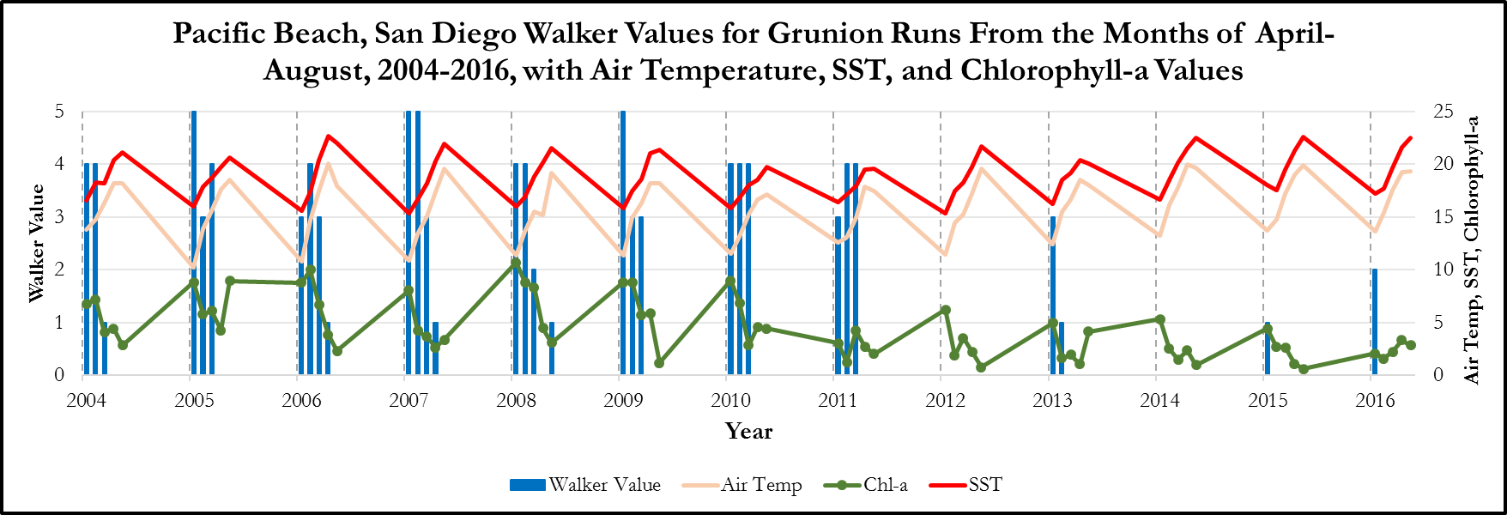
Analyzing NASA Earth Observation Data to Evaluate Grunion Response to Ecosystem Changes Forced by Recent Environmental Conditions in California’s Oceans
Abstract
Objectives
The California grunion is an endemic fish species vital to the California coast, acting as a versatile food source for many species such as seabirds, large mammals, and other fish in the food web. This species, known primarily for the unique way in which they spawn, have two specialized regions. Historically, they only occur in Southern California and northern Baja California and are vulnerable to air and ocean temperature changes. In the last 16 years, scientists recorded grunion spawning further north to the San Francisco Bay area. In response to air and ocean temperature increases, the fish migrate to cooler waters they are more adapted to. This is an issue due to the fact that the grunion found here are much smaller in size, indicating the north coast may not be as suitable for the species. Increased beach activity, beach cleaning practices, and coastal erosion significantly contribute to the decrease in population and the significant shift of spawning areas. This project, in collaboration with the Grunion Greeters Project, used Aqua MODIS satellite data for sea surface temperature (SST) and chlorophyll-a concentration to create a time series of the California coast from 2003 to 2017. Analyzing this product will help predict grunion spawning areas and can be used to develop beneficial management practices as well as establish new protective areas to keep the species thriving and safe.
Determine potential grunion spawning beaches and factors that affect grunion run presence and magnitude
Analyze sea surface temperature and chlorophyll-a time series to identify potential future grunion spawning sites along the California coast
Aid future decision-making to manage seasonal spawning locations and to protect the grunion
Study Area
Methodology
Aqua MODIS
2003
SST
Chl-a
Apr
Predict grunion migration trends and patterns
Locate grunion run beaches
TIME SERIES MAPS
Aug
Earth Observations
In situ
grunion data
2016
Southern California Oceans
Aqua MODIS
Results
Figure 1: Monthly anomalies of chlorophyll-a concentrations for the months April-August during 2003-2016 were calculated for stations in major coastal grunion run areas. The figure is ordered so that the stations descend from north to south and each bar represents one month. The Pacific Decadal Oscillation (PDO and El Niño Southern Oscillation were added for comparison.
10°C
15°C
2003
2010
2016
20°C
0 mg/m³
15 mg/m³
Figure 2: Mean sea surface temperature, chlorophyll-a concentrations, in situ air temperature and grunion run data (Walker Value) are plotted together for comparison for Pacific Beach in San Diego. Each bar represents the months April-August for every year between 2003-2016.
30 mg/m³
Figure 3: Monthly sea surface temperature means for the month of April are represented on the top row of images for the years 2003, 2010 and 2016 along the California coast. Over there years, there is an overall increase in temperature, especially in the south by approximately 2°C. The bottom images exhibit the chlorophyll-a concentrations over the time period. Concentration have decreased overall, again mostly in the south coast.
Conclusions
Grunion data were plotted against air and water temperature anomalies calculated from in situ and remote sensing sources.
Chlorophyll-a and SST time series maps were generated to create another comparison map.
Temperature anomalies were compared to the Pacific Decadal Oscillation and El Niño Southern Oscillation indices to look for broader-scale patterns of the grunion migrations.
Project Partners
Grunion Greeters Project
Team Members
Acknowledgements
Benjamin Holt
NASA DEVELOP National Program Science Advisor
Nick Rousseau
NASA DEVELOP JPL Center Lead
Dr. Karen Martin
Pepperdine University, Grunion Greeters Project
Lael Wakamatsu
Team Lead
Sol Kim
Ariana Nickmeyer
NASA Jet Propulsion Lab – Summer 2017

