Slide 1
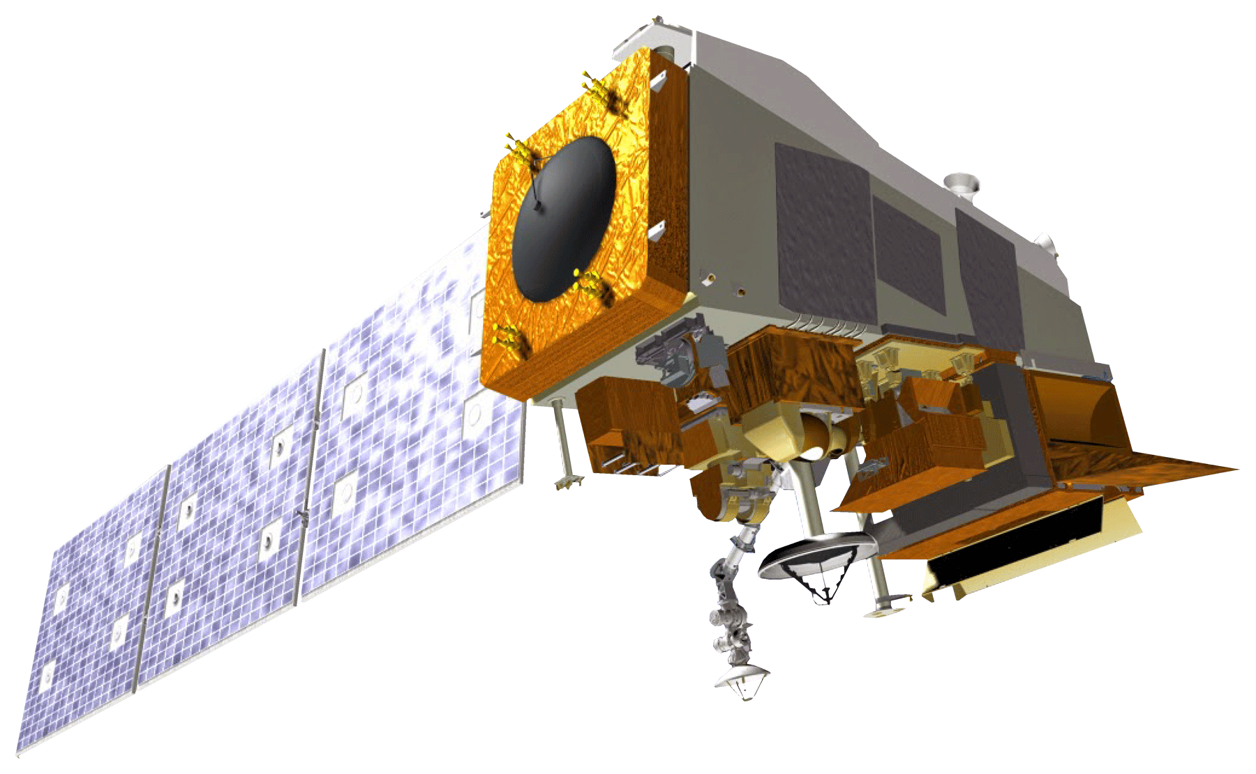
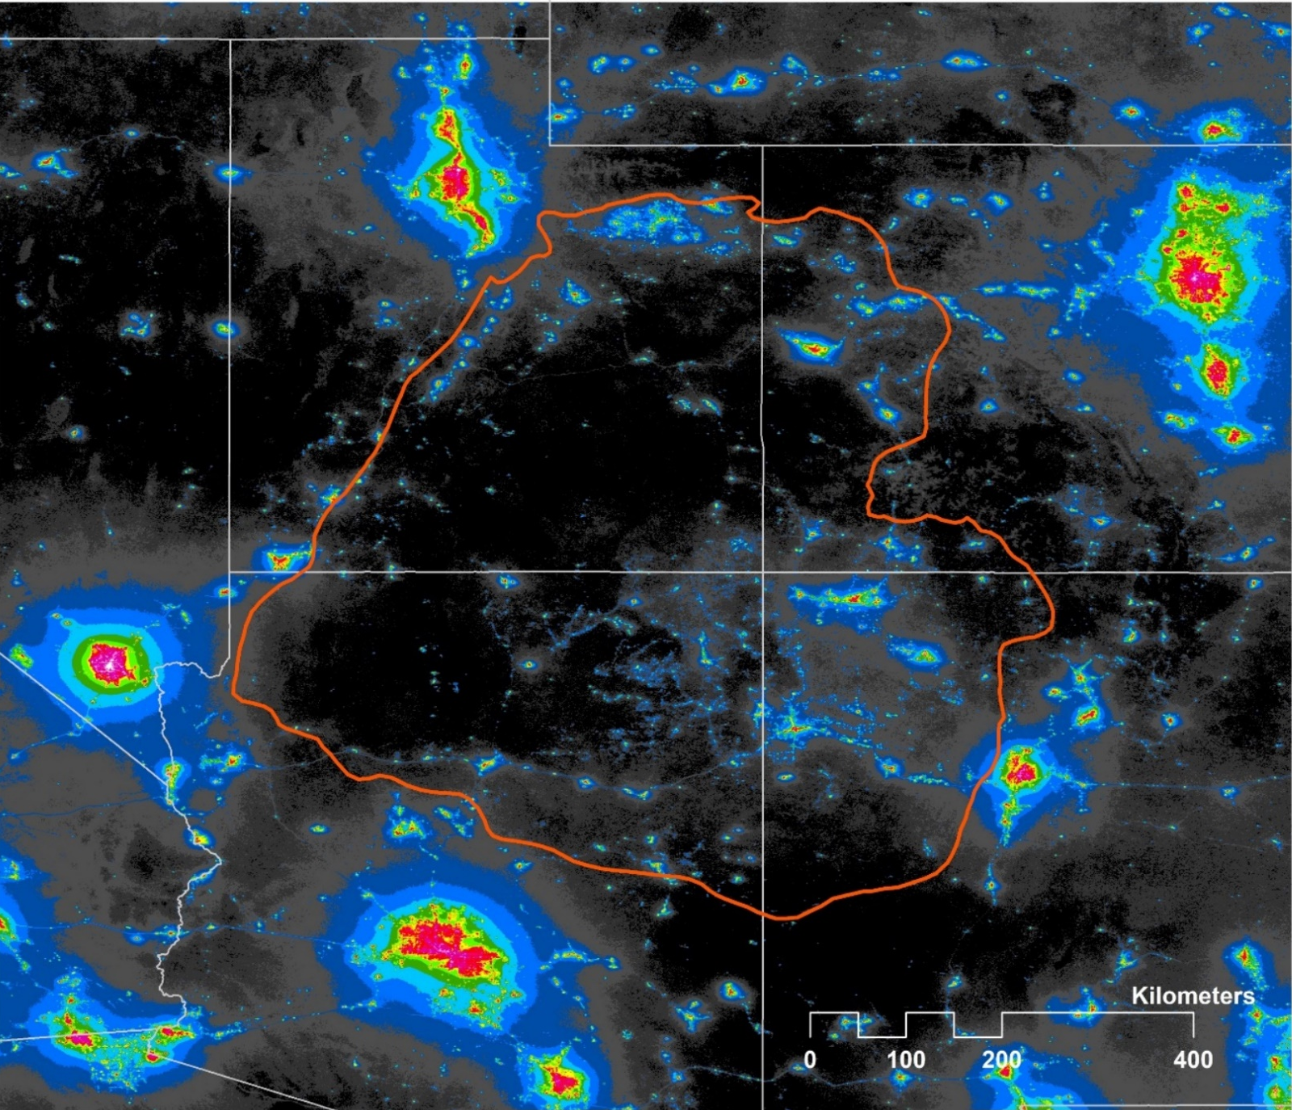
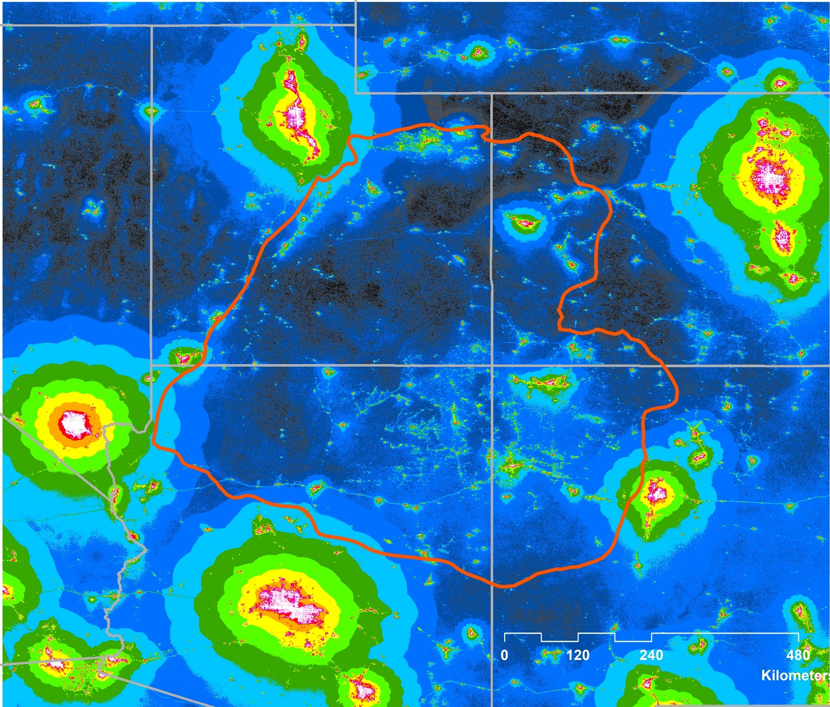
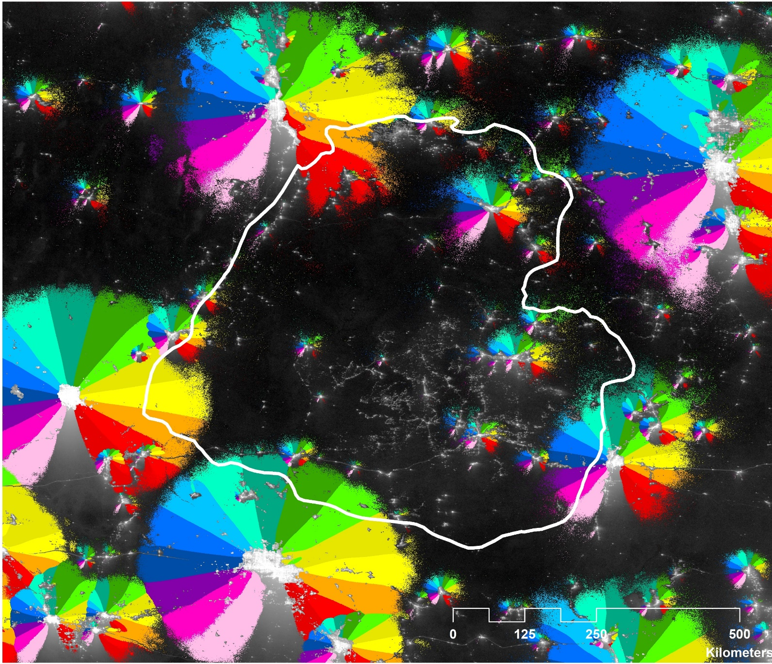
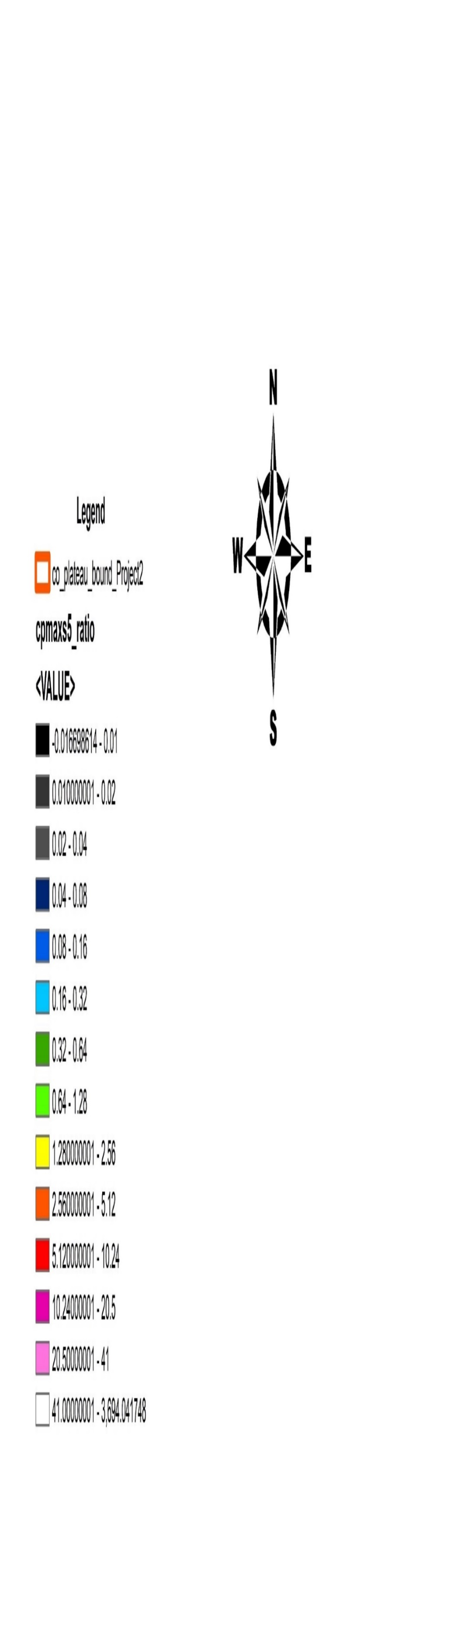

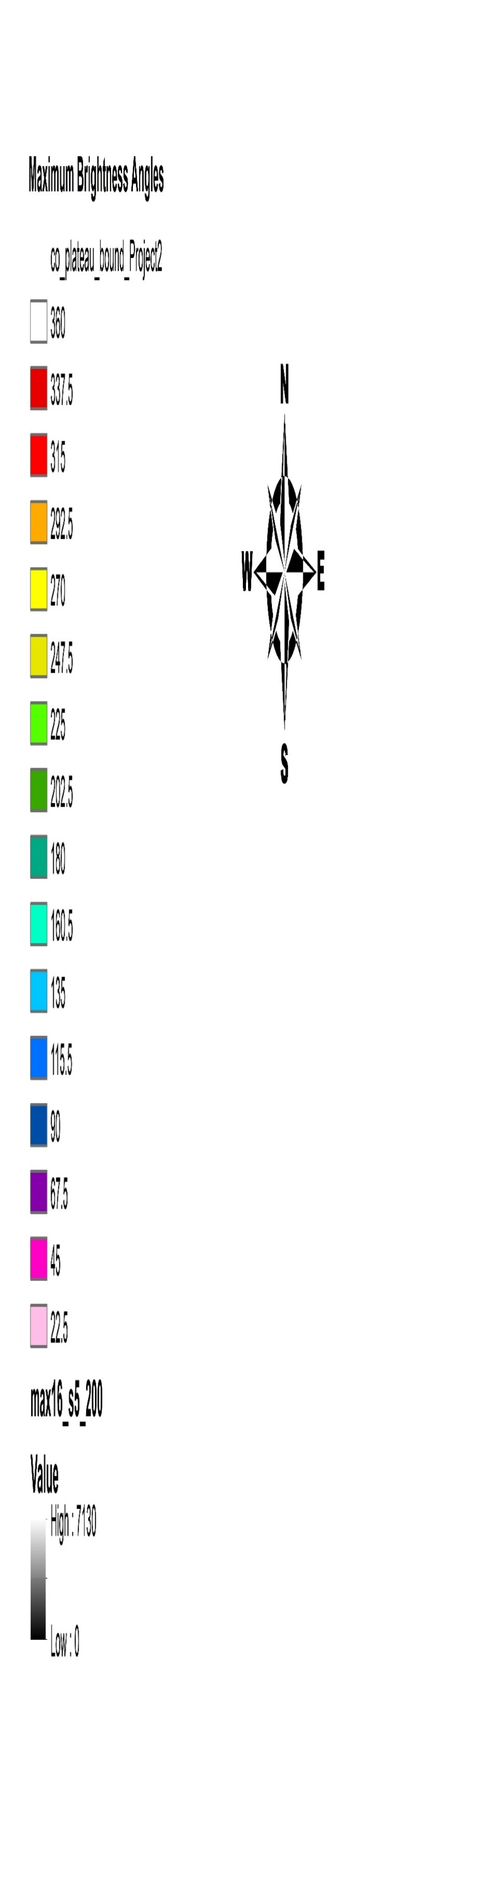
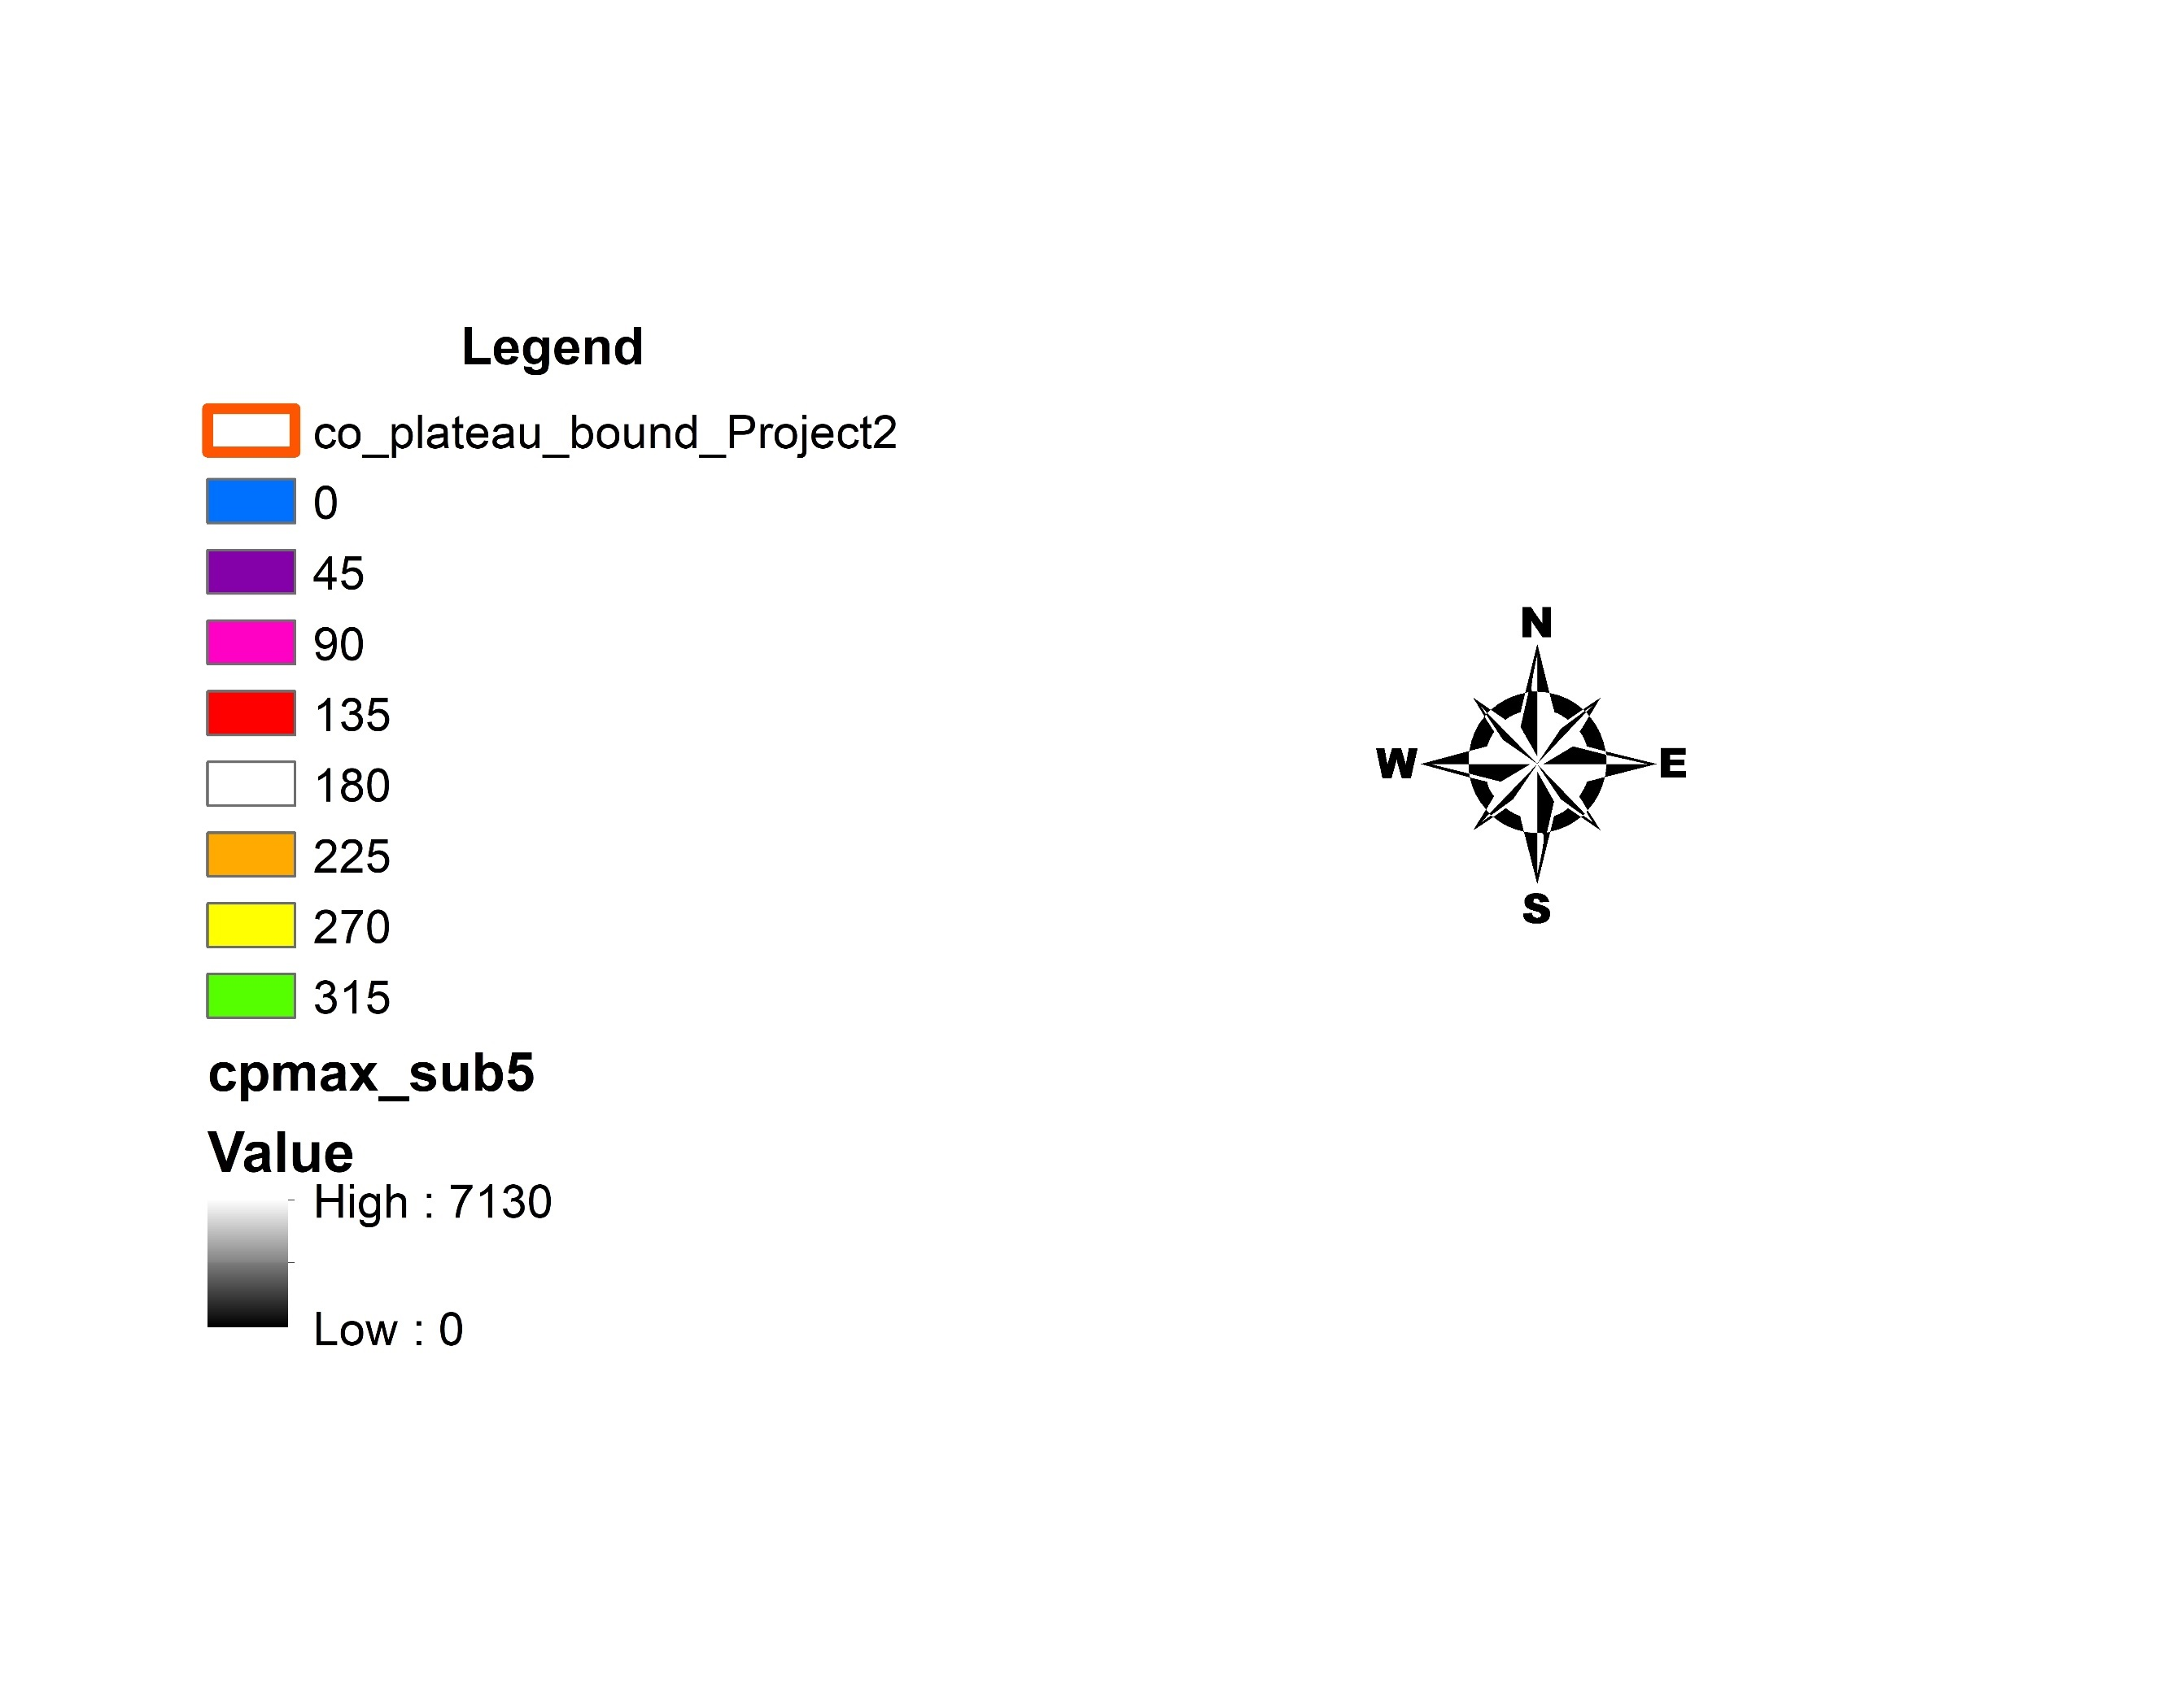


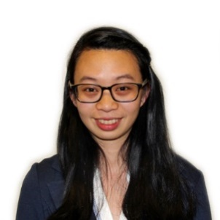

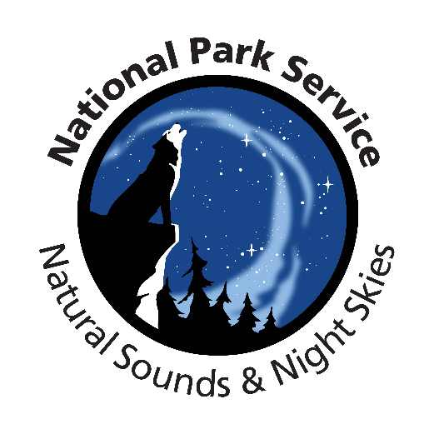
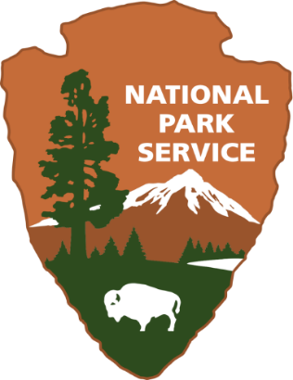
A Perspective on Nighttime Sky Glow over the Colorado Plateau by Integrating the Suomi-NPP VIIRS Day Night Band Sensor with a Customized Geolocation Data Processing Program
Abstract
Objectives
The rapid expansion of human population in conjunction with industrialization has resulted in increased artificial light pollution, also known as sky glow. Anthropogenic light pollution hinders the reproductive, migratory, and predatory habits of wildlife relying on the predictable diurnal cycle. Artificial light pollution not only degrades the quality in which humans view the night sky, but also causes adverse human health concerns including obesity, cancer, depression, and insomnia. The expansion of the Skyglow Estimation Toolbox (SET) Python program enabled adjustable zenith and azimuth angles, which assisted in determining the levels and the directions of anthropogenic light pollution impacting the Colorado Plateau. The SET program calculates artificial sky glow by applying the model of light propagation from Falchi (2016), Cinzano (2000), and Garstang (1989) to visible light radiance imagery from the Suomi National Polar-orbiting Partnership (Suomi-NPP) Visible Infrared Imaging Radiometer Suite (VIIRS) Day/Night Band (DNB). A composite image of the Colorado Plateau region was created for the months of June, July, August, September, and October of 2014 through 2016, and the available months of 2017, which included June and July. The updated SET program processed the composite image to produce a library of kernels, to generate Artificial Skyglow Maps modeling predetermined zenith and azimuth angle combinations. The resulting maps yield the direction of the greatest contribution of anthropogenic light pollution. Consequentially, the updated Skyglow Estimation Toolbox informed government agencies and stakeholders about the current state of anthropocentric light pollution in the Colorado Plateau and provided a basis for future action.
Analyze artificial light affecting the Colorado Plateau using the Skyglow Estimation Toolbox (SET)
Determine zenith and azimuth angles with higher sky glow values
Employ in situ data from the National Park to determine the statistical relevance of the values generated by SET.
Generate Artificial Skyglow Maps for the Colorado Plateau
Study Area
WY
SD
Colorado Plateau Study Region
OR
ID
NE
200 km Accuracy Buffer
NV
UT
CO
Earth Observations
400 km Kernel Buffer
Suomi National Polar-orbiting Partnership (NPP) Visible Infrared Imaging Radiometer Suite (VIIRS) Day/Night Band (DNB)
CA
Methodology
AZ
NM
Mexico
TX
VIIRS DNB Raster Data
Perform Noise Reduction
Sky Glow Map
Conclusions
Combining the Skyglow Estimation Toolbox and Suomi NPP VIIRS imagery allowed for the capability to model light pollution at predetermined zenith and azimuth angles.
SET offers broader, more dynamic capabilities and applications than handheld light meters, allowing local officials to expand the geographic scope of current light measurement practices.
Local officials and communities will have the capability to track changes in maximum brightness levels with the Skyglow Estimation Toolbox.
Clip Data to Study Area
Skyglow Estimation Toolbox
Determine Maximum Sky Brightness
Colorado Plateau Urban Development
Results
Zenith Ratio to Natural Brightness
Maximum Brightness Ratio, 67.5° Zenith
Azimuth Direction of Maximum Brightness , 67.5° Zenith
0.01
0.02
0.04
0.08
0.16
0.32
0.64
1.28
2.56
5.12
10.2
20.5
> 41
< 0.01
0.01
0.02
0.04
0.08
0.16
0.32
0.64
1.28
2.56
5.12
10.2
20.5
> 41
360°
337.5°
315°
292.5°
270°
247.5°
225°
202.5°
180°
160.5°
< 0.01
135°
115.5°
90°
67.5°
45°
22.5°
Artificial Brightness (μcd/m²)
Team Members
Acknowledgements
Low: 0
High: 7130
The Colorado Plateau Urban Development team is grateful for the guidance and collaboration received from their team of science advisors and those at the Wise County Clerk of Circuit Court’s Office: Joseph Spruce, Lead Science Advisor for NASA DEVELOP VA – Wise County; Dr. Kenton Ross, Lead Science Advisor for NASA DEVELOP National Program; Dr. L. DeWayne Cecil, Chief Climatologist at NOAA National Centers for Environmental Information and Program Manager of Global Science & Technology, Inc.; Bob VanGundy, Geology Instructor at The University of Virginia’s College at Wise; and Eric White, Center Lead at NASA DEVELOP VA – Wise node.
Additionally, the team appreciates the cooperation, enthusiasm, and assistance of the Colorado Plateau Urban Development partners, who made this project possible: Randy Stanley, National Park Service Intermountain Region Natural Sounds and Night Skies Coordinator; Sharolyn Anderson, PhD, Research Scientist of the National Park Service Natural Sounds and Night Skies Division; Li-Wei Hung, PhD, Research Scientist of the National Park Service Natural Sounds and Night Skies Division; Bettymaya Foott, Coordinator, Colorado Plateau Dark Sky Cooperative; John Barentine, Program Manager, Colorado Plateau Dark Sky Cooperative; Dan Greenblatt, Colter Bay District Interpretive Ranger at Grand Teton National Park; and Samuel Singer, PhD, Executive Director of Wyoming Stargazing.
Margaret Mulhern
Project Lead
Manda Au
Ian Brastow
Project Partners
Colorado Plateau Dark Sky Cooperative
International Dark- Sky Cooperative
National Park Service, Intermountain Region
National Park Service, Natural Sounds and Night Skies Division
National Park Service, Grand Teton National Park
Wyoming Stargazing
Virginia – Wise
Fall 2017

