Slide 1
Southern Rockies Ecological Forecasting II
Tracking Mule Deer for Wildlife Corridors between Seasonal Habitats in the Southern Rockies
Tyler Rhodes (Project Lead)
Allison Chappell
Michael Sclater
Maggie Jenkins
Amanda Flake
Cody Walker
Notes:
Hi, my name is Tyler Rhodes, and I am the Project Lead for the Southern Rockies Ecological Forecasting Team, this is the second term for this project. I graduated from Old Dominion University with a BS in Geography.
Hi, my name is Mike Sclater, and I graduated from Virginia Tech with a BS in Geography
Hi, my name is Amanda Flake, and I am a senior at Old Dominion University, graduating with a BA in Geography.

Slide 2
Community Concerns
Economically important
Hunting
Tourism
Ecologically important
Keystone species
Diverse ecosystem
Where are the Mule deer going?
Image Credit: Creative Commons “Tracks In the Snow” Chris Goforth
Notes:
Mule deer are a large source of income in the Southern Rocky region. Hunters of mule deer contribute millions of dollars to the local economies through lodging, licenses, supplies, food, and gas purchases during each hunting season. The money in turn contributes to the overall economic growth of this region.
Ecologically, mule deer are important because they are a keystone species that promote a diverse ecosystem. Mule deer populations have been declining, and because of this many other Southern Rocky wildlife species have been affected.

Slide 3
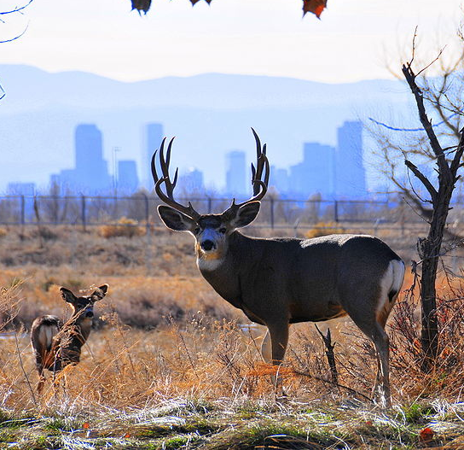
Community Concerns
Anthropogenic features
Oil and Natural gas wells/pipelines
Buildings
Roads
Fences
Image Credit: Oborseth
Notes:
The creation of oil and gas lines, along with urban sprawl, have caused indispensable migratory corridors to disappear, which in turn is causing a decline in mule deer. The increase in human features has caused these herds to migrate at different times.
Research shows that herds near more-developed areas are migrating earlier and moving faster. The reason is so that they can get around these areas and to lower elevations in time for the cold season.

Slide 4
Objectives
Improve understanding of mule deer migration
Determine how anthropogenic features affect migration
Document ideal conservation areas
Identify migratory corridors to maintain the current population
Image Credit: Oregon Dept. of Fish & Wildlife
Notes:
Our teams objectives was to utilize NASA Earth observing satellites to improve knowledge and understanding of mule deer migration
Determine how human development such as roads, fences, buildings, oil and natural gas wells affect mule deer and their migration patterns
Document ideal mule deer habitat areas for future conservation
Identify conservation areas by running unsupervised classifications on Modis Phenology in ERDAS Imagine

Slide 5
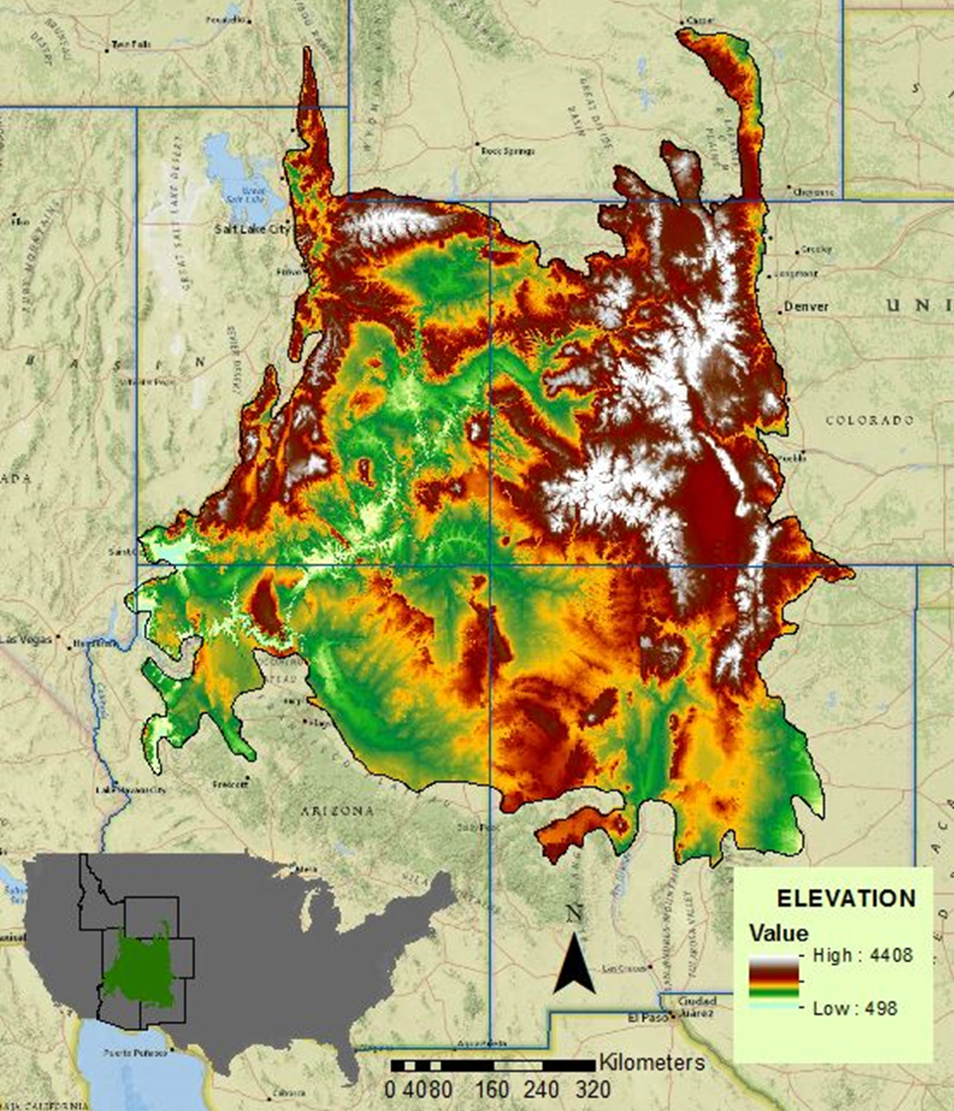
Study Area
Location: Southern Rocky Mountains
Six states: Arizona, Colorado, Idaho, New Mexico, Utah, Wyoming
Encompasses: 516,754 km²
Study period:
2011- 2014
Meters
Notes:
The focus for our project was the Southern Rockies Landscape Conservation Cooperative which spans six states and encompasses approximately 516,000 square KM
The study time period is from 2011- 2014

Slide 6
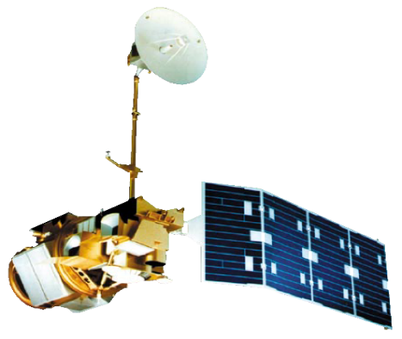
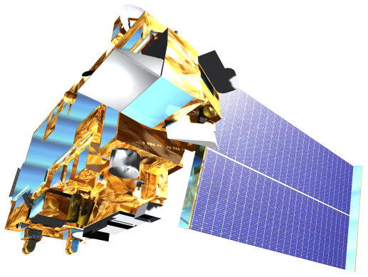
Earth Observations
Landsat 5 TM
Landsat 8 OLI
Terra MODIS
Aqua MODIS
Notes:
Landsat 5 TM (Thematic Mapper) and Landsat 8 OLI (Operational Land Imager), which each have a 30m resolution were downloaded and used for land cover identification.
MODIS Moderatate-resolution imaging spectroradiometer sensors Aqua and Terra which both have a 1km resolution were used to create the Forwarn climate data which we then clipped and ran unsupervised classifications on.

Slide 7
Methodology
Cluster Busting
MODIS Phenology layers added plus
Preprocessing of layers in stack
Unsupervised classification using ISODATA into 30 classes
Identification of classes
Recode and reclassifying yet again
Assembly of all final classes
Notes:
The data that was downloaded was from ForWarn which is a satellite monitoring and assessment tool that provides an overview of possible forest disturbances for the U.S. The ForWarn data, which has a 231 meter nominal resolution, uses MODIS satellite imagery to create maps and track the vegetation phenology in the U.S. Our goal for this project was to find suitable wildlife corridors in the SRLCC for our partners utilizing the ForWarn data. We first ran an unsupervised classification in ERDAS Imagine using the 7 NDVI Vegetation phenology layers and put them into 30 distinct layers using isodata. We then compared those classes to the Utah State mule deer suitability map to find a best fit for each of those 30 layers. We wanted to see if using the MODIS day of year would work better so we tried the clusterbusting technique on those layers. Additionally we wanted to include other factors such as slope, aspect, and DEM to aid in the classification. We stacked those three layers on top of the ForWarn data and ran yet another clusterbust on that layer stack. Finally we compared each final map to see which one worked the best.

Slide 8
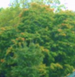
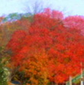
NDVI
Season Max NDVI
Left 80% Max
Right 80% Max
Left 20% Max
Right 20% Max
Left Minimum
Right Minimum
Spring
Growing Season
Fall
Image Credit: USFS
Notes:
MODIS data processed to produce NDVI curve that has 14 layers at 231m resolution. These 17 layer images contain seven NDVI and corresponding day of year values. Left 20% is the beginning of season, left 80% is the onset of maximum greenness aka greenup, MAX is the peak of the growing season, right 80% is the beginning of brown down and right 20% is the end of season.

Slide 9
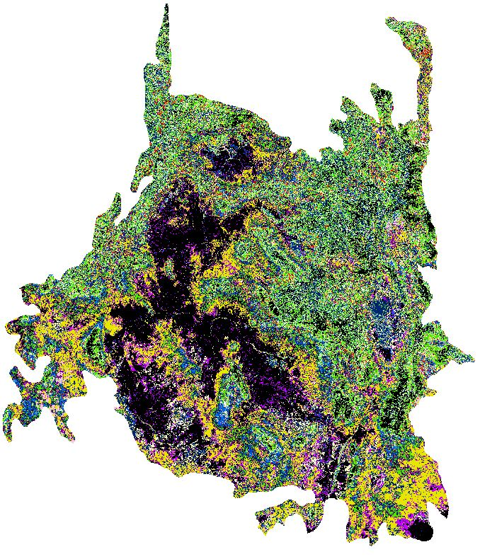
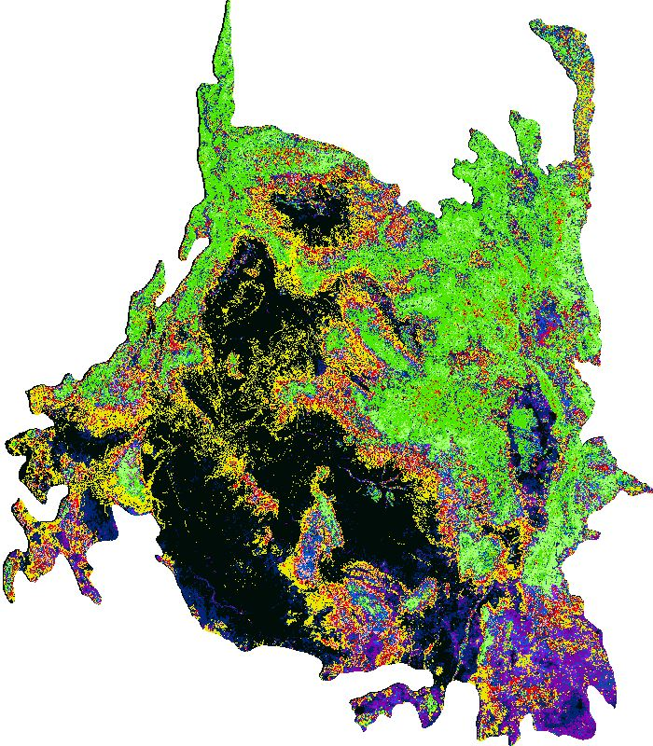
Results: Cluster busting
Notes:
Some of the layers where split between multiple classes of the Utah State map so we created a subset layer for the confused classes and ran another unsupervised classification on those layers, breaking them up again into 30 classes. This technique is known as clusterbusting. Then we repeated the process, comparing each layer to the Utah State map to find the best fit for each class. After each layer was classified, we took the classes from the first unsupervised classification and the 30 from the second run and merged the two into one layer and then color coded each layer to match with Utah State color code in ArcMap.

Slide 10
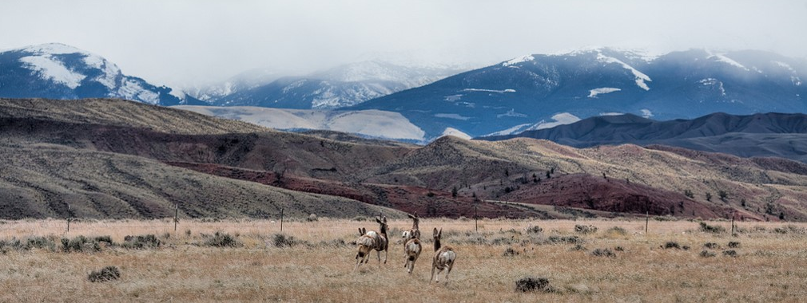
Errors and Limitations
Anthropogenic feature factors
Subjectivity of classifications
Winter concentration class comparison
Image Credit: Greg Westfall
Notes:
Due to time constraints we were unable to add anthropogenic factors, such as oil well pads, roads, buildings, and fences, to our maps.
Subjectivity in the classification process caused errors to occur due to different interpretations of the data
The comparison did not result in an exact match of the two maps because the scale of the study areas are not representative of each other. Due to this, the smaller study area did not successfully include the winter concentration that is visible in the SRLCC boundary.

Slide 11
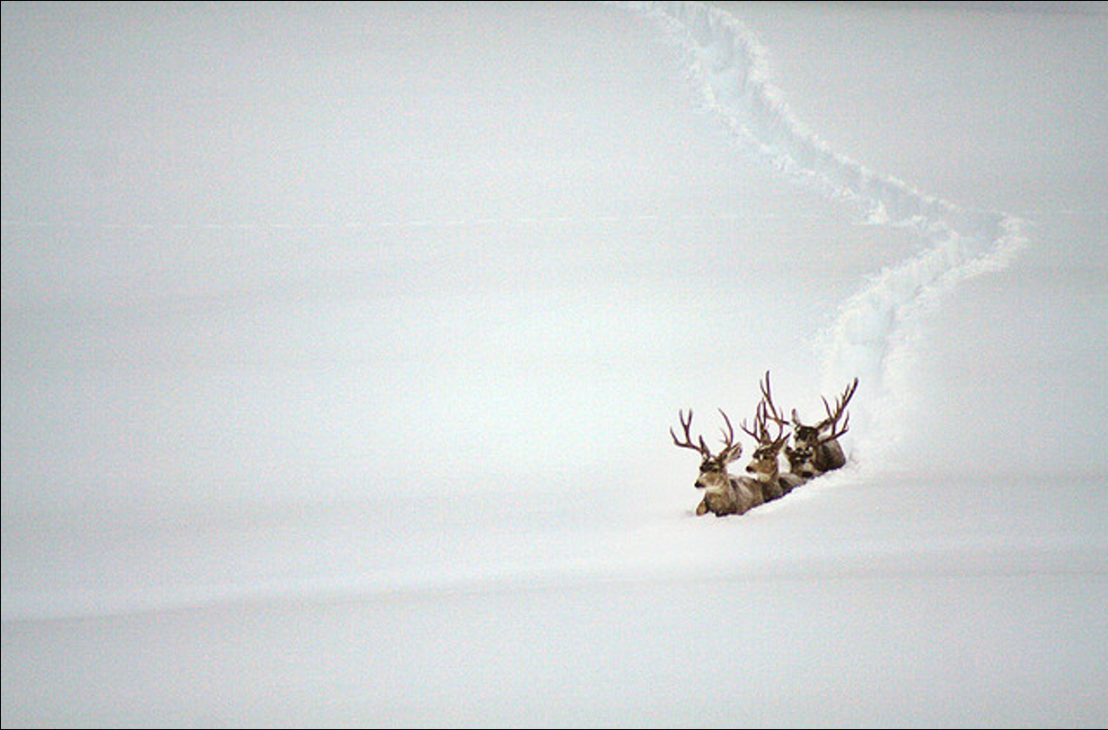
Future Work
GPS collar data
Accuracy assessment as a preliminary visual check
Image Credit: Laura Tidwell
Notes:
Future work could include obtaining and using GPS collar data to track mule deer’s migration as to better understand decisions made during their migration routes.
Snow duration data along with PRISM Climate data would be beneficial to research the start of fall and spring migration.
An accuracy assessment, such as with GPS collar data, on the final maps would permit the end user to see the accuracy of created maps.

Slide 12
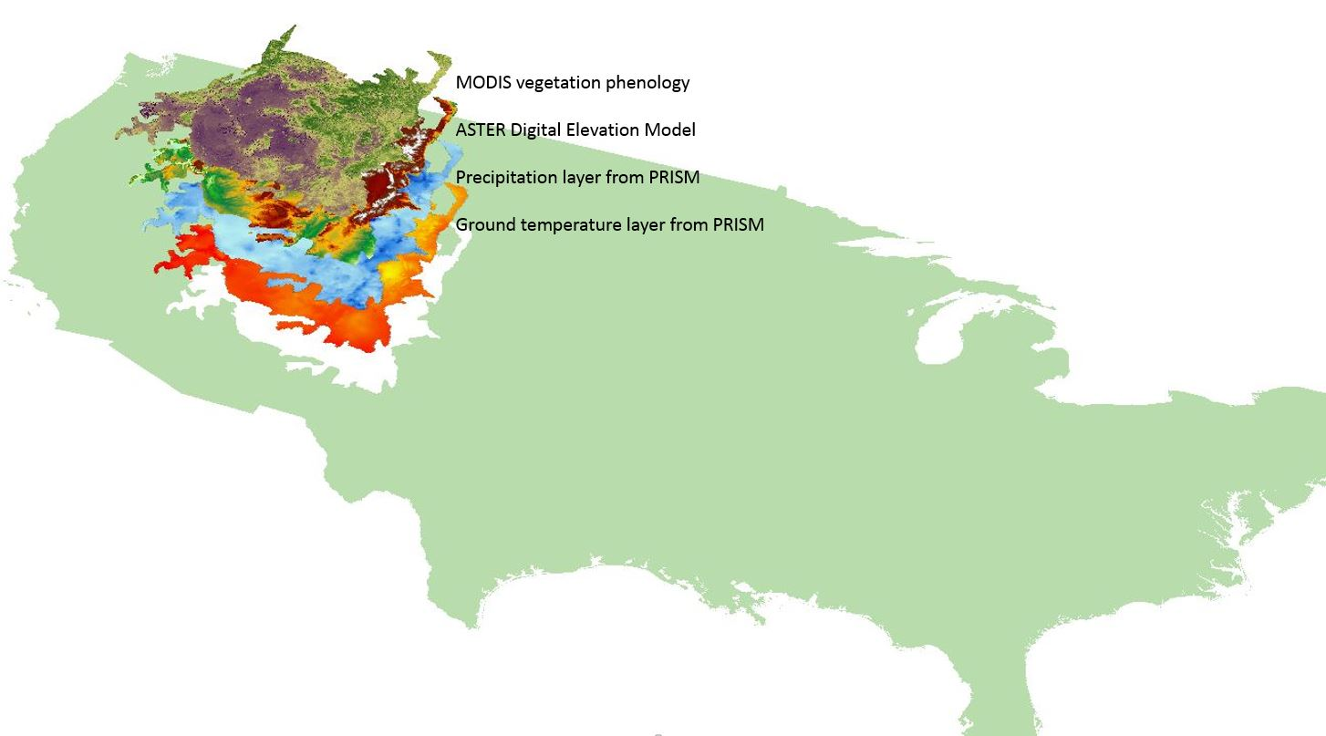
Future Work
Snow duration data
PRISM climate data
Notes:
The Southern Rockies Ecological Forecasting II looked at several layers to find ideal locations for mule deer corridors. Layers shown above from the top down are MODIS Vegetation Phenology, a DEM from Aster, precipitation and surface temperature from Prism.
Image Credit: SREFII Team.

Slide 13
Advisor
Dr. Kenton Ross
NASA DEVELOP National Program Science Advisor
Partners
Southern Rockies Landscape Conservation Cooperative
John Rice
Mule Deer Western Association of Fish and Wildlife Agencies (WAFWA) Working Group
Jim Heffelfinger
Others
Emily Adams
NASA DEVELOP Langley Center Lead
Rebekke Muench
NASA DEVELOP Langley Assistant Center Lead
Past Contributors from Fall 2015
Ross Reahard (Project Lead), Teresa Fenn, Jeri Wisman

