Slide 1
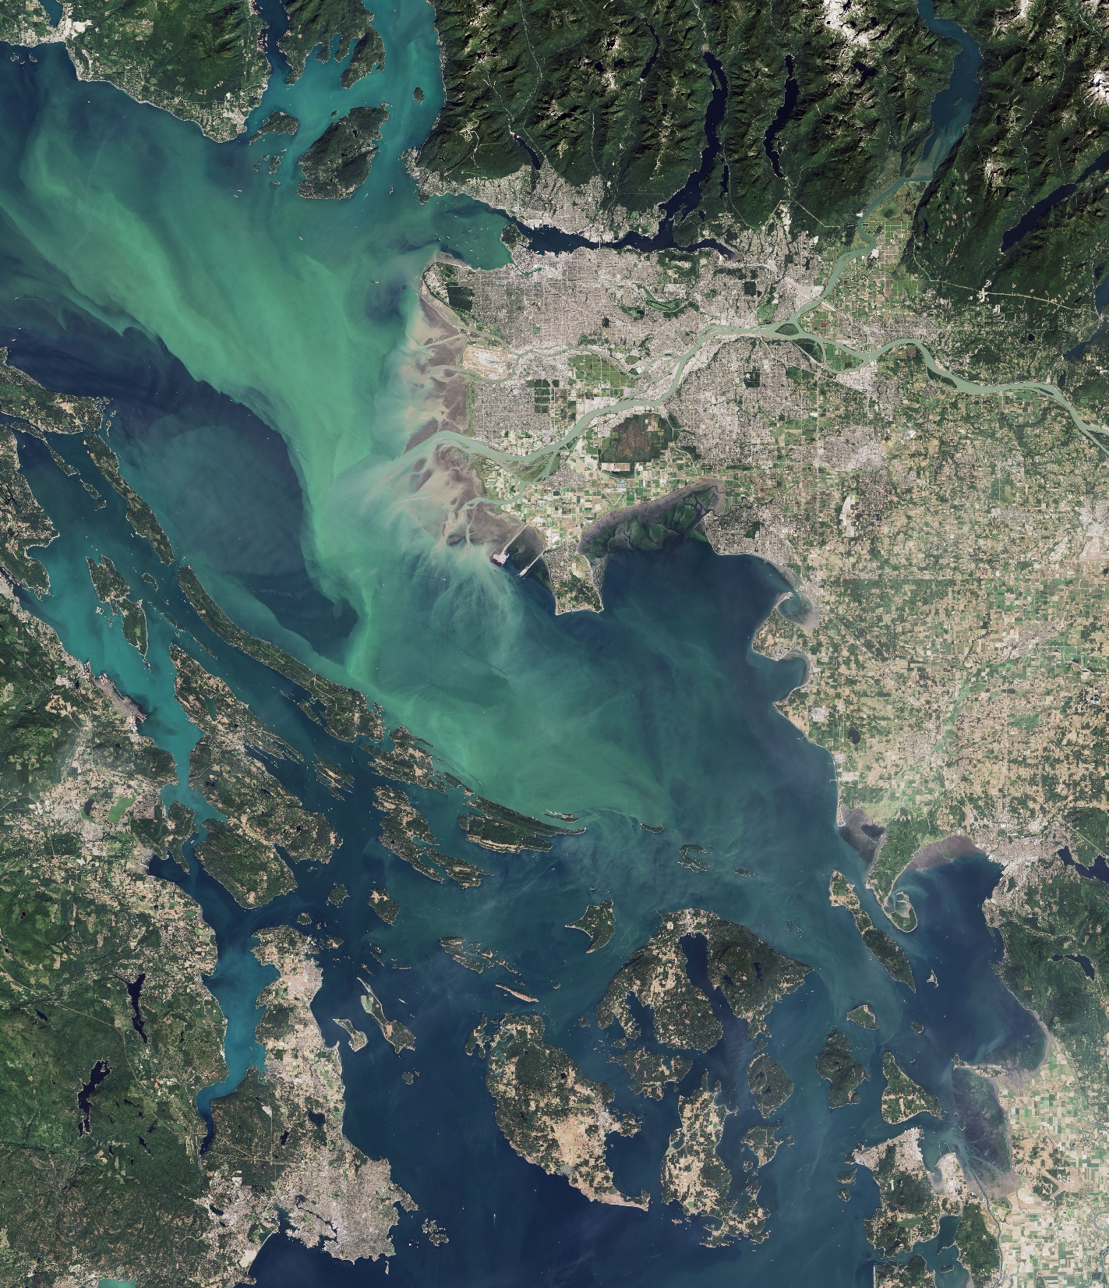
DEVELOP Orientation
Module 4. Resources & Opportunities to Make the Most Of
EARTH
ACTION

Slide 2
RESOURCES & OPPORTUNITIES
People
Programmatic
Technical
Professional Development
Coding Workshops
Virtual Machines
DAACs
Data Pathfinders
DESC
ARSET Trainings
Resources
Leads
Fellows
Senior Fellows
Advisors
Node Networks
National Program Office
NPO Support Team
DEVELOP Alumni
HQ Personnel
Your Teammates
DEVELOPedia
Webinars
NPO Office Hours
LinkedIn & Facebook Groups
Alumni Speakers & Visitors
Professional DEVELOPment Week
Anniversary Events: Meet Ups

Slide 3
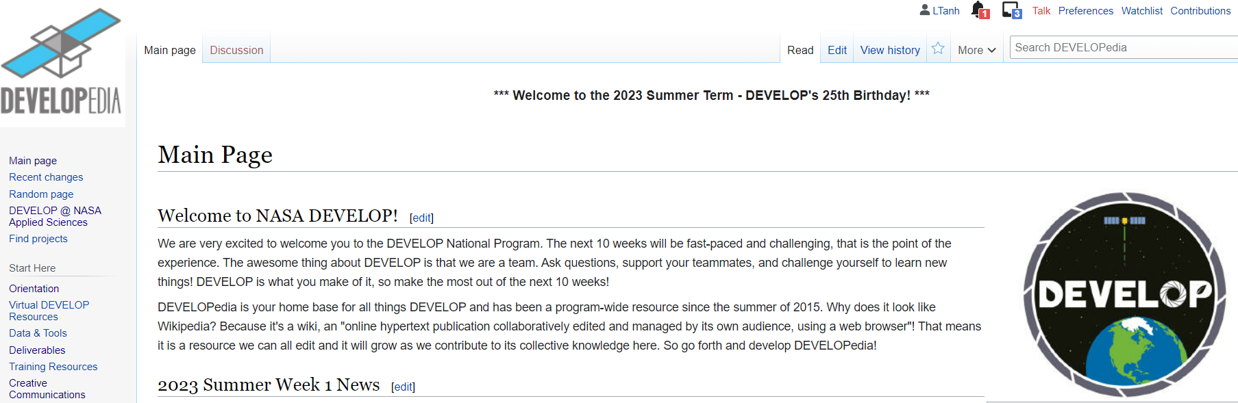
RESOURCES & OPPORTUNITIES
DEVELOPedia
DEVELOPedia is your primary source for all things DEVELOP. It is an internal wiki intended to serve three purposes:
  Share critical information about the program and projects
  Hosts detailed information relating to term logistics (templates, deadlines, etc.)
  Source of information about past projects, participants, resources, guidelines, opportunities, and more!
Visit DEVELOPedia daily for weekly news, due dates, deliverable templates, training resources, past project deliverables, and more! Best Practice: make it your landing page for the term!
DEVELOPedia is a collaborative effort and living document, constantly adapting to meet the needs of the NASA DEVELOP National Program and the people that make the program great (That’s you!).
Note: this is a resource that you keep access to even after your term ends!
Completing Your Personal DEVELOPedia Page is a Week 1 Deliverable!
Make sure to include a picture, a long-term email address, information about your background & interests, & a link to your LinkedIn profile!
http://www.devpedia.developexchange.com
POCs: Laramie Plott & Amanda Clayton

Slide 4
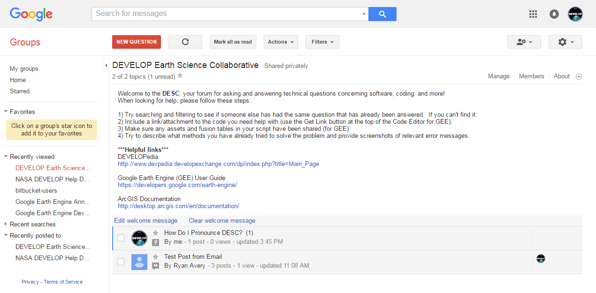
RESOURCES & OPPORTUNITIES
By The Way
The DESC is not a full-service help desk but is crowd sourced by DEVELOP alumni, Leads, & participants – It’s possible that your question could go unanswered.
DEVELOP Earth
Science Collective (DESC)
A forum for all your software, geospatial, and coding questions! Participants should feel welcome and comfortable to help each other troubleshoot and respond to each others’ questions
Can email forum directly like a regular email address
Be sure to attempt troubleshooting on your own as a team and with your Lead before posting
Copy link, go join, and bookmark the DESC on your favorite browser!
https://groups.google.com/d/forum/developesc

Slide 5
RESOURCES & OPPORTUNITIES
Virtual Machines
Virtual machines are a resource for DEVELOPers to run processing and access specific software. Note: Some NASA locations have limitations in accessing VMs due to firewalls. Please turn off your VM after each use to avoid incurring extra costs!
Online Policies:
Virtual machines should be used for DEVELOP purposes only, meaning absolutely no games, commercial radio, or music/video downloads (unless it’s for the project).
No Facebook, Twitter, etc. unless it’s for DEVELOP purposes!
Limited use of personal emails are acceptable as long as they DO NOT interfere with your project work.
Be mindful of the websites you visit and links you click on.
Be diligent against phishing attempts.
Software:
Installation of legally licensed software is permitted if the software is necessary to complete your project – but you must have approval from your Lead.
If you have questions regarding permissibility of software, please contact your Lead.
Do not make copies of proprietary software.

Slide 6
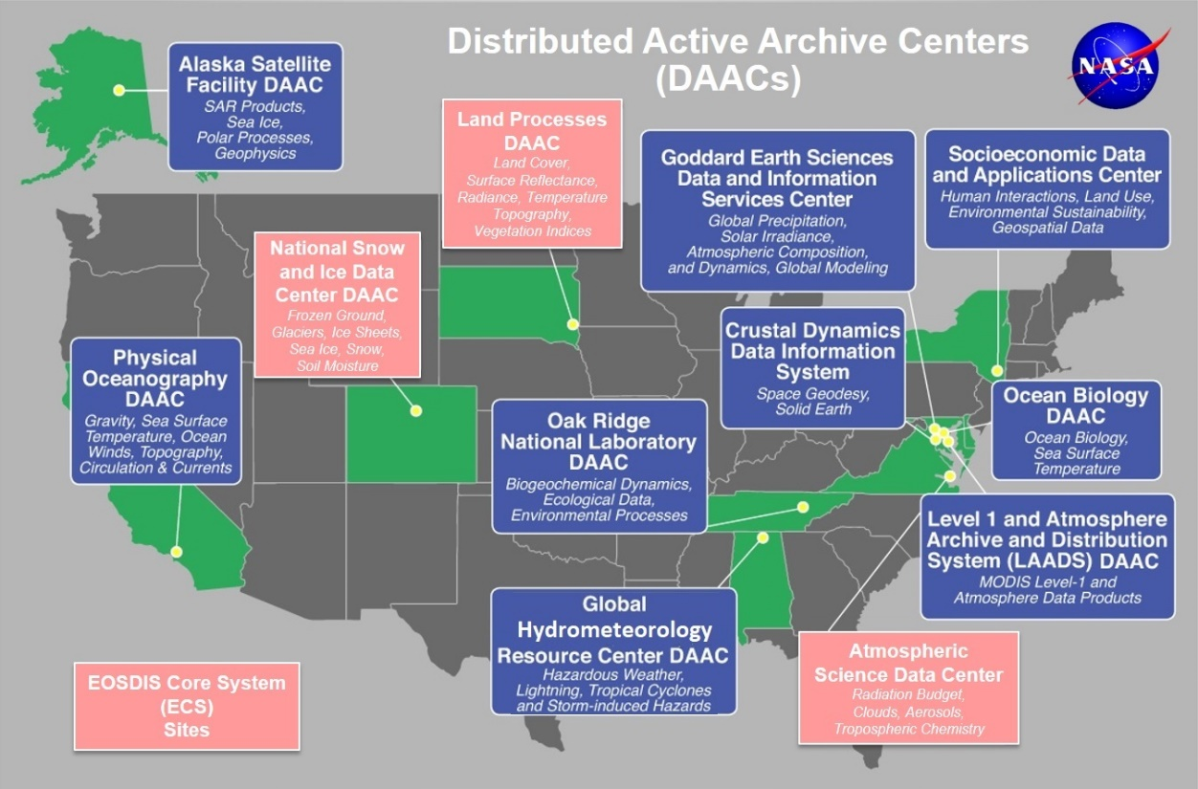
RESOURCES & OPPORTUNITIES
By The Way
DAAC websites are a great way to access NASA Earth observation data! You can also find thorough documentation and metadata attached.
NASA Data Centers (DAACs)
The Earth Observing System Data and Information System (EOSDIS) is designed as a distributed system, with major facilities at Distributed Active Archive Centers (DAACs) located throughout the United States.
These institutions are custodians of EOS mission data and ensure that data will be easily accessible to users.
The EOSDIS DAACs process, archive, document, and distribute data from NASA's past and current Earth-observing satellites and field measurement programs.
DAACs provide services to users whose needs may cross the traditional boundaries of a science discipline, while continuing to support the particular needs of users within the discipline communities. User services include:
  Assistance in selecting and obtaining data
  Access to data-handling and visualization tools
  Notification of data-related news
  Technical support and referrals

Slide 7
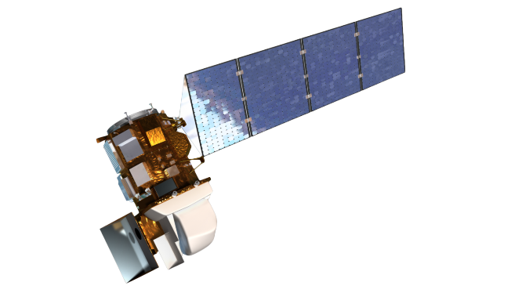
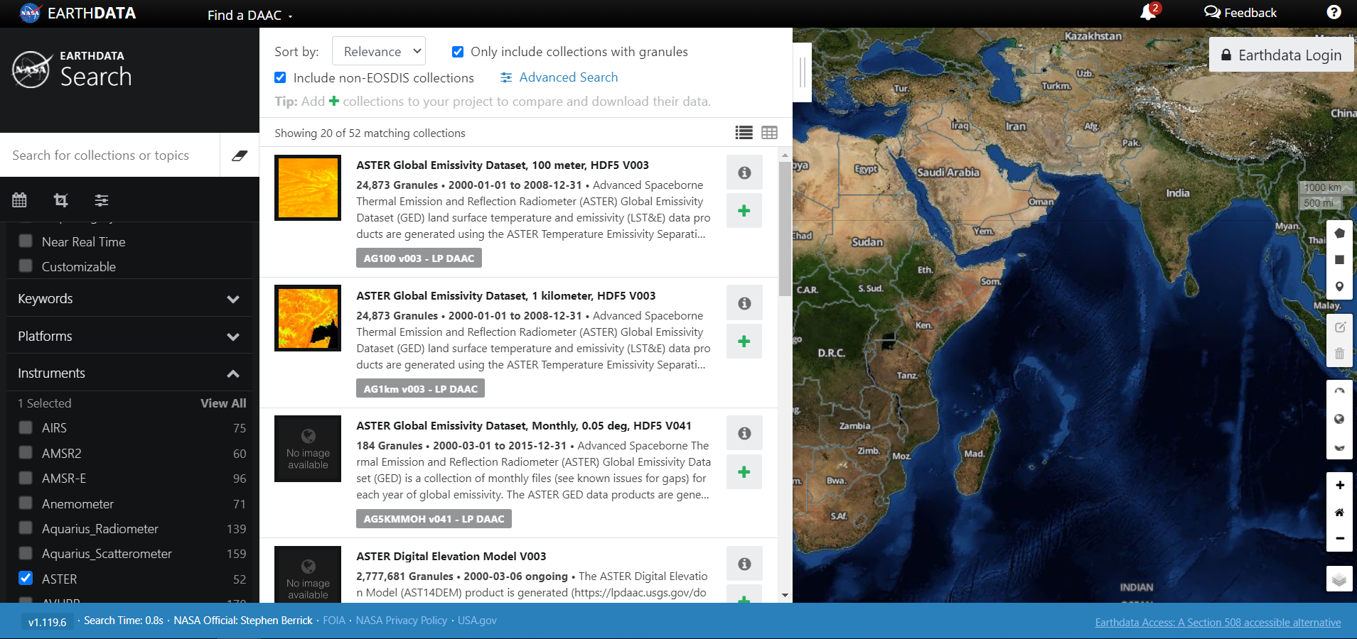
RESOURCES & OPPORTUNITIES
DAAC Resources
Need access to NASA data? Check out the following sites:
EOSDIS Distributed Active Archive Centers (DAACs) https://earthdata.nasa.gov/about/daacs
Earth Data Search https://search.earthdata.nasa.gov/search
Earthdata Forum https://forum.earthdata.nasa.gov/
  Ask questions about data types, access, issues, etc.
LP DAAC AppEEARS https://lpdaac.usgs.gov/tools/appeears/
  Simple and efficient data access and transformation
Now where did I put those data…?
New to using NASA Earth science data?
Data Pathfinders provide direct links to commonly-used datasets across NASA’s Earth science data collections
· Agriculture & Water Resources
· Biological Diversity & Eco Forecasting
· Geographic Information Systems
· Disasters· Health & Air Quality· Wildfires

Slide 8

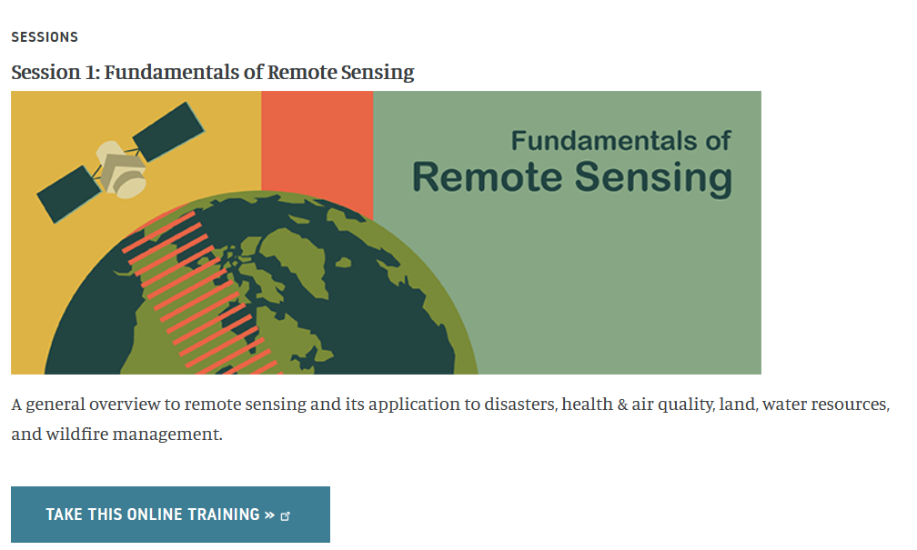
RESOURCES & OPPORTUNITIES
By The Way
ARSET is a great resource for brushing up on your remote sensing skills!
ARSET
Through ARSET trainings, you can learn how to:
Use NASA data for environmental management
Search and access NASA resources relevant to your needs
Visualize, interpret, and apply remote sensing data and imagery
Remote Sensing Fundamentals: These webinars are available for viewing at any time. They provide basic information about the fundamentals of remote sensing and are often a prerequisite for other ARSET trainings. https://appliedsciences.nasa.gov/join-mission/training/english/fundamentals-remote-sensing
  Session 1: Fundamentals of Remote Sensing
  Session 1A: NASA’s Earth Observing Fleet
  Session 2A: Satellites, Sensors, Data and Tools for Land Management and Wildfire Applications
  Session 2B: Satellites, Sensors, and Earth Systems Models for Water Resources Management
  Session 2C: Fundamentals of Aquatic Remote Sensing
https://appliedsciences.nasa.gov/what-we-do/capacity-building/arset

Slide 9
RESOURCES & OPPORTUNITIES
Coding Workshops
DEVELOP offers optional coding workshops for participants to build and improve their programming skills.
Participants can choose between:
  Python – covers the basics of Python programming and introduces geospatial Python topics including the use of ArcPy for ArcGIS Pro. Good for participants who have never programmed or never used Python before. Cannot enroll in R if enrolled in Python. 10/1-10/3
  R – covers the basics of R programming and introduces geospatial R topics. Good for participants who have never programmed or never used R before. Cannot enroll in Python if enrolled in R. 10/1-10/3
  Advanced Topics – covers advances geospatial methods for using R, Python, and ArcPy to retrieve and process imagery. Good for all Participants regardless of skill level 10/8-10/10
Times and dates for all workshops available on the Fall 2024 Events calendar.

Slide 10
RESOURCES & OPPORTUNITIES
Webinars & Workshops
DEVELOP offers webinars and workshops periodically through the term to share information about a variety of topics including:
Weekly deliverable webinars (video posts on Teams)
DAAC Workshops – 9/24 12-5p ET
Fundamentals of Remote Sensing – 9/25, 3-4p ET
Esri Cartography Webinar – 9/30, 3-4p ET
Esri Office Hours #1 – 10/8, 2-3p ET
Esri Office Hours #2 – 10/23, 4-5p ET

Slide 11




RESOURCES & OPPORTUNITIES
DEVELOP Social Media
DEVELOP National Program: features projects, node highlights & accomplishments, VPS announcements www.facebook.com/developnationalprogram
Once a DEVELOPer, Always a DEVELOPer: job posts
https://www.facebook.com/groups/387243741376125/
Articles & Important Events: Tweet @NASA_DEVELOP or #NASADEVELOP
http://twitter.com/#!/nasa_develop
NASA DEVELOP National Program:
Project and promotional videos www.youtube.com/user/NASADEVELOP
NASA DEVELOP National Program: job posts, job skills & tips, and important events. This is a private group! Follow the link to join!
www.linkedin.com/groups/4343498
By The Way
Watch time spent on social media during work hours. If you are going to be on it, you should probably be on the DEVELOP pages liking and commenting on DEVELOP posts!

Slide 12
RESOURCES & OPPORTUNITIES
Opportunities
Reapplying to DEVELOP
Lead & Fellow Positions
Professional DEVELOPment Week
DEVELOP Day
Presenting DEVELOP Work
Publishing
Conference Attendance

Slide 13
RESOURCES & OPPORTUNITIES
Reapplication & Eligibility
DEVELOP Terms: 10 weeks
Classifications:
Currently Enrolled Student
Recent Graduate (within 2 years of graduation)
Early or Transitioning Career Professional (2+ years after graduation from last degree)
Eligibility Requirements:
18+
Minimum 3.0 GPA (for paid positions)
Strong interest in Earth science and remote sensing
Able to provide personal transportation to and from DEVELOP location
DEVELOP does not provide transportation to nodes nor can DEVELOP provide a badge to a participant’s driver to gain access to NASA Centers
U.S. citizenship is required to apply to the following in-person opportunities: ARC, JPL, LaRC, MSFC, GSFC, NCEI
Reapplication:
Required if you would like to continue with DEVELOP in a future term
The returning application is shorter and does not require letters of recommendation
By The Way
Applications for the Fall DEVELOP term are currently open and close on Oct 4th.

Slide 14
RESOURCES & OPPORTUNITIES
Enhanced Capacity Building Opportunities
We will compete multiple full-time Lead and Fellow opportunities this fall that will begin in January 2025!
Application information will be posted to DEVELOPedia soon.
Lead Positions
California – Ames (ARC)
California – JPL (JPL)
Colorado – Fort Collins (CO)
Georgia – Athens (GA)
Fellow Positions
To be announced

Slide 15
RESOURCES & OPPORTUNITIES
Leads
Leads manage a DEVELOP Node (75%) and provide Programmatic Support (25%). Leads are located at the DEVELOP Node they manage: ARC, CO, GA, GSFC, ID, JPL, LaRC, MA, MSFC, NC.
Eligibility: US Citizenship, college degree with min 3.0 GPA, 1+ term(s) with DEVELOP, Recent Graduate or Early/Transitioning Career Professional applicant status, ability to begin the position in early September at the office location, and ability to work 40 hours/week during standard business hours.
Responsibilities:
Participant Management – selections, onboarding, performance tracking, time management, professional development
Project Management – idea generation, proposal writing, project execution, deliverable reviews, project handoff
Partner Engagement & Relationship Management – identify new partners, manage relationships, coordinate handoffs
Office Management – lead logistics for the DEVELOP node, networking, coordination of resources, etc.
Programmatic Support – support programmatic and element team initiatives & tasks as assigned, support travel and representation at conferences, meetings, pop-up locations, etc.

Slide 16
RESOURCES & OPPORTUNITIES
Fellows
Fellows lead programmatic support specific to an Element (Communications, Project Coordination, Impact Analysis, Geoinformatics) or an Initiative (Pop-Up Projects). Element & Initiative Fellows can be located at a NASA Center (ARC, GSFC, JPL, LaRC, MSFC).
Eligibility: US Citizenship, college degree with min 3.0 GPA, 1+ term(s) with DEVELOP, Recent Graduate or Early/Transitioning Career Professional applicant status, ability to begin the position in early September at the office location, and ability to work 40 hours/week during standard business hours.
Element Fellow Responsibilities:
Lead Element Initiatives – manage element initiatives, complete programmatic tasks, track timelines and progress, communicate efforts to the program, support reporting requirements to NASA HQ
Programmatic Support – support programmatic activities beyond their Element as assigned
Initiative Fellow Responsibilities:
Programmatic Support – support programmatic and element team initiatives & tasks as assigned, travel support
Partner Engagement & Relationship Management – identify new partners, manage relationships, coordinate handoffs
Participant Management – selections, onboarding, performance tracking, time management, professional development
Project Management – idea generation, proposal writing, project execution, deliverable reviews, project handoff

Slide 17
RESOURCES & OPPORTUNITIES
Element Fellow Responsibilities
Geoinformatics
Project Coordination
Communications
Impact Analysis
Tutorial Collection & Curation
DEVELOP Code Curation
Software Carpentry Instruction
Curation & Communication of GIS & RS Resources
Coordination w/DAACs
Deliverable Review
Export Control Submissions
Project Webpage Content
DEVELOPedia Project Pages
Coordinate Recruiting Efforts
Social Media
Ambassador Corps
Review & Manage Creative Communication Deliverables
Support Newsletter Production
Write Web Features
Exit Surveys
Manage PGA
Collect Indicators
Conduct Partner & Alumni Interviews/Features
Create Term Report Card

Slide 18
RESOURCES & OPPORTUNITIES
Senior Fellows
Senior Fellows support programmatic needs and work across Elements managing specific activities. They are part of the NPO Support Team and responsibilities will be assigned based on interest, skill, and programmatic need.
Senior Fellows are located at LaRC.
Eligibility: US Citizenship, college degree with min 3.0 GPA, 2+ term(s) with DEVELOP, Recent Graduate or Early/Transitioning Career Professional applicant status, ability to begin the position in early September at LaRC, and ability to work 40 hours/week during standard business hours.
Collective Senior Fellow Responsibilities:
Coordinate Software Carpentry Trainings
Oversee Software Release Handoffs
Manage CSDA Use
Manage StoryMaps
Manage Export Control Submission Process
Review Deliverables
Update DEVELOPedia
Update Orientations
Manage Mailman Listserv
Produce Annual Newsletter
Maintain Project & Partner Tracking Sheets
Collect Content for Monthly Reports & ESD Weeklies
Support travel to conferences, meetings, site visits, pop-up locations, etc.

Slide 19

RESOURCES & OPPORTUNITIES
Join the Ambassador Corps
The DEVELOP Ambassador Corps was established in Summer 2013 to amplify the presence of DEVELOP and the NASA’s Earth Action at university campuses and increase the number of applicants from qualified participants not near DEVELOP nodes.
DEVELOP Ambassadors make a volunteer commitment to represent DEVELOP at their academic institution, as well as in their professional workplaces and additional communities.
Roles & Responsibilities:
Share information about NASA DEVELOP (and NASA’s Earth Action)
Increase the number of applications from qualified students and recent graduates from universities who are not near DEVELOP nodes and have historically been underrepresented at DEVELOP
Engage in personal and peer-to-peer conversations with potential applicants and emphasize the diversity of DEVELOP experiences
Interested? Reach out to Jennifer Hall (Jennifer.Hall@ama-inc.com)

Slide 20
MENTORSHIP OPPORTUNITY
Connect with an Alumni Mentor
DEVELOP alumni are incredible sources of knowledge, support, and networking. Whether they were a participant recently or long ago, our alumni have plenty of career advice to offer, as well as tips and tricks to help participants succeed during the term. For the Fall 2024 term, we are offering participants the opportunity to be paired with an alumni mentor.
What to Expect
Virtual mentorship meetings: Participants and alumni are expected to meet several times on Teams throughout the term. In-person meetings are not expected or required, but are a bonus if mentors/mentees are close enough.
Engaging and helpful career discussions: Alumni mentors will be matched with participants based on each participant’s career interests.
A safe space to discuss challenges: Mentees are encouraged to come with questions.
For more information, please review the guidelines. To participate as a mentee, please take the interest survey by 9/19.

Slide 21


RESOURCES & OPPORTUNITIES
Professional DEVELOPment Week
Networking and professional development are two critical aspects of DEVELOP!
In week 5, DEVELOP hosts a variety of skill-building activities, guest speakers, and other professional development opportunities. Take advantage of these if you can! Events this fall include:
  Academic Panel
  Career Panel
  Speaker Series
  Cover Letter Workshop

Slide 22
RESOURCES & OPPORTUNITIES
Presenting & Publishing Your Work
For the purposes of ensuring appropriate export control review, performance metric tracking, and reporting to NASA HQ, any and all presentations or publications related to DEVELOP (projects or the program in general) must be communicated to, and content shared with, NPO before submission of the presentation or publication.
Submitting work for presentation or publication is encouraged; however, ALL research is shared property of NASA; therefore, you must have permission prior to submitting your research anywhere.
Coordinate with your Lead, and, if approved at your node, send a simple email with your ideas before the presentation or publication to Amanda.L.Clayton@nasa.gov with the following information:
  Description of the activity – conference, presentation to a class, publication, etc.
  Timeline for the activity – when the event is or deadline for publication, etc.
  Cost estimate (if applicable) – DEVELOP has a small amount of funds set aside to support publishing and presenting work.

Slide 23
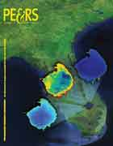
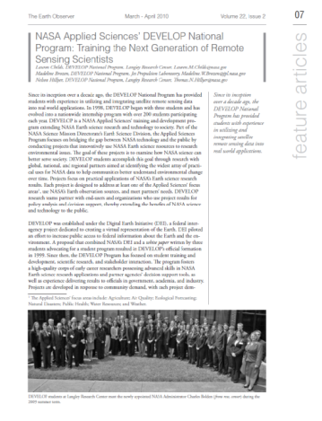
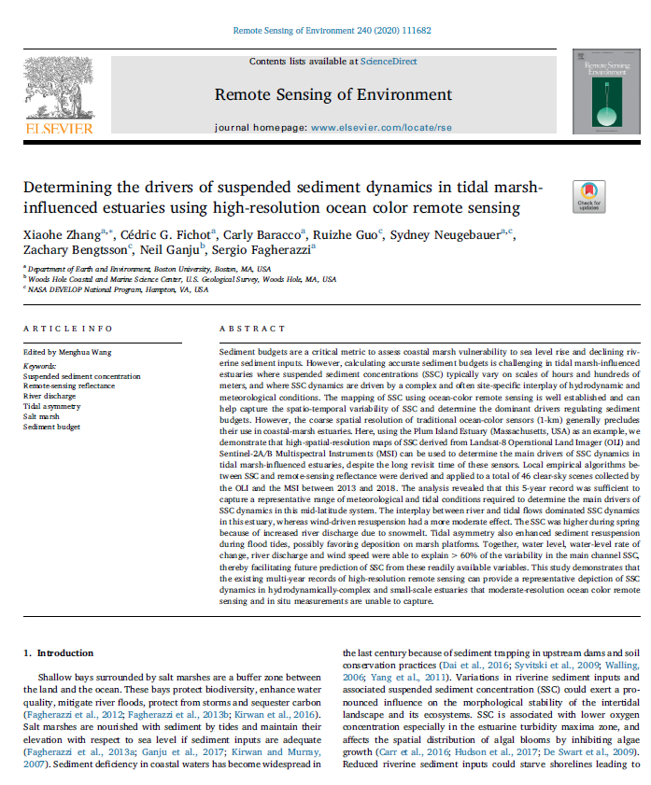
RESOURCES & OPPORTUNITIES
By The Way
DEVELOP publishes in both peer-reviewed venues and in “gray literature” venues! You can see all of the publications on the DEVELOP website’s Media Page.
Publications
Publications are a great avenue for getting the word out about the great research you are a part of with DEVELOP!
DEVELOP usually publishes a 2-3 peer-reviewed articles each year
Publications can be pursued by motivated DEVELOPers, however, they are not a metric of project success and this work is typically outside DEVELOP.
If you are interested in working your project toward a potential publication, contact your Lead, Project Coordination, and Amanda.
Reminder: All publications must be approved by NPO and NASA’s Export Control process before submission! This means before you ever send a draft to the publisher!

Slide 24
RESOURCES & OPPORTUNITIES
By The Way
You might be interested in publishing as soon as week 1 of the term! However, we recommend waiting to see the project results before deciding if your outcomes are fit for publication!
Publication Process
Discuss with your Lead and Science Advisor
Select publication venue
Contact Amanda Clayton (Amanda.L.Clayton@nasa.gov) for NPO pre-approval
Draft the manuscript
Submit draft to NPO for review
NPO and project team go back-and-forth with edits to create a final version
NPO submits this pre-print version into export control – NASA Export Control takes about 2-6 weeks
Once approved, the content can be submitted to the publication venue
Keep Amanda in the loop with any and all edits from the publisher
The final-final version must be resubmitted to NASA Export control

Slide 25
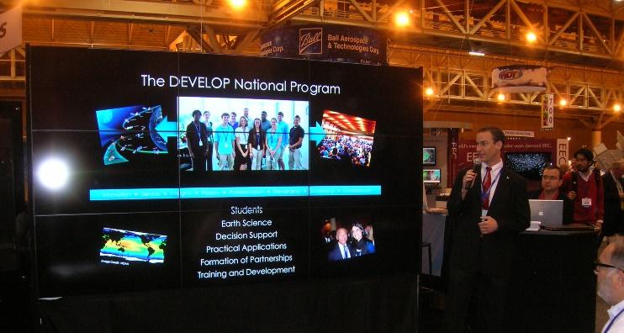
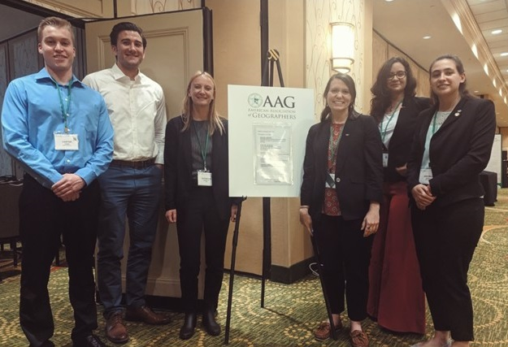
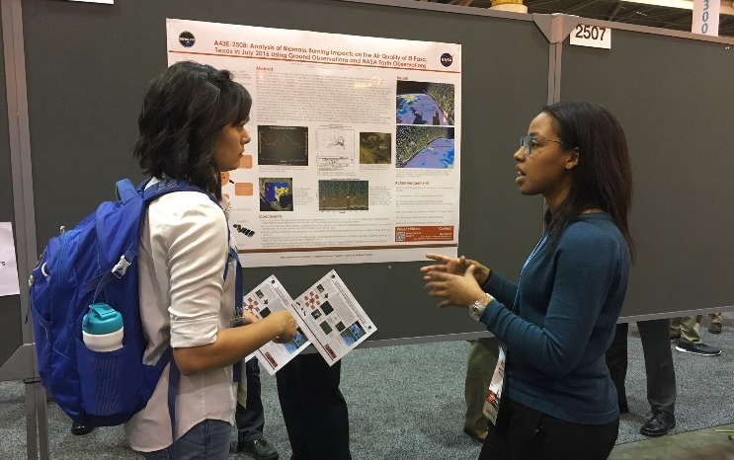
RESOURCES & OPPORTUNITIES
Conferences
DEVELOP presents projects at over 30 conferences each year.
If you have an idea for a conference you’d like to attend (virtual or in-person), discuss with your Lead and together reach out to NPO.
There is a small travel pot provided to each node to support some travel, however those funds may already be accounted for at any specific time.
Ways to attend cost-effectively:
  Choose a conference that is virtual or local
  Present DEVELOP work at a conference you already are planning to attend either for school or personally.
  Pursue school-funding opportunities.
  Apply for travel grants offered by professional societies.
  Look for opportunities to volunteer in exchange for registration or travel costs.
  Look for competitions like the AGU Michael Freilich Data Visualization & Storytelling Contest.
By The Way
Many virtual conferences are free to attend – take advantage of this! Look at opportunities like: AmeriGEO Week, Society for Conservation GIS, Esri User Conference (plenary is free), etc.

Slide 26
Thank You.
Explore all of the resources available to you! And if you find helpful resources, share them!

