Slide 1
Huntsville Urban Development II
Utilizing NASA Earth Observations to Map the Urban Heat Island and Evaluate Heat Vulnerability in Huntsville, Alabama
James Karroum • Awroni Bhaduri • Kindrea Gibbons • Natalie O’Kraski
Alabama — Marshall | Summer 2023

Slide 2
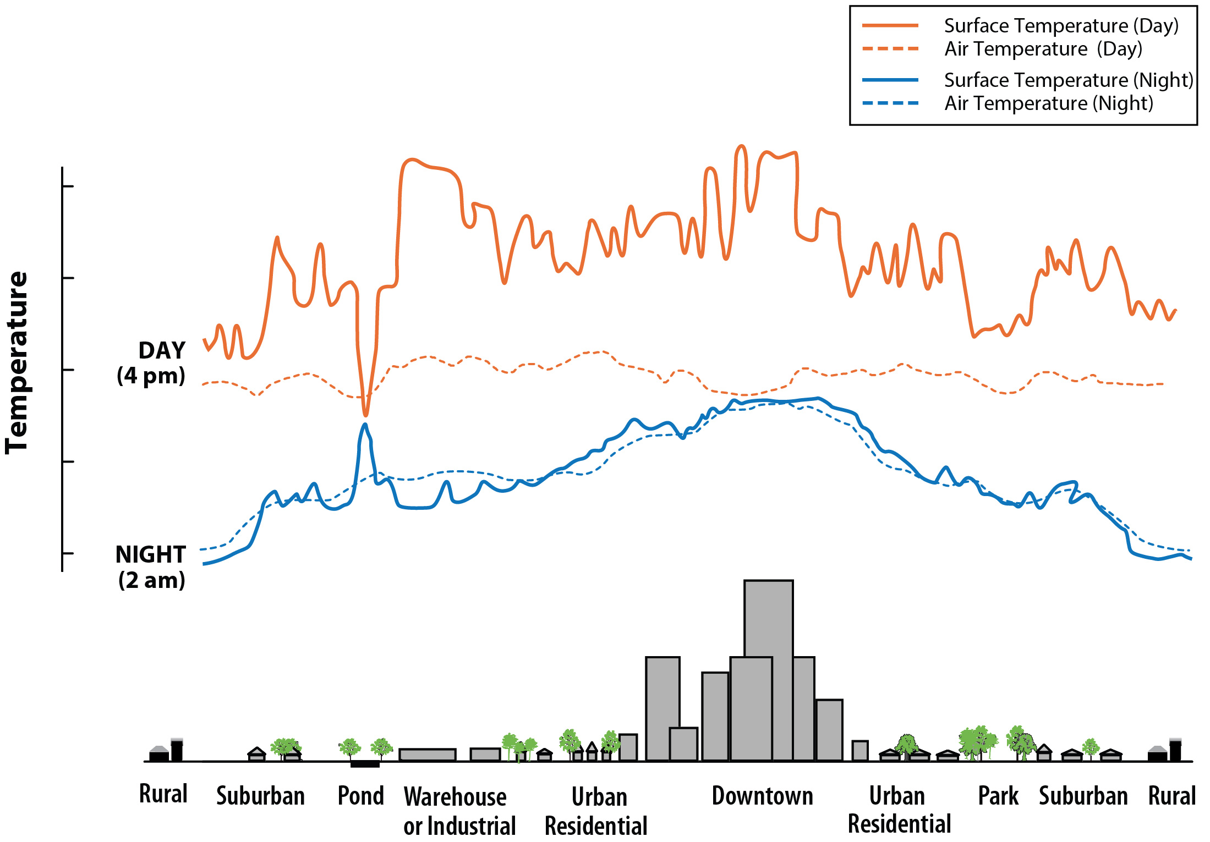
Scientific Background: Urban Heat Islands
Causes
Change in surface reflectance, emissivity, and conduction of heat.
Wind flow disruptions
Decreased water infiltration
Decreased soil moisture
Effects
Increased energy consumption
Decreased air quality
Adverse human health impacts
Image Credit: USGS
Notes:
Urban Heat Islands are urbanized areas that experience higher temperatures due to reduced natural landscapes and the presence of urban materials. This leads to increased energy consumption, decreased air quality, and adverse human health impacts. Increased temperatures from UHI have direct effects on human health. The elderly, children, individuals with preexisting conditions, and underprivileged households are most susceptible to heat morbidity.
------------------------------Image Information Below ------------------------------
•Image Credit: USGS
•Image Source: https://www.usgs.gov/media/images/urban-heat-islands (Public domain)

Slide 3
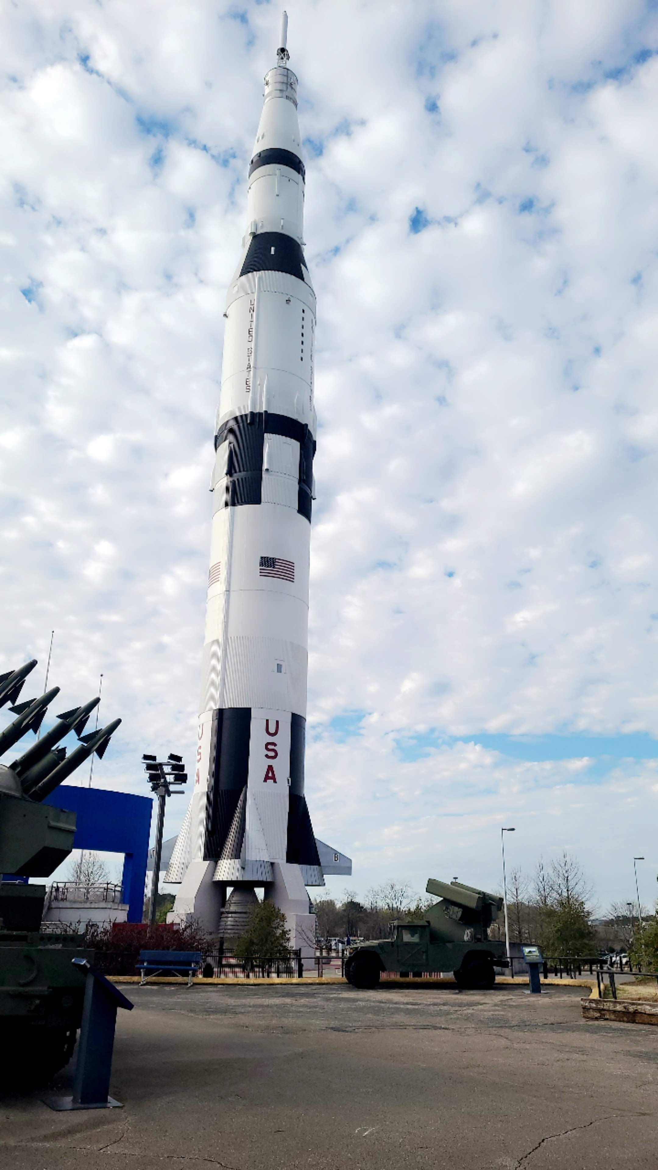
Partners
City of Huntsville
​Director of Urban and Economic Development
Arborist – Landscape Management Department
Geographic Information Systems Manager
Image Credit: Kindrea Gibbons
Notes:
The team partnered with the City of Huntsville’s Director of Urban and Economic Development (Shane Davis), Arborist within the Landscape Management Department (Marc Byers), and Geographic Information Systems (GIS) Manager (Amy Kenum). Decision-making capabilities and implementation processes vary among departments, as each office collaborates with city leaders to develop policies and sustainable plans to increase tree cover, reducing the effects of the UHI in Huntsville. The city currently does not have the capacity to conduct remote sensing analysis and hopes this collaboration will shed light on the various remote sensing and Google Earth Engine (GEE) analysis that are useful in urban planning research.
------------------------------Image Information Below ------------------------------
•Image Credit: Kindrea Gibbons
•Image Source: taken by participant

Slide 4
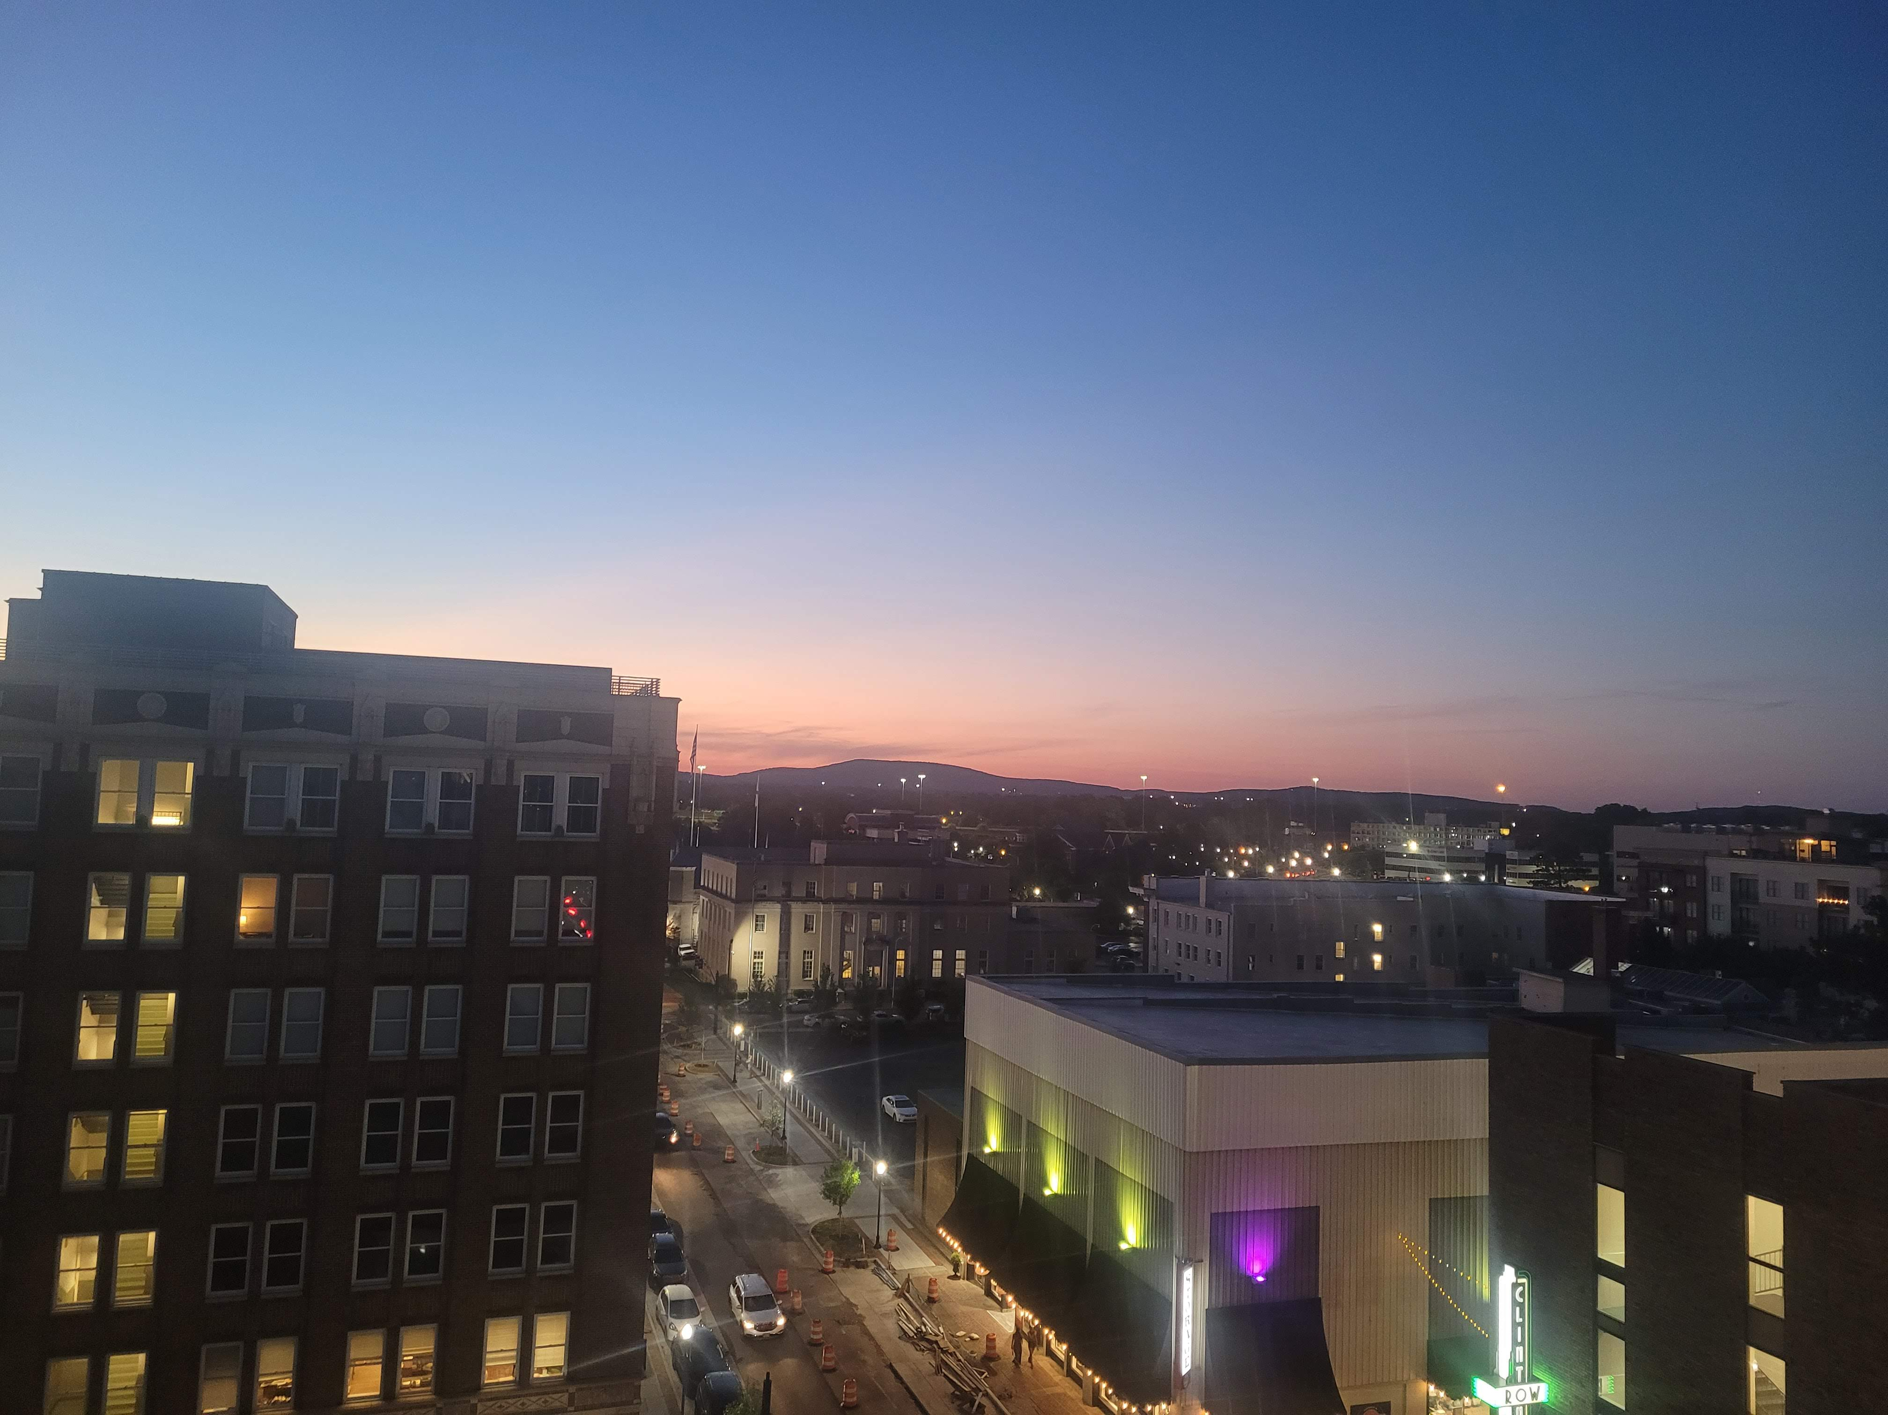
Objectives
Map changes in land surface temperature (LST) and vegetation/permeability over time.
Classify roof materials’ impact on UHI.
Assess priority areas for urban tree planting based on the UHI and heat vulnerability.
Image credit: Kindrea Gibbons
Notes:
Changes in LST were processed and mapped using ECOSTRESS data in ArcGIS Pro. Classification of roof materials was done by processing Maxar Imagery in Google Earth Engine and ArcGIS Pro. Assessing socioeconomic risk factors was done by processing census-block and LST data in Google Earth Engine and ArcGIS Pro.
------------------------------Image Information Below ------------------------------
Image Credit: Kindrea Gibbons
Image Source: Taken by participant

Slide 5
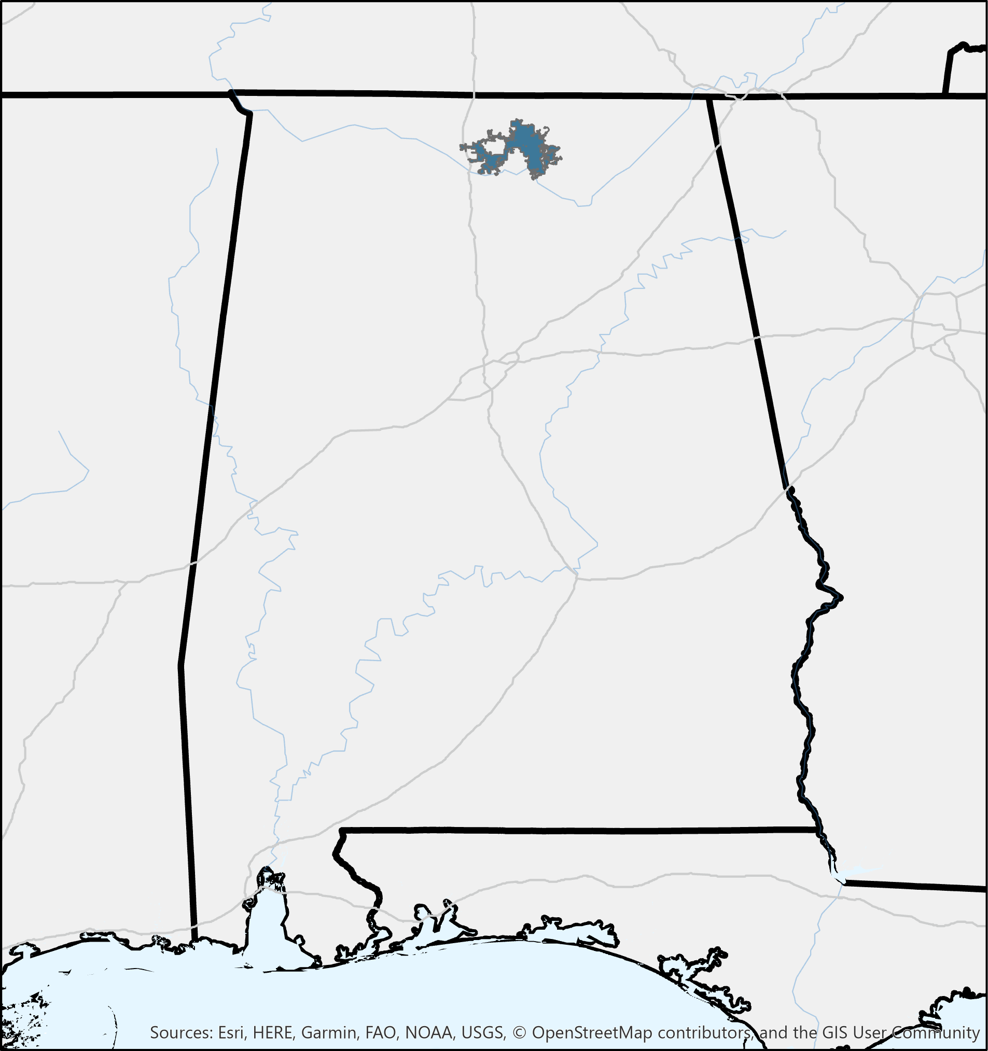
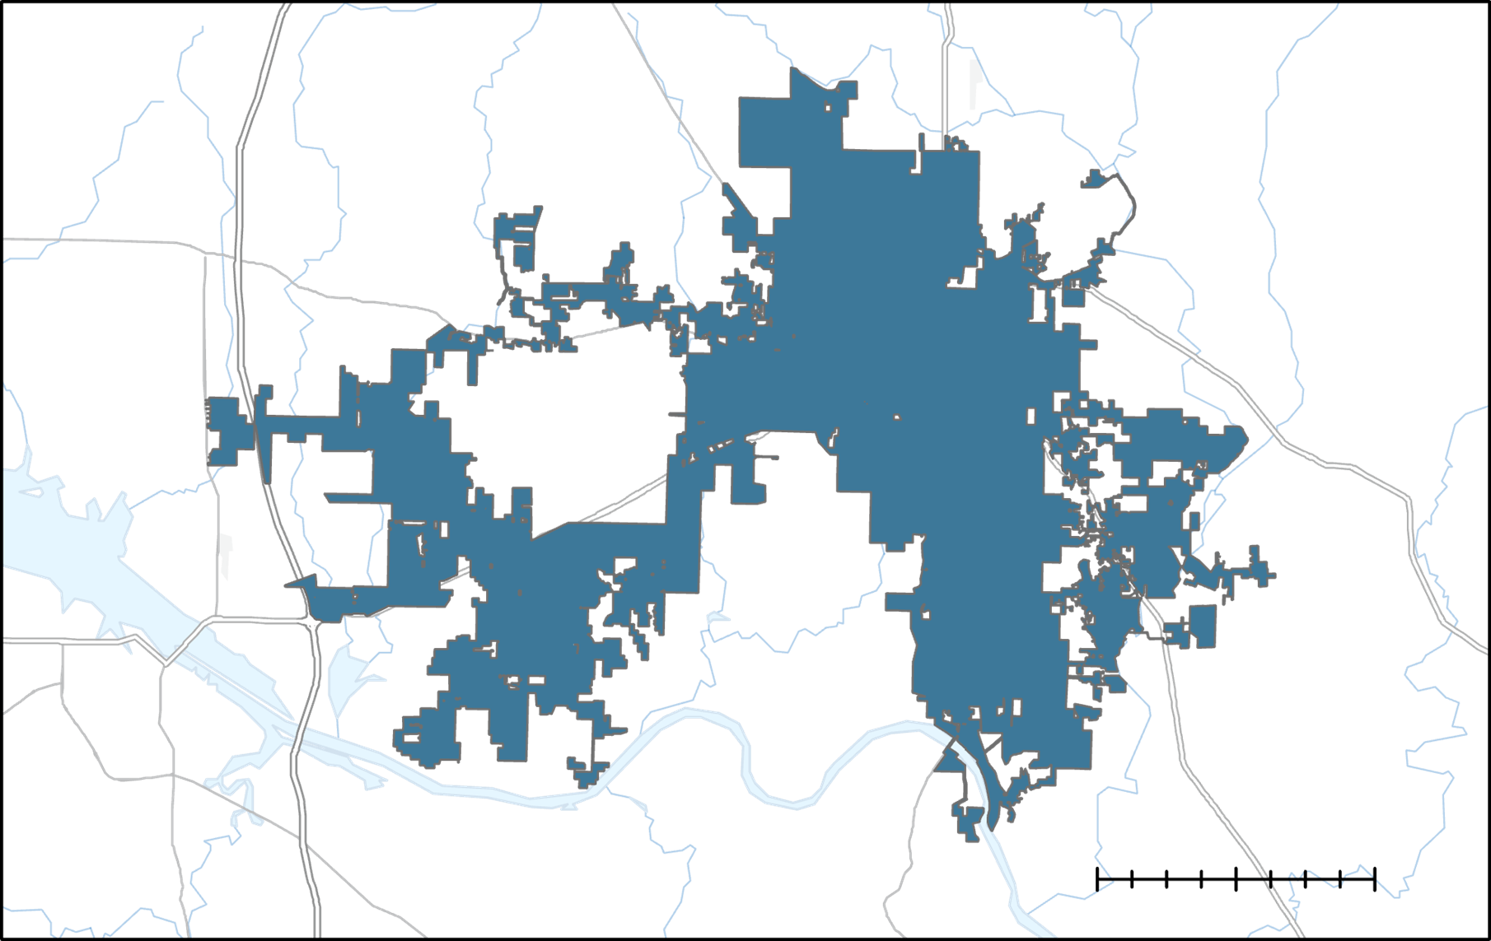
Study Area & Study Period
Huntsville, AL
Alabama
​
Study Period:
2019 to 2022
Huntsville
June to August of each year
0 8.5 17
miles
Notes:
The study area of this project is the city of Huntsville focusing on Identifying UHIs during the meteorological summer consisting of June to August of 2019 through 2022.
------------------------------Image Information Below ------------------------------
Image credits: Awroni Bhaduri
Image Source: Created by Participant in Arc GIS Pro.
Basemap credits: Esri, HERE, Garmin, GAO, NOAA, USGS, © OpenStreetMap contributors, and the GIS User Community

Slide 6
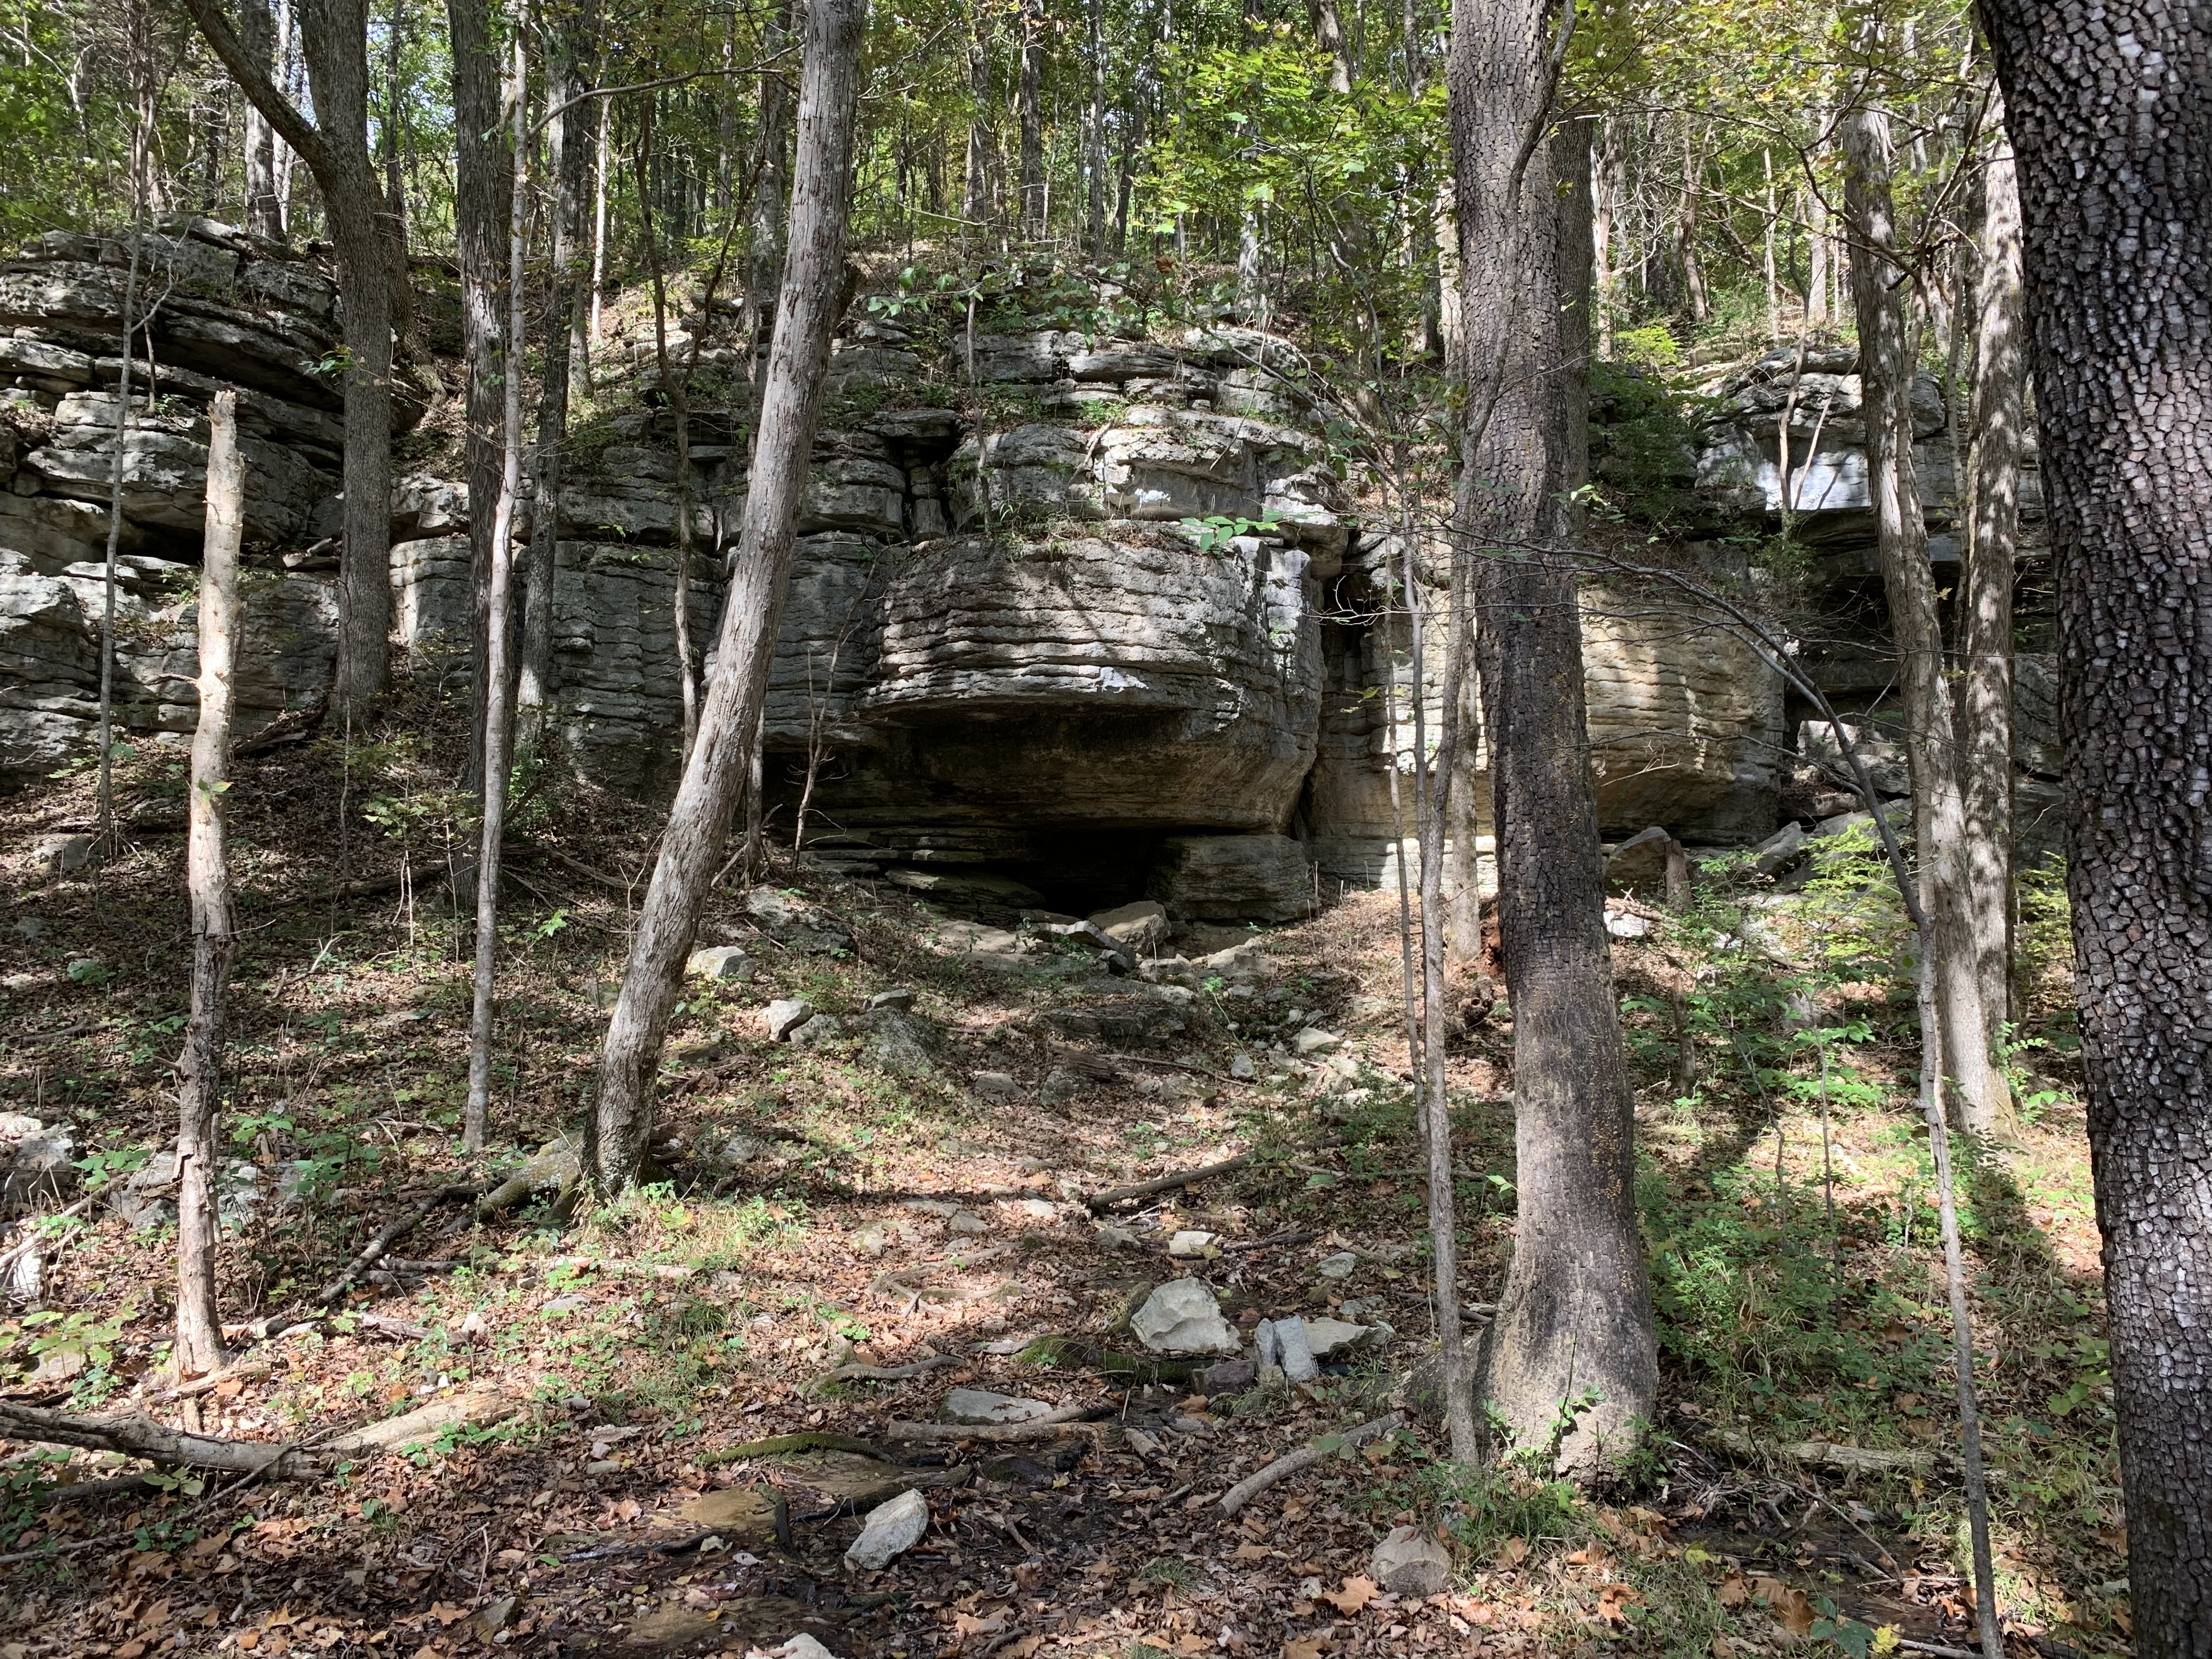
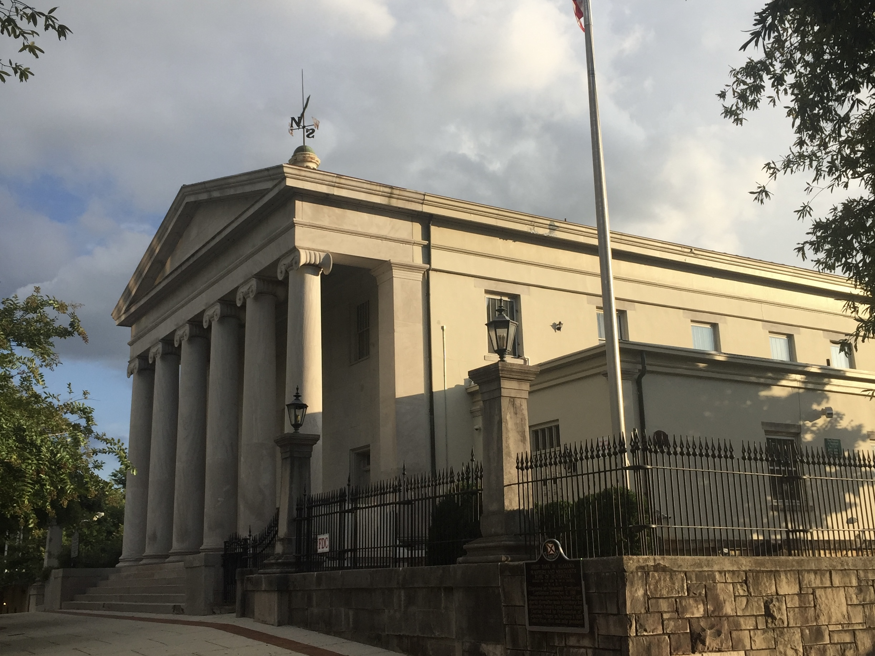
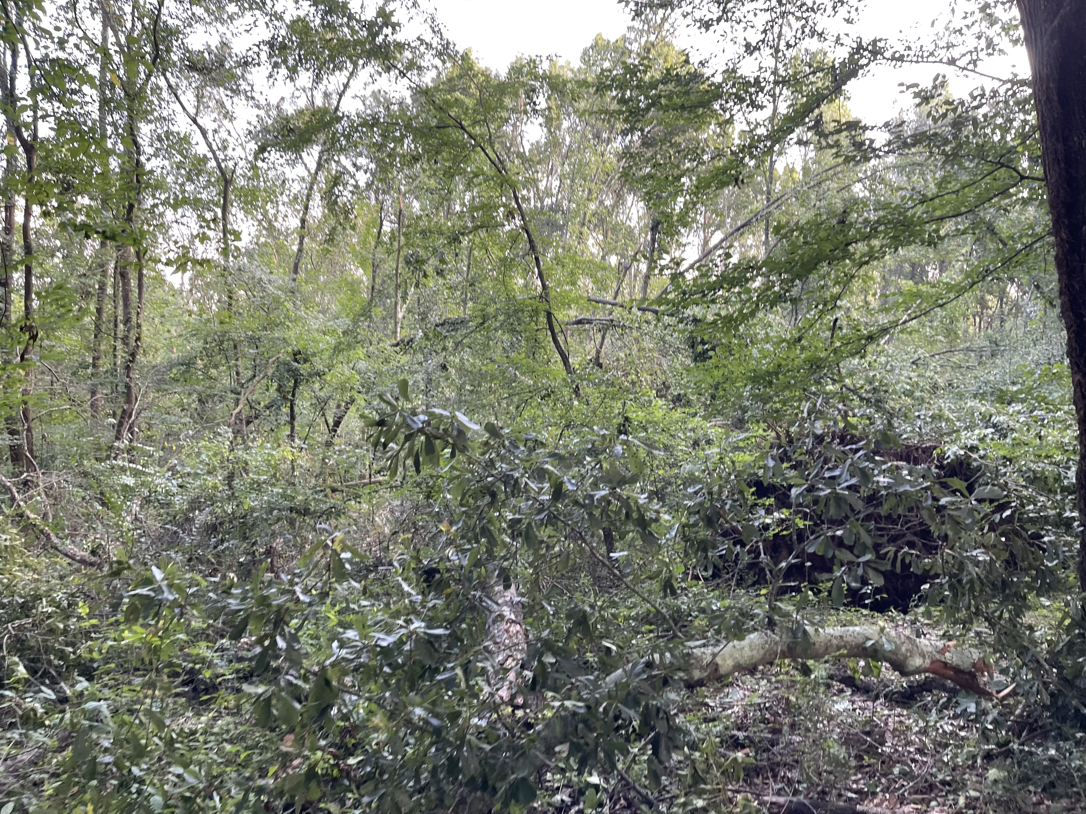
Community Concerns
Asphalt and tree impact on temperature
Impact of additional heat on community and vulnerable Populations
Impact of urban expansion on natural beauty of Huntsville
Image credits: Natalie O'Kraski
Notes:
------------------------------Image Information Below ------------------------------
•Image Credit: Natalie O'Kraski
•Image Source: Taken by participant

Slide 7
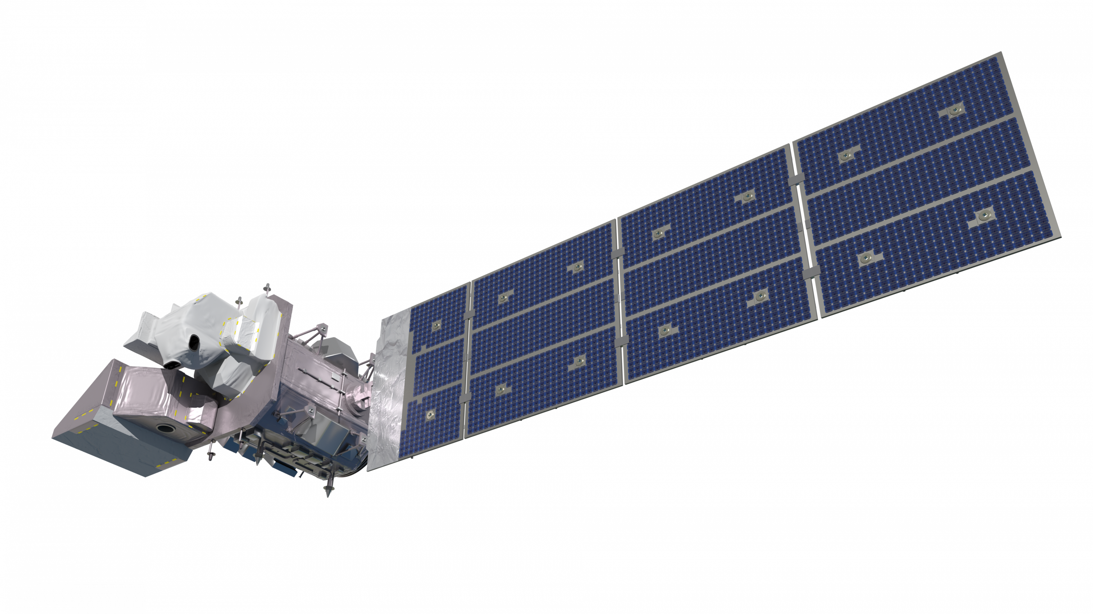
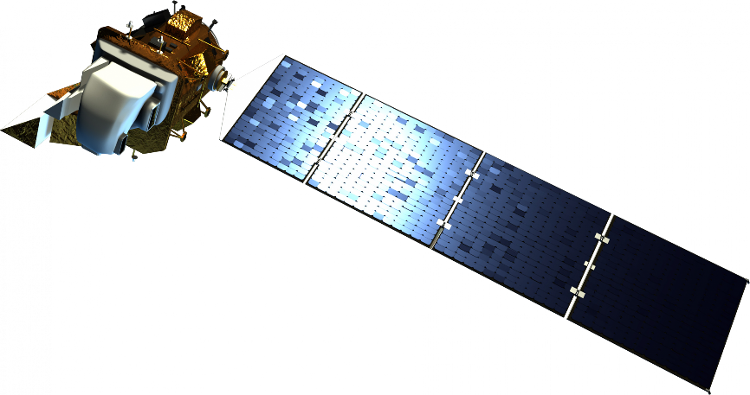
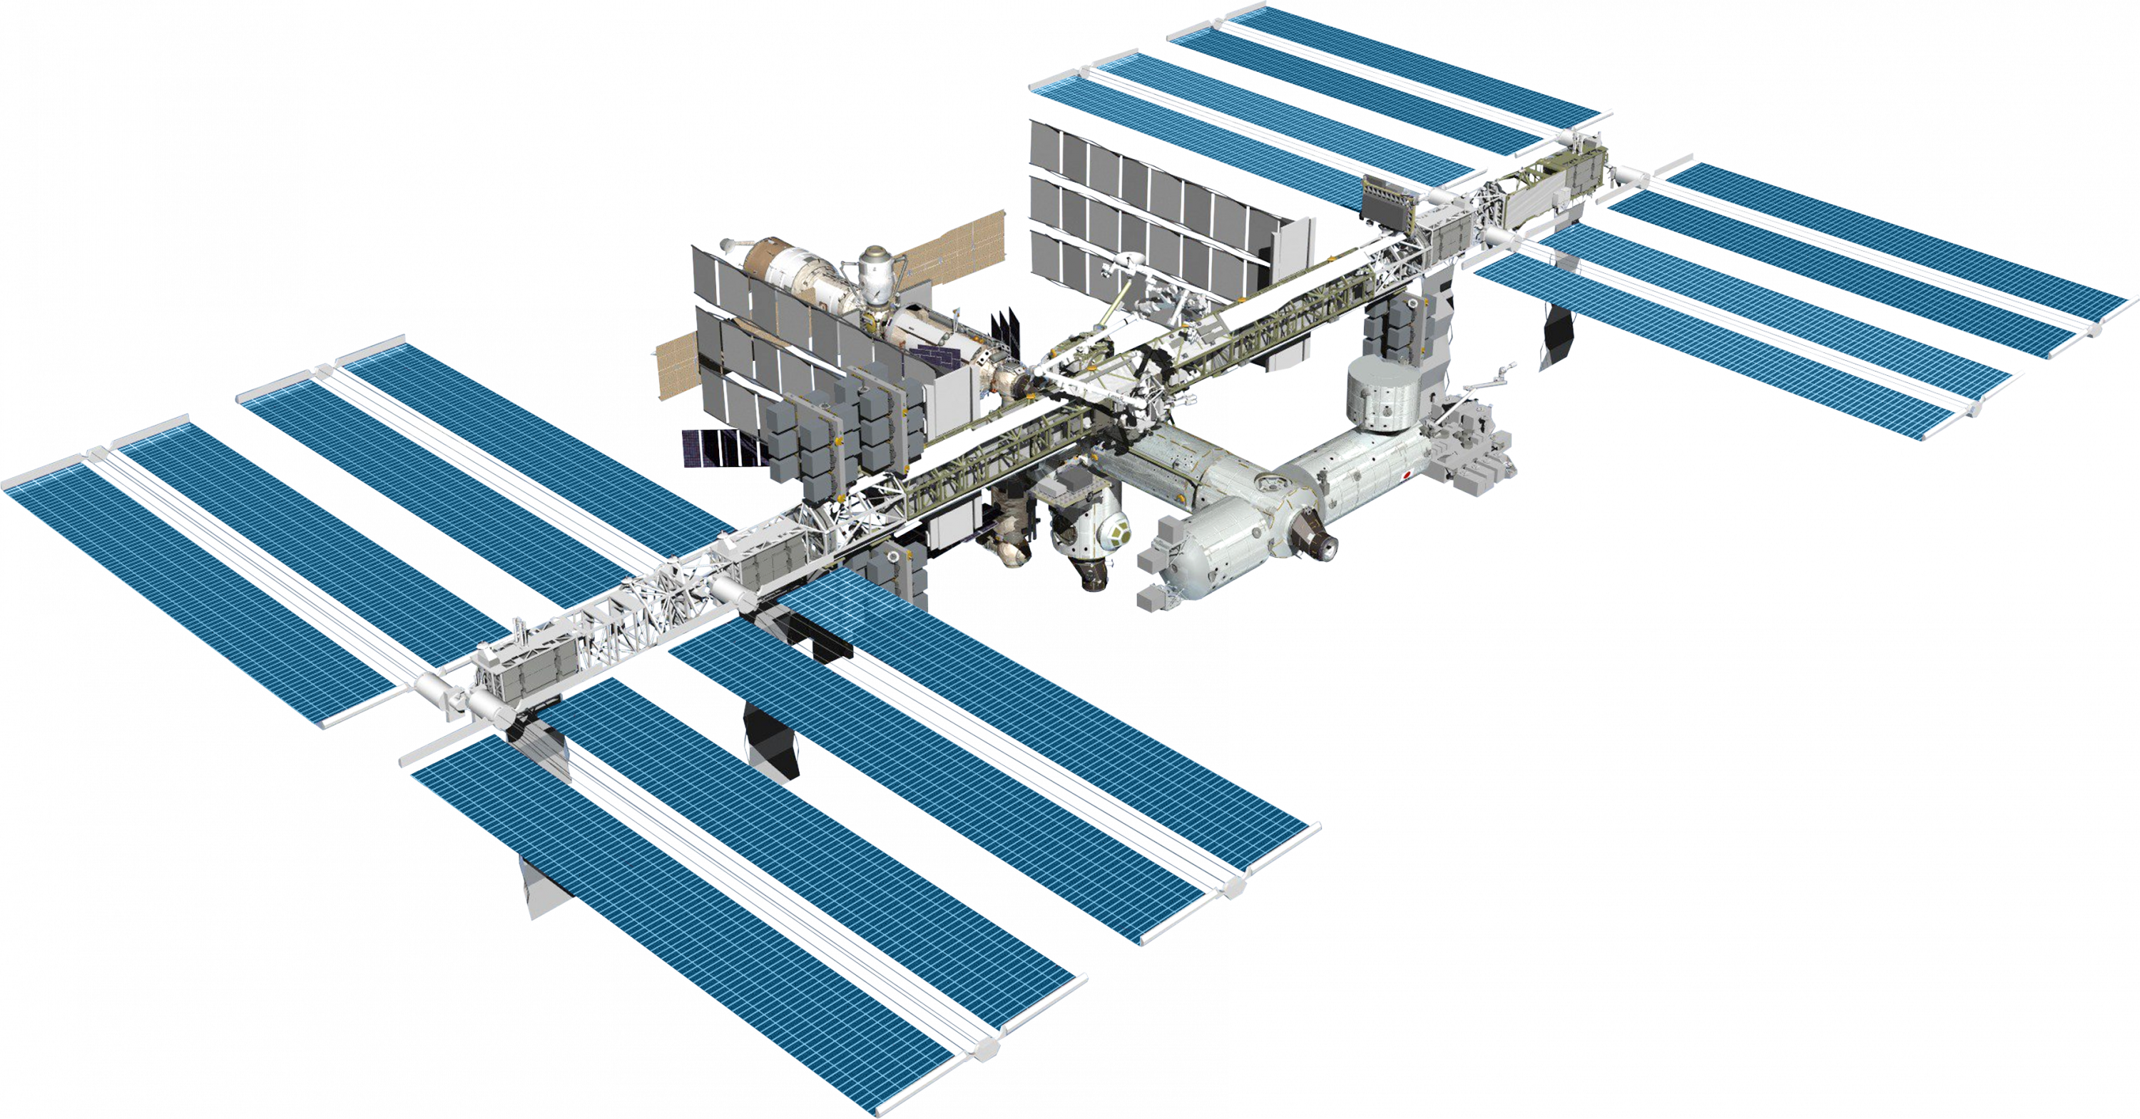
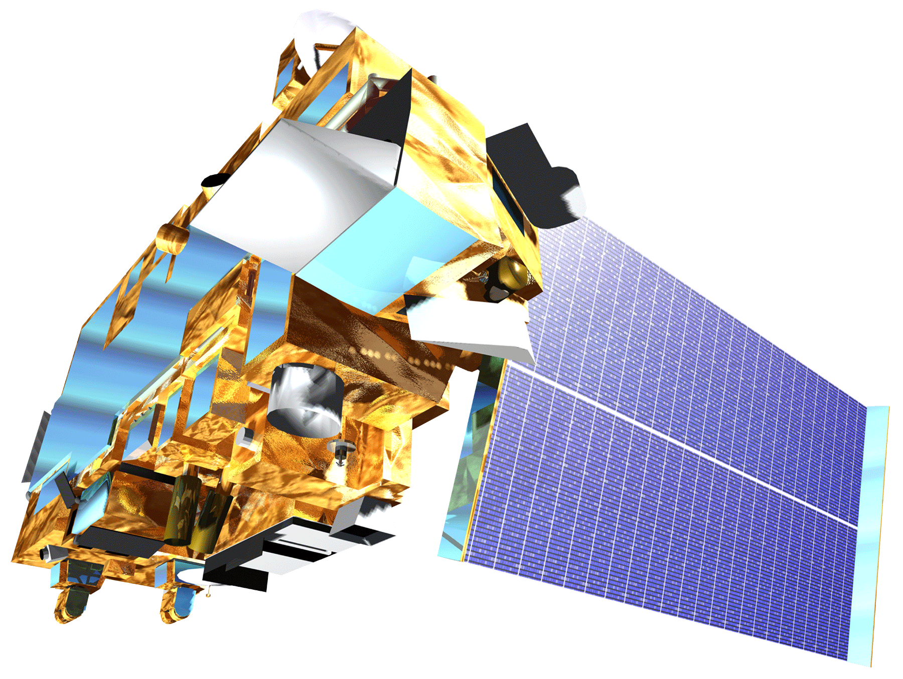
Satellites & Sensors
Maxar WorldView-2 & Worldview-3
Landsat 8 OLI & TIRS
Landsat 9 OLI 2 & TIRS 2
ISS ECOSTRESS
TERRA MODIS
Image Credit: NASA
Notes:
These notes should be thorough enough for someone not familiar with the project to clearly present the material.
NOTE: For every image on the slide include an image source in the speaker notes (ex. URL; Name, Affiliation, etc.). ALL images need to be created by a DEVELOPer, in the public domain (federal agency), or published under a creative commons license (if attributed correctly). See an example citation below:
------------------------------Image Information Below ------------------------------
Maxar Worldview-2
• Image Credit: DigitalGlobe, © 2021 DigitalGlobe NextView License
NOAA/NASA GOES Project (Public Domain)
All others:
• Image Credit: NASA
• Image Source: https://science.nasa.gov/get-involved/toolkits/spacecraft-icons (Public domain)

Slide 8
Methodology
Data sources:
ECOSTRESS
Landsat
Tree Equity Score
Maxar
Parameters:
LST
NDVI & NDBI
Socioeconomic factors
Reflectance
End products:
LST time series
Vegetation + impervious time series
Heat vulnerability map
Roof classification map

Slide 9
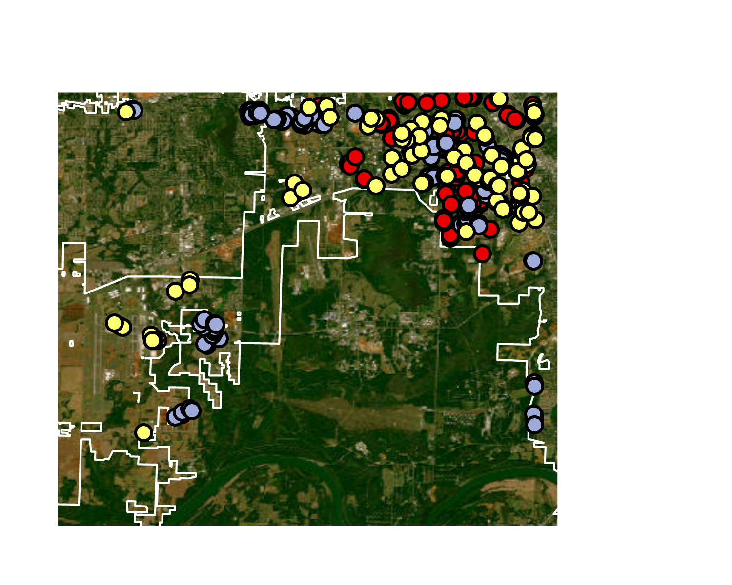
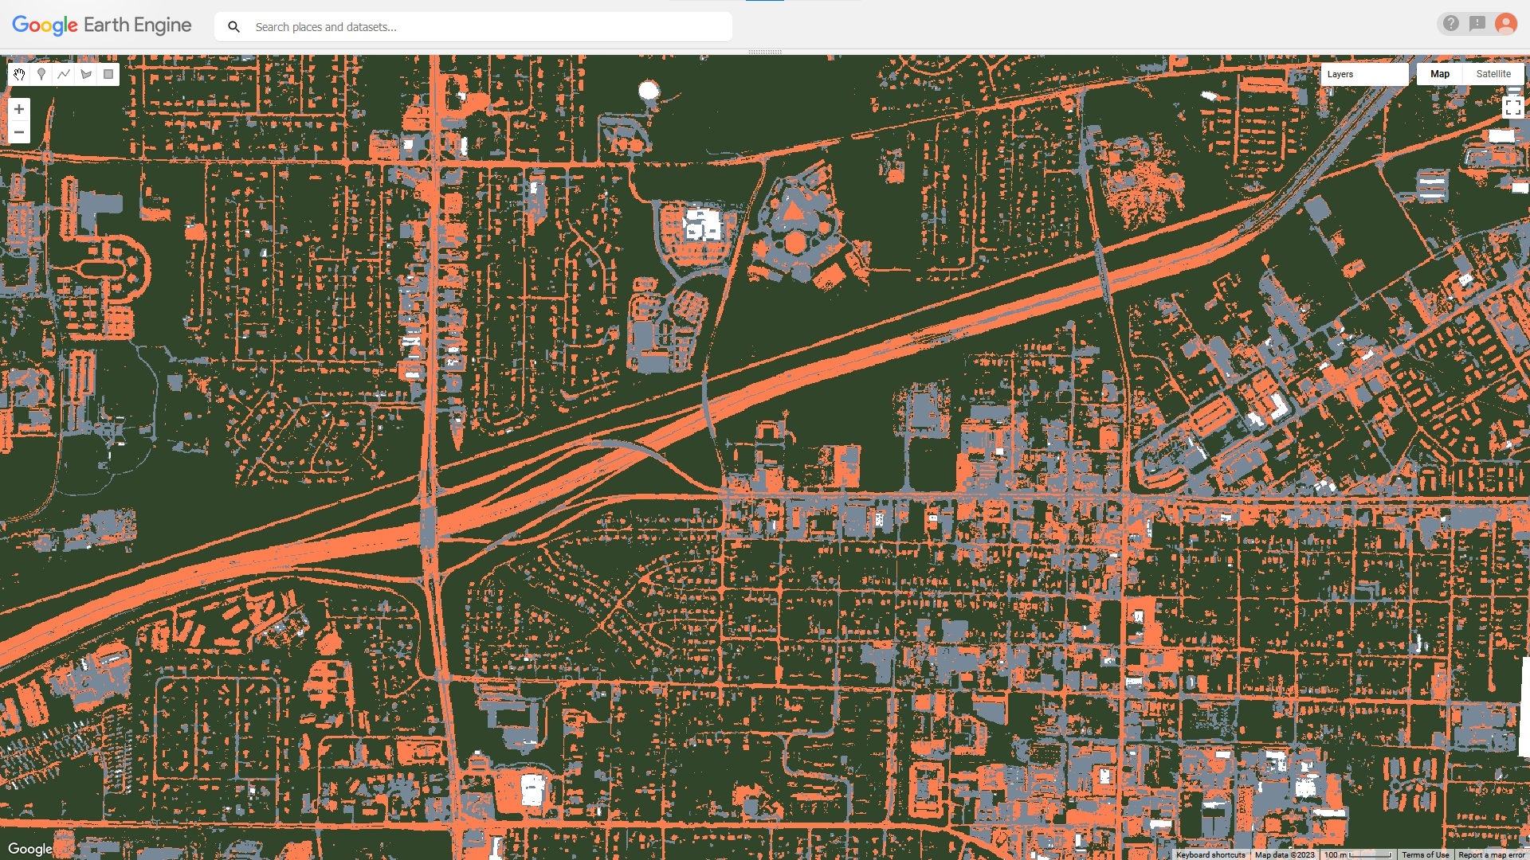
Methodology: Roof Classification
High-resolution imagery —>
Training points for automatic classification and validation
Image credit: Esri, Maxar, Earthstar Graphics, and the GIS User Community
Notes:
The team used Maxar multispectral imagery to identify and sort roofs into categories for the purpose of comparing to LST data for potential correlation of roof type with the severity of the urban heat island effect. The team provided training points for each of four roof categories, and one category of everything else, to a Google Earth Engine script so it could sort the image into each relevant category. We also gave it points that we knew belonged in each category and created a confusion matrix to assess how successful it was at sorting the map into each category.
------------------------------Image Information Below -----------------------------
Image credit: Esri, Maxar, Earthstar Graphics, and the GIS User Community

Slide 10
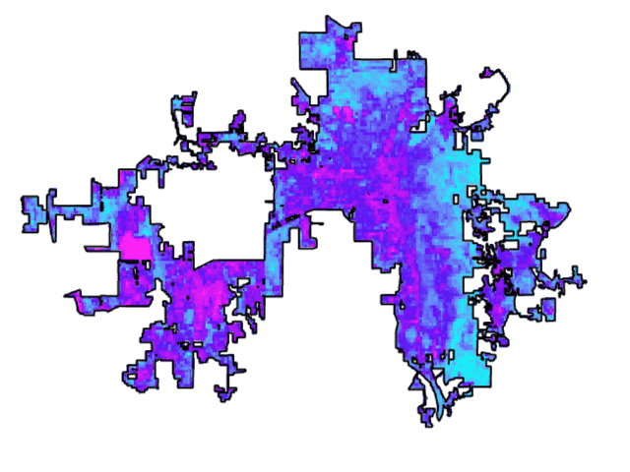
Results: Average NDBI
2019 to 2022
More built-up
Less built-up
0
4.25
8.5
17 Miles
Notes:
This slide displays the average Normalized Difference Built-up Index (NDBI) from June 1st to August 31st for 2019 to 2022. Each image represents the summer NDBI average in sequential order. The image in which western Huntsville is brightest pink represents 2022. Areas in bright pink, particularly in west Huntsville, indicate highly developed areas while areas in turquoise indicate land that is not heavily developed. The growing pink areas indicate where urban expansion is occurring within Huntsville. The bright pink square in western Huntsville represents the Toyota Manufacturing Plant.
------------------------------Image Information Below ------------------------------
Gif Credit: Natalie OKraski
Gif source: created by team member using ArcGIS Pro

Slide 11
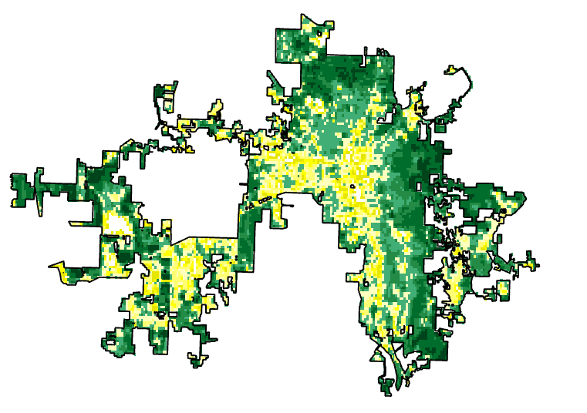
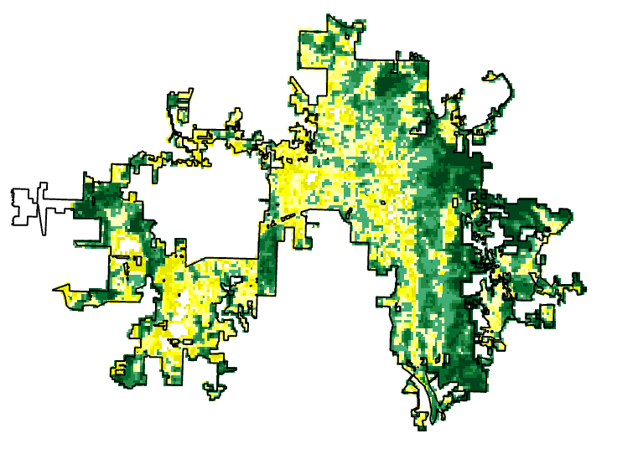
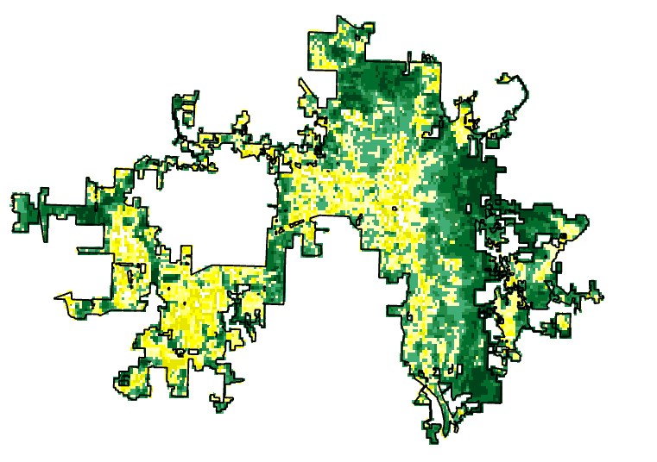
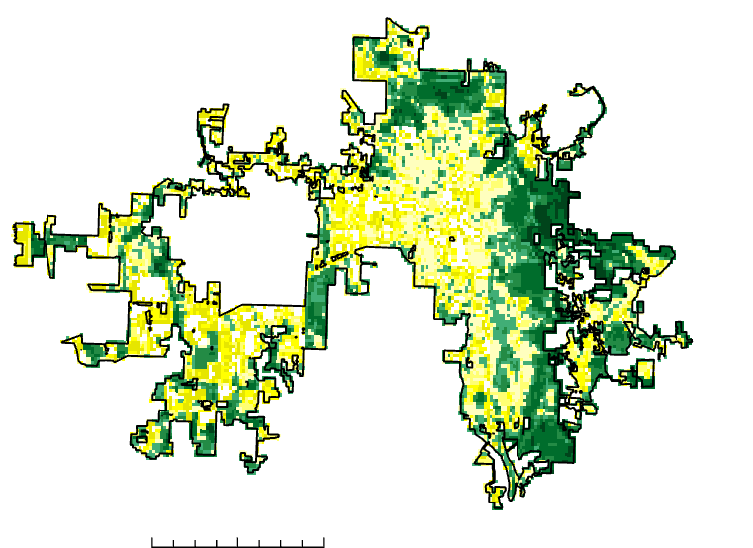
Results: NDVI
2019
2020
2021
High Vegetation
Low Vegetation
0
7.5
15 Miles
2022
Notes:
This slide is displays the Normalized Difference Vegetation Index Average during the meteorological summer (June 1 to August 31st) for the city of Huntsville for the years 2019 to 2022. Areas that are displayed in green are highly vegetated with yellow corresponding to the areas that are low in vegetation and white areas representing no vegetation.
------------------------------Image Information Below ------------------------------
Image credit: Kindrea Gibbons
Images: Created by participant using Arc GIS Pro

Slide 12
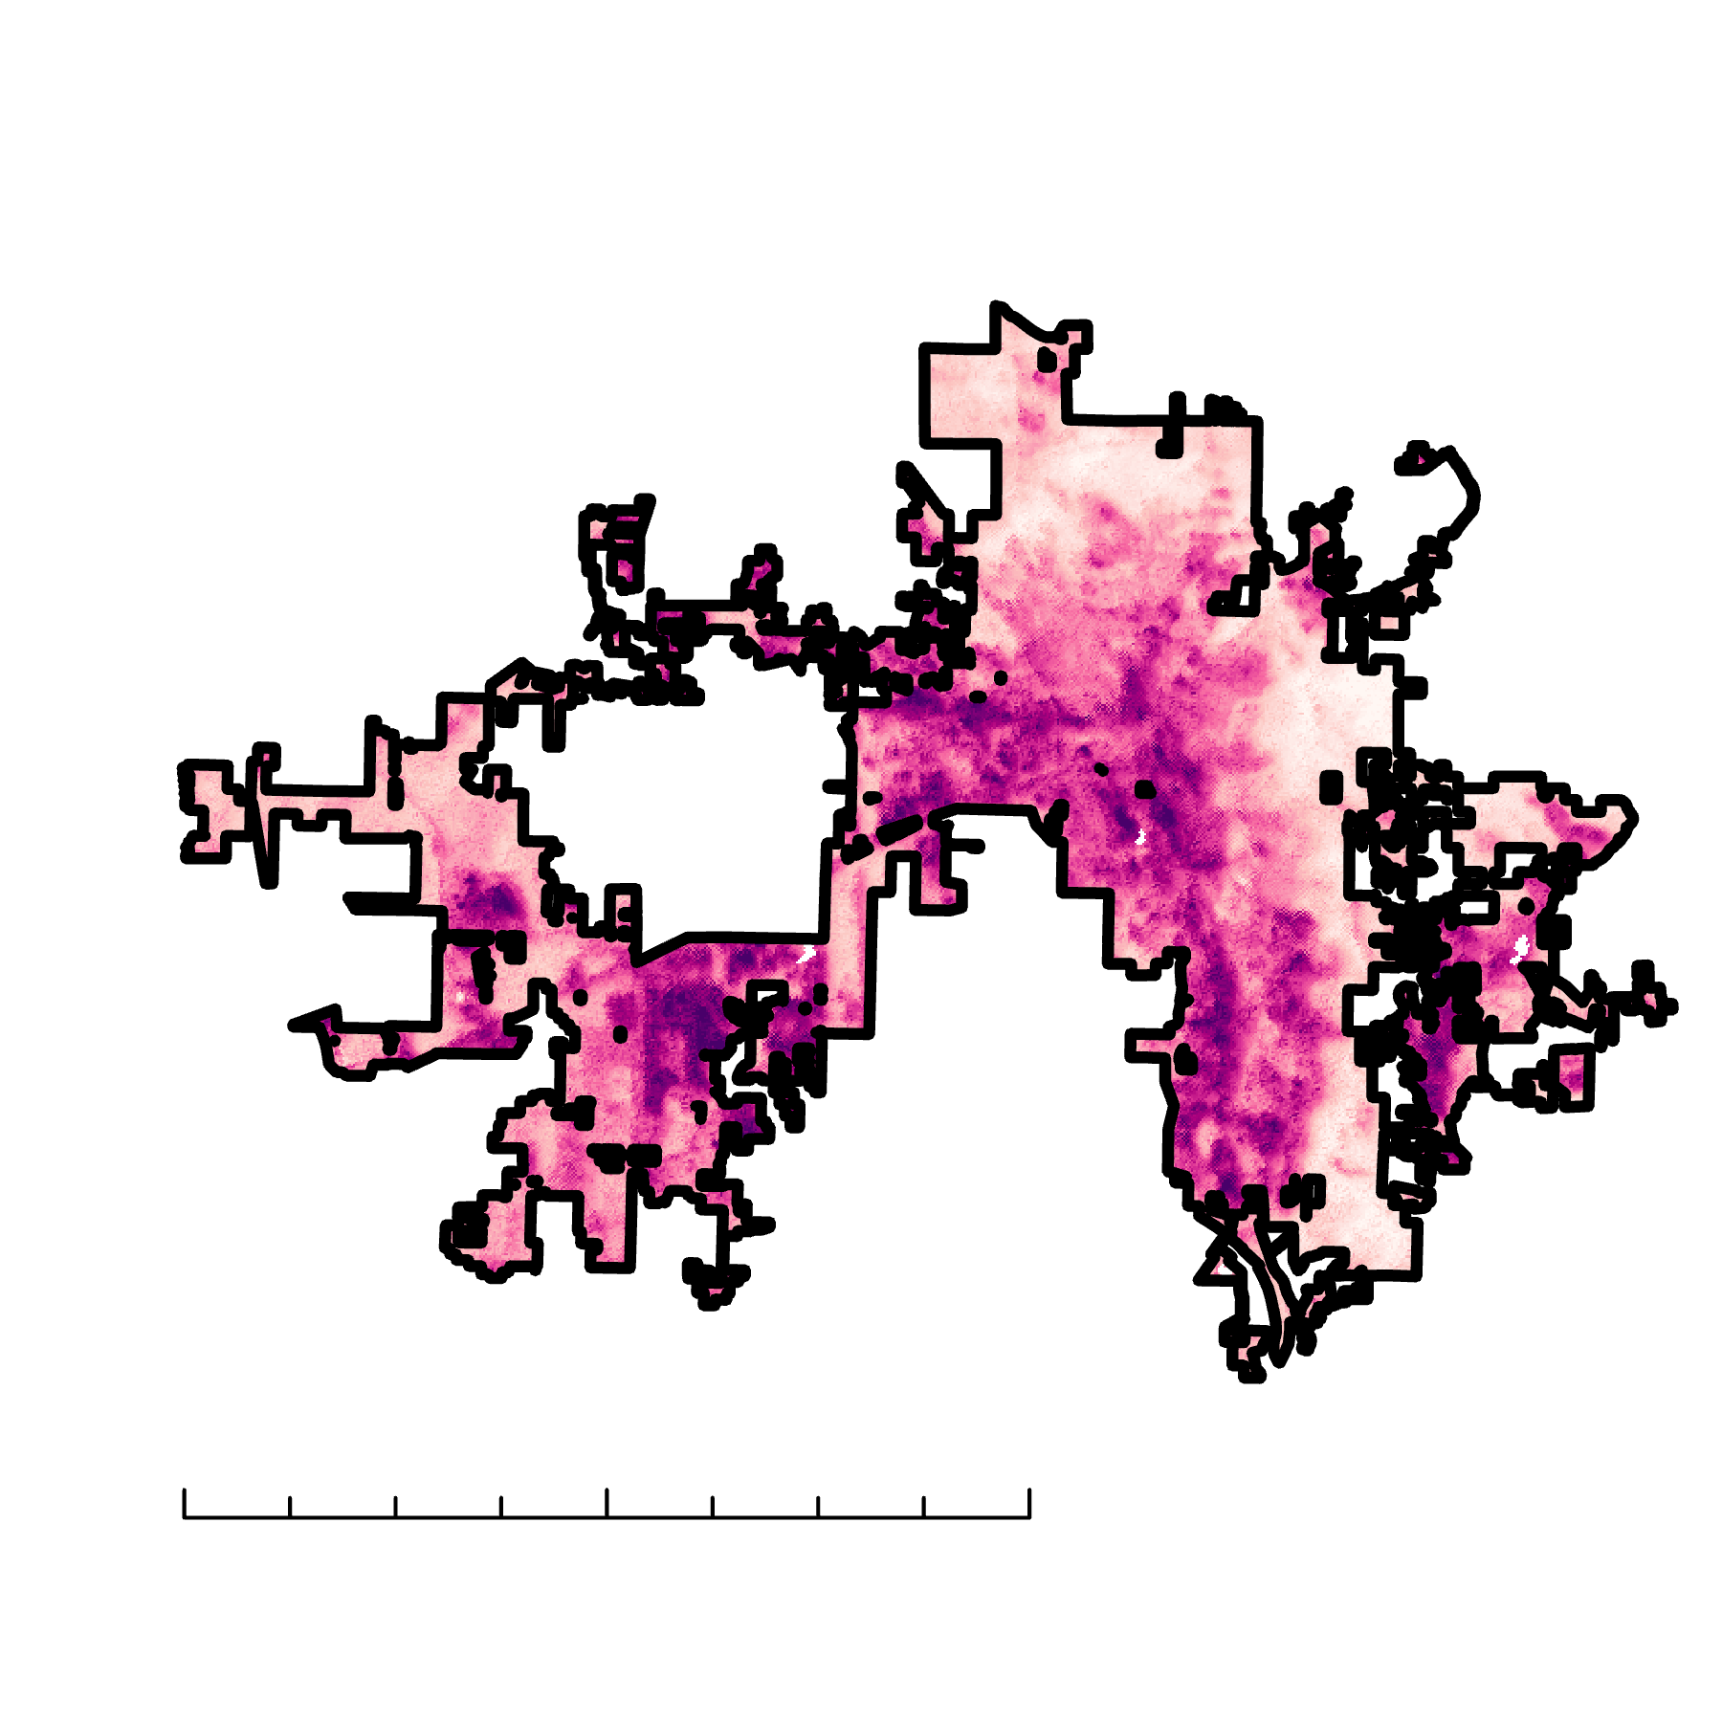
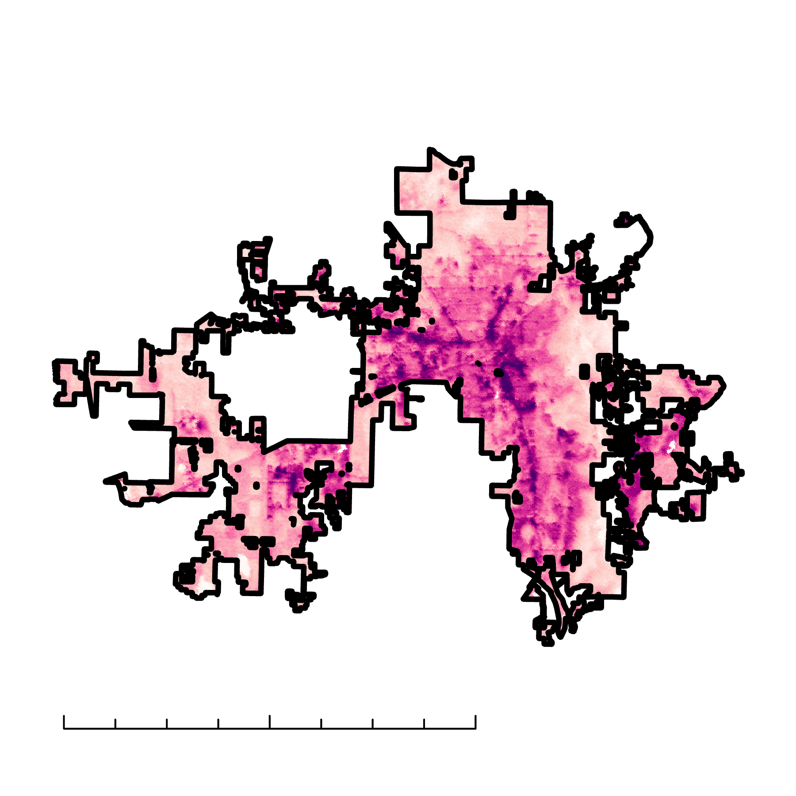
Results: LST
Daytime LST
Nighttime LST
High
0
4.25
8.5
17 Miles
0
4.25
8.5
17 Miles
Low
Notes:
Daytime LST is from August 2022 at 2:33 PM; Nighttime LST is from June 2020 at 11:32 PM. LST for Daytime ranged from 23 C to 44 C. LST for Nighttime ranged from 12 C to 34 C.

Slide 13
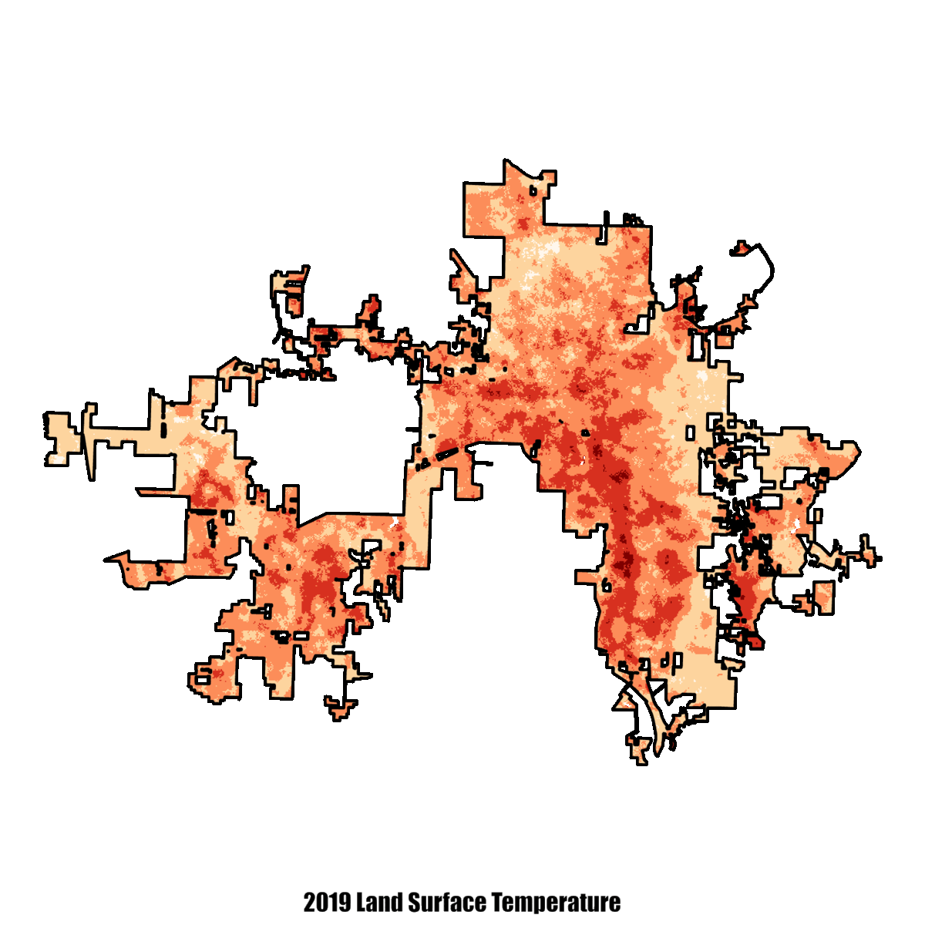
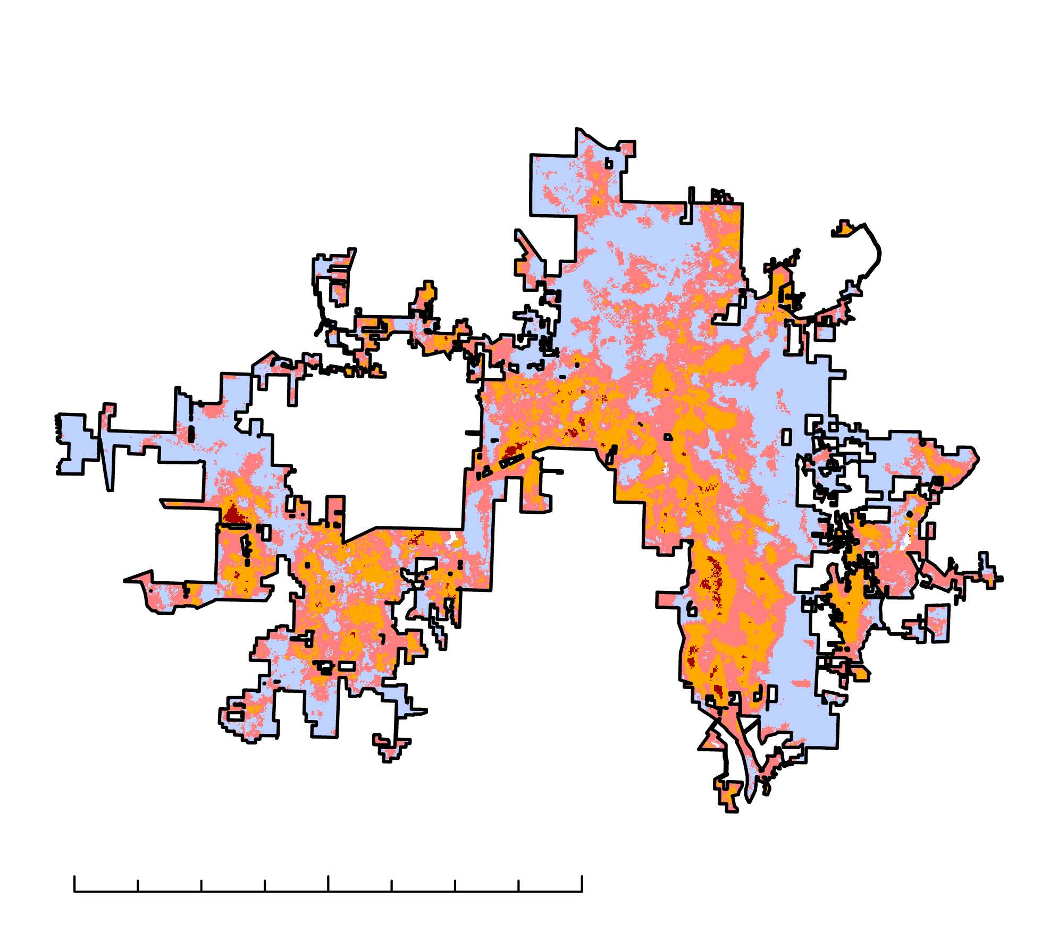
Results: Average LST and Anomalies
Δ LST (°C)
LST (°C)
≤ 0
≤ 22
≤ 5
≤ 27
≤ 10
≤ 32
0
4.25
8.5
17 Miles
≤ 15
≤ 37
≤ 20
≤ 42
2019 LST Difference from Baseline
Notes:
This slide shows the average LST for each year of the study period. Regardless of the year, a UHI is visible in the downtown area, industrial areas, and newly developed areas.
The map on the right shows the difference in LST compared to an area in Huntsville that is wooded and experiences approximately the same LST regardless of the year. In other words, the baseline is the LST that Huntsville would experience if it was not urbanized. This map also shows locations where LST is clearly higher than the baseline. For 2019, the baseline value was calculated by averaging the pixel values of 9 pixels in the bottom right corner of Huntsville, which was 301.436 K.
------------------------------Image Information Below ------------------------------
•Image Credit: Awroni Bhaduri
•Image Source: Created by participant using ArcGIS Pro

Slide 14
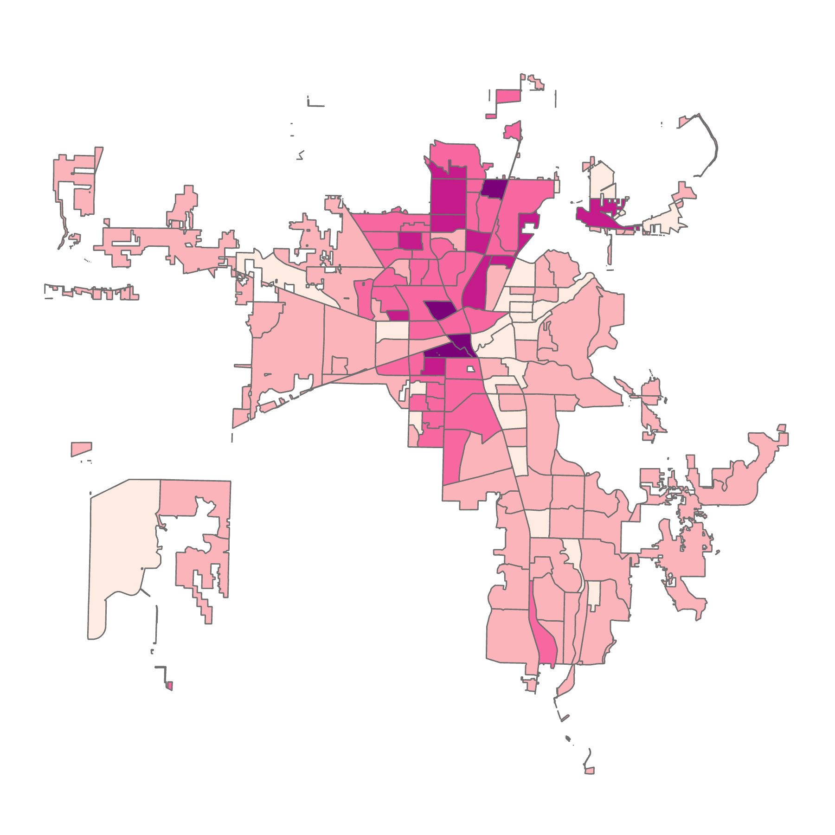
Heat Mitigation Priority by Census Block
Socioeconomic factors equally weighted (from Tree Equity Score):
Proportion in poverty
Proportion of People of Color
Unemployment rate
Health Risk Index
Proportion under age 18
Proportion age 65 or older
Heat Vulnerability Index
≤ 0.25
≤ 0.35
≤ 0.45
≤ 0.55
≤ 0.67
Data for this map were collected from 2014 to 2018 and predate Huntsville's most recent city limits expansion.
0
4.25
8.5
17 Miles
Notes:
To visualize human factors that could determine priority areas for UHI mitigation, the team mapped multiple socioeconomic inputs that the Tree Equity Score uses to determine. The Health Risk Index is self-reported poor mental health, poor physical health, asthma, and coronary heart disease equally weighted. The team calculated where each census block lay on a scale from the minimum to maximum value for a given factor, and mapped that as shown.
------------------------------Image Information Below ------------------------------
•Image Credit: James Karroum
•Image Source: Created by participant using ArcGIS Pro

Slide 15
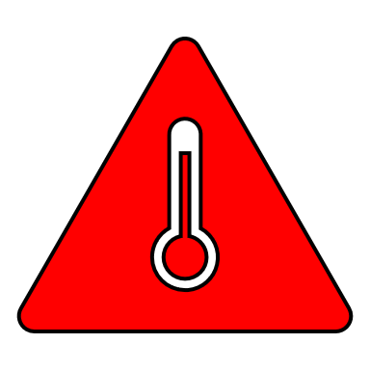
Conclusions
Inconsistent change trends: LST factors can change by month and year.
Strongest UHI-related factors are in downtown, industrial areas, and new development.
West-central Huntsville has greatest potential for heat reduction and community health benefits from tree-planting.
Notes:
Year-to-year LST change averaged across the city exhibited no trend over the study period, and this irregularity showed that the factors contributing to LST change can vary in severity month to month and year to year.
LST, NDVI, and NDBI indicate the strongest urban heat island effect in downtown, industrial areas, and newly developed neighborhoods.
Heat vulnerability data, where available, and when combined with LST, vegetation, and permeability maps, indicate that west-central Huntsville is the area with the most potential for heat reduction and community health benefits from tree-planting efforts.
Icon credits: Microsoft 365 Powerpoint

Slide 16
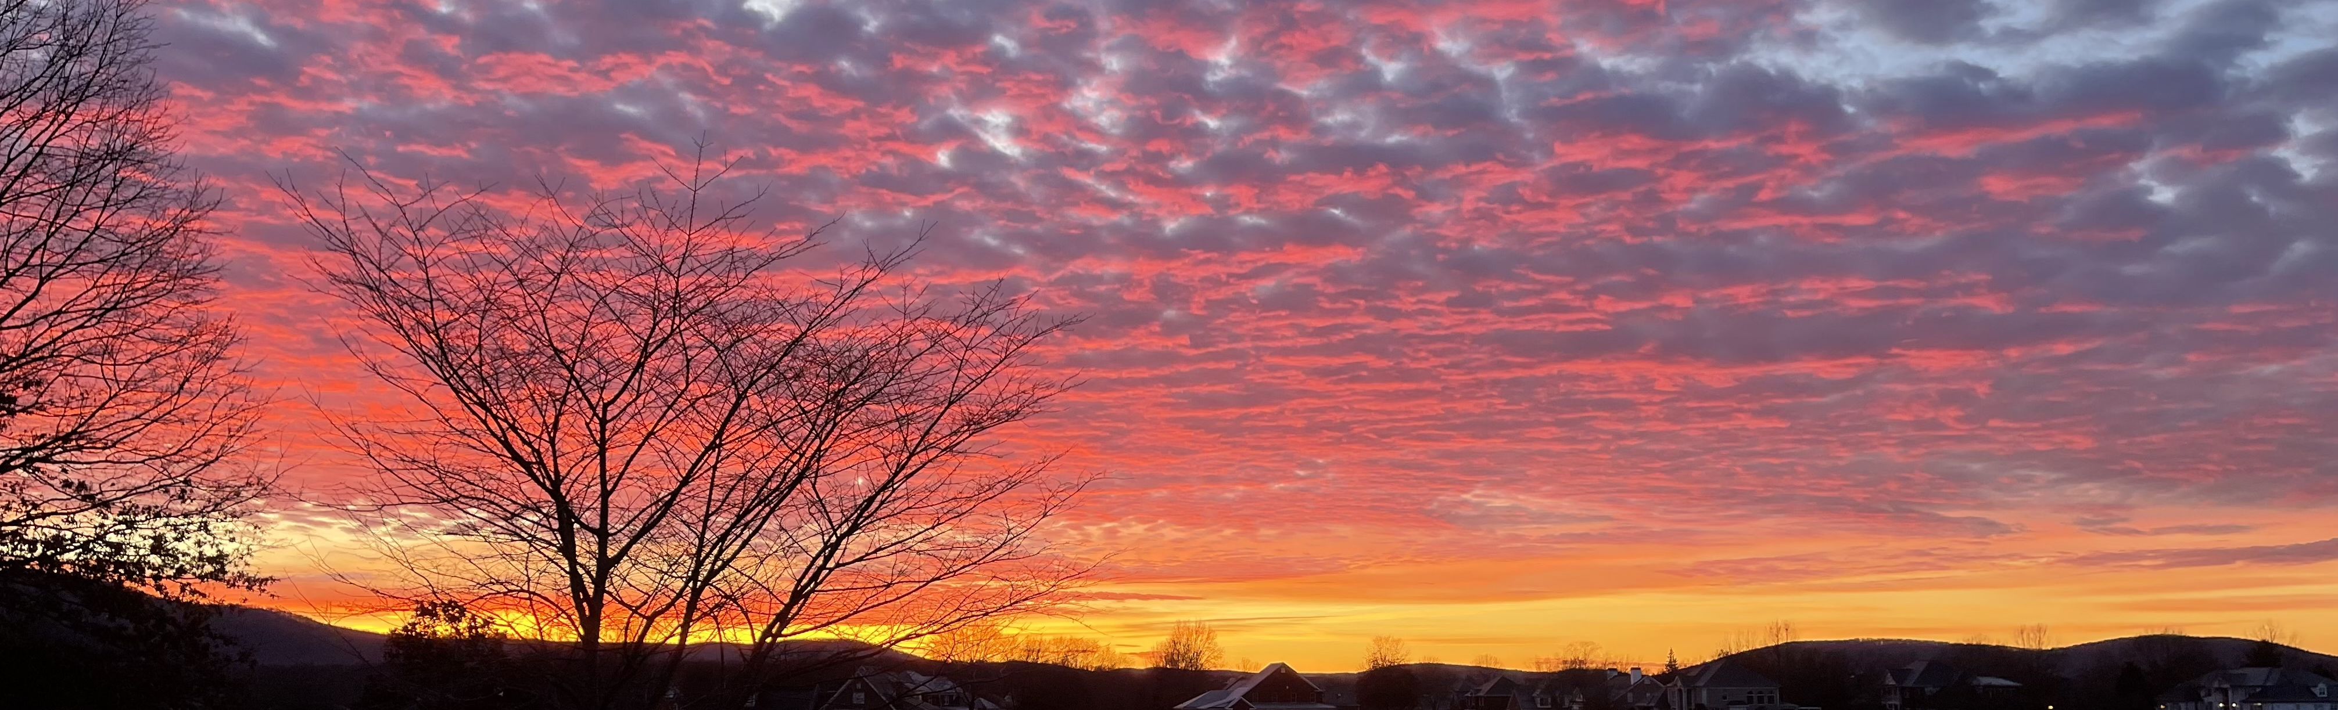
Image credit: Natalie O'Kraski
Cloud cover varied per year and may have skewed results
Social factors and their weights may not represent true community need for trees
Use of Census data older than the study period may have skewed results
Each pixel in the LST map was not represented equally by ECOSTRESS data
Errors and
Uncertainties
Notes:
Cloud masks were generated for the data used, but there is no guarantee that it was completely accurate.
The social factors and the weights given to them that were used could possibly not portray the need for trees accurately.
LST satellite imagery used for the city of Huntsville would not always cover the entire city. Because of this, the averages calculated and mapped may not represent the true LST exhibited during the study period.
------------------------------Image Information Below ------------------------------
•Image Credit: Natalie O'Kraski
•Image Source: taken by participant

Slide 17
Future Work
Investigate cause of variance in LST.
Assess roof material's effect on UHI.
Identify viable areas for tree planting initiatives.
Image Credit: Marc Byers
Notes:
Evaluate the effects of climate and weather patterns on LST Determine if the effects of Industrial activities of surrounding regions effects LST in HSV
------------------------------Image Information Below ------------------------------
•Image Credit: Marc Byers
•Image Source: provided by the Partner

Slide 18
Advisors:
Dr. Jeffrey Luvall, NASA Marshall Space Flight Center
Dr. Robert Griffin, The University of Alabama in Huntsville
Laramie Plott, DEVELOP Fellow
Brianne Minton, Auburn University
Partners:
City of Huntsville
Shane Davis, Director of Urban and Economic Development
Marc Byers, Arborist of Landscape Management Department
Amy Kenum, Geographic Information Systems Manager
First Term Team Members:
Greta Paris, DEVELOP
Sabine Nix, DEVELOP
Thomas Quintero, DEVELOP
Amanda Tomlinson, DEVELOP
Special Thanks:
John Mandel, NASA IMPACT
Notes:
The NASA DEVELOP Huntsville Urban Development II Team at MSFC would like to thank our advisors, partners, and first team members for their guidance and contribution to this project!

