Slide 1
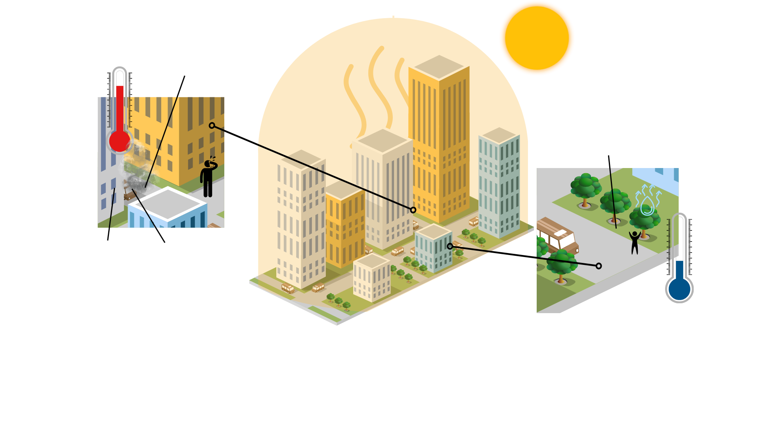
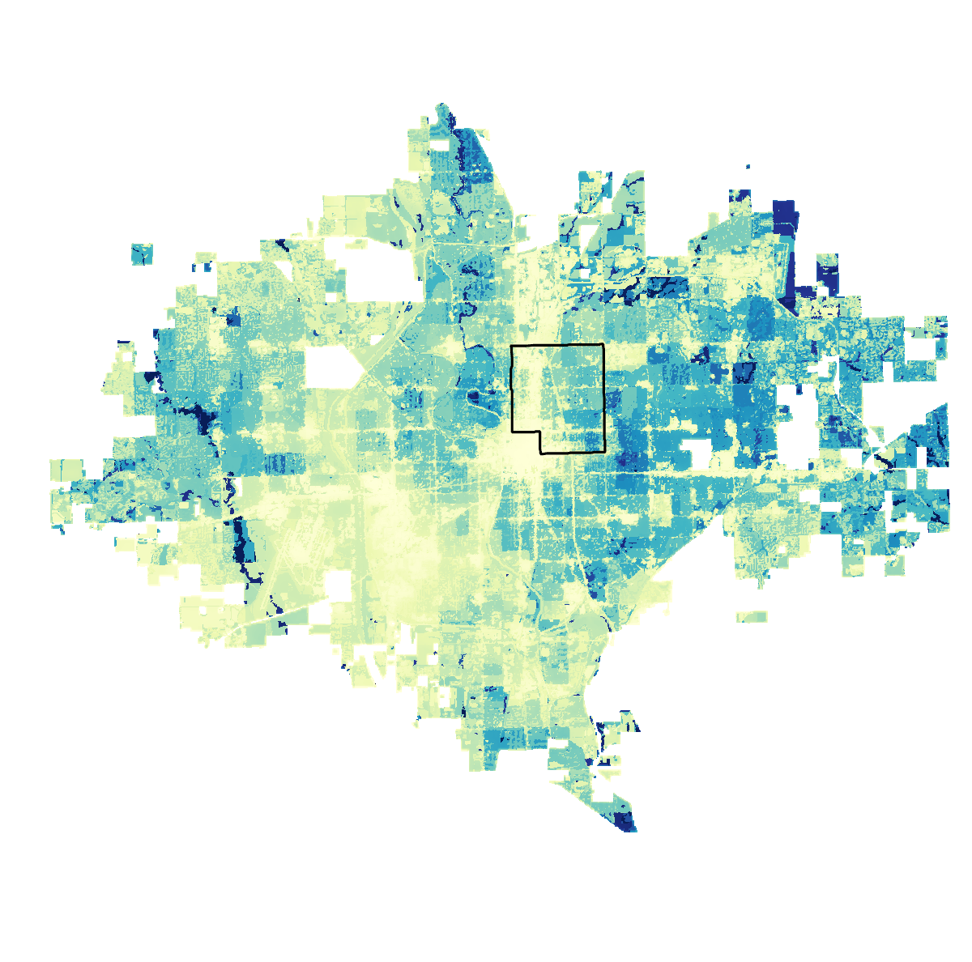
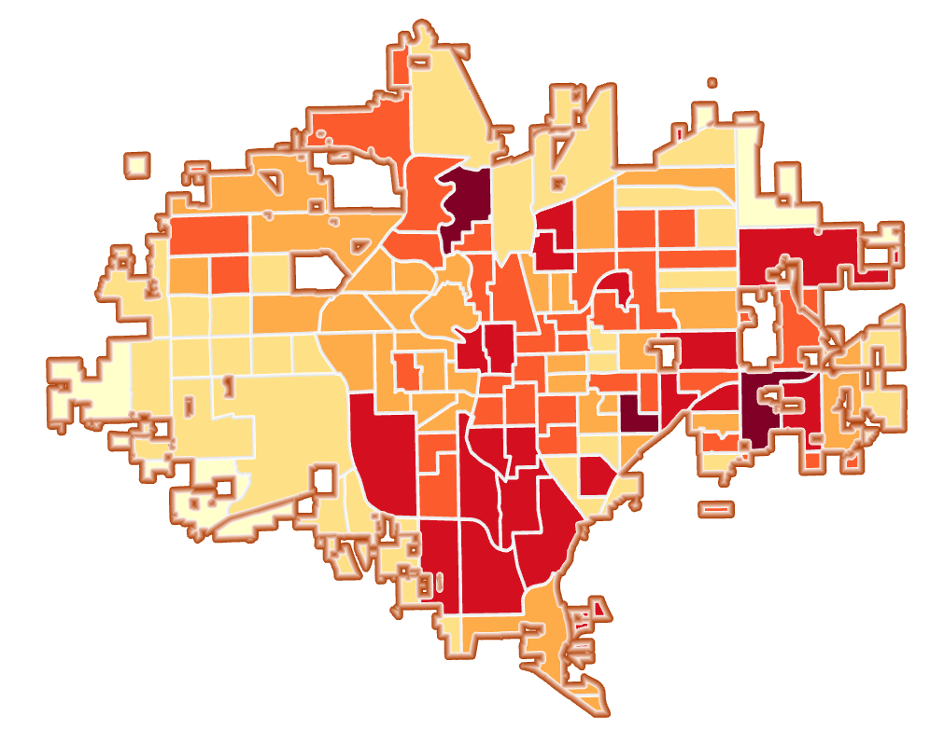
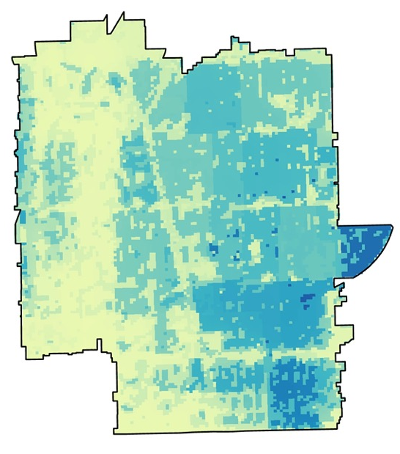
Quantifying and Mapping Urban Heat to Inform Equitable and Sustainable Urban Planning Initiatives in Wichita, Kansas
What Is an Urban Heat Island?
Heat and Environmental Justice
Space between buildings traps heat
Wichita Climate II
Lack of green space or trees for shade and evapotranspiration or water loss
Extreme heat impacts populations in the same city in different ways based on their sociodemographic characteristics or ability to cool, creating heat inequity.
The presence of “intra-urban” heat islands is largely due to the spatial distribution of buildings, impervious surfaces, and vegetation.
Urban heat increases the risk of heat-related morbidity and mortality and can place an inequitable burden on vulnerable populations, like low-income areas or those with pre-existing health conditions.
Dark, compact surfaces like concrete absorb and trap heat
Waste heat from vehicles and machinery
An Urban Heat Island is an urban or metropolitan area that is significantly warmer than its surrounding rural areas due to how well the surfaces in each environment absorb and retain heat.
Exposure to Heat + Sensitivity to Heat + Capacity to Adapt = Heat Vulnerability
How Can Satellite Data Help?
Satellites can help us quantify the magnitude of urban heat islands & delineate parts of Wichita that are disproportionately affected by urban heat.
ISS ECOSTRESS
Landsat 8 TIRS
Combining environmental variables, like land surface temperature, with socioeconomic and health variables, like asthma prevalence and disability, gives us a heat vulnerability index by Census tract
Heat Mitigation Index in Wichita, KS
Many of these highly heat vulnerable areas towards the center of Wichita have also been historically redlined, like zip code 67214
Heat Mitigation Index
Based on current tree canopy cover in Wichita, KS
Increasing canopy cover is an effective methodology for lowering heat burden on communities that experience vulnerability
What happens to the ability of these heat vulnerable areas to mitigate heat if we increase canopy cover in Wichita?
-6.1 to -4.3 (low vulnerability)
-4.2 to -1.4
-1.3 to 0.1
0.2 to 1.8
1.9 to 4.4
4.5 to 8.0 (high vulnerability)
Heat Mitigation Index
Based on increased tree canopy cover in Wichita, KS
Increasing canopy cover in heat vulnerable areas can strengthen climate resiliency through incorporating environmental justice into decision making.
0.98 (higher ability to mitigate heat)
0.07
Team Members
Acknowledgements
Project Partner: Nina Rasmussen (City of Wichita)
Advisors: Lauren Childs-Gleason & Dr. Kent Ross (NASA Langley)
Fellow: Julianne Liu
Previous Contributors: Brooke Laird, Melissa Ashbaugh, Muskaan Khemani, Sadie Murray
Big thanks to: Lance Watkins, Christina Dennis & Akshay Agarwal for their guidance and support on this project
EXAMPLE
Ritisha Ghosh
Project Lead
Richard Kirschner
Project Team
Raina Monaghan
Project Team
Ria Mukherjee
Project Team
Images
Icons by Freepik, IconHubs, pixelperfect, wahya (flaticon), Urban heat graphic created on Canva, Elements from Skechtify, Alexel, Pesky, Viktor Morozuk, Leremy Gan, gstudioimagen, and vectorwin
Virtual Environmental Justice

