Slide 1
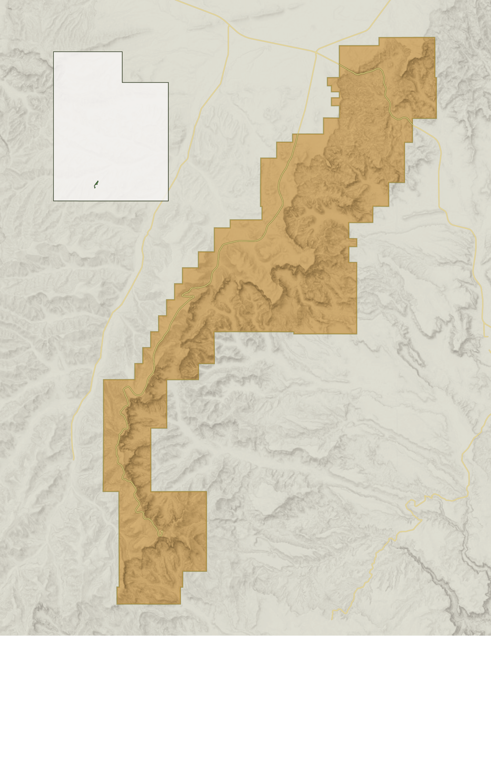
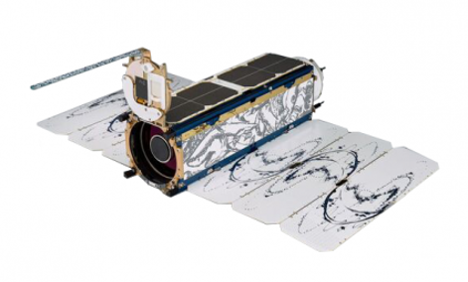
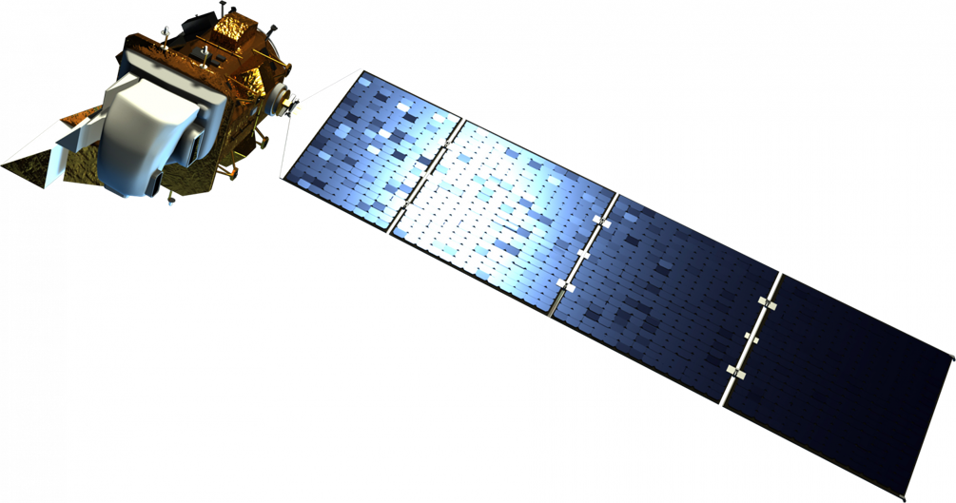
Monitoring Vegetation Health and Water Availability in Bryce Canyon National Park for Drought Stress Mitigation Planning
Abstract
Methodology
NDVI/NDWI
Bryce Canyon Water Resources
Bryce Canyon National Park is home to groundwater-dependent ecosystems (GDEs) that are threatened by a multidecadal drought and increased groundwater extraction due to a spike in tourism. These ecosystems contain unique species that are only found in areas where near-surface groundwater is present, such as aspen groves and fens. These species contribute to the high biodiversity found in Bryce Canyon, which boosts an ecosystem’s productivity and the services it provides to the park. Unfortunately, many of these GDEs are too small to identify with traditional Earth observation platforms and are difficult to physically reach for monitoring purposes. This project partnered with the National Park Service to identify springs and seeps as a proxy for GDEs within Bryce Canyon from 2013–2022. The team mapped groundwater discharge with high resolution National Agriculture Imagery Program (NAIP) and assessed park vegetation trends with Landsat 8 Operational Land Imager (OLI) and PlanetScope imagery. In-situ precipitation data and the Western Land Data Assimilation System (WLDAS) were used to produce time series of climatic variables. Seeps and spring locations were predicted using random forest classification and maximum entropy machine learning models.
PlanetScope DOVEs (PlanetExplorer)
How has vegetation and water changed in space?
2017 – 2022
Change Maps
Landsat 8 OLI
(USGS)
Cloud & Shadow Masks, NDVI
How have they changed over time?
2013 – 2022
Time Series
NAIP Imagery
(USDA)
Direct Detection
Are spring and seep NDVI/NDWI values statistically unique?
Study Area
2018
Input
Analysis
Output
Bryce
Canyon
City
(Google Earth Engine & ArcGIS Pro)
12
Predictive Modeling
LiDAR (URGC)
Geologic Formations (USGS)
2018
2022
Spring or Seep Prediction Map
Tropic
NAIP Imagery (USDA)
Soil Types (SSURGO)
Maximum Entropy
Bryce Canyon
National Park
2021
No Date
Input
Analysis
Output
Results
(ArcGIS Pro)
Bryce Canyon
Vegetation Change
Landsat 8, 2013 to 2022
Bryce Canyon
Predicted Groundwater
MEM, 2017 to 2022
N
N
0
5 Miles
N
Objectives
Vegetation Trend
(Mann-Kendall Statistic)
Predicted Probability of Seep or Spring
Apply sophisticated remote sensing techniques to:
Detect springs, seeps, and groundwater-dependent ecosystems
Understand changes in vegetation presence and health
Visualize changes in climate
Create a framework for future applications
Increasing NDVI
0.90 to 1.00
No Change
0.75 to 0.90
Decreasing NDVI
0.50 to 0.75
0
5 Miles
0
0.00 to 0.50
Earth Observations
ESRI, HERE, Utah BLM
5 Miles
Conclusions
Utah Geospatial Resource Center
NDVI and NDWI alone are not a reliable indicator of spring and seep presence
Maximum Entropy models predicted the probability of where springs and seeps are located
Snowfall and snow sublimation have decreased since 1979 while rainfall has remained consistent; pervasive drought conditions suggest that snow is an important contributor to vegetation health
PlanetScope DOVEs
Landsat 8 OLI
Acknowledgements
Project Partner
Team Members
Partners: Tyra Olstad (Bryce Canyon National Park, National Park Service)
Advisors: Sean McCartney (Science Systems & Applications, Inc., GSFC)
Fellows: Carli Merrick (Science Systems & Applications, Inc., GSFC) and Nicole Ramberg-Pihl (Science Systems & Applications, Inc., GSFC)
Special thanks: Dr. Jessica Erlingis (University of Maryland, GSFC)
This model contains modified LIDAR (2018) data from UGRC, NAIP (2021) and Soil Survey data collected by USDA, geological features maps (2022) from USGS and altered by NPS, and PlanetScope Data (2017-2022).
Aaron Carr
Project Lead
Melanie Frost
Ashley Grinstead
Alissa Stark
Fall 2022
Maryland - Goddard
Node Location

