Slide 1
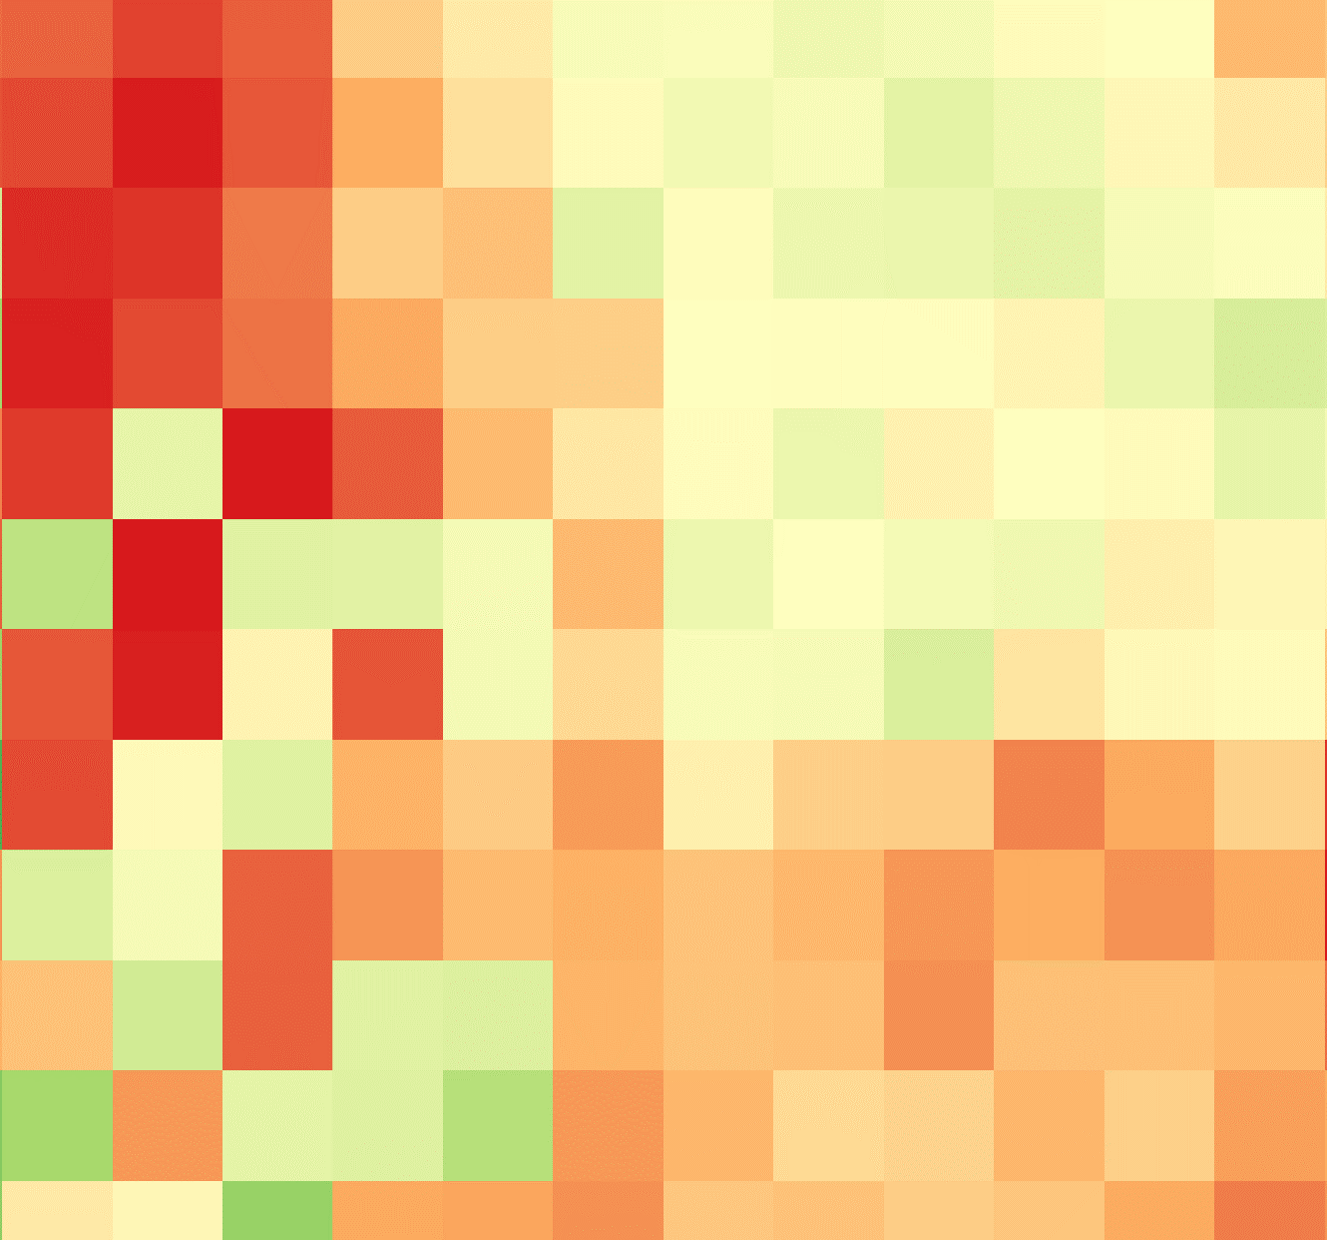
KENYA AGRICULTURE & FOOD SECURITY
Utilizing NASA Earth Observations in the RHEAS Model to Enhance Drought Monitoring and Mitigation in Kenya
Ryan Good
Ryan Marshman
Amanda Tomlinson
Chiara Phillips
Alabama – Marshall | Summer 2019
Notes:
Speaker Notes: Hello everyone! We are the Kenya Agriculture & Food Security Team, and our project was centered around using several different NASA Earth Observations in the RHEAS Model in order to improve drought monitoring and mitigation in Kenya. *each team member introduces themselves, starting with project lead*

Slide 2
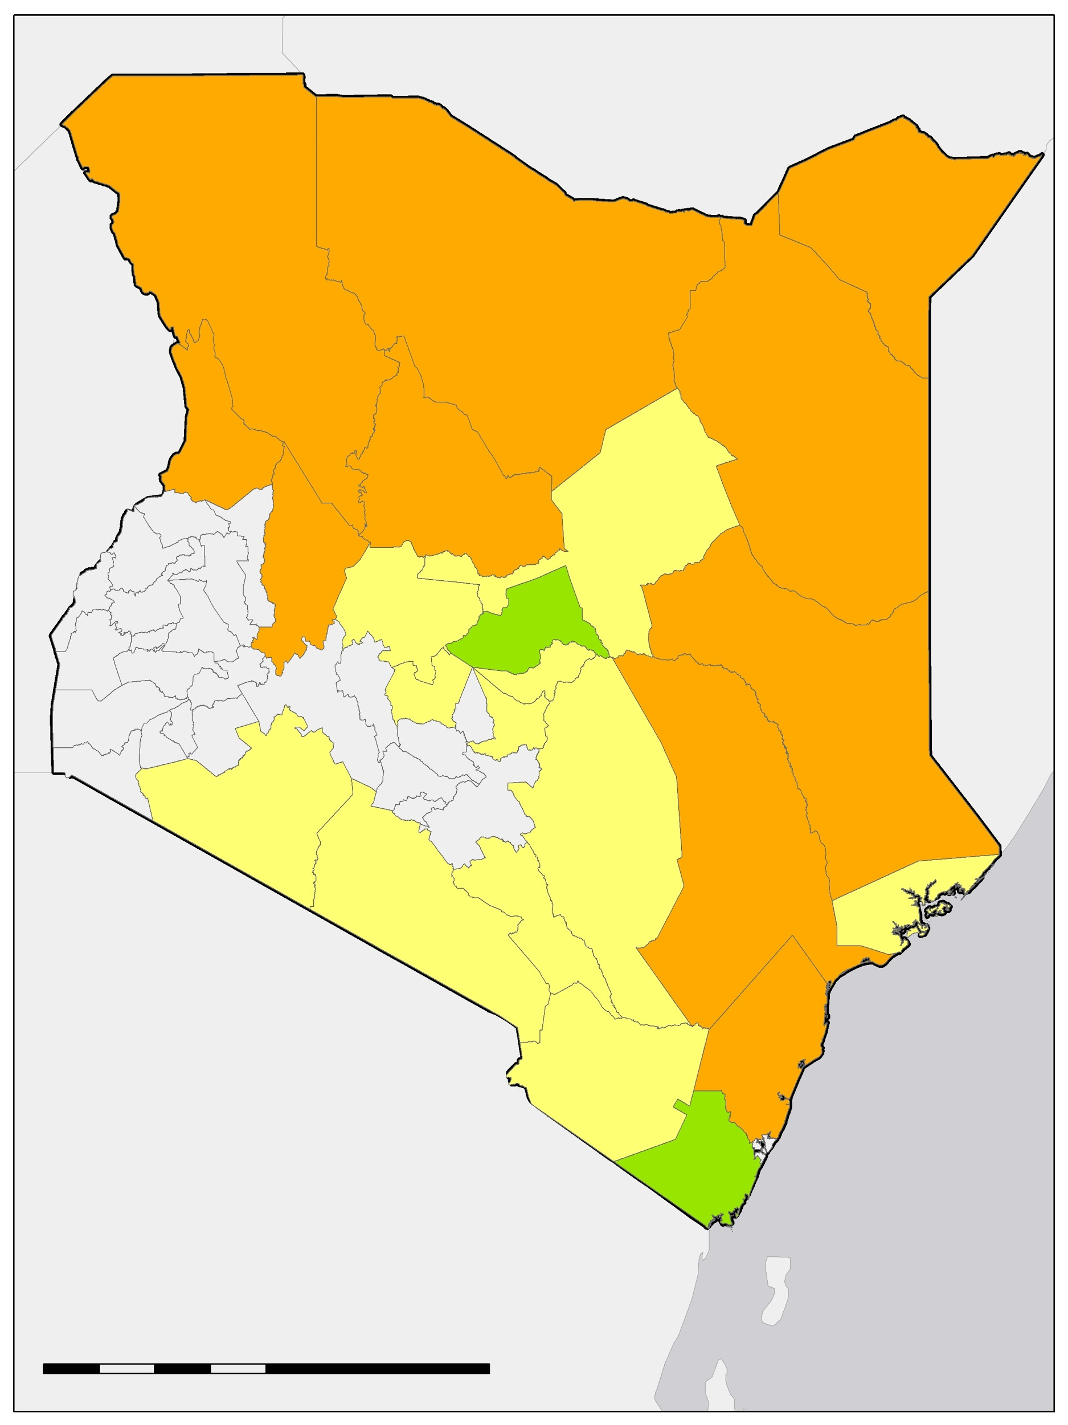
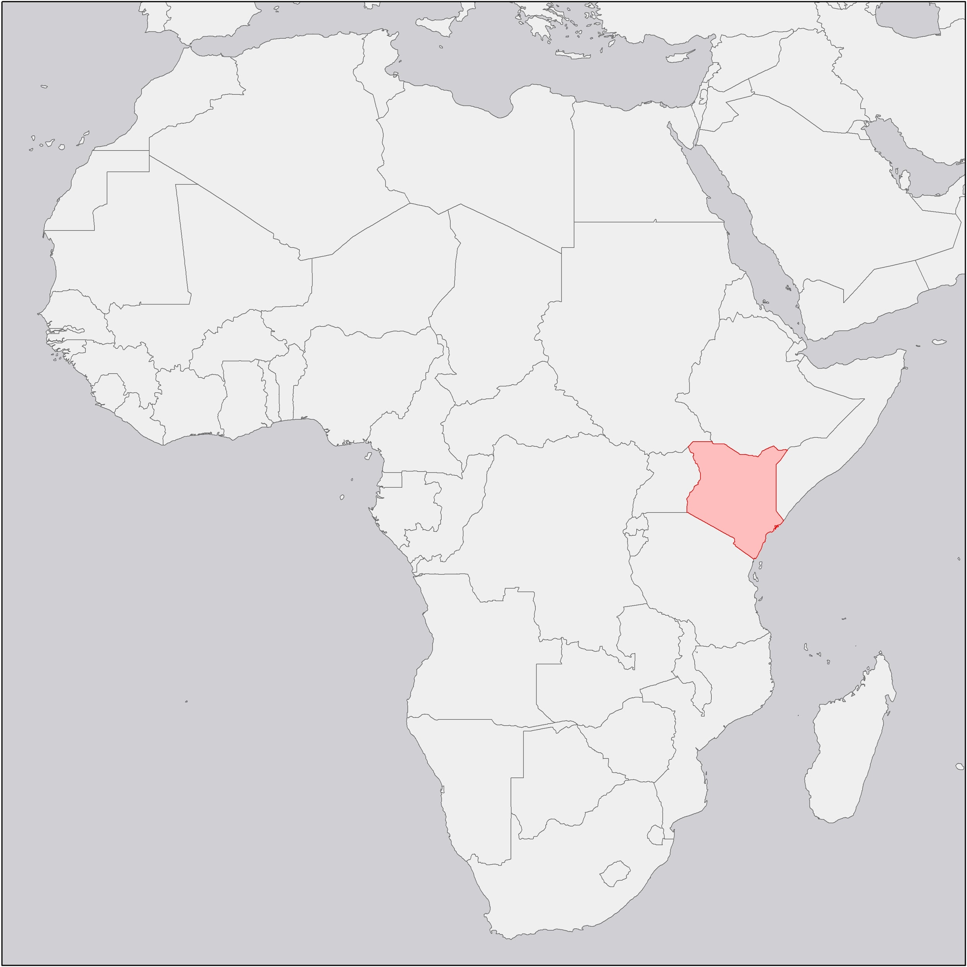
NDMA Drought Classifications for April 2019
STUDY AREA & PERIOD
The study area for this project encompassed the entirety of Kenya.
Approximately 80 percent of the land surface of the country is arid or semi-arid.
We created daily raster images of ten drought indices between January 2016 through April 2019.
100
200
400
km
No data
Alert
Normal
Alarm
Notes:
Speaker Notes: This project studied the entire country of Kenya which is composed of 47 counties. All of our data analysis was done on the county level, and you can see the counties and their drought status as of April 2019 according to the National Drought Management Authority’s Early Warning Bulletins on the map here. *point out map* The counties in gray are not included in the bulletins that the NDMA creates as they are not classified as arid or semi-arid. All of the counties that are in color on this map are within the 80% of Kenya that is classified as arid or semi-arid. We trained our model using data from 2012 to 2014, but accurate rasters were created for January of 2016 to April of 2019.
Map Credit: Kenya Agriculture & Food Security Team (Chiara Phillips), made in ArcMap with base layer “Countries” from Natural Earth https://www.naturalearthdata.com/downloads/50m-cultural-vectors/50m-admin-0-countries-2/

Slide 3
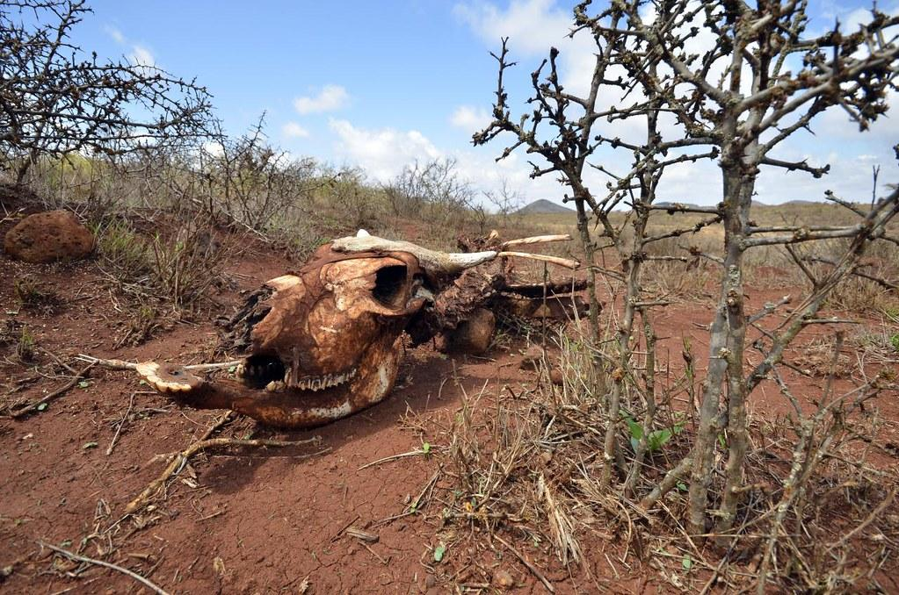
COMMUNITY CONCERNS
Kenya is experiencing drought, with 5 counties in an “Alarm” classification as of May 2019.
Crop yields in 2019 will be well below average for the second consecutive season.
Agriculture is 26% of Kenya’s GDP and over 70% of its workforce.
3.4 million people in Kenya are currently labeled as food insecure. 2.6 million of those people are identified as in “Crisis” or above.
Image Credit: Neil Palmer
Notes:
Speaker Notes: As for the community concerns, Kenya is currently experiencing drought with 5 counties in the “Alarm” classification which is the second most extreme classification of drought behind emergency. This means that environmental and production indicators are outside of their seasonal norms. In addition, crop production is currently significantly below average for the second season in a row. Not only is this a concern for feeding Kenya’s population, but also in providing jobs for their workforce. 26% of Kenya’s Gross Domestic Product is reliant on agriculture with 70% of the Kenyan workforce is also linked to agriculture. Our research aims to help the 3.4 million food insecure people in Kenya. 1.6 million of those people are labeled as being in a “Crisis” situation by the National Drought Management Authority. This means that those people either have large consumption gaps that are reflected in high levels of malnutrition or can marginally meet food needs by depleting essential livelihood assets.
Image Credit: Neil Palmer at CIAT
Image Source: https://ccsearch.creativecommons.org/photos/e2ee7743-2717-46ac-b6f8-97b3d0c958a2 (CC BY-SA 2.0)

Slide 4
OBJECTIVES
Generate rasters derived from 10 drought indices for study area using RHEAS
Compare outputs from the model to NDMA data for partner needs
Compile an Operating and Procedure manual to assist second term team
Present initial results to partners and solicit feedback for refinements to model
Image Credit: USAID
Notes:
Speaker Notes:
The first objective of the project was to generate rasters derived from ten drought indices using the Regional Hydrologic Extremes Assessment System, or RHEAS, model, including the Combined Drought Indicator, Soil Moisture Deficit Index, Standardized Precipitation Index, and the Standardized Runoff Index.
Our next objective was to create a framework in order to compare the model outputs with current NDMA data, which relies on vegetation health, to better assist them in assimilating different indices into their Early Warning Bulletins.
Next, we then wanted to create an Operating and Procedure manual to help the second term team in validating and building from our results.
Our last goal for the project was to present the initial results to our partners on the ground in Kenya in order to adjust how the second term team will run the model so it could be better suited to partner needs.
Image Credit: USAID
Image Source: https://www.flickr.com/photos/usaid_images/7776405972/ (CC BY-NC 2.0)

Slide 5
PARTNERS
NDMA (end user)
National Drought Management Authority
Agency of the Kenyan government
Ensures drought does not end in emergency
Monthly Early Warning Bulletins
RCMRD (collaborator)
Regional Centre for Mapping of Resources for Development
SERVIR partner in their Eastern and Southern Africa region
Works across multiple countries and provides in-country support and coordination
SERVIR (collaborator)
A joint venture between NASA and USAID
Provides satellite-based Earth monitoring and geospatial information to underdeveloped countries
Image Credit: Sara Miller
Notes:
Speaker Notes: The end user for our project is the NDMA, or National Drought Management Authority. They are an agency of the Kenyan government that works to ensure that drought does not end in emergency through their monthly Early Warning Bulletins that we are working to improve. As previously mentioned, we aimed to better these Early Warning Bulletins that currently just utized the Vegetation Condition Index that comes from NDVI data, so we wanted to provide the NDMA with complimentary data sources to make their bulletins more accurate.
To meet with our objectives, we collaborated with two organizations: NASA SERVIR and the RCMRD. NASA SERVIR is a joint venture between NASA and USAID that provides satellite-based Earth monitoring and geospatial information to underdeveloped countries. The RCMRD, also known as the Regional Centre for Mapping of Resources for Development, is a SERVIR partner in their Eastern and Southern Africa region that works across multiple countries and provides in-country support and coordination.
Image Credit: Sara Miller (NASA SERVIR)
Personal Photo

Slide 6
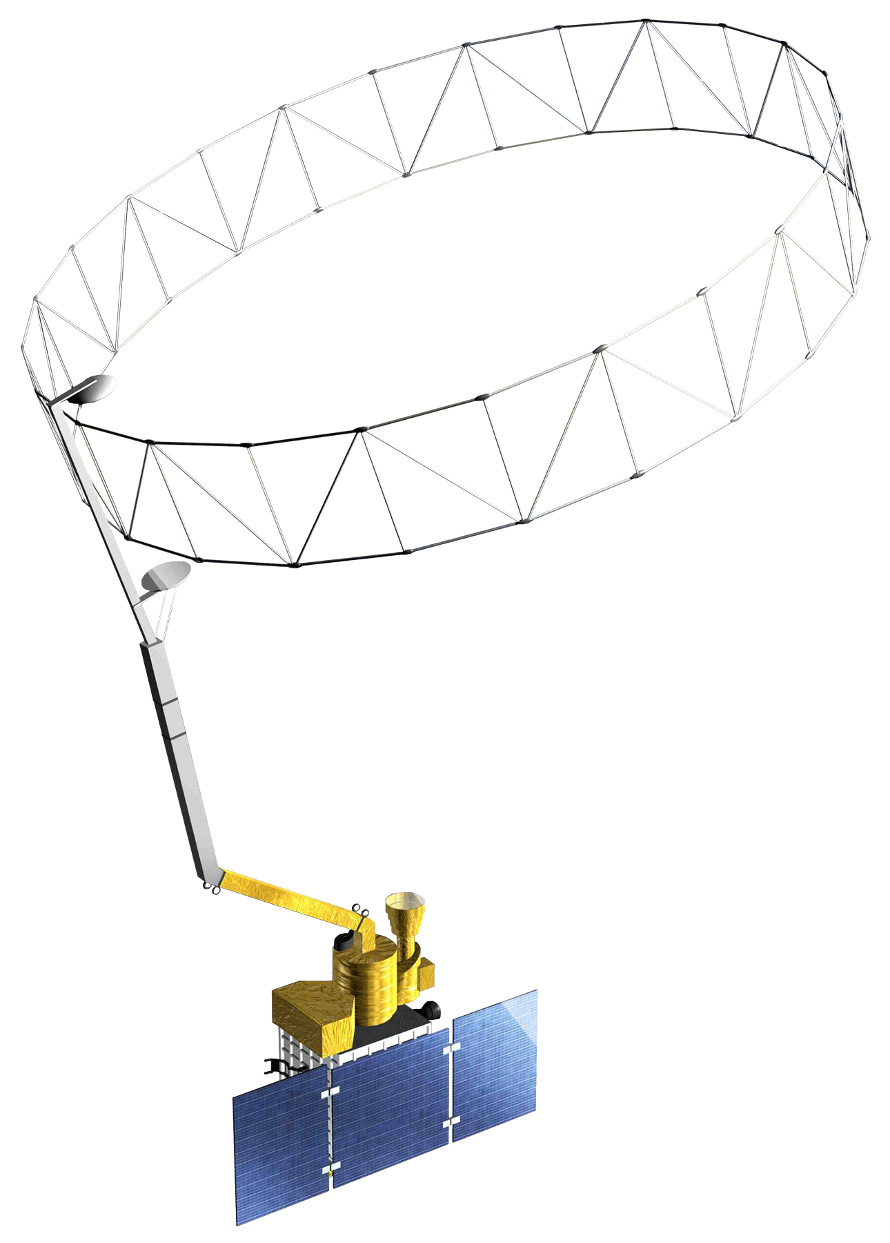
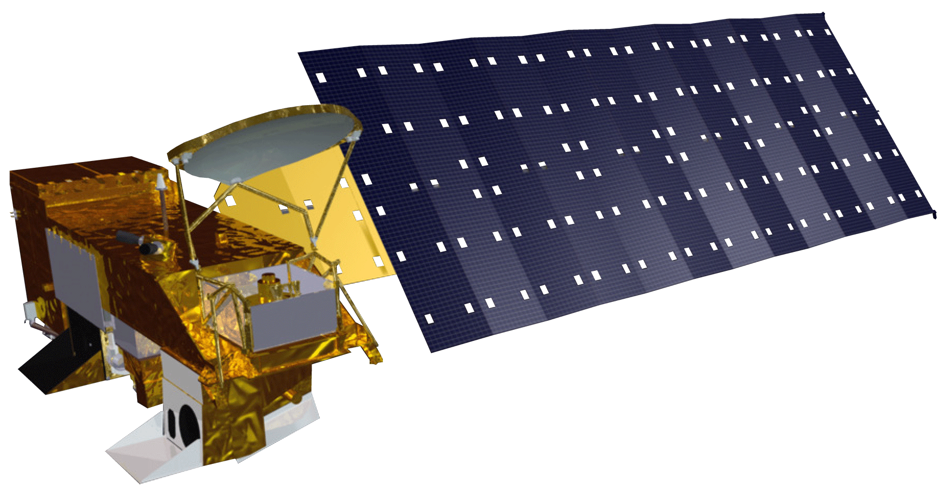
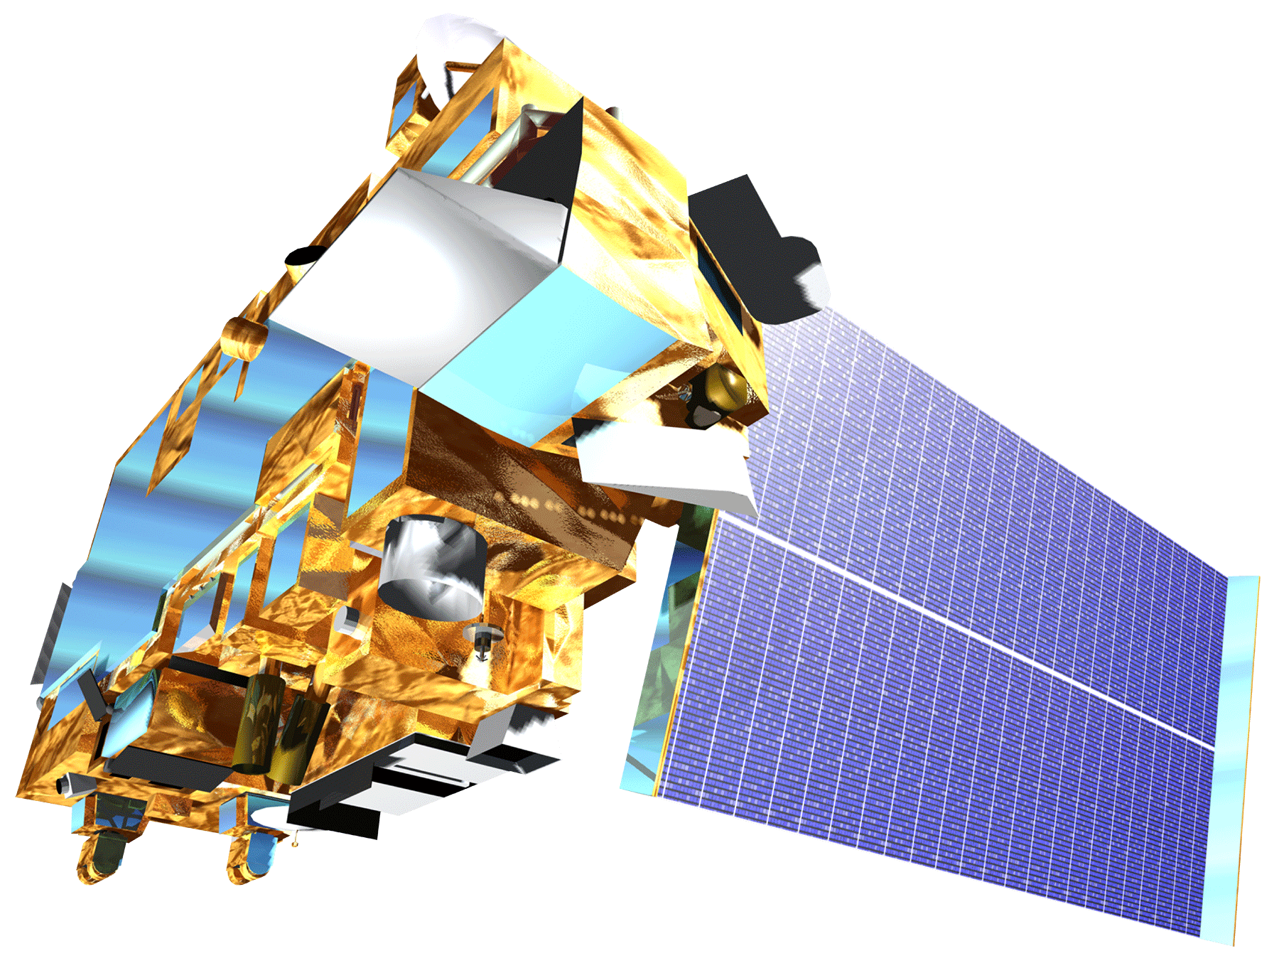
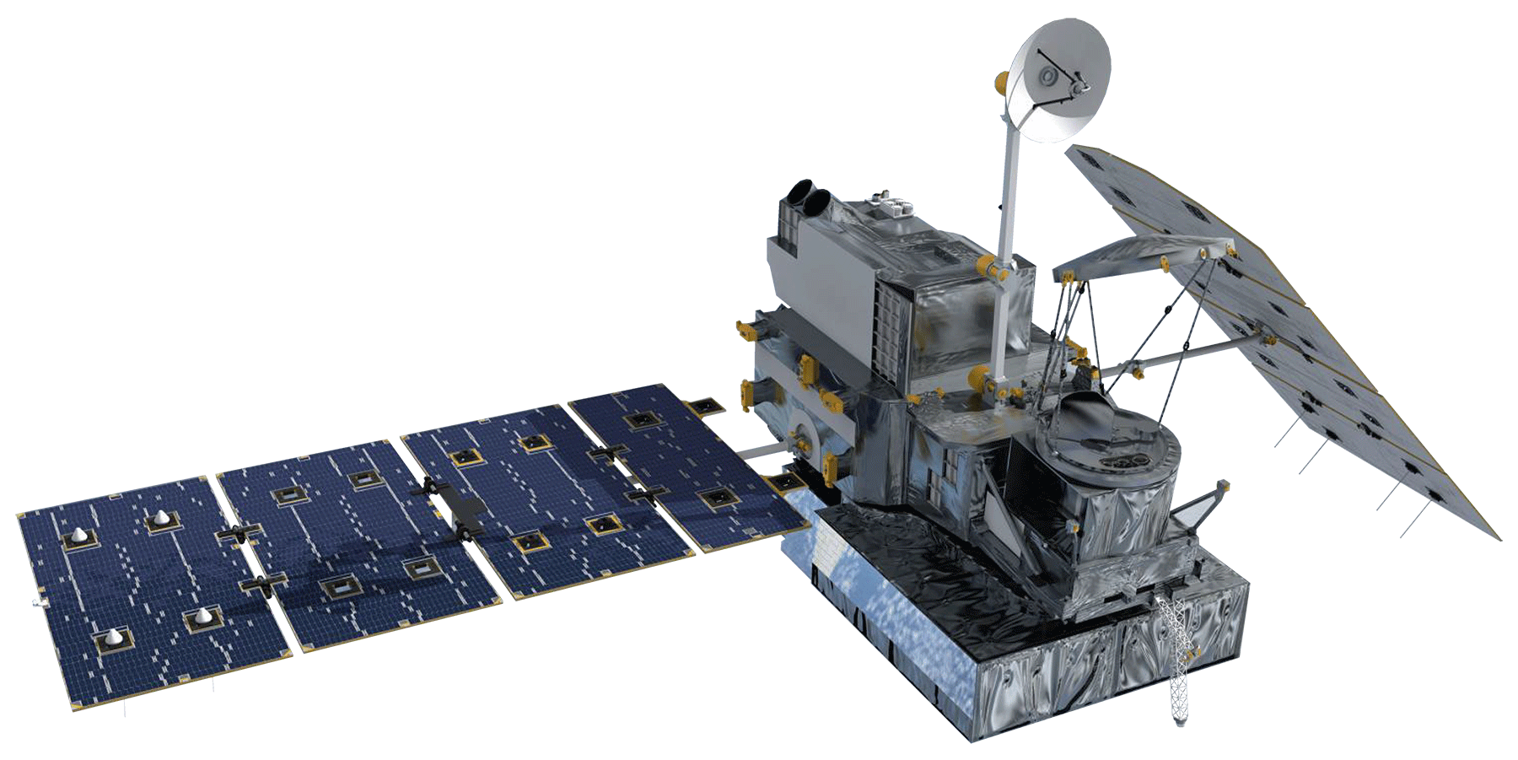
SATELLITES & SENSORS USED
Aqua MODerate resolution Imaging Spectroradiometer (MODIS)
Soil Moisture Active Passive (SMAP) L-Band Radiometer
Global Precipitation Measurement (GPM) Dual-frequency Precipitation Radar (DPR)
Terra MODerate resolution Imaging Spectroradiometer (MODIS)
Image Credits: NASA DEVELOP
Notes:
Speaker Notes: This project used a variety of different satellites and sensors including the SMAP L-band Radiometer for soil moisture data, the Terra and Aqua MODIS for vegetation condition data, and the GPM DPR for precipitation data.
Image Credit: NASA DEVELOP
SMAP: http://www.devpedia.developexchange.com/dp/images/b/b5/20_SMAP.png
Terra: http://www.devpedia.developexchange.com/dp/images/9/91/05_Terra.png
Aqua: http://www.devpedia.developexchange.com/dp/images/b/bf/06_Aqua.png
GPM: http://www.devpedia.developexchange.com/dp/images/1/14/08_GPM.png

Slide 7
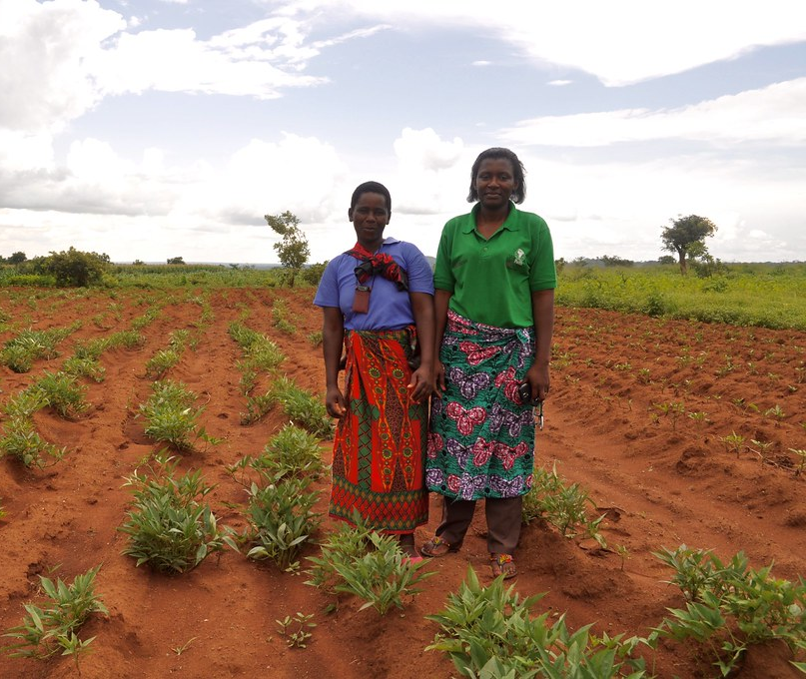
ANCILLARY DATASETS
National Center for Environmental Prediction (NCEP)
Land Surface Temperature (LST) data
Climate Hazards Group Infrared Precipitation with Station Data (CHIRPS)
Precipitation data
National Drought Management Authority (NDMA)
Early Warning Bulletins
Drought classification
VCI data
Image Credit: CHAM Communications
Notes:
Speaker Notes: We also used three ancillary datasets for this project. The first was land surface temperature data from NCEP. The second was precipitation data from CHIRPS. Finally, we gathered drought classification data and VCI data from the NDMA.
Image Credit: CHAM Communications
https://ccsearch.creativecommons.org/photos/455a80b9-3740-439b-84a0-34827aacb97f (CC BY-NC-SA 2.0)

Slide 8
METHODOLOGY
Ingest data through RHEAS model
Compile soil moisture, land surface temperature (LST), and precipitation data
Data Acquisition
Process data using the Variable Infiltration Capacity (VIC) model
Standardize outputs through RHEAS
Data Processing
Analyze time series for results from indices
Calculate correlation values between model outputs and current NDMA bulletins
Data Analysis
Drought Time Series
Evaluation of RHEAS Drought Indices
Story Map
End Products
Notes:
Speaker Notes: Our project followed four main steps. We first acquired our data using the ingest function in the RHEAS Model. We ingested data from all of our sources beginning in 2012 through as recent as data was available. We ingested soil moisture, land surface temperature, and precipitation data from the sensors we just mentioned. The next step was processing our data. We did this through the Variable Infiltration Capacity model in RHEAS. The VIC Model is a large-scale hydrologic model that utilizes land surface models in conjunction with the meteorological drivers to produce pixels, which in this project were at a 25 kilometer resolution, that show whatever indices we tell the model to calculate. RHEAS standardizes all the data that is fed into it, which is one of the great benefits of the model. It can take data from different sources and resolutions and create standard outputs. The data was save to a postGIS database in which code had to be run to extract the rasters, generating our drought indices. The indices we told the model to create for Kenya were the Standardized Precipitation Index and the Standardized Runoff Index, both for 1-,3-,6-, and 12-month accumulation periods; the Combined Drought Indicator; and the Soil Moisture Deficit Index. Data was calculated for each index daily from January 1, 2014 to April 30, 2019. We also standardized the VCI data from the NDMA in order to allow better comparisons to our indices by calculating a z-score for each value. We then moved on to data analysis, where we started by creating time series for each of the indices for each of Kenya’s 47 counties. We then used Pandas in Python to calculate Pearson correlation coefficients and covariance between the calculated indices. The standardized VCI data was also included in the correlation calculations. From this data, we created our end products. A drought time series, the RHEAS drought indices and the team’s evaluation of them, and a story map to be used by the NDMA for outreach.

Slide 9
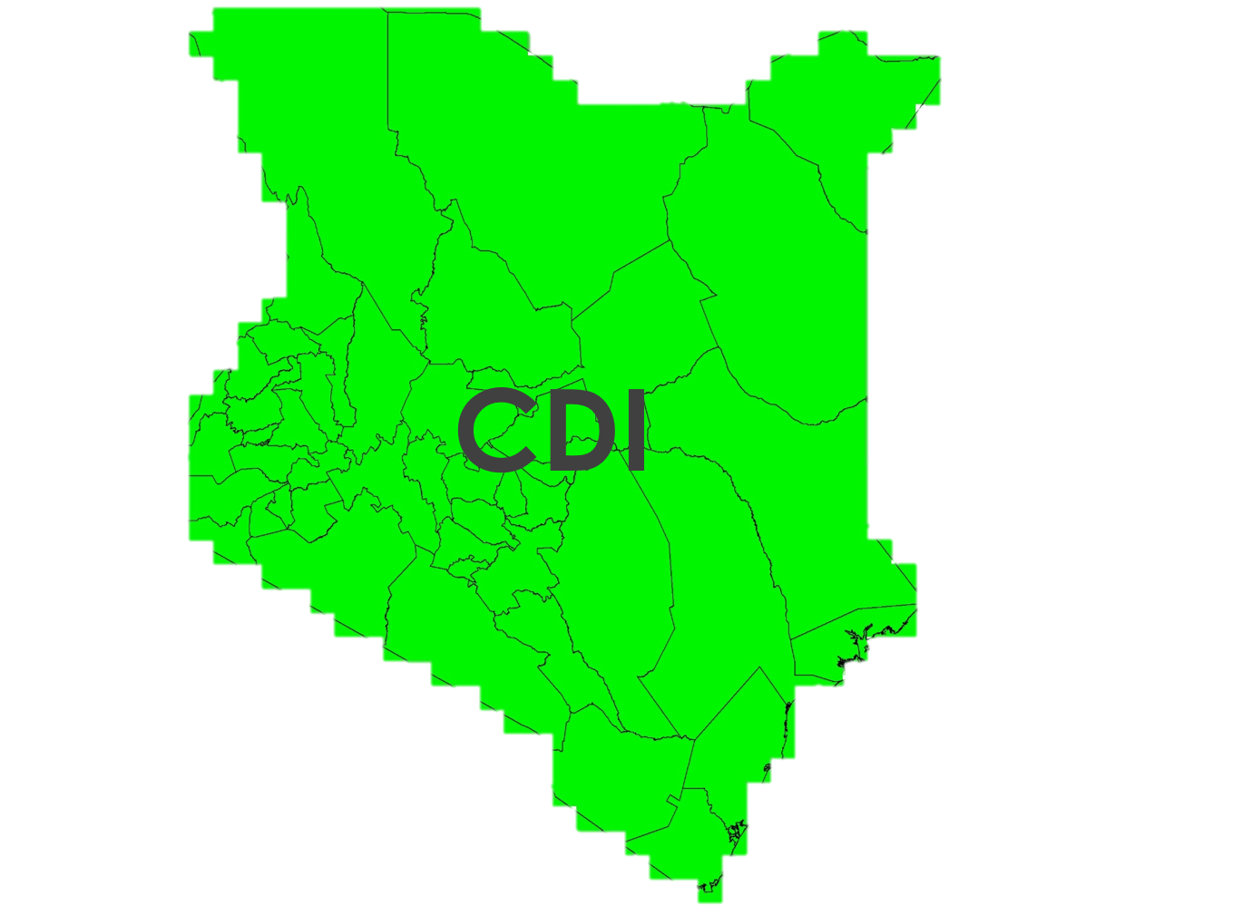
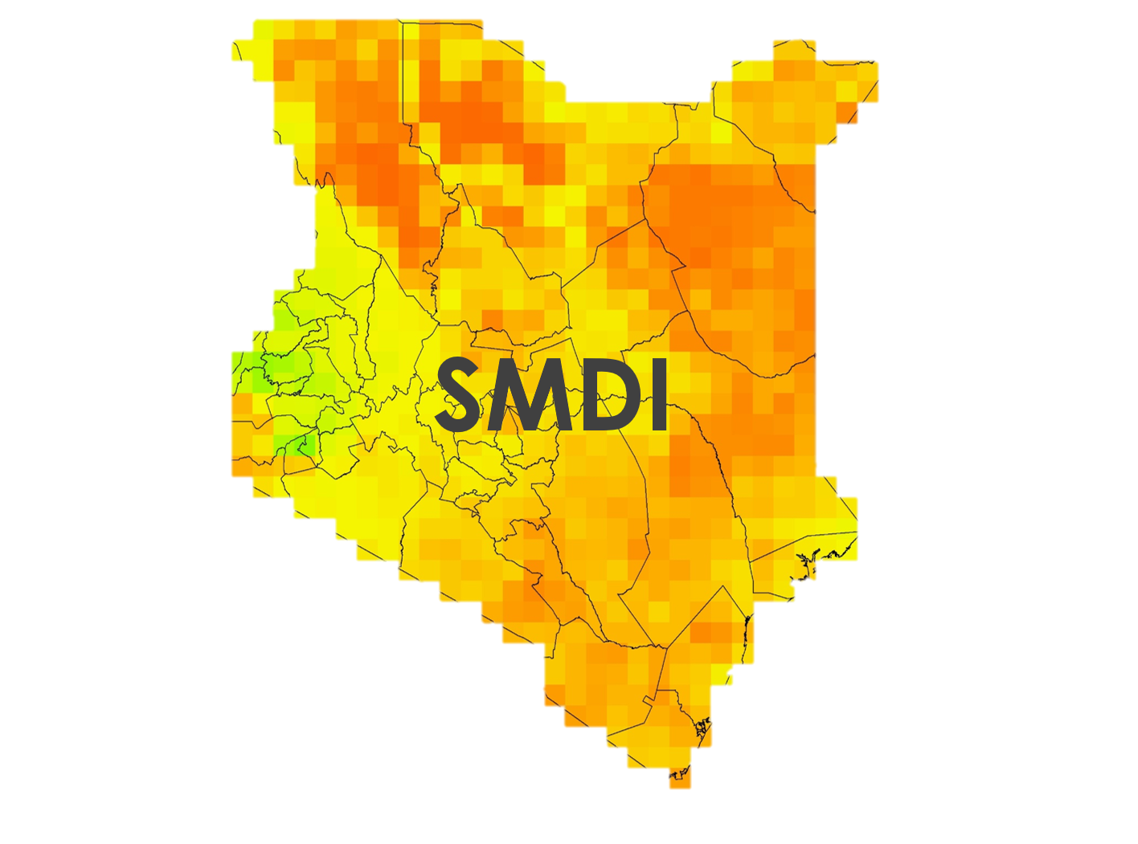
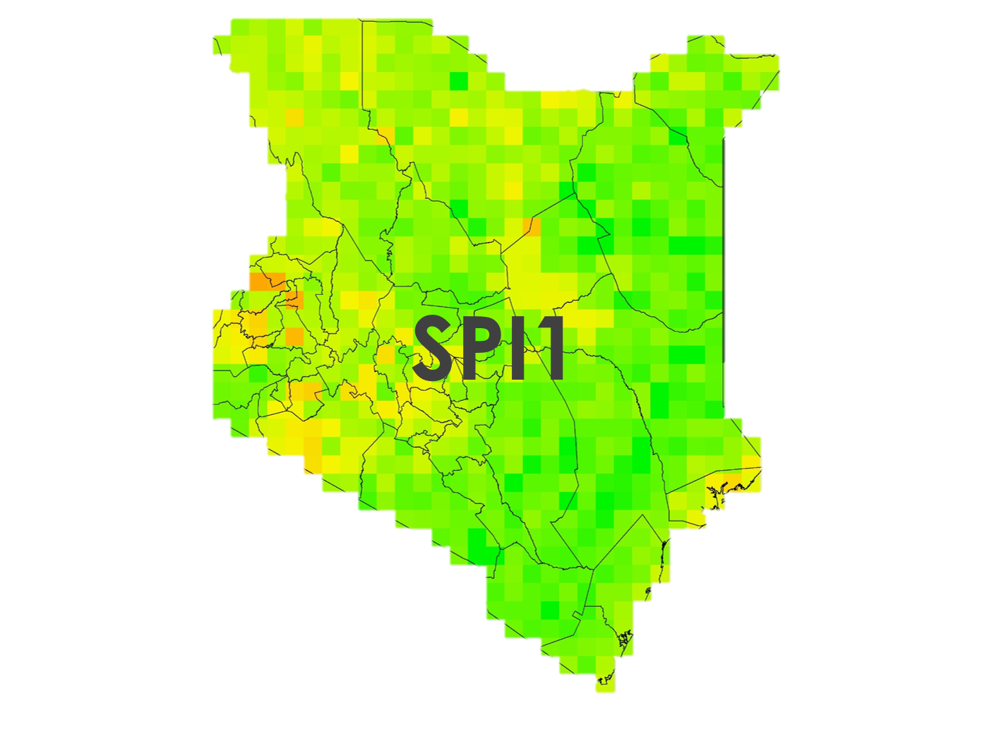
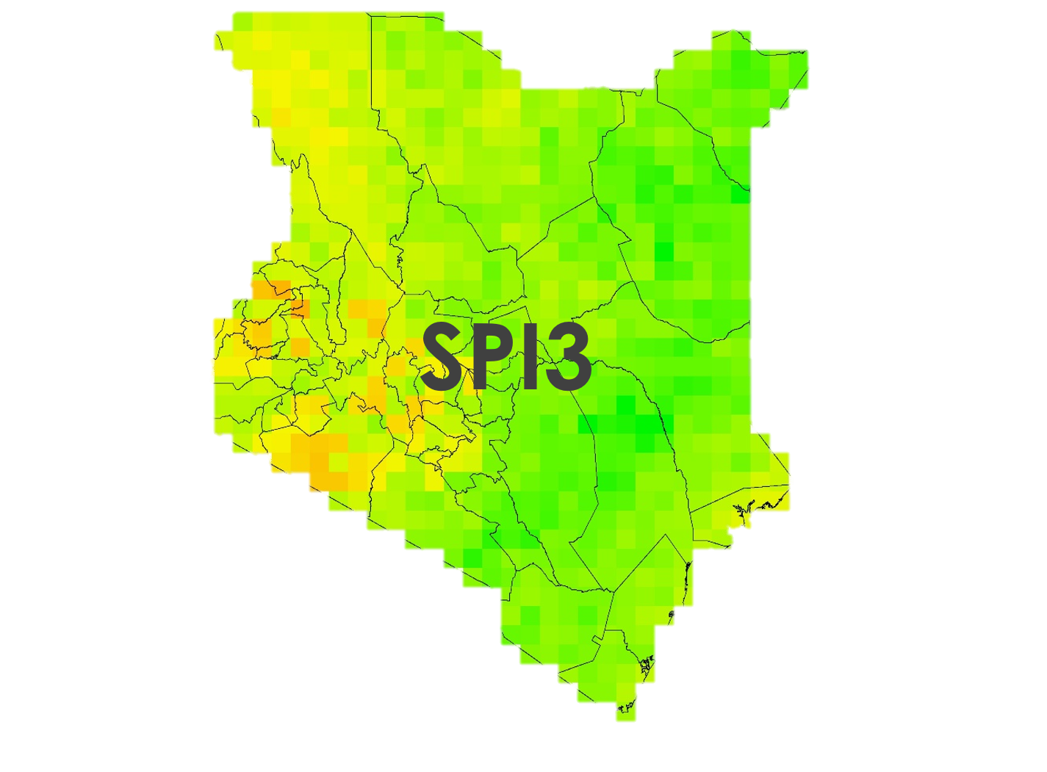
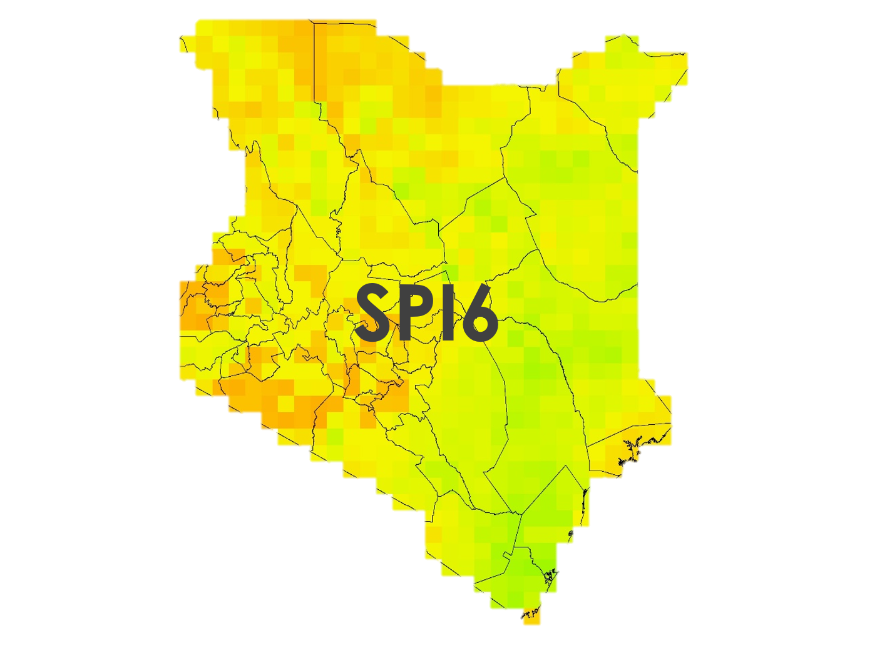
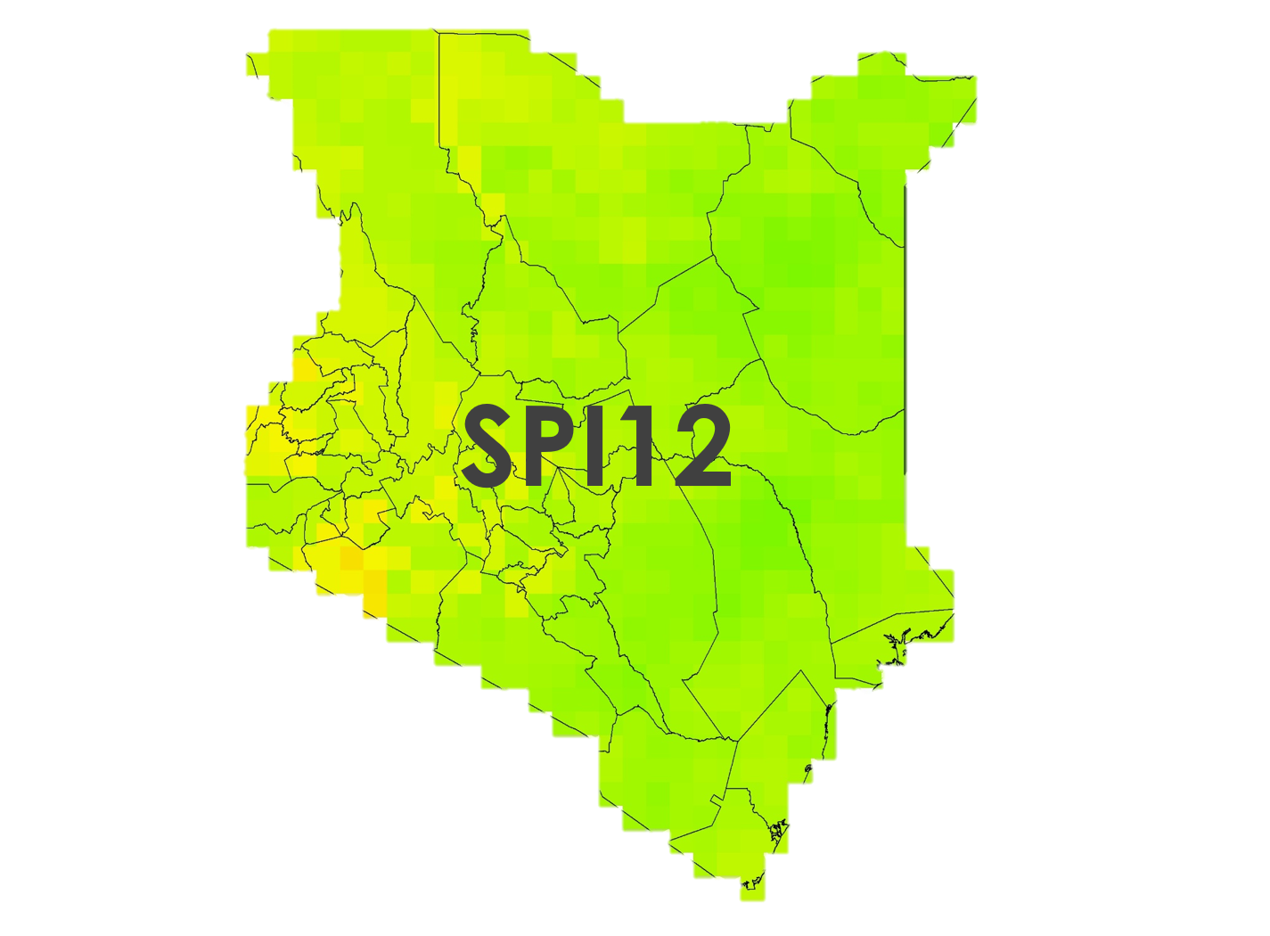
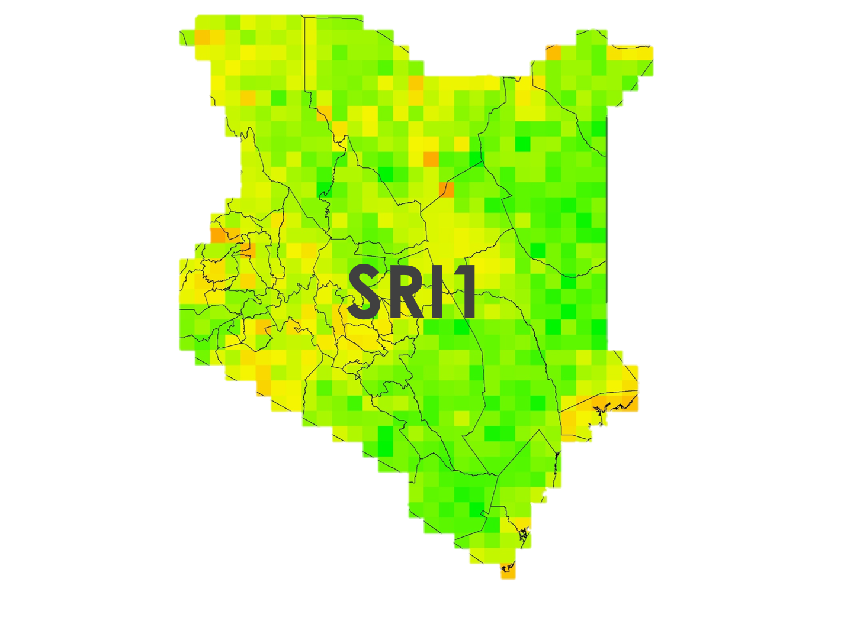
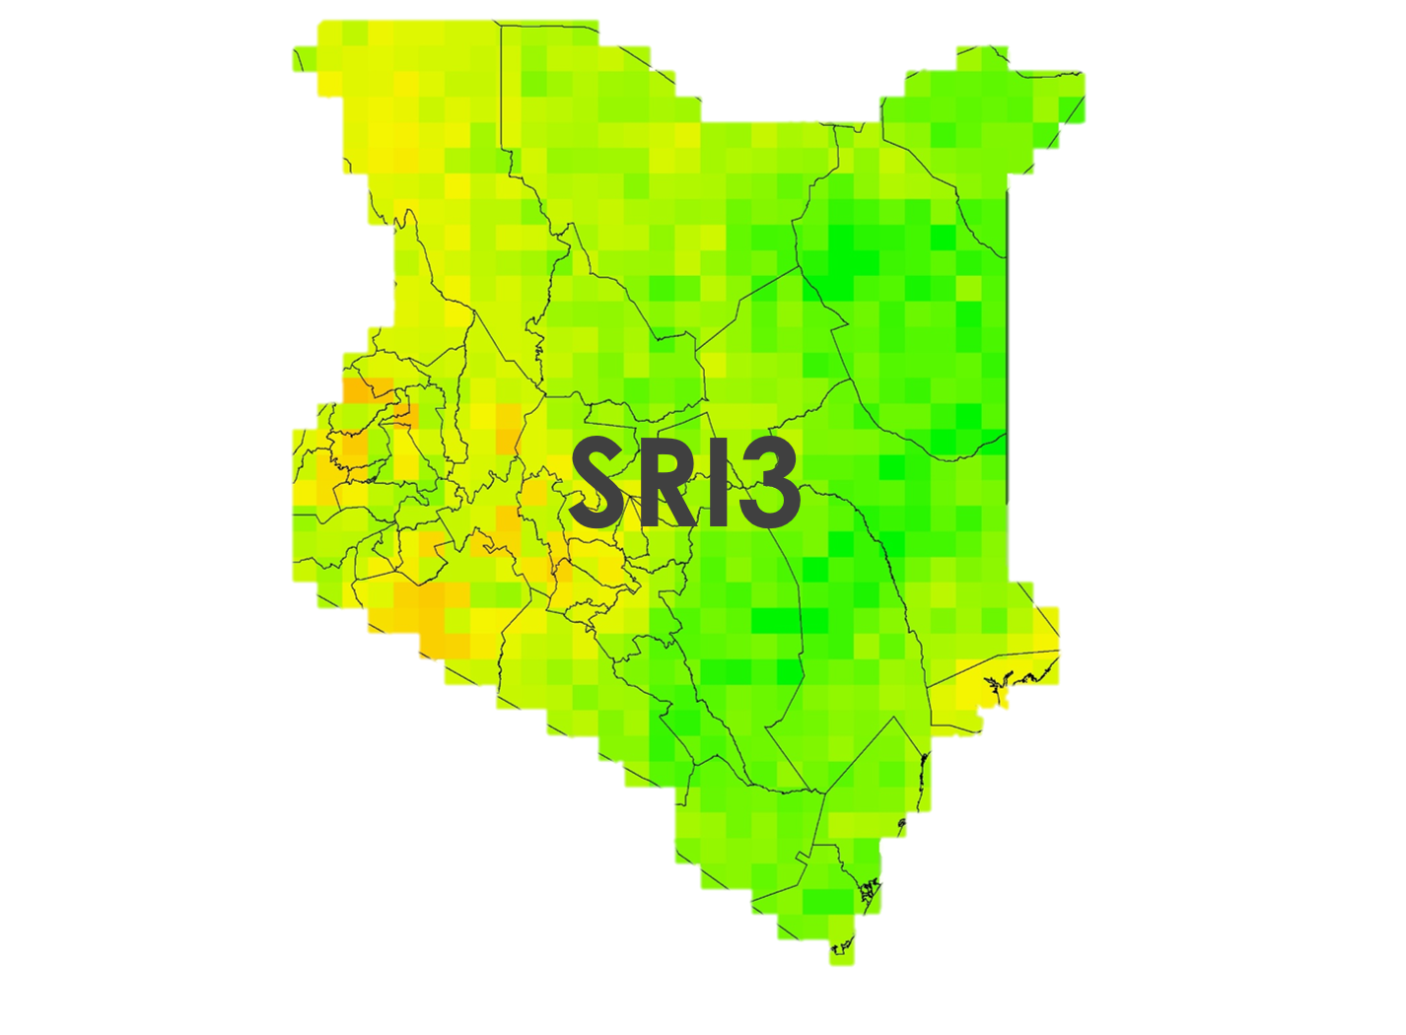
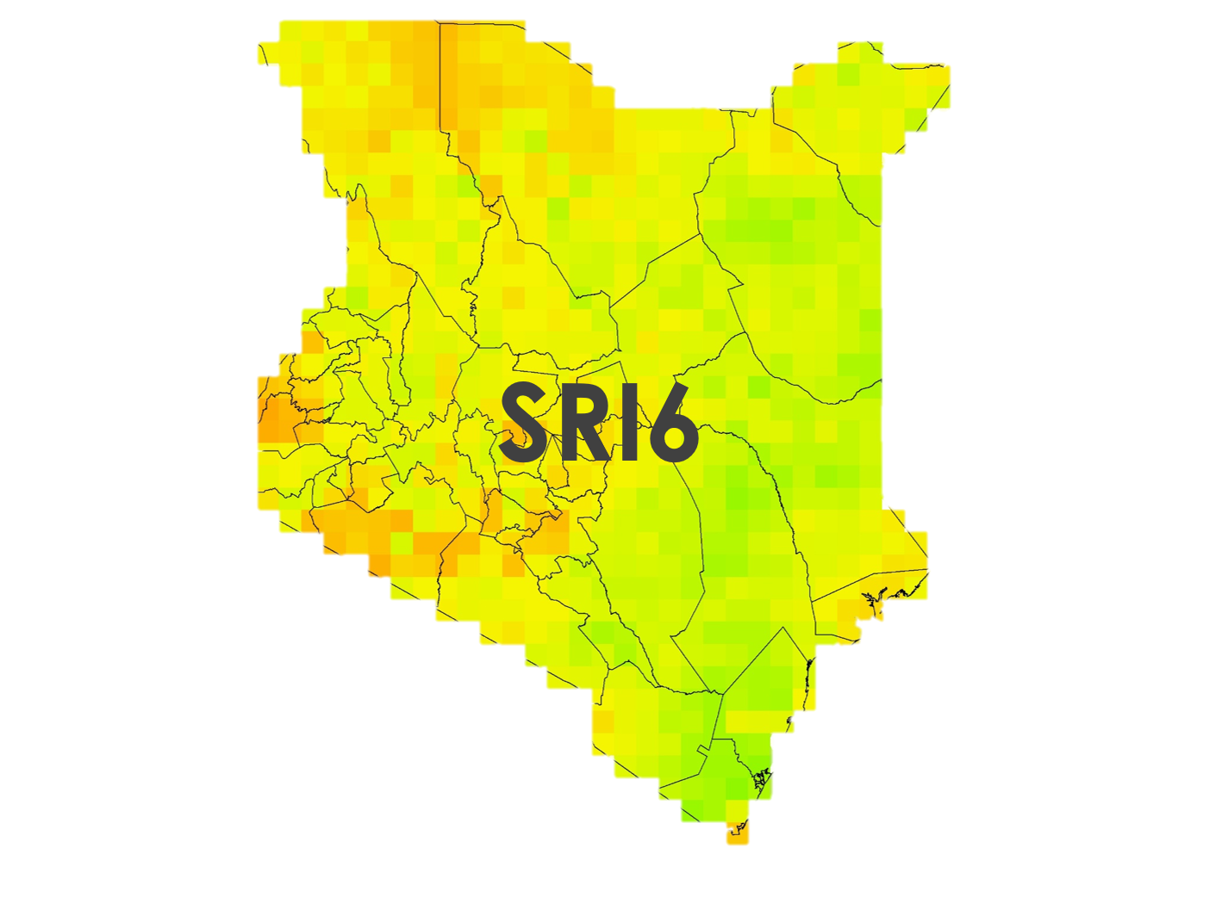
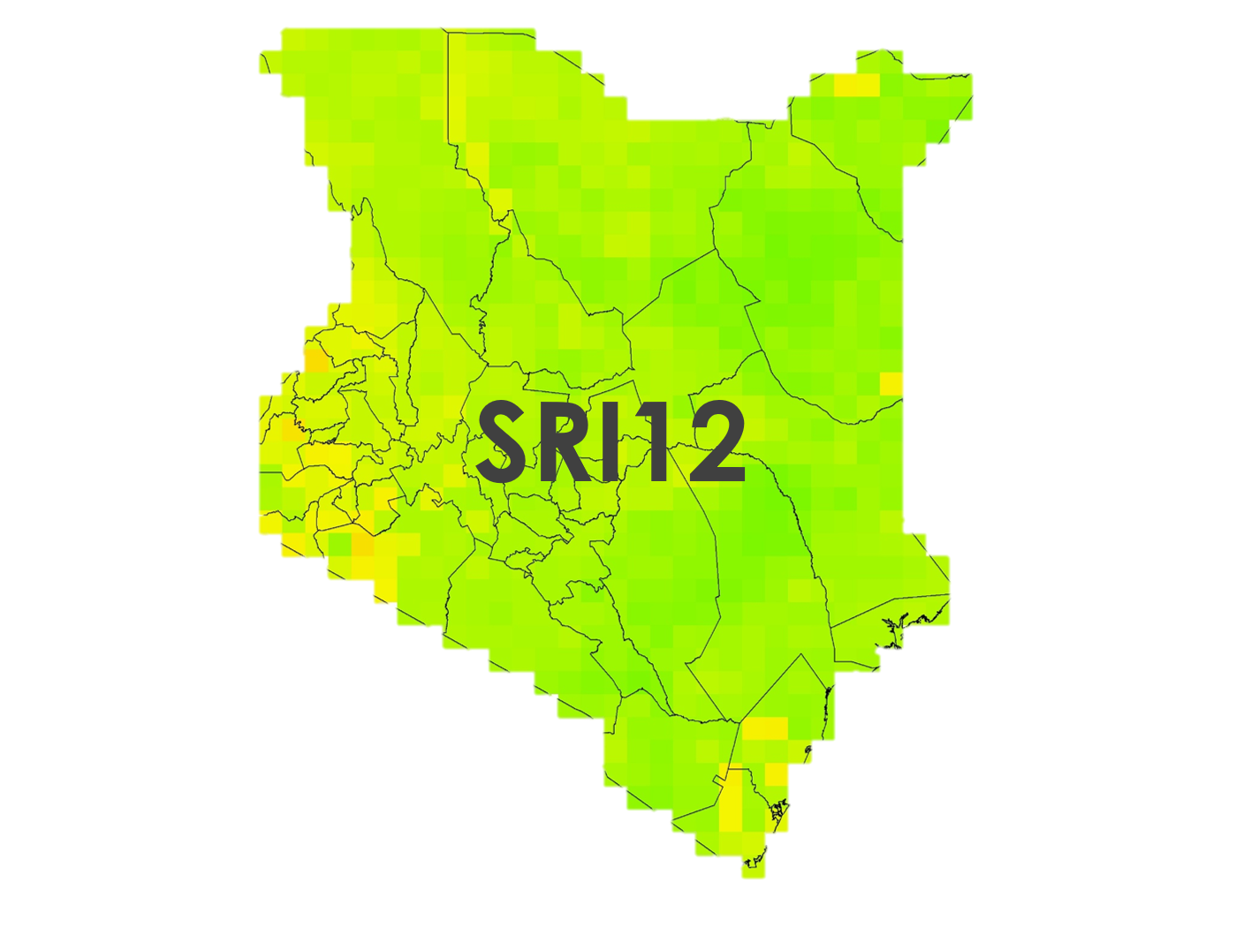
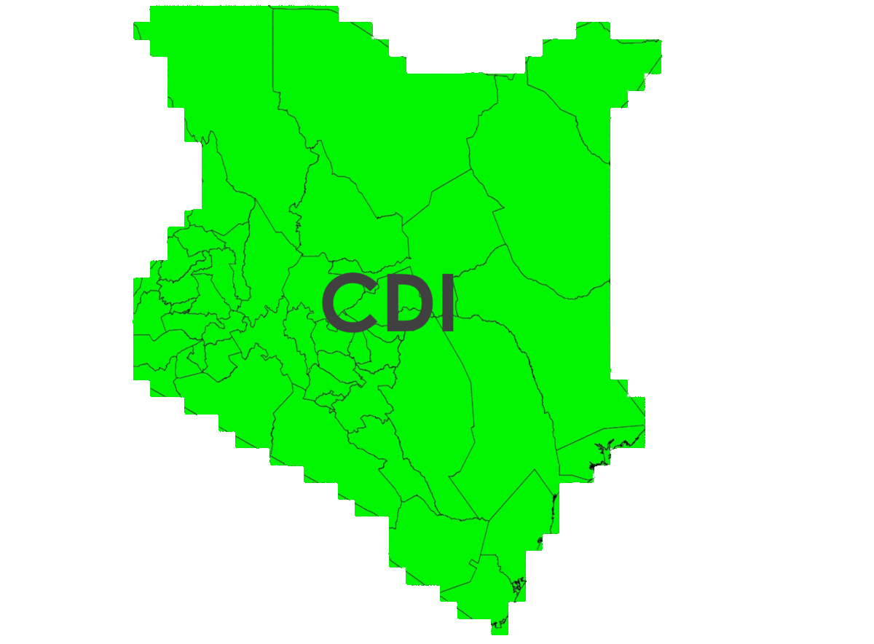
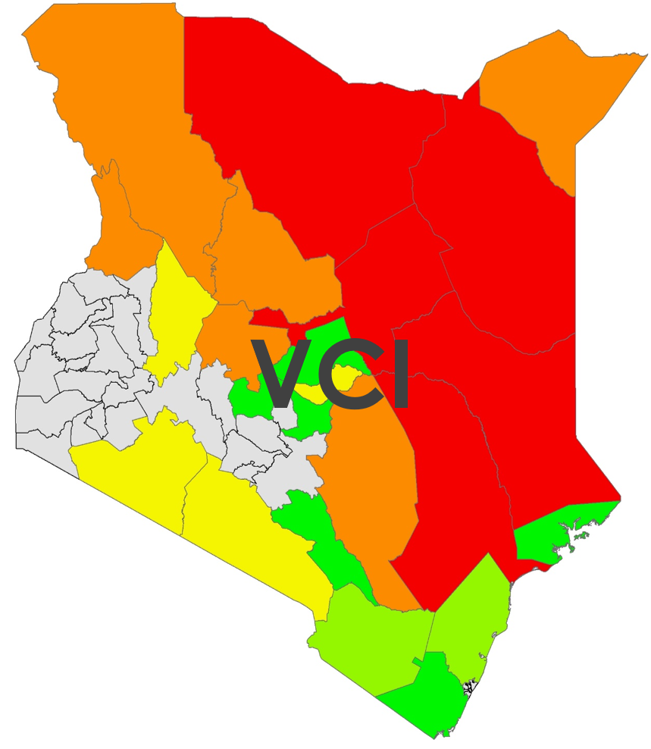
RESULTS
NDMA’s Current Measure
RHEAS Results
Notes:
Speaker Notes: Our results were composed of the ten drought indices *list indices* that we just mentioned for each of Kenya’s 47 counties, for each day from January 1st, 2016 to April 30th, 2019. If you’re keeping track, that is about 743,000 total data points with CHIRPS data. We also ran the model using GPM as the source for precipitation data, so you can double that number. Obviously, we can’t show you all of them, so these are images from RHEAS for January 1st, 2019, a quick snapshot of all the data that was created.

Slide 10
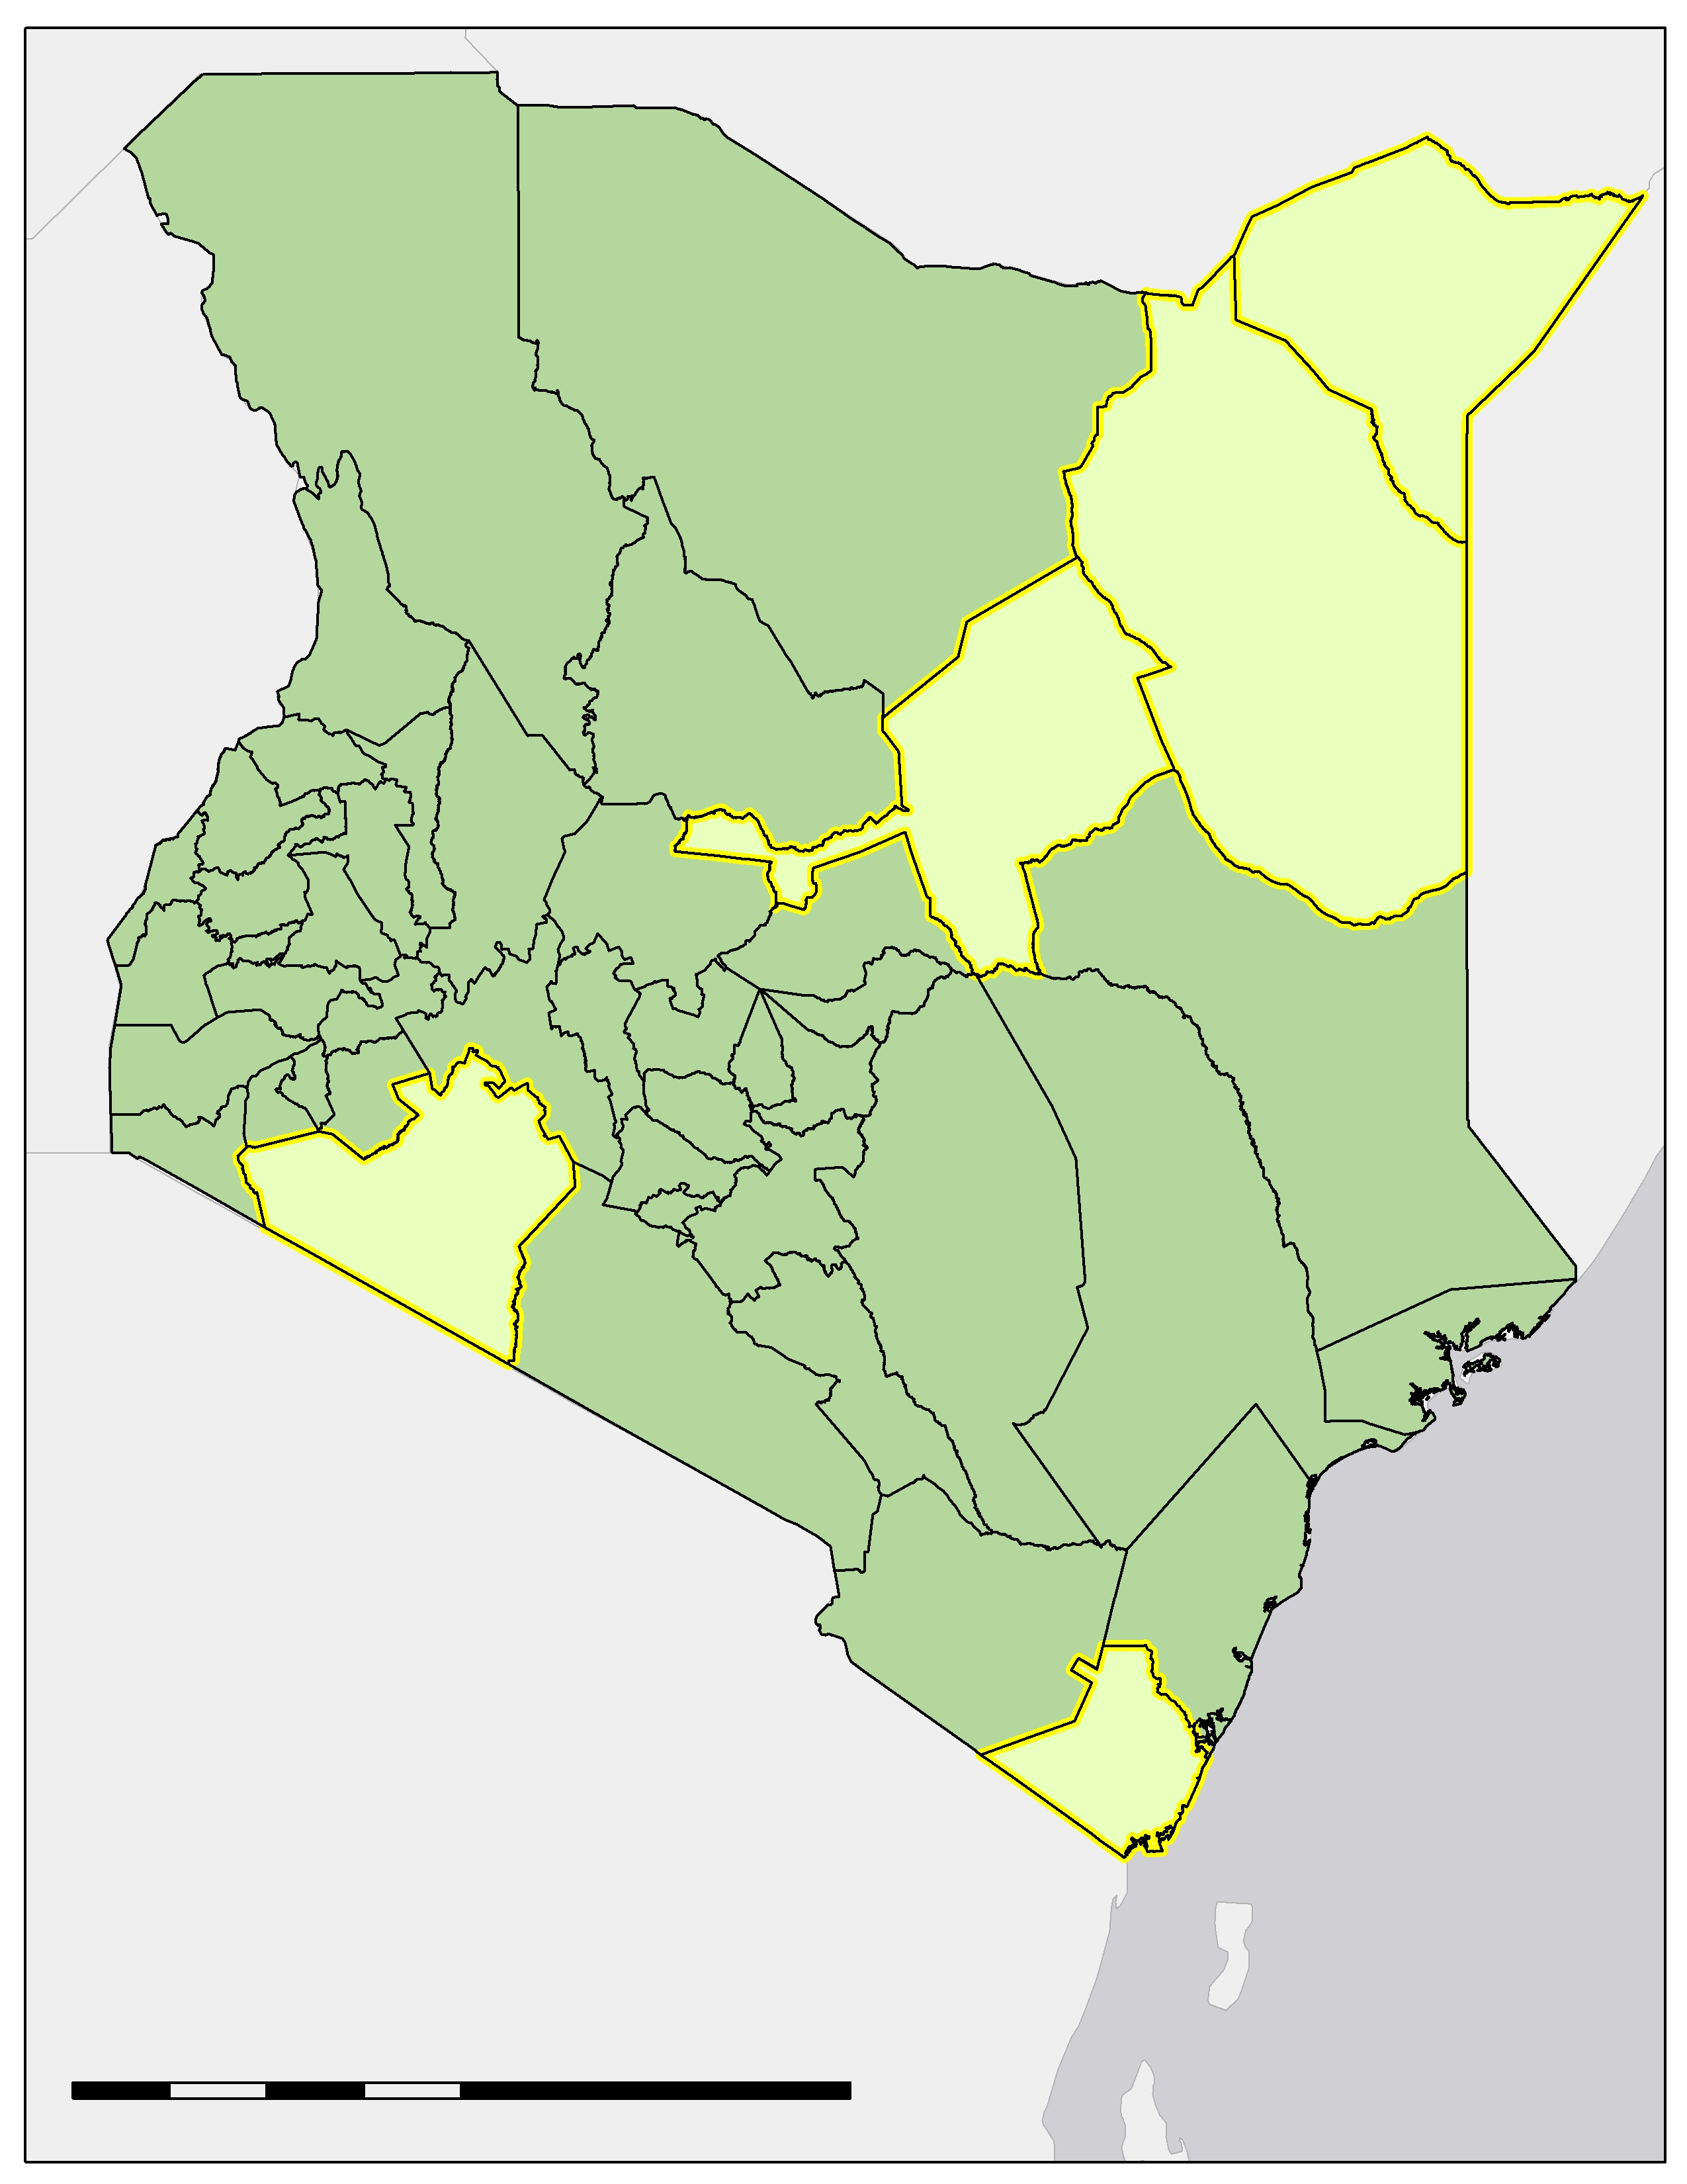
RESULTS – Case Study Counties
Case Study Counties
M
Five Case Study Counties
Selected across geographic and hydrologic ranges
Regularly Experience Drought: Wajir (W), Isiolo (I)
Rarely Experience Drought: Narok (N), Kwale (K)
Close to Median: Mandera (M)
W
I
N
K
100
200
400
km
Case Study Counties
Other Counties of Kenya
Notes:
Speaker Notes:
Because there was so much data available, we picked 5 case study counties based on their geographic and hydrologic differences to be representative of country-wide trends.
Two that regularly experience drought: Wajir and Isiolo
Two that rarely experience drought: Narok and Kwale
And one that is pretty close to the median: Mandera

Slide 11
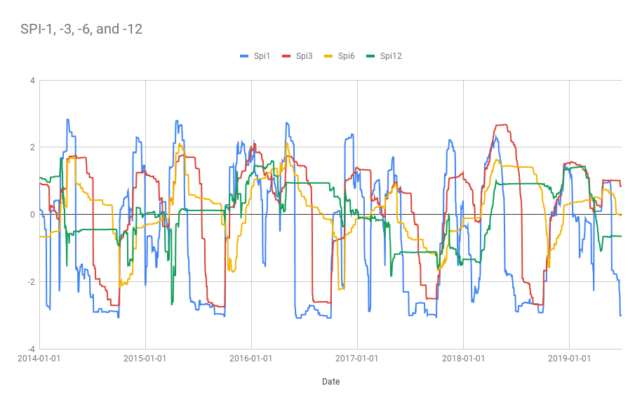
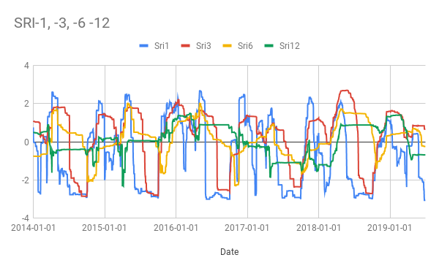
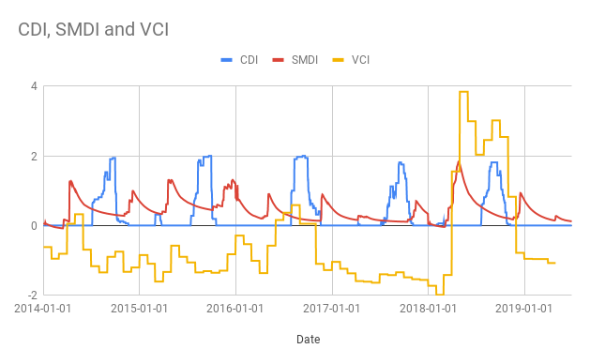
RESULTS – Time Series for Isiolo County
Notes:
Speaker Notes:
Looking at one of our case-study counties, we can generate a time series to compare the results from the different drought indices.

Slide 12
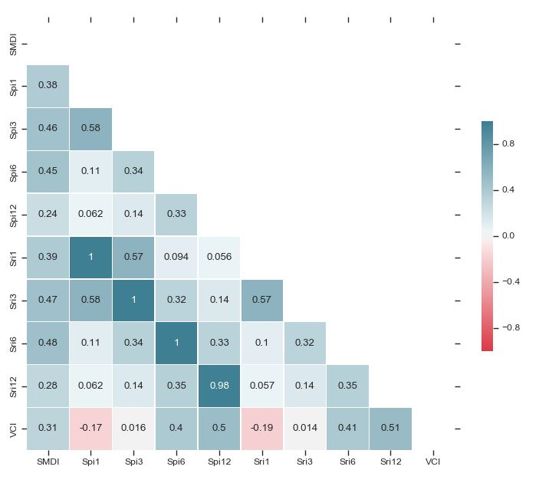
RESULTS – Correlation for Isiolo County
Comparing continuous drought indices
SPI/SRI are highly correlated
Spi1/Sri1 were negatively correlated with VCI
Notes:
Speaker Notes:
We wanted to examine how the different continuous drought indices compared with each other by calculating their correlations. We didn’t include CDI in this heatmap because it is categorical and can’t be directly compared against the continuous indices.
As you can see, SPI and SRI are highly correlated, so moving forward, when predicting drought, choosing one should be sufficient.
In addition, Spi1 and Sri1 were the only ones with negative correlations with VCI, making them outliers compared to the other indices.
The other counties experienced similar results to Isiolo County.

Slide 13
RESULTS – SPI1 AND SPI12
Notes:
Speaker Notes:
Spi1 and Sri1 are such outliers because they are looking exclusively at short-term changes and are directly influenced by individual rain events. That means that these indices are good at looking at surface soil moisture, but are not immediately comparable to longer-term indices such as Spi12, pictured here.
The current tool that the NDMA uses, VCI, relies solely on vegetation health indicators, which have a time lag in displaying the impacts of rain or drought events. In contrast, Spi1 and Sri1 visualize rain events independent of vegetation growth, and therefore could be effective tools in an early-warning forecasting system.
The long-term indices, such as the 6- and 12-month accumulations are more illustrative of water table accumulations and changes. The differences between the short and long-term indices are visualized on this slide.

Slide 14
RESULTS – CDI
0 = No Drought
1 = Precipitation Deficit
2 = Soil Moisture Deficit
3 = Vegetation Stress Following Precipitation Deficit
4 = Vegetation Stress Following Precipitation/Soil Moisture Deficit
Notes:
Speaker Notes:
The combined drought indicator or CDI is a categorical index with values ranging from 0 to 4, with 0 meaning no drought, 1 meaning a precipitation deficit, 2 meaning a soil moisture deficit, 3 meaning vegetation stress following precipitation deficit, and 4 meaning vegetation stress following precipitation and soil moisture deficit.
Towards the beginning of our project, we hypothesized that the CDI would be the most useful index, as it takes precipitation deficit, soil moisture deficit, and vegetation stress into account.
However, for the data we were able to analyze:
CDI was never higher than 3,
and most of the time it indicated no drought, as seen in this animation.
This suggests that moving forward, CDI could be more useful if the thresholds that calculate the different categories within CDI were adjusted to pick up more of the differences in the data.

Slide 15
CONCLUSIONS
Drought indices that cover a longer period of time (SPI12, SRI12) provided a clearer connection to the water table while indices that look at shorter time periods of time are more closely linked to soil moisture (SPI1, SRI1).
SPI1 and SRI1 have high potential for use in a short-term forecasting system.
VCI, NDMA's current measure, does not effectively measure smaller changes in drought as well as the RHEAS-generated indices, making it comparatively limited for inferring drought status.
Notes:
Speaker Notes:
We were able to reach a few initial conclusions from looking at the time series for the different drought indices. The first was that the drought indices that take into account longer periods of time, such as SPI and SRI for a 12-month accumulation period, seem to be linked to the groundwater table over just precipitation related water. The SPI and SRI for 1- and 3-month accumulation are more closely linked to immediate precipitation and soil moisture.
SPI1 and SRI1 have high potential for use in a short-term forecasting system.
In addition, we concluded that the Vegetation Condition Index is comparatively limited in inferring drought status due to its inability to effectively measure short-term changes in drought conditions. It is a more holistic drought indicator, but it does not pick up on short-lived droughts.
Lastly, we were able to draw was that the Soil Moisture Deficit Index, or SMDI, is the most practical all-purpose index because it operates independently of plant health. This is important because Kenya is prone to invasive species that stay green year round, making and VCI data inaccurate for plants that are actually relied on by the Kenyan people. It can also effectively measure short- and long-term drought events.

Slide 16
LIMITATIONS & FUTURE WORK
Limitations
Future Work
25 km resolution
No assimilation
Validation and incorporation
5 km resolution
Assimilation
Forecasting
Image Credit: IHH Humanitarian Relief Foundation
Notes:
Speaker Notes: One limitation of our project was only being able to run it at a 25 kilometer resolution. The NDMA evaluates drought risk on a ward level, and wards are much smaller than that 25 kilometers in some cases, so ideally the model will be run at a much smaller 5 kilometer resolution. Another limitation that we faced during this project was that we were unable to run assimilation during the term. The assimilation function in RHEAS uses observations from SMAP or Soil Moisture Ocean Salinity, or SMOS, on a weekly level to “fact check” the model’s calculations. Unfortunately, this function wasn’t useable yet.
These limitations brings us to what future work can and will be done for this project. We are the first term of a two-term project, so a second DEVELOP team will seek to validate our results and perform some of the functions that we were unable to do. This includes running the model at a 5 kilometer resolution which will be much more useful to the NDMA in their incorporation of RHEAS into their calculations for figuring out drought risk. They will also aide the NDMA in incorporating RHEAS into their Early Warning Bulletins. The team will also start assimilation runs in order to analyze whether or not the function provides a better picture of drought in Kenya. We were running the model in a “Nowcast” mode, meaning that the model could only calculate values for days that had data from the sensors. The second term will hopefully begin using the “Forecast” function in RHEAS, projecting drought conditions into the future.
Image Credit: IHH Humanitarian Relief Foundation, İHH İnsani Yardım
Image Source: https://search.creativecommons.org/photos/9af780ad-c033-4448-bba3-f5f6e0b269a9 (CC BY-NC-ND-2.0)

Slide 17
SERVIR: Dr. Lee Ellenburg, Emily Adams, Dr. Vikalp Mishra, and Sara Miller
RCMRD: Lilian Ndungu
NDMA: Nelson Mutanda
DEVELOP Center Lead: Madison Murphy
Science Advisors: Dr. Jeffrey Luvall and Dr. Robert Griffin
Mentors: Helen Baldwin and Maggi Klug
Notes:
Speaker Notes: We’d like to thank our advisors, our partners and collaborators, and the DEVELOP leadership for all of the support they have given us along the way.

Slide 18
Thank you! Questions?
Ryan Good
Project Lead
Chiara Phillips
Ryan Marshman
Amanda Tomlinson
Notes:
Speaker Notes:
We also want to thank all of you for coming out to watch the presentation! If you have any questions, we can take those now.

