Slide 1
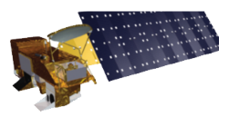
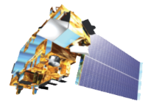
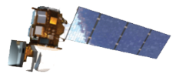
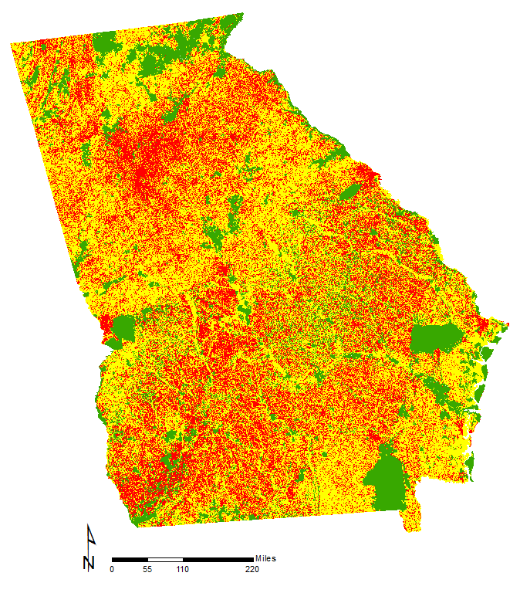
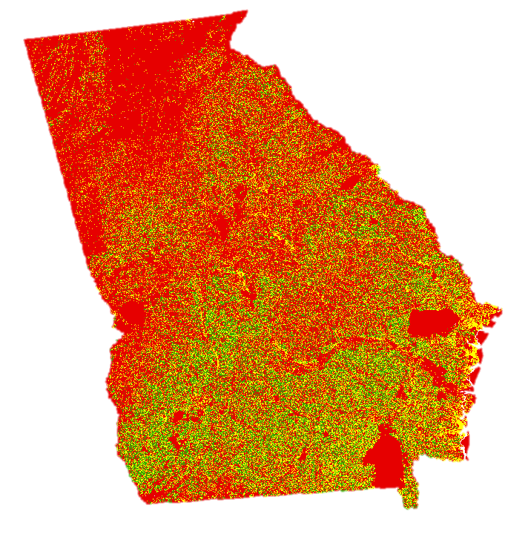

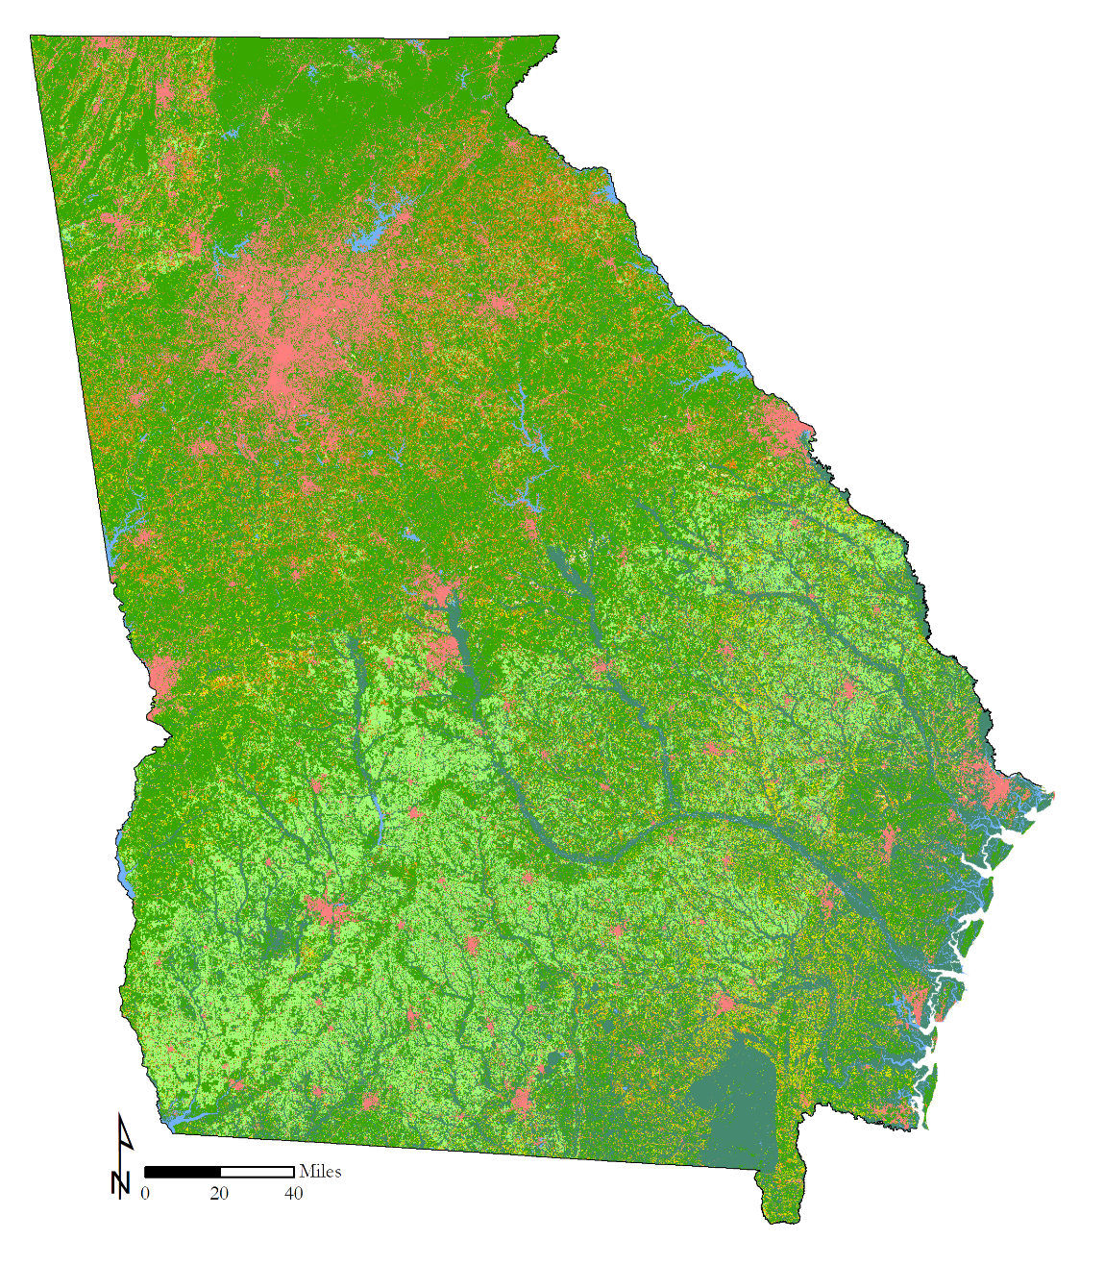
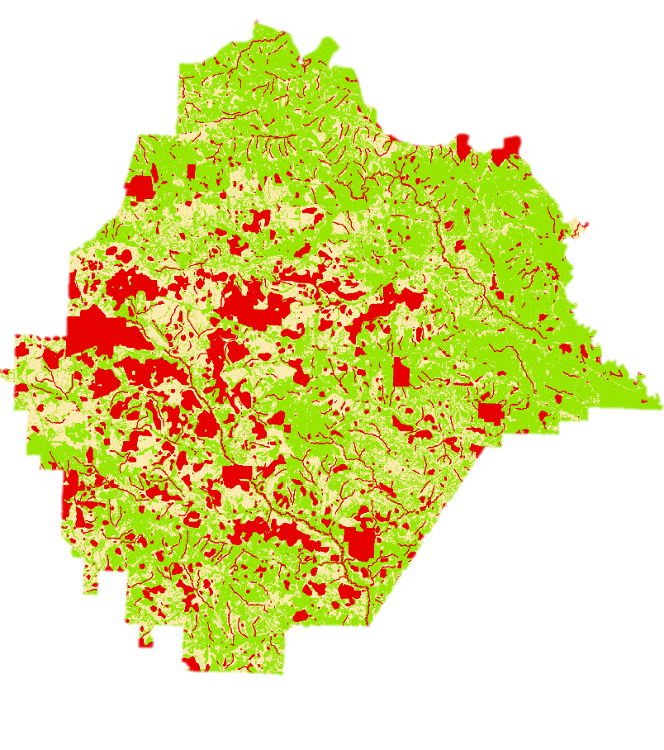








Identifying Suitable Areas for Solar Power Generating Facilities while Reducing Conflicts with Sensitive Habitats and Wildlife Populations
Abstract
Earth Observations
Solar energy is a rapidly growing industry in the state of Georgia. The increasing popularity of solar farms is encouraging decision-makers and developers to incorporate a sustainable plan for utility-scale solar developments. However, the construction and siting of solar farms could have a threatening impact on environmentally sensitive habitats and associated species. NASA DEVELOP partnered with The Nature Conservancy and the Georgia Department of Natural Resources to conduct an analysis to inform solar site planning and to communicate with key stakeholders. The team analyzed land cover trends from Landsat 8 OLI in addition to solar insolation data sets from Terra CERES. These Earth observations were combined to classify and extract data layers for a solar site suitability and conflict identification model following the Land Use Conflict Identification Strategy (LUCIS). Additionally, the DEVELOP team utilized endangered species habitat layers, with a focus on the gopher tortoise (Gopherus polyphemus) primarily due to its role as a keystone species in these sensitive areas. These data were used to generate end products that depict potential conflicts between ideal solar energy sites and endangered species habitats, and prioritize development areas outside of these conflicts. This project also developed a case study with higher resolution and supplementary ancillary data in Taylor County, GA. The results of this project will be utilized by The Nature Conservancy and Georgia Department of Natural Resources to recommend suitable sites for environmentally conscious solar farm construction.
Satellite | Instrument
Aqua (2002) | Clouds and the Earth’s Radiant Energy System (CERES)
Terra (1999) | Clouds and the Earth’s Radiant Energy System (CERES)
Landsat 8 | Operational Land Imager/Thermal Infrared Sensor (OLI/TRIS)
Results
Environmentally
Sensitive Habitats
Developer Criteria
Conflict Mapping
Objectives
Study Area
Raise awareness on the need for considering vulnerable environmentally sensitive areas in the solar farm development process.
Create a Land-Use Conflict Identification Strategy (LUCIS) model that identifies areas suitable for solar farm development in the state of Georgia and delineates conflict areas with environmentally sensitive areas.
Utilize the LUCIS model to create user-friendly communication platforms that our partners and stakeholders can use to support future land-use planning.
+
=
Most Sensitive
Moderately Sensitive
Least Sensitive
Most Suitable
Moderately Suitable
Least Suitable
Our analysis resulted in a clear delineation of areas of land use conflict between environmental and energy development stakeholders, and a prioritization process to recommend future land use.
Georgia Energy
Methodology
Define Stakeholder Needs – Environmental and Developer
Conclusions
Develop Goals, Objectives, and Criteria for
Land-Use Conflict Identification Strategy (LUCIS) model
The rapid growth of the solar industry in Georgia has created concerns about environmental impact and efficient placement of solar farms.
This analysis addresses the community’s concern by creating maps that indicate the best locations for solar farm implementation while minimizing environmental impact.
These maps can immediately impact the direction of the solar industry that will accommodate the concerns of the developer and environmental community.
Acquire and Input Data into Land-Use Scenarios
Environmental Protection Scenario
Solar Developer Scenario
Gopher Tortoise Habitat (UGA)
Protected Lands (GADNR)
Solar Insolation (CERES)
Slope
(DEM)
Project Partners
Granite Rock Outcrops (NRCS)
Land-Use (CropScape)
Land-Use (CropScape)
Aspect
(DEM)
The Nature Conservancy
The Georgia Department of Natural Resources
Prime Farmland
(NRCS)
Floodplains
(FEMA)
Roads
(GA)
Parcels
(GA)
Streams
(NWI)
Acknowledgements
Product: Map Indicating Environmentally Sensitive Areas
Product: Suitability Map for Solar Farm Development
Dr Marguerite Madden, University of Georgia
Dr. Jeff Hepinstall-Cymerman, University of Georgia
Cassidy Jordan, The Nature Conservancy
Matt Elliott, Georgia Department of Natural Resources
Dr. Paul Stackhouse, NASA
LUCIS Model
Team
Members
Lynn Abdouni
Team Lead
Emad Ahmed
Natalia Bhattacharjee
Roger Bledsoe
Christopher Cameron
Suravi Shrestha
Austin Stone
University of Georgia – Summer 2017
Notes:
Solar energy is a rapidly growing industry in the state of Georgia. The increasing popularity of solar farms is encouraging decision makers and developers to incorporate a sustainable plan for utility scale solar developments. However, the construction and siting of solar farms could have a threatening impact on environmentally sensitive habitats and associated species. NASA DEVELOP has partnered with The Nature Conservancy (TNC) and the Georgia Department of Natural Resources (GDNR) to conduct an analysis that will be used to inform solar site planning and to communicate with key stakeholders. The team analyzed land cover trends from Landsat 8 OLI in addition to solar insolation data sets from Terra CERES. These Earth observations were combined to classify and extract data layers for a solar site suitability and conflict identification model. Additionally, the DEVELOP team focused on the gopher tortoise (Gopherus polyphemus) primarily due to its role as a keystone species in these sensitive areas. These data were used to generate end products that depict potential conflicts between ideal solar energy sites and endangered species habitats, and prioritize development areas outside of these conflicts. This project also developed a case study with higher resolution and supplementary ancillary data tailored to Taylor County, GA. The results of this project will be utilized by TNC and GDNR to recommend suitable sites for environmentally conscious solar farm construction.

