Slide 1
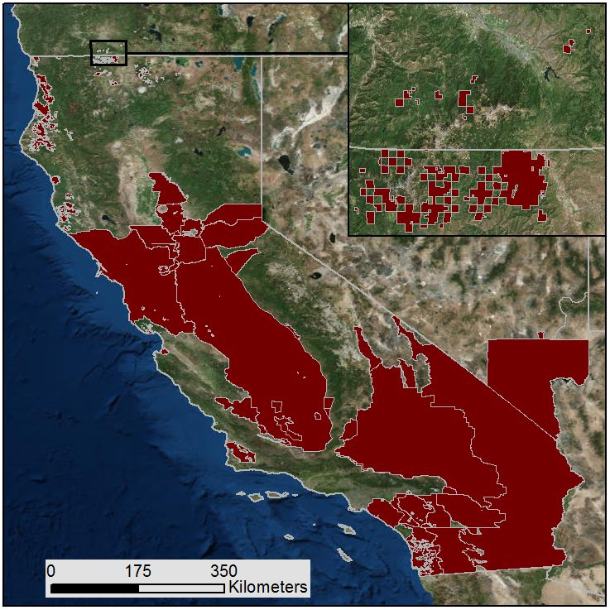
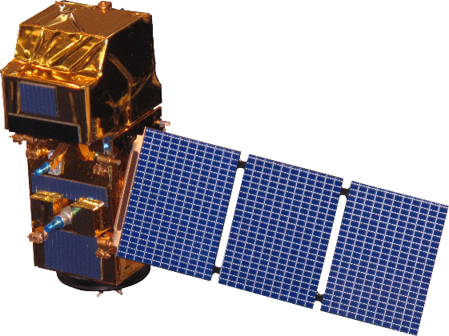
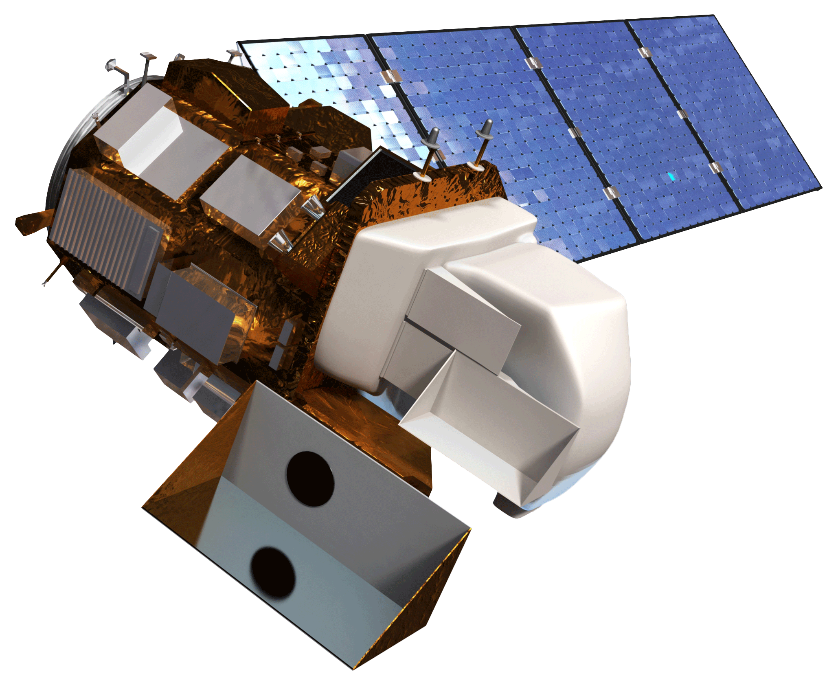
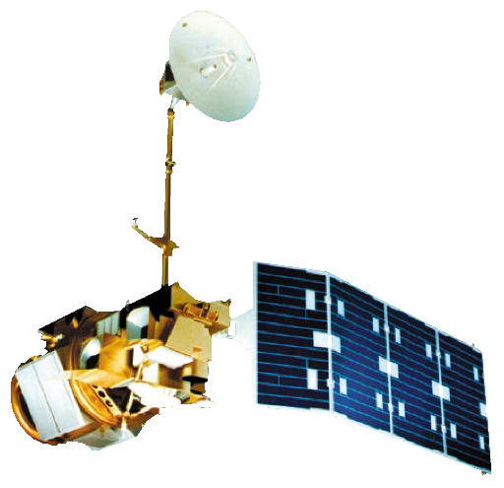
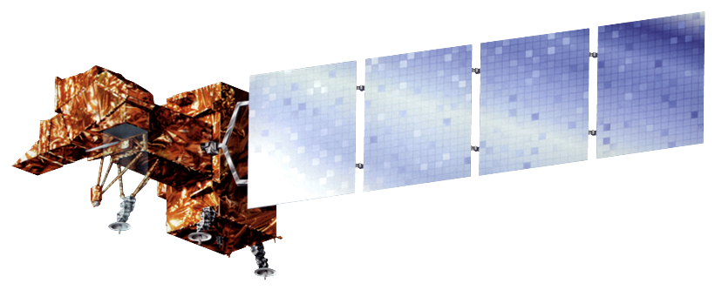
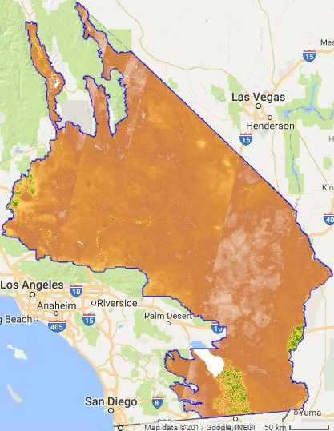
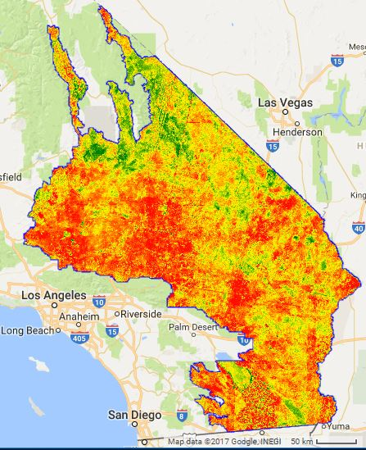
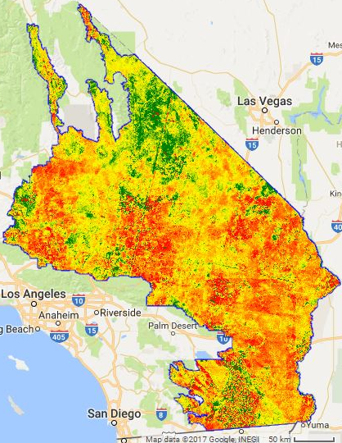
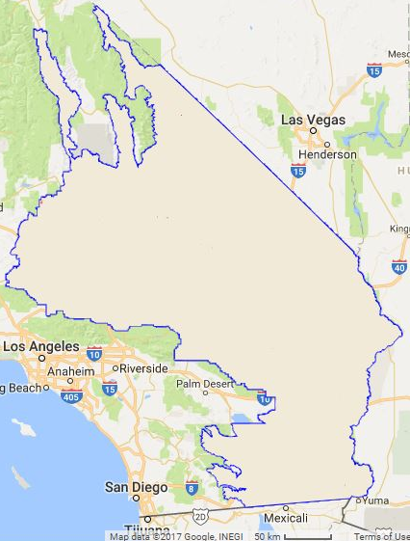
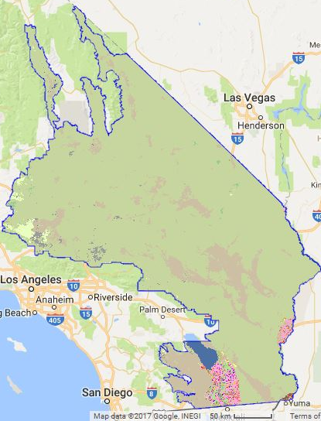
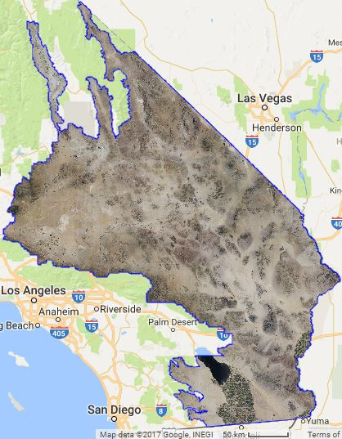
Improving Detection of Land Use Changes in Habitat Conservation Plan Areas Using NASA Earth Observations and a Landscape Anomaly Detection Tool
Abstract
Study Area
The US Fish and Wildlife Service (USFWS) monitors and approves the creation of Habitat Conservation Plan (HCP) areas under the Endangered Species Act (ESA). Habitat Conservation Plans allow economic development in areas that have threatened and endangered species with the agreement that the developer provides a necessary alternative habitat for the species that rely on areas being developed. The USFWS creates each HCP with the landowner or developer, and the HCP is tailored to fit the needs of both the proposed development or land use and the species that will be affected. While regulations limit the activities and development in HCP areas, it is difficult for the USFWS to effectively monitor all the land that falls within HCPs. Partnering with the USFWS, a user-friendly interface was developed in the Google Earth Engine API to display remotely sensed imagery obtained from Landsat 5 TM, Landsat 7 ETM+, Landsat 8 OLI, and Sentinel-2 MSI satellites. These data were used to remotely determine past land use changes in the HCPs from 2000 to 2017. The user interface displays Relative Greenness Index, percent change in Relative Greenness Index, Normalized Burn Ratio (NBR), cropland data, and National Agriculture Imagery Program data to assist in land use change evaluation. This tool will be used by biologists and conservationists at the USFWS to detect land use change.
Objectives
Identify an area and time of interest to detect land use change using the Landscape Anomaly Detection Tool
Analyze the vegetation change based on the area and time selected
Explain land use change using ancillary data overlays
Document the change through the export of maps and images from the tool
Landsat 8 OLI
Sentinel-2 MSI
Earth Observations
Habitat Conservation Plans
Landsat 5 TM
Project Partners
Landsat 7 ETM+
US Fish and Wildlife Service, Pacific Southwest Region
US Fish and Wildlife Service, Midwest Region
Satellite Imagery
Google Earth Engine API
NDVI
Land Use Change Identification
Relative Green
Percent Change in Relative Green
HCP Polygons
Normalized Burn Ratio
Land Use Change Identification
National Agriculture Statistics Service
National Agriculture Imagery Program
Google Earth Engine API
Methodology
Month & Year of Interest
Baseline
Pacific Southwest Cross-Cutting II
Results
NDVI
-1 Minimum vegetation
1 Maximum vegetation
Relative Green
-1 (Vegetation Loss)
0 (No Change)
1 (Vegetation Gain)
Percent Change Relative Green
-100% (Vegetation Loss)
0 (No Change)
100% (Vegetation Gain)
Normalized Burn Ratio
-0.35 Fire Likely
-0.15 Fire Unlikely
US Department of Agriculture
National Agriculture Statistics Service Cropland Data
US Department of Agriculture National Agriculture Imagery Program
Team Members
Acknowledgements
Conclusions
Dr. Kenton Ross – NASA Langley Research Center, Science Advisor
Pat Lineback – USFWS, Pacific Southwest Region, Ecological Services Program, Regional GIS Coordinator
Dan Cox – USFWS, Pacific Southwest Region, Ecological Services Program, Regional Habitat Conservation Coordinator
Brian Huberty – USFWS, Midwest Region, National Wetland Inventory, Regional NWI and Remote Sensing Coordinator
This material contains modified Copernicus Sentinel data (2017), processed ESA.
Recent land use changes can be detected with Landsat and Sentinel imagery.
The possible cause of land use changes in an HCP can be determined using ancillary data sets such as USDA Cropland, USDA NAIP, and NBR data, or validated with field visits.
This Google Earth Engine tool will enable biologists at the USFWS to more effectively detect land use changes in HCPs.
Kim Johnson
Project Lead
Jarell Perez
Michaela Britt
Justin Herbst
Emily Gotschalk
Zachery Stout
Virginia – Langley
Fall 2017

