Slide 1

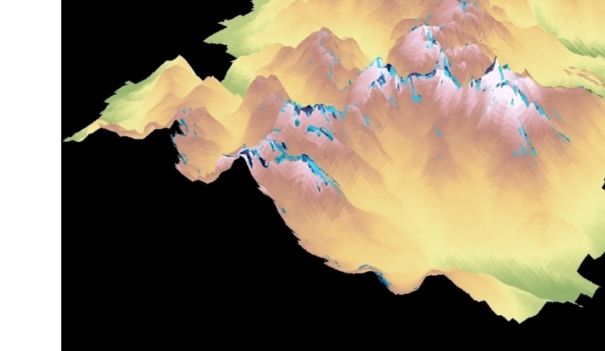
Discovering Archaeological Sites by Utilizing NASA Earth Observations to Detect Changes in Snowpack Coverage in Intermountain National Parks
NORTHERN GREAT PLAINS WATER RESOURCES
Anne Gale (Project Lead)
Michael Brooke
Xin Hong
Cody Vineyard
Notes:
Good (morning/evening). My name is Michael Brooke. I am the Center Lead for the NASA DEVELOP node at the Wise County and City of Norton Clerk of Court’s Office in Wise, VA. I am also a member of the Northern Great Plains Water project.
Good (morning/evening). My name is Xin Hong.
Good (morning/evening). My name is Cody Vineyard.
Our team lead, Anne Gale, sends her regrets. She is not able to be with us today.
Our project uses NASA Earth observations to detect changes in the glaciers over time in the Intermountain National Parks.

Slide 2
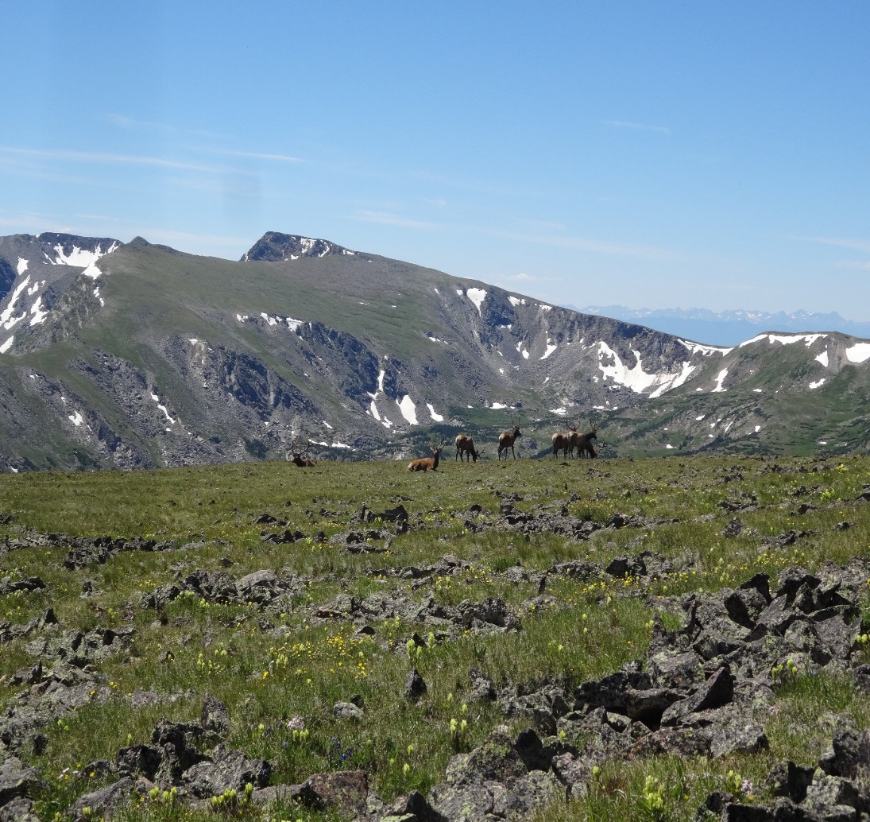

Our Partner
Image Credit: Kelly Stehman
IMAGE CREDIT: KELLY STEHMAN
Notes:
In honor of their 100 year anniversary, the National Parks Service has partnered with NASA DEVELOP for several different projects this year. For our specific project, we partnered with Rocky Mountain National Park, located to the northeast of Denver, Colorado.
Image source: Kelly Stehman, Rocky Mountain National Park

Slide 3
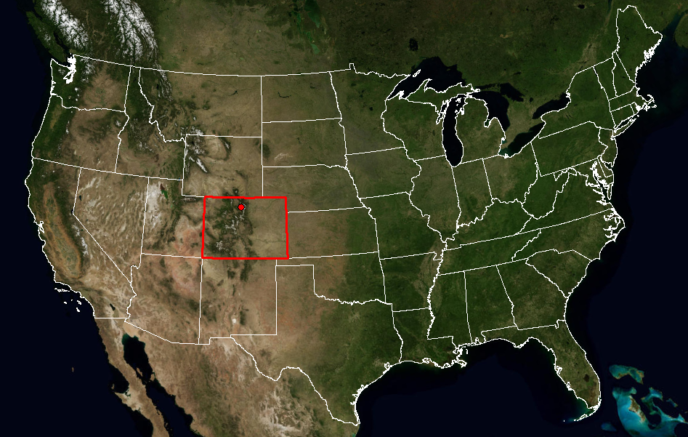
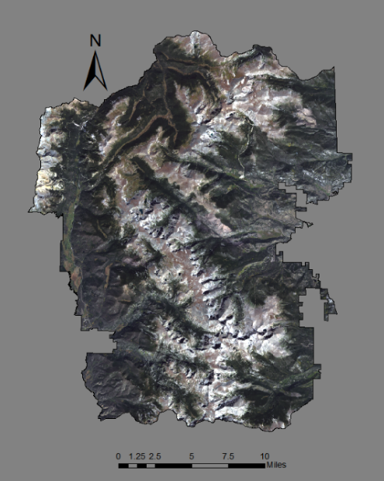
Study Area & Period
Study Area: Rocky Mountain National Park, located in North-Central Colorado
Study Period: January 1995 to December 2015
Rocky
Mountain National Park
Image Credit: USGS
IMAGE CREDIT: KELLY STEHMAN
Notes:
This project is a case study of the glaciers at Rocky Mountain National Park located to the northeast of Denver, Colorado. Like other National Parks in the Intermountain region of the northern United States Great Plains, Rocky Mountain National Park is experiencing snow and ice melt due to changes in climate. Our study years spanned from 1995-2015 with a special focus on the extreme warmest and coldest years. During those years, we concentrated on August 20 to September 30 since August 20 was the first Landsat scene that was free of any snow from the previous winter while scenes after September 30 frequently had freshly collected snow in many of the areas.
Image Source: USGS National Map

Slide 4
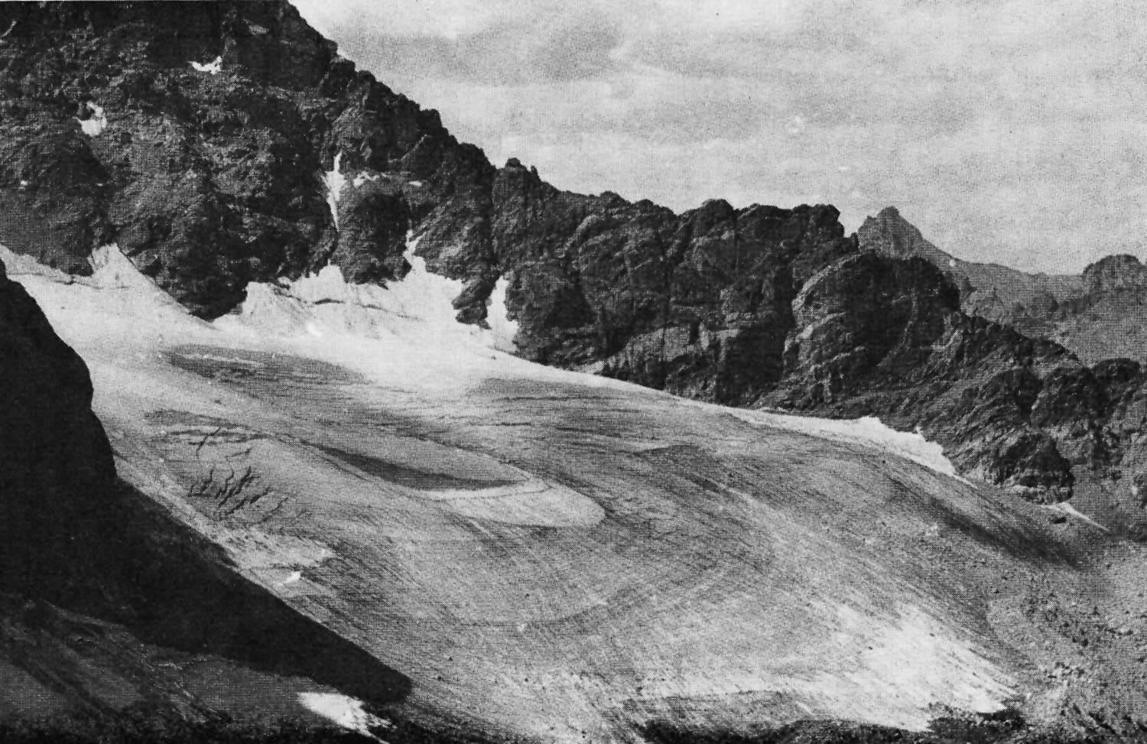
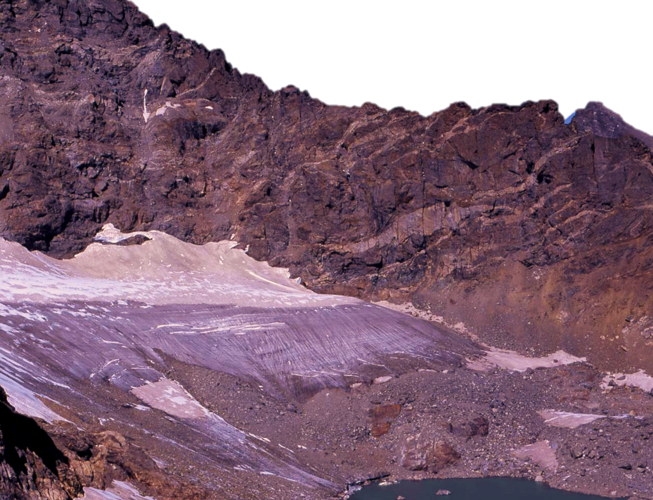
Objectives
Example of a retreating glacier in the Rocky Mountains, revealing ground for discovery
2003
2003
1898
Image Credit: NASA
Notes:
We have two main objectives of this study. The first is to find where the land has been freed from snow and ice. The second is to classify the remaining snow and ice into ice fields or glaciers. These are photos of the Arapaho Glacier found in Colorado. The pictures are taken 105 years apart, and there is a clear depiction of melting. What once stretched all the way down the hill, is now a pond.
Imaging Source: http://earthobservatory.nasa.gov/IOTD/view.php?id=5668

Slide 5
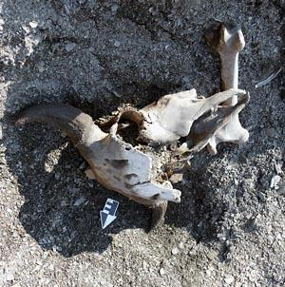
Community Concerns
Preserve archaeological artifacts
Locate recently uncovered potential archaeological sites
IMAGE CREDIT: NPS
Notes:
One of the missions of the National Park Service is to mitigate impacts of climate change to mountain cultural heritage resources. Receding ice has the potential to reveal previously undiscovered archaeological sites. Rocky Mountain National Park desires to preserve the archaeological artifacts from the newly exposed sites.
Image Source: https://www.nps.gov/archeology/sites/npSites/glacierIcePatch.htm - By: R. L. Kelly

Slide 6
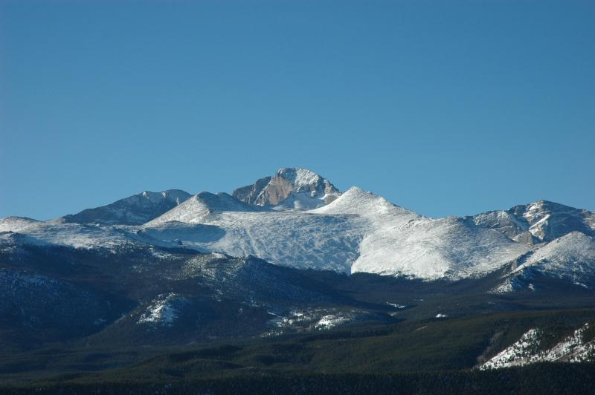
Objectives
Map the persistent ice and snow cover (PISC) over our study period
Map the change in PISC over time
Compare Landsat data to ROMO’s ground survey to identify additional glaciers for their glacier profile
Map the snow frequency over the study years
IMAGE CREDIT: NPS
Notes:
We had three main objectives of this study. The first was to find where the land had been freed from snow and ice in order to locate potential archaeological sites . The second was to classify the remaining snow and ice into ice fields or glaciers.

Slide 7

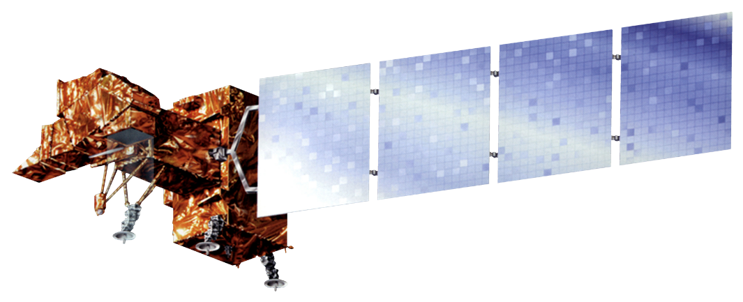

Earth Observations
Landsat 5 Thematic Mapper (TM)
Landsat 8 Operational Land Imager (OLI)
Landsat 7 Enhanced Thematic Mapper Plus (ETM+)
Notes:
Our project uses NASA Earth observations to detect changes in the glaciers over time in the Intermountain National Parks.
We used data from Landsat 5’s Thematic Mapper, Landsat 7’s Enhanced Thematic Mapper Plus, and Landsat 8’s Operational Land Imager to map the ice and glacier positions each year.

Slide 8
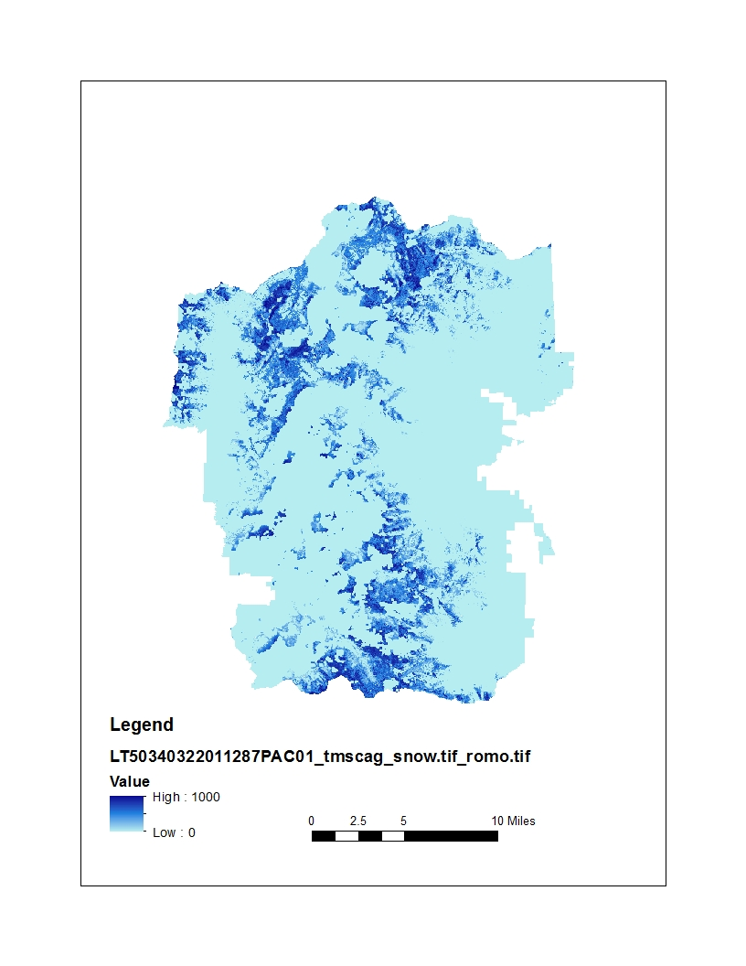
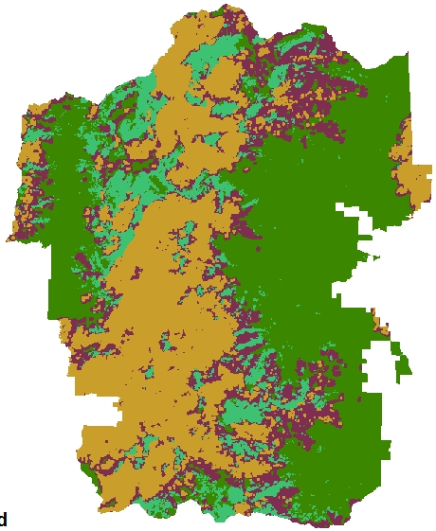
Ancillary Dataset
USGS Landsat-based Snow Cover Product
Cloud mask
Normalized Difference Snow Index (NDSI)
Good data
Probable water
Possible cloud cover
Probable cloud cover
NDSI
1
-1
0
5
10 mi
Notes:
We began our research by downloading the Landsat-based Snow Cover Product from the USGS.

Slide 9
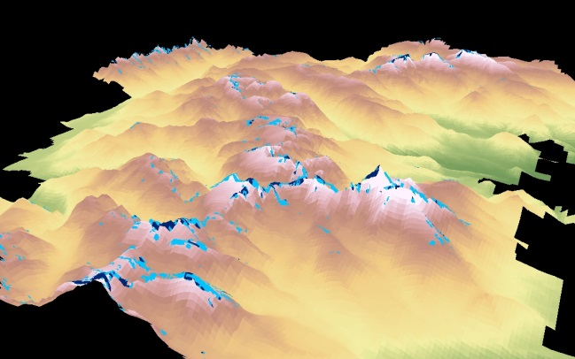
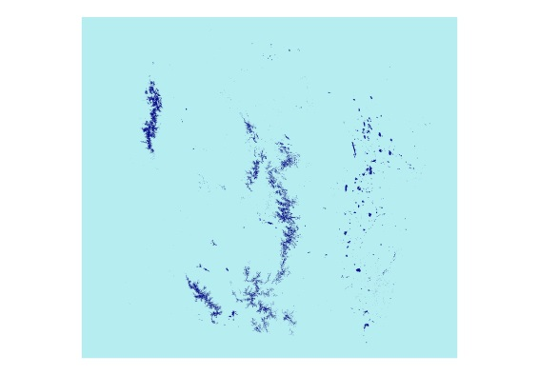
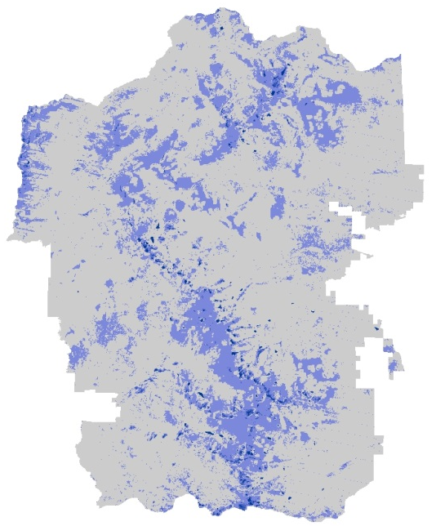
Methodology
Ice Field
Glacier
Elevation (meter)
High: 4347.19
Map Package for End User
Low: 2316.57
NDSI*
Land Cover Change Detection
High: 1000
Low: 0
Classified the Data
Snow frequency
Data Acquisition
0
1-21%
22-57%
*NDSI = (Green-SWIR)/(Green+SWIR)
58-100%
Notes:
To accomplish our objectives we began by downloading data from the Prism climate group from Oregon State University to develop an individual climatology for the Park. Monthly average temperature from April to September was compares to the 30-year average to determine which years had the least and greatest potential for snow melt. According to the Prism climate datasets and the available Landsat scenes, we selected 1995, 1999, 2000, 2014, and 2015 as our study years.
Image Source: Prism

Slide 10
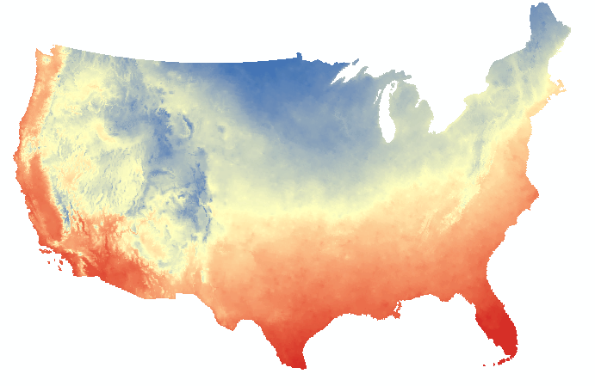
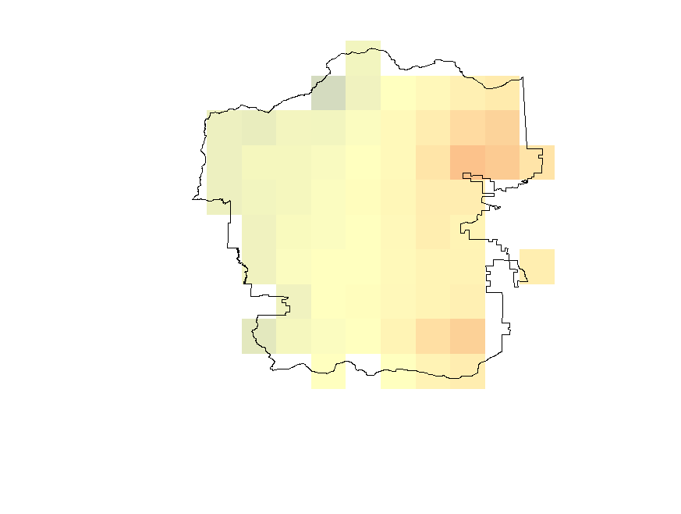
PRISM Climate Data
Temperatures
Higher
1995, 1999, 2000, 2014, and 2015 were selected to map the persistent ice and snow cover
Lower
Notes:
To accomplish our objectives we began by downloading data from the Prism climate group from Oregon State University to develop an individual climatology for the Park. Monthly average temperature from April to September was compares to the 30-year average to determine which years had the least and greatest potential for snow melt. According to the Prism climate datasets and the available Landsat scenes, we selected 1995, 1999, 2000, 2014, and 2015 as our study years.
Image Source: Prism

Slide 11
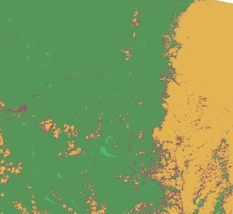
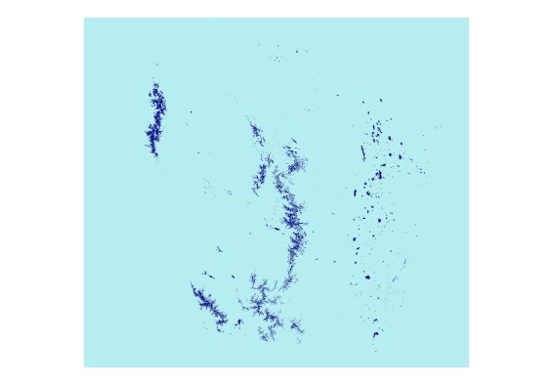
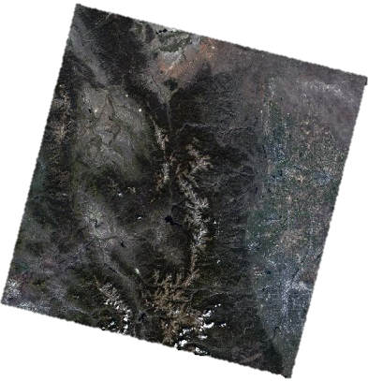
Methodology
Normalized Difference Snow Index & Landsat
Cloud mask
Landsat scene
Removed cloud cover using cloud mask
Filled the removed cloud cover with Landsat scenes
WRS Path 34, Row 32
Normalized Difference Snow Index (NDSI)
High: 1000
Low: 0
Good data
Probable water
Possible cloud cover
Probable cloud cover
Notes:
We downloaded the Landsat satellite images data from U.S. Geological Survey.
The Landsat data was used for mapping the snow and ice fields.

Slide 12

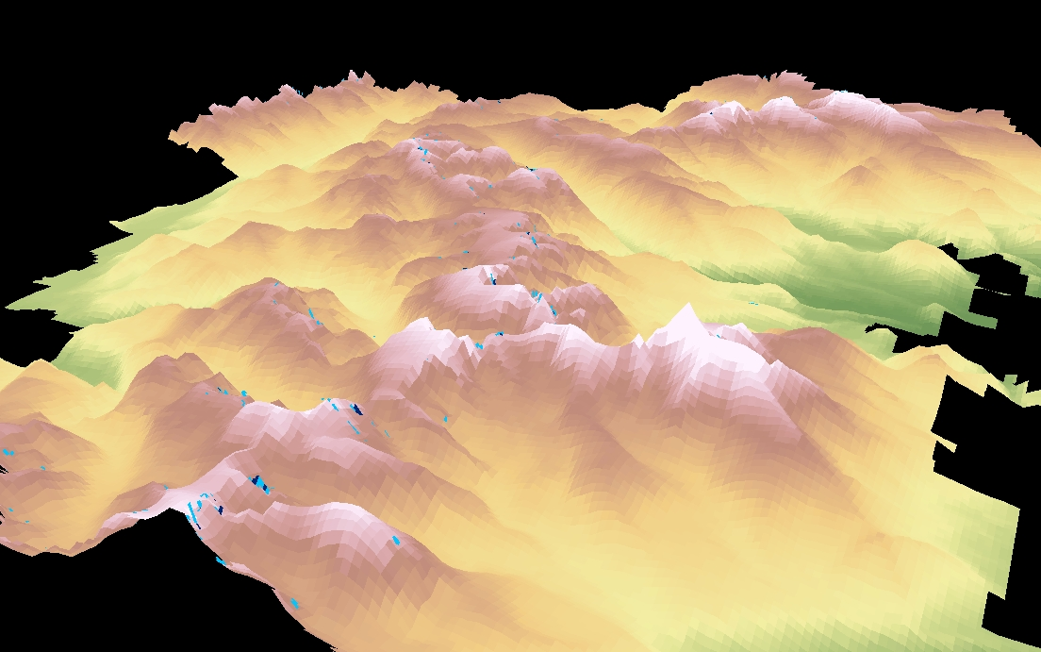
Results
Ice field and glacier cover maps of 1995 and 2015
1995
2015
Land Cover
Elevation (meter)
Ice Field
High: 4347.19
Glacier
Low: 2316.57
Notes:
By referring to the climate data, we mapped ice fields and glaciers that cover five different years which had temperature anomalies (either hotter or colder than the average). Here are two examples of the resultant maps: ice field and glacier cover in 1995 and 2015.
These are images of our study area using the Digital Elevation Model. The green areas are the valleys and the light brown and cream colors are the peaks. The light blue area are ice fields. The darker blue areas are glaciers. On the left side, you see the data from 1995. On the right side are the glaciers from 2015. As you can see, our data shows that the glaciers are shrinking.

Slide 13
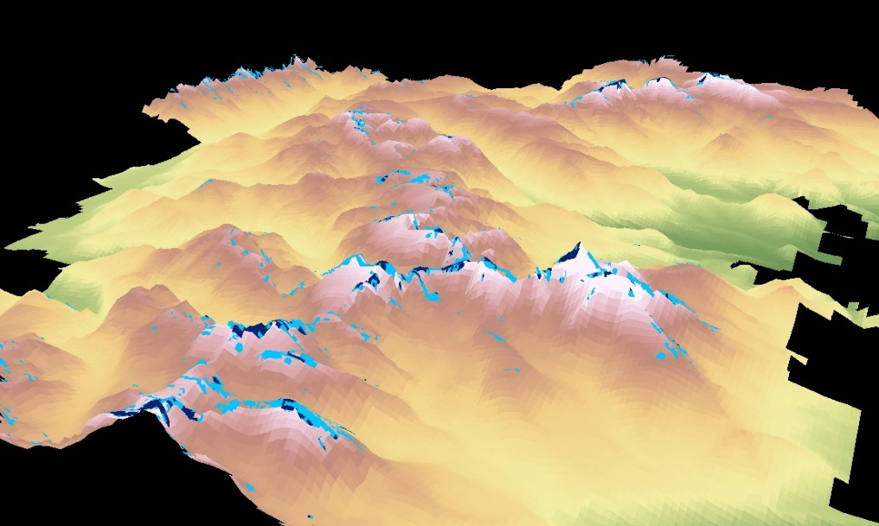

Results
Snow and Ice Cover at Rocky Mountain National Park
1995
2015
Free of Ice or Snow
Ice Field
Glacier
Notes:
Let’s zoom in for a closer look. The top row shows the study area in 1995 and 2015. The lower row is zoomed in to the same glacier in 1995 and 2015. According to our data, this glacier has melted 51%.

Slide 14
Results
Glacier and ice fields cover over study years
Notes:
The area of glacier and ice field for the study years. Questions of the chart?

Slide 15

Results
Snow Frequency
0
1-21%
22-57%
58-100%
Notes:
According to the available data, we mapped the snow frequency for 14 out of 20 years. We used cell statistics in ArcGIS to sum the snow frequency of these 14 years. The sum was divided by 14. Then generated this above snow frequency map over the study years.

Slide 16
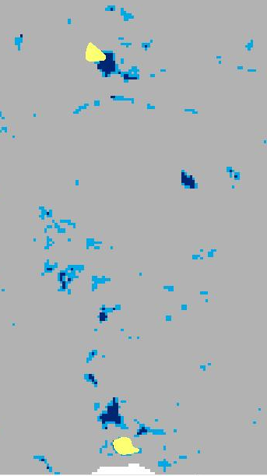
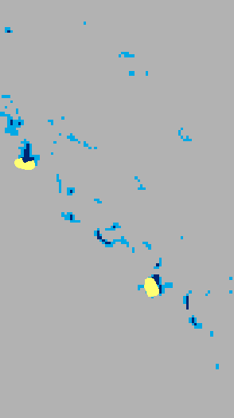
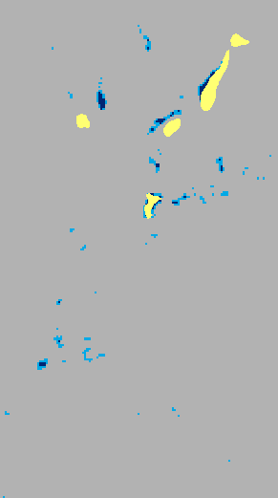
Results
Ice Fields
Ice field from field survey vs. classified ice field from Landsat imagery
Field Study of Glacier & permanent ice
Free of ice or snow
Ice Field
Glacier
Notes:
We compared the ice fields that we found for 2015 with the ice fields provided by Rocky Mountain National Park. Our goal was to locate ice fields that haven’t been recorded in their inventory.
The image showing here is the amplification of a part of the glaciers. Areas in yellow are the iced fields collected by field survey, areas in light blue and dark blue are the ice fields and glacier we found for 2015. We can tell that there are a couple of ice fields and glaciers in 2015 which have not been recorded by the filed survey. For the Rocky Mountain, this is helpful information for completing their glacier profiles.

Slide 17
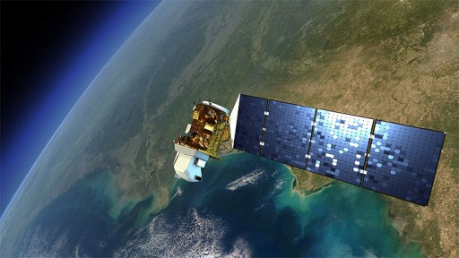
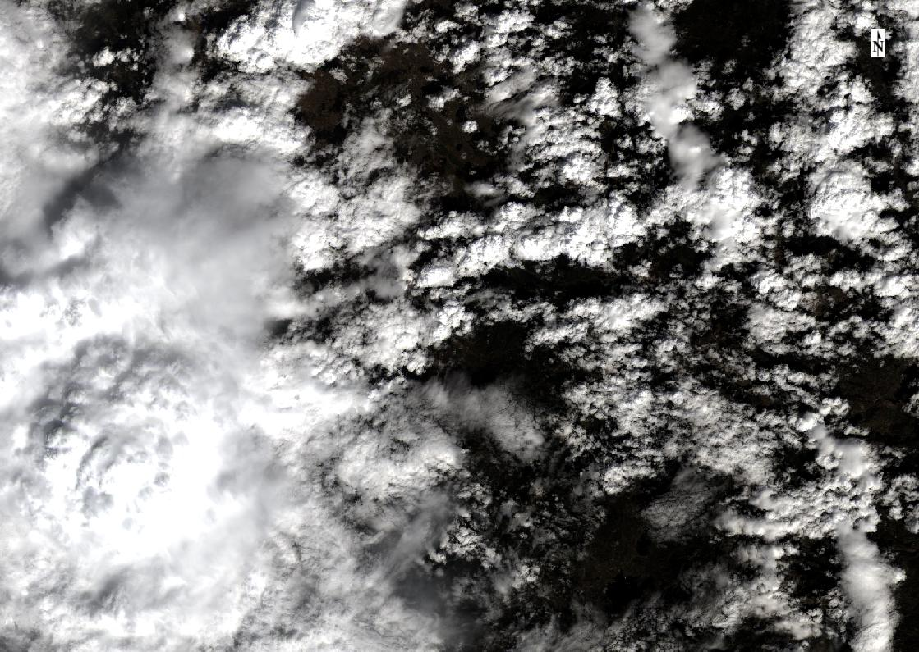
Limitations
Temporal resolution of Landsat data (16 days)
Summer is the wet season which Rocky Mountain region has more cloud cover than usual
Notes:
We had a couple of limitations for our project. The first is that Landsat passes over a certain area every 16 days. The second limitation was the amount of cloud cover that occurs above Rocky Mountain during the months of our study period as air lifts over the mountains.
Image Source: http://spaceflight101.com/spacecraft/landsat-ldcm/

Slide 18
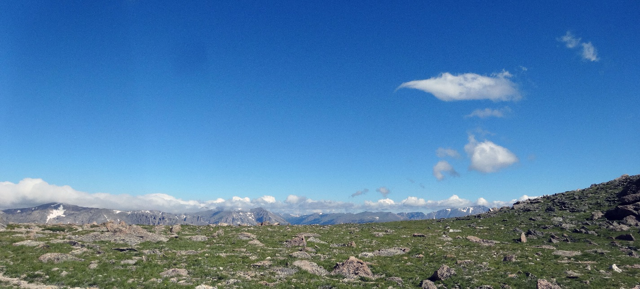
Conclusions
IMAGE CREDIT: NPS
In general, both glacier and ice field covers receded from 1995 to 2015
1999 and 2014 were the peak years for glacier formation, while 2000 was the recession year in between
Notes:
According to our research, Rocky Mountain’s glaciers decreased 69%. Their ice fields decreased 51%.
Image Source: Kelly Stehman, Rocky Mountain National Park

Slide 19
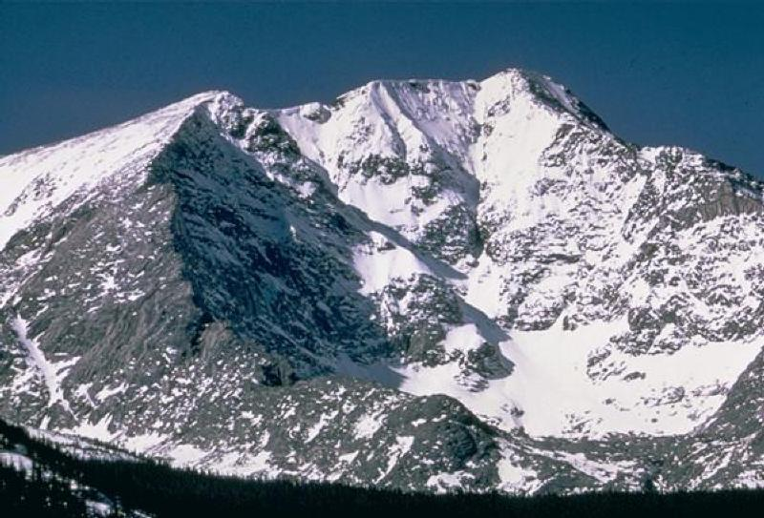
Conclusions
Approximately 0.352 square miles of glaciers were found by the Landsat images that were not included in Rocky Mountain National Park’s field survey inventory. These previously unknown glacier patches are mainly distributed near Rowe Glacier and Moomaw Glacier.
IMAGE CREDIT: NPS
Notes:
Image Source: https://www.nps.gov/media/photo/gallery.htm?id=2D37E30B-155D-451F-67D4002025462368

Slide 20
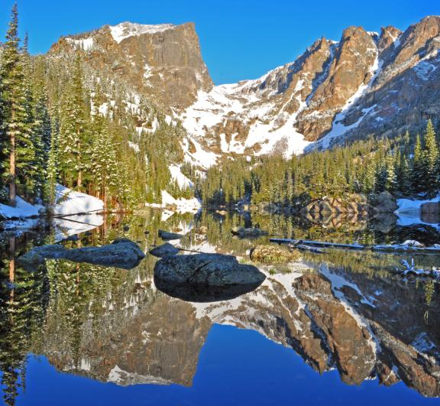
Future Work
Expand study area to other National Parks
Map changes in the vegetation and fire regime of the park
Model a forecast until the glaciers completely melt
n
IMAGE CREDIT: NPS
IMAGE CREDIT: NPS
Notes:
This project is the first of two terms. The second term will use our results as a baseline to begin to map the changes in the fire regime and the vegetation changes. In addition, the Rocky Mountain National Park desires a forecasting model to depict when the glaciers will completely melt.
Image Source: https://www.nps.gov/media/photo/gallery.htm?id=016D0F70-1DD8-B71B-0BF43FF8619649E6

Slide 21

Acknowledgements
Partners
1) Tom Lincoln, Intermountain Region of the National Parks Service
2) Kelly Stehman, Rocky Mountain National Park
Science Advisors
1) Dr. Kenton Ross, NASA DEVELOP National Program
2) Dr. DeWayne Cecil, NOAA NCEI, Global Science and Technology
3) David Selkowitz, USGS Alaska Science Center
4) Bob VanGundy, The University of Virginia’s College at Wise
5) Mike Bender, NASA DEVELOP National Program
Notes:
Thanks everybody!

Slide 22
Questions?
Notes:
Thanks everybody!

