Slide 1
Arizona Health
& Air Quality
Enhancing Extreme Heat Intervention and Preparedness Activities in Maricopa County, AZ
Amy Stuyvesant
Emma Baghel
Geordi Alm
April Rascon
Rocky Garcia
Bernardo Gracia

Slide 2
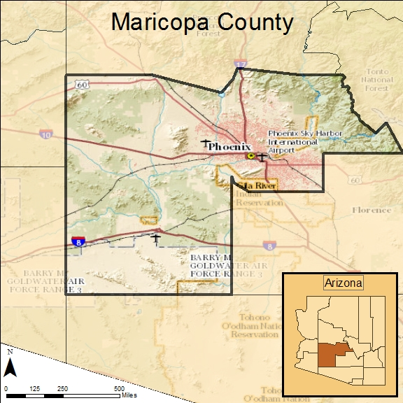
Study Area and Dates
Study Dates: May 2005 - September 2015
Notes:
Basemap: ESRI basemaps
The study area encompases Maricopa County, AZ only. This includes the major city of Phoenix, which we are interested in based on its UHI effects. We studied primarily from May 2005 - Septemebr 2015.

Slide 3
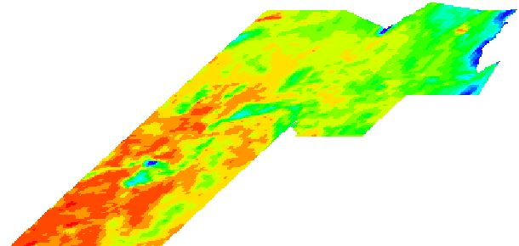
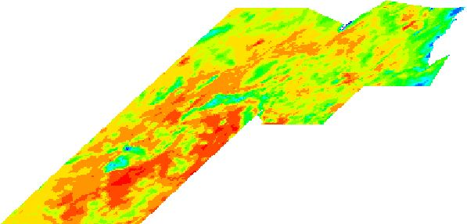
Objectives
Analyze extreme heat anomaly days to understand where, how, and why daily variations occur.
Determine the current use and frequent users of relief resources in order to establish how this correlates with current socioeconomic vulnerability assumptions.
Analyze the variability within anomalies and survey results to determine where, when, and how relief efforts should intervene.
Surface Temperature on May 21, 2005
Surface Temperature on July 2, 2005
Notes:
Our project fills knowledge gaps associated with the variability within the UHI effect. On top of this, previous studies have used statistical regressions to assume demographic patterns. We have access to survey results that will more accurately calculate these demographic trends. Together, we will be able to provide a more detailed look into the UHI variable effect on top of locating communities most at risk so that the MCDPH’s adaptive capacity may effectively anticipate needs for relief efforts.

Slide 4
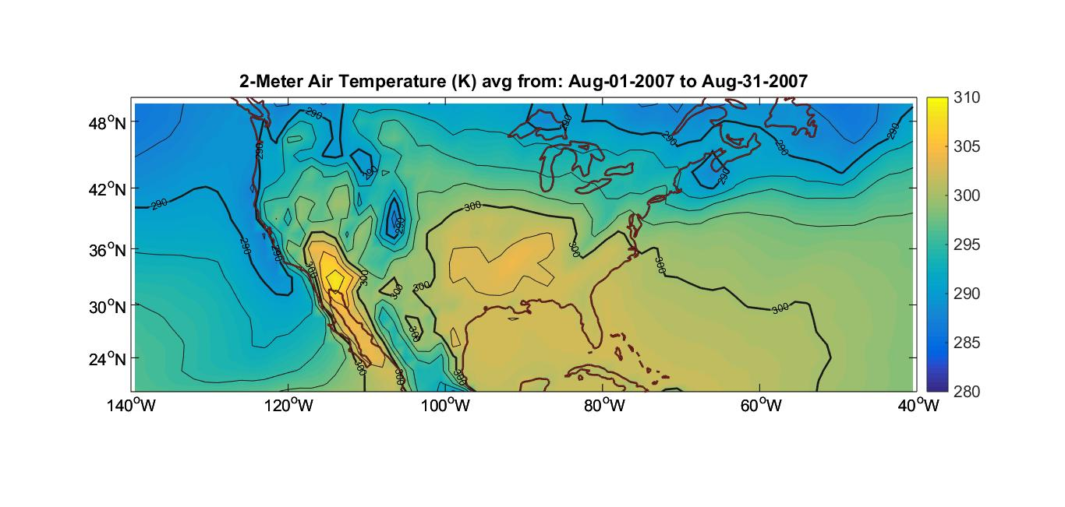
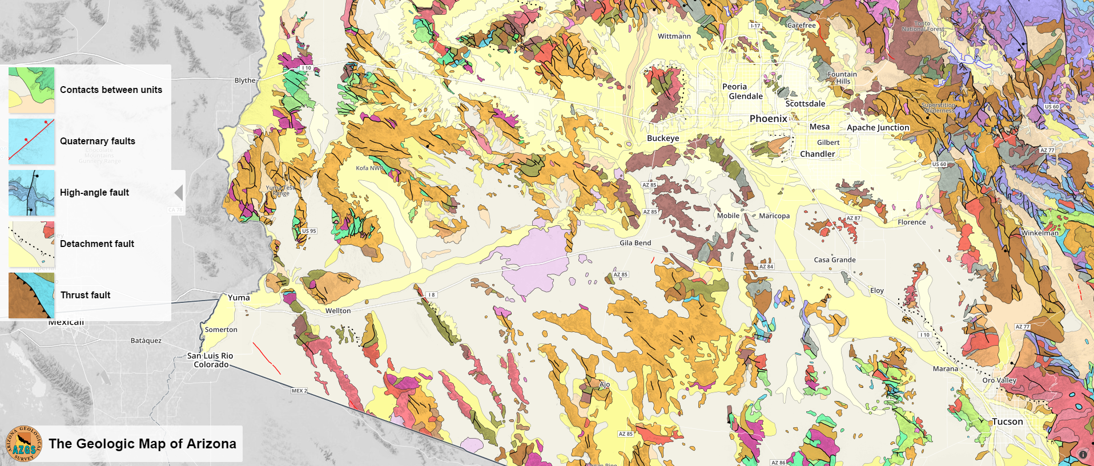
Image Credit: AZGS
Community Concern
Extreme heat is a chronic health hazard and is expected to become more dangerous with increased urbanization
Civilians most affected: those without air conditioning, proper insulation, low-income, newcomers, homeless, minorities, and socially isolated.
Notes:
Extreme heat causes heat related and heat caused deaths throughout Maricopa County. These effects are not distributed equally throughout the city or among demographic groups. While these deaths are tragic, they are preventable.
Image Source: http://commons.wikimedia.org/wiki/File:Claude_Monet_-_The_Magpie_-_Google_Art_Project.jpg

Slide 5
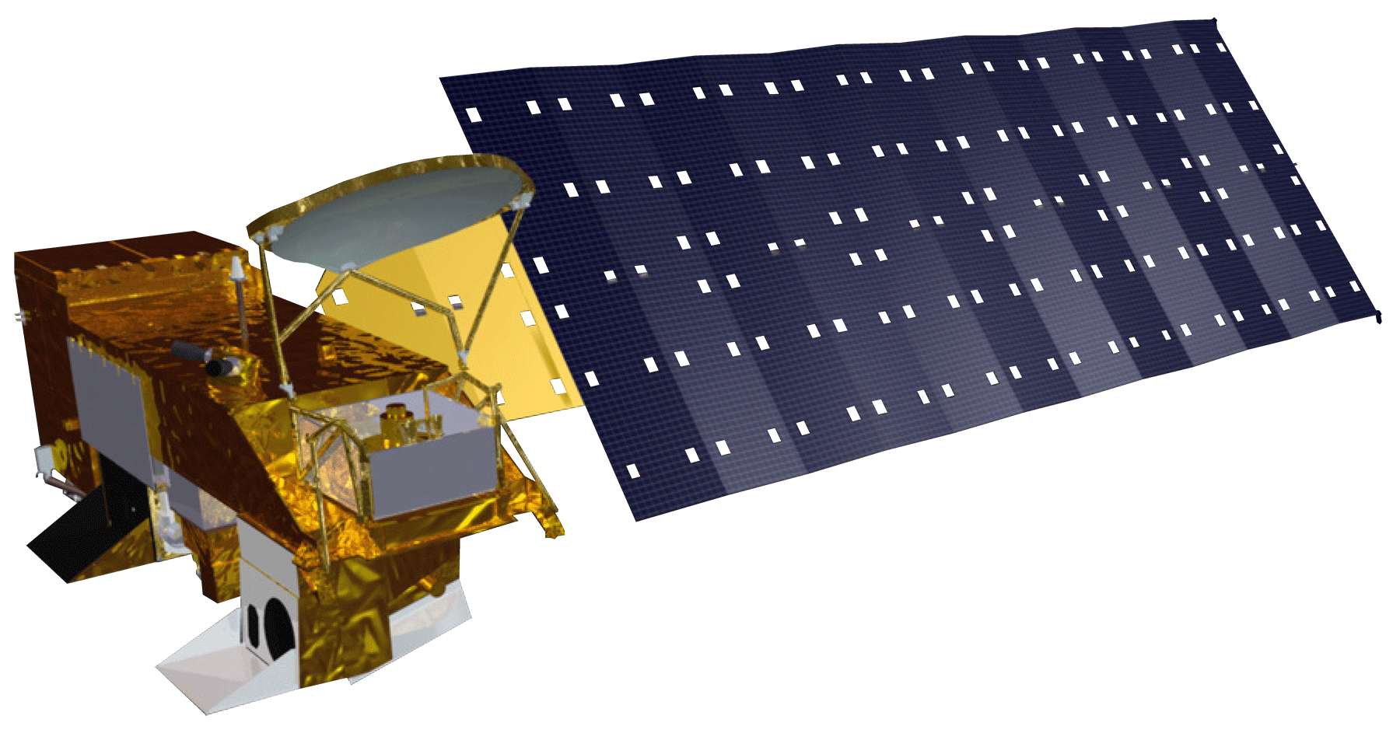
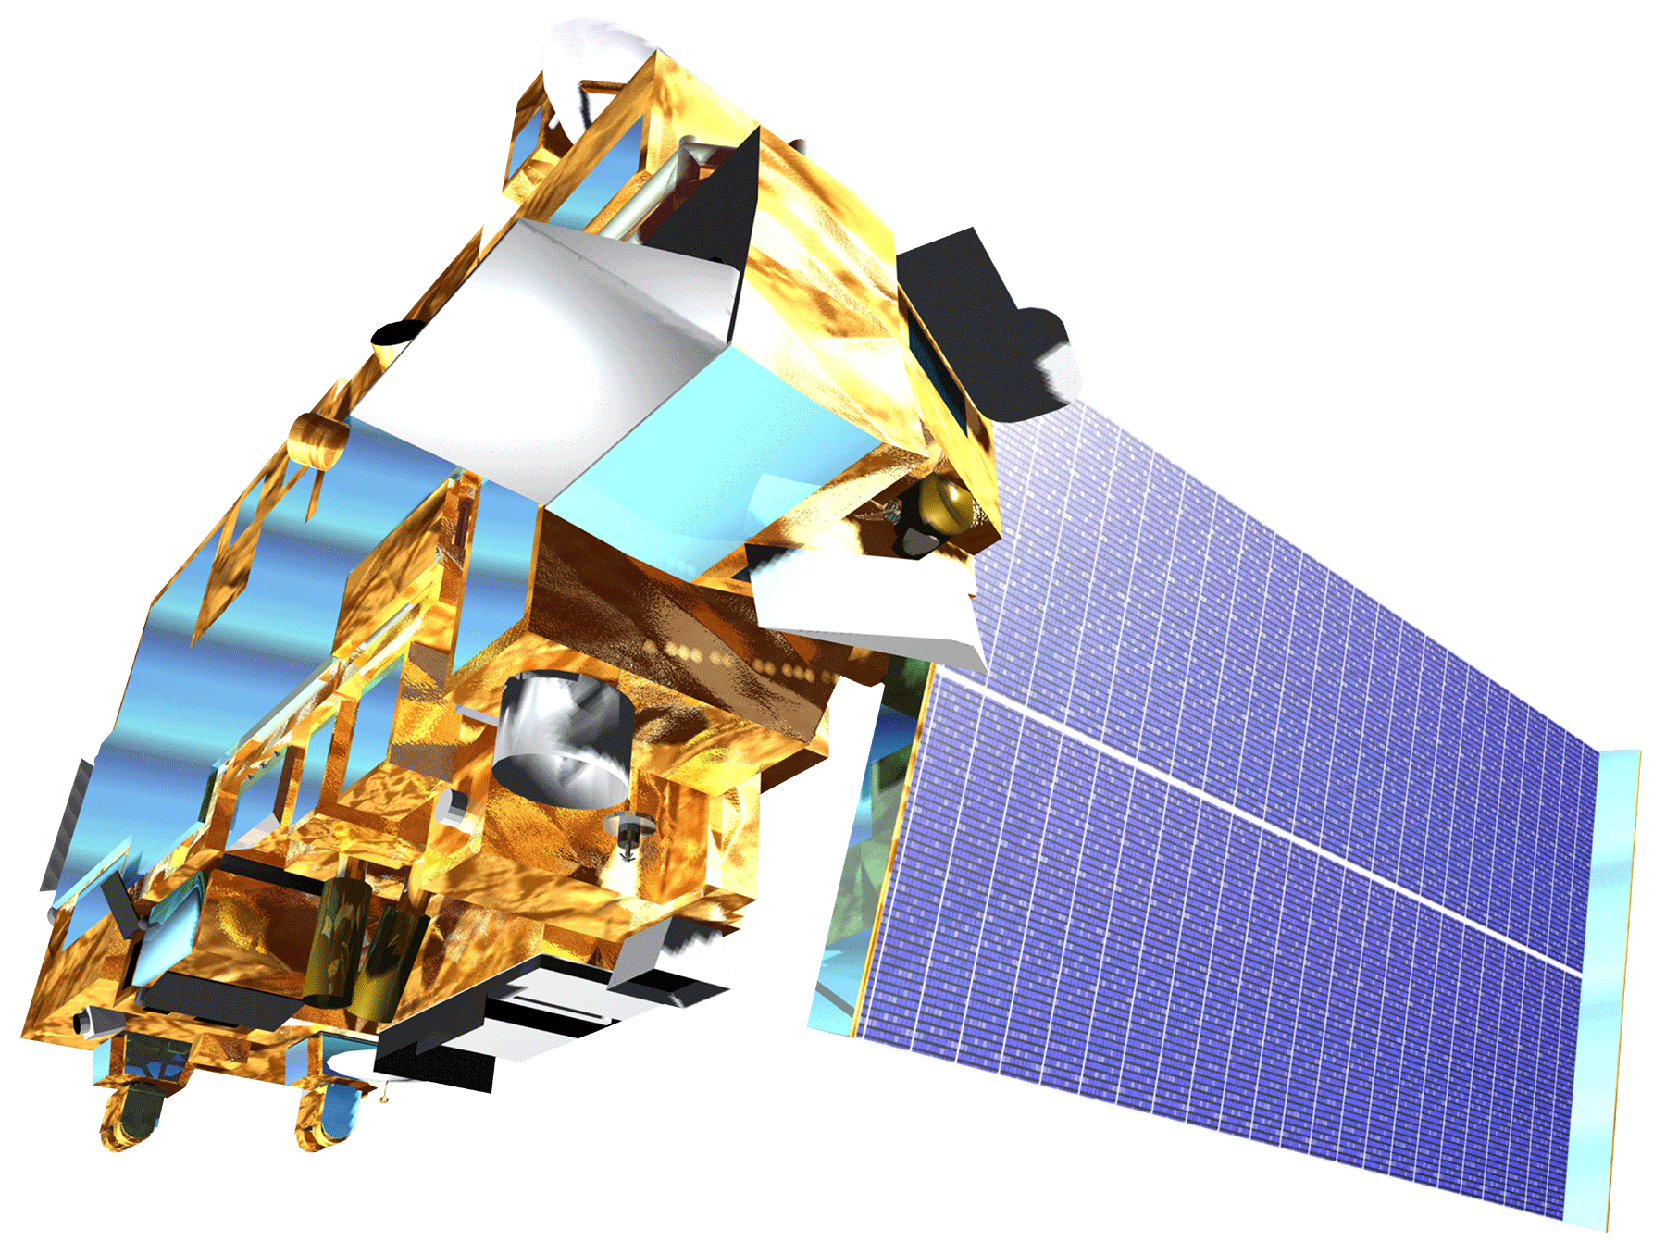
NASA Satellites and Methods
Aqua MODIS
Landsat 8
Used to gather daily surface temperature data per census tract for statistical comparisons
Used for refining the spatial resolution of temperature averages over census blocks
Surface Temperature Averages
Terra MODIS
Simply used to compare surface temperature values with Aqua MODIS for accuracy.
Cluster Analysis
Average Comparisons
Nuances within UHI
Notes:
We primarily used Aqua MODIS to gather surface temperature values on a daily basis. These values were averaged by census tract and compared in two ways: 1) in a cluster analysis to determine if the 30% hottest tracts are clustered and if so how these clusters compare over time and 2) how the measures of average surface temperature compare to each other within a season and between years. This will reveal both spatial nuances and actual surface temperature nuances within the UHI effect.

Slide 6
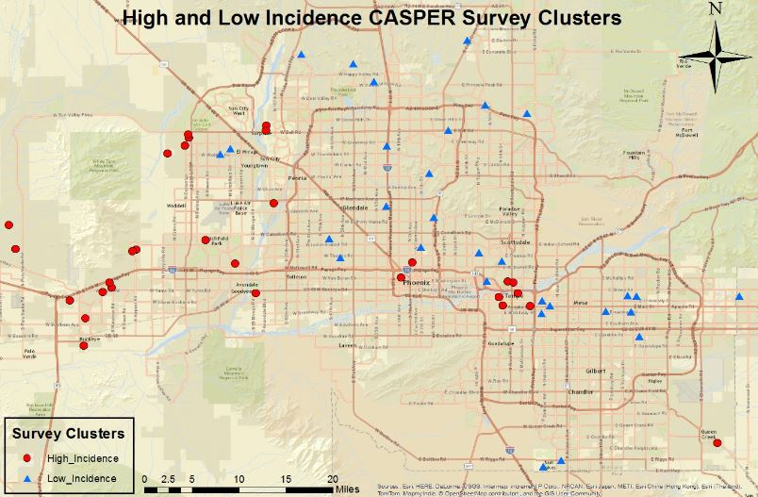
Survey Analysis Methods
Likelihood of AC Use
Raw CASPER Results
Comparison to Assumed Patterns
Likelihood of Visiting Cooling Center
Raw CASPER Survey Data
Notes:
With the survey results we ran various regression to answer questions regarding the likelihood of AC use (against things like income, home address, race, gender, age). We also looked at what factors made someone more or less likely to visit a cooling center. We added a spatial component by mapping clusters of survey respondents and their answers.

Slide 7
Results
There is an association of the amount of extreme heat days between month and year
Table 1: Temperature heat anomaly days (n = 768) for month (May – September) and year (2005–2014). Note: Bold values indicate entries where the standard residual indicated a value very different from the expected value. Source: University of Utah’s MesoWest database.
 | Study Years
Month | 2005 | 2006 | 2007 | 2008 | 2009 | 2010 | 2011 | 2012 | 2013 | 2014
May | 5 | 7 | 2 | 3 | 4 | 0 | 0 | 6 | 0 | 6
June | 12 | 27 | 20 | 19 | 8 | 19 | 15 | 22 | 29 | 25
July | 28 | 22 | 21 | 25 | 26 | 27 | 24 | 22 | 22 | 25
August | 13 | 13 | 20 | 20 | 24 | 21 | 27 | 20 | 21 | 15
September | 8 | 2 | 12 | 5 | 10 | 18 | 14 | 7 | 11 | 10
Total | 66 | 71 | 75 | 72 | 72 | 85 | 80 | 77 | 83 | 81
Notes:
A test for association revealed that month is associated with year, meaning that each month did not have a consistent count of extreme heat days (a day with a max air temperature over 104F) through the year range 2005 - 2014. From this we can look at where values deviated from their expected count. We found that July and August remained fairly consistent while May showed the most variation. This highlights the need for strong adaptivity in the beginning of the season as well as intense consistency in relief efforts in the mid season.

Slide 8
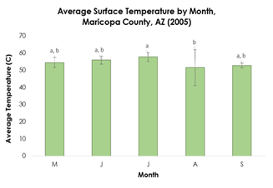
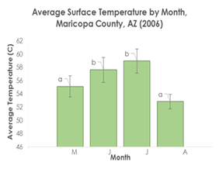
Results
Within a single season, average surface temperature significantly differs between months.
Figure 1: Average surface temperature (C) for each month in the year 2005 (left) and 2006 (right) in Maricopa County, AZ. Averages represent the hottest 30% of census tracts for each day that were then averaged monthly. Like letters above error bars indicate values that are not significantly different. Source: Aqua/MODIS MYD11A1 LST L3 product.
Notes:
Average surface temperature are not the same throughout the season. Interestingly, August consistently held the lowest surface temperature. On top of that, it also held the most amount of cloudy days, confirming that surface temperatures should be lower in this month. The way averages differed varied between years, but generally the early and late season were close and the mid season were also similar to each other. This again highlights the differing needs of relief networks throughout the season.

Slide 9
Conclusions
Placeholder for animation of cluster analysis results
There is significant clustering that shifts throughout the season
Relief efforts should shift correspondingly
Average values within a month in a season and between a single month throughout the years does significantly vary
Relief efforts should intensify for a consistently hot July and be prepared for large variability in the early season
Notes:
We established the within a season, the hottest census tracts are not always the hottest. On top of this, surface temperatures are not consistent throughout the season, where some months are consistently higher than other months. Surface temperatures are important to analyze because they reflect the UHI more directly than air temperature. When the surface heats more, there is more heat able to be trapped at night, creating a positive feedback loop. Knowing this pattern, the MCDPH can strategically aim their warning messages at the riskier areas in that part of the season. This will hopefully allow more individuals to know when to seek cooling centers and when the event will be amplified and sustained by a stronger UHI potential.

Slide 10
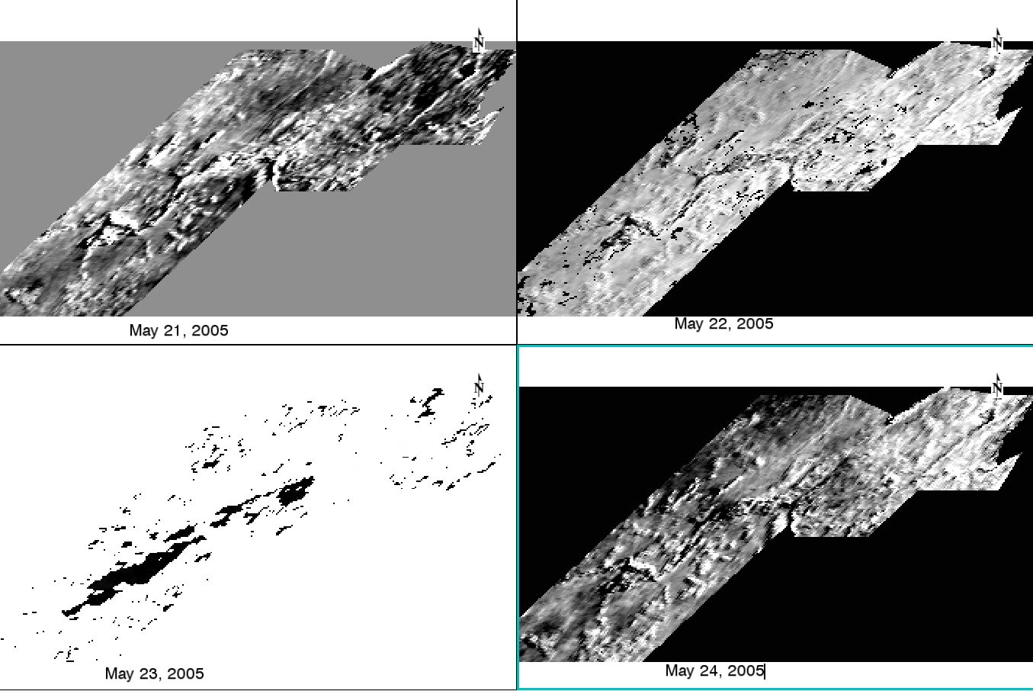
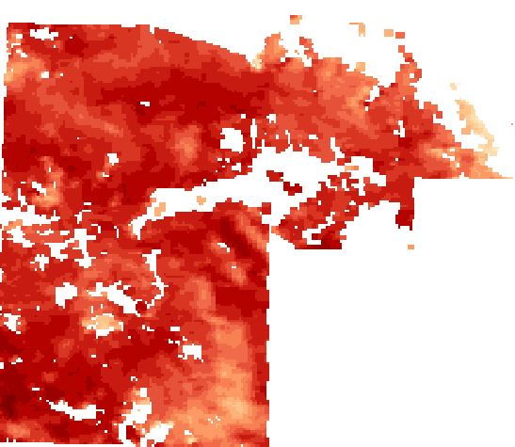
Limitations
MODIS/Aqua vs. MODIS/Terra pass over times in relation to Landsat 8 pass over time
Large amount of NA values from clouds in August
Surface Temperature August 12, 2007
(MODIS/Aqua - MODIS/Terra) / (MODIS/Aqua + MODIS/Terra)
Notes:
Satellites have different pass over times and therefore do not allow for a direct apples-to-apples comparison between images. We chose the Aqua satellite because the pass over times 1030 am and pm, more closely proximate the true maximum temperature in a daily cycle. However, when then using the Landsat 8 satellites, these pass over times are closer to the other MODIS sensor satellite, Terra. We are aware that there are diurnal effects throughout a day, so we did a satellite comparison between Aqua and Terra to see how much of a difference this makes. On top of that, August proved to be a very cloudy month over all years, meaning that even though the count of extreme heat days was high, the actual days used for averages was much lower. We justified leaving these out based on the idea that cloudier days generally would not result in hotter surface temperature, therefore the average would not be thrown off by a large magnitude.

Slide 11
Future Work
Employ land use classification to answer why shifts occur
Explore possibility of longer term solutions (i.e. suitability analysis of strategic solar panel locations)
Satellite Image: Phoenix, AZ http://geology.com/satellite/cities/phoenix-satellite-image.jpg
Notes:
Our project aimed to answer the “how” and “when/where” questions of variations in the UHI effect. Future studies would benefit by increasing this analysis to tackle the “why” questions, such as quantifying surface feature classifications under each heat anomaly to determine any patterns. On top of that, we see potential for this project to continue even further and provide insight into longer term bigger focus solutions that tackle other DEVELOP areas of interest, such as energy and water resources. Over time, we would like to see this information used as a means to provide a suitability analysis for the effective placement of solar panels (or at least to get the conversations heading this way in how solar panels can help save lives in Maricopa) with the idea being that cleaner energy reducing negative climate forcings and solar panels specifically are less water intensive and can inherently cool buildings more efficiently when placed on rooftops by creating an inverse insulation effect.

Slide 12
Advisors
David Hondula - Arizona State University:
Geographic Science and Urban Planning
Dr. Kenton Ross - NASA DEVELOP National
Science Advisor
Partners
Arizona Department of Health Services
ASU Environmental Remote Sensing and
Informatics Lab
ASU Center for Policy Informatics
Others
Emily Adams - NASA DEVELOP LaRC Center
Lead
Dan Wozniak - NASA DEVELOP LaRC Assistant
Center Lead
Jeff Ely - NASA DEVELOP Geoinformatics
Scientist
Grant Mercer - NASA DEVELOP LaRC 2015
Summer Participant

