Slide 1
Colorado Agriculture
Mapping Forest Species Composition at the Colorado State Forest using Landsat for Integrative Spatial Modeling
Brian Woodward
Eric Rounds
Sarah Carroll
Nicholas Kotlinski

Slide 2
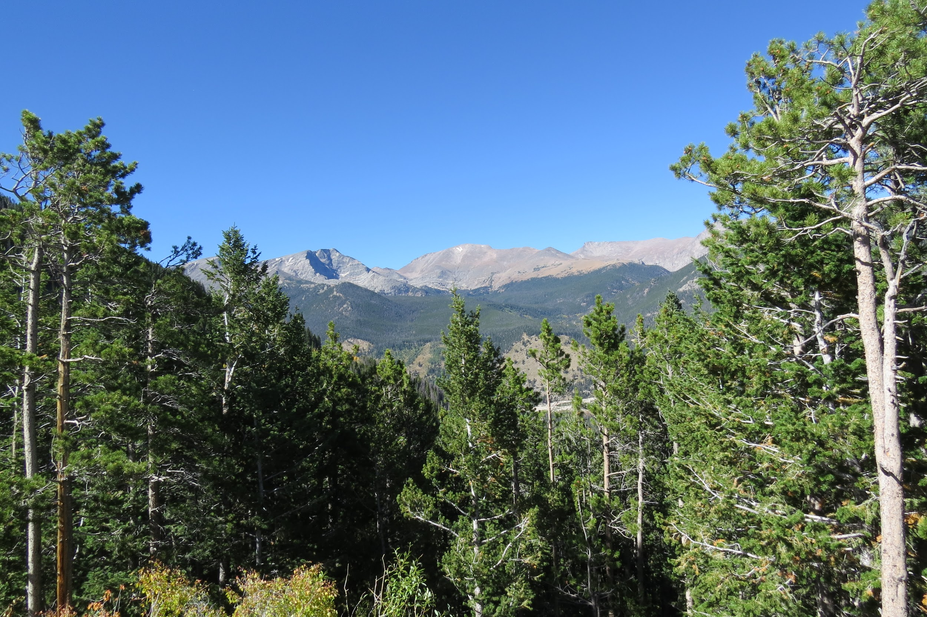
Community Concerns
Colorado State Forest natural resource, wildlife, and recreational management objectives
Tracking dynamics of forest health (beetle kill, wildfire, and harvests)
BANR - Assessing potential inventory of biofuel feedstocks
Image Credit: Sarah Carroll
Notes:
Park Management is actively managed for timber, recreation, wildlife, and grazing. An accurate and up-to-date map of species composition is needed to manage for this diverse range of objectives. A map of species composition can Additionally, communities in the Rocky Mountains are concerned about potential severe fires, aesthetics, and falling dead trees as a result of the recent mountain pine beetle epidemic.
Beetle Kill outbreak in Colorado has left many acres of dead trees. In 2014 alone, over 800,000 trees in the state were impacted by insect or disease activity. ( Annual Forest Health Report) Understanding how forests will recover and predicting future at risk areas for outbreak could be improved and aided with baseline species composition maps. Recovery trajectories can be predicted by pre-outbreak composition
3) BANR- A map of species composition could be used by BANR to map live and dead biomass as they assess the location and quantity of potential feedstock for biofuel

Slide 3
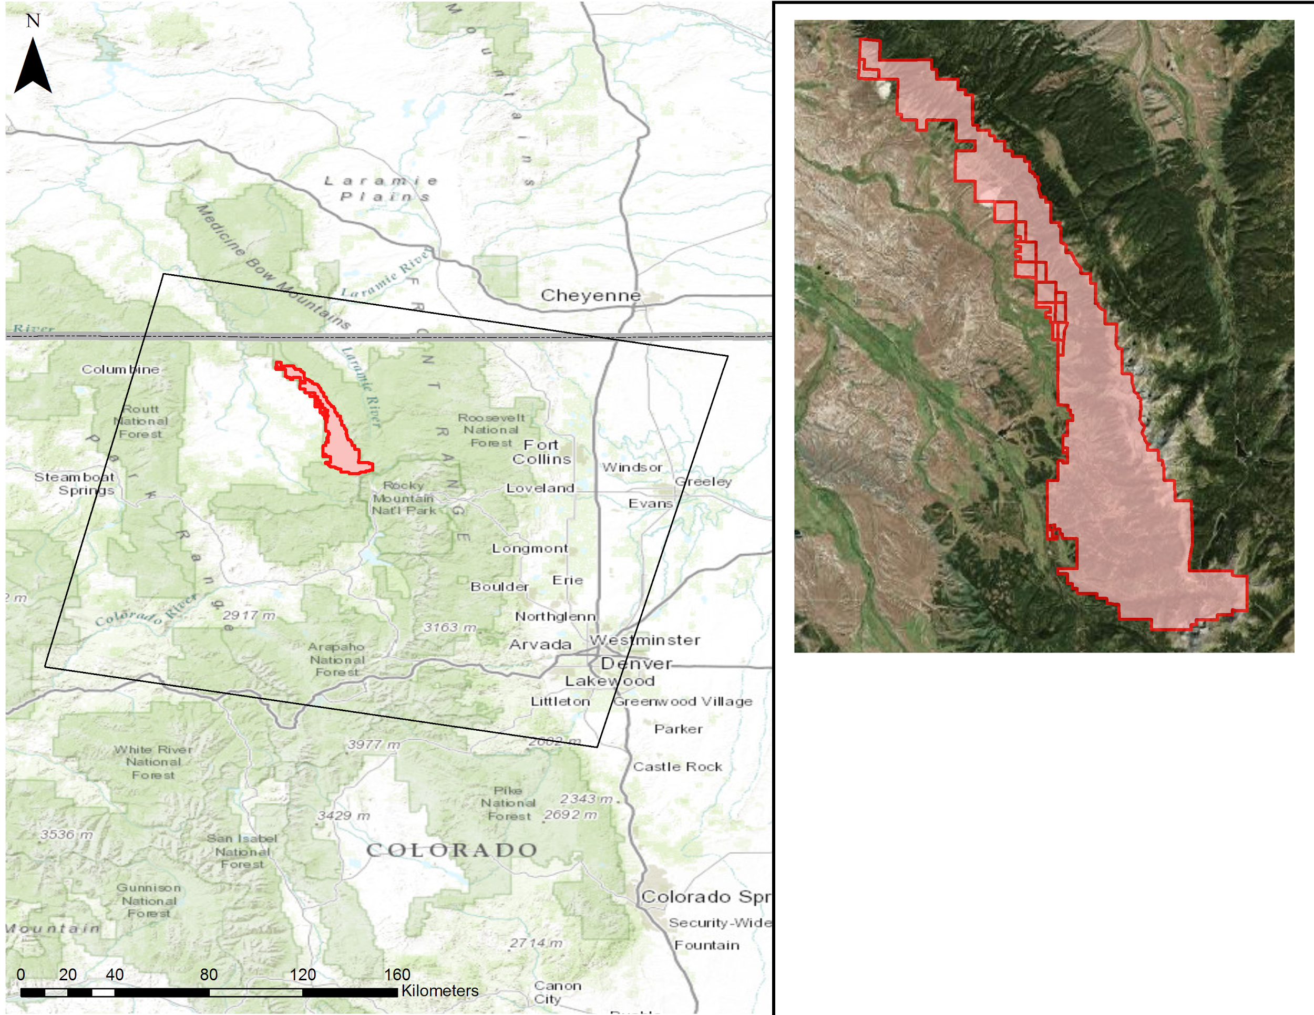
Study Area & Time Period
Location
Colorado State Forest
Time Periods
2002 - Pre-Beetle Kill
2014 - Post-Beetle Kill
Focal Species
Lodgepole Pine
Subalpine Fir
Engelmann Spruce
Aspen
Notes:
The study area focuses on the Colorado State Forest in north-central Colorado, which stretches across 70,000 acres through Jackson and Larimer counties. The area was established as a state park in 1970 and is now actively managed by Colorado Parks and Wildlife, Colorado State Forest Service and other partners. Elevation in the park ranges from approximately 2500 to nearly 4000 meters and more than seventy percent of the acreage is covered with coniferous forests ( Colorado Parks & Wildlife). The montane forests are dominated by Lodgepole pine (Pinus contorta), and fir-spruce communities in the subalpine zone including Douglas fir (Pseudotsuga menziesii), Engelmann Spruce (Picea engelmannii), subalpine fir (Abies lasiocarpa) , and aspen (Populus tremula) ( Wiken et al., 2011).
World Imagery Basemap Source: ESRI, Digital Globe
World Topo Basemap Source: ESRI

Slide 4
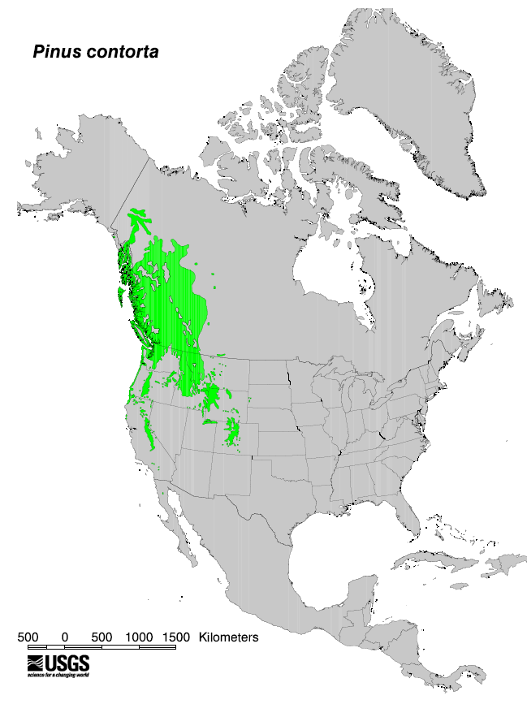
Objectives
Create refined species composition maps for use by our project partners
Employ a novel zero-inflated (ZI) regression tree model to identify the location and extent of tree species composition within the Colorado State Forest
Validate the model output and predicted dominant PCC by species using high-resolution NAIP and Worldview imagery
Notes:
The main objective of the project is the creation of a species composition map for use by our project partners in Colorado State Forest. This is novel because while previous projects and published works have integrated free medium-resolution imagery with other types of high resolution, and often expensive, sensors such as LIDAR, this project aims to utilize only freely available satellite imagery in combination with reference data to map tree species composition within the study area.
To aid in this project, we aim to utilize a novel zero-inflated model developed by researchers at the University of Montana to help enhance the reference data and imagery to accurately predict species distribution by canopy cover. This model is still being developed and our use of it provides an additional case study to test its feasibility and accuracy in temperate mountain environments.

Slide 5
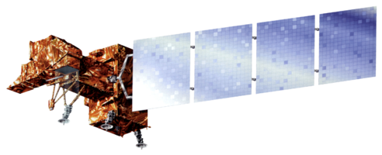
Data Acquisition
Platform | Data Product | Resolution | Source
Landsat 8 | OLI, TIRS | 30m | USGS Earth Explorer
Landsat 7 | ETM+ | 30m | USGS Earth Explorer
Landsat 5 | TM | 30m | USGS Earth Explorer
SRTM | Digital Elevation Model | 30m | USGS Earth Explorer
Reference Data | 2014-2015 Field-plot data | Excluded harvested plots
Notes:
In order to replicate the data used by Savage/Lawrence we gathered Landsat data for four different summer dates, with two scenes acquired for 2002(July & August) and two for 2014 (July & September). Also, SRTM data was downloaded from USGS Earth Explorer, providing us with a 30m DEM that we then used to create aspect and slope rasters .

Slide 6
STACK A (2014)
STACK B (2002)
Model Image Stack Band Number | Landsat (Year - Band) / Raster Data Set OLI
1 | July 2014 - Blue
2 | July 2014 - Green
3 | July 2014 - Red
4 | July 2014 - NIR
5 | July 2014 - MIR1
6 | July 2014 - MIR2
7 | July 2014 - TIR1 (Thermal)
8 | July 2014 - TIR2 (Thermal)
9 | September 2014 - Blue
10 | September 2014 - Green
11 | September 2014 - Red
12 | September 2014 - NIR
13 | September 2014 - MIR1
14 | September 2014 - MIR2
15 | September 2014 - TIR1 (Thermal)
16 | September 2014 - TIR2 (Thermal)
17 | SRTM DEM (30m)
18 | Slope
19 | Aspect
Model Image Stack Band Number | Landsat (Year - Band) / Raster Data Set July (TM ) / August (ETM+)
1 | July 2002 - Blue
2 | July 2002 - Green
3 | July 2002 - Red
4 | July 2002 - NIR
5 | July 2002 - MIR1
6 | July 2002 - MIR2
7 | July 2002 - Thermal
8 | August 2002 - Blue
9 | August 2002 - Green
10 | August 2002- Red
11 | August 2002- NIR
12 | August 2002 - MIR1
13 | August 2002 - MIR2
14 | August 2002 - Thermal
15 | SRTM DEM (30m)
16 | Slope
17 | Aspect
Notes:
Here are the two most recent image stacks used to run through the second step of the model. The two stacks were used to capture any differences between pre- and post-beetle outbreak on species identification in the model. Combinations based on specifications from Savage et al. (2015)

Slide 7
Step 1 Model Input & Purpose
Selected Reference Data:
Only Non-Harvested Plots
All Trees (Live + Dead Combined)
Live Trees Only
Dead Trees Only
Step 1 runs statistics on all possible combinations of reference data
Notes:
First, we run step 1 of the model. The statistical results of step 1 provides both an indicator of dataset reliability, but also a way to choose the model that fits the data the best. Based on this information you choose your model for the step 2 map output. In this case we used Savage et al’s (2015) model selection which was already written into the R code. Because the two study areas were similar in species composition and environmental factors we felt that changing the model was unnecessary. Moreover, Savage et al had great results and we attempted to reproduce their accuracy by using the same model. However, we did run several variations in the data [as seen on the slide].

Slide 8
Step 1 Model Output
Ten-fold cross validation model and Wilcoxon’s signed-rank test
 | Pure.SVM RMSE | Wilcox Pure.SVM CI Width | ZI.SVM.RF RMSE | Wilcox ZI.SVM.RF CI width
1 | 13.00 | 18.77 | 10.64 | 37.29
2 | 5.49 | 8.96 | 5.30 | 12.40
3 | 16.73 | 27.30 | 17.83 | 30.94
4 | 5.27 | 9.81 | 3.82 | 13.92
5 | 10.30 | 15.89 | 9.26 | 34.22
6 | 12.87 | 21.43 | 12.61 | 24.16
7 | 5.39 | 9.47 | 5.87 | 21.46
8 | 2.13 | 3.25 | 5.72 | 7.92
9 | 13.20 | 18.99 | 12.22 | 26.78
10 | 7.50 | 11.34 | 7.94 | 21.29
AVERAGE | 9.19 | 14.52 | 9.12 | 23.04
Notes:
The Resulting output is a spreadsheet of statistical from a Wilcoxons signed-rank test and 10-fold cross validation for each model to test how accurately our model is performing in its predictions. So each model is run 10 times, and each time, a random 25% of the data is excluded. This effectively creates 10 sub-samples in our dataset where each subsample is used once for validation, and all of the observations in the data set are used as training data for the model and statistical validation. The average of the 10 outputs can then be used as a single estimation for our desired statistics. In this case, it is the combination of the SVM.RF model from Savage 2015 was performed. The Wilcoxon’s signed-rank test, which is a test used for paired data sets with some assumptions, but no assumptions of normality or distristribution. So all parameters for this model are determined and added by the training data we input.
In this case the statistics we are most focused on are the confidence interval width, and the RMSE (This model uses a 95% confidence interval).
So when selecting a model that performed well, we are looking for a reasonable confidence interval size, (the smaller value the better), and then we want to look across and make sure the root-mean-square-error (RMSE) is also a reasonably small value in the context of our data. Since we are predicting percent canopy cover from 10-100, nearly 10% error is not outstandingly bad. The RMSE statistic supplements the mean difference used to create the CI

Slide 9
Methodology & Step 2 Workflow
Reference data:
percent canopy cover (PCC) by species using field-plot data
Imagery: multi-band composite image from Landsat scenes and DEM
Preprocessing
Model Processes Inputs
Outputs
Input
reference data
for target
species
Step 1: Model (GLM) binary classification of study area for tree species
Presence = 1
Absence = 0
Output = BIN
Binary map
Create Combination map from BIN*CON with raster calculator
Step 2: Regression model (SVM) of study areas
with Continuous Response
Output = CON
Continuous
Map
Output =
Presence
Data Only
Final Output: Continuous map of each target species
Notes:
At this point in our workflow, we have collected and organized reference data, and have compiled our multi-image and elevation derived data composites. Presumably we have selected the best model and reference data combination from step 1 as well. Now we run step 2 of the model which runs as follows [quickly go through slide].

Slide 10
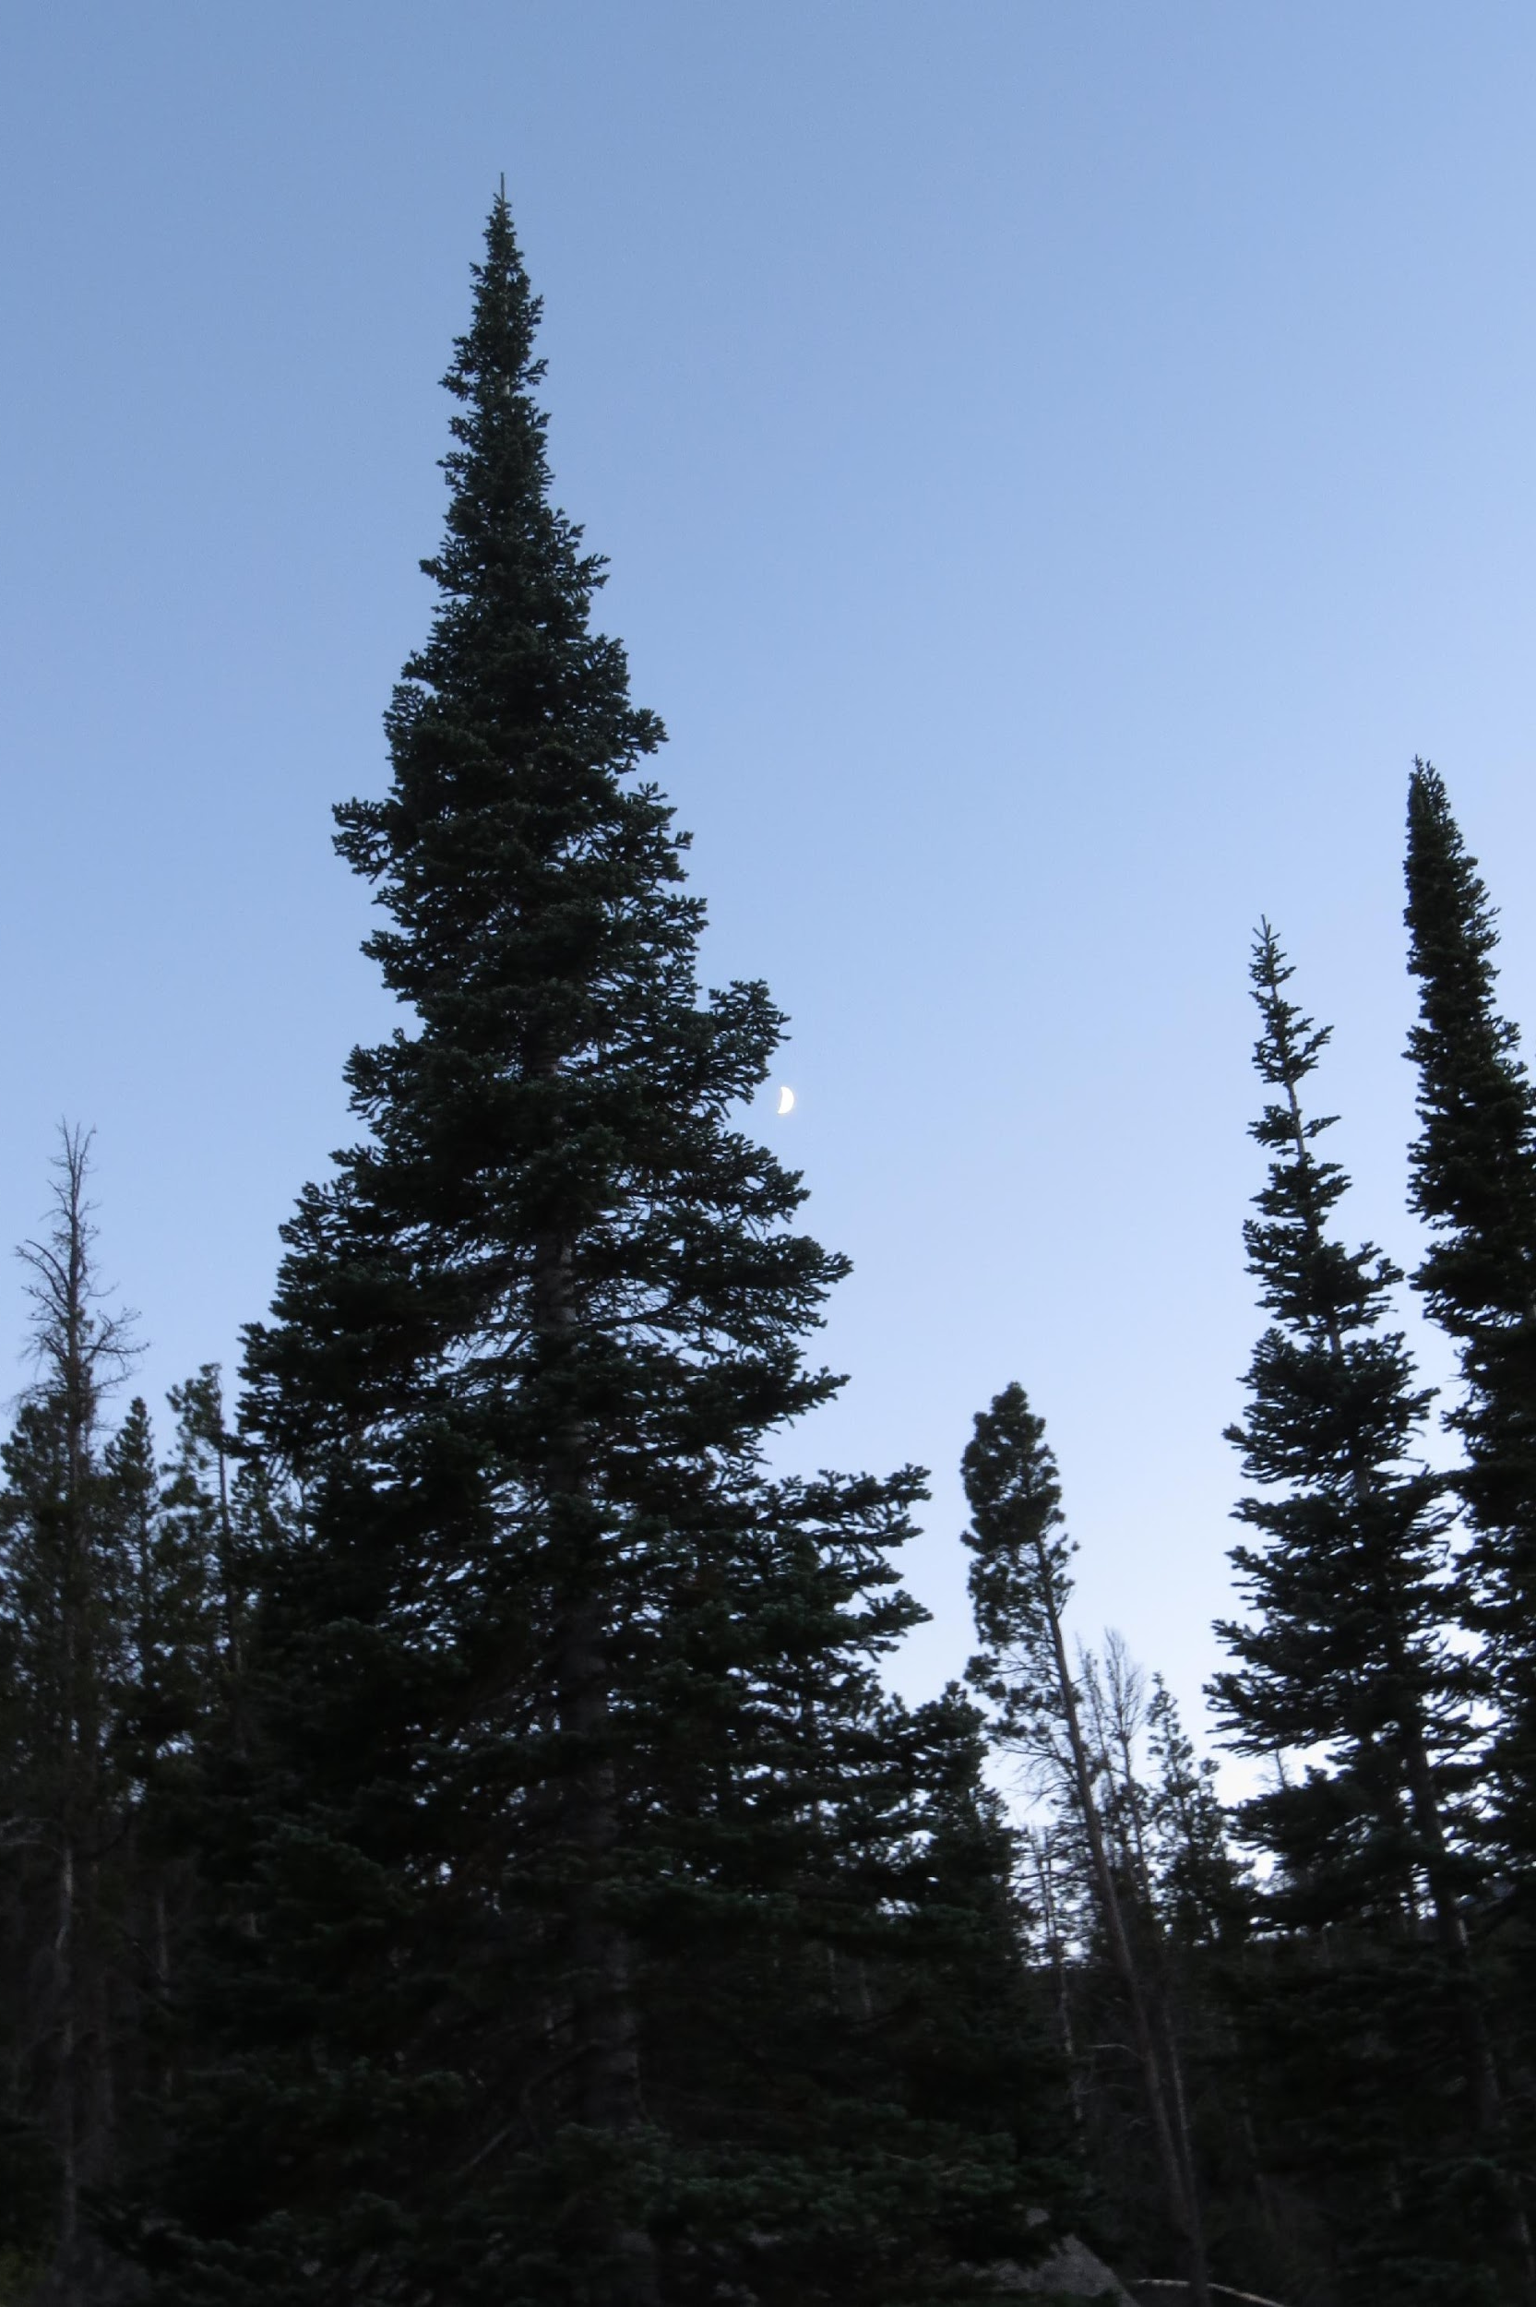
Step 2 Model Input and Processing
Inputs:
Image stack
One reference data spreadsheet per model run
Percent canopy cover map outputs:
All trees (live and dead) [4]
Live trees only [4]
Dead trees [1]
Dead lodgepole (2014 only) [1]
* [#] denotes output maps and corresponding
reference data sheets
Image Credit: Sarah Carroll
Notes:
Each run of model 2 requires two data files: the compiled image stack and a single species reference sheet for each run through the model.
For our purposes we have decided to test the accuracy of a variety of data combinations. 1. A collection of all live and dead trees for each species 2. We also took all dead trees out of the previous dataset to run only live trees of each species 3. We compiled all dead trees into a single species type to attempt to unconfuse the model between live and dead 4. Because lodgepole makes up such a large percentage of forest cover in the study area, and dead lodgepole in particular, we created an individual species composed of dead lodgepole to further parse out dead trees from live.

Slide 11
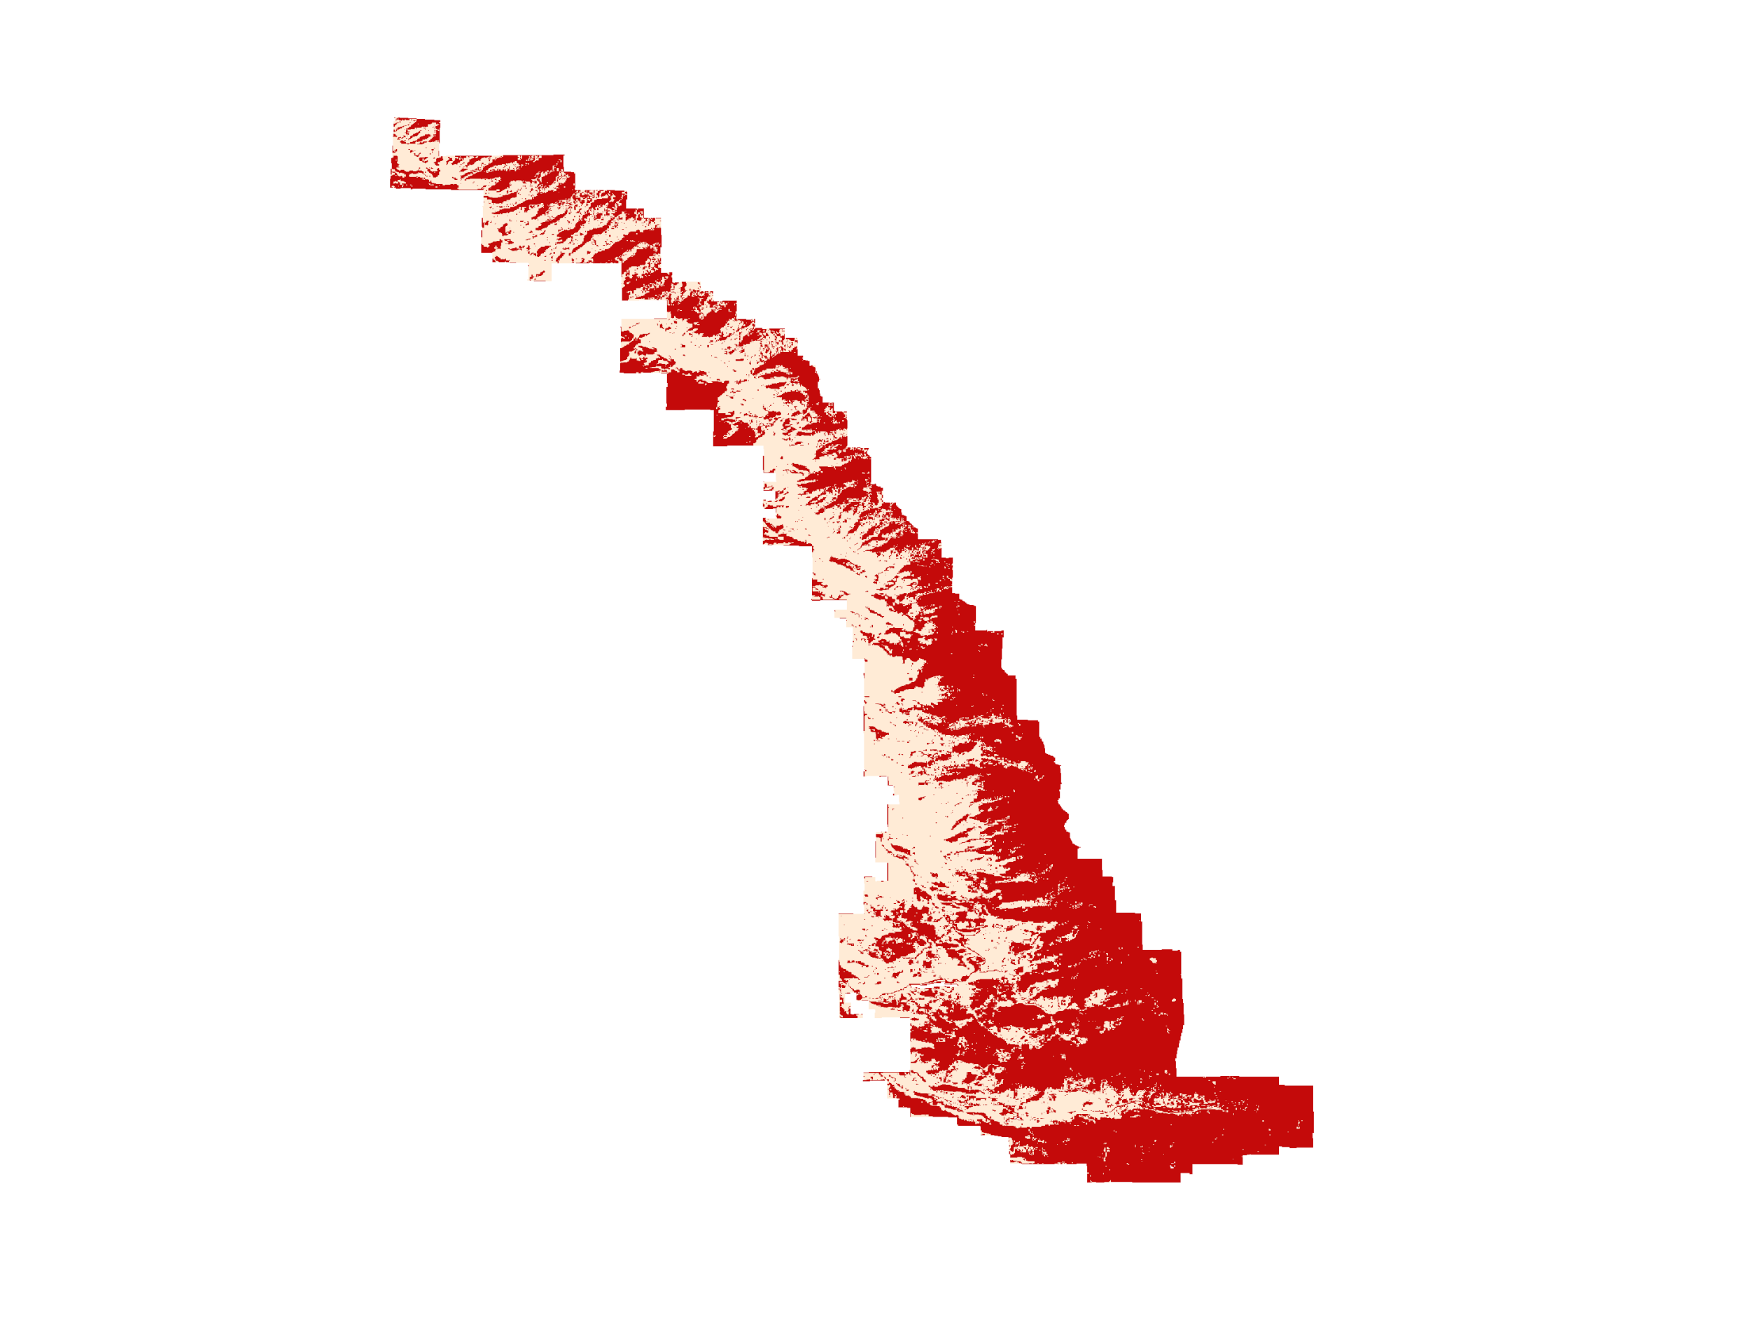
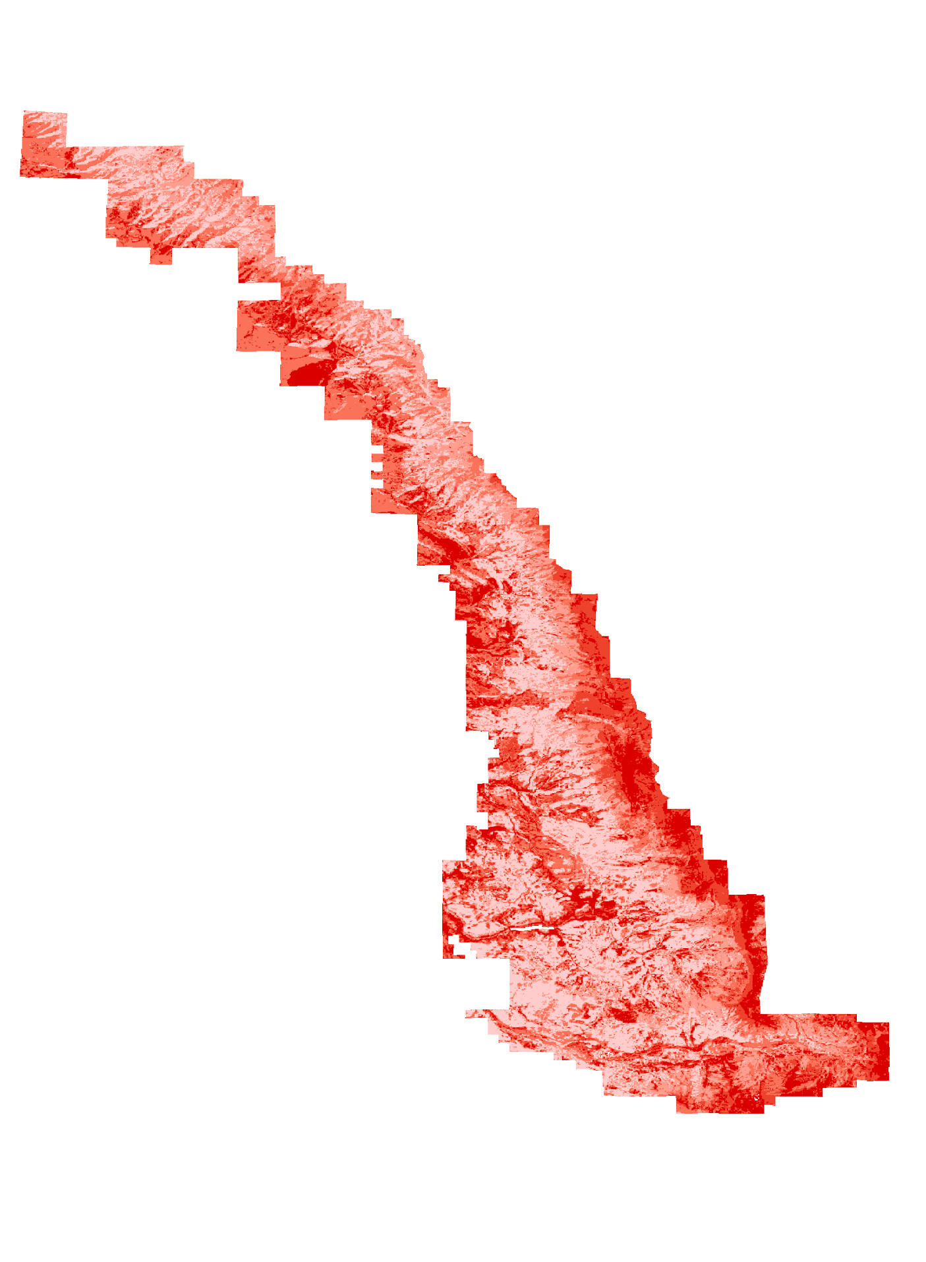
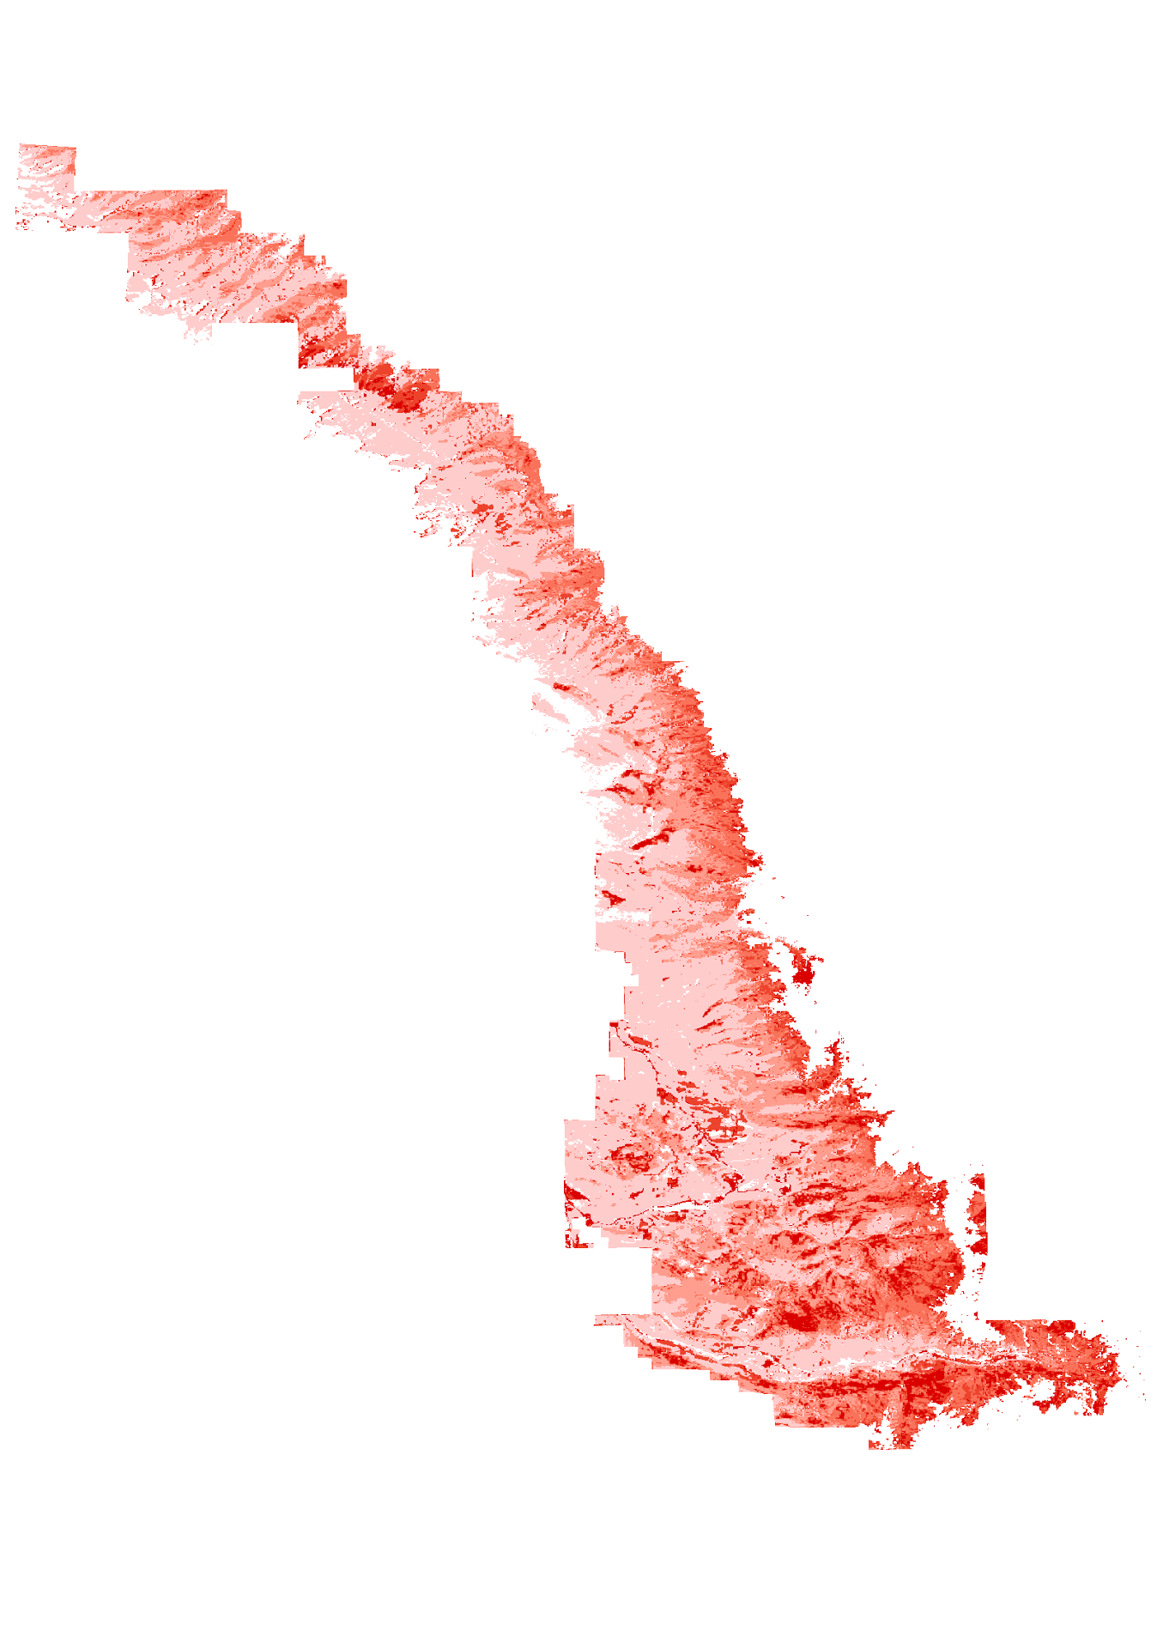
Step 2 Model Output Post-Processing
Binary (BIN)
Continuous (CON)
Combination
(BIN*CON + Forest Mask)
Notes:
The step 2 model binary and continuous output for each species were loaded into arcmap and the binary and continuous rasters were combined using raster calculator and the resulting raster was clipped to a forest/non-forest mask for a final raster output of percent canopy coverage by species

Slide 12
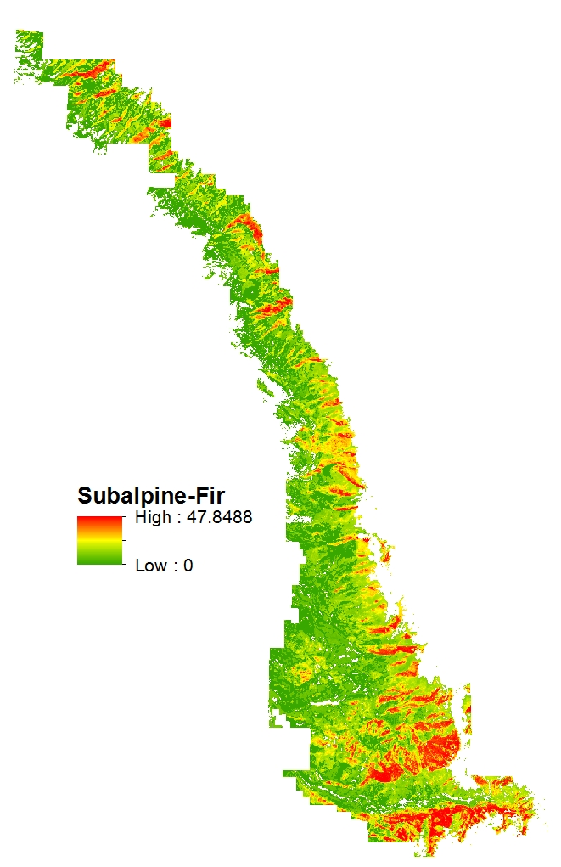
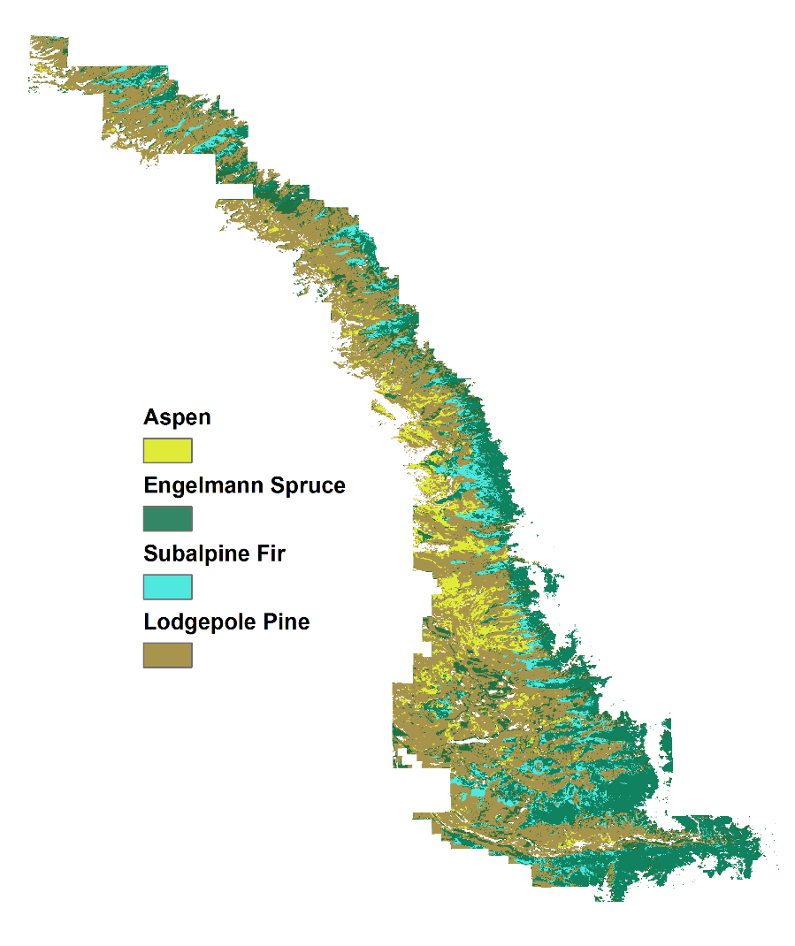
Results
Notes:
The final raster outputs for each species canopy coverage could be symbolized to reflect 1) continuos output of species canopy cover percentage throughout the entire study area which shows the highest percent cover to the lowest. Here, subalpine fir shows a maximum cover of 47%, which is in line with maximum percentage for fir from Savage et al. 2) It is also possible to visualize only the highest percentage of canopy cover to create a simple to understand species composition map of the study area, since species are often most identifiable based on geographic location.

Slide 13
Errors & Uncertainties
Inaccuracies in species identification using medium-scale resolution imagery
Small sample of reference data for model training may be insufficient (67 plots versus +300 plots)
High volume of dead trees in study area may confuse the training data and spectral signatures affecting species prediction
Potential of using other statistical models on output unknown

Slide 14
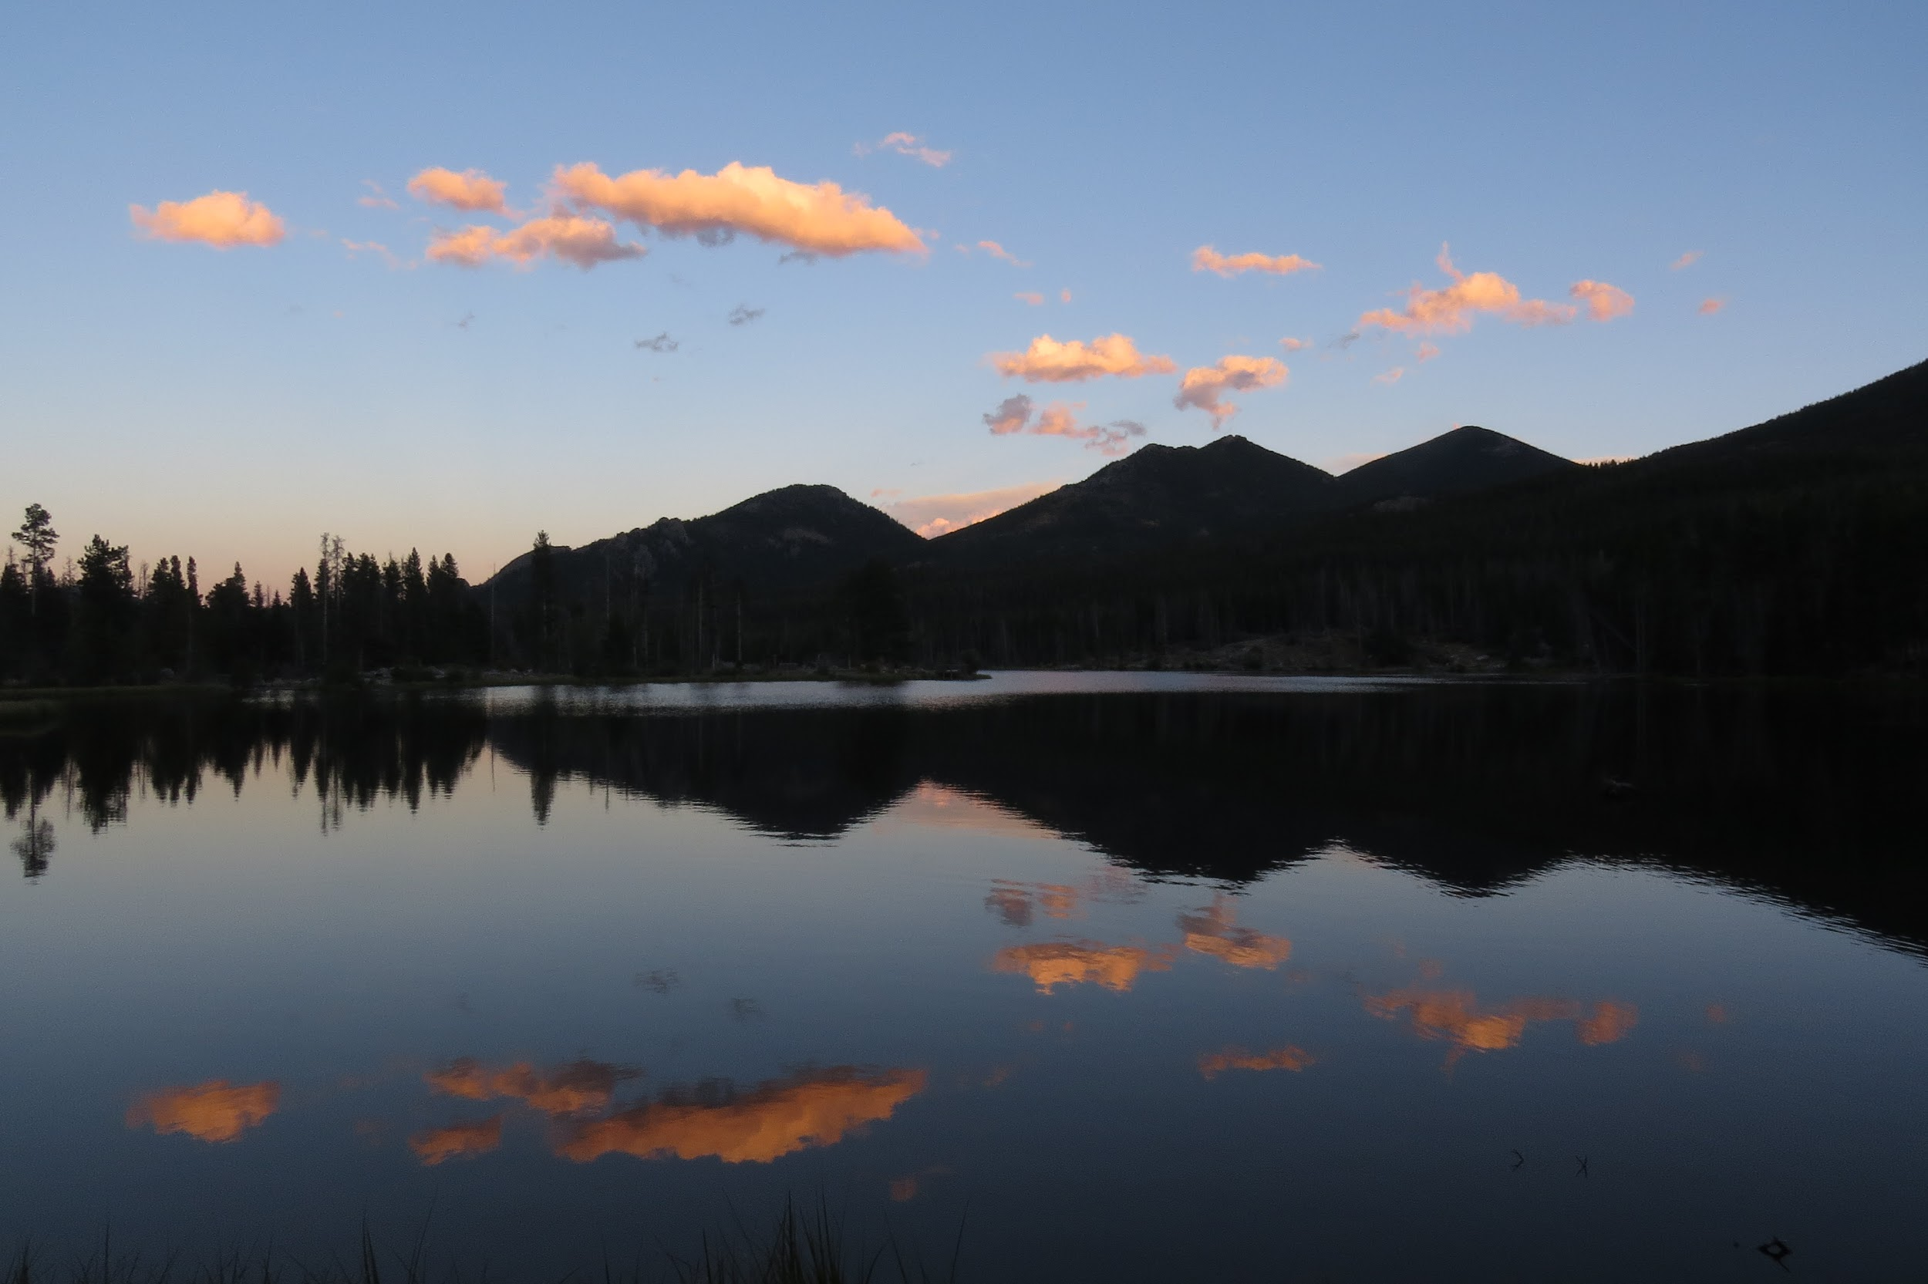
Future Work
Continued validation of reference data variations
Creating additional training plots to further bolster model
Image Credit: Sarah Carroll
Notes:
Future work will need to continue validating reference data variations in order to find the smallest root mean square error and confidence interval from the step 1 model output. Once we find the lowest source of error we can run a more confident model output. We also hope to create additional training plots by randomly selecting points throughout our study area and visually sampling for species type and canopy cover.

Slide 15
Acknowledgements
Advisors
Dr. Paul Evangelista, Colorado State University (CSU), Natural Resource Ecology Laboratory (NREL)
Partners
Tony Vorster, CSU, NREL, BANR
John Twitchell, Colorado State Forest Service (CSFS)
Others
Shannon Savage, Montana State University (MSU)

