Slide 1
Cape Hatteras Ecological Conservation II
Defining Methodology for Shoreline Delineation Using SAR and Optical Imagery to Inform Conservation Decision Making
Haley Baker
Mia Schwartz
Alexandre Passin
David Babson
Virginia – Langley | Summer 2024
Notes:
Hey everyone, I'm X and we are the Cape Hatteras Ecological Conservation II Team. Today we are going to be presenting our findings on _____________. Without further ado, lets get started!

Slide 2
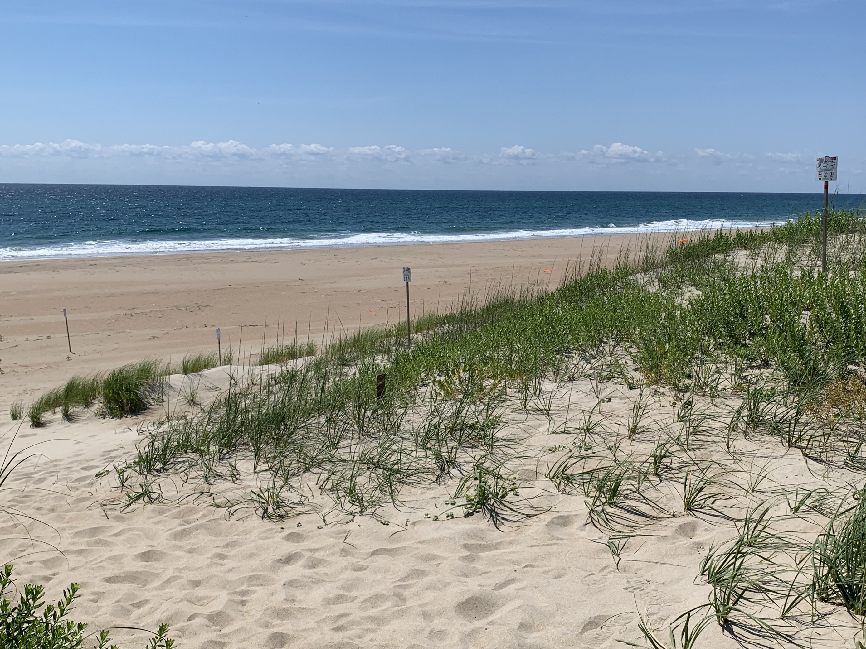
MEET THE TEAM
Mia Schwartz
Dave Babson
Haley Baker
Alexandre Passin
Image Credit: DEVELOP Team​
Notes:
My name is Haley Baker
My name is Mia Schwartz
My name is Dave Babson
My name is Alex Passin
----------Image Information Below----------
[Haulover Image]
Image Credit: Dave Babson
Image Source: Develop Team

Slide 3
PROJECT PARTNER
Cape Hatteras National Seashore
Michael Flynn, NPS Physical Scientist
Goals of CAHA
Conserve the ecosystem for wildlife
Implement measures to protect against coastal erosion that may damage infrastructure and natural beauty
Provide opportunities for community engagement
Image Credit: NPS, DEVELOP Team
Notes:
For our project, we partnered with the National Park Service, specifically Cape Hatteras National Seashore. Current conservation efforts on the National Seashore aim to conserve the land for the people who live in Cape Hatteras as well as the wildlife. The nesting shorebirds and sea turtles have been designated as vulnerable species. Current efforts by the National Park Service focus on adaptation through dredging and sediment management as well as relocation.
----------Image Information Below----------
NPS logo
https://www.nps.gov/index.htm
Cape Hatteras Team picture
Image Credit: DEVELOP Team

Slide 4
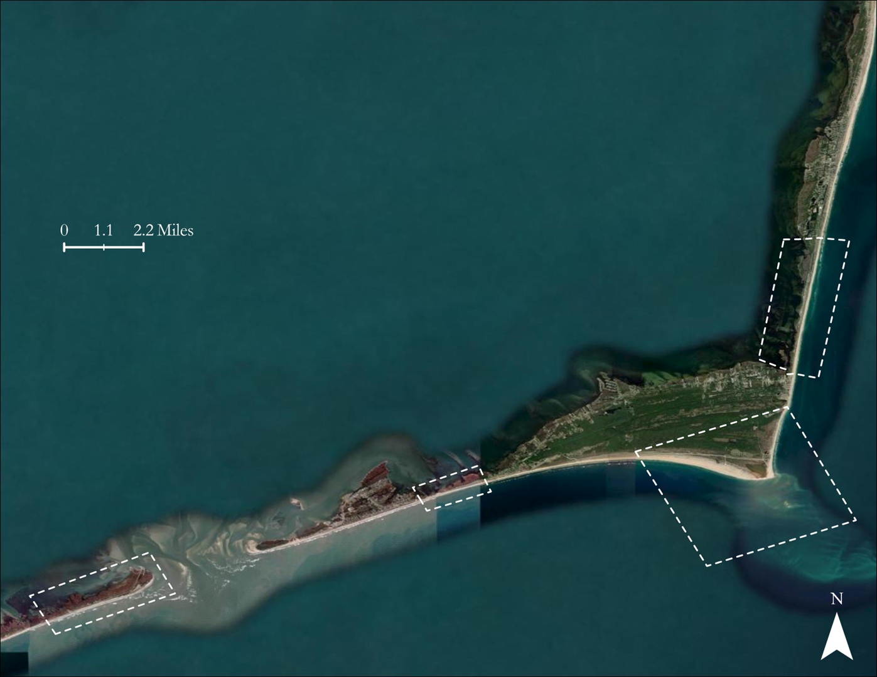
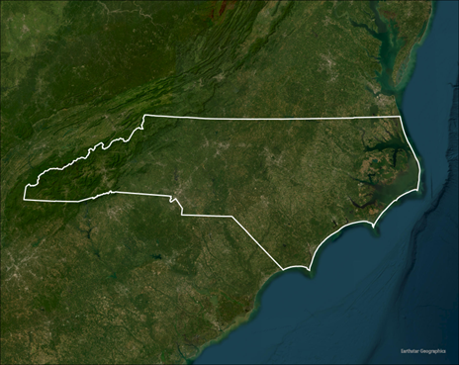
STUDY AREA & PERIOD
Cape Hatteras National Seashore
Areas of Interest
0 1 2 miles
Haulover
Pamlico Sound
North Carolina
Source: ESRI Imagery, Earthstar Geographics
Sandy Bay
Northern Ocracoke
Island
Cape Hatteras
Period: 2015 – 2023
Atlantic Ocean
N
Notes:
The NPS designated 4 areas of interest based on their vulnerability to coastal erosion. These areas include Haulover, Cape Hatteras, Sandy Bay, and Northern Ocracoke Island. While the original scope of the project intended for analysis specific to these areas, as the project progressed, we found that it would be more meaningful to our partners to create a methodology that captured the entire Cape Hatteras National Seashore, rather than focus our efforts on analyzing specific areas. So, we instead extracted the entire shoreline using satellite imagery from 2015 to 2023.

Slide 5
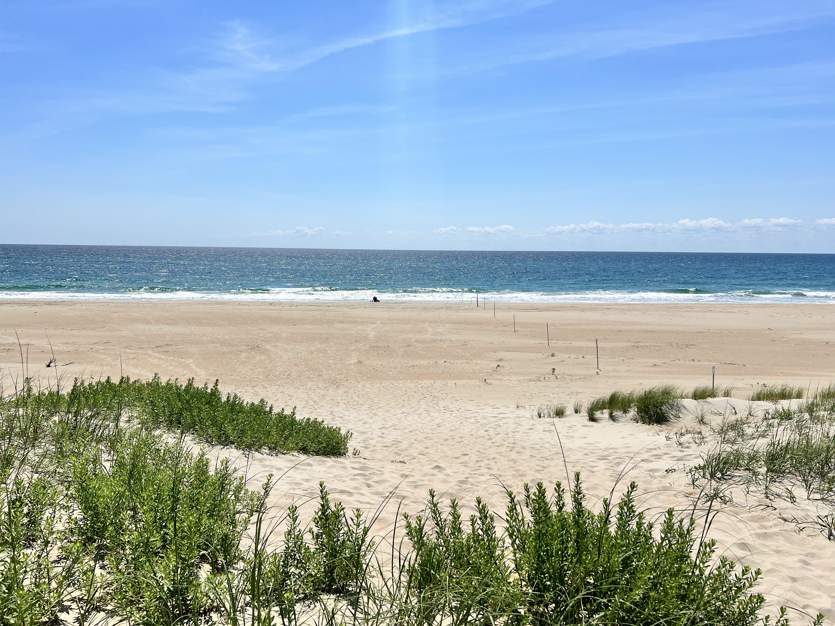
MOTIVATION
Community concerns over wildlife and infrastructure
Currently difficult to quantify natural shoreline change
Data collection methods are inefficient
We aim to help NPS find a better solution
Image Credit: DEVELOP Team
Notes:
So why does NPS need the ability to regularly check shorelines? As it stands, it’s difficult for NPS to quantify natural shoreline movement over time. The current shoreline delineation methods require someone to manually walk or ride along the shoreline and record GPS data, or to pay a large sum to have LIDAR imagery captured by drones. Due to the challenges presented by these two collection methods, shoreline data are generally only gathered following large storm events. These data aren’t usable for tracking shoreline change over time, as the shoreline after storm events is drastically different compared to the rest of the year. Not having access to data on change over time makes it difficult to address community concerns over wildlife endangerment and infrastructure damage. With those concerns in mind, we aim to provide NPS with a means of acquiring these data without spending lots of money or doing lots of time-intensive manual labor.
----------Image Information Below----------
[Haulover Beach picture]
Image Credit: David Babson
Image Credit: DEVELOP Team

Slide 6
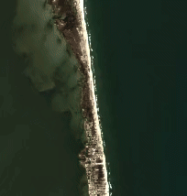
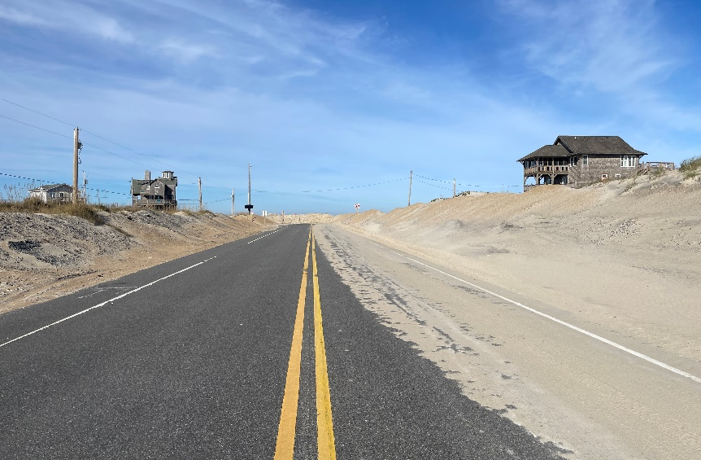
GENERAL BACKGROUND – TERM I
Used ArcGIS & Google Earth Engine
Created seasonal and annual shoreline change maps
Identified NC-12 as vulnerable to coastal erosion
Mitigation efforts on Rodanthe, Avon, and Cape Hatteras
An area where sand was washed onto NC-12
Basemap Credit: Google
Image Credit: Michael Flynn
Notes:
Our project is a continuation of the Spring's Cape Hatteras Ecological Conservation project. Their team used Google Earth Engine (GEE) and ArcGIS to acquire and analyze geographical data. They analyzed the cape Hatteras region by placing squares around the shoreline and marking what percentage of pixels inside that space were land vs. water during a few date ranges. This method identified what percentage of land was gained or lost during the given period. They created these change maps for seasonal and annual time ranges. They found significant land loss in the Cape Hatteras area during their study periods. Their findings prompted the NPS to focus mitigation efforts in the areas that were most impacted by coastal change, specifically Rodanthe and Cape Point.
----------Image Information Below----------
Top Image
Basemap credit: Google
Bottom Image
Image Credit: Michael Flynn, NPS (Used with Permission)

Slide 7
PROJECT OBJECTIVES
DEVELOP
A replicable method for shoreline delineation along the estuarine and seashores
ANALYZE
Shoreline
Change
The accuracy of our methodology using a confusion matrix
ASSIST
NPS by providing a method for shoreline delineation to inform future decision-making
Notes:
With the previous terms work giving NPS an idea of how much land was lost, our term was focused on visualizing that change. Our idea for this was to create a replicable method for shoreline delineation along both the estuarine and seashore sides of the Cape. By layering these delineations, you can see the physical change in the shoreline over time. After developing our method, we analyzed our results to ensure they were accurate. We accomplished this using a confusion matrix comparing shorelines generated by our methodology to reference shorelines that were created manually by NPS. This work is done to assist the NPS by providing them with a reliable and accurate method for generating shoreline delineations. This allows them to see how the shoreline has changed over time and use those data to inform future decision making.

Slide 8
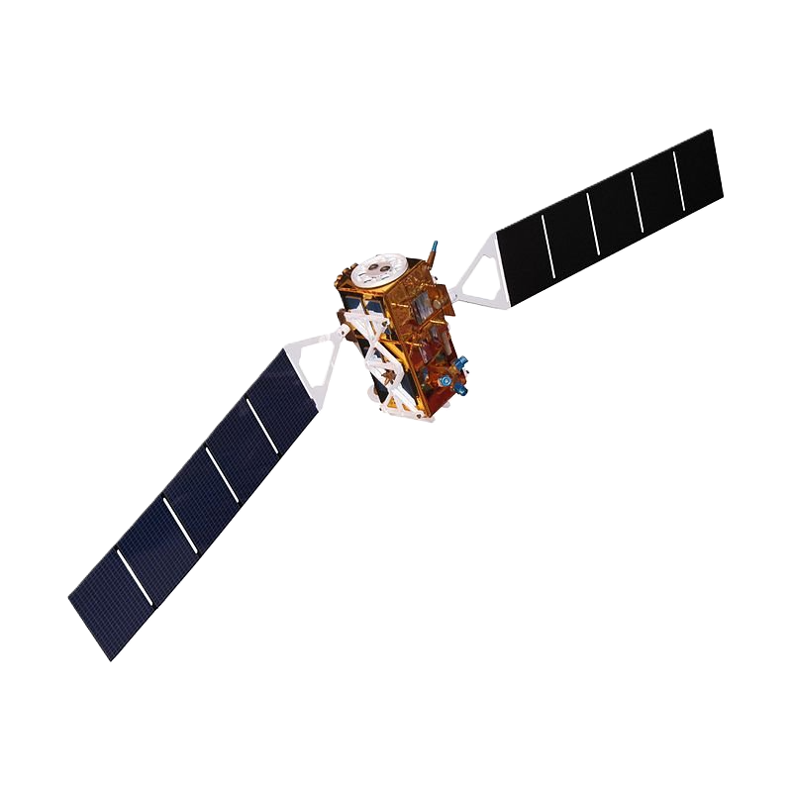
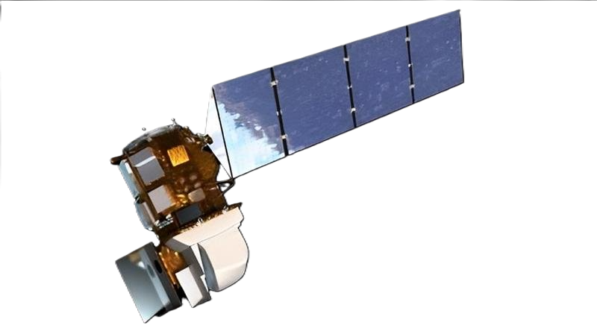
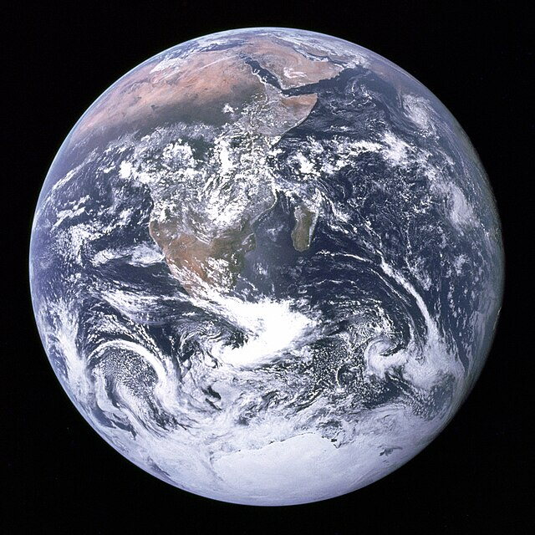
EARTH OBSERVATIONS
Sentinel-1 C-SAR
Landsat 8 OLI
Active Radar Satellite
Emits electromagnetic waves
Measures backscatter from the land surface
Captures microwave light
Passive Optical Satellite
Sunlight reflected off Earth’s surface
Captures visible and infrared light
Image Credit: Rama Harrison
Schmitt or Ron Evans, NASA
Notes:
Our method uses data from two satellites, Sentinel-1 Synthetic Aperture Radar (SAR) and Landsat 8 Operational Land Imager (OLI).
Sentinel-1 is an active satellite that sends out a radar signal that then bounce off the Earth's surface and returns to the satellite.
Because of this method, Sentinel-1 can penetrate cloud coverage and take clear images no matter the weather or time of day.
Landsat 8, on the other hand, is a passive optical satellite that observes sunlight reflected off the Earth’s surface and cannot penetrate clouds.
Both satellites capture visible and infrared light.
----------Image Information Below----------
[Earth Image]
Image Credit: [Harrison Schmitt or Ron Evans] [Public Domain]
Image Source: [https://commons.wikimedia.org/wiki/File:The_Earth_seen_from_Apollo_17.jpg]
[Sentinel-1 Image]
Image Credit: [Rama] [CC BY-SA 2.0 FR]
Image Source: [https://en.wikipedia.org/wiki/Sentinel-1# ]
[Landsat -8 Image]
Image Credit: [NASA] [Public Domain]
Image Source: [Landsat 8 | Landsat Science (nasa.gov)]

Slide 9
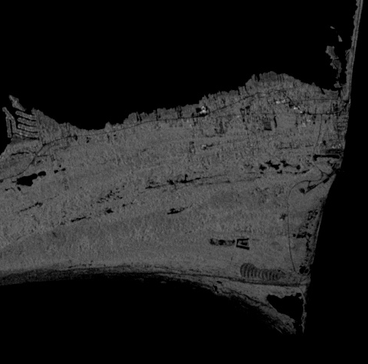
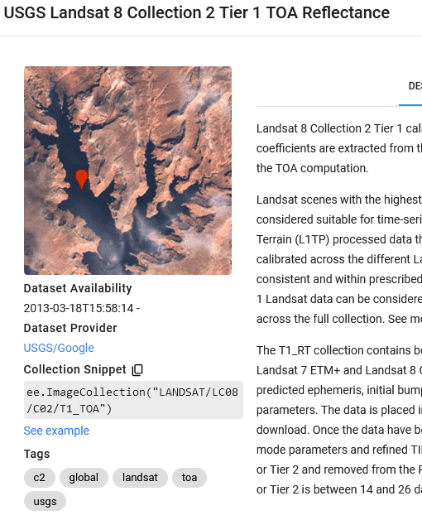
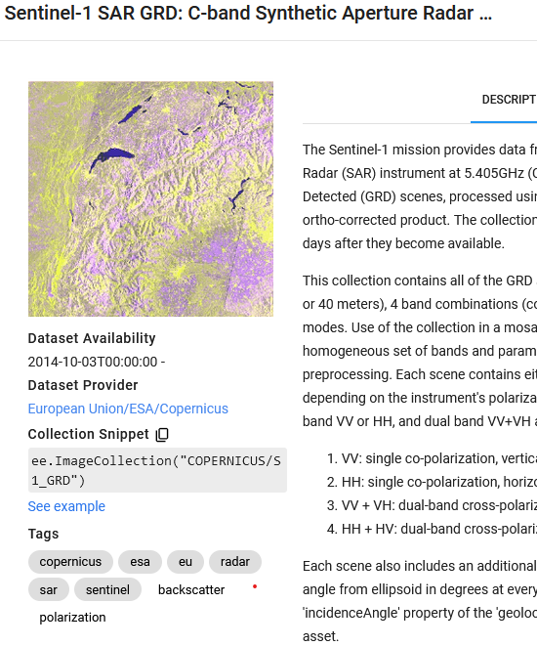
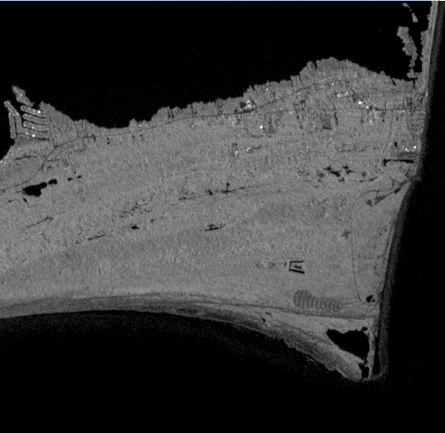
ACQUISITION
ACQUISITION
PROCESSING
PROCESSING
ANALYSIS
ANALYSIS
Date Range
Area of Interest
30th Percentile
VS
Google Earth Engine
Sentinel-1 and Landsat 8 Data
90th Percentile
Notes:
So how do we get these data? We use google earth engine! Google earth engine is a cloud-based geospatial analysis platform with a large satellite database that is easy to pull data from. We developed a program in google earth engine that imports the satellite databases, filters the data to a given date range and area of interest, and then filters by percentile to generate a composite image of the darkest pixels from across the entire year. On the right you can see the difference in clarity and visible land between a 30th percentile and a 90th percentile SAR image. We used an 85th percentile filter for the Sentinel-1 data and a 65th percentile filter for the Landsat data. We use a lower value for the Landsat to filter out cloud cover. From there, we export the data to a GEOTIFF file for further processing.
----------Image Information Below----------
Cape Hatteras Team picture
Image Credit: Microsoft office

Slide 10
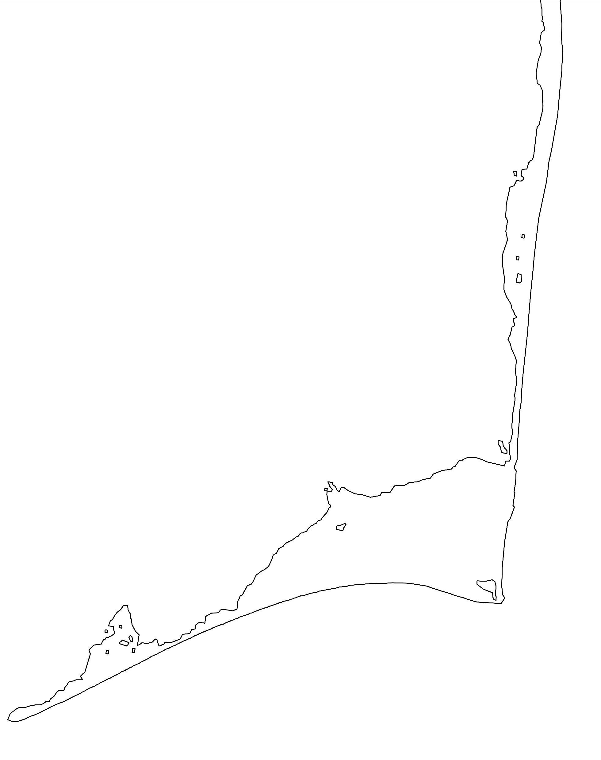
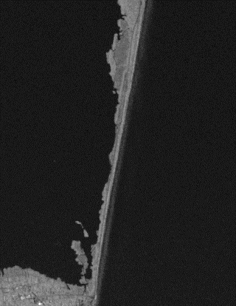
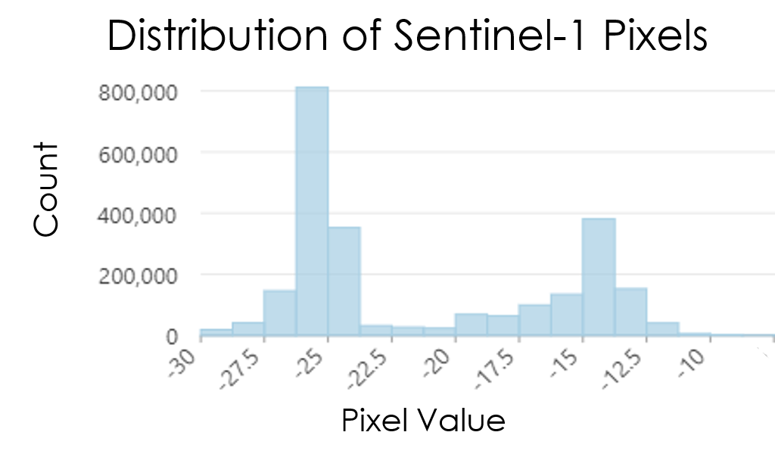
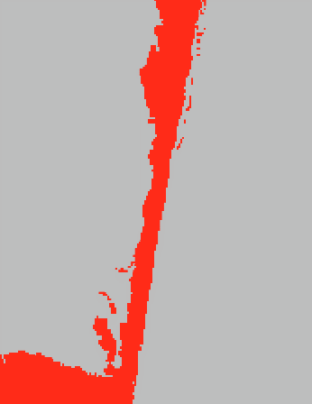
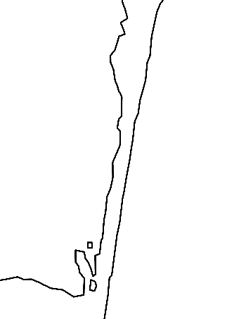
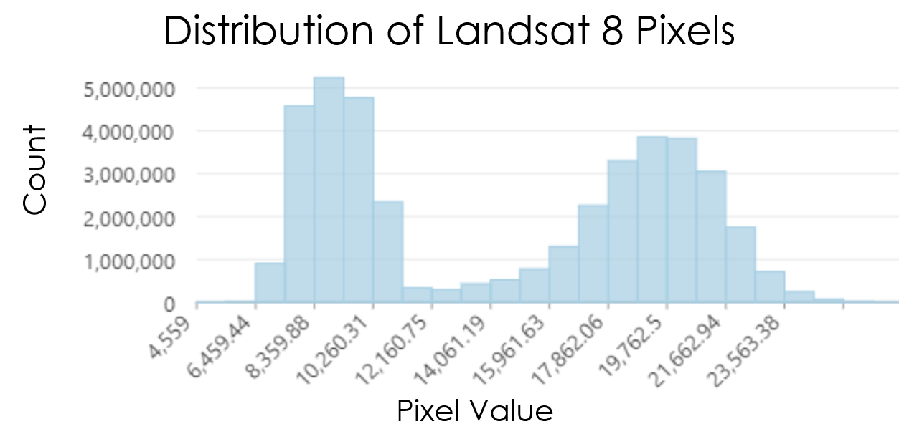
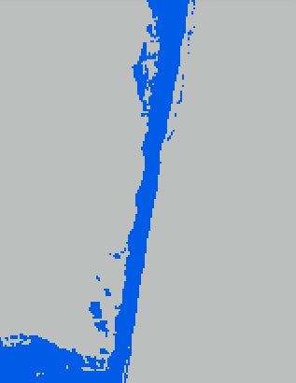
ACQUISITION
ACQUISITION
ACQUISITION
PROCESSING
PROCESSING
PROCESSING
ANALYSIS
ANALYSIS
ANALYSIS
Sentinel-1
Merged
Vectorized
Landsat 8
ArcGIS Pro
Image Credit ESRI
Notes:
Those exported Sentinel-1 and Landsat 8 datasets come in the form of rasters.
Each pixel in a raster has a value that represents its brightness.
Using ArcGIS version 3.3.0, these rasters can be plotted, showing the frequency of given pixel values which creates two distinct peaks that represent “water” and “land”.
The trough between the two is the “transition area” representing the shoreline.
The pixel value at the lowest point in the trough can be used as a threshold for a binary classification.
Everything to the left of the low point is classified as water with a value of 0, and everything to the right is classified as land with a value of 1.
The two resulting rasters can then be merged into one that includes all land pixels from both Landsat 8 and Sentinel-1.
Using a few geoprocessing tools, the merged raster can be cleaned up and converted into a line feature, delineating a shoreline!

Slide 11
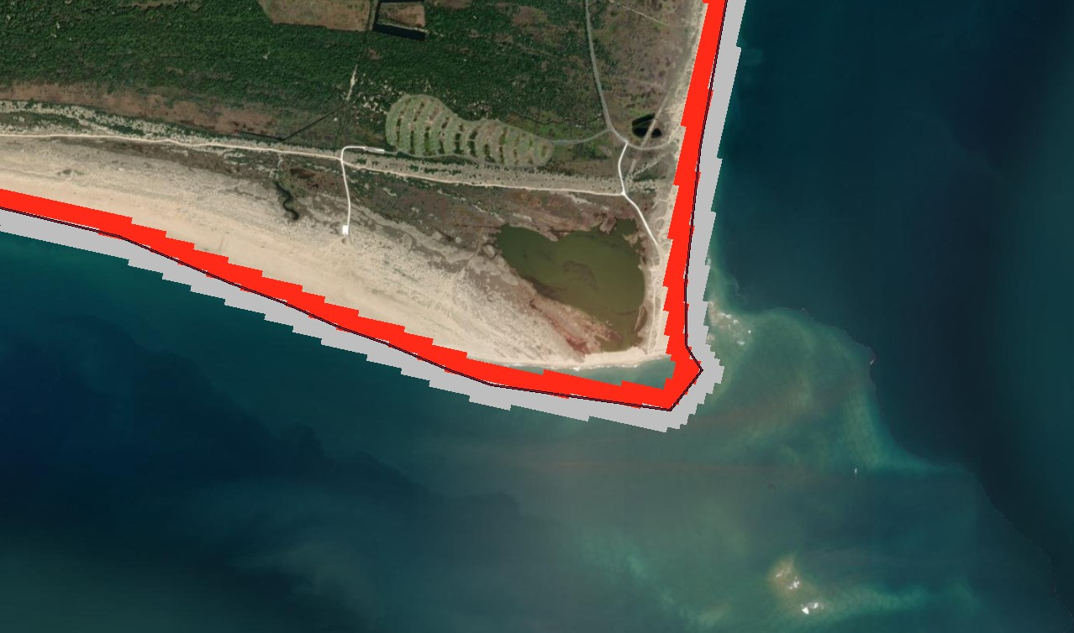
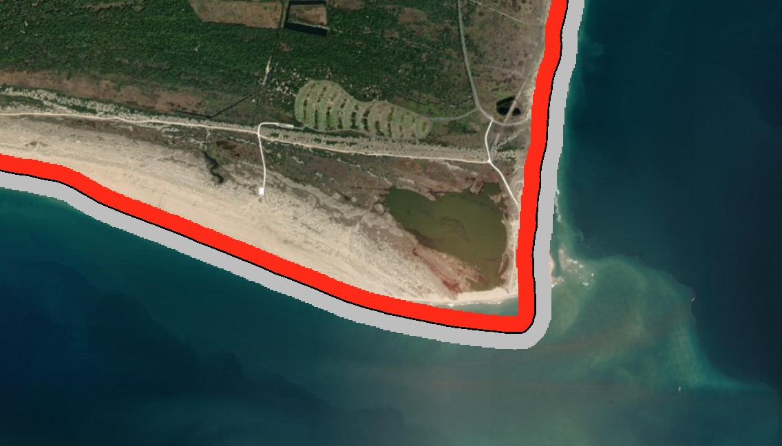
ACQUISITION
ACQUISITION
ACQUISITION
PROCESSING
PROCESSING
PROCESSING
ANALYSIS
ANALYSIS
ANALYSIS
Predicted Shoreline over Predicted Raster Segment
Reference Shoreline over Reference Raster Segment
Classification Value | 0 | 1 | Total | User Accuracy | Kappa
0 | 56 | 0 | 56 | 100% | 0
1 | 31 | 65 | 96 | 67.7% | 0
Total | 87 | 65 | 152 | 0% | 0
Percent Accuracy | 64.4% | 100% | 0% | 79.6% | 0%
Kappa | 0 | 0 | 0 | 0% | 61%
Notes:
To ensure accuracy of our proposed methodology, we decided to statistically validate our work by using a confusion matrix. Confusion matrices are used to predict how many values are correct and incorrect within a classification. In this case, to determine the accuracy of the binary land-water classification of our proposed shoreline. To do this, we generated accuracy assessment points over our proposed raster, then extracted the value of them over the reference raster provided by the National Park Service. We do have a known bias – the reference shoreline was captured at High Tide, while our shoreline is an average water line of an entire calendar year. Even with this known bias, however, we achieved a Percent Accuracy of around 80%, successfully validating our methodology of shoreline delineation along the Atlantic Coast.
---------------------------------------------
Basemap Imagery: Esri, MAXAR

Slide 12
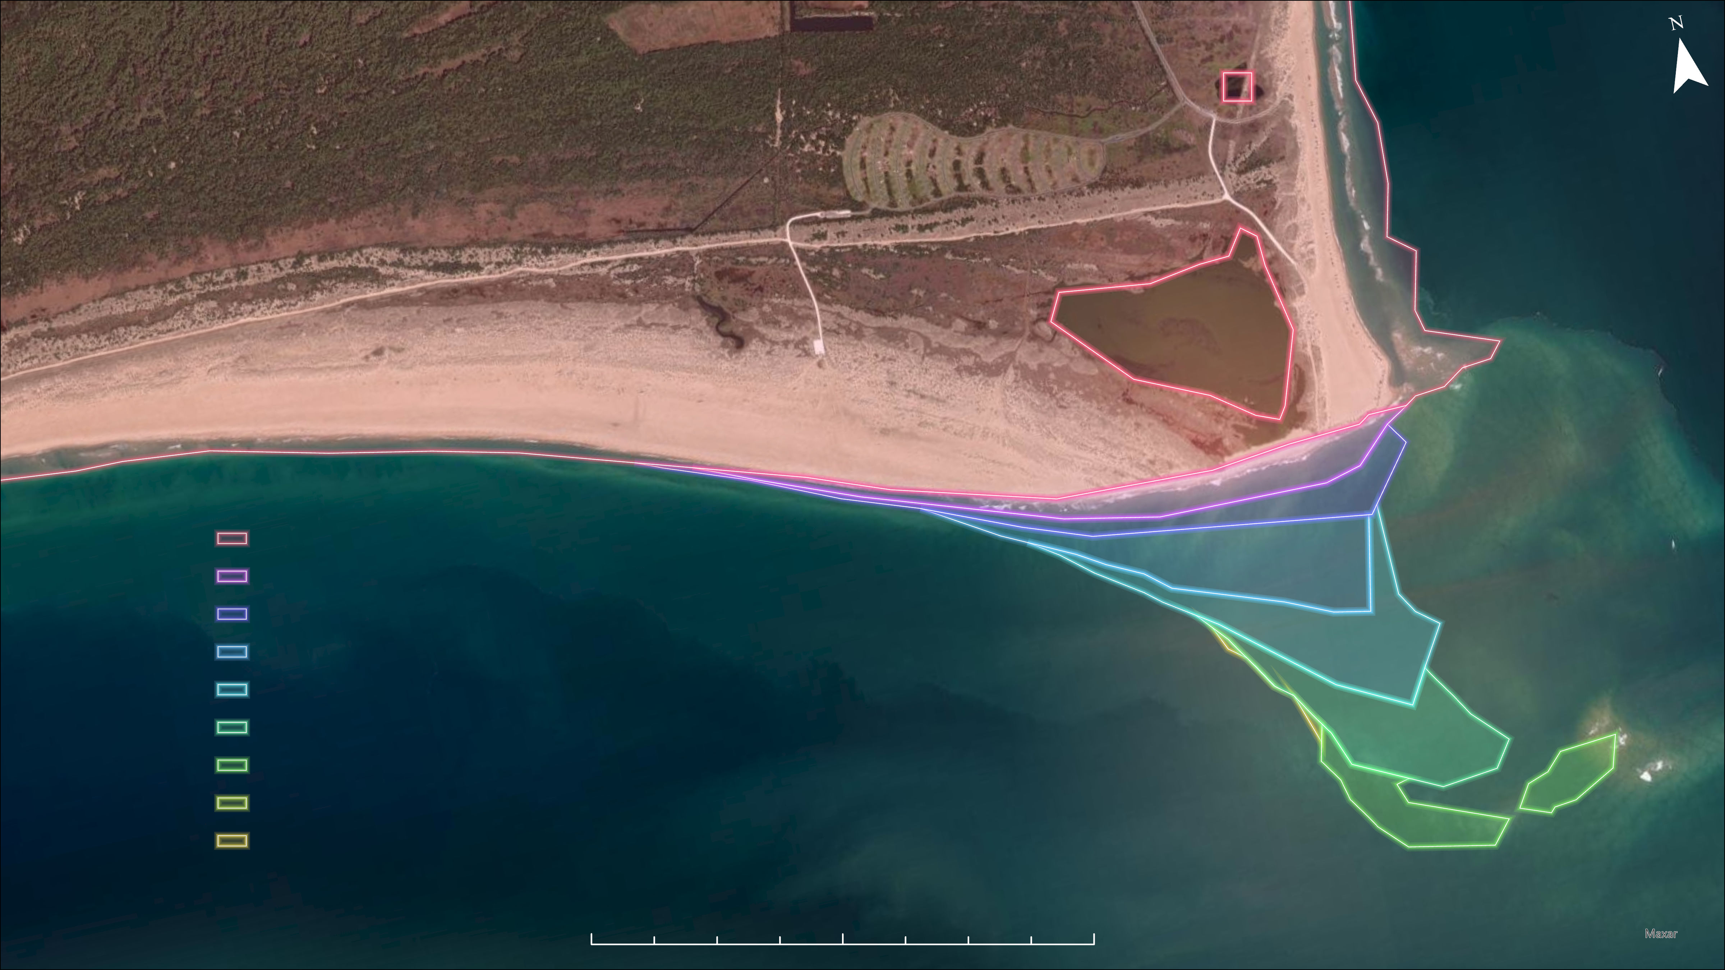
RESULTS
Delineated Shorelines for 2015-2023 of Cape Hatteras, Outer Banks, NC
2023 Shoreline
2022 Shoreline
2021 Shoreline
2020 Shoreline
2019 Shoreline
2018 Shoreline
2017 Shoreline
2016 Shoreline
2015 Shoreline
Sources: ESRI, Sentinel-1, Landsat 8 OLI
0
0.25
0.5
1 Miles
Notes:
With our methodology statistically validated, we can confidently say that our proposed methodology is accurate and replicable for the National Park Service to use for any future Atlantic Coast shoreline analysis. However, more work will need to be done to validate the accuracy of the method along the Pamlico Sound coastline.

Slide 13
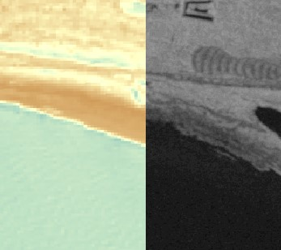
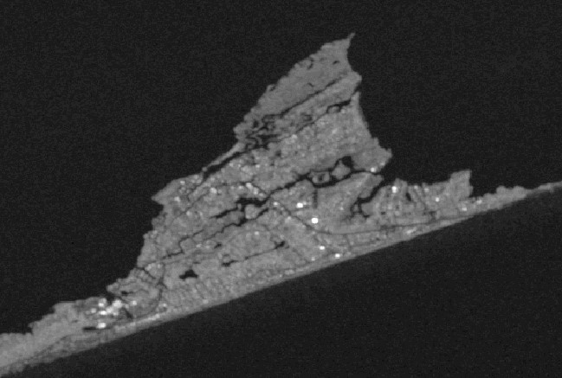
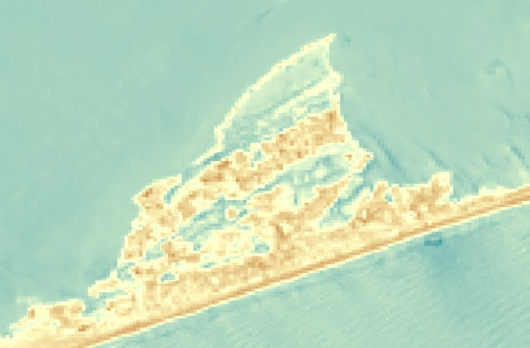
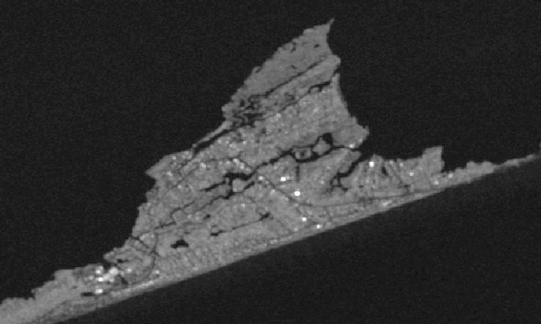
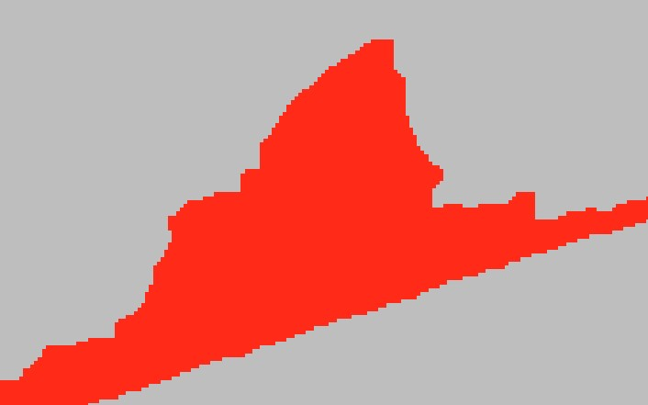
ERRORS AND UNCERTAINTIES
SAR (left) captures the estuarine side, while Landsat (right) struggles to identify the emergent wetlands of the Pamlico Sound.
SAR (left) is capable of capturing inlets and internal bodies of water but are lost during the process of merging the SAR and optical rasters.
Landsat (left) captures sand on the Atlantic beaches, while SAR (right) is unable to identify sandy beaches.
Notes:
While overall accurate, our methodology does have errors and limitations. On the left, you will see two images of a section of Cape Hatteras. The left image is Landsat-8 imagery, and the right is Sentinel-1 imagery. As you can see, Sentinel-1 tends to miss sand along the Atlantic coastline; this is because the texture of the Outer Banks’ white sandy beaches is difficult for the radar waves to bounce off to generate an image, so sand is miscategorized as water and left out. This error led us to deviate from the original goal of using only SAR data and instead to synthesizing SAR and optical imagery to ensure all aspects of the topography were captured.
The opposing side of this, however, is seen in the top right – Sentinel-1 (the black and white image) is exceedingly successful at capturing the emergent wetlands of Durant Point, as well as along the rest of the Pamlico Sound. Landsat 8, on the other hand, categorizes a large portion of the wetlands as water. Again, this finding led us to synthesizing SAR and optical data instead of using SAR imagery alone.
Finally, a significant limitation of our methodology is the inability to capture inlets and some internal water bodies. This is evident in the bottom right images – Sentinel-1 imagery on the left, and the final binary classification of the synthesized SAR and optical imagery on the right. As you can see, many inlets are categorized as land. This is because Landsat 8 is not adept at capturing these inlets. In addition, our threshold-based classification approach and the overlay statistic we used during processing led these water pixels to be classified as land. Because of this, our method is only successful in delineating the outer edge shoreline of the Outer Banks.
----------Image Information Below----------
Image Credit: Created by DEVELOP team
Image source: Sentinel-1 and Landsat 8 in GEE

Slide 14
CONCLUSIONS
DATA: Using SAR data alone is infeasible; however, combining SAR and optical data create accurate shorelines
Notes:
To conclude, using SAR data alone does not accurately capture the shoreline on the ocean side because it groups a large portion of sand as water. Therefore, using only SAR to delineate the shoreline will not give an accurate image of the Atlantic shoreline.

Slide 15
CONCLUSIONS
DATA: Using SAR data alone is infeasible; however, combining SAR and optical data create accurate shorelines
METHODOLOGY: Creating a replicable methodology to delineate shorelines for NPS officials to monitor shoreline change
Notes:
However, by combining SAR and optical data, we were able to create an accurate delineation of the Atlantic coastline along the Cape Hatteras National Seashore. In order to delineate the shoreline, we created a seven-step, easily replicable methodology in ArcGIS Pro 3.3.0.

Slide 16
CONCLUSIONS
DATA: Using SAR data alone is infeasible; however, combining SAR and optical data create accurate shorelines
METHODOLOGY: Creating a replicable methodology to delineate shorelines for NPS officials to monitor shoreline change
OTHER USES: Potential third-party application of the methodology to shoreline and estuarine areas in other National Parks
Notes:
In the future, the NPS would be able to use the methodology from this project for future analysis of the seashore and inform conservation decision-making within the park. This methodology also has the potential to be applied to other National Parks, specifically for tracking shoreline change along coastal areas.

Slide 17
Michael Flynn (NPS Partner)
Olivia Landry (NASA DEVELOP Lead, Virginia – Langley)
Dr. Kenton Ross (NASA DEVELOP Science Advisor)
Dr. Xia Cai (NASA DEVELOP Science Advisor)
Cape Hatteras Ecological Conservation I
Ella Haugen (Project Lead)
Alyson Bergamini
Julian Alcantara

