Slide 1
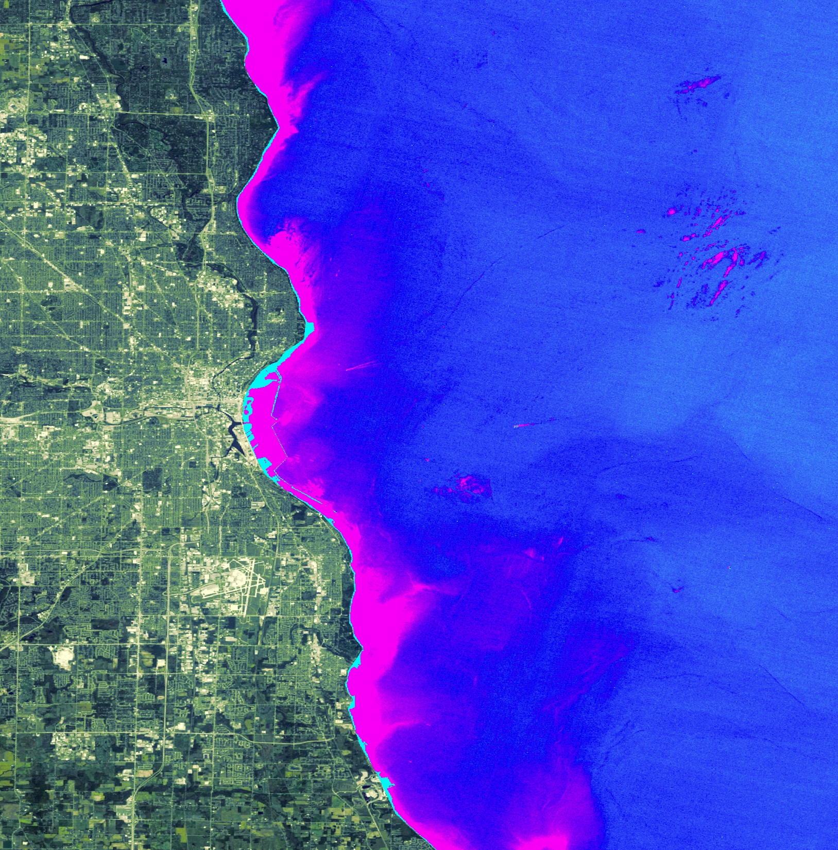
2018 Summer | California - Ames
Lake Michigan Water Resources
Utilizing NASA Earth Observations and Community Science to Detect and Map the Displacement of Cladophora along the Milwaukee County Shoreline
Jerrold Acdan
Steven Chao
Lawrence Fujiwara
Ella Golovey
Notes:
Opening Slide Script
Steven
Hi, my name is Steven Chao.
Lawrence
Hi, my name is Lawrence Fujiwara.
Ella
Hello, my name is Ella Golovey.
Jerrold
Hi everyone! My name is Jerrold Acdan. Together, we are the Lake Michigan Water Resources team here at Ames. Thank you all for joining us this morning.
Our presentation is entitled “Utilizing NASA Earth Observations and Community Science to Detect and Map the Displacement of Cladophora along the Milwaukee County Shoreline.”
Image Source
Lake Michigan Water Resources Team
“Landsat composite image overlaid by a turbidity layer” → created by the team

Slide 2
About Milwaukee County
Located in the state of Wisconsin on the west side of Lake Michigan
Estimated population of more than 950,000 residents
Tourism is an important source of revenue for Milwaukee’s economy
1,400 acres of beaches and parkland adjacent to the water
Keeping the beaches clean is often a priority for the city of Milwaukee
Image Credit: Groundwork Milwaukee
Notes:
About Milwaukee County Script
Jerrold
Before we dive into the technical aspects of our project, let’s give a little bit of background on our project
As you can tell from the title, our study area is focused on Milwaukee County, which is located in the state of Wisconsin on the west side of Lake Michigan
The county has an estimated population of more than 950,000 people
Tourism, especially the type related to the ecosystem services provided by Lake Michigan, is an important source of revenue for the cities along the shoreline.
Therefore, keeping the beaches clean is often a priority for the city of Milwaukee
Image Source
Groundwork Milwaukee
“beach” → received permission to use via email from our project partner, who captured the image.
http://www.groundworkmke.org/

Slide 3
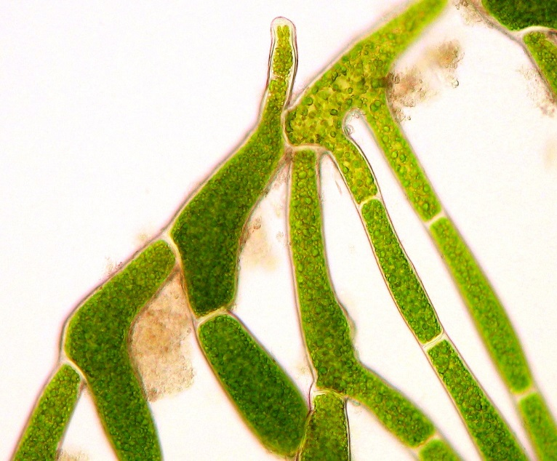
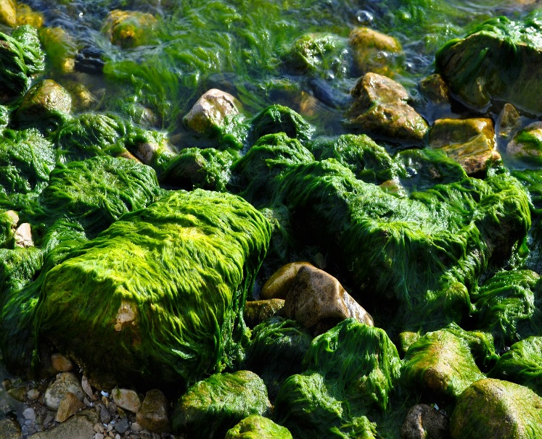
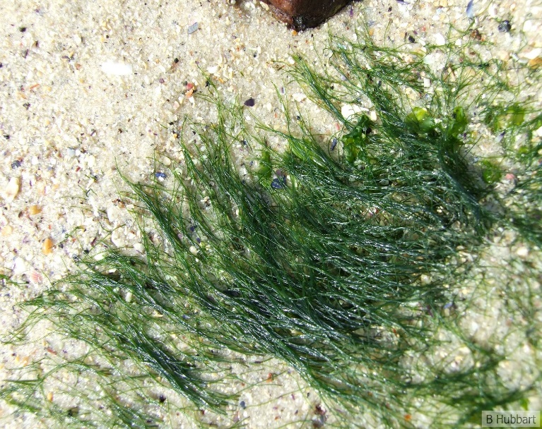
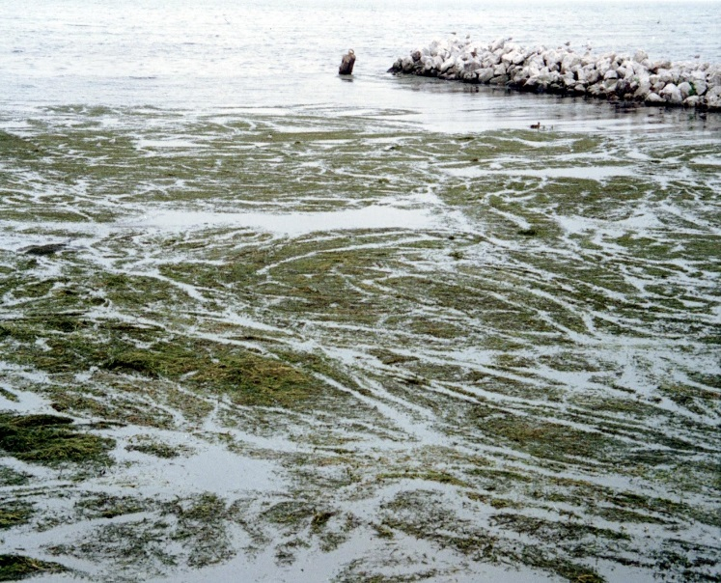
What is Cladophora?
Filamentous green macroalgae
Grows on hard substrates and in clear waters
Peak growing season is between June and September
Image Credits: John, Michael Patterson, Bernadette Hubbart, & NOAA GLERL on Flickr
Notes:
What is Cladophora? Script
Jerrold
Another word you might remember from our project title is “Cladophora”
What is that, exactly? Cladophora is a genus of filamentous green macroalgae that is found naturally in Lake Michigan
It grows attached to hard surfaces, such as rocks and boulders on the lake floor.
It grows that most during the summer, primarily between June and September when the water is warm and there’s plenty of sunlight to provide energy for Cladophora to grow
Image Sources
Flickr
“cladophora2” by John → CC BY-NC 2.0
https://www.flickr.com/photos/johngiez-/4466043958/in/photolist-857SHK-4iP5bB-JyQBs-857PYX-jBraMe-4iTyPG-hFJvm-noYZcH-rc7qQm-7dbEj7-N9hE6o-7NDDgU-xv38gt-wxr2Wd-xs894J-xcWGPn-xcQepJ-7dwncj-aAYuiE-bZuDHG-gp9RmK-gp9wNf-ejtJyq-6co9aH-d6awBQ-85aVGS-24Ros7e-7dbPeb-7wA9rU-FcjLfX-rRJpKE-24MCZrL-wEJWti-wBVWCY-wnD8KE-vHnZg6-rvi7UJ-rHqUJf-qLx8dy-24MCZNC-24MCZSq
“Blanket of Algae” by Michael Patterson → CC BY-ND 2.0
https://www.flickr.com/photos/michaelnpatterson/5043485718/in/photolist-hWJVK-5vBWn-avwoD5-azi1jJ-5Yx5ak-LNZeB-LNZsF-8FFbAj-byifmF-MAd6U-a1hugK-cxDF7C-yMgSKv-MAd8h-9bSyNU-9bSyWL-z3LLPY-yegerD-ye7xQ1-z5Be3B-z8Q6xN-z8Qiaq-z3LREQ-z4MPap-zb97eZ-57Jphs-zbYtu4-zbYTnK-zb9tag-9bPuwH-yegyMx-yMgChT-wSCTPA-z8QzrU-5sLou-yegvAT-za7yzb-K9Wmxr-wWsMLz
“DB_2008_007” by Bernadette Hubbart → CC BY-ND 2.0
https://www.flickr.com/photos/36409587@N07/7214197974/in/photolist-857SHK-4iP5bB-JyQBs-857PYX-jBraMe-4iTyPG-hFJvm-noYZcH-rc7qQm-7dbEj7-N9hE6o-7NDDgU-xv38gt-wxr2Wd-xs894J-xcWGPn-xcQepJ-7dwncj-aAYuiE-bZuDHG-gp9RmK-gp9wNf-ejtJyq-6co9aH-d6awBQ-85aVGS-24Ros7e-7dbPeb-7wA9rU-FcjLfX-rRJpKE-24MCZrL-wEJWti-wBVWCY-wnD8KE-vHnZg6-rvi7UJ-rHqUJf-qLx8dy-24MCZNC-24MCZSq
“Macrophytes (aquatic plants) in Lake St. Clair” by NOAA GLERL → CC BY-SA 2.0
https://www.flickr.com/photos/noaa_glerl/4075280041/in/photolist-7d7SLZ-yMWGGF-ejo1e6-25YeZ6u-okgynK-oywC1N-8KAgML-h45yjZ-fqT7Dt-o87MTi-GLumEV-5ctDE1-Frshdx-nXtLDh-8S8f6j-ejtHty-db7mdC-8KAeD1-GUaKq-4ZbG1T-wybyMd-ejnZU6-pvNeXe-GUaHC-6sjB2J-6Xw3DQ-ejo27K-dtnBQS-4kpitM-4EFAFu-HgaphZ-4ktmdo-7VQvfA-ejtHw3-ejnZ7B-2U6ukS-Hgapst-25YeYds-5tC9NP-8grtnc-JDdUpH-qh9QZr-L8Sw19-5tC9ui-274UGCk-572MYz-24j9E6h-5rnc1a-HVRtvY-HVRrGh

Slide 4
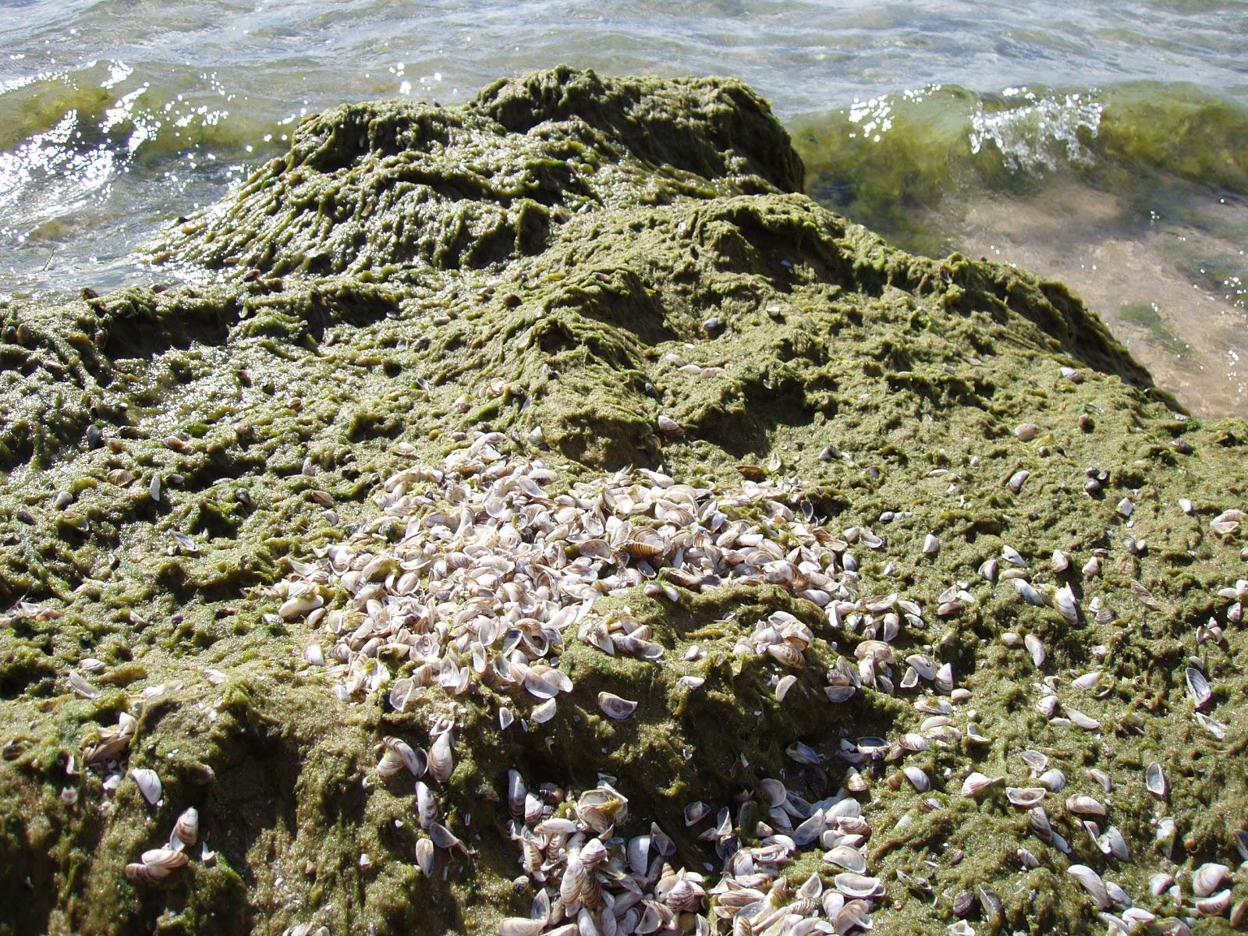
Community Concerns
Detaches from the lake bottom and washes up on beach shores
Decaying Cladophora produces an unpleasant pungent smell
Unaesthetic and deters people from visiting the beach
Image Credit: NOAA GLERL on Flickr
Notes:
Community Concerns (Part 1) Script
Jerrold
While the algae itself is non-toxic, a recent resurgence in the deposition of Cladophora on Milwaukee beaches has caused some concerns among local communities.
During sloughing season, which occurs between August and October, changing environmental conditions and wave action detach patches of Cladophora from the hard substrate they were growing on, essentially killing them.
The patches then float to the surface and are carried by the water currents to the shoreline and deposited on the beach
Deposited dead Cladophora decays, and produces an unpleasant pungent smell
Not only is it smelly, but it is also unaesthetic
The smell and sight of decaying Cladophora deters people from visiting the beach
Image Source
Flickr
“2208” by NOAA GLERL → CC BY-SA 2.0
https://www.flickr.com/photos/noaa_glerl/8741972684/in/photolist-ejuTUY-24Ros7e-7dbPeb-qXz8gN-afLL3R-7dwncj-5VWCew-3etTPK-nAou4e-7VdA3t-7ySW6d-vdGrxC-5dtXEZ-9d947Z-osDQEA-oe1dvq-d74W9Y-zdUaP-cR8zBN-6VARrJ-7yVxVs-JPgwF-ovhJQw-75CxNT-bLAJEk-oviB6w-XbkFcj-hnFtTE-dwpEY-owrg2a-ppsBBF-efwmeW-8jYnTg-7wA9rU-75Vwcw-oeYHYF-4zvxXY-8uRcDD-CzkvN7-76fKzv-ovibqj-3DJUQd-82auDM-NNrmV-rxKks6-78D5M4-oxfLDH-4zrirv-qFSJ8P-oveJDM

Slide 5
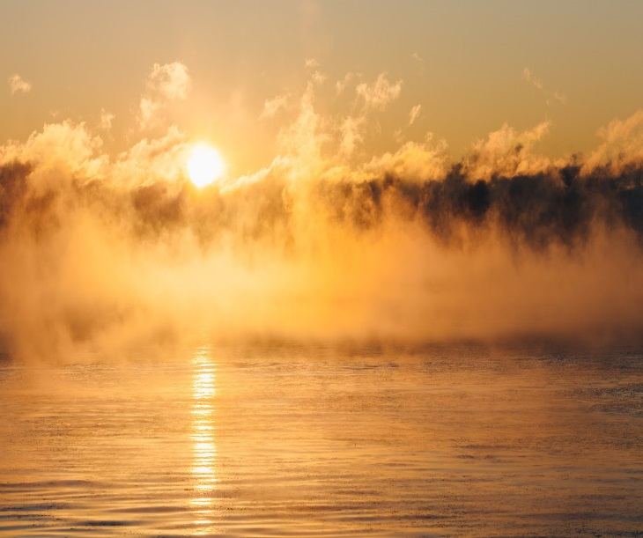
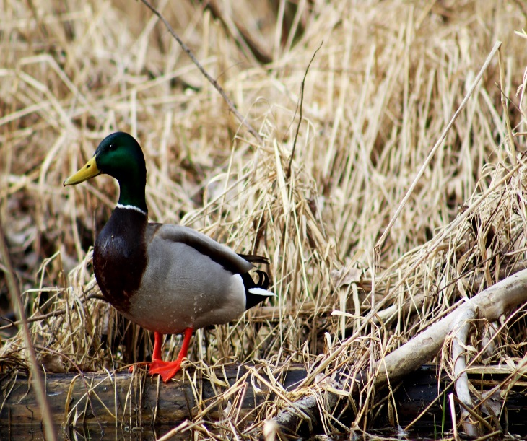
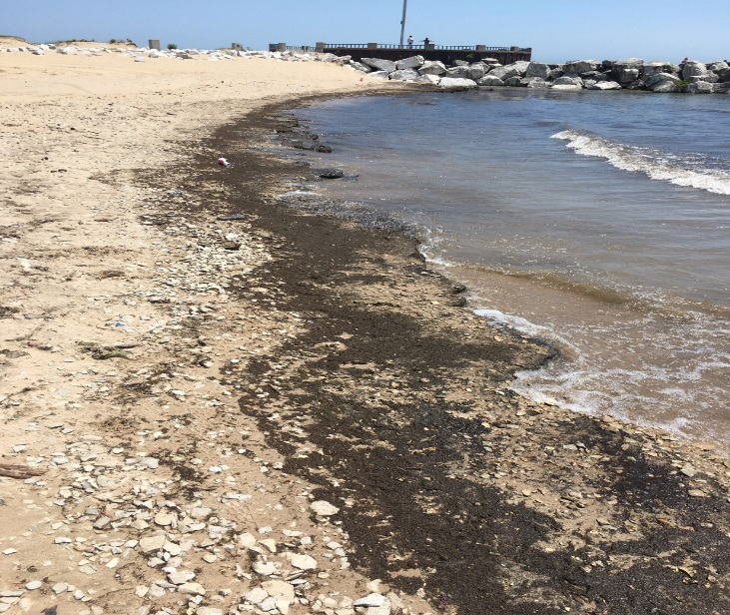
Community Concerns
Breeding ground for bacteria that harm humans and wildlife if ingested
Reduction in local water quality
Closing a beach due to pollution can result in losses of $37,000+ per day
Image Credits: Tyler Butler, John Westrock, & Kimson Doan on Unsplash; Groundwork Milwaukee
Notes:
Community Concerns (Part 2) Script
Jerrold
Furthermore, the decaying Cladophora deposits are breeding grounds for bacteria that can harm humans and wildlife if ingested
This also leads to reductions in local water quality
Finally, closing a beach due to pollution can result in economic losses of more than $37,000 per day for businesses and communities adjacent to the closed off area.
Image Sources
Unsplash
License Information for all images on Unsplash: https://unsplash.com/license
Duck by Tyler Butler: https://unsplash.com/photos/10QTgVg-UoA
People on Beach by Kimson Doan: https://unsplash.com/photos/AZMmUy2qL6A
Milwaukee Sun by John Westrock: https://unsplash.com/photos/Xb76CUAq7yU
Groundwork MIlwaukee
“Cladophora on beach” → received permission via email from our project partner, who captured the image.
http://www.groundworkmke.org/

Slide 6
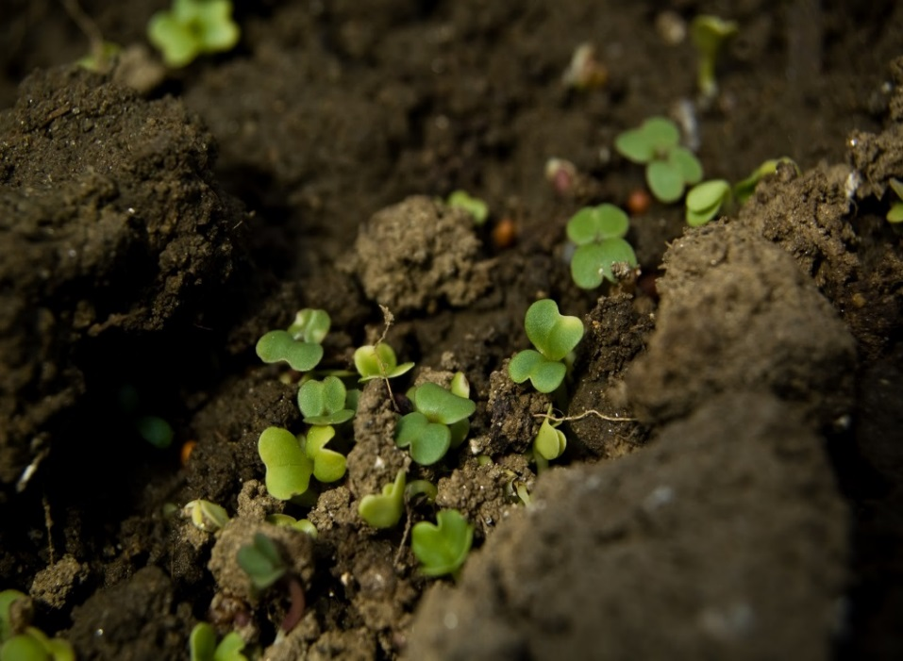
Project Partner
Groundwork Milwaukee (GWMKE)
Non-profit organization dedicated to environmental restoration through community-based campaigns
Seeks to earn Milwaukee County’s yearly contract to clean Cladophora washup
Aims to compost the algae instead of sending it to the landfill
Image Credits: Groundwork Milwaukee; Ryan Dickey & Brian Boucheron on Flickr
Notes:
Project Partner Script
Lawrence
The NASA DEVELOP National Program collaborated with Groundwork Milwaukee for this project.
Groundwork Milwaukee is a local chapter of the larger non-profit organization called Groundwork USA.
Groundwork’s mission is to establish community-based partnership that promote environmental restoration, economic and social well -being.
Groundwork Milwaukee holds many education and career development programs and are hoping to expand their program by earning Milwaukee County’s yearly contract to clean Cladophora wash-up.
Their aim is to compost Cladophora rather than sending it to the landfill as it is normally done.
Image Sources
Flickr
Morning Milwaukee by Ryan Dickey → CC BY 2.0
https://www.flickr.com/photos/meesterdickey/37746832645/in/photolist-Zvyogp-6cBnok-8Ad3gj-VssA8d-8edwkn-fowgNL-ZQasLj-8fJBU6-bMLVki-9bpgXv-87hrr9-2fvSsP-PbB7A-8fJCmc-5dGQ91-8vFFuF-3hC2AE-F1mjz-8KVLbe-8egvos-8vFBHR-posjb-iVzP2j-aNyJ1p-BSQuSj-obQBbP-4e3cj3-5kxQGm-awETSZ-posqi-7tBTXf-Z3WTZ5-8ecGtP-6zAbBh-av2KTu-obRwnD-ZbnmTS-nD6euu-5Yason-ZfEsiM-3yNphU-5kxPWL-oJE5AV-7o77i3-DLrqcf-ori8iy-e35PhW-ot56HZ-9ZbJhe-cq7bsU
“Fairyland Mesclun Mix” by Brian Boucheron→ CC BY 2.0
https://www.flickr.com/photos/bert_m_b/2399010625/in/photolist-4DZyha-Lmsi3w-rSwyrb-qomsAB-27twipE-GMV7eB-Lo7aXC-Z9AqF1-26Ztnav-22dgGze-25g6eUC-27eyoe6-281y1cb-25ooQJX-27E4cxp-212UaDS-27CK6zK-28jjgPU-21nbKsU-H3YdYx-26xCv94-gge2Nu-Kps95b-ZmU6HQ-HspKx8-27hyzLu-24m4EWU-25Mq3Ut-25JqjRw-D59L8m-Z52bxb-Lmw1k5-28q14TE-27zPie6-24m4DKf-CiRpJ3-25utSBh-afi2LK-28kA9RM-26AKzpq-Leaypj-HTwBN6-p2Aafo-JPBLQF-YbWRy8-25EMnUY-HbxfqR-25ZjEob-28bNbUp-HgYu9V
Groundwork Milwaukee
Volunteers by Groundwork Milwaukee → received permission via email from our project partner, who captured the image.
http://www.groundworkmke.org/

Slide 7
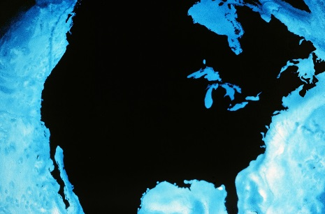
Project Objectives
Create a Cladophora Habitat Suitability Map and a Cladophora Wash-Up Predictive Map to identify factors influencing growth, displacement, and deposition
Utilize the ArcGIS Collector tool to gather in situ data of Cladophora washup locations using a mobile phone application
Produce a project story map and launch a social media campaign to raise awareness of issues related to Cladophora
Image Credits: vgrigas, Jason Howie, & NOAA GLERL on Flickr
Notes:
Project Objective Script
Lawrence
Development of this project was based on the question, “How can we utilize NASA Earth Observations to help Groundwork?”
Keeping this question in mind, the team established these three objectives:
**Click**
Our first objective was to create a Suitability Map and a Predictive Map. The Habitat Suitability Map was made to identify areas where Cladophora mostly likely grows based on factors listed in literature reviews. The Predictive Map indicates where Cladophora will most likely wash up based on shoreline curvature and bathymetry.
**Click**
Our second objective was to create a ArcGIS Collector Mobile App for Groundwork to use to gather robust in-situ data. Using ArcGIS Collector, student interns at Groundwork Milwaukee were able to collect locations of Cladophora wash up as well as inputting valuable information such as date and time they collected the point data, the amount of wash up, freshness of the algae wash up etc.
**Click**
Our third and last objective was to launch a social media campaign and create a story map to have a variety of media platform to help inform the public of the issues around Cladophora, highlight the benefits of utilizing NASA Earth Observations to serve local communities, and educate the general public by sharing our project’s methodology and results.
Image Sources
Flickr
“North America” by NOAA GLERL → CC BY-SA 2.0
https://www.flickr.com/photos/noaa_glerl/8740580363/in/photolist-ejnL2r-dSLd4U-dzERHs-kGR1it-kGSzW9-kGSDfo-kGSBLG-6HCtu7-qDuycf-8a5Htv-ejttaf-dUMKqU-ejtuxG-qwNJz8-dkCMHT-hrsUW7-ejtt8A-6HuCqg-8kmAh6-UgZnXj-UgZi7s-4jvBrZ-TeFAWU-UjAMwF-af8Jpw-dxKFiX-d53B7u-kGQvz8-kGQwF6-eR8RHM-kGQyxn-79MENW-kGQwQe-kGQyvt-2S6be3-eZmBi3-8t7Q5d-6swEB6-eR8T22-ejtHrw-8t7QdS-ddYze8-kGQthn-kGSCyd-kGR51i-kGSyXq-kGQteX-kGSDjb-kGQxHM-ejwAeG
“BangaloreIndiaCellphoneShots2011-30” by vgrigas → CC BY-SA 2.0
https://www.flickr.com/photos/64235983@N08/6352520326/in/photolist-aFmjYw-5Udarx-4hr8L5-6RU1a5-aFhTGt-3CG3io-5nv9Y8-9jkpUP-2tn5U5-9QLJCb-74iZ34-8ugNPu-HKsHEG-6EeTfA-cE7R6C-CLK28-6aMHyY-6B8hiJ-fPqkLr-6ojoYt-4txCPk-36Z42K-aFidua-8XCWDK-5EVFaZ-6Dmduj-67sZoJ-6VzTxv-5NE3CP-7ixnZL-9w2HdE-7Qv819-4HDJfu-6w4WJ8-2fMZft-nsZZfj-8fPksV-f5HHQ-5FC3zo-bceSPg-4tDFSu-6rgwu5-6dvm5R-aFhpJr-pZzmd-2oTJX-4sHsnY-2CETo-5Udc2p-9GuZe3
“Instagram and other Social Media Apps” by Jason Howie → CC BY 2.0
https://www.flickr.com/photos/jasonahowie/7910370882/in/photolist-d41HES-8yo7ut-pYWo6m-e3tpK2-e1yRKg-7bd3g8-nHMPq4-dUmKE4-sb3ug6-e1GtBw-7FZa71-JFS53E-e1EPSV-7TujKv-e1FY7m-e1QGUD-qK2hu2-8VH9YR-qK7x1s-dV5Q7M-9kaLeU-9k7Hva-gSX6xi-8AEGzs-e3Hopo-nR5QKx-7i3mTV-qK7wWQ-JbfyDr-JYFT48-pNbKcq-9RHj3y-7mgAv9-e5CAgW-qGU5Hs-boUfVP-qsLgce-a4Ps6h-qi7hrH-e3tjUp-5Q6W9t-7bhSPn-VC86u7-c3jJAY-pKnp3K-a4Lz2F-8MbLYp-9JAu9u-avCZ1n-G1dDuf

Slide 8
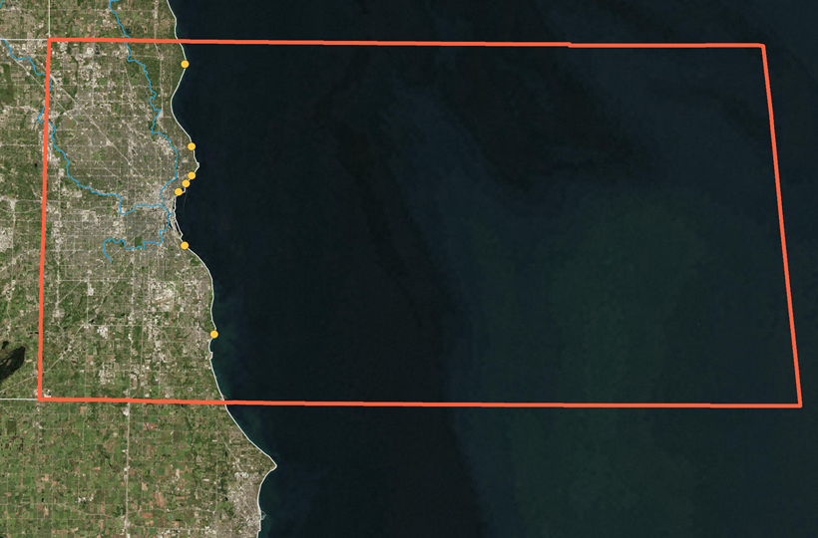
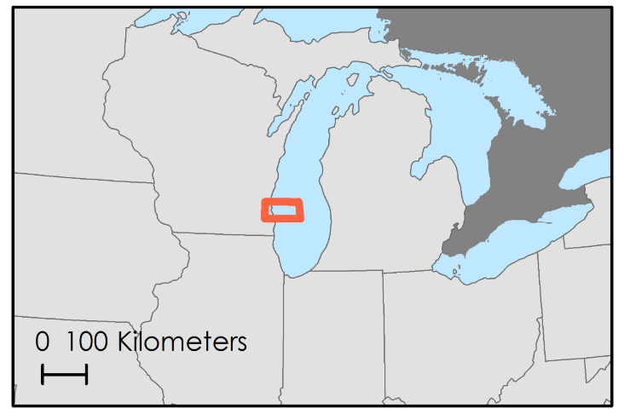
Study Area & Period
Milwaukee County, Wisconsin
West shoreline of Lake Michigan
Summer months of 2016 & 2017
Seven beaches
Doctors Park
Milwaukee
Atwater Beach
McKinley Beach
Lake Michigan
Bradford Beach
Veterans Lagoon Beach
South
Milwaukee
South Shore Park
Grant Park Beach
Beach
0
10
km
River
Milwaukee County
County Boundary
Notes:
Study Area & Period Script
Lawrence
The project study area is the Milwaukee County boundary. We chose this study area boundary because it encompasses all 7 beaches, that Groundwork will be responsible for clean up if they win the contract.
The study period was chosen to be the summer months of 2016 & 2017 because the peak growing season of Cladophora is between June and September and it is during these times that the Cladophora wash up is most seen on the beaches.
Map Source
Lake Michigan Water Resources Team
“study area map” → created by the team

Slide 9
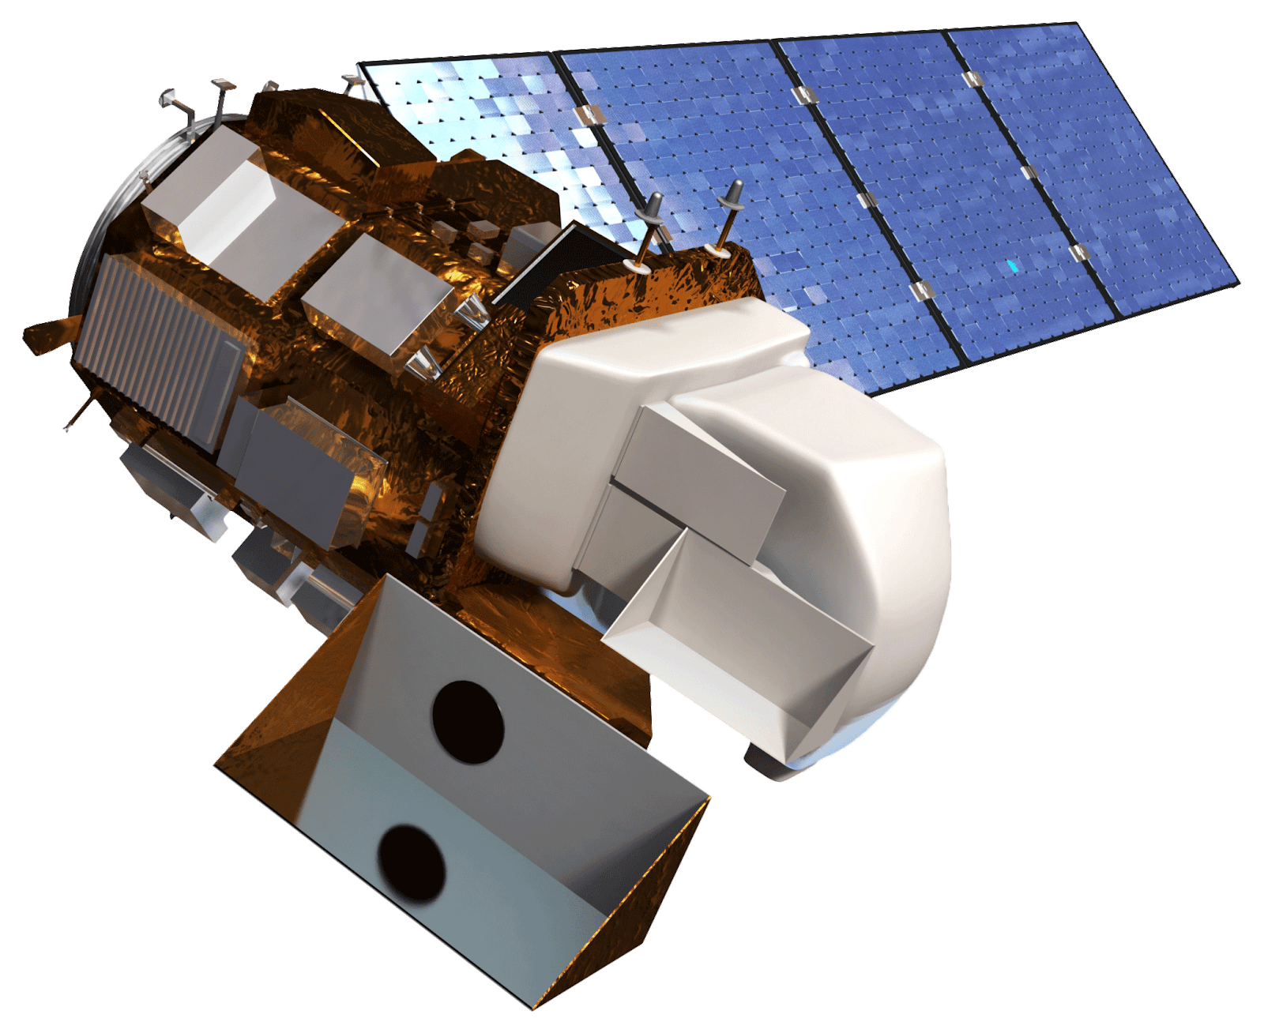
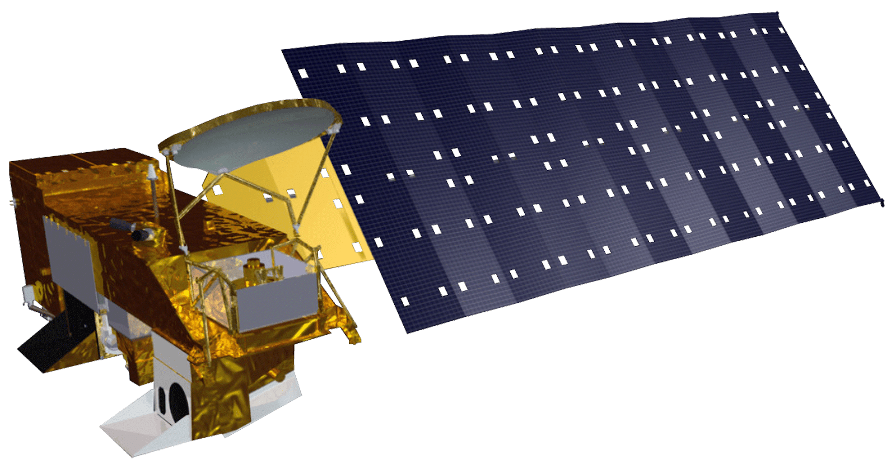
NASA Earth Observations
Image Credits: NASA; Wikimedia
Landsat 8 OLI
Aqua MODIS
Water Temperature
FAI, SAV, Turbidity
Notes:
NASA Earth Observations Script
Lawrence
For our project imagery from 2 different satellite platforms were used.
**click**
We utilized Landsat 8 Operational Land Imager to derive turbidity, floating algae index and submerged aquatic vegetation maps.
We used Landsat imagery that had no cloud coverage or very small amount of cloud coverage that fit in our study period to get the best results.
**click**
To obtain Lake Michigan’s surface water temperature, we also utilized the Aqua MODIS.
Image Sources
DEVELOPedia
“Landsat 8” → Public Domain (NASA)
http://www.devpedia.developexchange.com/dp/index.php?title=List_of_Satellite_Pictures
“Aqua MODIS” → Public Domain (NASA)
http://www.devpedia.developexchange.com/dp/index.php?title=List_of_Satellite_Pictures
Wikimedia Commons
“Earth Western Hemisphere transparent background” → Public Domain
https://commons.wikimedia.org/wiki/File:Earth_Western_Hemisphere_transparent_background.png

Slide 10
Methodology Overview
SUITABILITY FACTORS
Bathymetry
Mussel Distribution
Substrate
Turbidity
Water Temperature
END PRODUCT
Cladophora Habitat Suitability Map
METHOD: Multi-Criteria Evaluation
Compare
METHOD: Submerged Aquatic Vegetation Mapping Algorithm
Submerged Aquatic Vegetation Map
EARTH OBSERVATIONS
Aqua MODIS
Landsat 8 OLI
METHOD: Floating Algae Index
Floating Algae Map
END PRODUCTS
ArcGIS Collector & Social Media Campaign (in situ data)
PREDICTIVE FACTORS
Bathymetry
Nearshore Structures
Population Density
Shoreline Curvature
Compare
END PRODUCT
Cladophora Washup Predictive Map
METHOD: Multi-Criteria Evaluation
Ground Truth
Notes:
Methodology Overview Script
Ella
In order to achieve the project objectives, we developed a habitat suitability map, a washup predictive map, and a series of tools to gather in situ data to ground truth these maps and collect data for future analysis.
First we considered factors influencing Cladophora growth and used multi-criteria evaluation to determine the most likely areas that Claodphora is growing. We compared this to known submerged aquatic vegetation by using a mapping algorithm.
Second, we considered factors known to influence algal washup and used multi-criteria evaluation to identify beaches that are susceptible to high rates of algal washup. We compared this to satellite imagery that indicates floating algae by using a floating algae index calculation.
Finally, we developed a series of tools to collect in situ data that will be used next term to groundtruth these maps and refine the factors used in our analysis.

Slide 11
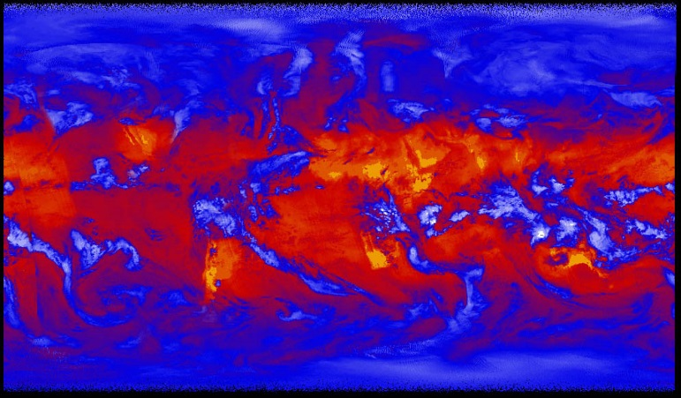
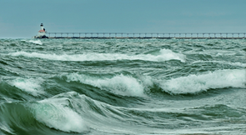
Factors Influencing Cladophora Growth
Bathymetry: Water depth
Substrate: Only grows on hard surfaces
Water Temperature: Thrives in warmer temperatures
Mussel Distribution: Proxy for phosphorus levels
Turbidity: Influences light penetration
Image Credits: NOAA GLERL, NASA GSFC, & Tom Gill on Flickr
Notes:
Factors Influencing Cladophora Growth Script
Ella
According to our literature review, the factors influencing Cladophora growth include:
**click**
Bathymetry, which indicates water depth. Cladophora is known to grow in shallow areas and is not known to grow any deeper than 20 meters in Lake Michigan.
**click**
The next factor is substrate, which is the surface type that the algae can grow on. Cladophora only grows on hard surfaces so areas that are sandy or muddy cannot provide suitable habitat.
**click**
Third is water temperature. Warmer temperatures enhance algal growth and cladophora thrives in water temperatures between 50-70 degrees Fahrenheit. This also means that there are higher levels of growth in the summer months.
**click**
The fourth factor influencing growth is higher levels of phosphorus which is represented by the distribution of mussels since there was no available data for phosphorus levels. Mussels cycle phosphorus and provide nutrients that increases algal growth so their distribution is a good indicator for higher nutrient levels.
**click**
The final factor influencing algal growth is turbidity. Turbidity influences the amount of light that penetrates through the water, so areas that are less turbid have deeper light penetration that increases the growth of Cladophora.
Image Sources
Flickr
“Lake Michigan” by NOAA GLERL → CC BY-SA 2.0
https://www.flickr.com/photos/noaa_glerl/8740583225/in/photolist-ejnLSM
“’First Light’ Taken by NASA’s Newest CERES Instrument on Suomi NPP” by NASA GSFC → CC BY 2.0
https://www.flickr.com/photos/gsfc/6807081341/in/photolist-bnw58p-ocPTfq-i2cFkA-6N6fsn-rgLEXj-acRuf6-cJYzqJ-HSbj7u-bk4ZES-XDNagB-d2ohkW-jNNcSk-25LghmN-qAWEhn-PmDER-7sxFVQ-ckE7N1-ohMF8y-o2Uhi-jQCv3a-2592aCd-26X4wEn-26NNqFG-dQs2rB-24Hpy7q-5t5L5w-9LPBnH-dxkgAE-oEUXUd-HqcQRc-8h2kgS-pPNjM1-dTyiZx-H561j3-iUDzyA-jQCwEt-dN4vr7-anteXk-d1bdo5-VWBRq9-9BFAzY-96uVcj-geVrzM-hoYWJ3-i5druB-qkgwR3-jQEM3G-Fvs4dP-dwEsZC-6iKD1r
“Celedon Waves” by Tom Gill → CC BY-NC-ND 2.0
https://www.flickr.com/photos/lapstrake/9452050060/in/photolist-fpfebm-26J3AKA-Fm3yjb-23uw2QC-qP5c4Y-eNKzXm-9A4hVD-pufxNu-9qbMPH-bAeZEa-5BadTf-9e7Bno-5jrnWa-7GSrAT-6wJGKQ-6wEwKz-c5Z9VL-35KMHK-cLA8TY-ziMQnY-bmZBV1-e5QyZH-eh3M63-nrsVya-jx6CSc-jx9JLG-EGCjaZ-akhNhL-p9Mr9-fiB7V9-98b9YS-d92AvG-anay8R-5cPK4-j6aZnE-6MFwj2-nLyzX4-5SDk5V-7iEyah-8GF7MM-38FHhH-pZxYMs-9882bT-GbWNBP-dbiZ5x-iJKF5L-4ypLT5-afqXyF-6tgeUo-dQaKdV

Slide 12
Methodology: Habitat Suitability Maps
Bathymetry
Substrate
Water Temperature
Mussel Distribution
Turbidity
Cladophora Habitat Suitability
Notes:
Methodology Habitat Suitability Maps Script
Ella
In order to produce a habitat suitability map we added all of these factors and considered the most suitable parameters for algal growth.
**click**
For bathymetry we clipped the map to areas no deeper than 20 meters.
**click**
Then we included substrate data that indicated where hard surfaces where located,
**click**
then water temperature that shows areas with higher temperatures,
**click**
and then we added a mussel distribution map that shows where there are higher amounts of mussels,
**click**
finally we added turbidity data where the most turbid areas are in red and least turbid are in blue.
**click**
After adding all of these factors together we developed a habitat suitability map that indicates areas that are most susceptible and least susceptible for Cladophora growth.
Image Sources
Lake Michigan Water Resources Team
Layers created by the team

Slide 13
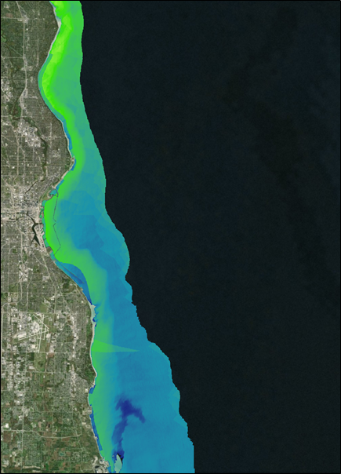
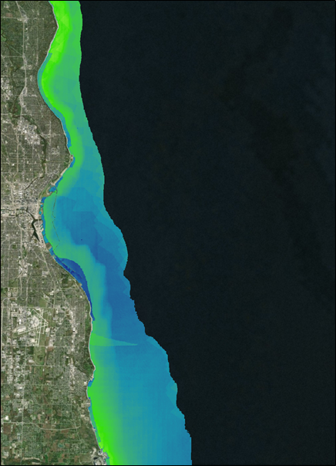
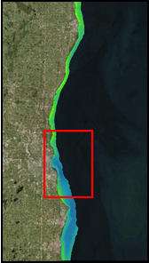
Results: Habitat Suitability Maps
September 2016
September 2017
Milwaukee
Milwaukee
Habitat Suitability
High
Low
0
10 km
Notes:
Results: Habitat Suitability Maps Script (Part 1)
Ella
We compared the habitat suitability maps for September of 2016 and 2017 and our results were very similar.
We noticed that most of the suitable habitat is located in the northern shores of Lake Michigan and becomes less suitable in the southern portion of our study area.
**click**
One interesting element we noticed was this blue area on the map that indicates a low probability of algal growth in 2016 but not in 2017.
Map Sources
Lake Michigan Water Resources Team
Layers derived by the team

Slide 14
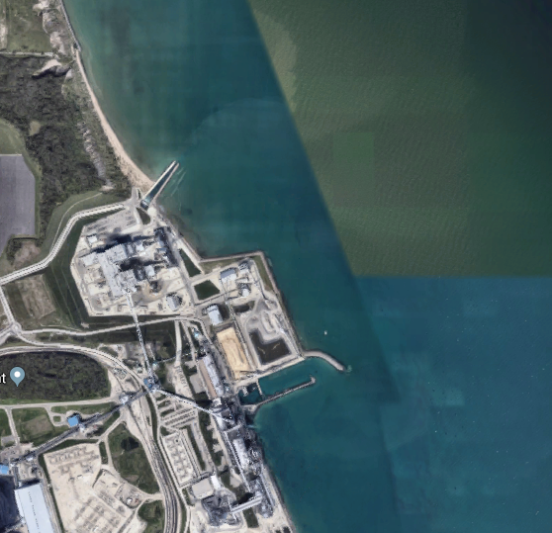
Results: Habitat Suitability Maps
September 2016
Habitat Suitability
Milwaukee
High
Low
0
10 km
Inset Image Credit: Imagery ©2018 Google, TerraMetrics
Notes:
Results: Habitat Suitability Maps Script (Part 2)
Ella
We found out that there is a power plant located in this area and it uses water from Lake Michigan in their cooling system, and then returns the water back into the lake.
This creates a lot of turbidity in the area and makes sense that there would be low suitable habitat.
The satellite image taken in 2017 shows that the power plant was not releasing water back into Lake Michigan and consequently has more suitable habitat due to low turbidity levels.
Map & Image Sources
Lake Michigan Water Resources Team
“Habitat Suitability Map” → created by the team
Google Maps
“Oak Creek Power Plant” on Google Maps → Imagery ©2018 Google, TerraMetrics
https://www.google.com/maps/place/Oak+Creek+Power+Plant/@42.8506205,-87.8334087,2382m/data=!3m1!1e3!4m8!1m2!2m1!1soak+creek+power+plant!3m4!1s0x880540006f04abf3:0xdeb28de414bf68ac!8m2!3d42.8429325!4d-87.8532671

Slide 15
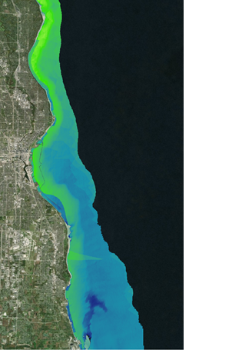
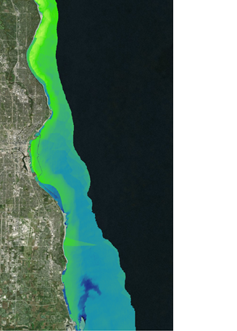
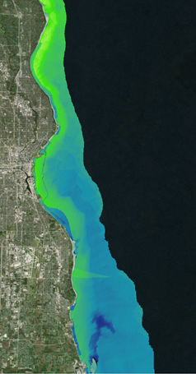
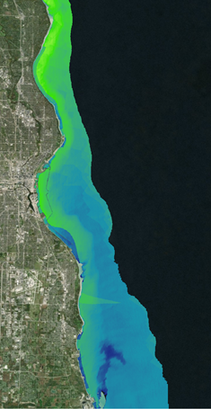
Results: Habitat Suitability Maps
Habitat Suitability
High
Low
0
10 km
Factors
Weighted
Equally
Bathymetry
Weighted
Less
Water
Temperature
Weighted
More
Bathymetry
Weighted Less
&
Water Temperature
Weighted More
Notes:
Results: Habitat Suitability Maps Script (Part 3)
Ella
In the original habitat suitability map we weighed all of the factors equally and assumed that each parameter will have equal impacts on Cladophora growth, but in reality, different parameters have varying levels of impact on Cladophora growth.
**click**
Here is an image of the current habitat suitability for September 2016,
**click**
Here is the image if bathymetry was weighted less than the other factors.
We ran this calculation because bathymetry was already considered when we clipped the study to only include areas less than 20 meters, so we wanted to see how this would alter the results if it was weighted less.
**click**
The next calculation we tried was weighing water temperature more than the other factors.
Water temperature has a large influence on suitable habitat so we ran a calculation to reflect that in our map.
**click**
And finally, we ran a calculation to see what the map would look like after considering both factors: weighing bathymetry less and weighing water temperature more.
As you can see, these maps are almost exactly the same and altering our factors didn’t make much of a difference.
This may be due to uncertainty in the values we should use when weighing factors.
After developing these habitat suitability map, we used a submerged aquatic vegetation mapping algorithm to compare our results.
Map Source
Lake Michigan Water Resources Team
“Habitat Suitability Maps” → created by the team

Slide 16
Methodology: Submerged Aquatic Vegetation (SAV) Maps
green
blue
coastal
blue
radiance for band i
average deep water radiance for band i
Notes:
Methodology: Submerged Aquatic Vegetation Maps Script
Steven
As we quickly realized in the beginning of this project, you can’t detect Cladophora from satellite imagery.
In other words, you can’t just look at a satellite image and say, “Hey there’s Cladophora in this image pixel.”
So, in order determine which parts of our study area had Cladophora, we relied on a method called the Submerged Aquatic Vegetation Mapping Algorithm, or SAVMA.
SAVMA was developed by Shuchman and others at Michigan Tech Research Institute.
We chose the green, blue, and coastal blue bands from our satellite images, calculated the at-sensor radiance values, and ran each pair of bands (green and coastal blue, blue and coastal blue, and green and blue) through SAVMA, which is the depth invariant index shown here.
The equation is a bit complex but here is a condensed rundown:
There are two main variables in the equation: X and K.
X takes the band and changes the pixel values so that it corrects for water depth and removes deep water pixels.
It uses each pixel’s radiance value and the average deep water radiance value. K takes in the variance of each band and the covariance of each band pair.
As I mentioned previously, we apply this equation for three band pairs, so we end up with three new images (green-blue, green-coastal blue, and blue-coastal blue).
We then processed those images to separate sand from SAV.

Slide 17
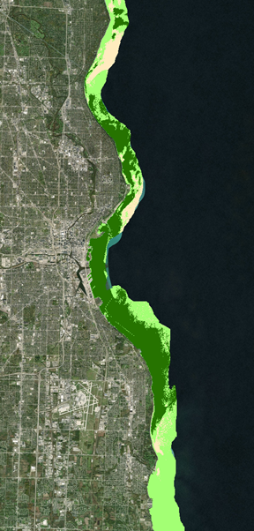
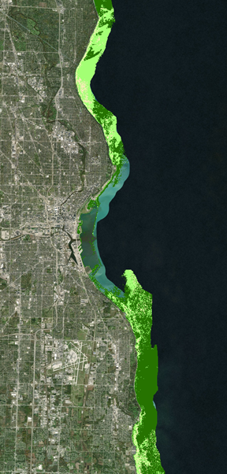
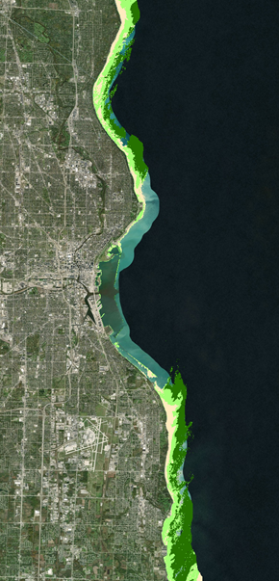
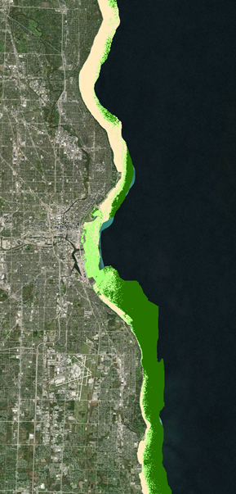
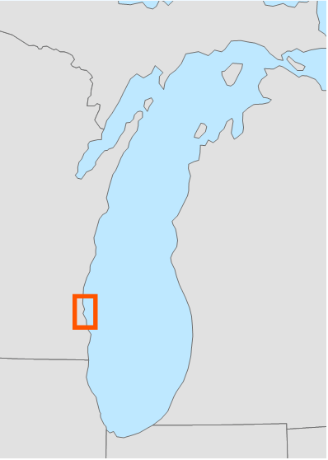
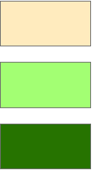
Results: SAV Maps
Sand
Less Dense SAV
Dense SAV
0
10 km
June 2016
July 2016
September 2016
September 2017
Notes:
Results: Submerged Aquatic Vegetation Maps Script
Steven
Here are the maps the equation produced for our specified months in our study area.
We clipped our results to the 10-meter bathymetry contour line since Cladophora doesn’t really grow at depths below 10 meters.
All maps show a substantial amount of Cladophora growth along the shorelines.
Map Sources
Lake Michigan Water Resources Team
Layers derived by the team

Slide 18
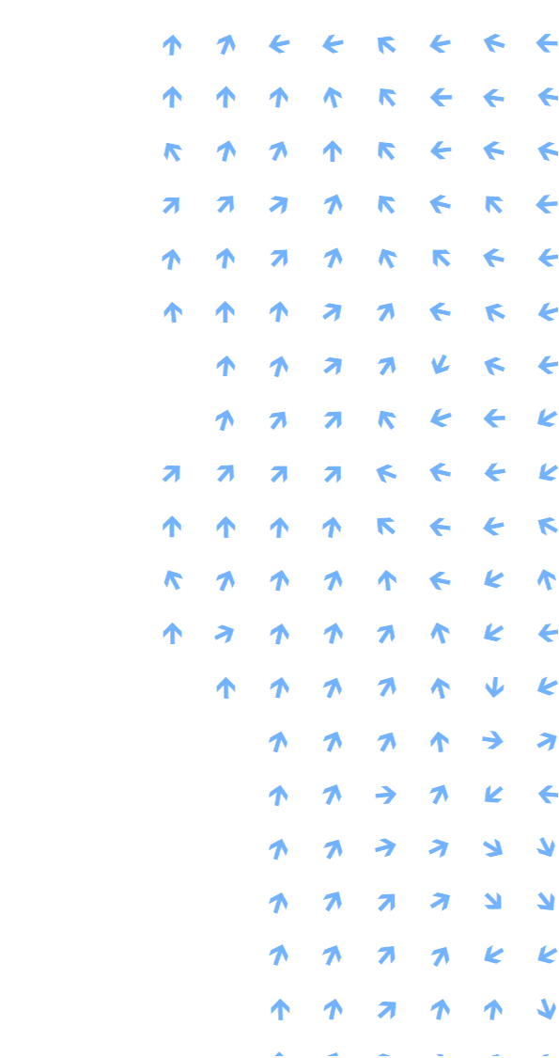
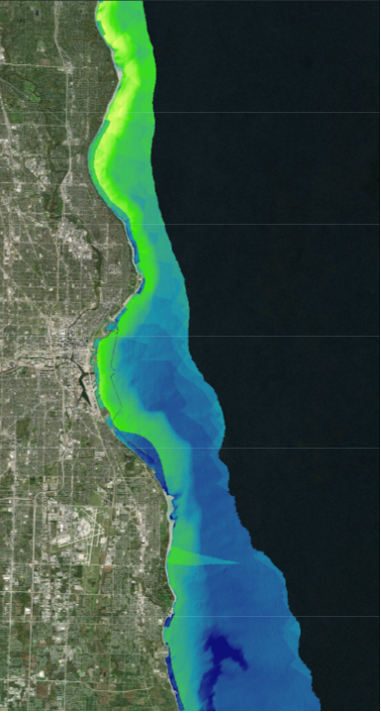
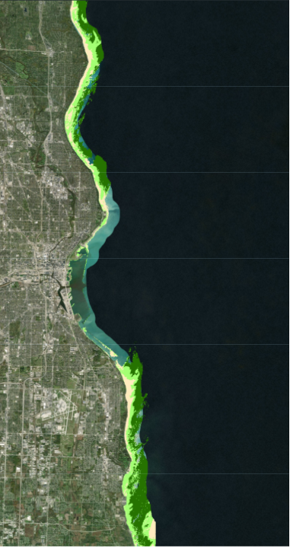
Analysis: Habitat Suitability Map & SAV Comparison
September 2016
Habitat Suitability
SAVMA Classification
High
Low
Sand
Less Dense SAV
Dense SAV
0
10 km
0
10 km
Notes:
Analysis: Habitat Suitability Maps & SAV Comparison
Steven
Looking at the Habitat Suitability Map, there seems to be a general north to south gradient, where the northern part of the image has a higher suitability for Cladophora growth.
Looking at the SAVMA imagery, one thing that is different from our Habitat Suitability Map is that as you go from the the shoreline to the 10 meter bathymetry contour, the vegetation turns from no vegetation (or sand) to dense SAV.
This goes against the literature review (and our suitability map), which states that the deeper you go, the less Cladophora you will have.
One likely explanation for this is that this trend is more on the large scale, and that on the small scale such as this, there are variations in the trend.
It could be that the shallowest parts of the Lake are simply too shallow to allow Cladophora to grow.
You may notice that the entire center portion of the image has no data.
This is because the SAVMA equation, as I mentioned before, removes all deep water pixels.
However, this part is clearly shallower than 10 meters.
We believe these pixels are appearing as deep water pixels for two possible reasons:
1) As found in the literature, really, really dense SAV causes water to have a very low reflectance. This could make the shallow water appear as deep water.
2) That portion of the lake is where the Milwaukee River empties into Lake Michigan. Milwaukee River is where a lot of sewage is dumped into, so it could be that area is very rich in nutrients, making those pixels, once again, appear as deep water. Comparing it to the Habitat Suitability Map, which suggests that the location is conducive to Cladophora growth, the area may very well have high SAV growth because of the rich nutrients. The only way to figure this out is to fly there, dive underwater, and take a picture of what’s there, and we’ll discuss more about this later.
Map Sources
Lake Michigan Water Resources Team
Layers derived by the team

Slide 19
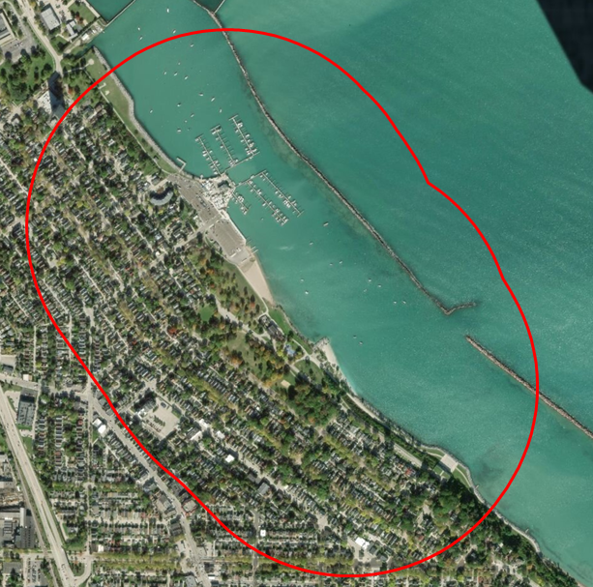
Methodology: Washup Predictive Map
Predictive Factors
Nearshore Structures
Shoreline Curvature
Population Density
Bathymetry
South Shore Park
Notes:
Methodology: Predictive Map Script
Lawrence
Our Predictive Map, was created based off a literature review written by Riely et al. which they found that the deposition of Cladophora was influenced by nearshore structures, shoreline curvature, local population density and nearshore bathymetry
We obtained the population density from U.S Census Bureau and used the same bathymetry data shown in previous slides
We also used ESRI’s Spatial Analyst to calculate curvature and decided to count the number of near shore structures at fell within 500m of each 5 beaches.
**click**
Here we are looking at an example with just one of the 5 beaches, the South Shore Park.
As you can see there are many nearshore structures within 500m buffer of the beach.
We have counted each and every nearshore structure that fell within our buffer zone and used those values to weight them in our map.
Maps Source
Lake Michigan Water Resources Team
created by the team

Slide 20
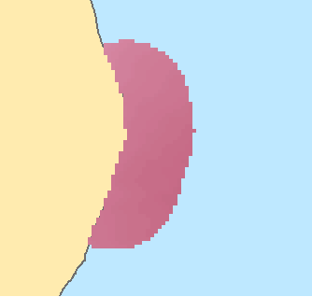
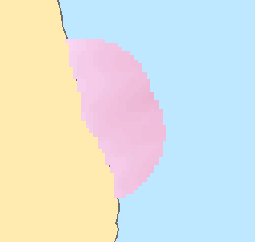
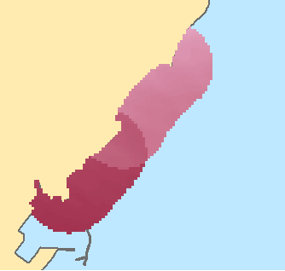
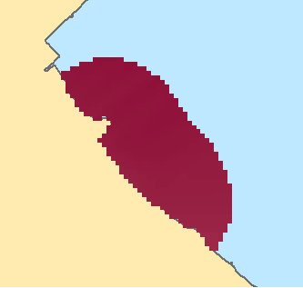
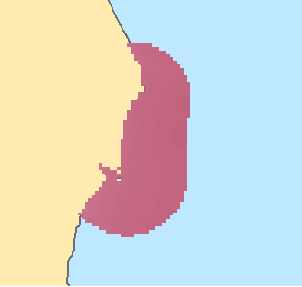
Results & Analysis: Washup Predictive Map
A
A
B
Doctors Park
Atwater Beach
B
Milwaukee
C
C
D
0
0.35
km
E
Lake Michigan
South Shore Park
Grant Park Beach
0.4
km
McKinley
Beach
D
Bradford
Beach
0
0.35
km
South
Milwaukee
Surface Water Current Direction
(June)
Population Density
Predictive Value
E
Beach
↙
0
10
km
Low
High
Low
High
Notes:
Results & Analysis: Washup Predictive Map
Lawrence
This here is the final product of our Predictive Map where you can see the 6 beaches with their predictive value based from all the factors from the previous slides
We did not include one beach, the Veterans Beach because it was in a freshwater lagoon, with no near shore structures
Our results show that South Shore Park had the highest predictive value
Deneine Powell, the executive director of Groundwork Milwaukee, confirmed with us that the South Shore Park does indeed a lot of Cladophora wash up
Map Source
Lake Michigan Water Resources Team
Layers derived by the team

Slide 21
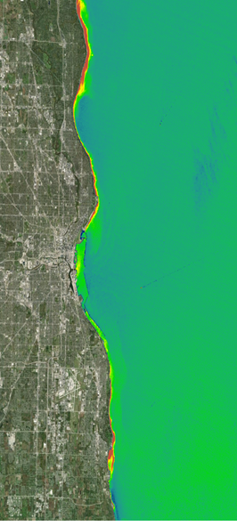
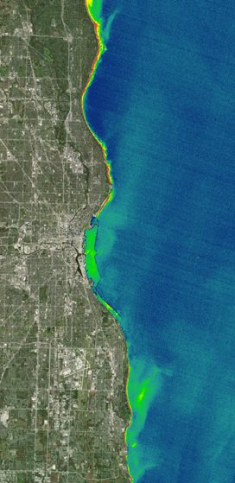
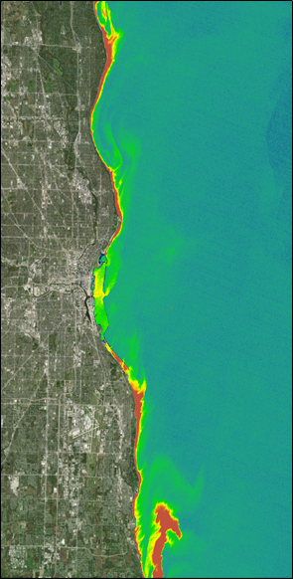
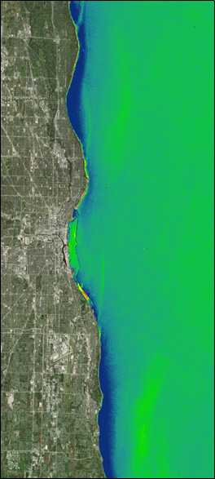
Results: Floating Algae Index Maps (FAI)
Floating Algae Index
High
Low
0
10 km
June 2016
July 2016
September 2016
September 2017
Notes:
Results: Floating Algae Index (FAI) Script
Lawrence
Without in situ data to validate washup predictive maps, we decided to compare them to floating algae index maps
FAI was produced by processing Landsat Imagery using the water quality index software ACOLITE.
We were hoping to consistently see patches of (blue) high FAI indexes along the shoreline throughout all our images, like in September 2017 .
However, as you can see, it varies with each image.
One explanation for this is that Cladophora may have already washed up onto the beaches, for example in September 2016, or the currents have taken the floating Cladophora elsewhere outside of our study area.
To see if this might be true, we overlaid water current direction data over our FAI maps..
Maps Source
Lake Michigan Water Resources Team
created by the team

Slide 22
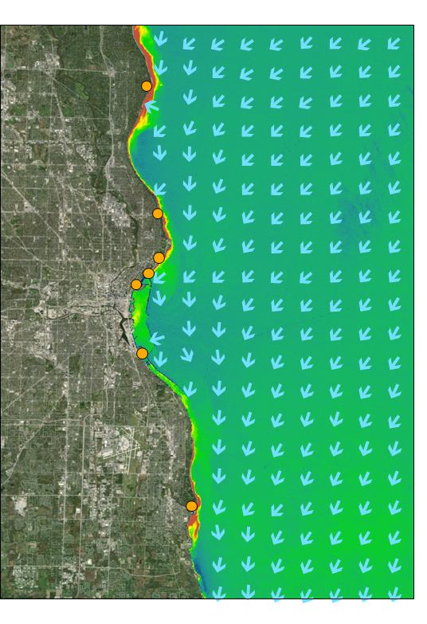
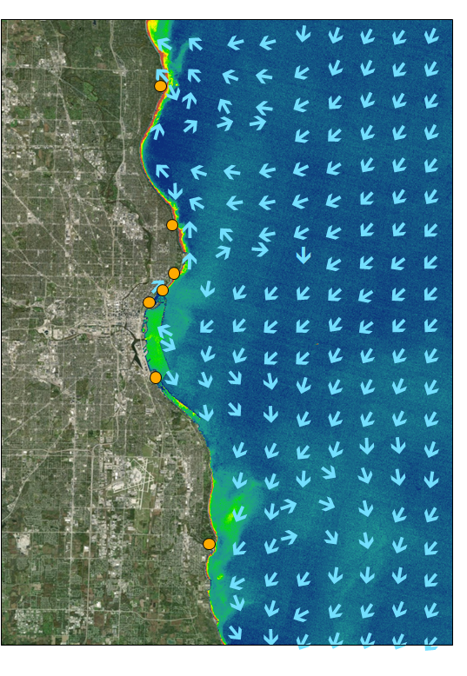
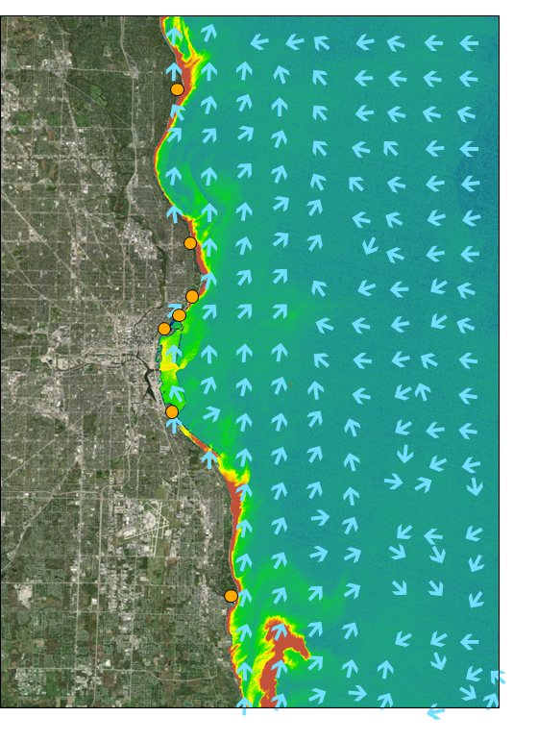
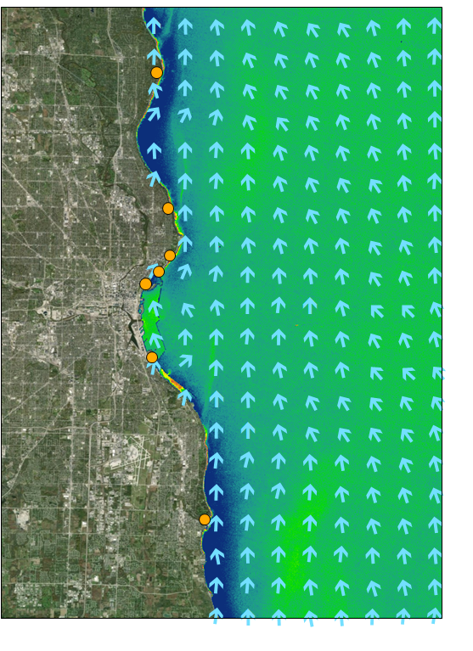
Results: FAI & Lake Currents
Floating Algae Index
High
Low
Currents
Beach
0
10 km
June 2016
July 2016
September 2016
September 2017
Notes:
Results: FAI & Lake Currents Script
Lawrence
Here we have overlaid the FAI to lake current data.
As you can see lake current drastically changes from month to month.
Looking at these 4 images, it is hard to say that any one of the 6 beaches gets the most Cladophora wash up.
There are no apparent patterns or correlations between these 4 images.
Maps Source
Lake Michigan Water Resources Team
created by the team

Slide 23
Errors and Uncertainties
Habitat Suitability = (? x Bathymetry) + (? x Water Temperature) + (? x Substrate) + (? x Phosphorus Levels) + (? x Turbidity)
Lack of in situ data for validation purposes
Needed for coefficient calibration in habitat suitability and washup predictive models
Lack of high spatial resolution data
Pixel size is too large to directly detect algae on beaches
Some datasets not span entire study area
Lack of data in general
e.g. Lake Michigan phosphorus levels not found
Notes:
Errors and Uncertainties Script
Steven
The errors and uncertainties in our project can be boiled down to a few factors:
First, there is a lack of field data collected needed for validation purposes in our study area
Being able to have some ground data from our study area and study period of what is sand and what is SAV would help us calibrate and validate all our maps.
We also didn’t know how to weigh each parameter of the suitability map. Having ground data would allow us to build a robust model by accurately determining the weights for the parameters.
As Lawrence mentioned, the Floating Algae Index doesn’t account for turbidity. There’s another method, called the Scaled Algae Index, which takes FAI, accounts for turbidity, and more accurately detects algae in the water. However, you have to know from field observations if there is floating algae in the satellite image to use the Scaled Algae Index, which we can’t officially confirm, so we couldn’t use it.
Second, if we were able to find data that we needed, we ran into another issue: the lack of high resolution data
Landsat data has a spatial resolution of 30 meters by 30 meters.
Unfortunately, the beaches along Lake Michigan are pretty small and the shoreline is pretty curvy. Thus, a lot of the beaches were the size of one pixel and a lot of other spatial data didn’t exactly line up with the shoreline.
For example, we had upwelling and nutrient data, which would have been beneficial for our suitability map; however, given the large spatial resolution, the pixels didn’t cover the areas we wanted. You can see it in this image.
Last, there is a lack of data in general
As our literature review states, phosphorus is a limiting factor for Cladophora in Lake Michigan. While we used some proxies of phosphorus, not being able to collect phosphorus data and use that collected data in our suitability map introduces some uncertainty. In addition, phosphorus levels aren’t possible to determine from satellite imagery yet, although there is research being done on this.
Image Source
Lake Michigan Water Resources Team
Image created by the team

Slide 24
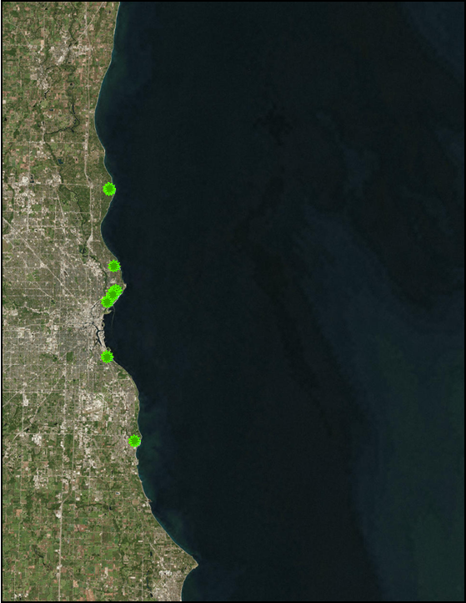
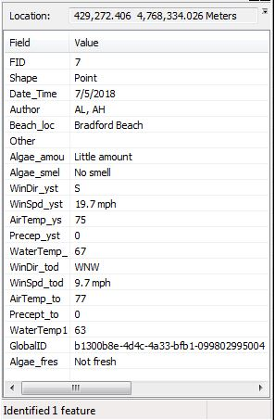
Future Work: Collector for ArcGIS
Points gathered using Collector for ArcGIS
0
10 km
Cladophora wash up locations
Notes:
Future Work: Collector for ArcGIS
Lawrence
For our term we have created maps on the Collector for ArcGIS so that interns working for Groundwork Milwaukee can utilize their mobile phone to collect in situ data of Cladophora washup locations.
When we created the Collector maps in a way that makes it is easy to use so that the person collecting data can add plenty of information appended to each point as data features.
Data gathered will be used by the next term project members to calibrate & upgrade their model.
Image and Map Source
Lake Michigan Water Resources Team
created by the team

Slide 25
Future Work
Attempt Different Approaches for Detection
Synthetic Aperture Radar
Software for Assisted Habitat Modeling
Incorporate Community Science
Launch social media campaign on Twitter
Validate Models with in situ Data
Collector for ArcGIS
Community science campaign
Image Credit: Groundwork Milwaukee
Notes:
Future Work Script
Lawrence
This DEVELOP project is planned to continue during the fall 2018 term.
The future team with do three things:
First, they will attempt to use different methods for the detection of Cladophora such as utilizing synthetic aperture radar or software for assisted habitat modeling
Second, together with Groundwork Milwaukee, a social media campaign will be launched on Twitter to encourage community involvement in Cladophora beach cleanup and washup location data collection
Finally, all in situ data collected will be used to assess the accuracy of all maps and models created during this term and the future one as well
Images Source
Groundwork Milwaukee
Received permission to use via email from our project partner, who captured the image.
http://www.groundworkmke.org/

Slide 26
Conclusions
Creating a Cladophora Habitat Suitability Map is difficult due to the lack of data and research in the Great Lakes Region
SAV maps shows a substantial amount of Cladophora within the 10 meter bathymetry contour
Cladophora Predictive Washup Maps suggest that the southern beaches will generally experience more algae deposition
Floating Algae Index maps reveal that accurately predicting washup locations is challenging due to the variability of wind and water surface currents
Data data points from the ArcGIS Collector App will be used during the fall 2018 DEVELOP term to assess the accuracy of the Cladophora Predictive Washup Map
Notes:
Conclusion Script
Steven
To conclude our project, we realized that creating our maps are really difficult:
**click**
Creating a Cladophora Habitat Suitability Map is challenging due to the lack of data, especially high resolution data, and research in the Great Lakes region.
**click**
Our SAVMA maps show a lot of SAV in our study area, but some portions of our study area have no data due to those areas being perceived as deep water by our equation.
**click**
The Predictive Washup Map suggests that the southern beaches will tend to have more washup, but the FAI maps reveal that accurately predicting where the algae is going to washup is difficult because of the huge variability in wind and water surface currents.
**click**
Simply put, all of our products would benefit from ground data. As previously mentioned, Groundwork Milwaukee is currently using the ArcGIS Collector App tool to identify locations of Cladophora washup. The future fall DEVELOP team will use this data to validate and re-asses our products.

Slide 27
Acknowledgments
Thank you for listening!
Groundwork Milwaukee
Deneine Christa Powell, Executive Director
Lawrence Hoffman, GIS Program Manager
Alex Halloway & Alex Litscher, GIS Interns
Science Advisors at NASA Ames Research Center
Dr. Juan Torres-Pérez, Bay Area Environmental Research Institute
Dr. Sherry Palacios, Bay Area Environmental Research Institute
DEVELOP National Program Staff at NASA Ames Research Center
Jenna Williams, Center Lead
John Dilger, Geoinformatics Fellow
Notes:
Acknowledgments Script
Steven
Finally, we would like to acknowledge our partners at Groundwork Milwaukee and our science advisors and mentors at NASA Ames Research Center.
**click**
Thank you all for listening!

