Slide 1
Southern California Disasters II
Assessing the Effectiveness of Simulated HyspIRI Data for Use in USDA Forest Service Post-Fire Vegetation Assessment and Decision Support
Heather Nicholson
Amber Todoroff
Madeline LeBoeuf

Slide 2
Community Concerns
Credit: Inciweb
There has been an increase in the number of wildfires in California due to drought and warmer weather.
In 2014, approximately 5,500 wildfires burned roughly 90,000 acres in California.
An increase in wildfires can lead to soil erosion, loss of life, and expansion of invasive plant species.
It is necessary to be able to quickly map the burn severity of a wildfire in order to mitigate the effects.
Notes:
Slide is self explanatory. Photo is of the Aspen Fire
Image Source Website (http://inciweb.nwcg.gov/photos/CASNF/2013-07-24-1129-Aspen-Fire/picts/2013_07_28-10.10.19.904-CDT.jpeg)

Slide 3
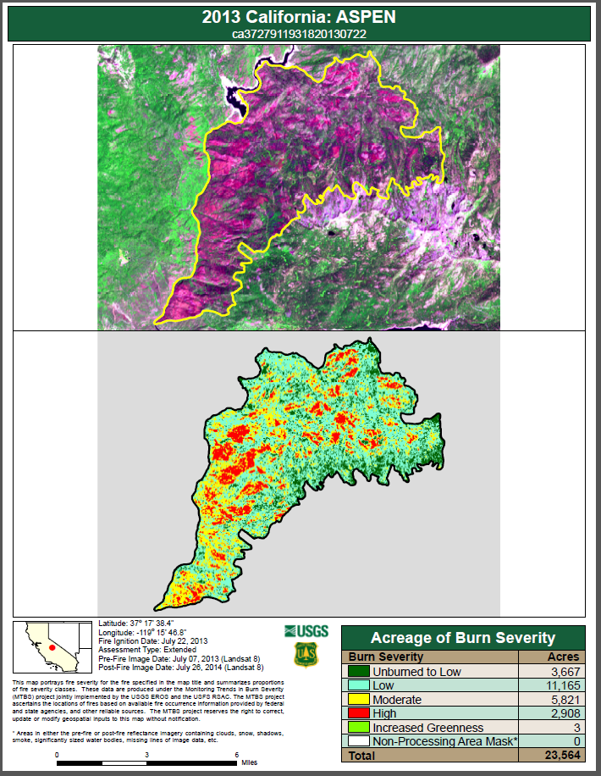
Current Methods
BAER: Burned Area Emergency Response
RAVG: Rapid Assessment of Vegetation Condition After Wildfire
MTBS: Monitoring Trends in Burn Severity
All three programs currently use multispectral sensors, such as Landsat, in order to map burn severity after a fire.
Credit: USDA Forest Service MTBS
Notes:
The USDA Forest Service (USFS) currently uses Burned Area Emergency Response (BAER), and Rapid Assessment of Vegetation Condition (RAVG) programs to quickly map and characterize vegetation and soil impacts due to major wildfires; these programs employ multiple burn indices to create post-fire change and burn severity product. Some of the most standard indices being used are the Normalized Burn Ratio (NBR), Differenced Normalized Burn Ratio (dNBR), Relative Differenced Normalized Burn Ratio (RdNBR). The forest service also uses MTBS to monitor long term trends in burn severity.
Currently these programs are using multispectral sensors onboard different Landsat platforms. Recent studies suggest that Landsat-derived burn severity products overvalue the cover of burned areas and undervalue the cover of unburned areas because of Landsat’s coarse spectral resolution

Slide 4
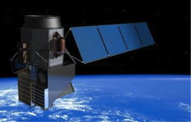
HyspIRI – Hyperspectral Infrared Imager
Credit: HyspIRI Mission Study, JPL
The goal is to study the world’s ecosystem and provide critical information on natural disasters, such as wildfire and drought
The missions is currently in a study stage
Airborne campaigns were conducted in 2013, 2014, and continuing into 2015
Simulated HyspIRI data was computed from MASTER and AVIRIS data
Notes:
In order to assess the capability of HyspIRI data, airborne campaigns were conducted in 2013, 2014, and continuing into 2015. Simulated HyspIRI data were collected during said flights using data from co-flown AVIRIS and MASTER data on a NASA ER-2 aircraft.

Slide 5
HyspIRI
Landsat 8
HyspIRI – Visible to Shortwave Infrared (VSWIR)
Originally 19 day repeat time; Now 16 day repeat time
380 nm to 2500 nm in < = 10 nm band
Originally 60m; Now evolving to 30m
HyspIRI is scheduled to launch in 2022
5 Years
Landsat 8 - Operation Land Imager (OLI)
16 day repeat time
8 spectral bands from 400 nm to 2400 ; 1 Panchromatic band
Spectral Bands at 30 m; Panchromatic band at 15m
Landsat 8 platform launched February 11, 2013
Minimum of 5 year life design
HyspIRI – Mid and Thermal Infrared (TIR)
5 day repeat time; day/night
8 Thermal bands from 4 µm to 12 µm
60 meter resolution
HyspIRI is scheduled to launch in 2022
5 Years
Landsat 8 - Thermal Infrared Sensor (TIRS)
2 Thermal Infrared bands from 10.60 µm to 12.51 µm
Collected at 100 meters but resampled to 30 m resolution
Landsat 8 platform launched on February 11, 2013
Minimum of 3 year life design
Notes:
When launched, the HyspIRI satellite will include two instruments: an imaging spectrometer measuring the visible to short wave infrared (VSWIR: 380 nm – 2500 nm) in 10 nm contiguous bands and a multispectral imager measuring from 3 to 12 μm in the mid and thermal infrared (TIR). Not only will HyspIRI be spectrally superior to Landsat, but recent announcements suggest that HyspIRI’s VSWIR will have a 30m spatial resolution and a 16 day revisit time, which is comparable to Landsat. HyspIRI TIR sensing capabilities will have a 60m spatial resolution with a 5 day revisit time. In order to assess the capability of HyspIRI data, airborne campaigns were conducted in 2013, 2014, and continuing into 2015. Simulated HyspIRI data were collected during said flights using data from co-flown AVIRIS and MASTER data on a NASA ER-2 aircraft (Jet Propulsion Laboratory 2014). Comprehending the possibilities of HyspIRI’s fine spectral resolution is crucial in explaining burn severities and patterns in such detail that is not available with Landsat-based ratios.

Slide 6
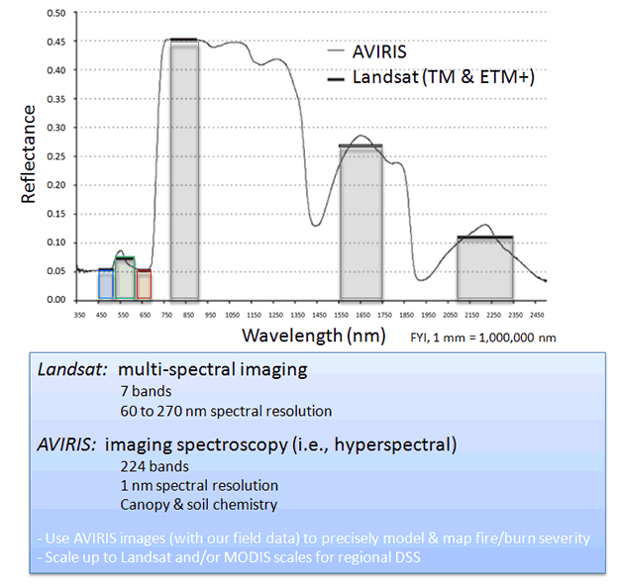
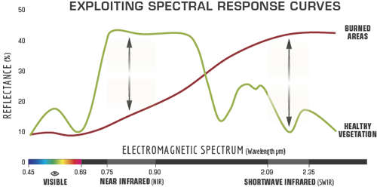
Hyperspectral and Multispectral
Credit: USDA Forest Service, RSAC
10 NM
Credit: USDA Forest Service, Northern Research Station
Notes:
Talk about the difference between multi-spectral and hyperspectral images here, and areas in which hyperspectral can have an advantage in terms of remote sensing
Image Source Website(AVRIS VS LANDSAT): http://www.nrs.fs.fed.us/disturbance/fire/extreme_fire_effects_mn/
Image Source Website(Exploiting Spectral Curves): http://www.fs.fed.us/eng/rsac/baer/barc.html

Slide 7
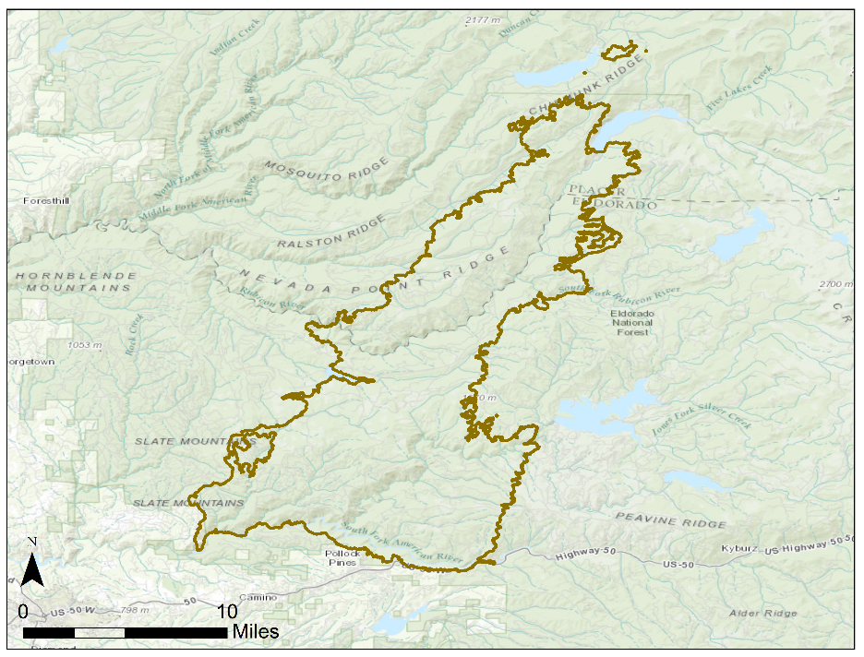
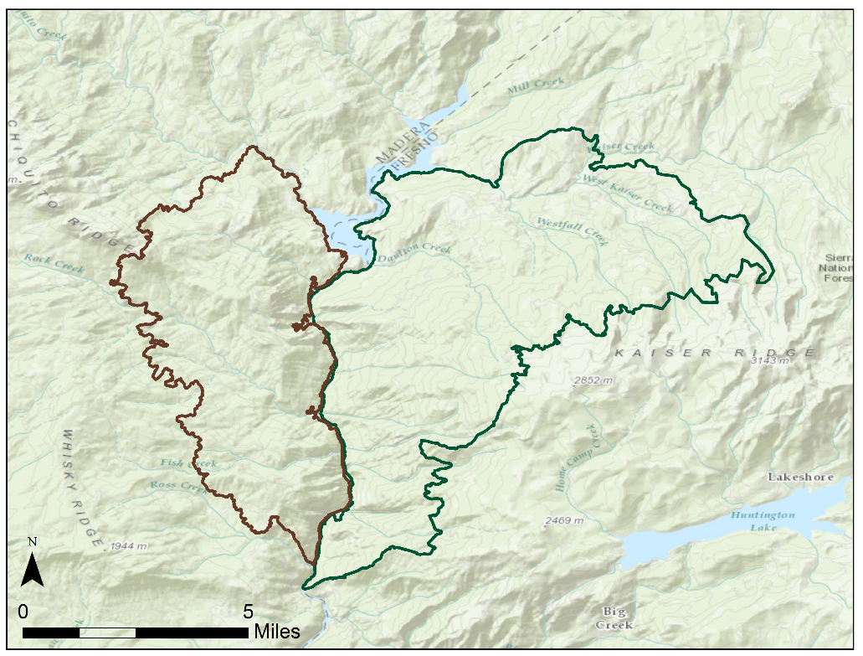
Study Area
Notes:
The Aspen fire was discovered on July 22, 2013 and was considered contained and controlled by August 11, 2013. The French fire was discovered on July 28, 2014 and was considered contained by September 3, 2013. The King fire was discovered on September 13, 2014 and was considered contained around October 9, 2014.
Basemap credits:
Esri, HERE, DeLorme, TomTom, Intermap, increment P Corp., GEBCO, USGS, FAO, NPS, NRCAN, GeoBase, IGN, Kadaster NL, Ordnance Survey, Esri Japan, METI, Esri China (Hong Kong), swisstopo, MapmyIndia, © OpenStreetMap contributors, GIS User Comm.

Slide 8
Project Objectives
Utilize simulated HyspIRI data to produce wildfire burn severity and vegetation monitoring products, such as dNBR and RdNBR, to aid wildfire mitigation and ecosystem restoration
Quantitatively compare simulated HyspIRI derived products to similar Landsat based products calculated by the USDA Forest Service to determine how hyperspectral data can be used to improve upon current methods
Credit: Inciweb
Notes:
Slide is self explanitory
Image Credit Website: http://inciweb.nwcg.gov/photos/CASNF/2014-07-28-1307-French-Fire/picts/2014_07_29-19.42.01.765-CDT.jpeg
Image of French Fire

Slide 9
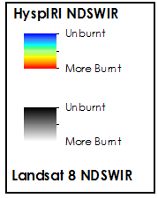
Rim Fire – HyspIRI Qualitative Analysis
Credit: SSC DEVELOP California Disasters I
Notes:
The first term of this project, which was in summer 2014 project, qualitatively compared a multiple of HyspIRI computed indices to those computed with Landsat data. These included ravg products such as DNBR and RdNBR, SAVI, SMI, ect. This maps shows a comparison of the Normalized Difference Shortwave Infrared Index computed between Landsat and HyspIRI.

Slide 10
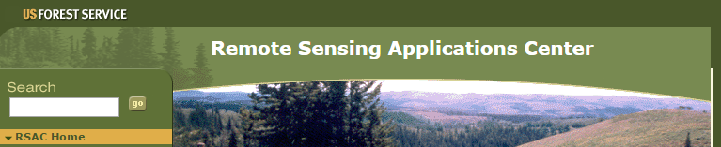
Download Simulated HyspIRI and US Forest Service Data
Methodology
MASTER and AVIRIS georeferenced and subsetted
Burn Indices Calculated in ERDAS IMAGINE Model Maker
Quantitative Comparison between results and US Forest Service Products
Notes:
We downloaded simulated HyspIRI VSWIR data from AVRIS and simulated HyspIRI TIR data from Master.
We downloaded landsat 8 data from USGS earth explorer.
We download BAER and RAVG from the RSAC website
We downloaded MTBS from the MTBS website

Slide 11
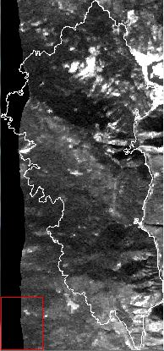
Download Simulated HyspIRI and US Forest Service Data
Methodology
MASTER French Fire
MASTER and AVIRIS georeferenced and subsetted
Subset
Burn Indices Calculated in ERDAS IMAGINE Model Maker
Quantitative Comparison between results and US Forest Service Products

Slide 12
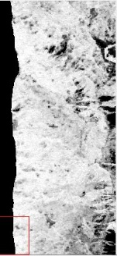
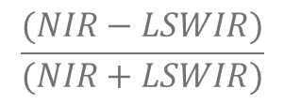
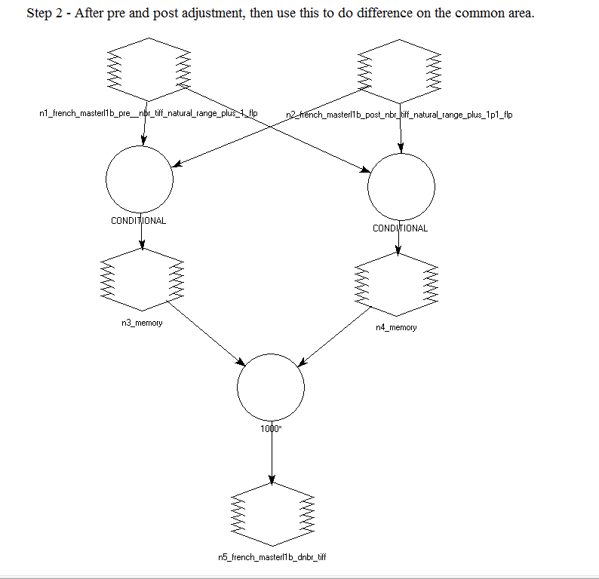
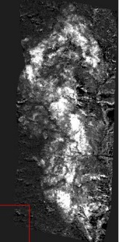
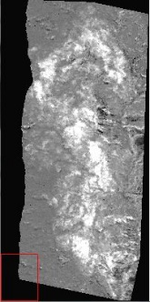
Download Simulated HyspIRI and US Forest Service Data
Methodology
NBR
MASTER and AVIRIS georeferenced and subsetted
dNBR
Burn Indices Calculated in ERDAS IMAGINE Model Maker
$${1000(NBR}_{pre}− {NBR}_{post})$$
RdNBR
Quantitative Comparison between results and US Forest Service Products
$$\frac{dNBR}{\begin{aligned}\sqrt{abs\left({NBR}_{pre}\right)} \\ \end{aligned}}$$

Slide 13
Download Simulated HyspIRI and US Forest Service Data
Methodology
*Methodology development and implementation still in progress
MASTER and AVIRIS georeferenced and subsetted
Burn Indices Calculated in ERDAS IMAGINE Model Maker
Quantitative Comparison between results and US Forest Service Products

Slide 14
Aspen Fire Preliminary Results

Slide 15
Aspen Fire Preliminary Results - dNBR Indices

Slide 16
Aspen Fire Preliminary Results - RdNBR Indices

Slide 17
French Fire Preliminary Results

Slide 18
French Fire Results - dNBR Indices

Slide 19
French Fire Preliminary Results - RdNBR Indices

Slide 20
King Fire Preliminary Results

Slide 21
King Fire Preliminary Results - dNBR Indices

Slide 22
King Fire Preliminary Results - RdNBR Indices

Slide 23
Errors and Uncertainty
TBD

Slide 24
Conclusions
TBD

Slide 25
Future Work
TBD

Slide 26
References
AghaKouchak, Amir, Linyin Cheng, Omid Mazdiyasni, and Alireza Farahmand. 2014. "Global Warming and Changes in Risk of Concurrent Climate Extremes: Insights from the 2014 California Drought." Geophysical Research Letters.
Cal Fire. 2014. Cal Fire: Incident Information. Accessed June 24, 2015. http://cdfdata.fire.ca.gov/incidents/incidents_stats?year=2014.
Faivre, Nicolas, Jin Yufang, Michael Goulden, and James T. Randerson. 2014. "Controls on the Spatial Pattern of Wildfire Ignitions in Southern California." International Journal of Wildland Fire.
Green, Robert, Simon Hook, and Elizabeth Middleton. 2014. Status of the HyspIRI Mission Concept. Pasadena: Jet Propulsion Labratory, California Institute of Technology.
Hebel, Cassie L., Jane E. Smith, and Kermit Cromack Jr. 2009. "Invasive Plant Species and Soil Microbial Response to Wildfire Burn Severity in the Cascade Range of Oregon." Applied Soil Ecology.
Hudak, Andrew T., Peter R. Robichaud, Jeffrey S. Evans, Jess Clark, Keith Lannom, Penelope Morgan, and Carter Stone. n.d. "Field Validation of Burned Area Reflectance Classification (BARC) Products for Post Fire Assessment."
Jet Propulsion Laboratory. 2014. HyspIRI Mission Study. Accessed June 2014. hyspiri.jpl.nasa.gov.
Kokaly, Raymond F., Barnaby W. Rockwell, Sandra L. Haire, and Trude V.V. King. 2007. "Characterization of Post-Fire Surface Cover, Soils, and Burn Severity at the Cerro Grande Fire, New Mexico, Using Hyperspectral and Multispectral Data." Remote Sensing of the Enviroment.
Parsons, Annette. 2003. "Burned Area Emergency Rehabilitation (BAER): Soil Burn Severity Definitions and Mapping Guidlines." Guidlines.
Sutherlin, Timothy, Eric Mack, Heather Nicholson, Caitlin Ruby, and Luke Wylie. 2014. Assessing the Effectiveness of Simulated HyspIRI Data for Use in USDA Forest Service Post-Fire Vegetation Assessment and Decision Support. NASA DEVELOP.
Swain, Daniel L., Micheal Tsiang, Matz Haugen, Singh Deepti, Allison Charland, Bala Rajaratnam, and Noah S. Diffenbaugh. 2014. "The Extroridinary California Drought of 2013/2014: Character, Contex, and the Role of Climate Change." American Meteorological Society.
1999. USDA Forest Service. Accessed June 2014. www.fs.fed.us.
van Wagtendonk, Jan W., Ralph R. Root, and Carl H. Key. 2004. "Comparison of AVIRIS and Landsat ETM+ detection capabilities for burn severity." Remote Sensing of Environment 92: 397-408.

Slide 27
Advisors
Joseph Spruce, Senior Scientist and Lead Science Advisor at NASA SSC
James “Doc” Smoot, Senior Scientist and Assistant Science Advisor at NASA SSC
Dr. Kenton Ross, DEVELOP National Science Advisor, LaRC
End-Users
USDA Forest Service Remote Sensing Applications Center (RSAC), End User, POC: TBD
USDA Forest Service Eastern Forest Environmental Threat Assessment Center (EFETAC), End User, POC: Dr. Steve Norman, Research Ecologist
Partners
USDA Forest Service Rocky Mountain Research Station, Missoula Fire Sciences Laboratory, Collaborator/Boundary Organization, POC: Dr. Robert Keane, Research Ecologist
HyspIRI Science Team, JPL, Collaborator, POC: Dr. Robert Green, Science Lead

Slide 28
Joseph Spruce, Senior Scientist and Lead Science Advisor at NASA SSC
James “Doc” Smoot, Senior Scientist and Assistant Science Advisor at NASA SSC
Dr. Kenton Ross, DEVELOP National Science Advisor, LaRC
Advisors
USDA Forest Service Remote Sensing Applications Center (RSAC
USDA Forest Service Eastern Forest Environmental Threat Assessment Center (EFETAC)
USDA Forest Service Rocky Mountain Research Station, Missoula Fire Sciences Laboratory
HyspIRI Science Team, JPL
Partners
Ross Reahard – SSC DEVELOP Center Lead Eric Mack – SSC DEVELOP Former Participant Caitlin Ruby –SSC DEVELOP Former Participant Timothy Sutherlin –SSC DEVELOP Former Participant Luke Wylie – SSC DEVELOP Former Participant NASA DEVELOP National Program Office
Others

Slide 29
Questions?

