Slide 1
Wyoming Ecological Forecasting
Mapping Cheatgrass Phenology and Distribution in a Post-Wildfire Landscape in Wyoming’s Medicine Bow National Forest
Darin Schulte(Project Lead)
Chandra Fowler
Stephanie Krail
Oliver Miltenberger

Slide 2
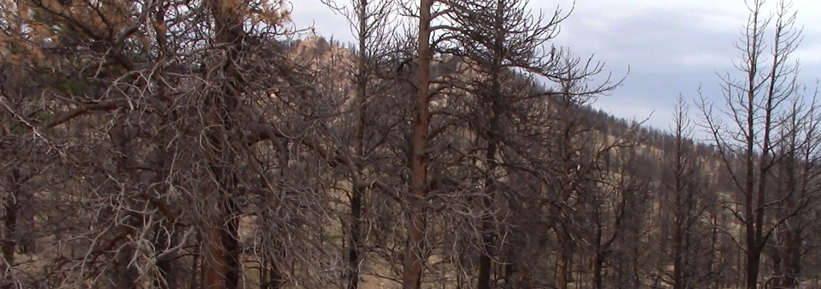
Community Concerns
Cheatgrass is a problematic invasive species
2012 Arapaho wildfire in the Medicine Bow National Forest, WY
Expensive & labor intensive mitigation
Accurate maps needed for targeted management
Arapaho Wildfire site 2015
Notes:
Cheatgrass is known throughout the Western U.S. as a problematic invasive species that can alter hydrologic and nutrient regimes, outcompete native grasses and increase fire intensity while thriving in post-burn areas. As of 2005, an estimated 22.5 million ha in the US were affected by cheatgrass. In 2012 the Arapaho wildfire spread through portions of the Medicine Bow National Forest (MBNF) of Southern Wyoming, leaving the area highly susceptible to cheatgrass encroachment. Project partners at Wyoming Game and Fish Department and the US Forest Service, Laramie District have identified cheatgrass management within the Arapaho site as a priority.
Mitigation of areas where cheatgrass has successfully established can be very costly and labor intensive. Currently, field surveys are the only method of estimating cheatgrass distribution in MBNF, but the rugged terrain makes comprehensive mapping infeasible. In order to effectively target areas for cheatgrass management, accurate maps of cheatgrass cover are needed, as well as information regarding the local phenological cycles of cheatgrass to effectively plan timing of herbicide application.
Image Source: Wyoming Ecological Forecasting DEVELOP team

Slide 3
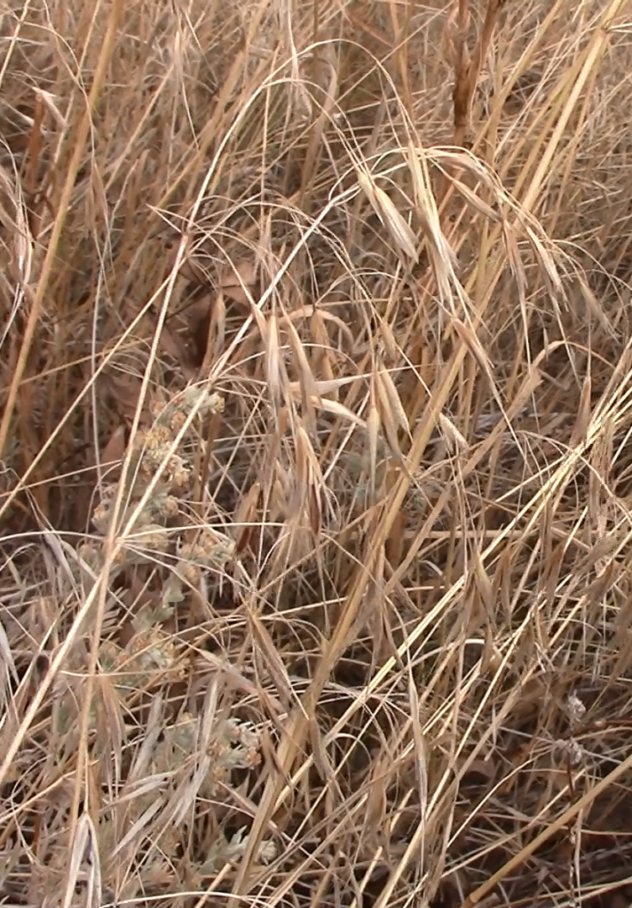
Objectives
Utilize a Species Distribution Model (SDM) for mapping cheatgrass cover
Assess phenological characteristics of areas with predicted cheatgrass cover
Inform targeted mitigation of cheatgrass populations for project partners
Notes:
We created a Species Distribution Model (SDM) for the 2012 Arapaho wildfire site using data from multiple NASA Earth Observation platforms. Our goal was to test the abilities of four distinct modeling approaches in their ability to predict cheatgrass cover three years after the fire event. Furthermore, we made use of Terra MODIS data pertaining to phenological stages of vegetation within the study area in order to provide project partners with the necessary information for locating cheatgrass populations and timing the aerial application of herbicides.
Image Source: Wyoming Ecological Forecasting DEVELOP team

Slide 4
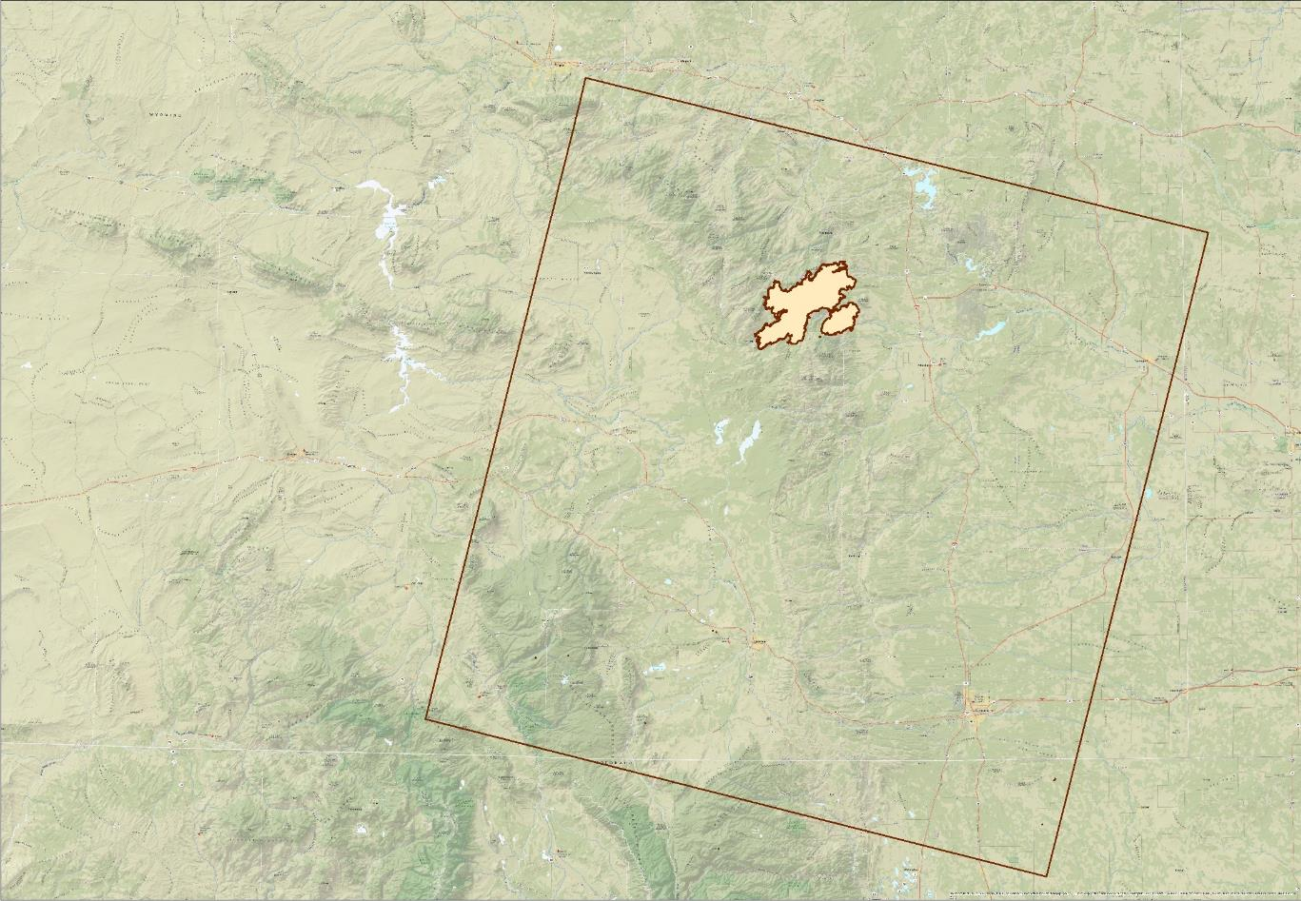
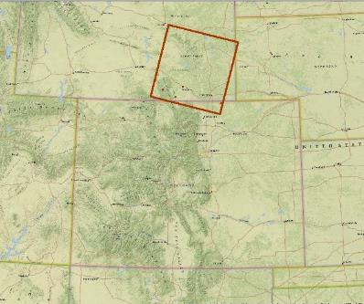

Study Area
Wyoming
Colorado
Legend
Arapaho Wildfire Extent
Outline of Path 34 Row 31
Notes:
The study area consists of the site of the 2012 Arapaho wildfire (42.201° N latitude, -105.49° W longitude) in Medicine Bow National Forest in Southeastern Wyoming (WRS2 Path 34 Row 31). The Arapaho wildfire was one of the largest fires of the season in Wyoming. The site includes over 98,115 acres of burned area that originally ignited from a lightning strike and burned from June 27th to August 23rd, 2012. The study area ranges in elevation from approximately 1500 m to 3100 m and primarily consists of ponderosa pine forest and sagebrush steppe ecosystems.
The DEVELOP Wyoming Ecological Forecasting project used data from the 2015 growing season in an attempt to map current day cheatgrass distribution, as well as data from 2009 to 2015 to analyze trends in seasonal phenology.
Base Map Source: National Geographic, Esri, DeLorme, HERE, UNEP-WCMC, USGS, NASA, ESA, METI, NRCAN, GEBCO, NOAA, increment P Corp.

Slide 5

Methodology
Data Acquisition
Data
Processing
Modeling
Results
Landsat 8
OLI and TIRS
Vegetation Indices
Species Distribution
Model
Cheatgrass
Cover Map
SRTM
Topographic Indices
MODIS subsetting tool
Phenological Time Series
Terra MODIS
Notes:
Methodology
Our general workflow consisted of four main stages: Data Acquisition, Data Processing, Modeling, and Analysis of Results. We followed two main paths through the workflow which can be traced from left to right in the diagram; one resulting in the production of cheatgrass cover maps, and the other resulting in a collection of phenology time series data for areas predicted to have cheatgrass present
The following slides walk through each of the four workflow stages in more detail.

Slide 6
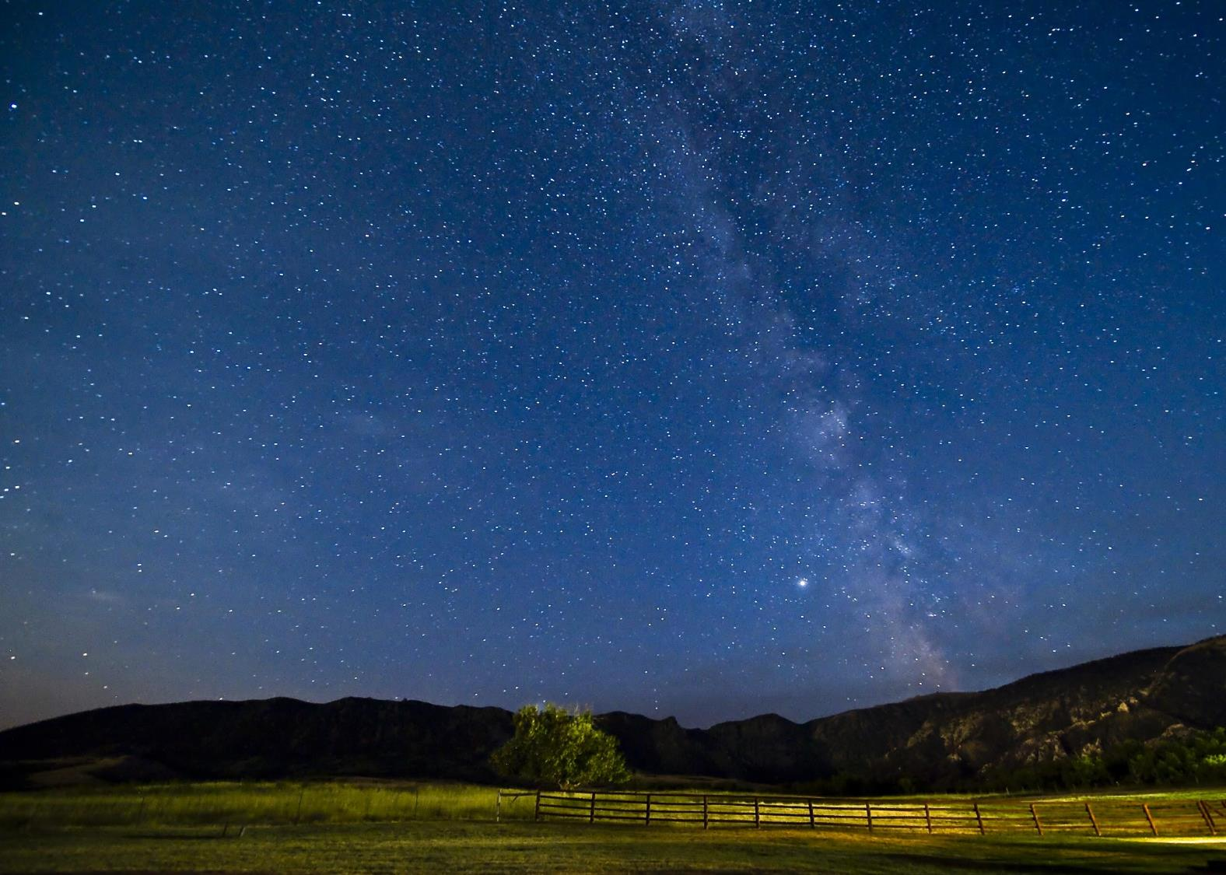
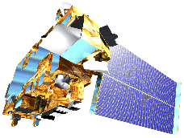
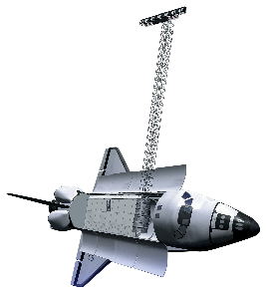
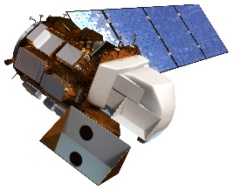
Earth Observations
Terra
Landsat 8
SRTM
)
Photo Credit: Gary Elsasser
Notes:
Geospatial data and imagery came from Landsat 8, Terra, and Shuttle Radar Topography Mission (SRTM).
Satellite images source: http://www.devpedia.developexchange.com/dv/index.php?title=List_of_Satellite_Pictures
Background image source:
https://www.flickr.com/photos/speakerx/2920553541/in/photolist-arXjbq-zjERSy-5s5APp-a4GMYa-a5k7JL-pvgxpi-pv1JZw-xaXAmw-p2dji2-o3ENfG-oKeGTr-pBMzUe-deB1e7-bVw76w-zkVsY7-uzuLHf-f5ERFG-dXf3ge-pbRdyw-a6LURQ-orjShD-oAwCfZ-2aAt7c-ann6jc-rNP1z6-pbR8Je-9eJLc2-3Qg8Np-acHPKf-o8fcAP-fWDfDo-qBNpSr-vJnxt4-g4Em9g-dcpbDm-agciZ9-yp5Crp-feXHNZ-fU48HY-c3R7ib-924GdG-aJHDRB-g9bjMe-krhT8-9K1hTv-rshXMF-dHAEGf-8DhdPo-8ba8ss-9DoJ1e

Slide 7
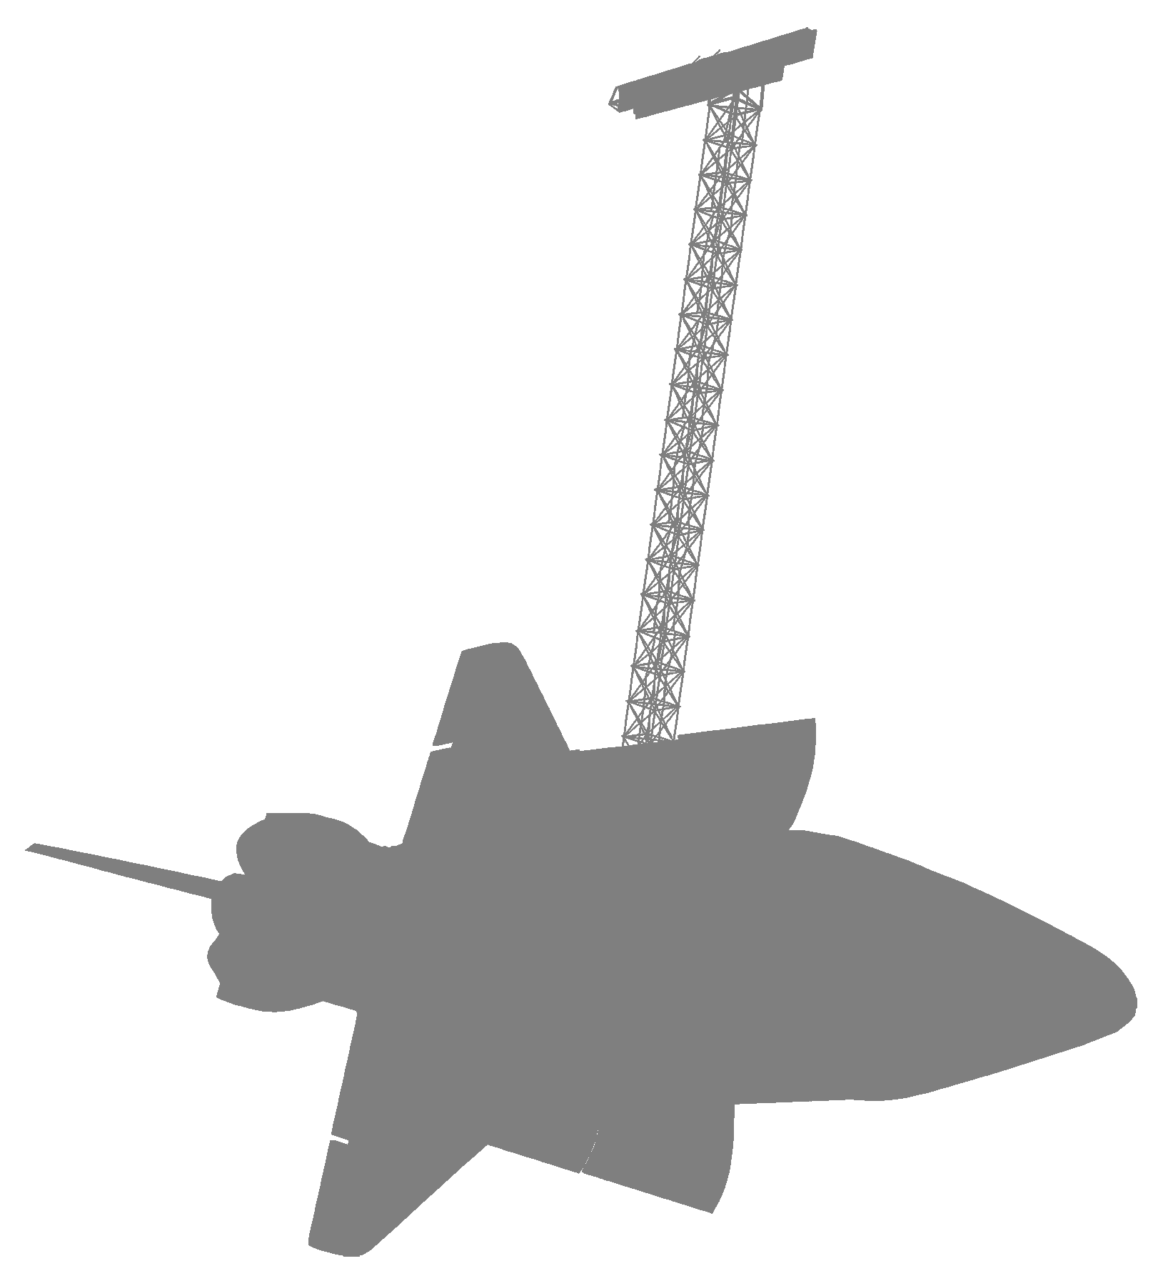
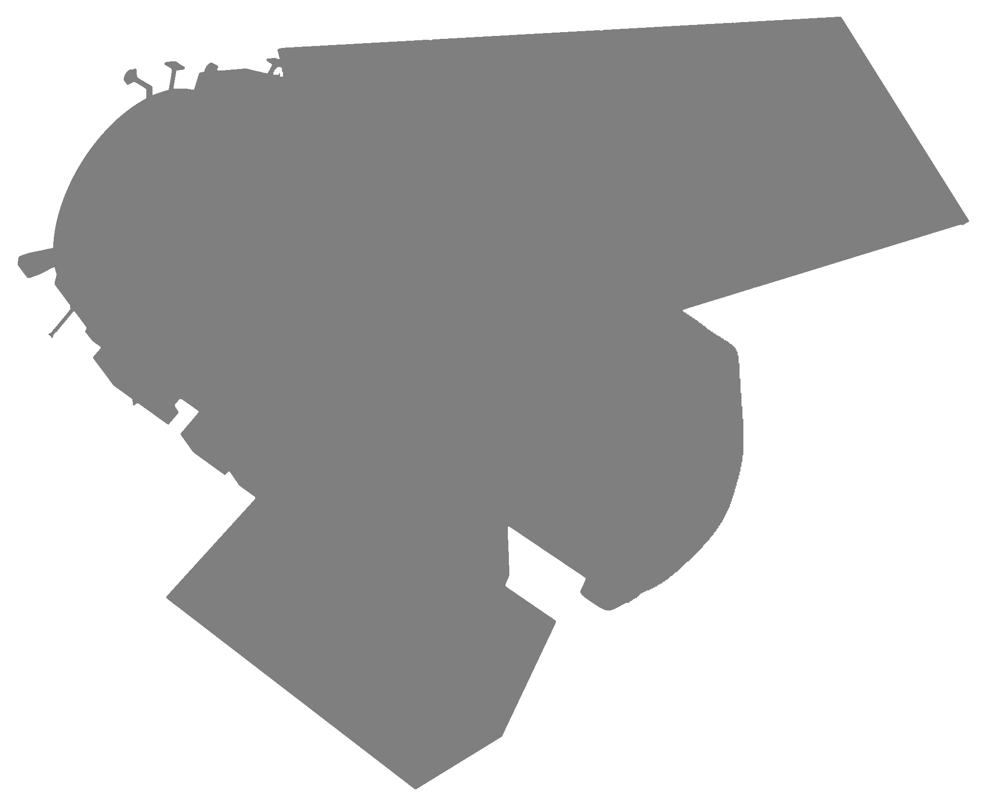
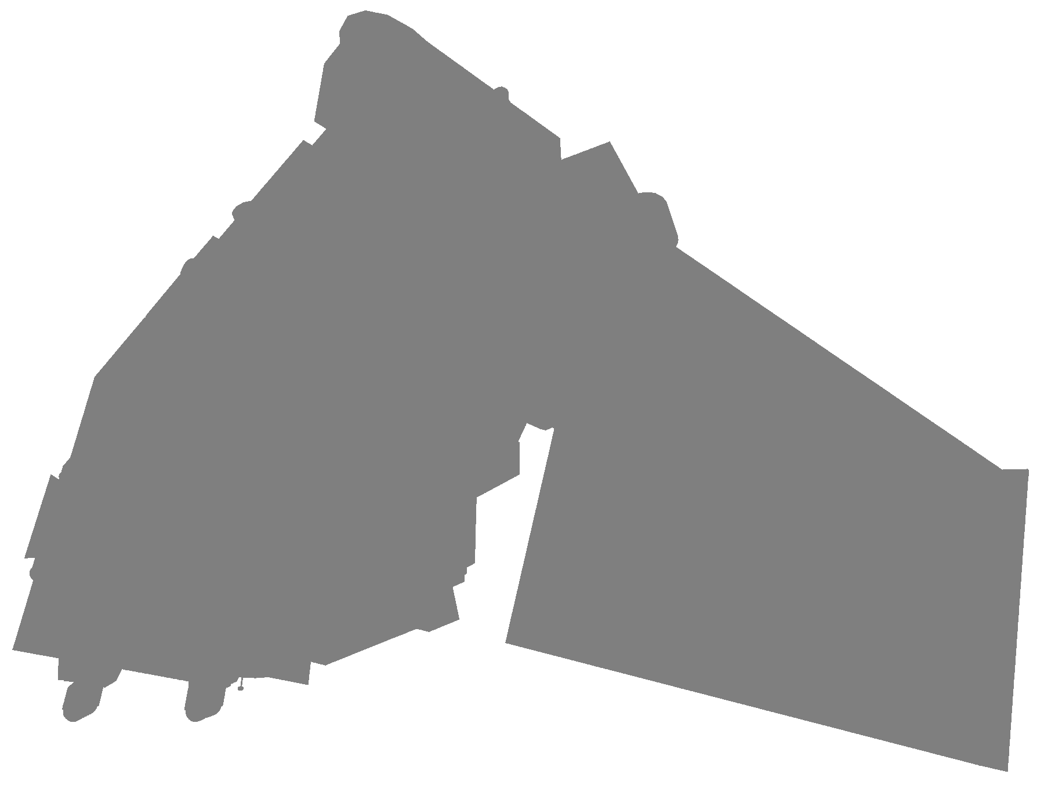
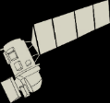
Data Acquisition
Results
6
1
7
Landsat 8 scenes
(OLI & TIRS data)
SRTM Digital Elevation Model (DEM)
Years of Terra MODIS MOD13Q1 data
Notes:
We collected six cloud-free Landsat 8 scenes for the study period between May & September 2015 from the USGS Earth Explorer website. Operational Land Imager (OLI) & Thermal Infrared Sensor (TIRS) data were collected and used to derive a series of vegetation indices that served as predictor variables (or covariates) in the Species Distribution Model. We also downloaded Shuttle Radar Topography Mission (SRTM) data in the form or a 30 m Digital Elevation Model (DEM) from the USGS Earth Explorer.
Additionally, we acquired seven years of Terra MODIS MOD13Q1 product data which consists of two vegetation indices, the Normalized Difference Vegetation Index (NDVI) and the Enhanced Vegetation Index (EVI). Data are available at a 16-day temporal resolution and a 250 m spatial resolution and were collected from the Oak Ridge National Laboratory Distributed Active Archive Center (ORNL DAAC) using the MODIS Collection 5 Land Products Global Subsetting and Visualization Tool.
EarthExplorer:
earthexplorer.usgs.gov
MODIS Land Product Subsets:
http://daac.ornl.gov/MODIS/modis.shtml

Slide 8
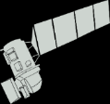
Data Processing
9
8
Vegetation
indices
Topographic
indices
Presence / Absence
Phenology
time series
Notes:
Raw Landsat 8 and SRTM data were processed before serving as inputs to the species distribution models. Nine vegetation indices were derived from OLI data, and eight topographic indices were derived (or explicitly provided by) SRTM data. Field data originally consisted of percent coverage data. These data were converted to presence/absence using the threshold of 40% or greater coverage required to constitute a presence assignment.
MODIS NDVI & EVI data required no special pre-processing apart from requesting the data for a subset of specific locations within the study site, and arrived fully processed with the ORNL DAAC web enabled data visualization tool.

Slide 9
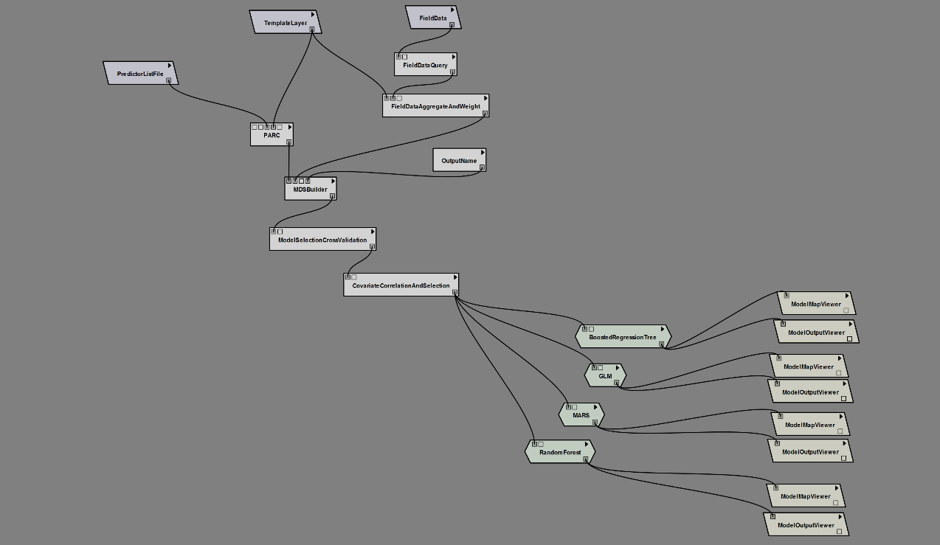
Modeling-SAHM
Input Data
Processing
Steps
Results
Results
Models
Notes:
Species Distribution Models were constructed in the USGS Software for Assisted Habitat Modeling (or SAHM for short). This slide provides an example of the SAHM workflow and its four general phases; Input data, Processing steps, Models, and Results.
Input Data: Input data consisted of derived vegetation and topographic indices as raster data, and field data from 2014 & 2015 converted to presence/absence values.
Processing Steps: Processing steps ensured that all data were in the same projection, had the same coordinate system and geographic extent. All raster inputs were clipped to the study area and resulted in a ‘stack’ of predictor (i.e., covariate) raster layers. Covariate raster data at each of the field data locations was extracted, and the field data were divided into cross validation folds for modeling and evaluation metrics. Finally, a covariate correlation matrix was generated wherein highly correlated predictor variables were identified and when appropriate, removed. A total of 16 covariates were used in the subsequent model runs.
Models: SAHM allows for multiple models to be asynchronously run on the same data. We ran four species distribution models including; Boosted Regression Tree (BRT), Generalized Linear Model (GM), Multivariate Adaptive Regression Splines (MARS), and a Random Forest model (RF).
Results: Each model generates a series of results including maps and evaluation metrics.

Slide 10
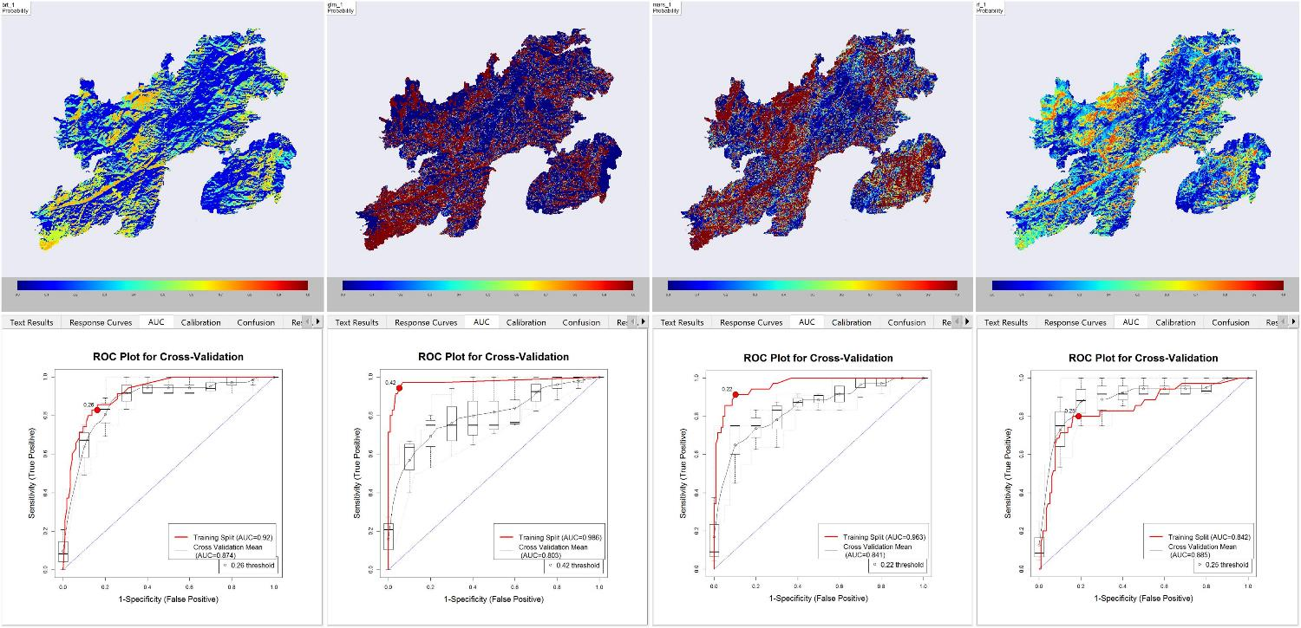
Modeling-SAHM
BRT
GLM
MARS
RF
Results
Notes:
SAHM generates a ‘spreadsheet’ view that allows the user to simultaneously view model output and evaluation metrics for multiple models. Pictured here is the spreadsheet view consisting of continuous probability maps in the top row, and the Receiver Operating Characteristic curves (ROC) plots in the bottom row for each model type. These results suggested a general level of agreement between models, with no individual model performing extremely well. All models were run with default settings in SAHM, and further exploration of parameter values should be expected to yield different results. The Random Forest model had slightly better performance when considering the difference between training and cross validation AUC values, and was selected for further analysis.

Slide 11
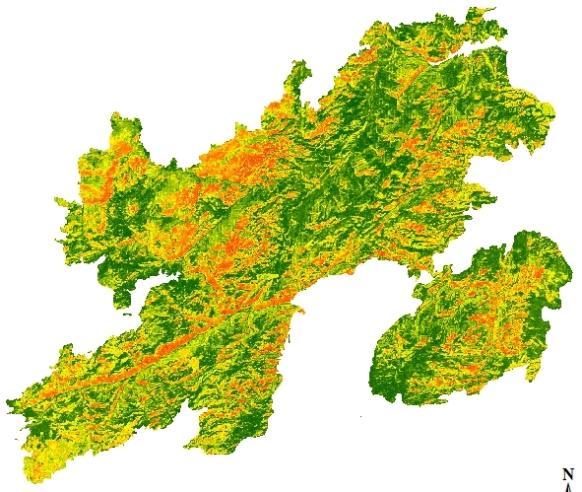
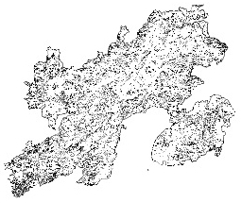
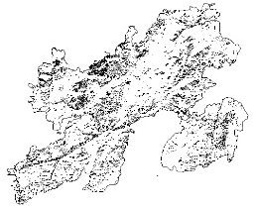
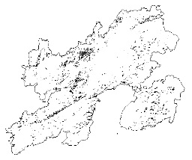
Results
0.4-0.6
High
8862.93 ha
Results
0.6-0.8
Low
7495.56 ha
0.8-1.0
2191.5 ha
Notes:
Shown above is the continuous probability map of cheatgrass cover for the Arapaho wildfire site. Regions in red have the highest predicted probability of cheatgrass presence, and dark green regions have the lowest. It is important to note that the probability map denotes the probability of occurrence given the sampling design, and not necessarily the true probability of occurrence.
Project partners expressed the need for area estimates of cheatgrass cover, and the inset maps provide estimates of the area predicted to have cheatgrass present, discretized into three probability classes. This allows project partners to inform their estimates by the probabilities assigned by the species distribution model. As an example, the lower right inset map identifies approximately 2,200 ha of land predicted to have cheatgrass present with probability between 0.8 & 1.0.

Slide 12
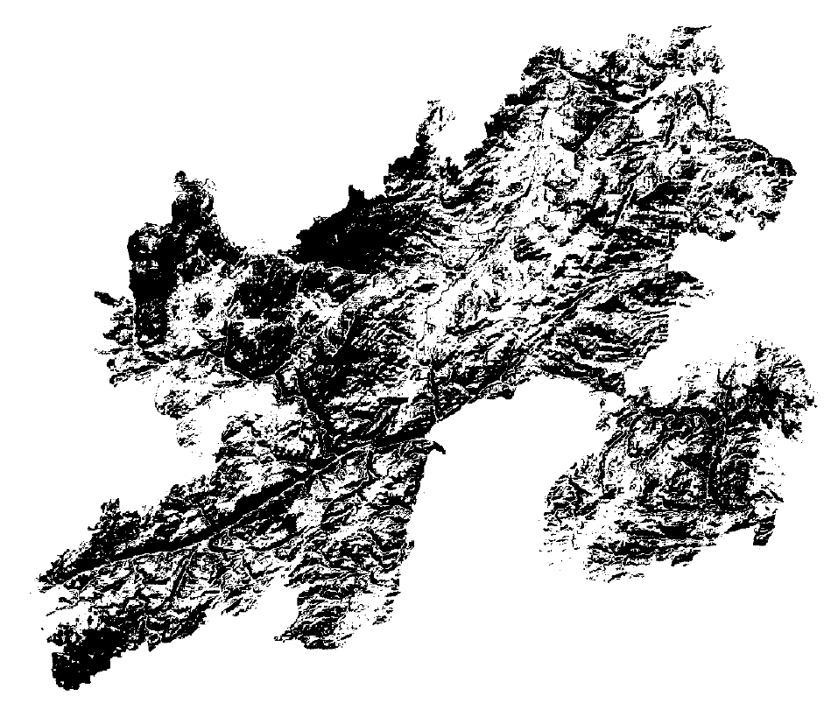
Results
Legend
Absence
Presence
Results
Notes:
SAHM also generates a binary classification map illustrating predicted presence/absence in each pixel. The binary classification map is created from the continuous probability map by defining a probability threshold above which pixels will be classified as presence locations. The SAHM default value of Specificity = Sensitivity was used to produce the binary map for this project, however, exploring additional options may prove useful in future analyses. This threshold resulted in pixels with a probability of cheatgrass presence above approximately 0.472 being classified as presence locations, otherwise, locations were designated as absence points

Slide 13
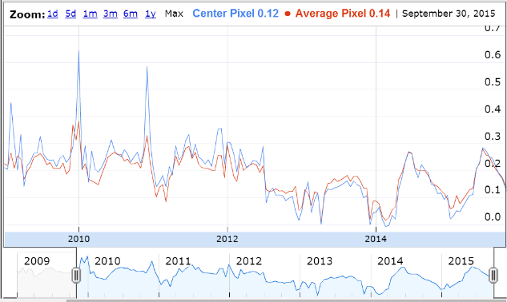

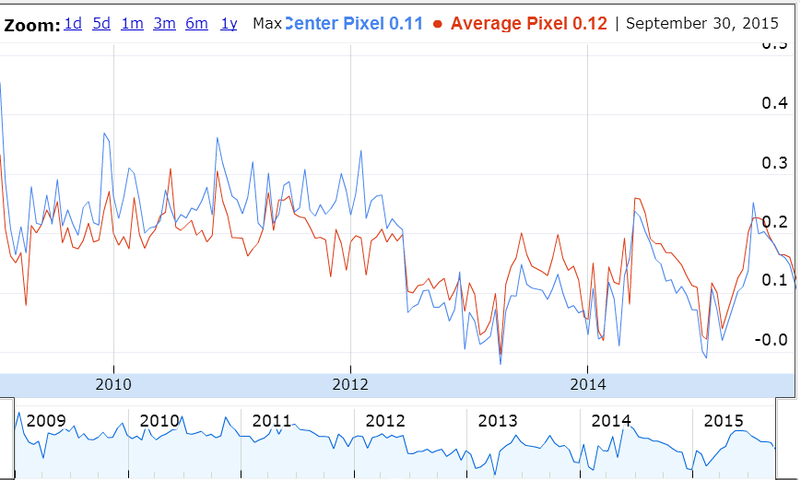
Results
Results
Legend
Absence
Presence
Notes:
Five locations within the study area that exhibited a noticeable clustering of presence values were selected to analyze seasonal phenology patterns. Terra MODIS NDVI and EVI data were collected from the MOD13Q1 product for coordinates approximately in the center of large presence clusters. MODIS data are at a relatively coarse spatial resolution (relative to Landsat data), and in an attempt to get phenology information for cheatgrass populations in the study area, we limited our analysis to five locations with large numbers of contiguous presence values.
The MOD13Q1 product provides NDVI & EVI data every 16 days. We compared seasonal and annual trends in the vegetation indices from 2009 through the 2015 growing season. Illustrated above are EVI time series plots for two locations generated by the MODIS Subsetting Tool, an online data visualization tool from Oak Ridge National Laboratory. In these figures, blue lines indicate the EVI data for the central pixel (approximately the Latitude / Longitude coordinates we provided), and the red lines indicate the average pixel values within a user defined radius from the central pixel. We defined the radius to be the minimum allowed 1 km.

Slide 14
Results
Pre-Fire EVI
Arapaho
Fire
Post-Fire EVI
Results
Legend
Absence
Presence
Pre-Fire EVI
Arapaho
Fire
Post-Fire EVI
Notes:
Though the spatial resolution of MODIS data prohibits a per Landsat pixel analysis of seasonal trends, general differences between pre- and post-fire vegetation indices values were apparent. The Arapaho fire in 2012 had a distinct effect on EVI values as shown in the figures in this slide. Additionally, noticeable differences in pre- and post-fire annual maximum and minimum EVI values can be seen.
Of particular concern to our project partners, is estimating green-up and senescence timing for cheatgrass in the area. On regional and continental scales, this is often done by monitoring vegetation indices for periods of rapid change. While the approach holds promise for applications in the management of invasive plant species such as cheatgrass which have noticeably different times for green-up and senescence than many native species, the relatively coarse spatial resolution of data such as MODIS vegetation indices, may limit its utility in sites as small as individual fire extents.
While this may be the case, the approach did provide strong indications of early growing season vegetation production as highlighted by the green bars in the post-fire EVI sections of the figures. Such data may still be valuable for very homogenous sites, even when the focal area is relatively small.

Slide 15
Errors and Uncertainties
Input Data
              Cloud cover and snow
Field data from multiple years
Percent cover threshold
Modeling
Exploring parameter values
Binary classification threshold
Phenology
Phenology mapping after recent fires
Spatial & temporal resolution of MODIS data
Notes:
There are several areas of potential error and uncertainty in the project. We divided these into three main categories.
Input Data: The study area for this project was relatively small, and obtaining cloud free data was not particularly challenging. However, the potential effect of cloud cover on the species distribution models is not immediately apparent. Furthermore, in an area such as the Medicine Bow National Forest with a high degree of variability in elevation, the effect of snow cover on model outputs needs to be considered. Field data consisted of a strong majority of absence points after the 40% cover threshold was applied when recoding to presence/absence values. In order to address this, presence field data from the previous year (2014) were included for locations in which cheatgrass was assumed to persist into 2015. Based on expert opinion, this was thought to be a justifiable addition, however, the field data were still strongly overrepresented by absence points, and the lack of presence points most likely had an influence on model performance as portions of the data were withheld during cross-validation steps. The 40% cover threshold for constituting a presence value was supported by previous research in a nearby Wyoming fire site, however, it was recommended that multiple thresholds be explored in order to determine the effect particular decisions may have.
Modeling: Default parameter values were used for all four models in SAHM. Numerous opportunities exist for exploring potential parameter values, and may increase the performance of particular models. In light of the relatively poor performance of all models, parameter exploration should be useful in determining whether that is a result of accepting defaults, or whether the particular modeling approach is not appropriate for the problem. Similarly, the binary classification map is a derived product of the probability maps generated by SAHM models. As such, the choice of threshold value to constitute a presence, should be explored in order to determine the sensitivity to threshold choice.
Phenology: It is not clear how much of a time lag is necessary after a fire event for vegetation indices to provide reliable estimates of phenological processes. The quality of information would be strongly influenced by the specific site context, as well as the particular vegetation indices being used. As noted earlier, the spatial and temporal resolution of the MOD13Q1 product data presents a challenge for analyzing vegetation index trends at a site specific scale such as an individual fire extent.

Slide 16
Conclusions
Cheatgrass Species Distribution Model
              Valuable tool for management
              Further model refinement needed
Final Products for Partners
Cheatgrass cover maps
Phenology time series
Notes:
General conclusions for the project suggest that the application of species sistribution models for management of invasive plant species such as cheatgrass holds promise as a valuable tool for land managers. The flexibility of modeling techniques provides great opportunity for refining and tailoring models to specific projects, though a tradeoff between model complexity and interpretability exists. However, the performance of several of the models in this project using only default values suggests that model refinement is certainly a worthwhile endeavor, and may enhance model performance and usefulness.
The final products delivered to our project partners include cheatgrass cover maps and area calculations based on these maps, as well as general phenology time series data for locations predicted to have cheatgrass present.

Slide 17
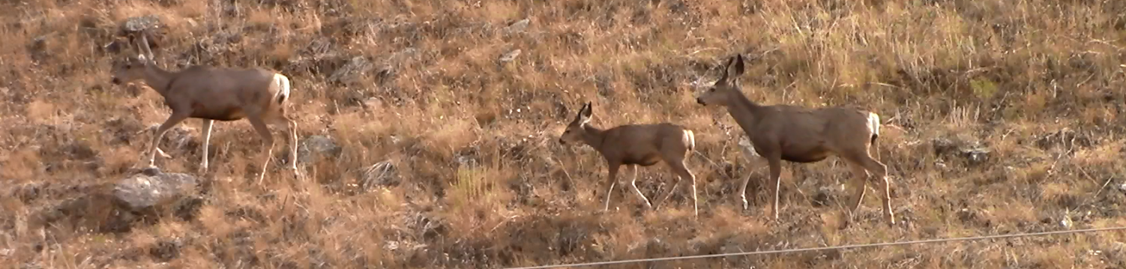
Future Work
Continued application of Species Distribution Models for cheatgrass management
Ensemble modeling
Additional field data for model validation
Mapping critical habitat
Notes:
Based on the results of this project and similar previous studies, it is recommended that species distribution models continue to be applied in cheatgrass management. Ensemble techniques in which strengths of multiple models may be combined to improve the overall prediction may prove very useful in a context such as this. Validating model performance would greatly benefit from additional field data collection in areas not included in the model construction. Species distribution models provide an opportunity for mapping critical animal habitat. A Fort Collins node DEVELOP project in the upcoming term will be doing just that by applying species distribution models to map critical mule deer habitat in the Medicine Bow National Forest.
Image Source: Wyoming Ecological Forecasting DEVELOP team

Slide 18
Advisors
Dr. Paul Evangelista, Natural Resource Ecology Laboratory, Colorado State University
Dr. Amanda West, Natural Resource Ecology Laboratory, Colorado State University
Partners
Wyoming Game and Fish Department
USDA Forest Service, Laramie District
Natural Resource Ecology Laboratory, Colorado State University
Others
Katherine Haynes (USDA Forest Service, Laramie District)
Ryan Amundson (Wyoming Game and Fish Department)
Brian Woodward (NASA DEVELOP at USGS Colorado State University)
Ryan Anderson (Natural Resource Ecology Lab, Colorado State University)

