Slide 1
Great Plains Agriculture
Utilizing NASA Earth Observations to Monitor Drought Conditions for Enhancement of Rangeland Management
Tiffani Orne (Liberty University)
Eric Dombrowsky (Christopher Newport University)
Emily Gotschalk (Christopher Newport University)
Notes:
[Tiffani] My name is Tiffani Orne. I’m a recent graduate of Liberty University where I majored in psychology.
[Emily] My name is Emily Gotschalk. I’m a biology major at Christopher Newport University
[Eric] My name is Eric Dombrowsky. I’m an economics major at Christopher Newport University, and we are the Great Plains Agriculture team.

Slide 2
The Great Plains Region
March to October
2011 – 2013
Notes:
[Eric]
This study focused on the Great Plains region of the United States. The GP region encompasses a large portion of the American Midwest, stretching from Canada to Mexico.
Our team partnered with Dr. Justin Derner of the USDA Agricultural Research Services Rangeland Resources Research Unit. The USDA currently uses products like VegDRI and the US Drought Monitor to determine drought severity.
Using the Drought Severity Index developed by the Summer GP Agriculture Team, we looked at the growing season for recent years of major drought.

Slide 3
Community Concerns
Rangelands have uses beyond agriculture that provide supplemental income for ranchers and farmers
Severe drought since 2011
$400 million in losses in Oklahoma, USDA provides drought assistance
Impacts the country and the world
Source: Statesman Photo Blog
Notes:
[Eric]
Approximately 80% of the GP is used for agriculture and dryland farming. Further, its rangeland is extensively used for livestock grazing, wildlife habitat, watershed protection, recreation, ecotourism, and fee hunting.
Since in 2011, the region has been faced with severe drought. For example, in the years 2011 and 2012, Oklahoma alone has lost over $400 million worth of production, primarily due to loss of crops and livestock. Many counties across the region qualify for federal drought assistance, and at this point the USDA has diverted approximately $30 million to assist farmers and ranchers affected by the drought.
The implications of severe drought are far reaching, and could lead to nationwide increases in food prices for products such as beef, pork, poultry, and dairy.
Additionally, because the US is such a large player in global food production, food prices could not only rise in the U.S., but also throughout the world.

Slide 4
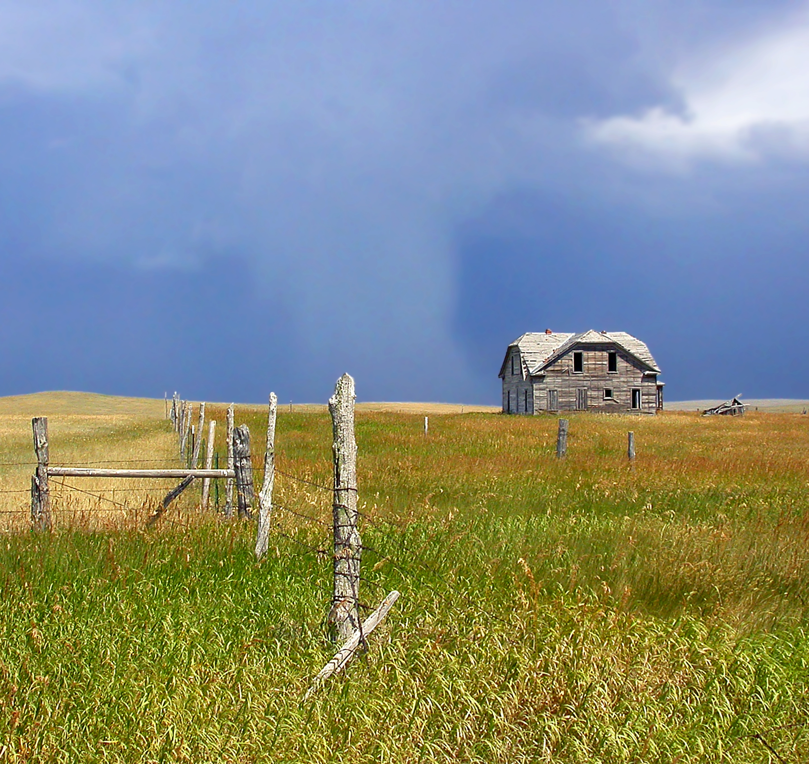
Objectives
Expand the Drought Severity Index (DSI) to the Great Plains region
Provide partner with a methodology for monitoring drought severity at a local scale
Source: South Dakota Birds
Notes:
[Tiffani]
The Summer GP Agriculture team developed a Drought Severity Index for Colorado and Wyoming. The main objective of this study was to expand that DSI throughout the entire GP region. The current project also used total precipitation over 180 days rather than the 30 day period used previously.
We also sought to provide the project partner with a sustainable methodology in order to continue using the DSI to monitor drought at a local scale.

Slide 5
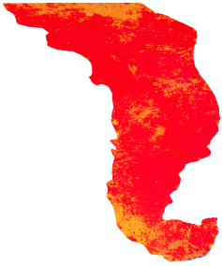
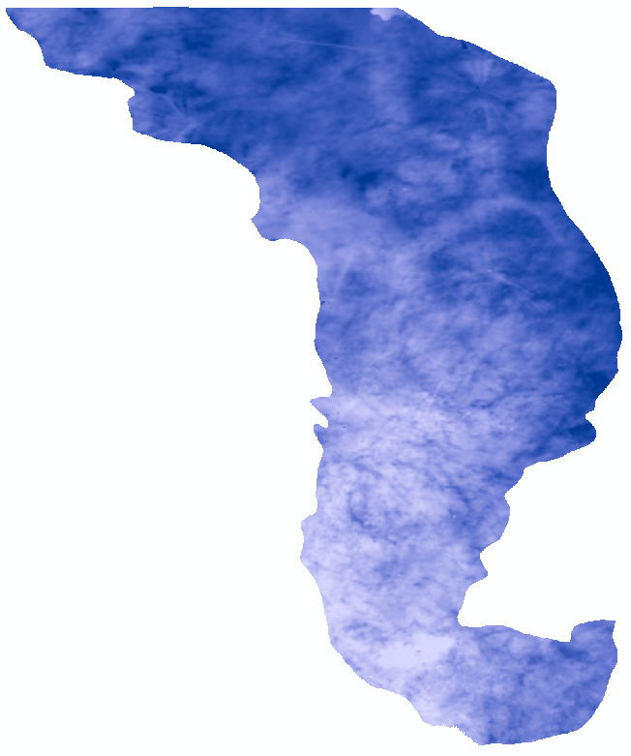
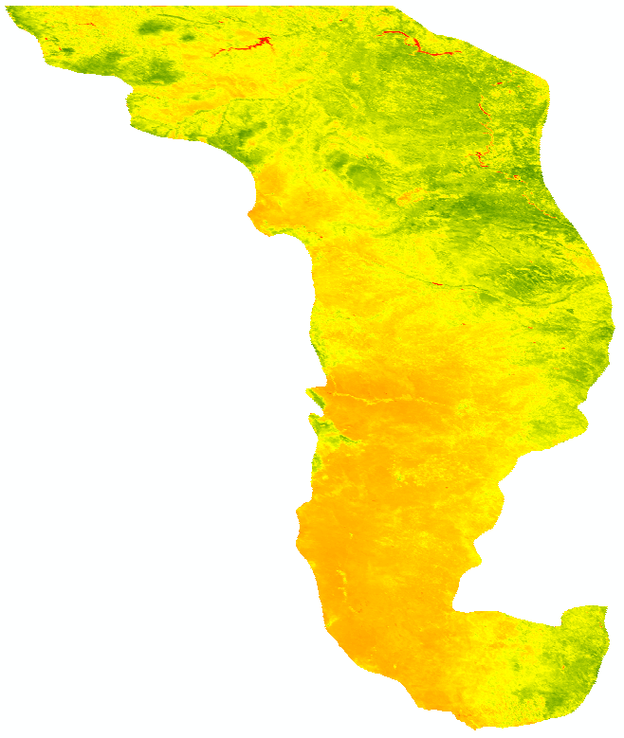
Methodology
Data Acquisition
Data Processing
Mosaic, Clip
Data Analysis
Aqua MODIS – Land Surface Temperature (LST)
Drought Severity Index
(1/4) scaled LST
+
(1/2) scaled MPE
+
(1/4) scaled NDVI
Clip, Total
NOAA MPE – Precipitation
Terra
Mosaic, Clip, NDVI
Terra MODIS – Surface Reflectance
Notes:
[Tiffani]
Data Acquisition
Several NASA and NOAA satellite products were used to collect data for this project.
The Aqua MODIS Land Surface Temperature product and the Terra MODIS Surface Reflectance product were collected from the USGS GloVIS website. MODIS data were collected from March through October for the years 2011 through 2013.
NOAA MPE precipitation data were collected from the NWS Advanced Hydrologic Prediction Service. Daily values were aquired for September 2010 through September 2013.
A shapefile was downloaded from the USGS showing regions of the United States.
Data Processing
ERDAS Imagine was used to edit the shapefile to only include the GP region.
All MODIS data tiles were mosaicked into a single file for each day, and then clipped to the GP shapefile
Terra MODIS surface reflectance data were used to calculate the Normalized Difference Vegetation Index, or NDVI
A python script was used to calculate 180 day precipitation totals
Data Analysis
Once initial processing was completed, the raster calculator tool in ArcGIS was used to calculate the Drought Severity Index throughout the region using land surface temperature, precipitation, and NDVI.

Slide 6
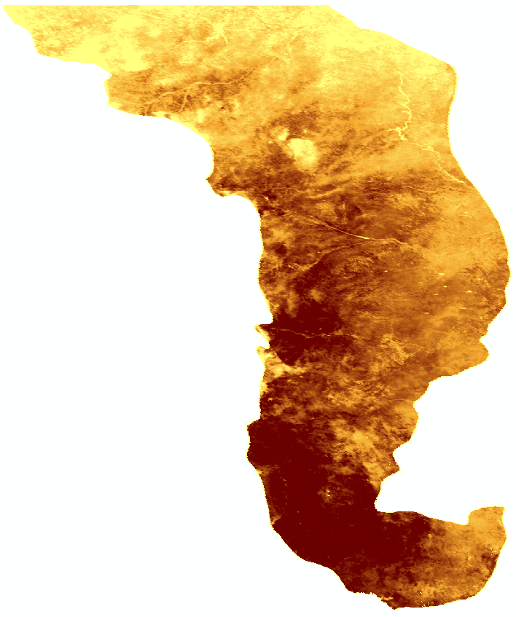
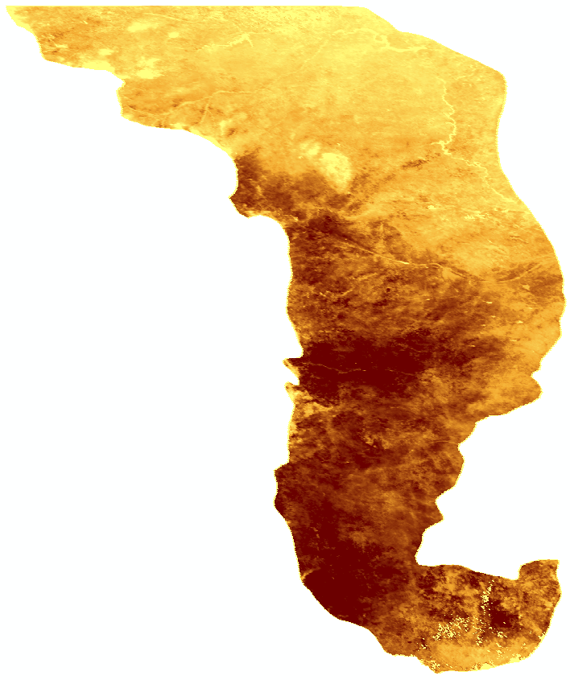
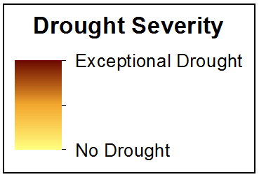
Results
Maps created by this project showed drought severity throughout the Great Plains region of the United States on July 12, 2012 (left) and July 12, 2013 (right)
Drought severity increased between the two years in the central part of the region. The southern portion of the region shows an improvement in drought conditions
2012
2013
Notes:
[Tiffani]
This slide shows the results of the drought severity index on July 12, 2012 and 2013. An increase can be seen in severity in the central part of the region, while a decrease is seen in the southern portion.

Slide 7
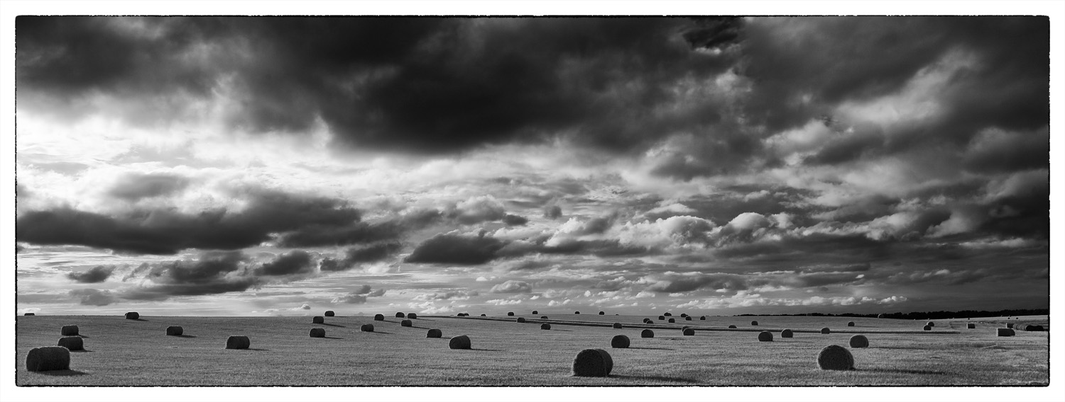
Conclusions
Source: Brett L. Erickson Wordpress
Utilizing the DSI provides local-scale drought severity information for an entire region
Precipitation accounted for half of the DSI equation
180-day totals allowed for the effects of precipitation from a previous season
Notes:
[Emily]
Utilizing the DSI provides local-scale drought severity information for an entire region.
Precipitation accounted for half of the DSI equation. 180-day totals allowed for the effects of precipitation from a previous season.
Maps and methodologies were provided to the project partner to equip them to continue using the DSI to monitor drought and provide up-to-date information to farmers, ranchers, and land managers. The US Drought Monitor and VegDRI provide drought severity information as well but at a much broader scale than the DSI we are providing.

Slide 8
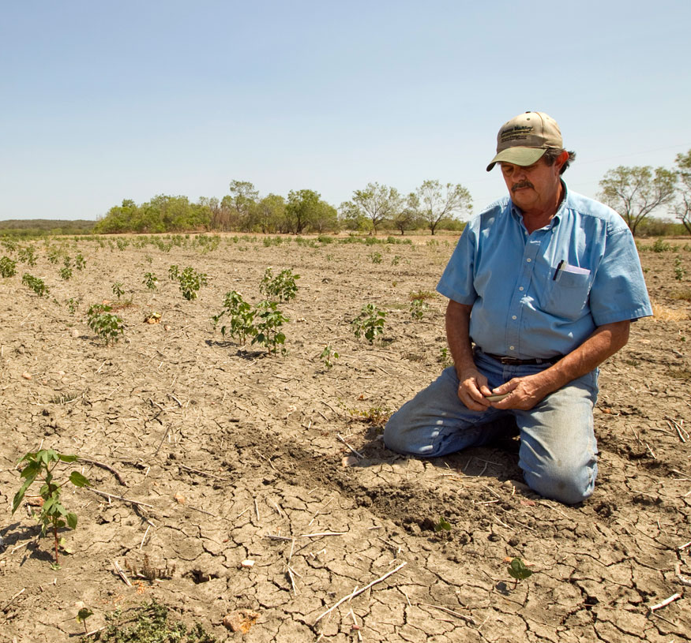
Future Work
Incorporate more data from years prior to 2011 and years after 2013
Adjust coefficients for the variables in the DSI for a more accurate reading
Source: Statesman Photo Blog
Notes:
[Emily]
A future project could incorporate more data to the index, specifically the years prior to 2011 and years after 2013. The addition of previous years would allow users to see the difference in the results between drought and non-drought years. Continuing to track drought severity in the future would allow users to determine whether management practices are accomplishing their objective.
Another goal for a future project would be to adjust the coefficients in the DSI to allow for a more accurate reading. This would increase uniformity and accuracy at the local level.

Slide 9
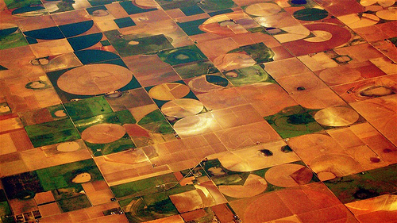
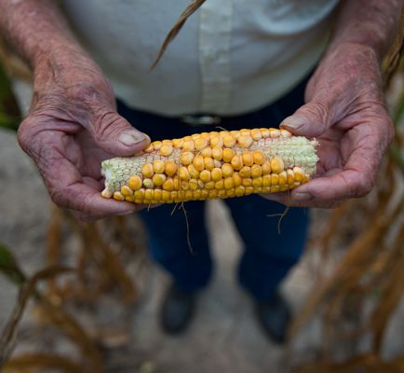
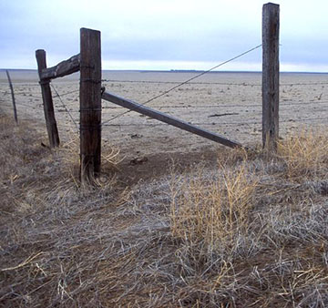
Acknowledgements
Dr. Kenton Ross
NASA DEVELOP National Science Advisor
Dr. Justin Derner
USDA ARS RRRU
Amberle Keith
Idaho State University
AJ Williams
Massachusetts Institute of Technology
Jonathan Hicks
Christopher Newport University
Lance Watkins
Mississippi State University
Summer 2013 Great Plains Team
Source: Smashing Magazine
Source: National Geographic
Source: University Corporation for Atmospheric Research
Notes:
[Emily]
To finish, we would like to thank the many people who helped us complete this project:
--Our science advisor, Dr. Ross
--Our project partner, Dr. Justin Derner
--The previous Great Plains Agriculture team
--Lance Watkins, who wrote the initial python script we used
--And Amberle Keith, AJ Williams, and Jonathan Hicks for helping us with data processing, python scripting, and various other technical issues

