Slide 1
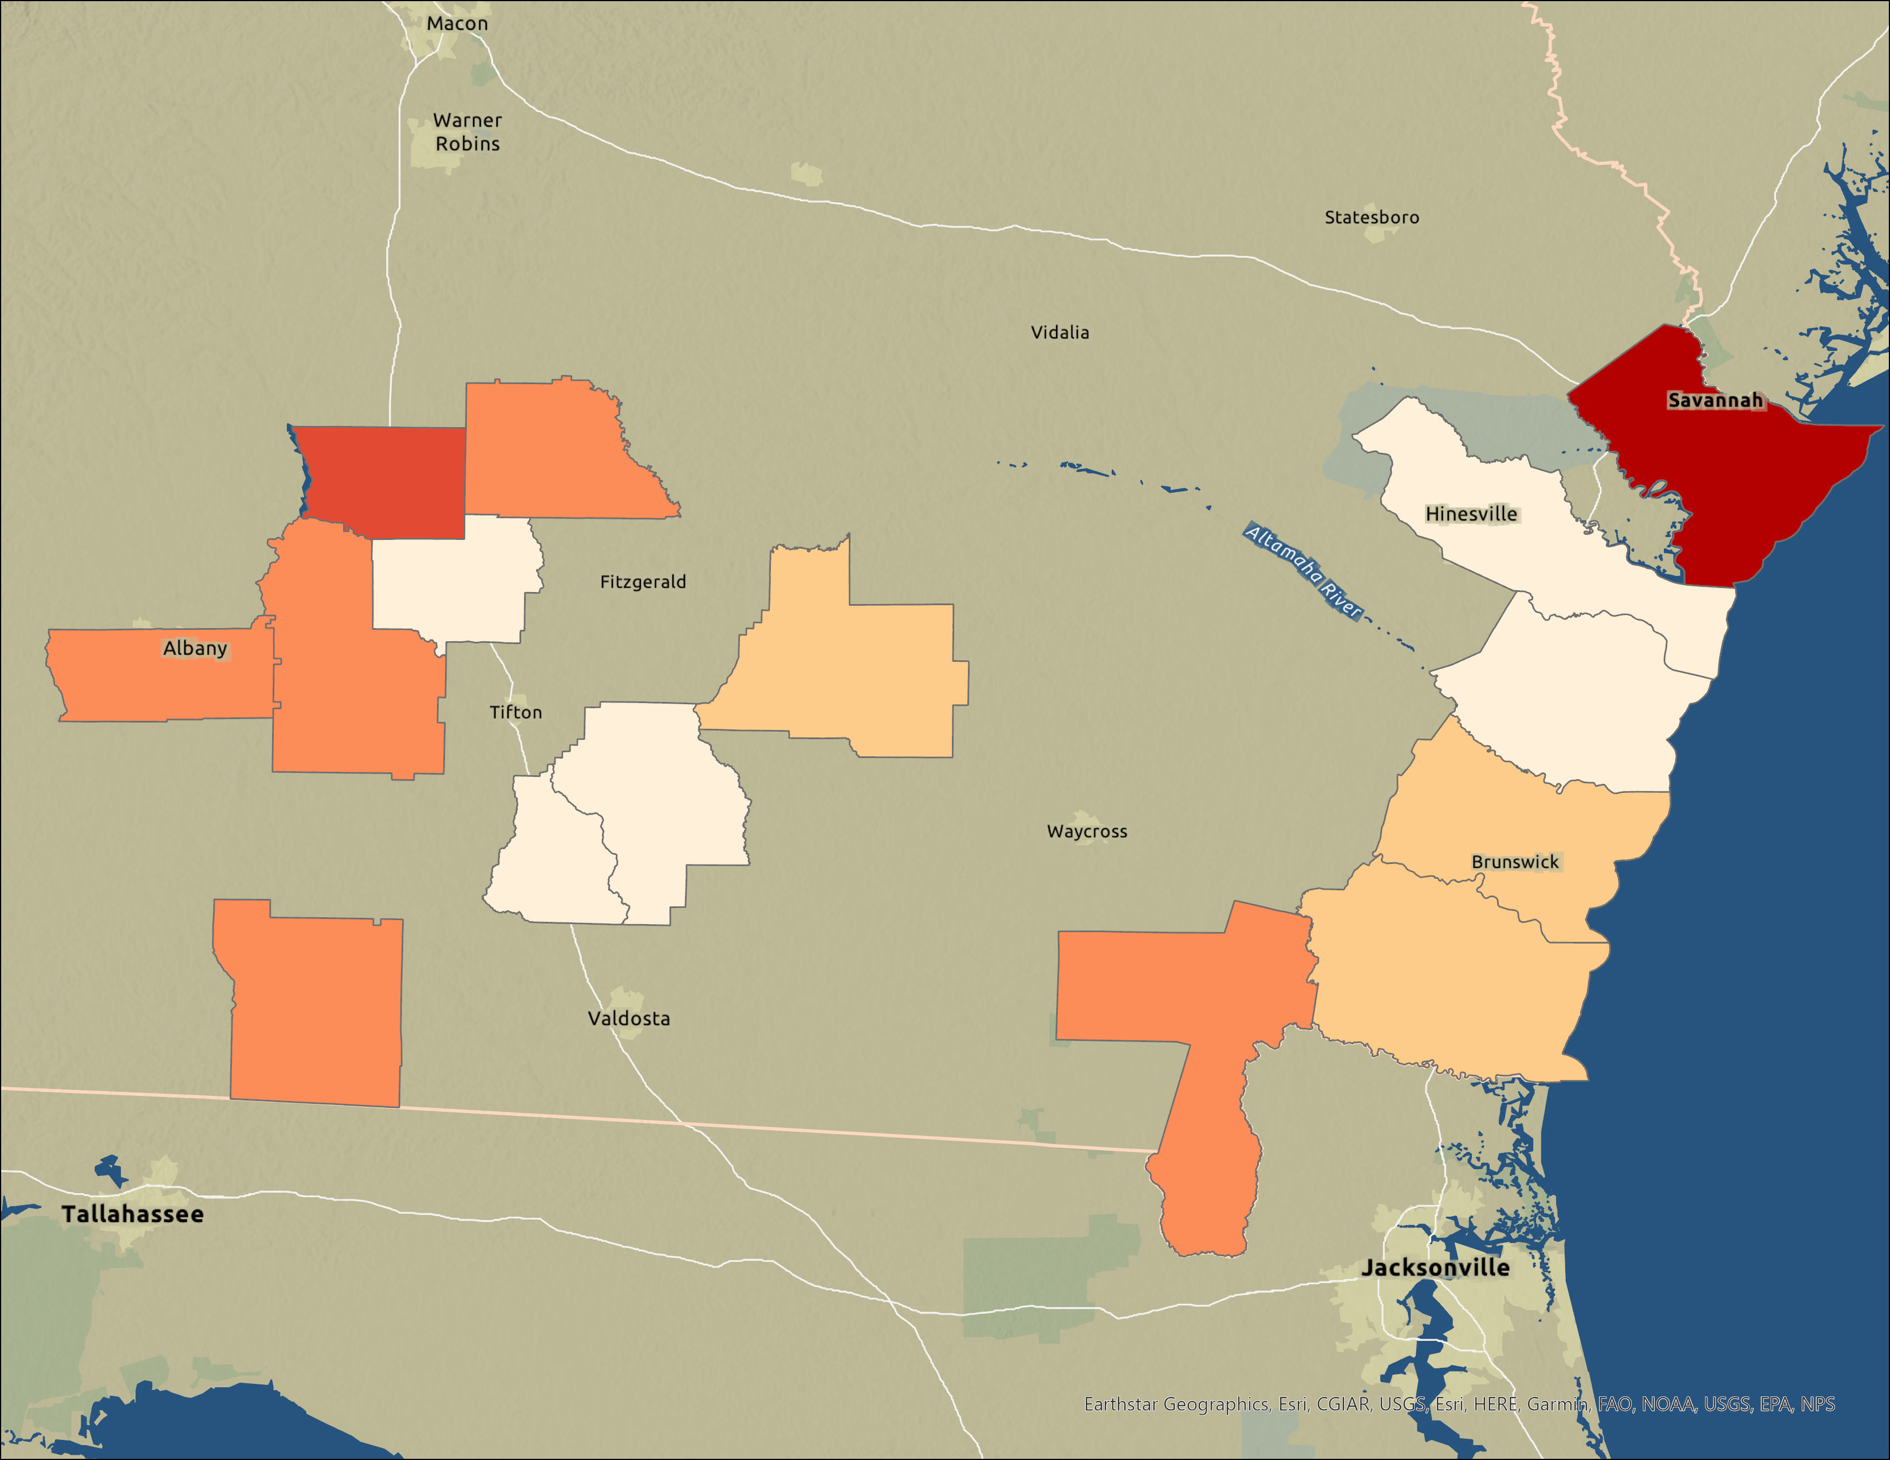
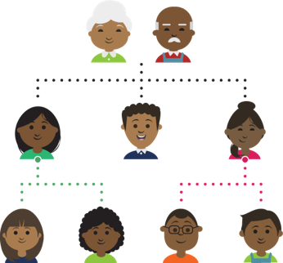
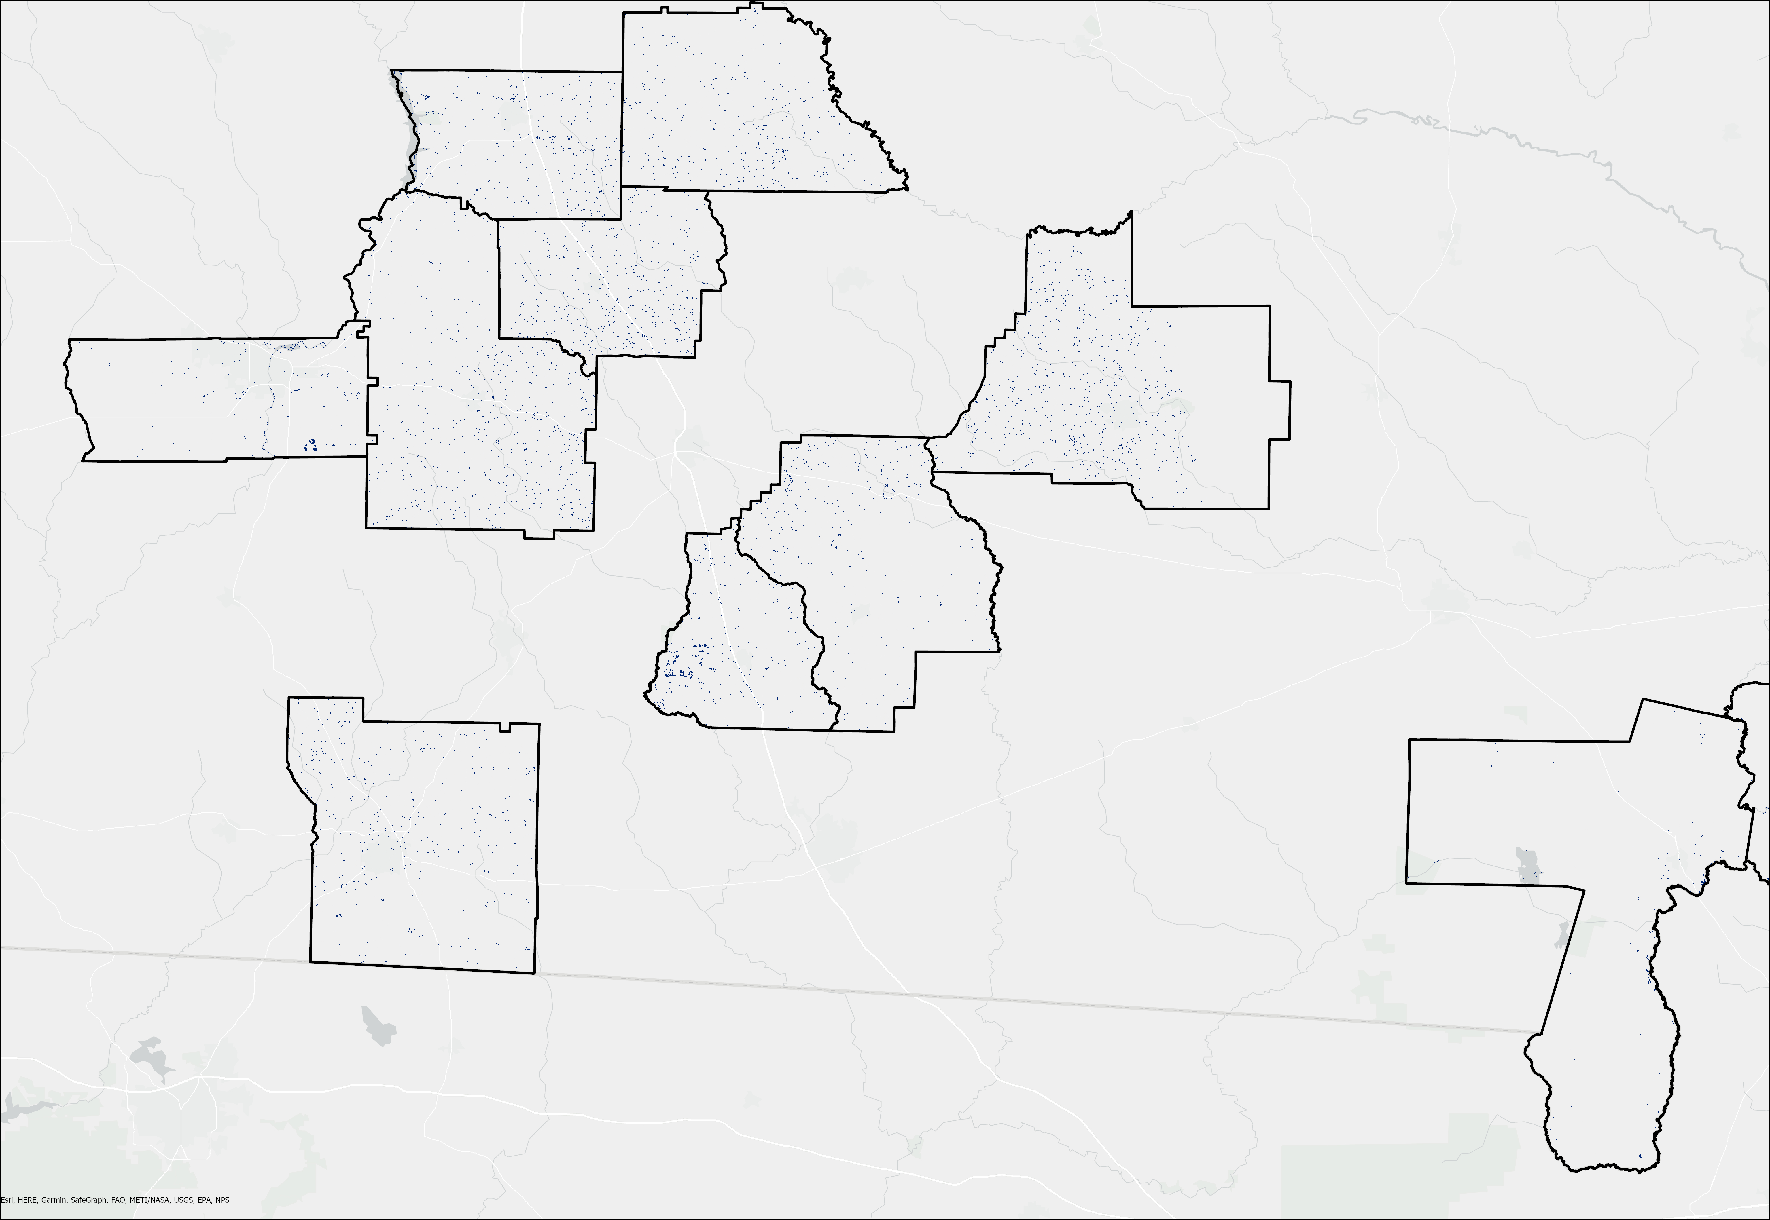
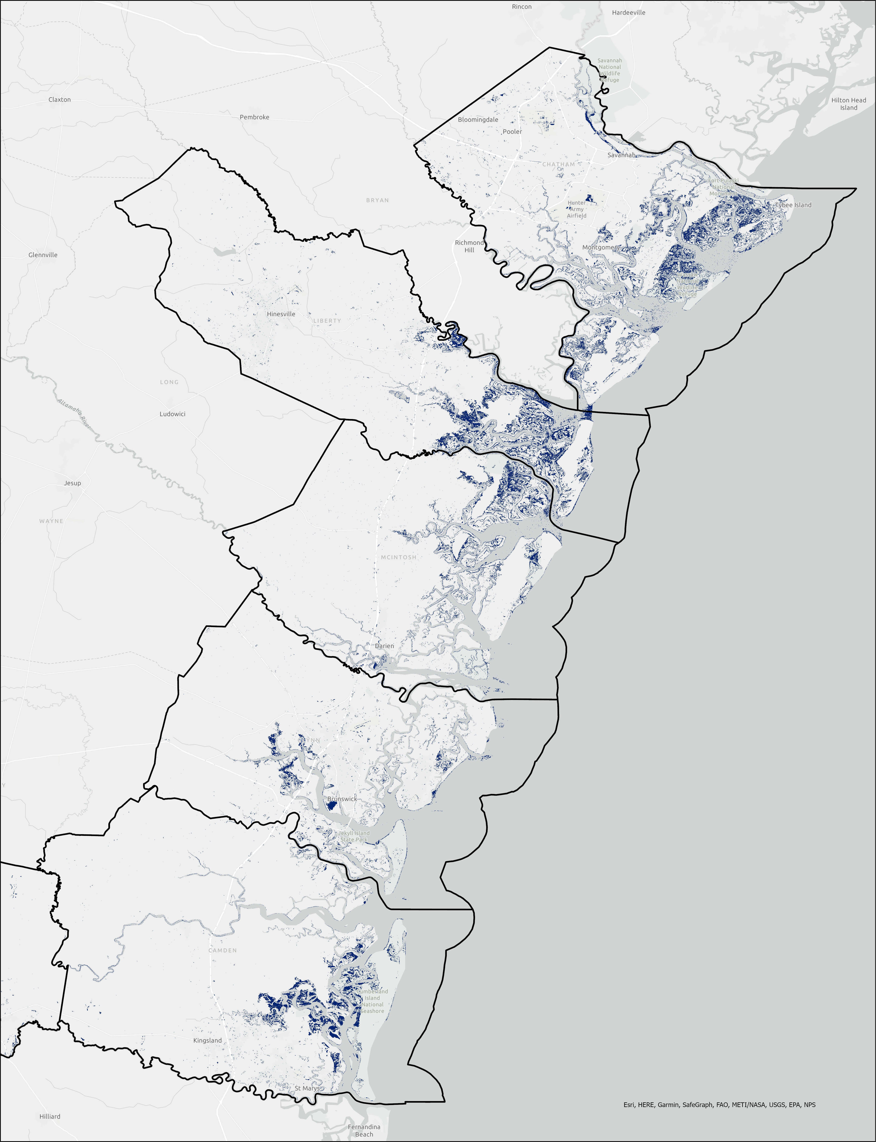
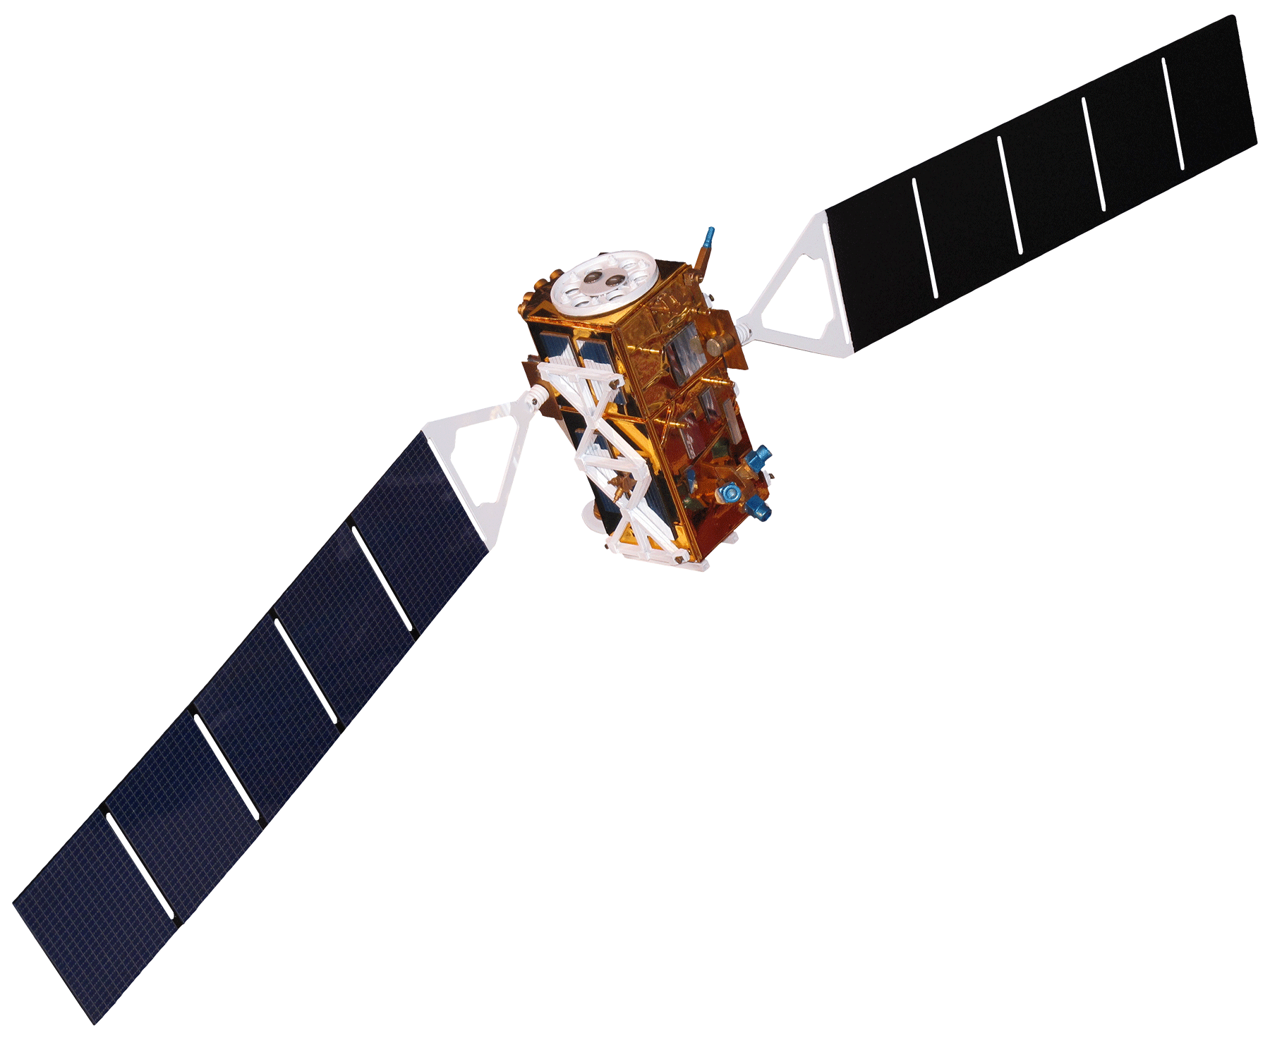
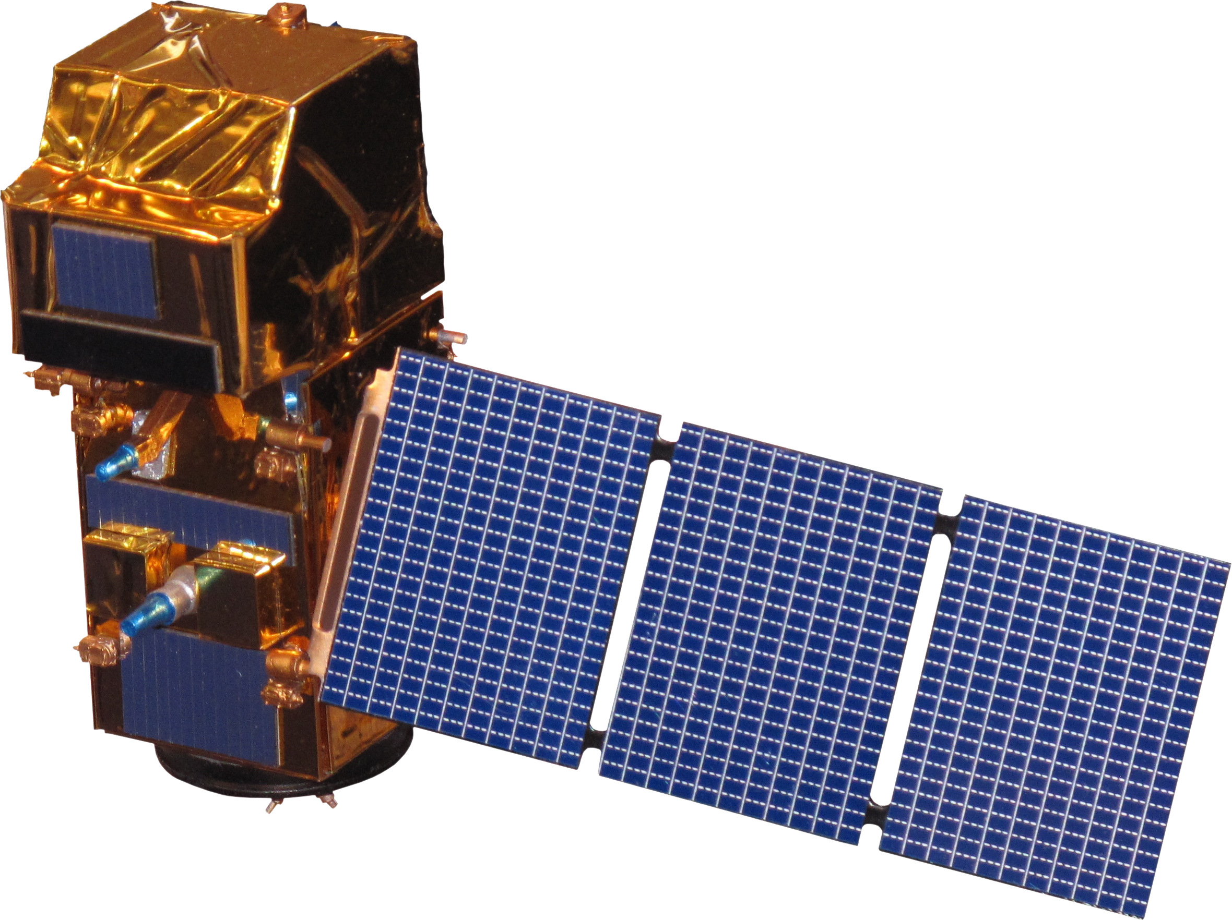
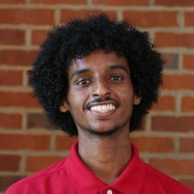
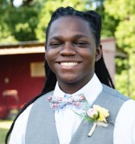
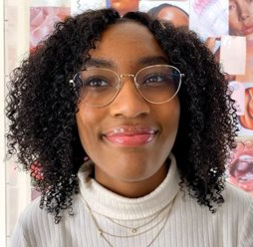
Georgia Disasters II
Evaluating the Impacts of Hurricane Irma on Georgia Heirs’ Property Owners Using NASA Earth Observations
Hurricane Irma was the sixth most costly hurricane in the U.S.A.
Estimated $670 million of property damage in Georgia
Max wind speed 62 mph
Rainfall of 3-7" inland
Storm surge of 3-5ft
Heirs’ property owners were unable to receive aid through FEMA
Heirs’ Property
Heirs’ property is created when a property owner passes without a will, making all their descendants fractional property owners.
Percent Heirs
2.8 – 4.6%
7.1 – 9.9%
1.9 – 2.8%
4.6 – 7.1%
9.9 – 13.0%
Identification: Each heirs’ property is unique, making identification challenging. We used the latest sale date and owner name/address as our major indicators.
Wilcox
Chatham
Meet the Smiths
Post-disaster: Ineligibility to receive disaster relief funds, blighted properties, land stealing, and loss of generational wealth
Crisp
Liberty
Image: Microsoft Office 365
Doughtery
Turner
The highest concentration of heirs’ properties is along the Georgia – South Carolina Low Country.
Worth
Coffee
McIntosh
Berrien
Glynn
Chatham County – 13.1%
Cook
Approximately 28,000 total heirs – 7.3%
Thomas
Charlton
Camden
This pattern roughly correlates with the Centers for Disease Control's Social Vulnerability Index – already vulnerable populations have the most heirs’ property.
0
20 mi
Flood Extent
Flood
The most flooding was identified along Georgia's coast Low Country.
Wilcox
Flood
Crisp
Dougherty
Turner
Coffee
Chatham
Chatham County – 7.2% of land area
Liberty County – 7.0% of land area
Worth
Berrien
Liberty
Thomas
Cook
Charlton
Flood
McIntosh
Earth Observations
Flood
Glynn
Despite heavy inland rainfall, most flooding seems to be due to storm surge along waterways.
Camden
0
10 mi
Landsat 8 OLI
Sentinel-1 C-SAR
Sentinel-2 MSI
Team Members
Project Partner
Georgia Heirs Property Law Center
Acknowledgements
EXAMPLE
Georgia Disasters Team: Isabella Chittumuri, Nancee Uniyal
Advisors: Dr. Cassandra Johnson Gaither (USDA Forestry Service); Dr. Marguerite Madden (University of Georgia); Joseph Sousa (Georgia Department of Community Affairs)
Special Thank To: Jimmy Nolan (Carl Vinson Institute), Dr. Ryan Thomson and Dr. Conner Bailey (Auburn University)
Shakira Rogers
Project Lead
Nathan Tesfayi
Clarence Brookins-Jackson
Matthew Murray
Georgia – Athens

