Slide 1
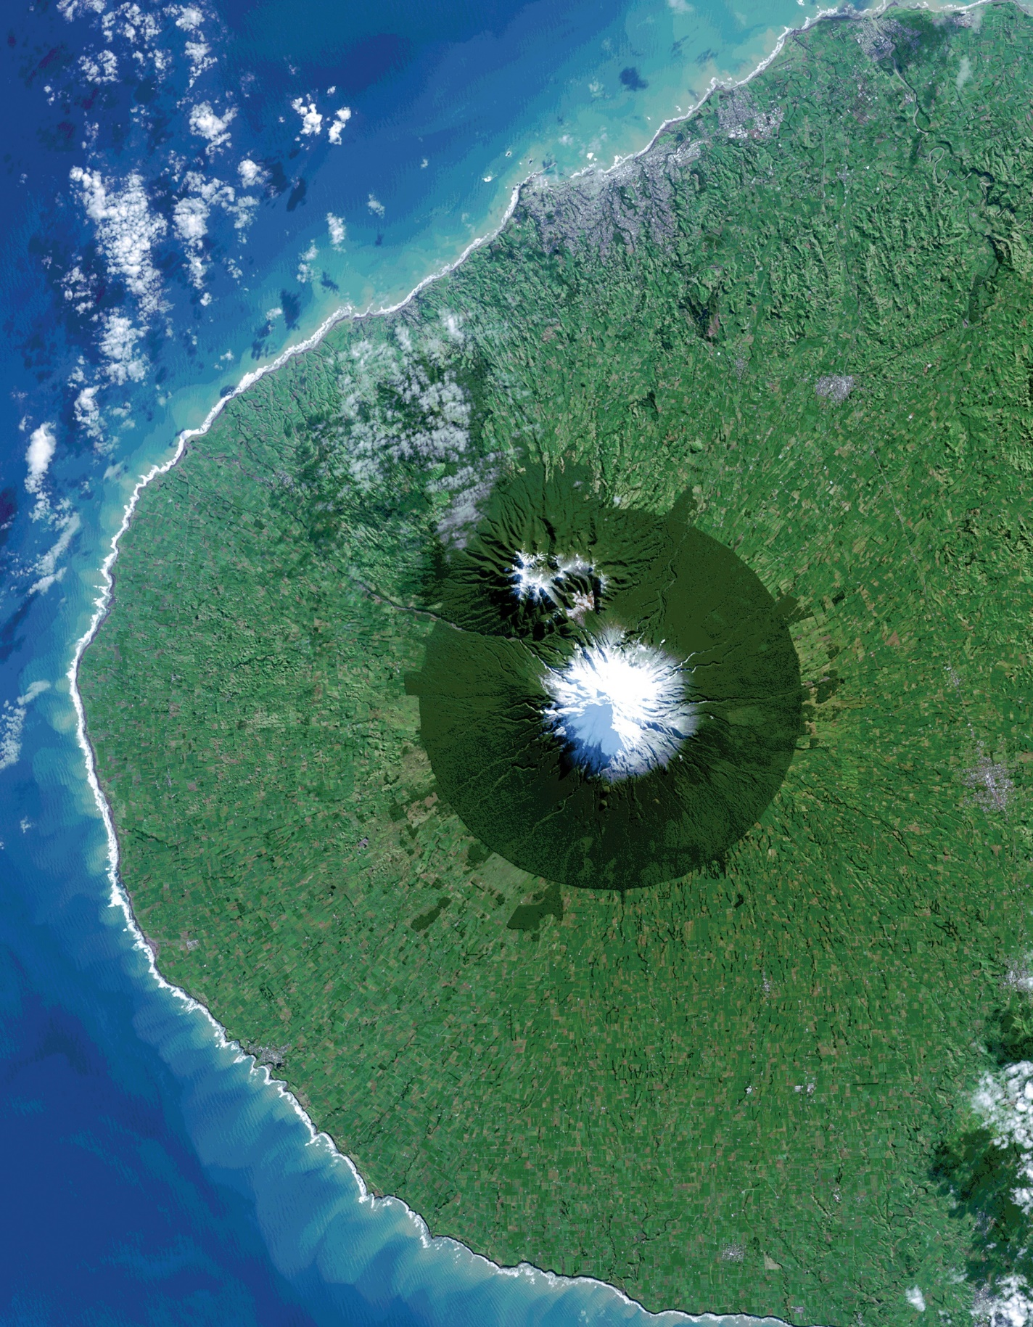
Website Image
Fall 2022
Youngstown and Warren Disasters
Virginia – Langley

Slide 2
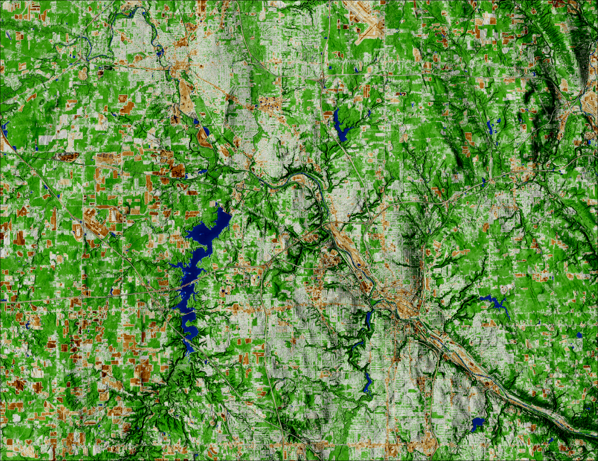
Youngstown and Warren Disasters
Caption: NDBI-processed imagery from a June 2022 Landsat 9 OLI image. This composite image shows the cities of Warren (top left) and Youngstown (bottom right). The areas in white and brown represent the built environment. While areas in green represent land that is not as built-up, such as forest. Built-up areas can indicate where surface run off could occur, resulting in pluvial flooding.
Metadata Tags: Landsat 9 OLI, NDBI, Lauren Mahoney, Nada Haddad, Thomas Ferrell, David Henriques

