Slide 1
SOUTHERN ARIZONA ECOLOGICAL FORECASTING
Molly Spater (Project Lead)
Natalie Queally
Detecting and Monitoring Invasive Buffelgrass in the National Parks of Southwestern Arizona
Nick Rousseau
Erika Higa
Notes:
Hello, we are the Southern Arizona Ecological Forecasting Team. My name is Natalie Queally and I graduated from UCLA with a Bachelor’s in Geography and Environmental Studies and minor in Geographic Information Systems and Technologies and Conservation Biology. My name is Nick Rousseau, I am the Center Lead at JPL and I have a Master’s in Geology from CA State University Northridge. My name is Erika and I am a Geoinformatics Fellow and Assistant Center Lead, Bachelor’s in Geography/Environmental Studies and minor in Geographic Information Systems and Technologies.
My name is Molly Spater and I graduated from UCLA with a Bachelor’s in Geography and minor in Geographic Information Systems and Technologies. I am the Project Lead.

Slide 2
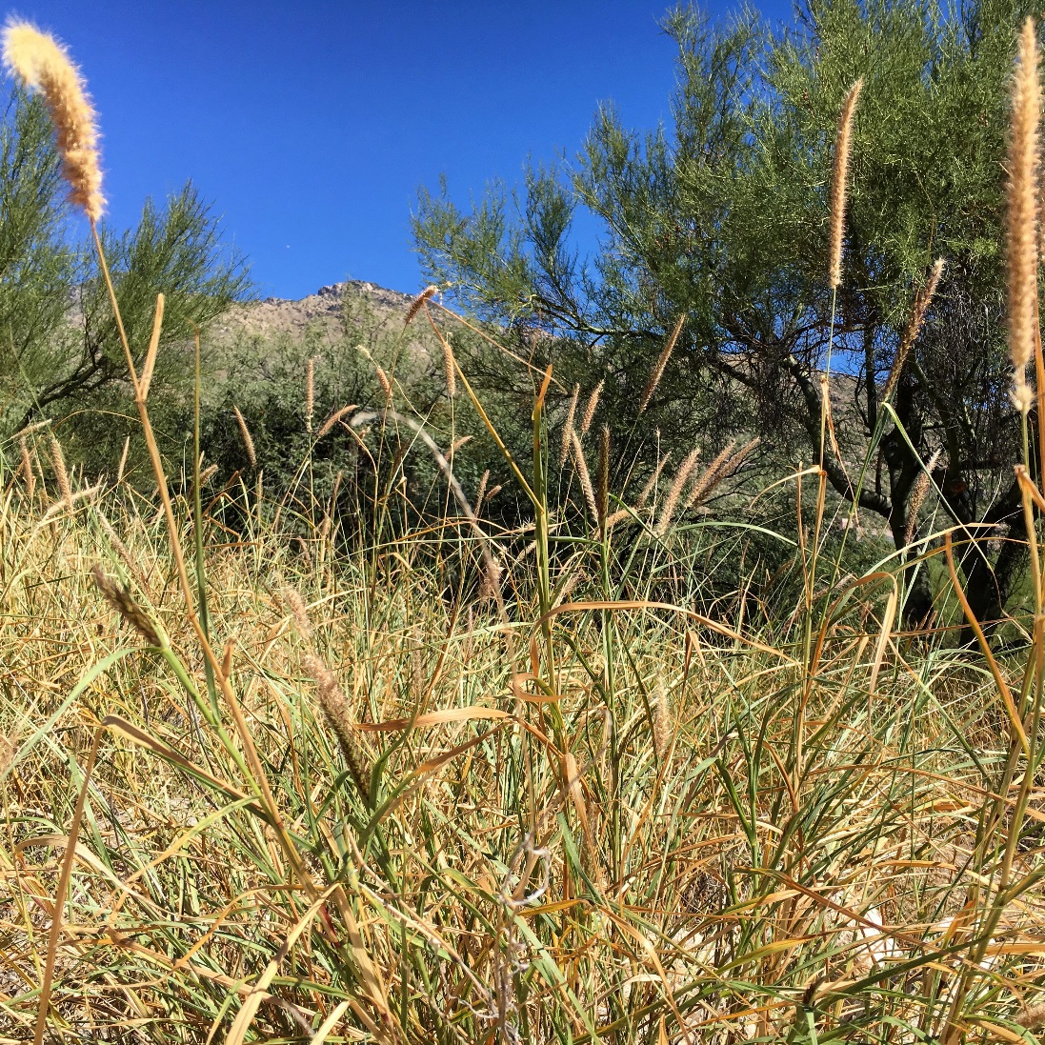
Pennisetum ciliare
Invasive shrub grass native to Africa and Eurasia
Introduced to the Southwestern U.S. to improve degraded rangelands
Invaded both disturbed and undisturbed desert environments
Widely-distributed in the Sonoran Desert ecosystem
Image Source: Molly Spater
Notes:
Pennistum ciliare, or buffelgrass, is a deep rooting grass native to Africa and Eurasia. It was originally brought to the United States as early as 1889 to improve degraded rangelands, as it stabilizes soils and is very drought-tolerant. The species has proven to be an aggressive invader by taking over the landscapes of the Sonoran Desert and threatening to transition native ecosystems into grasslands.
Image Source: Molly Spater

Slide 3
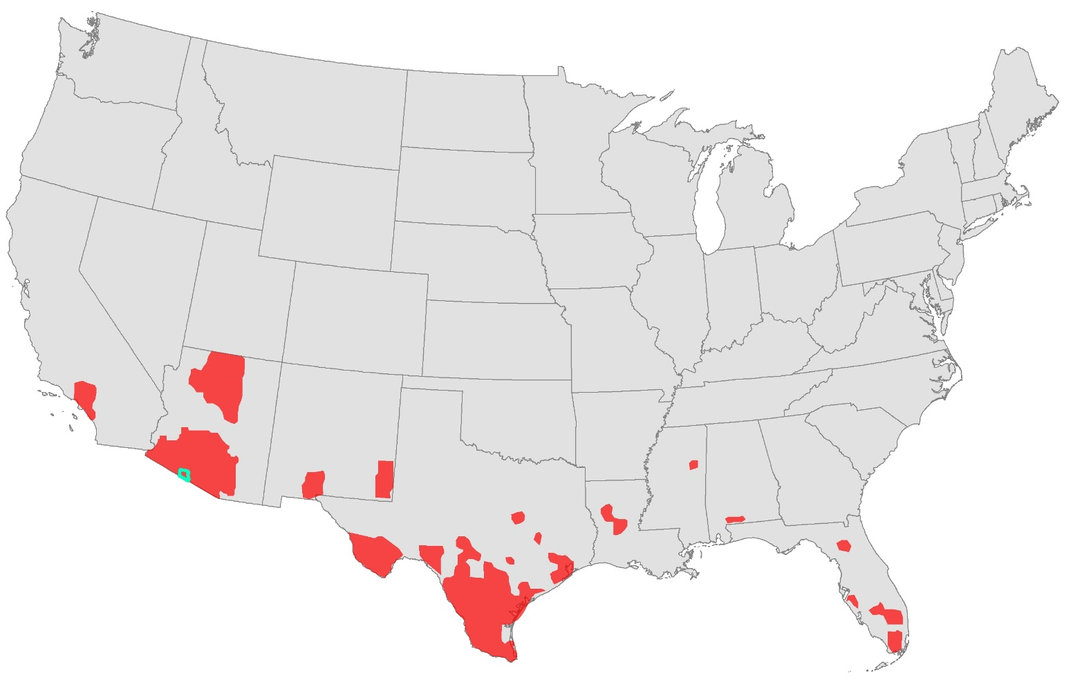
Pennisetum ciliare
Estimated National Distribution of Buffelgrass
Buffelgrass presence
Data Source: Utah State University Herbarium
OPCNM Boundary
Notes:
This map is an overview of buffelgrass distribution in US. The aqua color outlines the study area of this project which will be discussed later.
Recreated and simplified map with data from: http://herbarium.usu.edu/webmanual/

Slide 4
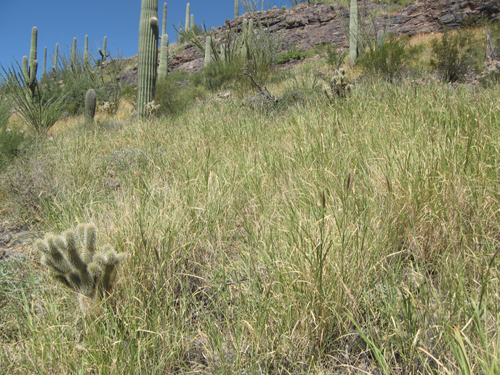
Community Concerns
Buffelgrass spreads rapidly and fills the normally-barren gaps between native vegetation
Buffelgrass outcompetes native desert plants for water and soil nutrients
Buffelgrass increases wildfire severity and the number of wildfire events
With wildfire frequency, buffelgrass threatens public safety and property
Image Credit: NPS
Notes:
Buffelgrass alters local ecosystems of the Sonoran Desert. Buffelgrass fills in spaces normally barren in the desert landscape via a root system that enables it to outcompete native plants for nutrients and respond to precipitation events faster. By filling in these spaces the plant forms a dense mat as seen in this picture. The plant burns extremely easily and extremely hot, causing more frequent and severe wildfires. Changes in the fire regime damage native ecosystems not adapted to these conditions and threaten human populations in the Sonoran Desert.
Image Source: https://www.nps.gov/sagu/learn/nature/buffelgrass.ht

Slide 5
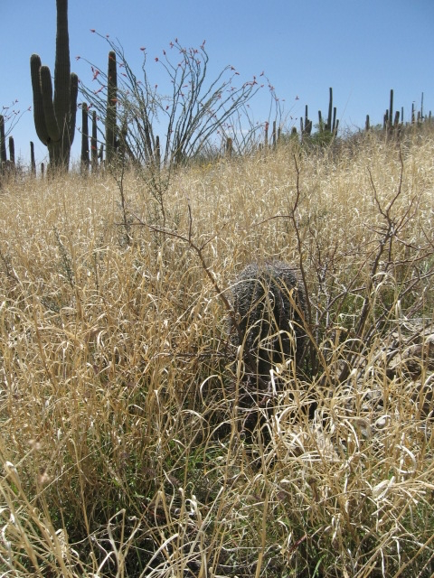
Objectives
Utilize NASA Earth Observations and WorldView-2 data to detect invasive buffelgrass
Investigate the effectiveness of the CLaRe and MTMF metrics used in Wallace et al (2016) for buffelgrass detection
Create classification map of buffelgrass presence/absence in Organ Pipe Cactus National Monument
Image Credit: NPS
Notes:
The objective of this project is to improve the capacity of the NPS to detect and monitor buffelgrass infestations utilizing NASA Earth Observations and remote sensing techniques. Remote sensing would expand the spatial extent of surveys and decreases costs.
The second objective was to investigate the effectiveness of the CLaRe and MTMF metrics, the two methodologies provided by our partners, for bufflegrass detection.
Lastly, we aimed to create classification maps to show the presence and absence of buffelgrass to track the growth and spread within their parks and plan education efforts.
Image Credit: https://www.nps.gov/sagu/learn/nature/invasive-plants.htm
Image Source: https://www.nps.gov/media/photo/gallery.htm?id=011B683D-155D-451F-67DB70F9CD0C5714

Slide 6
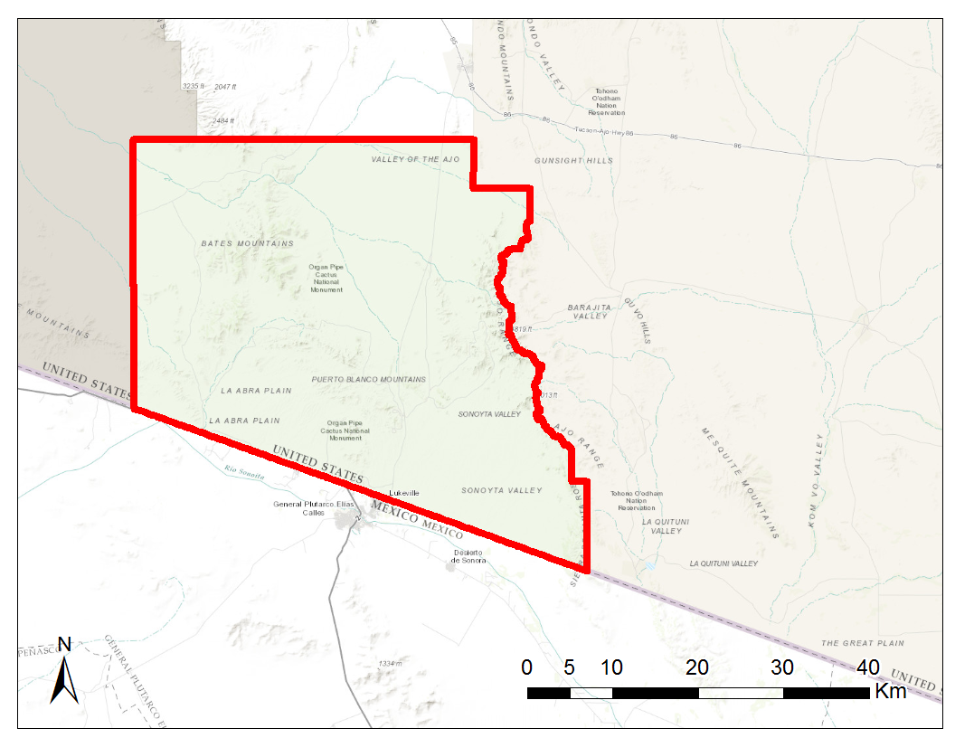
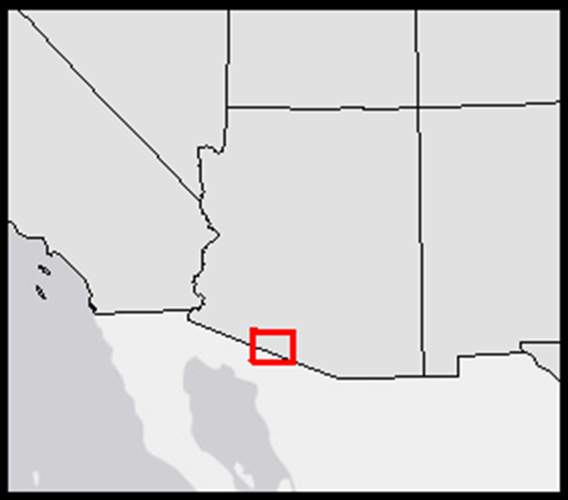
Study Area and Period
Organ Pipe Cactus National Monument
Years: 2009-2012
Focus on months of high precipitation
Arizona
Organ Pipe Cactus National Monument
Data Source: NPS
Notes:
The study area for this project is Organ Pipe Cactus National Monument located in southern Arizona. Organ Pipe Cactus National Monument covers 516 square miles of the Sonoran Desert. The study period is 2009 -2012 corresponding to available field data.
Base map Source: Esri, HERE, DeLorme, Intermap, increment P Corp., GEBCO, USGS, FAO, NPS, NRCAN, GeoBase, IGN, Kadaster NL, Ordnance Survey, Esri Japan, METI, Esri China (Hong Kong), swisstopo, MapmyIndia, © OpenStreetMap contributors, and the GIS User Community

Slide 7
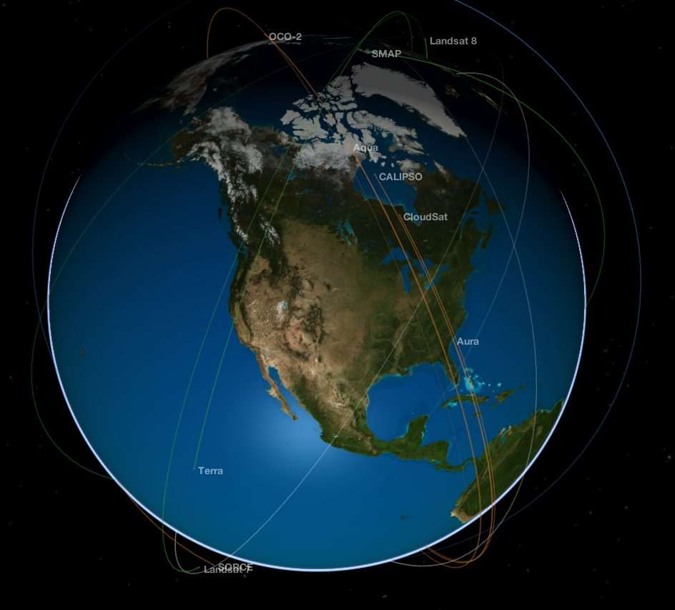
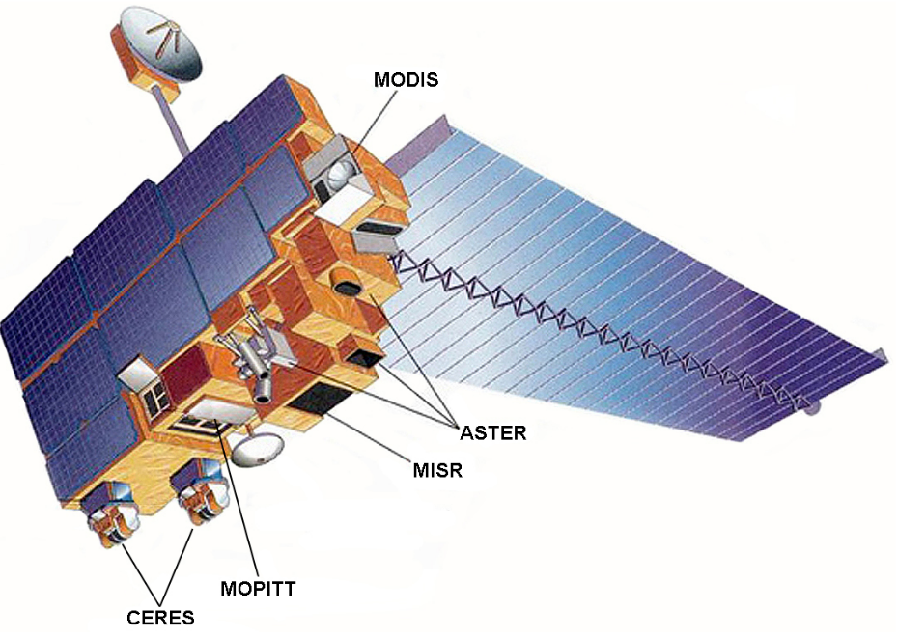
NASA Satellites and Sensors
Aqua/Terra: Moderate Resolution Imaging Spectroradiometer (MODIS)
Image Credit: NASA.gov
MODIS GPP/NPP Project and Global Evapotranspiration Project (University of Montana)
Image Credit: NASA Eyes on Earth
Notes:
Data acquisition for this project focused on the Moderate Resolution Imaging Spectroradiometer aboard the Aqua and Terra satellites. Normalized Difference Vegetation Index (NDVI) values were calculated from 8-day composite MODIS images. Gross Primary Productivity and Evapotranspiration data derived from MODIS was downloaded from the University of Montana, also at an 8-day scale.
Image Source: https://www.nasa.gov/directorates/heo/scan/services/missions/earth/Terra.html

Slide 8
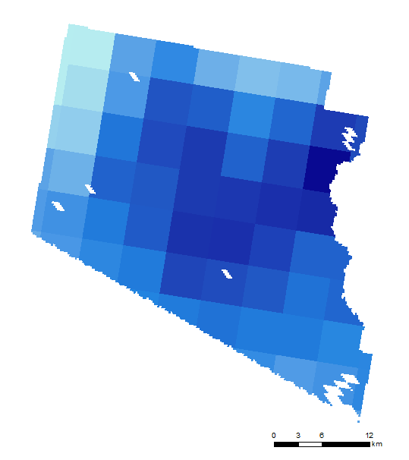
PRISM Climate Group
Oregon State University
Daily precipitation data
resampled from 4 kilometers to 250 meters
Aggregated for varying accumulation periods up to 2 months
January 17 -24th, 2010
64.12 mm
103.33 mm
Notes:
Daily precipitation data was downloaded from the PRISM Climate Group out of Oregon State University. 8-day accumulation rasters were created with Python code to correspond to MODIS 8-day NDVI data. Accumulation rasters were also made to test precipitation lag times of 8 to 64 days.

Slide 9
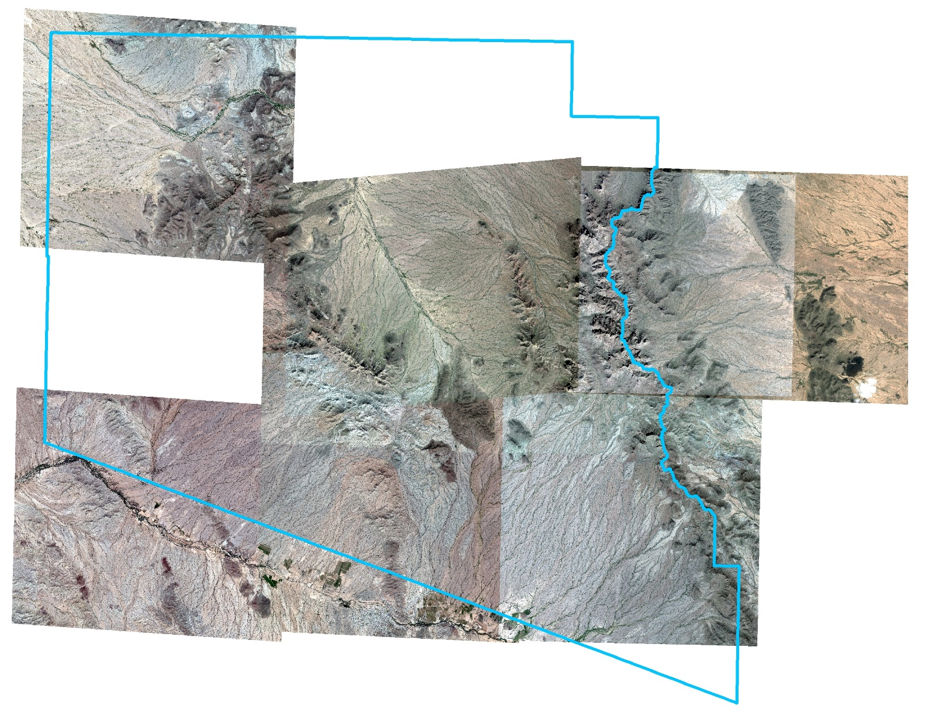
WorldView-2
Launched October 2009
Commercial satellite with up to 0.46 meter spatial resolution
Image Credit: Satellite Imaging Corporation
Notes:
WorldView-2, a commercial satellite with resolution up to 0.46 meters, was also downloaded. Images were available only in 2012, and only covering a portion of the park.
Image Source: http://www.satimagingcorp.com/satellite-sensors/worldview-2/

Slide 10
Methodology
Mixture-Tuned Matched Filtering (MTMF)
Spectral
Based
Technique
WV-2
Climate-Landscape Response (CLaRe)
Model
Spatial
Correlation
Technique
MODIS
Image Credit: NPS
Notes:
Our project focused on two different methodologies for buffelgrass detection, one based on spectral signature data provided by our project partner Temuulen Sankey and the other on correlations with environmental variables provided by our project partner Cindy Wallace.
Image Source: https://www.nps.gov/sagu/learn/news/sazrlp.htm

Slide 11
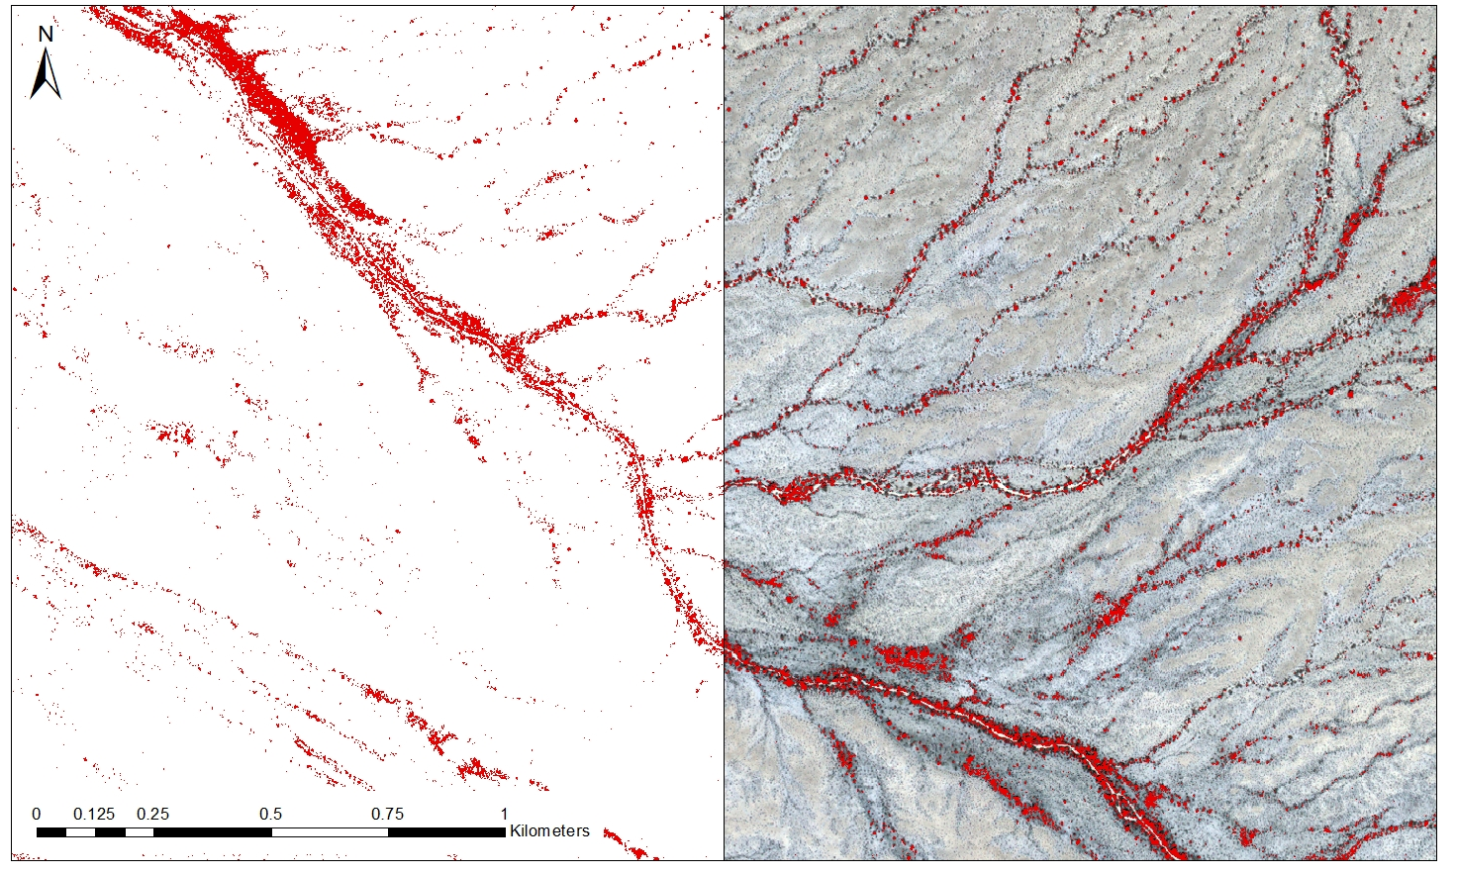
What is MTMF?
MTMF = Mixture-Tuned Matched Filtering
Subpixel, spectral-based analysis
Incorporates field measurements of target spectra
Buffelgrass
Absence
Presence
Notes:
Mixture-tuned matched filtering (MTMF), is a subpixel, spectral-based approach to detecting buffelgrass. Subpixel means it gives an estimate of % land cover within each pixel of the image. Spectral-based means it relies on reflectance across the electromagnetic spectrum. The method requires “target spectra,” which it will look for in the image. Buffelgrass spectra was measured by our project partner at Northern Arizona University using a spectrometer.
The image is just an example of what an MTMF output will look like. On the left half you can see what the map would look like if presence and absence were shown (absence in white, presence in red). On the right half you can see what the target pixels look like overlaid on the WorldView-2 image.

Slide 12
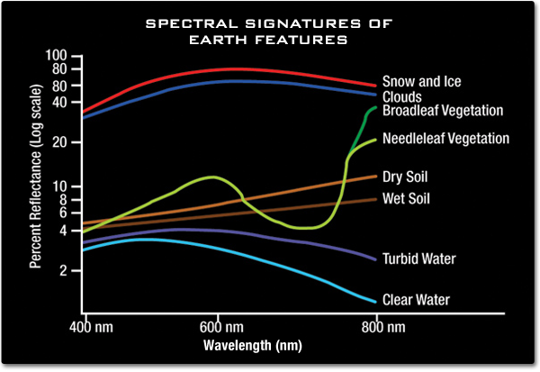
What is MTMF?
Land cover can be determined using the spectral signature – unique reflectance pattern across the EM spectrum
Image Credit: Jeannie Allen
Image Credit: NASA
Notes:
Different types of land cover reflect varying waves of the electromagnetic spectrum in different ways. This can be measured, and we call it the spectral signature.
The image on the left is an example of different spectral signatures. When processing an image, your computer would be able to separate pixels based on what pattern of reflectance they followed.
WorldView-2 images cover wavelengths from about 400 - 900 nanometers. This spans the visible light range and the near infrared. Other sensors may have a higher spectral resolution, covering a wider span of wavelengths at finer intervals.
It is easiest to differentiate between very different land cover types. For example, the spectral signature of clouds is very different from vegetation, which is very different from water. However, different vegetation types also have varying spectral signatures, as you can see in the distinction between broadleaf and needleleaf vegetation. So we tried this spectral-based approach to see if detecting buffelgrass using only its spectral information would be possible.
Image Source (left): http://missionscience.nasa.gov/ems/09_visiblelight.html
Image Source (right): http://earthobservatory.nasa.gov/Experiments/ICE/panama/panama_ex1.php

Slide 13
MTMF Methodology
WorldView-2 Image Acquisition
Image pre-processing
Target Detection: MTMF
Matched Filter Threshold Modeling
Cohen’s Kappa Coefficient
Binary Classification
Presence/Absence Map
Notes:
The first step was to acquire the WV-2 images, which we were able to do through USGS EarthExplorer. Once the images were acquired, there were two main phases of preprocessing: atmospheric correction and geometric correction. Atmospheric correction is important because it removes the effect of clouds and aerosols and helps extract more accurate spectral information for analysis. Geometric correction is used to correct image distortions caused by a myriad of factors like terrain relief, sensor altitude, and even the Earth’s curvature.
When the images were prepped for analysis, we began the MTMF process.

Slide 14
Methodology
WorldView-2 Image Acquisition
Image pre-processing
Target Detection: MTMF
Matched Filter Threshold Modeling
Cohen’s Kappa Coefficient
Binary Classification
Presence/Absence Map
Notes:
The first step was to acquire the WV-2 images, which we were able to do through USGS EarthExplorer.
When the images were prepped for analysis, we began the MTMF process.

Slide 15
Methodology
WorldView-2 Image Acquisition
Image pre-processing
Target Detection: MTMF
Matched Filter Threshold Modeling
Cohen’s Kappa Coefficient
Binary Classification
Presence/Absence Map
Notes:
Once the images were acquired, there were two main phases of preprocessing: atmospheric correction and geometric correction. Atmospheric correction is important because it removes the effect of clouds and aerosols and helps you extract more accurate spectral information in your analysis. Geometric correction is used to correct image distortions caused by a myriad of factors like terrain relief, sensor altitude, and even the Earth’s curvature.

Slide 16
Methodology
WorldView-2 Image Acquisition
Image pre-processing
Target Detection: MTMF
Matched Filter Threshold Modeling
Cohen’s Kappa Coefficient
Binary Classification
Presence/Absence Map

Slide 17
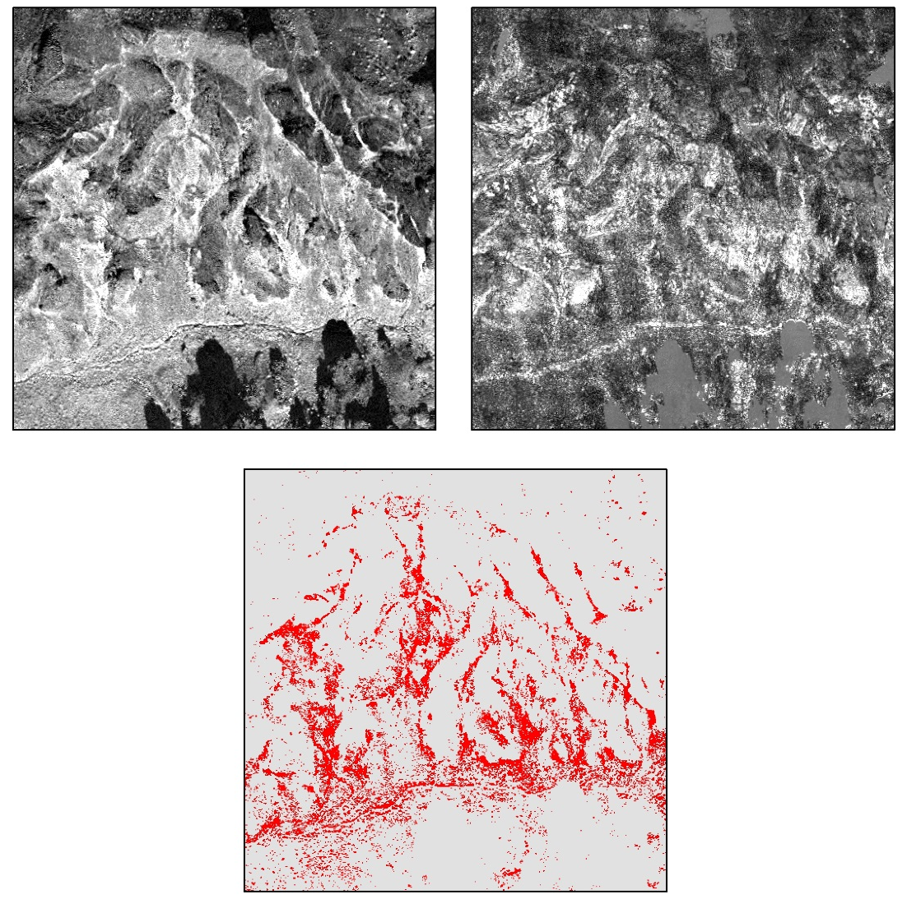
MTMF Target Detection
MF Score
Infeasibility Value
MTMF outputs:
Matched Filter (MF) Score
% coverage within pixel
Infeasibility Value
Used to reduce the number of false positives produced through Matched Filtering
The challenge: deciding how to balance the two outputs to create a classification map
High
High
Low
Low
Non-target
Target
Target Detected
Notes:
The output of MTMF are as follow:
MF Score: The matched filter score which is a measure of the percent cover of the target spectra within each pixel
Infeasibility Value: The infeasibility value estimates if there is likely a false positive (high MF score where there is actually no target spectra)
To create classification maps and isolate pixels with the target present, these two scores have to be balance. If there is a higher matched filter score and a lower infeasibility value, the chance of a correct classification is higher.
The images on the right show what the MF score and Infeasibility rasters look like. These two are combined using the raster calculator, and the resulting image shows the target and non-target areas.

Slide 18
Working with Field Data
Field points with attribute-derived buffers
Field points
Field data is necessary to test for classification accuracy
Point data is insufficient when working with 2m pixels
Field data can be extrapolated with the use of attributes from the dataset
Field presence
Field presence buffer
Field absence
Field absence buffer
Notes:
When making a classification map, it is necessary to have field points to test for accuracy. Otherwise, there is no way to test if the method is working. However, the field data we acquired had its own set of challenges. The main challenge is that it was point data, even though the points were meant to represent much larger areas. A point could be representing a patch with dimensions 100m x 100m, and we have no idea if this point is in the center, or on the edge, or even in a spot where a plant was actually growing.

Slide 19
Methodology
WorldView-2 Image Acquisition
Image pre-processing
Target Detection: MTMF
Matched Filter Threshold Modeling
Cohen’s Kappa Coefficient
Binary Classification
Presence/Absence Map
Notes:
After running the MTMF target detection, it was necessary to decide what to do with the outputs. This led to Matched Filter Score threshold modeling.

Slide 20
MF Thresholds
The same spatial extent with different MF thresholds
Buffelgrass presence/absence classification is affected by the thresholds set for MF and Infeasibility
Infeasibility < 10
MF > ?
For each MF threshold level, there are different levels of MTMF modeled classification and field data agreement
MF > 0.3
MF > 0.4
MF > 0.5
Absence
Presence
Notes:
Because we were already working with uncertainties in the extrapolated field data, we kept the Infeasibility Value slightly below the ENVI default of 18. Using a conditional statement in the raster calculator in ArcMap, we could easily adjust these thresholds and combine the MF and Infeasibility images into a resulting target image. For example, if Infeasibility <10 and 0.2 < MF <1, that counts as presence (1). The rest of the pixels are absence (0). This binary classification is what we used to determine if the presence/absence buffers intersect the MTMF presence/absence.
The images show how the presence pixels are reduced as the MF score minimum is increased.

Slide 21
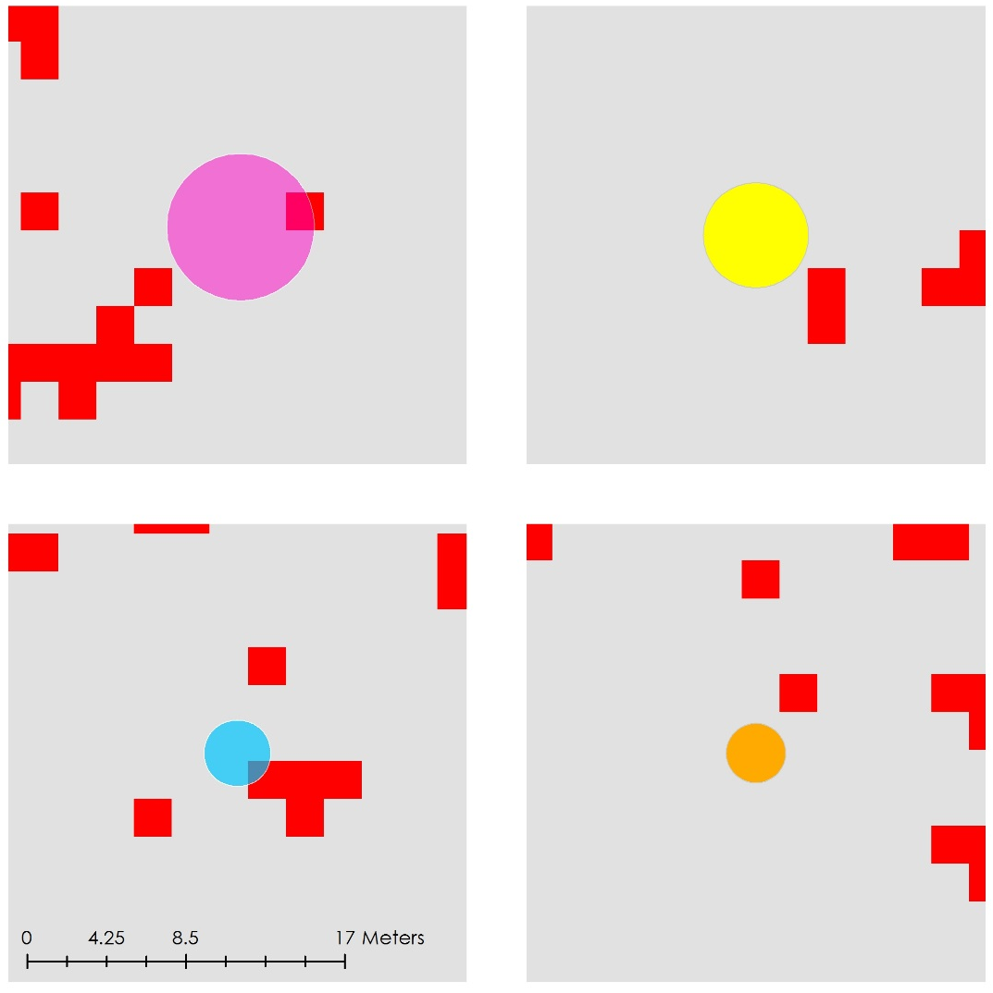
MF Thresholds
Changing the MF threshold impacts the accuracy of the model to predict buffelgrass presence.
MTMF and Field Data were compared through these four classes :
Yes yes (yy): the field presence buffer intersects at least one MTMF presence pixel
Yes no (yn): the field presence buffer does not intersect MTMF presence
No yes (ny): the field absence buffer intersects at least one MTMF presence pixel
No no (nn): the field absence buffer does not intersect MTMF presence
MTMF Presence
MTMF Absence
YY
YN
Field Presence
NY
NN
Field Absence
Notes:
Before we could test the accuracy of the MTMF model, we compared the results of the MTMF model with ground truth data. This occurred by breaking the results into four categories according to where Modeled Data and Field Data agreed on presence and absence of buffelgrass, and where they disagreed.

Slide 22
Methodology
WorldView-2 Image Acquisition
Image pre-processing
Target Detection: MTMF
Matched Filter Threshold Modeling
Cohen’s Kappa Coefficient
Binary Classification
Presence/Absence Map
Notes:
This agreement was then analyzed by calculating a Cohen’s Kappa Coefficient.

Slide 23
MF Threshold & Cohen’s Kappa
Cohen’s Kappa Coefficient:
Statistic used to measure agreement between two judges in sorting categorical items
Takes into account agreement occurring by chance
Date | MF Threshold | Kappa
January 16, 2012 | 0.1 | 0.340
 | 0.15 | 0.428
 | 0.2 | 0.487
 | 0.25 | 0.487
 | 0.3 | 0.407
February 10, 2012 | 0.1 | 0.577
 | 0.15 | 0.675
 | 0.2 | 0.841
 | 0.25 | 0.793
October 14, 2012 | 0.3 | 0.185
 | 0.4 | 0.450
 | 0.5 | 0.709
 | 0.55 | 0.097
 | Yes | No
Yes | 1012 | 31
No | 18 | 157
Notes:
Cohen’s Kappa is a statistic used to measure the agreement between two judges in sorting categorical items. The judges in this case would be field data and modeled data (via MTMF). When the data is YY or NN, the two judges are in agreement. Using Cohen’s Kappa helps quantify the strength of the agreement while taking into account the chance agreement. It compares the number of observed concordant items (YY and NN) to the number of chance expected concordant items. It essentially means that of all the items expected to be non-concordant by chance, 84% are concordant (see green chart).

Slide 24
Methodology
WorldView-2 Image Acquisition
Image pre-processing
Target Detection: MTMF
Matched Filter Threshold Modeling
Cohen’s Kappa Coefficient
Binary Classification
Presence/Absence Map
Notes:
Once the optimal MF threshold is determined from Cohen’s Kappa, we can create the binary classification of presence/absence for the final map.

Slide 25
Methodology
WorldView-2 Image Acquisition
Image pre-processing
Target Detection: MTMF
Matched Filter Threshold Modeling
Cohen’s Kappa Coefficient
Binary Classification
Presence/Absence Map
Notes:
Once the optimal MF threshold is determined from Cohen’s Kappa, we can create the binary classification of presence/absence for the final map.

Slide 26
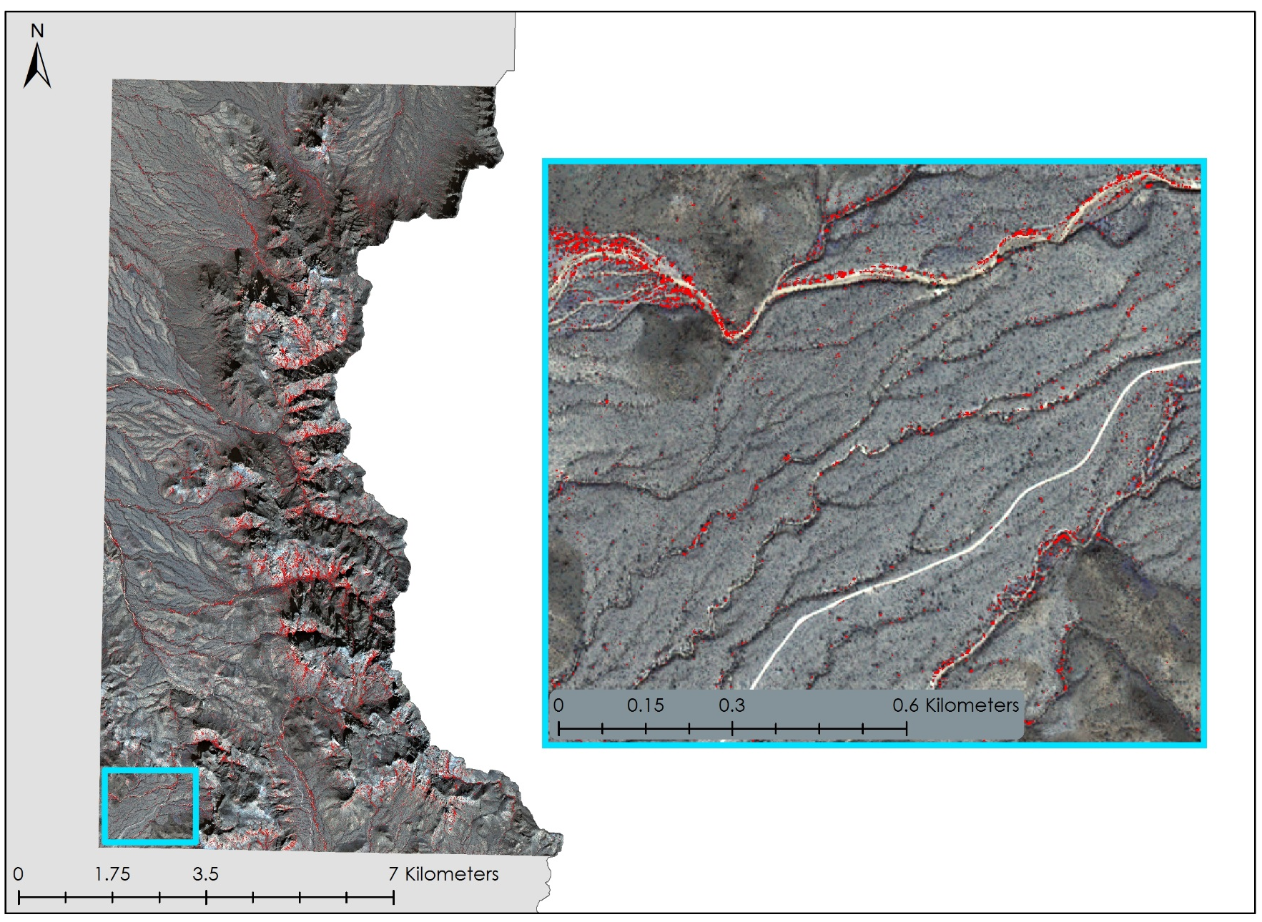
Classification Map
OPCNM
Presence
Notes:
This map was produced for February 10th 2012 using the 0.2 MF threshold derived from the Cohen’s Coefficient analysis. Areas where buffelgrass is predicted is shown in red.

Slide 27
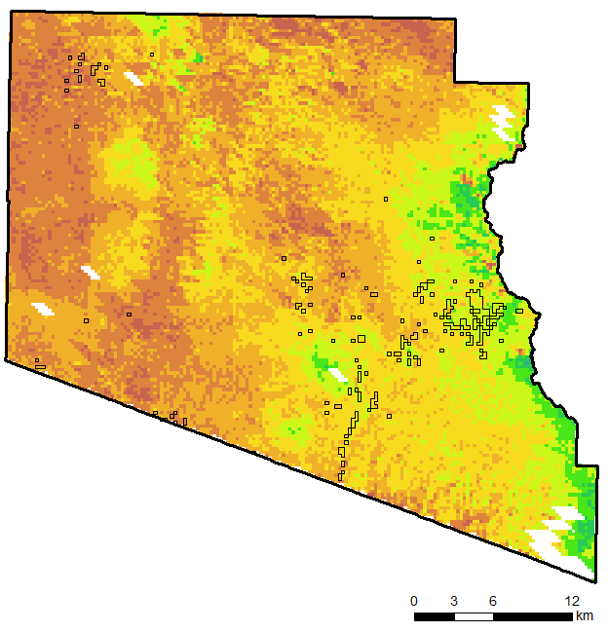
What is CLaRe?
CLaRe Metrics = Climate Landscape Response Model
Developed by Cynthia Wallace et al. 2016
Detects buffelgrass presence via correlations between measures of plant greenness and precipitation
Buffelgrass has a rapid response to precipitation, while native Sonoran Desert plant communities respond to longer periods of accumulated rain
Greenness = Normalized Difference
Vegetation Index (NDVI)
Precipitation = Accumulation period of up to 64 days prior to measurement of NDVI
0.0
1.0
Notes:
CLaRe or Climate Landscapre Response metrics were developed by our project partner Cindy Wallace and other collaborators. This methodology aims to detect buffelgrass presence through analyzing the strength of correlation values between measures of plant greenness and precipitation falling before those measurements. The methodology stems from the rapid response behavior of buffelgrass to precipitation. Native flora in the region, Wallace found, are more strongly correlated to longer periods of precipitation, especially summer monsoonal rain. Buffelgrass being the aggressive invader it is, will respond to faster and to to less precipitation.
Image Source: http://commons.wikimedia.org/wiki/File:Claude_Monet_-_The_Magpie_-_Google_Art_Project.jpg

Slide 28
CLaRe Methodology
Derived:
NDVI
&
Change in
NDVI
MODIS
Data
Acquisition
Image
Pre-Processing
Stratified Landscape
Pixel-wise Regression Analysis
T-Test Analysis
NDVI, ET, WUE
PRISM
Data
Acquisition
Image
Pre-Processing
Compiled:
8 – 64 day
accumulation
Daily Accumulation
Image Source: Molly Spater
Notes:
After acquiring the necessary data, all data was first reprojected and clipped to the study area. From the MODIS images we first derived Normalized Difference Vegetation index values. We then calculated our Change in NDVI rasters by subtracting the NDVI values from the image before a precipitation accumulation period from one that occurred directly after that same accumulation raster. We then clipped all data to the extent of three vegetation types in the park. We then ran a series of pixelwise regression to derive CLaRe metrics and performed t-test analysis.
Image Source: Molly Spater

Slide 29
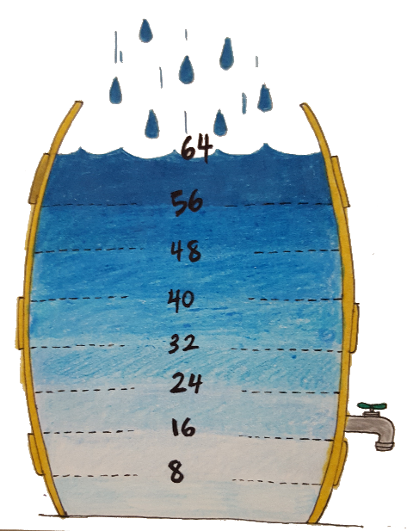
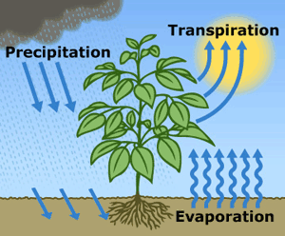
Correlation Iterations
Stratified NDVI ~ Precipitation
Stratified NDVI ~
Precipitation + Evapotranspiration
NDVI ~ Precipitation
Class 5
Class 6
Class 8
Class 5
Class 6
Class 8
Stratified Change in NDVI ~ Precipitation
Change in NDVI ~ Precipitation
Class 5
Class 6
Class 8
Image Credit: USGS and Molly Spater
Notes:
The pixel-wise regressions were run on several different datasets. The first were at the park wide scale between NDVI ~ Precipitation and Change in NDVI~ Precipitation. We next tested these correlations on the vegetation types individually. We then tested NDVI~ Precipitation and Evapotranspiration on the stratified level.
Image Source: http://water.usgs.gov/edu/watercycleevapotranspiration.html
Image Source: Molly Spater

Slide 30
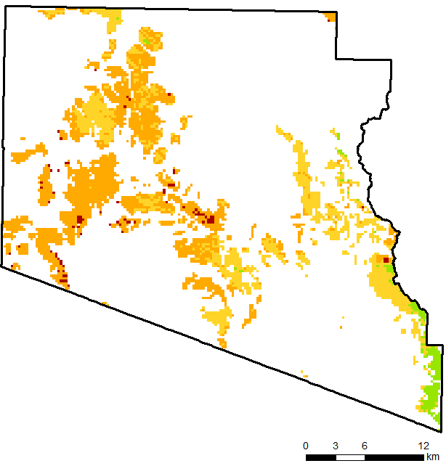
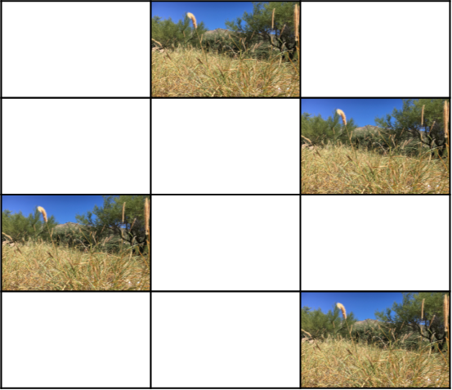
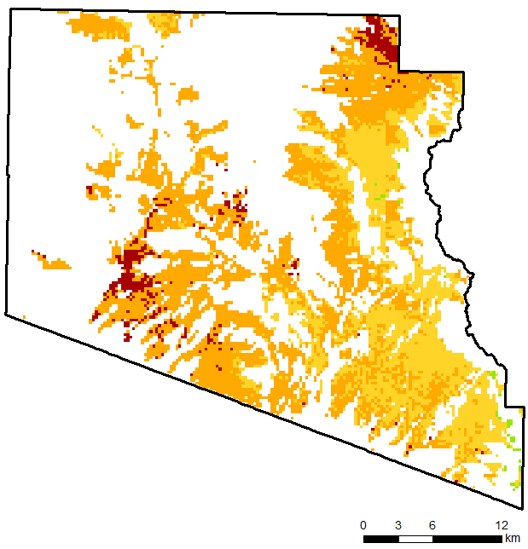
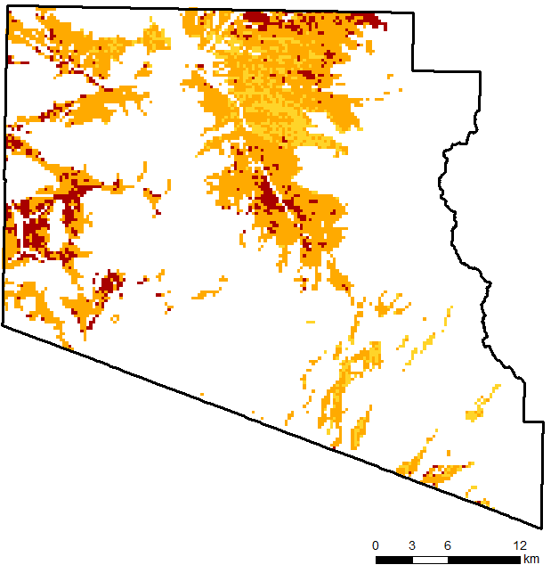
Is CLaRe Working?
Class 5
=
?
?
Class 6
Statistically
Different?
?
?
=
?
?
Class 8
?
?
Presence
Pseudo Absence
2011
0.0
1.0
NDVI ~ 40 Days Antecedent Precipitation
Image Source: Molly Spater
Notes:
From this analysis, images like the ones on the left are created. We next tested whether correlation values at pixels with known buffelgrass presence and unknown buffelgrass were statistically different. If so, this would indicate that CLaRe might be detecting the impact of buffelgrass on the dynamics of a landscape and that this type of research could eventually lead to a methodology land managers could follow to produce predictive buffelgrass location maps.
Image Source: Molly Spater

Slide 31
Is CLaRe working?
Results are mixed:
t-tests reveal a statistically significant difference in many of the iterations, HOWEVER, correlations were often weak, especially in the unstratified landscape
NDVI ~ Precipitation proved to have stronger correlations than Change in NDVI in all years except 2012
Similarities do appear between 2009 and 2011, and 2010 and 2012
Stratifying the landscape by vegetation type strengthened correlations in all years
Adding evapotranspiration into the equation strengthened correlations in all years except 2012
Image Credit: NPS
Notes:
The results from CLaRe were mixed. T-Tests revealed statistically significant differences between correlation values at pixels with known presence against those where presence was not known. However, the correlation values, especially those at shorter precipitation accumulation periods, in many cases were not very strong, indicating a weak relationship between NDVI and Precipitation, even in pixels with known buffelgrass. The iterations revealed that utilizing Change in NDVI is most effective when strong summer rains occur, as they did in 2012. All years at all lag times had strengthened correlation values when the landscape was stratified by vegetation type. Plant communities have their favored conditions, so by investigating each individually we are eliminating potential environmental variables we are not accounting for that could be compounding results at the park wide scale. Evapotranspiration also strengthened correlations, except in 2012.
Image Source: https://www.nps.gov/media/photo/gallery.htm?id=011B683D-155D-451F-67DB70F9CD0C5714

Slide 32
Precipitation and Evapotranspiration
Evapotranspiration 2011
Class 8 = Lower Elevation Shrubland
Significance = p< 0.05
Evapotranspiration
2009
2010
2011
2012
 | 24 Days | 32 Days | 40 Days | 48 Days | 56 Days | 64 Days
2011 | 0.219831 | 0.232819 | 0.323777 | 0.793169 | 0.985776 | 0.884932
Class 5
Class 6
Class 8
Image Credit: NPS
Notes:
From our results, we believe that the pattern of precipitation, in addition to just the amount, is key to CLaRe functioning, especially the pattern of summer rains. Years 2009 and 2011 appeared more dynamic in NDVI~Precipitation rasters , while years 2010 and 2012, appear more dynamic in the Change in NDVI ~ Precipitation. 2010 and 2012 experienced peaks followed by a month of no rain in the summer, indicating that plant productivity could have been more variable. 2009 and 2011 had more sustained precipitation throughout the summer which could have maintained more consistent plant health. Water is extremely limited in semi arid regions and even small changes to the balance can have dramatic impacts. We believe this is why evapotranspiration rates strengthened correlation values in all years except 2012. 2012 had strong monsoonal rains decreasing evapotranspirative stress on plant communities. Evapotranspiration rates also helped explain the pattern in when correlation values were statistically significant from those of unknown pixels. For example, for class 8 vegetation, lower level elevation shrublands, t-tests on NDVI ~Precipitation (which we only tested in 2011 due to lack of field data) revealed no statistically significant difference between pixels of known and unknown buffelgrass. Class 8’s lower evapotranspiration rates indicate less plant productivity. Less plant productivity could make it more difficult for CLaRe to detect differences in greenness at the MODIS 250 m scale.
Image Source: https://www.nps.gov/media/photo/gallery.htm?id=011B683D-155D-451F-67DB70F9CD0C5714

Slide 33
Errors & Uncertainties
Field Data was very inconsistent
Point data were supposed to represent plots
Plot sizes were not always included
Density data and exact location of plots not included either
Whether buffelgrass was pulled was only included in 2012 and did not include if treatment was successful
MF thresholds were based on field data extrapolation
Only a few images from 2012 were analyzed
Conservative approach was taken for Infeasibility Values and Matched Filter Scores
Notes:
There are some errors and uncertainties with our project.
First, the field data available for this project was very inconsistent and the plot sizes were not always included in the metadata. The exact location of the plots and the density data was also not available. Bufflegrass removal was only noted for the year 2012 and the data did not specify whether the treatment was successful. We were also not able to fully validate either our MTMF or CLaRe results due to the limited presence and absence data.
Second, only a few WorldView-2 images from 2012 were available to download and for us to analyze. MF thresholds were based on field data extrapolation for reasons already discussed. We also took a conservative approach for getting the Infeasibility Values and Matched Filter Scores.

Slide 34
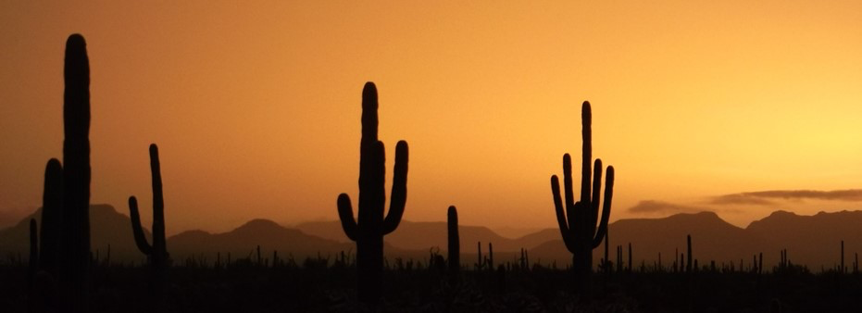
MTMF Conclusions
MTMF will be more useful for detecting pixels with at least 20% coverage buffelgrass
Higher MF scores appear to yield higher Kappa coefficients
There may be seasonal effects on classification accuracy
Accurate polygon field data is necessary for validation
Image Credit: NPS
Notes:
Higher Kappa coefficients with a higher MF threshold indicates that MTMF will be more useful in detecting areas with higher concentrations of buffelgrass (though with the spatial resolution in mind this could really be a couple of big plants). The difference in kappa coefficient values between images taken during January and February, which is the middle of the cool season, and October, just after the summer monsoonal rains, indicate that there may be seasonal effects on the classification accuracy. Accurate polygon field data (or target field data) was necessary to fully validate the modeled results.
Image Source: https://www.nps.gov/orpi/learn/nature/biosphere.htm

Slide 35
CLaRe Conclusions
CLaRe metrics are detecting a dynamic occurring in the landscape between NDVI and water balance variables, more field data is necessary to examine if buffelgrass is in fact impacting correlation values.
Further investigating these dynamics, rather than just precipitation, might allow for better predictions of buffelgrass locations in desert landscapes
Image Credit: Erika Higa
Notes:
Clare metrics appear to detect dynamics occurring at Organ Pipe between NDVI and water balance variables. We observed that the correlation between Change in NDVI and precipitation were strong even after only 24 and 32 days of accumulated vegetation indicating that CLaRe may be picking up the impact of buffelgrass. Native vegetation is higher correlated with longer accumulation periods. The addition of evapotranspiration strengthen correlations at shorter lag times indicating that more variables than just precipitation might be necessary to properly identify buffelgrass locations in a desert landscape.
Image Source: Erika Higa

Slide 36
Future Work
Testing methods in similar environmental conditions with more detailed ground truth data to see if in fact CLaRe metrics and MTMF can be regionalized
Testing MTMF on images from other years to develop a seasonal or monthly MF threshold that could be used by land managers
Testing CLaRe metrics with more environmental variables, especially those which impact water availability
Image Credit: NPS
Notes:
Future work must be done to further evaluate CLaRE and MTMF methods for bufflegrass detection. This work should include similar environmental conditions and much more detailed field data. MTMF should also be run on other years to test if a seasonal or monthly MF threshold exists that could be used by land managers. Testing could be done to see if correlation values are strengthen by isolating NDVI and environmental variables in the cool season. If buffelgrass is what is strengthening relationships, its ability to respond to precipitation at any point in time, unlike native vegetation adapted to monsoonal rain, should be further demonstrated. Other water balance variables could also be included to further inform correlation values.
Image Source: https://www.nps.gov/media/photo/gallery.htm?id=01428A54-155D-451F-67F8FA15C89C4849

Slide 37
Science Advisor
NASA Jet Propulsion Laboratory
Dr. Natasha Stavros
DEVELOP Mentor
Benjamin Holt
Partner Organization
National Park Service, Saguaro National Park Rincon Mountain District
Dana Backer, Park Ecologist
USGS Southwest Biological Science Center
Dr. Cynthia Wallace, Research Scientist
Dr. Seth Munson, Research Ecologist
Northern Arizona University (NAU)
Dr. Temuulen Sankey, Remote Sensing Scientist
Organ Pipe Cactus National Monument
Jeanne Taylor, Botanist
Notes:
We would like to acknowledge our science advisor Dr. Natasha Stavros for her guidance in our research and methodology. Jeanne Taylor provided field data that we were fortunate to use in our project. We would also like to thank our project partners Dana Backer, Dr. Seth Munson, and Dr. Temuulen Sankey for answering our questions and sharing their knowledge. We would especially like to thank Dr. Cynthia Wallace for her enthusiasm and support throughout the term. We would like to thank Ben Holt for making this project possible through the DEVELOP Program.
Thank you and we would like to open the door to any questions you may have.

