Slide 1
DEVELOP National Program
GEORGIA WATER RESOURCES
THE UNIVERSITY OF GEORGIA
Fall 2015
Imagery Gallery

Slide 2
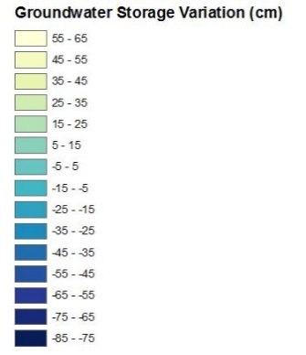
The University of Georgia
Georgia Water Resources
This image is derived from NASA’s GRACE Satellites during October 2002. This image shows anomalies in groundwater storage throughout the Floridan Aquifer. End-users can use this product as a low-cost alternative for measuring groundwater storage covering large regions.

Slide 3
The University of Georgia
Georgia Water Resources
This image is derived from NASA’s GRACE Satellites during October 2003. This image shows anomalies in groundwater storage throughout the Floridan Aquifer. End-users can use this product as a low-cost alternative for measuring groundwater storage covering large regions.

Slide 4
The University of Georgia
Georgia Water Resources
This image is derived from NASA’s GRACE Satellites during October 2004. This image shows anomalies in groundwater storage throughout the Floridan Aquifer. End-users can use this product as a low-cost alternative for measuring groundwater storage covering large regions.

Slide 5
The University of Georgia
Georgia Water Resources
This image is derived from NASA’s GRACE Satellites during October 2005. This image shows anomalies in groundwater storage throughout the Floridan Aquifer. End-users can use this product as a low-cost alternative for measuring groundwater storage covering large regions.

Slide 6
The University of Georgia
Georgia Water Resources
This image is derived from NASA’s GRACE Satellites during October 2006. This image shows anomalies in groundwater storage throughout the Floridan Aquifer. End-users can use this product as a low-cost alternative for measuring groundwater storage covering large regions.

Slide 7
The University of Georgia
Georgia Water Resources
This image is derived from NASA’s GRACE Satellites during October 2007. This image shows anomalies in groundwater storage throughout the Floridan Aquifer. End-users can use this product as a low-cost alternative for measuring groundwater storage covering large regions.

Slide 8
The University of Georgia
Georgia Water Resources
This image is derived from NASA’s GRACE Satellites during October 2008. This image shows anomalies in groundwater storage throughout the Floridan Aquifer. End-users can use this product as a low-cost alternative for measuring groundwater storage covering large regions.

Slide 9
The University of Georgia
Georgia Water Resources
This image is derived from NASA’s GRACE Satellites during October 2009. This image shows anomalies in groundwater storage throughout the Floridan Aquifer. End-users can use this product as a low-cost alternative for measuring groundwater storage covering large regions.

