Slide 1
Project Video: Tips & Tricks
DEVELOP Communications Team
Spring 2018

Slide 2
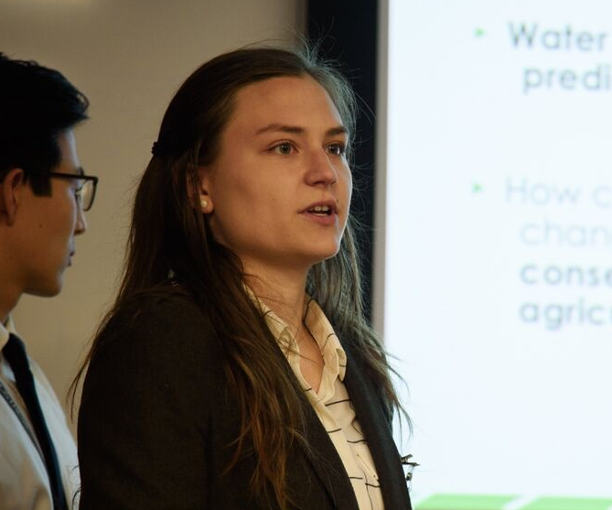
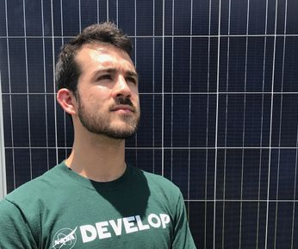
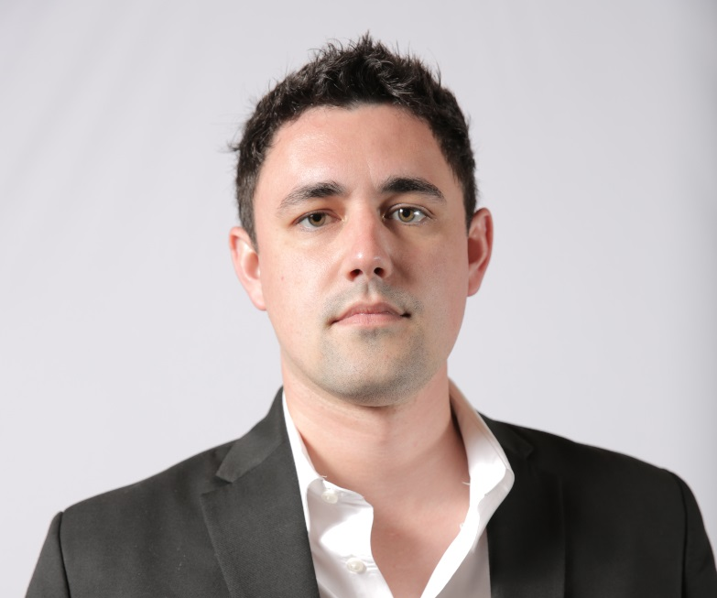
Your Communications Team
Jonathan O’Brien
jonathan.obrien@noaa.gov
Austin Counts
austin.d.counts@nasa.gov
Leah Kucera
leah.m.kucera@nasa.gov
Austin Stone
austin.h.stone@nasa.gov
develop.communications@gmail.com

Slide 3
The Project Video – Why?
The Project Video, or VPS (Virtual Poster Session), is your most externally-facing deliverable. This is your chance to get the word out about your project!
Communicates your work to society as a whole
Posted in many different venues (DEVELOPedia, Facebook, YouTube, etc.)
“If nobody knows what you’ve done, your work is only half finished”
develop.communications@gmail.com

Slide 4
General Timeline
WEEK 4: Each team signs up for a check-in
February 12th – 16th
WEEK 5: Video Outline Due
February 22nd
Comm team reviews & sends edits
WEEK 6: Video check-ins
February 26th – March 2nd
Comm meets with each project team to discuss video outline & ideas
WEEK 8: Video, Citation Log, & Transcript Due
March 15th
REMEMBER: the Project Video is a time consuming deliverable. Be sure to start early, set enough time aside to work on it, and set realistic expectations for what you can and can’t achieve.
develop.communications@gmail.com

Slide 5
General Criteria
NOTE: No footage/imagery of code and no non-federal government logos.
Project Video Length
< 3:00
Project Video Must Haves
Official DEVELOP opening & closing clips
3 mandatory statements
Credits (before official closing clip)
Citation log & proper citations
Word-for-word transcript (.txt file)
Media release forms for everyone on camera
License agreement forms for required content
develop.communications@gmail.com

Slide 6
Project Video Outline
Easy. Useful.
Guiding questions to help you identify material for your video
All information can be found in Project Proposal or Project Summary
Due Week 5
Used as a basis for the Week 6 Project Video check-in
*Preparation pays off
develop.communications@gmail.com

Slide 7
Project Video Transcript
Word for Word
Detailed script of your project video; uploaded with the final version as a .txt file
This document should match the speech in your video word for word
Templates can be found in your node folder in your node’s Google Drive folder or on the Project Video page on DEVELOPedia
develop.communications@gmail.com

Slide 8
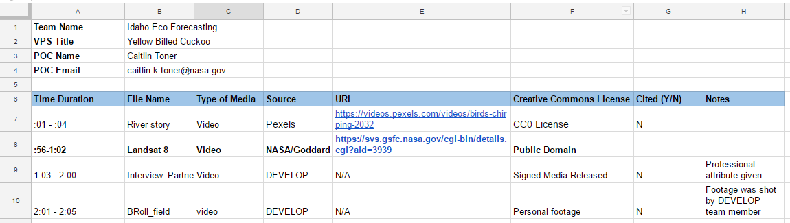
Citation Log
Will help minimize the amount of citations displayed.
A great organizational tool.
Comm Team has to check all sources.
Keep track of everything you download!
This form will also be used to provide you with feedback.
develop.communications@gmail.com

Slide 9
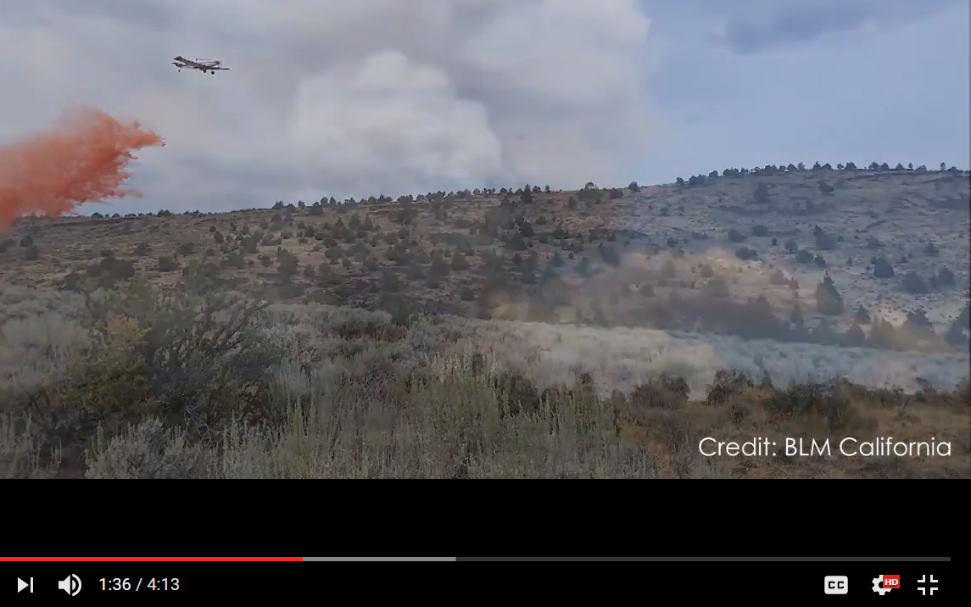
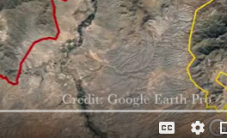
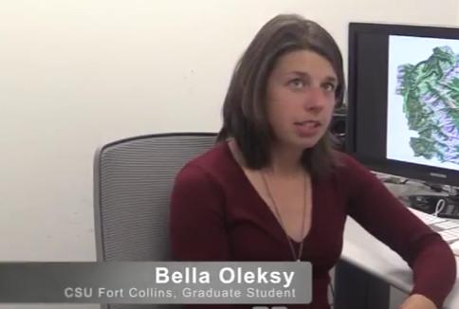
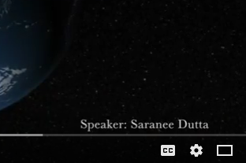
Music
Pictures
Video
Software
Interviews
Narration
develop.communications@gmail.com

Slide 10
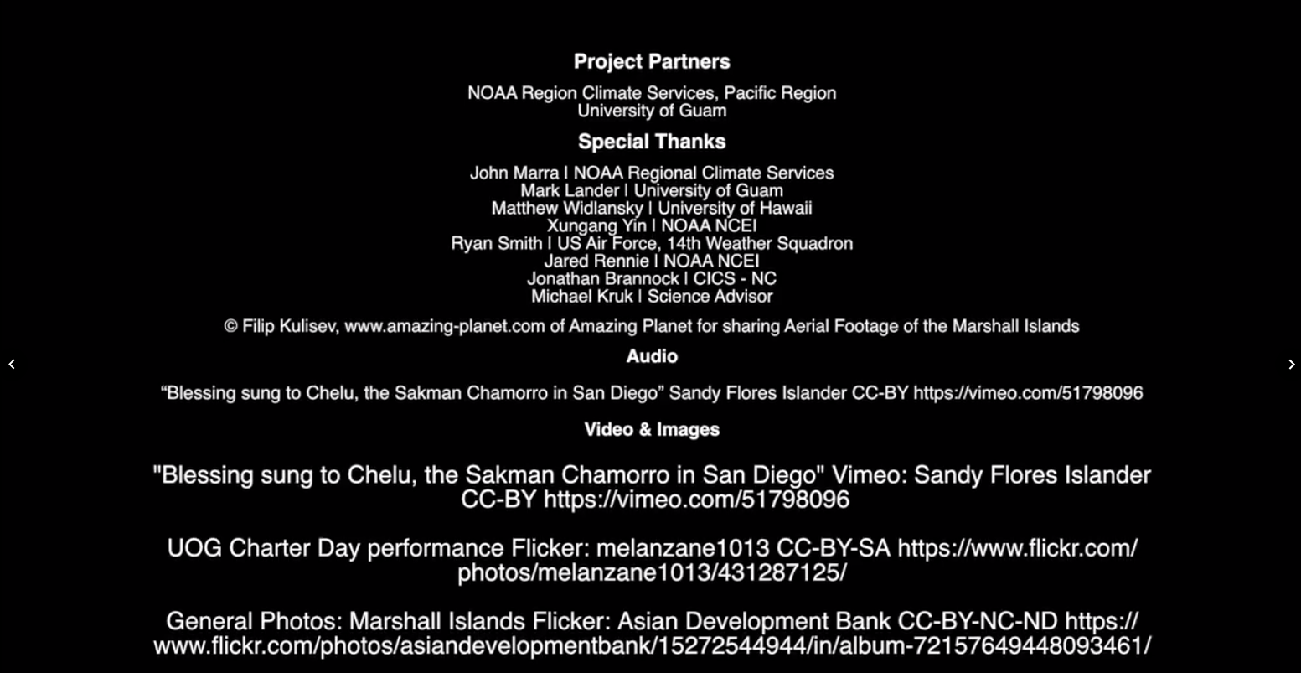
Citing in Credits
Credits come before the DEVELOP ending clip.
Media Designated by Type
Title of Content
Owner/Creator
License Type
Link
develop.communications@gmail.com

Slide 11
Mandatory Statements
These three statements must be included in every video!
This material is based upon work supported by NASA through contract NNL16AA05C and cooperative agreement NNX14AB60A.
Any opinions, findings, and conclusions or recommendations expressed in this material are those of the author(s) and do not necessarily reflect the views of the National Aeronautics and Space Administration (NASA).
NPR 2200.2C D.6.4.1: Trade names and trademarks are used in this report for identification only. Their usage does not constitute an official endorsement, either expressed or implied, by the National Aeronautics and Space Administration.
develop.communications@gmail.com

Slide 12
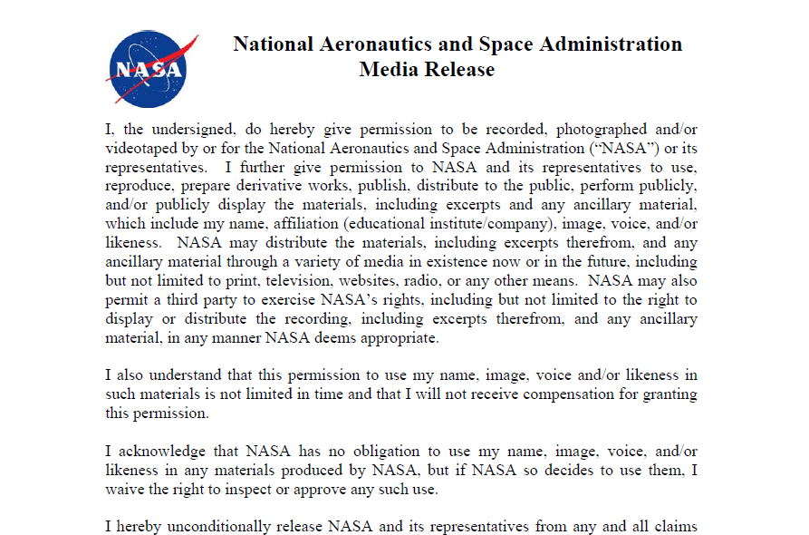
Media Release Form
Cover your bases
This form gives NASA written permission to record, film, & photograph another individual and distribute it to the public.
Anyone that appears onscreen and is identifiable must fill one out (including team members).
Send a hard copy original to NPO or keep one on file and send an e-copy to the Comm Team gmail.
develop.communications@gmail.com

Slide 13
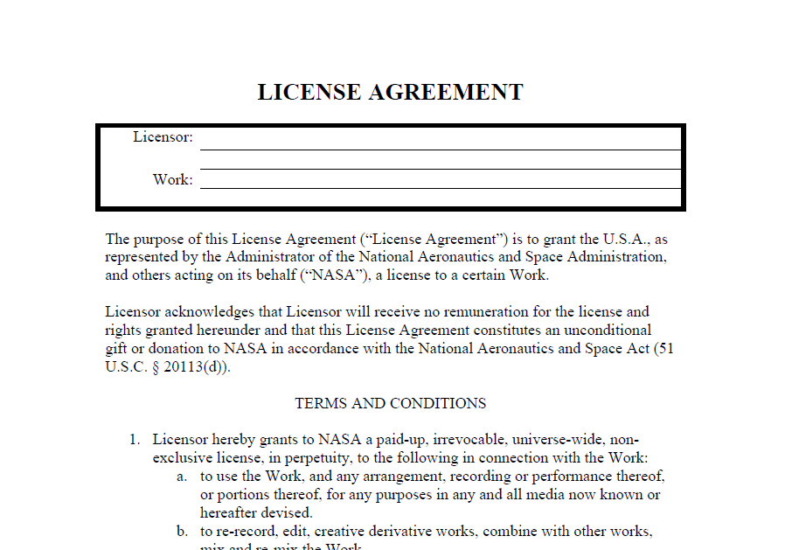
License Agreement
When in doubt, ask
This form gives NASA written permission to use another’s material.
A License Agreement form is only required for material that is non-Creative Commons and privately owned.
Footage taken by partner organizations may or may not require a License Agreement.
develop.communications@gmail.com

Slide 14
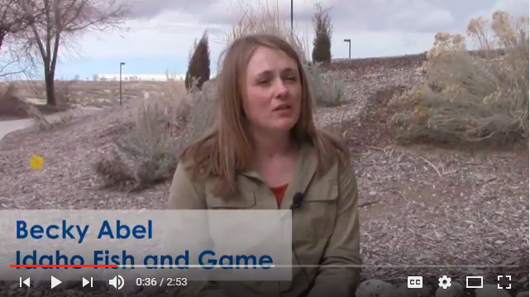
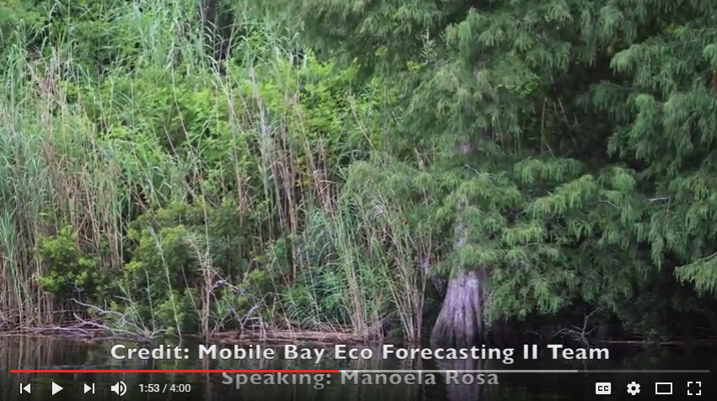
Video Editing Basics
VideoLAN Movie Creator
iMovie
Free Software
Options:
Adobe Spark
Windows Movie Maker
A-Roll – Primary footage
B-Roll – Secondary footage
Voice Overs – Be engaging
Lighting – Avoid shadows
A-Roll
B-Roll
develop.communications@gmail.com

Slide 15
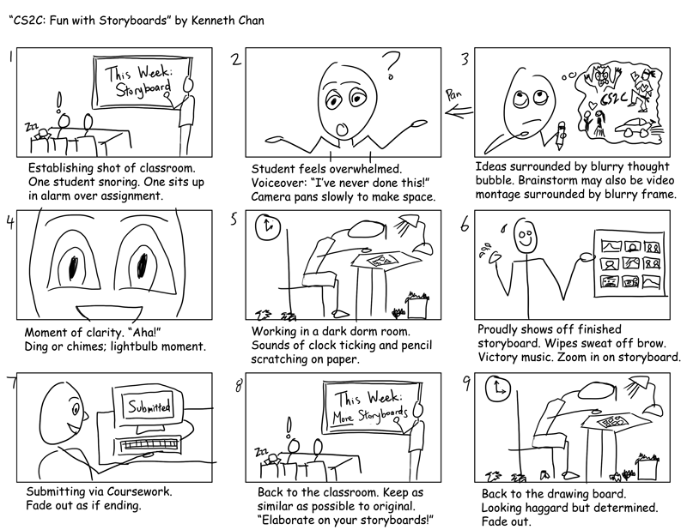
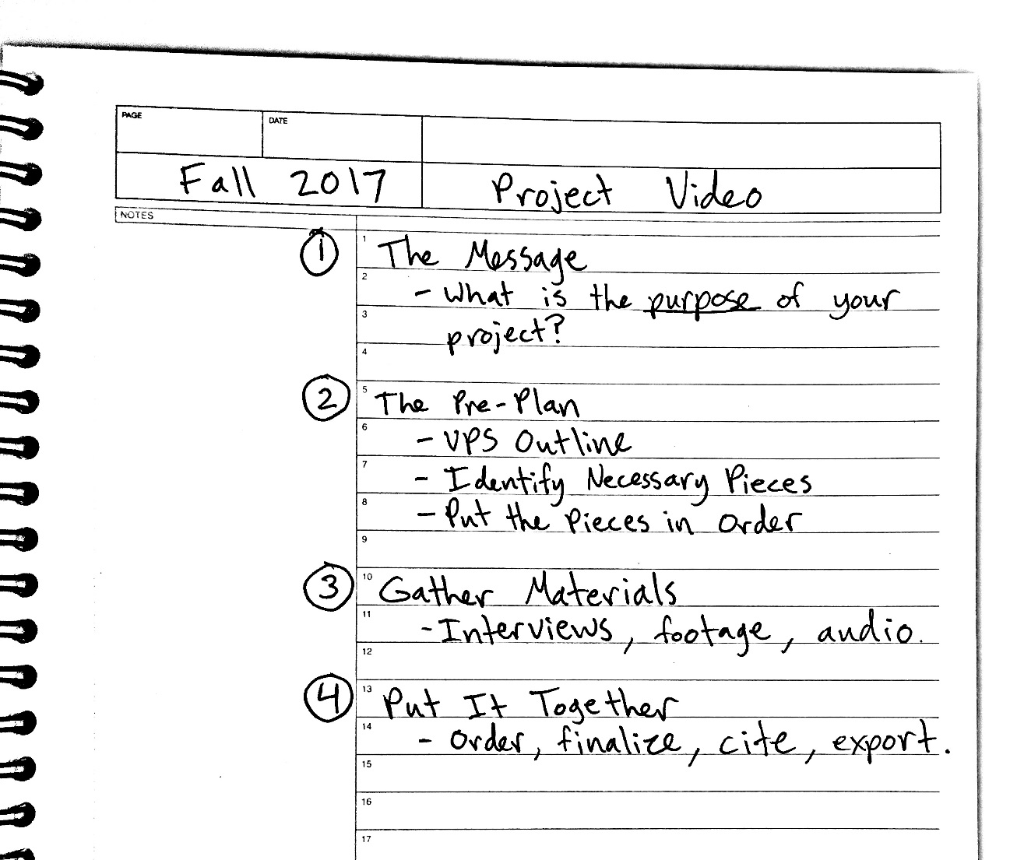
Think big. Start small. - Design Think!
Message
Mock-ups
Materials
Make it happen
develop.communications@gmail.com

Slide 16
What is your Message?
“Challenge yourself to think about the value of your work in a broader context.”
What are the community concerns associated with this project?
Why is this project important and how will this video add value to society?
What Earth observations did your team use?
What end-products are you producing and how are your partners going to use them?
Project Video is a story, not a technical paper. Make it compelling!!
develop.communications@gmail.com

Slide 17
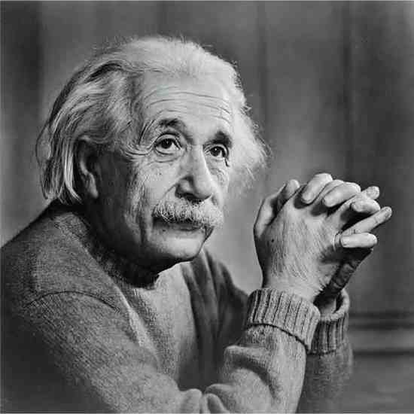
Think about your audience!
People have short attention spans.
Average video engagement length = 1:48
Ex: Navajo Nation I video = 4:20 minutes
2:34 minutes watched on average
3:00 minute video (MAXIMUM)
Explain complicated topics simply.
Refocused and higher level
Don’t go into unnecessary detail
Metaphors & analogies can help
Communicate science creatively! Use the right side of your brain.
“If you can’t explain it simply, you don’t understand it well enough”

Slide 18
Be creative & resourceful
Think about your platforms
Consider making it social-media-friendly
People are too busy to watch a long video; less is more. Be concise.
Use what you’ve got
Don’t have high quality audio equipment? Try using text and subtitles instead of speech.
Only have still images? Ken Burns it!
develop.communications@gmail.com

Slide 19
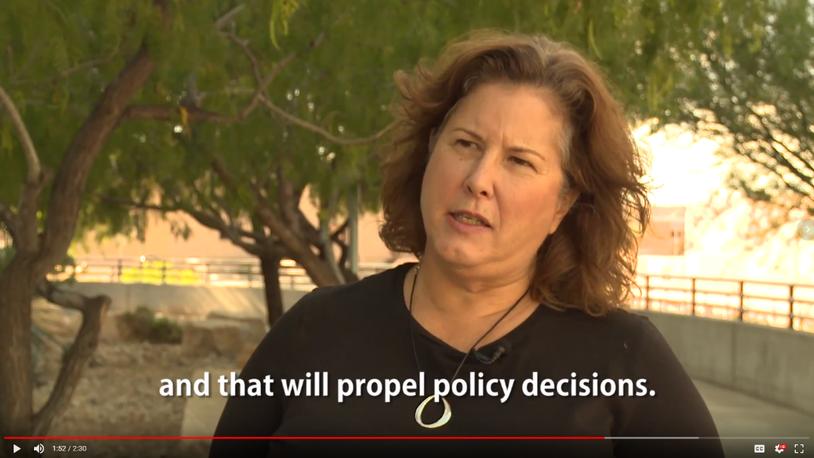
It’s OK to lean on your partners
They may be able to provide what you can’t:
B-roll footage (that you only have to cite once!)
Interviews
Imagery
An Insider’s Perspective
Partners can be a huge help, especially if your project takes place in another geographic location other than your node. They are often just as excited about the video as you!
develop.communications@gmail.com

Slide 20
Interviews
What are the next steps?
Will interventions be intensified in the region?
How will NASA satellite information contribute to the Ethiopia project?
Crafting Questions
Brainstorm list with team
Open-ended questions
(not YES or NO)
Start with: where, what, how, & why
Interview Preparation
4 - 5 questions prepared
Test audio & lighting ahead of time
During the Interview
Bring media release form
Ask about time constraints
Make interviewee feel comfortable; be conversational!
Explain your message
develop.communications@gmail.com

Slide 21
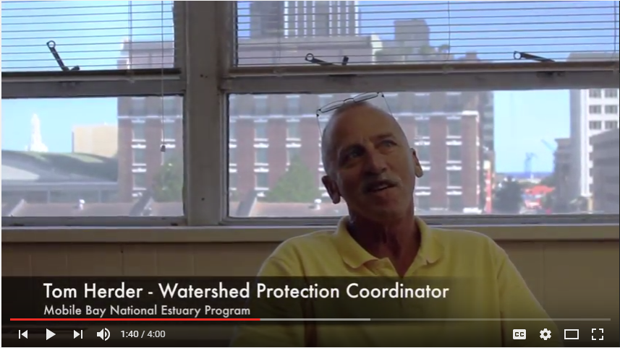
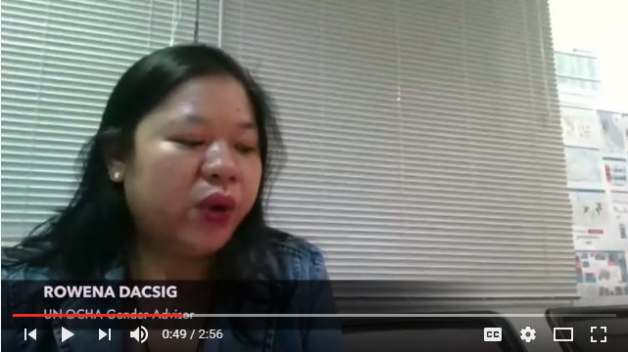
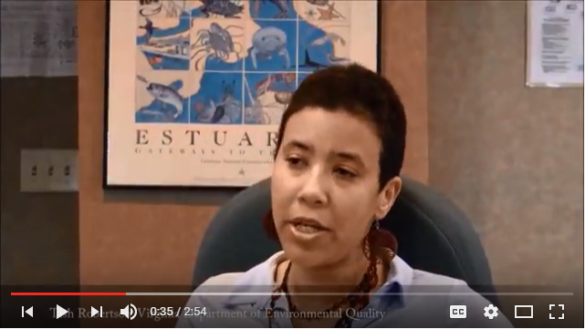
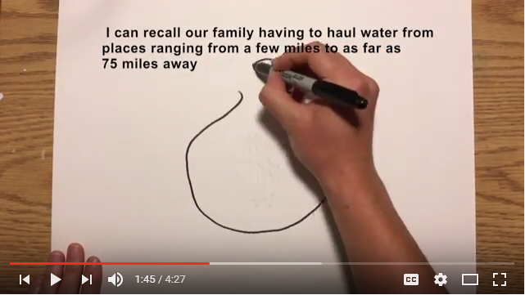
Interviews
Remote Interviews:
Send questions ahead of time
Ask to record on phone
If poor resolution, use B Roll
x Too much lighting behind speaker; face is darkly shaded
x Subject too small in frame
x Fuzzy audio
x Looking at script, not camera
x Framing
✓ Nice lighting
✓ Focus is right; subject looking at interviewer, not camera
✓ Framing
✓ Fuzzy interview audio, so added subtitles
develop.communications@gmail.com

Slide 22
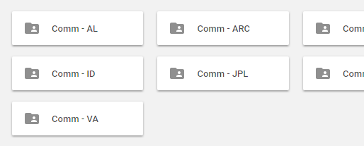
Project Video Submission
All Project Video-related deliverables will be uploaded to your node folder in Google Drive or emailed to the Comm Team
Project Video Outline – Week 5
Project Video – Week 8
Transcript – Week 8
Citation Log – Week 8
*Templates can be found in your node folder (i.e. Comm – NC) or on DEVELOPedia
Upload Videos, Citation Logs, & Transcripts here. You can also email them to develop.communications@gmail.com
develop.communications@gmail.com

Slide 23
Project Video Resources
Templates & Forms
DEVELOPedia Project Video Page
Materials & Software
Useful Links Sheet (feel free to add more)
Inspiration
Official DEVELOP YouTube Channel
Citing & Legal
Use & Citation Guidelines
Creative Commons License Types
YouTube CC Licensing Info
develop.communications@gmail.com

Slide 24
The Virtual Poster Session (VPS) Competition
People’s Choice
Based on:
Social media analytics
Shares that include: #NASADEVELOP
The Virtual Poster Session is a competition held every term where each video is judged for its creativity and communication of Earth science.
Grand Prize
Grand Prize judged on:
Content clarity
Memorable/creativity
Production
(Find the full judging rubric, here.)
develop.communications@gmail.com

Slide 25
Ways to stay connected!
DEVELOP Ambassador Corps
Represent NASA DEVELOP at your university and community
Gain networking & presentation skills
Build rapport
If you are interested in becoming an ambassador, contact us at develop.communications@gmail.com
develop.communications@gmail.com

Slide 26
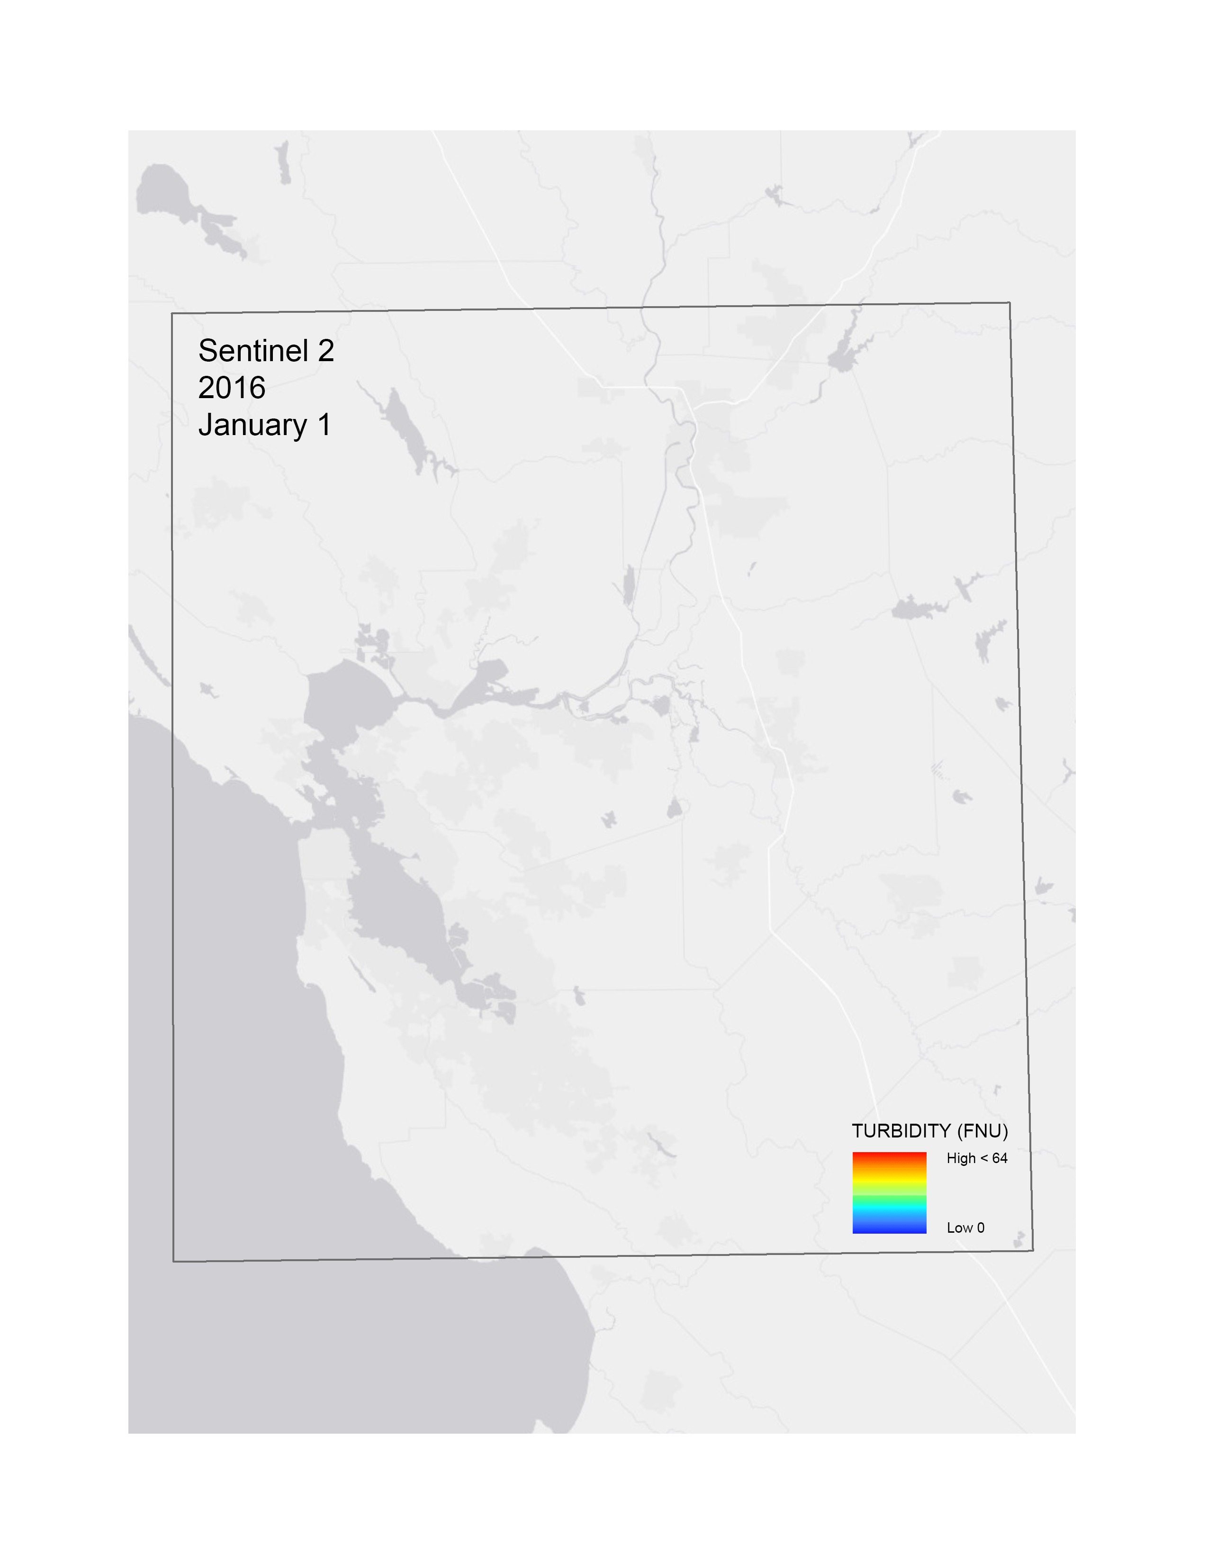
DEVELOP Social Media @NASA_DEVELOP #NASADEVELOP
Facebook - https://www.facebook.com/developnationalprogram/
Facebook – Once a DEVELOPer, Always a DEVELOPer
LinkedIn - https://www.linkedin.com/groups/4343498
Twitter - https://twitter.com/NASA_DEVELOP - @NASA_DEVELOP
YouTube - https://www.youtube.com/user/NASADEVELOP
Instagram – https://www.instagram.com/nasadevelop/
Have content that you want us to share on social media? Use our Media Submission Form!
We ♥ GIFs! Please share any project-related GIFs with the Comm team for social media use!
Encourage your node to DEVELOP our brand!

Slide 27
Thank you!
Email us anytime!
develop.communications@gmail.com

