Slide 1
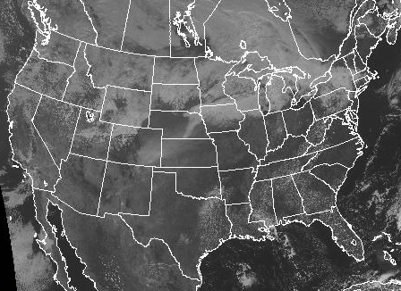
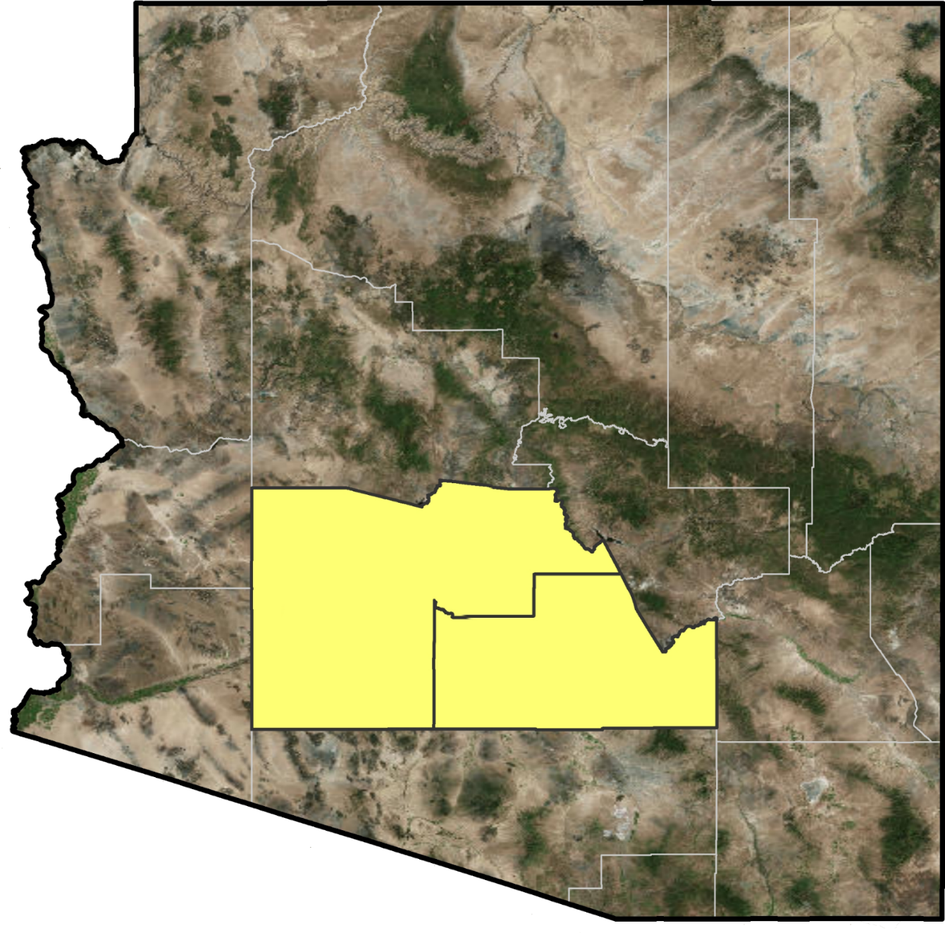
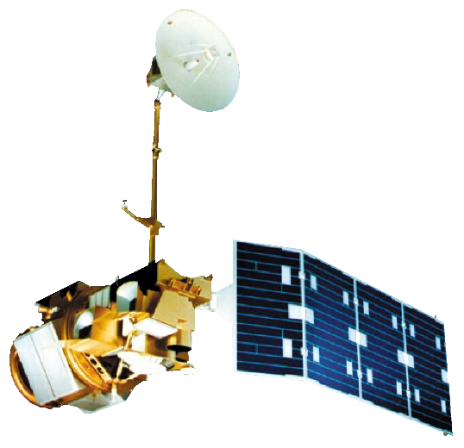
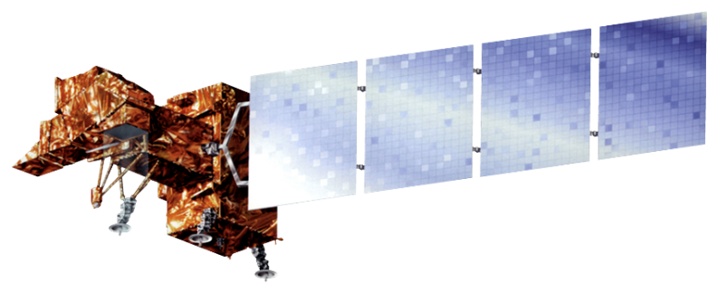
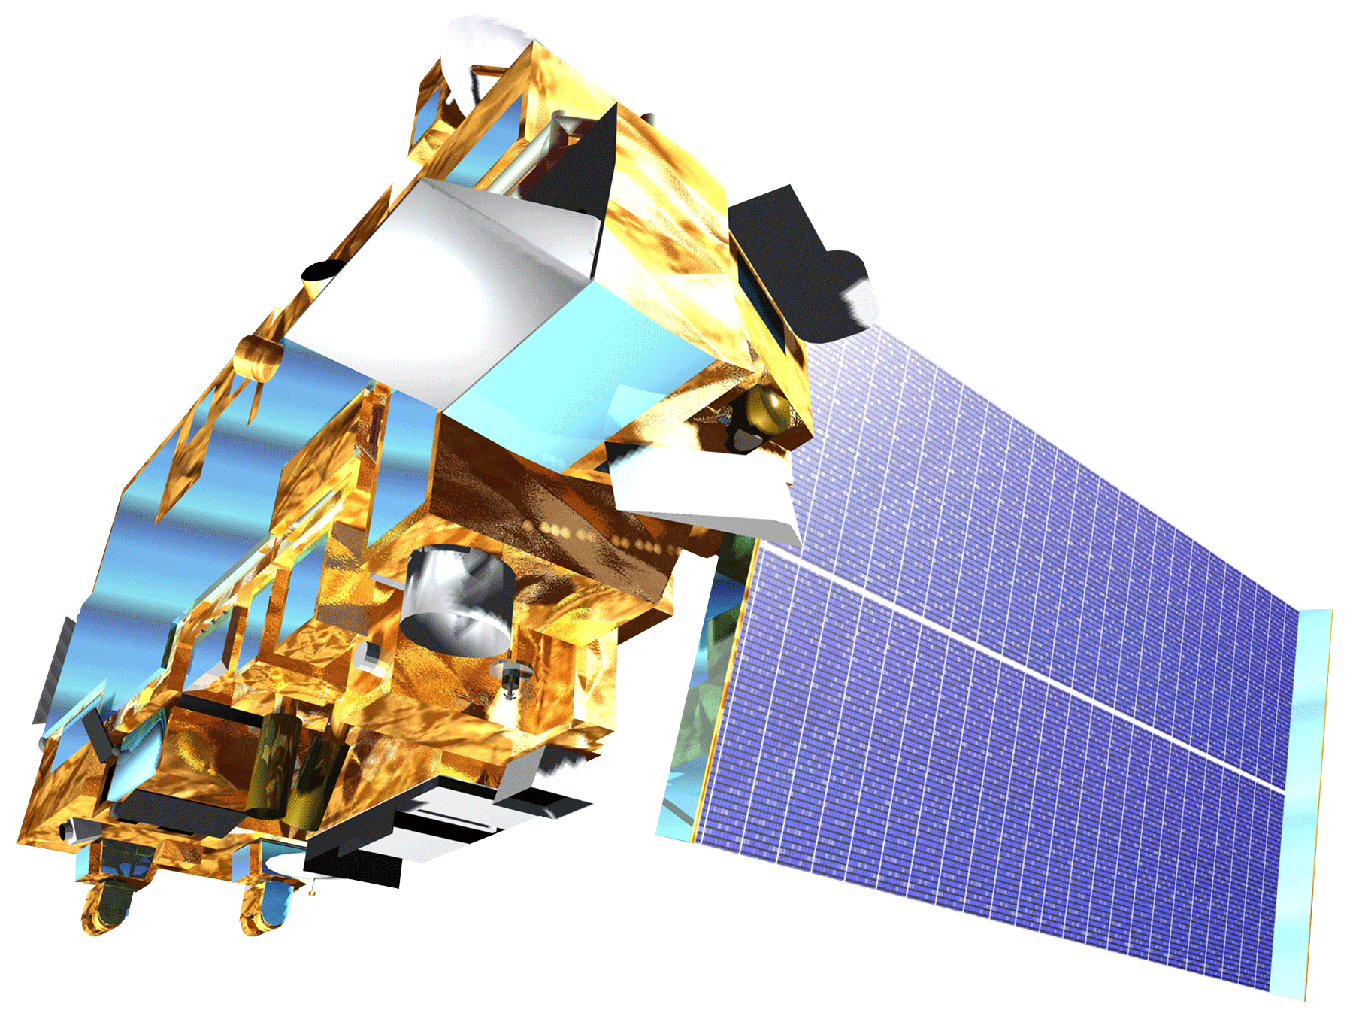
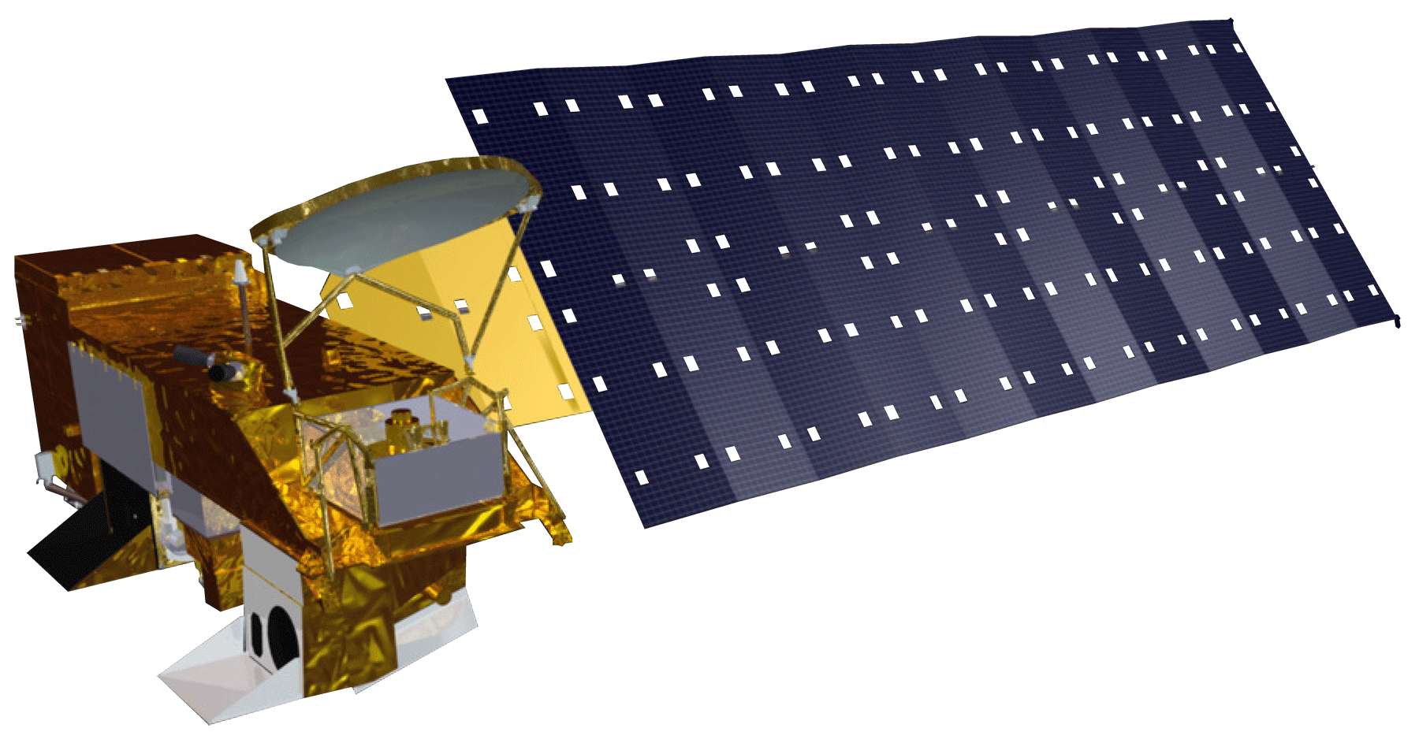
Modeling a Decade of PM₁₀ Concentrations in Maricopa County, Arizona for Air Quality and Epidemiological Analysis
Objectives
Methodology
Generate continuous and reliable predictions of PM₁₀ throughout Maricopa County, Arizona
Enhance the previous term’s model of PM₁₀, by incorporating a MODIS MAIAC and refined NOAA, USGS, and EPA ancillary data, in a mixed-effect, land use regression model
Combine the EPA’s Air Quality Index with the PM₁₀ time series to identify communities that are at a greater risk of exposure to poor air quality
PM₁₀ Land Use Regression Model
Satellite Data (MODIS, Landsat 7 ETM+)
Transportation (TIGER/ Line & Maricopa Air Quality Department Repository)
Meteorological Data (Daymet)
Elevation
(National Elevation Database - USGS)
Land Cover (Landsat 5)
County Line Data (TIGER/ Line Repository)
Abstract
Exposure to air pollution is associated with respiratory and cardiovascular morbidity and mortality. Particulate matter (PM) less than 10 microns in diameter is a key contributor to poor air quality, posing a significant public health hazard. In Maricopa County, Arizona the combination of a scarcely vegetated, semi-arid landscape and high anthropogenic activity (e.g. the prevalence of industrial and agricultural activity, wood burning, and vehicle emissions) results in atmospheric concentrations of particulate matter that can exceed federal air quality standards and threaten human health. Despite the presence of one of the Southwest’s most innovative pollutant monitoring networks, which benefits from the latest technologies in advanced real-time detection and prevention, the vast size and complex geography of Maricopa County make it difficult to monitor particulate matter in all communities of interest. Moderate Resolution Imaging Spectroradiometer (MODIS) Level 2 Aerosol Optical Depth data were utilized in combination with thermal infrared data, environmental variables, elevation, and transportation to predict particulate matter concentrations throughout Maricopa County. The predicted particulate matter concentrations were further examined in the context of the US Environmental Protection Agency’s (EPA) Air Quality Index, which relates particulate concentration to health impact, to categorize the health risk around schools throughout the county. The end products produced from this project were given to the Maricopa County Department of Public Health and the Maricopa County Air Quality Department for future epidemiological research and public outreach efforts.
Results
Study Area
Maricopa County Health & Air Quality II
NOAA (https://www.weather.gov/satellite#vis, 10/17/2016)
Maricopa
County
Pinal
County
Daily average PM10 values for the year 2013
Conclusions
Satellite data helps to pinpoint potential particulate matter issues to a specific geographic area and provides an easily interpretable graphic view to enhance decision-making for health and air quality thereby aiding epidemiological studies
Inclusion of additional model variables like thermal infrared (TIR) data and Daymet data refine the model and improve correlation in desert regions that are a particular challenge to analyze using satellite data due to the high amount of reflection of the surface
Since the diurnal changes in the concentration of PM10 are considerable, having a day-to-day time frame increases the efficiency of the model and adds confidence to the results
Earth Observations
Landsat 7 (1999)
Landsat 5 (1984)
Aqua (2002)
Acknowledgements
Project Partners
Terra (1999)
Dr. Itai Kloog
Geography and Environmental Development Department, Ben-Gurion University of the Negev, Be'er Sheva, Israel.
Past Contributors from Summer 2016
Jason Hodgson (Team Lead)
Leslie Araujo.
This material is based upon work supported by NASA through contract NNL11AA00B and cooperative agreement NNX14AB60A. Any mention of a commercial product, service, or activity in this material does not constitute NASA endorsement. Any opinions, findings, and conclusions or recommendations expressed in this material are those of the author(s) and do not necessarily reflect the views of the National Aeronautics and Space Administration and partner organizations.
Maricopa County Department of Public Health
Maricopa County Air Quality Department
Arizona State University, School of Geographical Sciences and Urban Planning
Team Members
Tamara Dunbarr
Team Lead
Michael Pechacek
Jayanth Serla
Parul Singh
Maricopa County Department of Public Health and Arizona State University – Fall 2016

