Slide 1
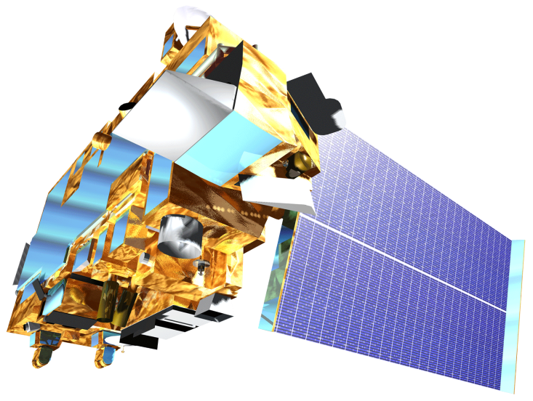

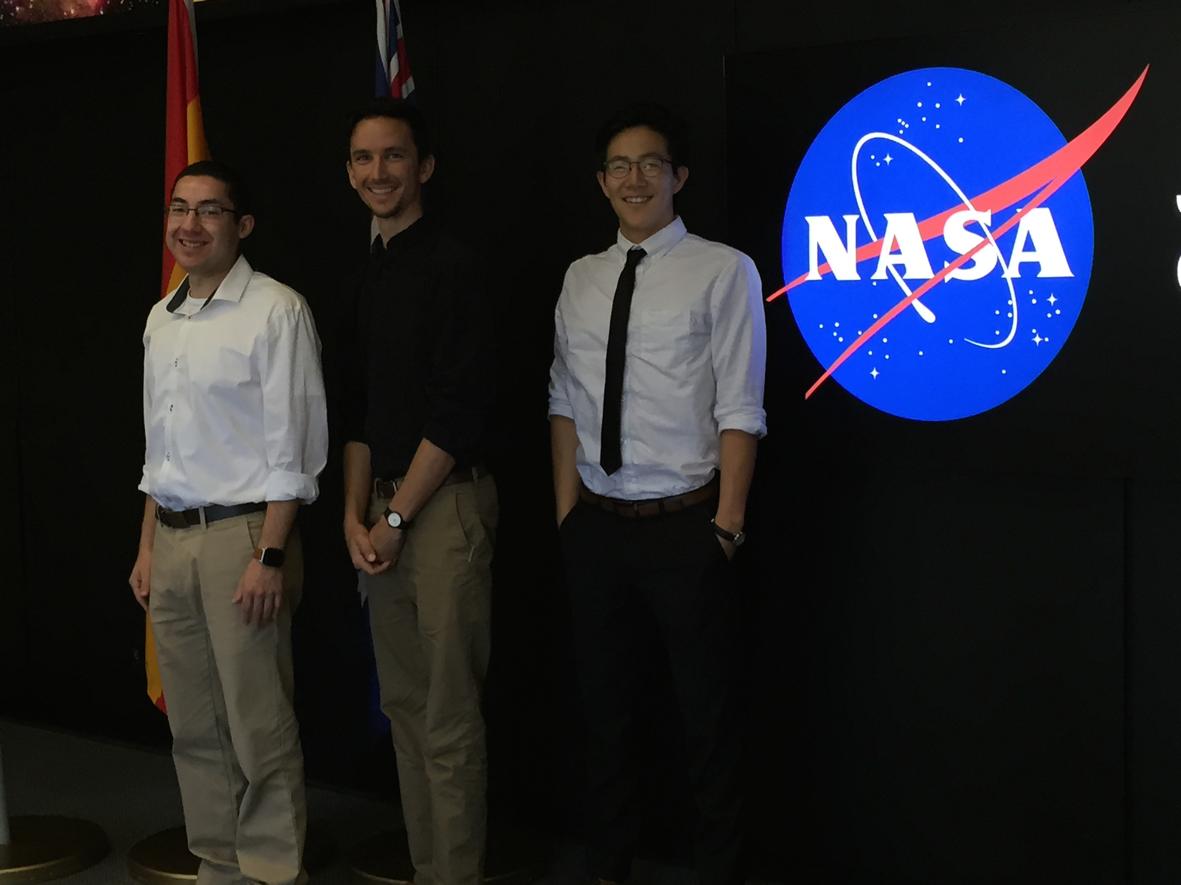
New Mexico Water Resources and Agriculture
Delivering Automated Evapotranspiration Data to the New Mexico Office of the State Engineer for Enhanced Water Resource Decision Making in New Mexico
Sol Kim (Project Lead), Agustin Muniz, Trevor McDonald
NASA Jet Propulsion Laboratory Summer 2015
Abstract
Objectives
Automate MODIS data acquisition
Streamline evapotranspiration product generation and delivery to the New Mexico Of the State Engineer
Disseminate products to decision-makers in the ranching, water resources, drought assessment and fire-response communities in the Eastern Plains Region of New Mexico through an easily-accessed online interface.
Study Area
Methodology
A visual representation of the automated data pipeline architecture. The pipeline initially retrieves the data and sends some data for processing. Once processing is done, all data is fed into an evapotranspiration (ET) algorithm to create ET outputs. The outputs will be hosted on a web server.
Data Retrieval
Pre-Processed Data
Internet
Data Conversion
ET Inputs
ET Algorithm
ET Outputs
Web Server
Databases
Results
Earth Observations
Use images.
Make sure that it has some sort of flow, that it makes sense. Show your results in a logical order.
No bullets.
Terra Aqua
Conclusions
Use bullets.
Use complete sentences with periods.
Team Members
Project Partners
Acknowledgements
New Mexico Office of the State Engineer, End-User
We thank everyone who helped in our project. Science advisors Joshua Fisher, Greg Moore, and Manish Verma provided insight and expertise that greatly assisted the research. Gwen Miller, Christine Rains, and Daniel Jensen assisted throughout the project guiding us through deliverables and answering research questions.
From Left to Right: Agustin Muniz, Trevor McDonald, Sol Kim
Jet Propulsion Laboratory

