Slide 1
CALIPSO Health & Air Quality
Creating tool to help identify Smoke Plumes Observed with CALIPSO and LANDSAT to Improve Future Research and Decision Making
Jordan Vaa (Project Lead)
Ashna Aggarwal
Courtney Duquette

Slide 2
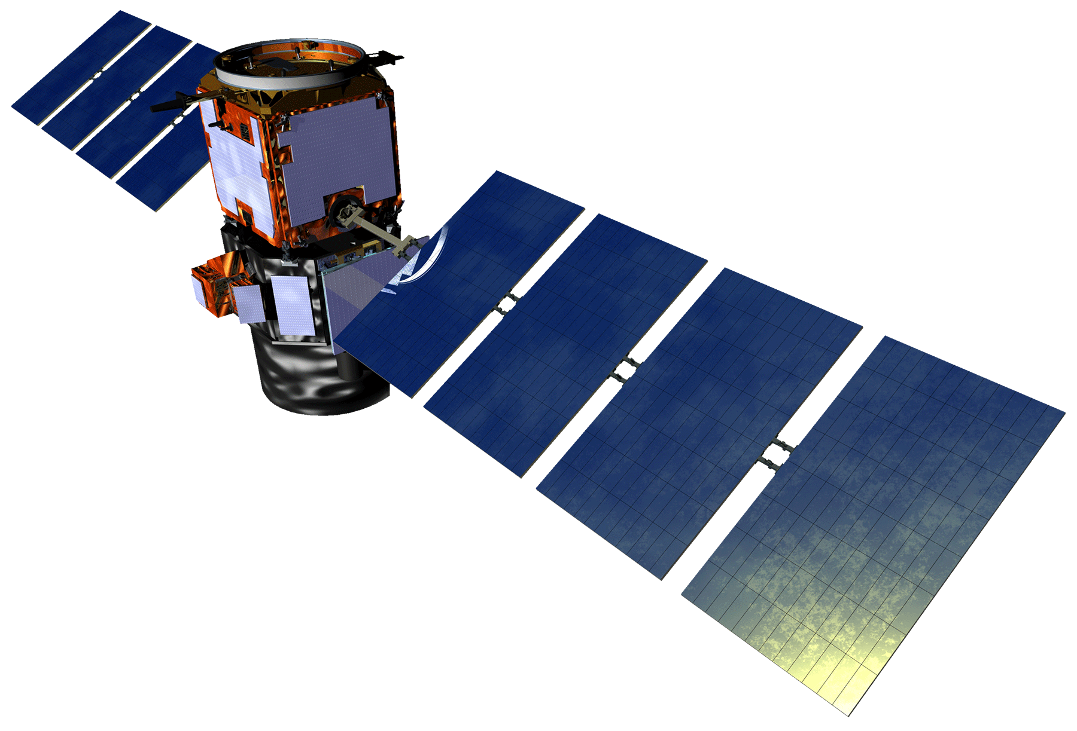

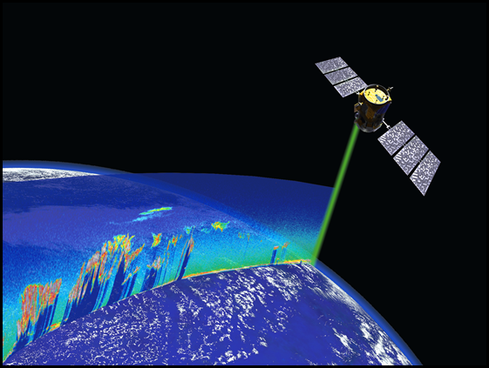
Background Information
CALIPSO
Imaging Infrared Imager (IIR)
Wide-Field Camera (WFC)
Cloud-Aerosol Lidar with Orthogonal Polarization (CALIOP)
Notes:
CALIPSO: Cloud-Aerosol Lidar and Infrared Pathfinder Satellite Observation
CALIPSO went up in early 2006 alongside the CloudSat, and uses its Lidar to take a vertical profile of atmospheric composition.
This works by firing the Lidar down into the atmosphere and measuring the reflected light.

Slide 3
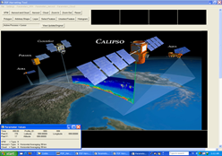
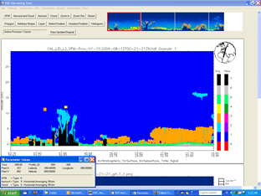


Community Concerns
Community Concerns
  PDFHarvester tool not open-source
  Unable to query aerosol types
Partners
  NASA CALIPSO Science Team; Partner POC: Dr. Charles Trepte
  National Institute of Aerospace:
Dr. Amber Soja
Notes:
Partner Organizations
NASA CALIPSO Science Team; Partner POC: Dr. Charles Trepte and Dr. Amber Soja
Community Concerns
Currently, the CALIPSO science team is using an outdated tool for data visualization and manipulation. This makes it very difficult to adapt and update the tool.
Amidst the wealth of CALIPSO data, it is difficult for researchers to quickly query aerosol types based on classification.

Slide 4
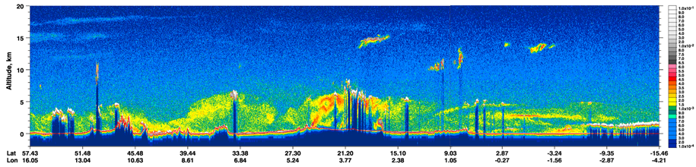

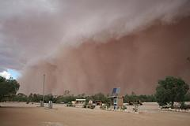
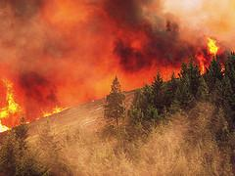
Objectives
Create a tool that allows researchers working with CALIPSO to view and classify clouds and aerosols
Selected object of interest can be exported into a database
Notes:
Objectives Overview
This project is focused on the development of a tool translated from an existing IDL code that will allow researchers working with Cloud-Aerosol Lidar and Infrared Pathfinder Satellite Observations (CALIPSO) to analyze clouds and aerosols. This tool will allow researchers to identify, outline, and categorize a suspected object. Then, the object will be exported into a database organized by criteria based on the researchers needs, such as location and aerosol type. With an organized method of storing specific aerosol objects, future analysis by the CALIPSO science team and other research groups will be more efficient.
Volcano: Walter Lim; The Day the Volcano Erupted - A Halloween Horror Story, Posted via email from Coolest Insights
Dust: Sydney Oats; Dust Storm Heading For Mungerannie Hotel Jan 31 2010, With kind Permission from Pam and Phill Proprietors Mungerannie Hotel.
Fire/ Smoke: Oregon Department of Forestry; Douglas Complex fires 2013: Rabbit Mountain. Photo courtesy of Marvin Vetter, 2013.

Slide 5
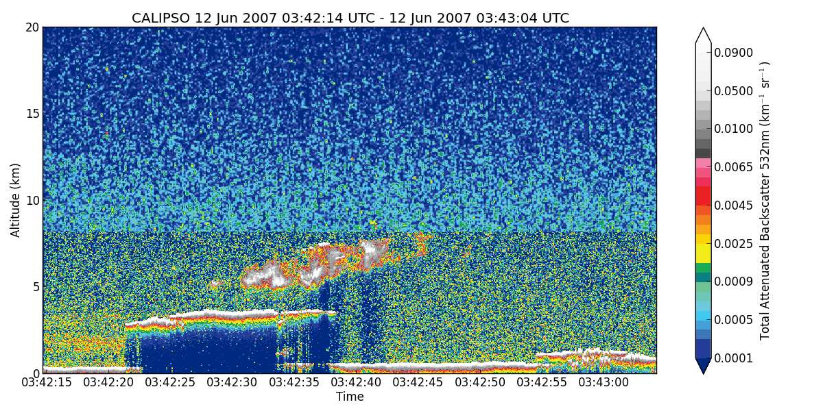
Project Methodology
NASA Earth observations
  CALIPSO, CALIOP - Vertical Profile of Aerosols
Acquisition & Processing
  The tool will take the .hdf files and produce plotted images where aerosol objects of interest can be selected
Notes:
Earth Observations & Parameters
CALIPSO, CALIOP - Vertical Profile of Aerosols
Terra and Aqua, Moderate Resolution Imaging Spectroradiometer (Modis)

Slide 6
Results
Pictures of Final tool once completed

Slide 7

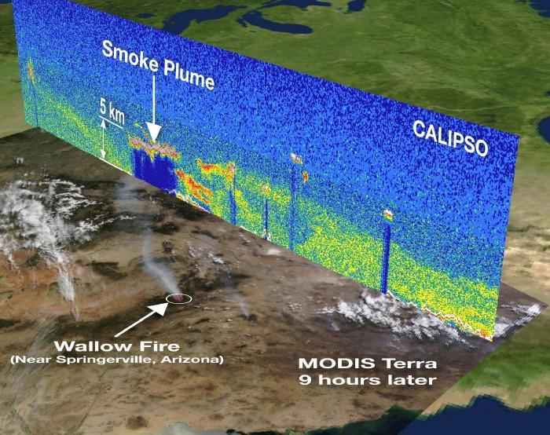
Benefits of Research
  Translation of the tool over from IDL into Python allows greater adaptability and flexibility
  Organization of data based on identifiable characteristics of smoke and aerosol objects
  Simplification of collaboration with a centralized data repository
Notes:
Benefit to End-User:
Simplify data collaboration by providing researchers with a centralized data repository
By translating the tool over from IDL into Python, it will allow for greater adaptability and flexibility
A means of organizing data based on identifiable characteristics of smoke and other aerosol objects

Slide 8
Future Work
  Additional Functionality such as tools for Drawing and Selecting Objects of Interest
  More Plot Types, as well as Functionality for Adding Plot Types
  Creation of a database of Aerosol Objects
  Implementing a Web-Application for Exploration and Use of Database

Slide 9
Acknowledgements
Advisors
  Dr. Kenton Ross (NASA DEVELOP National Program)
Partners
  NASA CALIPSO Science Team; Partner POC: Dr. Charles Trepte
  National Institute of Aerospace: Dr. Amber Soja
Others
  Brian Magill (NASA CALIPSO Science Team)
  Nathan Owen (Langley DEVELOP Center Lead)
  Chad Smith (Langley DEVELOP Assistant Center Lead)
This material is based upon work supported by NASA through contract NNL11AA00B and cooperative agreement NNX14AB60A.
Notes:
Advisors & Mentors:
Dr. Kenton Ross (NASA DEVELOP National Program)
Partner Organizations
NASA CALIPSO Science Team; Partner POC: Dr. Charles Trepte and Dr. Amber Soja

