Slide 1
New Mexico Water Resources
Delivering Automated Evapotranspiration (ET) Data to the New Mexico Office of the State Engineer for Enhanced Water Resource Decision Making in New Mexico
Trevor McDonald (Team Lead)
Sol Kim
Gregory Halverson
Augustin Muniz

Slide 2
Study Area
New Mexico
Focus on Eastern Plains Region
Benefits for:
Water Resources
Land Managers
Ranching
Agriculture
Fire Management
Emergency Response
Drought Assessment
Study Period
2000 – Current
Daily Products Generated
Notes:
Study Area: New Mexico with more focus on the eastern portion of New Mexico. This area has suffered the brunt of the state’s drought and has rangeland, agriculture, and oil/gas industries
Study Period: Limited by the availability of certain data products

Slide 3
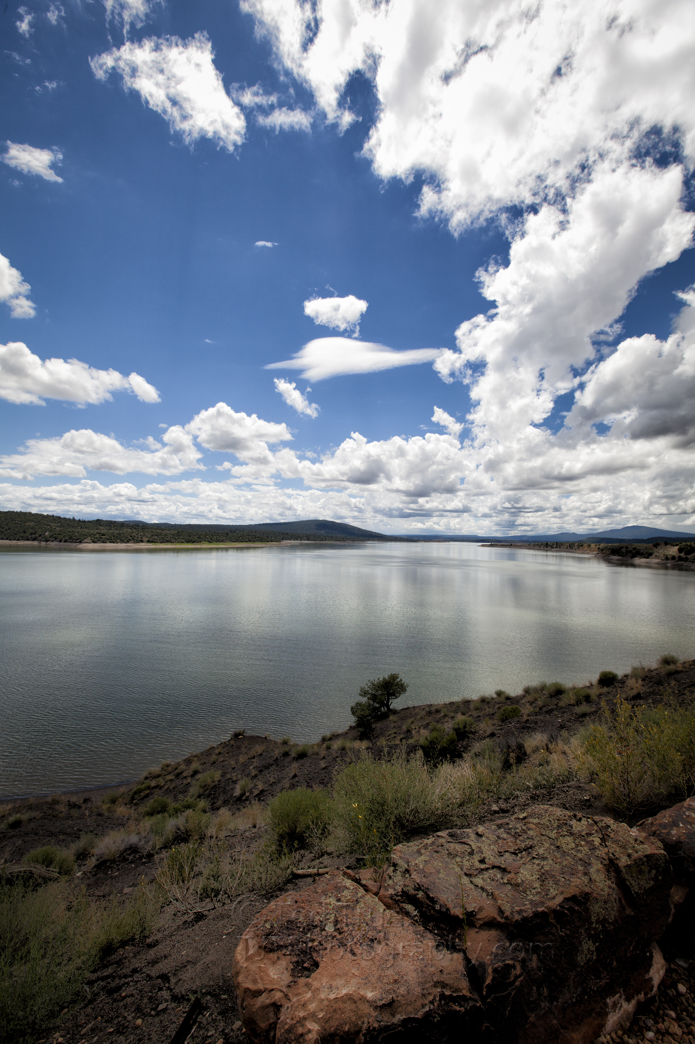
Community Concerns
New Mexico has suffered consistent drought conditions throughout the last decade
Decision makers need tools that facilitate accurate and timely rangeland condition assessments
Need for easily accessible, remotely-sensed ET data
Image Credit: Ted Truex
Notes:
Image Credit: Ted Truex

Slide 4
Objectives
Automate MODIS and NCEP data acquisition
Streamline PT-JPL ET product generation
Disseminate product to New Mexico decision makers via a web interface
NASA Satellites/Sensors
Satellites: Terra & Aqua
Sensor: Moderate Resolution Imaging Spectroradiometer (MODIS)
Notes:
Terra's orbit around the Earth is timed so that it passes from north to south across the equator in the morning, while Aqua passes south to north over the equator in the afternoon. Terra MODIS and Aqua MODIS are viewing the entire Earth's surface every 1 to 2 days, acquiring data in 36 spectral bands.

Slide 5
Methodology
Data Request
Pre-Processing
Post-Processing
Web Interface
Data Acquisition
PT-JPL ET Model
Leaflet
OpenLayers
Data Sources
NCEP
USGS
LAADS
ET Data Cycle
GeoTIFF
GDAL
CURL
GDAL
HEG
MATLAB

Slide 6
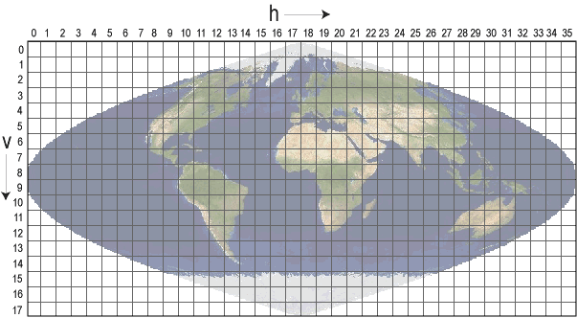
Methodology
From Swath Granules to Sinusoidal Tiles
Retrieve atmospheric MODIS data in swath granules
Grid each granule file onto a sinusoidal projection
For each sinusoidal tile, stitch together every granule that has overlap
Subset out the tile’s domain
Notes:
Top image: Shows atmospheric MODIS swath granules. Level-2 MODIS atmospheric products are produced at a spatial resolution of either a 1 by 1 kilometer or a 5 by 5 kilometer (at nadir) pixel array. Each MOD06_L2 product file covers a five-minute time interval (based on the start time of each MODIS Level-1B granule). This means that for 5km resolution parameters, the output grid is 270 pixels in width by 406 pixels in length for nine consecutive granules.
Bottom image: There are 460 non-fill tiles, tiles are 10 degrees by 10 degrees at the equator. The tile coordinate system starts at (0,0) (horizontal tile number, vertical tile number) in the upper left corner and proceeds right (horizontal) and downward (vertical). The tile in the bottom right corner is (35,17).
Bottom image: Shows sinusoidal tiles used by MODIS land products.
Image Credits: http://modis-atmos.gsfc.nasa.gov/MOD06_L2/grids.html (top)

Slide 7
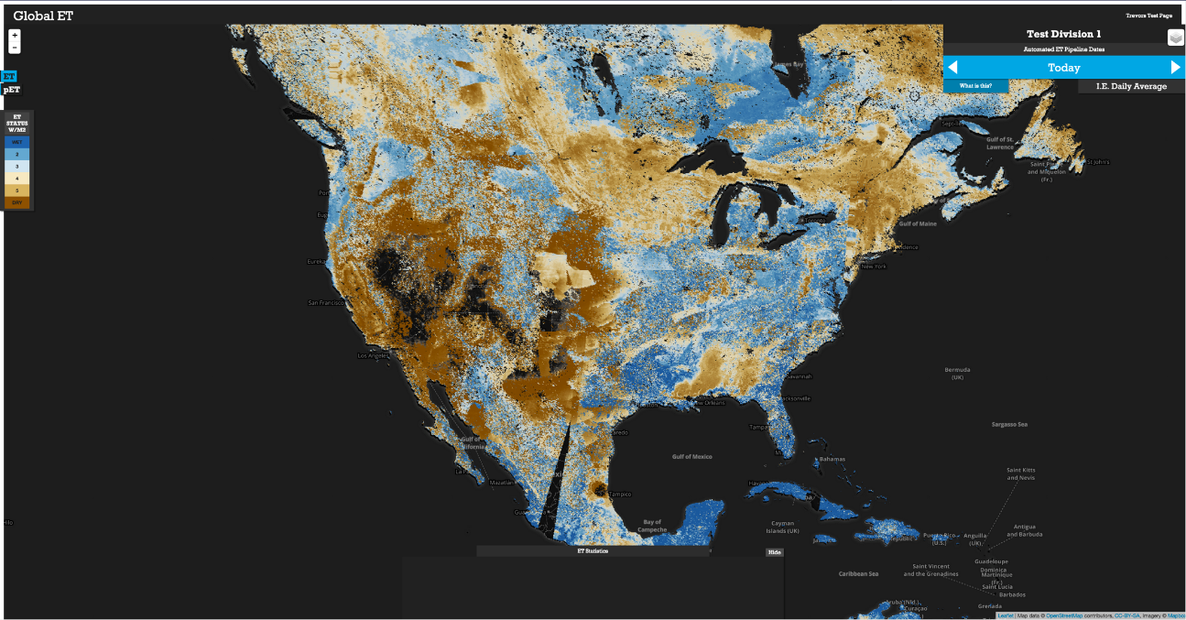
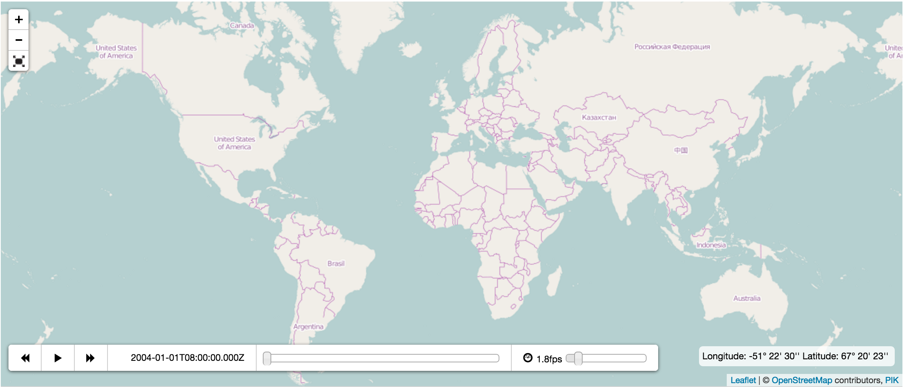
Methodology
Web Interface
Retrieve PT-JPL ET output product to convert from MATLAB to GeoTIFF
Using GDAL commands merge, project, and manage NoData Values
Move to designated GeoServer directory, then use CURL commands to enable within the Server
Create request through a Javascript client initiated via our web interface by users toggling through multi-temporal ET data products

Slide 8
Josh Fisher, NASA JPL
Greg Moore, CalTech
Laura Jewll, CalTech
Munish Sikka, CalTech
Manish Verma, CalTech
Advisors
Partner
John Longworth, New Mexico Office of the State Engineer
Nick Rousseau, DEVELOP – Center Lead
Gwen Miller, DEVELOP – Center Lead
Brittany Zajic, DEVELOP – Assistant Center Lead
Christine Rains, DEVELOP – Assistant Center Lead
Others

