Slide 1
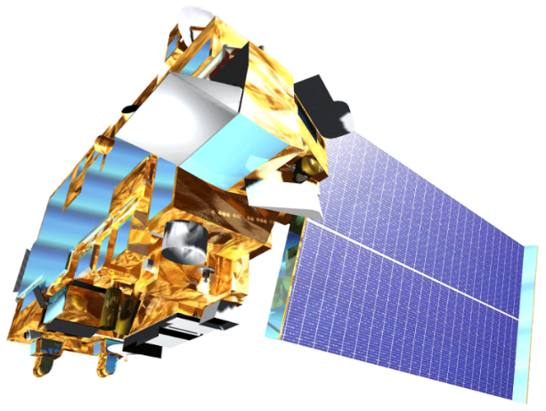
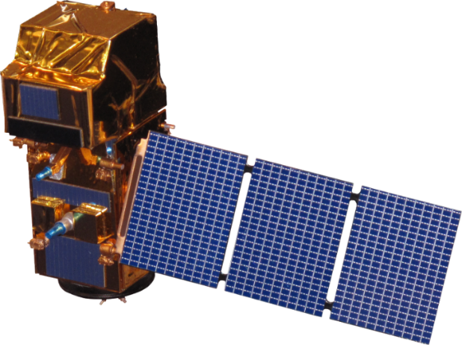
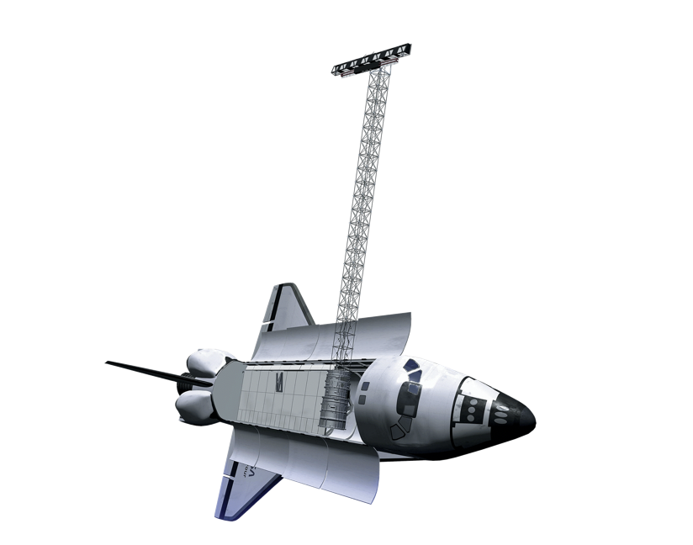
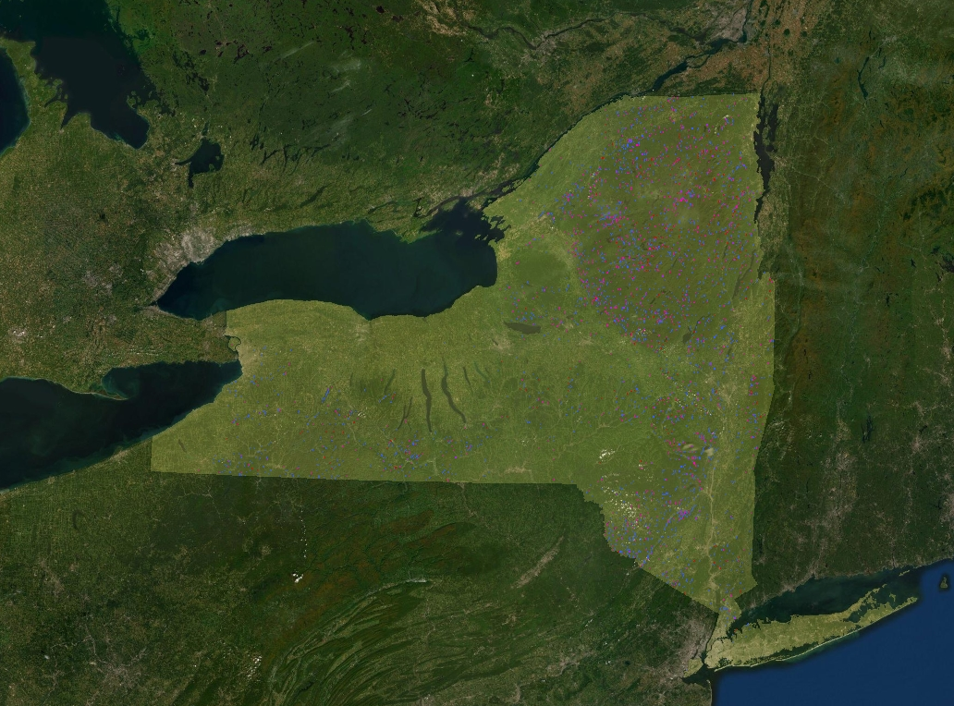
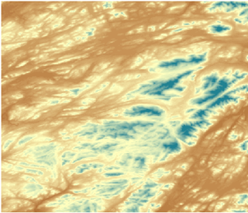
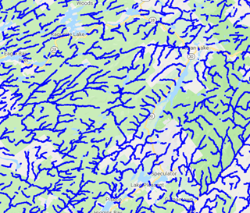
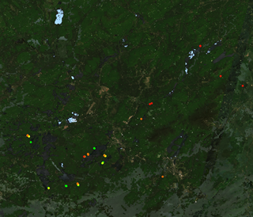
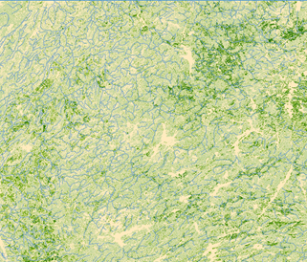
Comparing Efficiency of Space-Based Imagery to AVIRIS Airborne Data for the Identification of Hemlock Forests to Mitigate Invasive Species Expansion
Abstract
Objectives
New York Ecological Forecasting II
Hemlock woolly adelgid (HWA; Adelges tsugae) is an invasive species that threatens eastern hemlock (Tsuga canadensis) in US forests. Eastern hemlock has a greater capacity to store carbon, regulate stream temperatures, and provide habitat for wildlife compared to sympatric tree species. The New York Ecological Forecasting II team partnered with the New York State Department of Environmental Conservation’s Partnership for Regional Invasive Species Management, Adirondack Park Invasive Plant Program (APIPP) and Partnership for Regional Invasive Species Management, Saint Lawrence - Eastern Lake Ontario (SLELO PRISM), Adirondack Research, Cornell University, and the University of Vermont to support their hemlock conservation efforts. APIPP and SLELO currently lack detailed location data on hemlock stands. We created four hemlock distribution maps modeled using a random forest (RF) classifier in Google Earth Engine (GEE), each using data from either Landsat 8 Operational Land Imager (OLI) or Sentinel-2 Multispectral Imager (MSI), as well as variables closely linked to hemlock habitat (e.g. elevation, aspect, distance to nearest stream, soil moisture, soil acidity, land cover type). Ground-surveyed hemlock presence points allowed the team to train and validate these models and compare the accuracy of previous Airborne Visible/Infrared Imaging Spectrometer (AVIRIS) models to satellite-based models. Our team then used ancillary datasets, including HWA presence data and distance to nearest stream, to predict hemlock mortality in New York and forecast forest stream resiliency through 2049. These maps aim to improve APIPP’s and SLELO’s current hemlock inventories and HWA early detection efforts. Hemlock distribution maps created from OLI and MSI provide more efficient, repeatable models of hemlock distribution than those created with AVIRIS data alone. Our forecasting model also supports predictions that HWA spread will result in decreased hemlock populations across NY through 2049.
Utilize NASA Earth observations (EO) to map eastern hemlock distribution in New York State
Determine the strengths and weaknesses of each EO product tested to refine methodology for repeated future use
Analyze the success of the 2017 AVIRIS-based hemlock distribution map using ground survey data
Compare the success of mapping hemlock during leaf-on versus leaf-off periods
Earth Observations
Landsat 8 OLI
Terra ASTER
Sentinel-2 MSI
SRTM
Results
Methodology
Soil Acidity
Elevation
& Aspect
Soil Moisture
Temperature
Distance to Streams
Training Data
Random Forest Classification Algorithm
0
Pure Hemlock
20
Hemlock Dominant
40
Hemlock Subdominant
Conclusions
Kilometers
Study Area
Predicted Hemlock Distribution Map
Satellite-derived models provide a spatially and temporally robust alternative to airborne data for identifying potential hemlock presence across New York State.
Models created solely with spectral data were less accurate than those containing additional habitat parameters.
Loss of hemlock through 2049 is forecasted to reduce habitat suitability, including forest streams for aquatic species.
Project Partners
New York State Department of Environmental Conservation, Partnership for Regional Invasive Species Management, Adirondack Park Invasive Plant Program (APIPP) & Saint Lawrence- Eastern Lake Ontario (SLELO)
Adirondack Research, LLC
University of Vermont, New York Invasive Species Research Institute
Cornell University, Rubenstein School of Environment and Natural Resources
0
New York
200
0
APIPP
100
100
Km
Km
Team Members
Acknowledgements
Dr. Ezra Schwartzberg, Adirondack Research, LLC
Brendan Quirion, APIPP
Zachary Simek, APIPP
Dr. John Bolten, NASA Goddard Space Flight Center
Victor Lenske, NASA DEVELOP, Science Systems and Applications, Inc.
Dr. David Lagomasino, University of Maryland, NASA Goddard Space Flight Center
Paul Montesano, Science Systems and Applications, Inc.
GSFC New York Ecological Forecasting DEVELOP Team: Dr. Sara Lubkin, Madeline Ruid, Rachel Soobitsky, Ariel Walcutt, & Sean McCartney
GSFC Ellicott City Disasters DEVELOP Team
Rya Inman
Project Lead
Abigail Barenblitt
Ryan Hammock
Niharika ‘Chitra’ Kokkirala
Maryland – Goddard | Summer 2019

