Slide 1
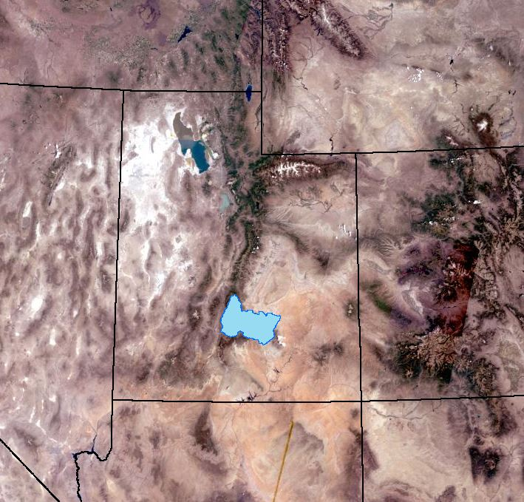
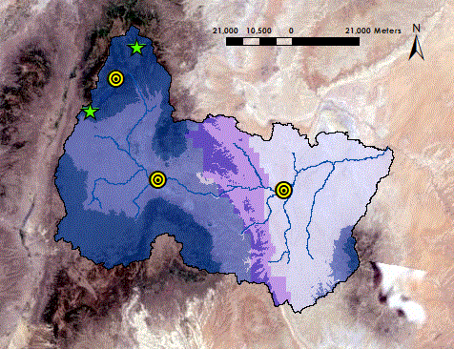
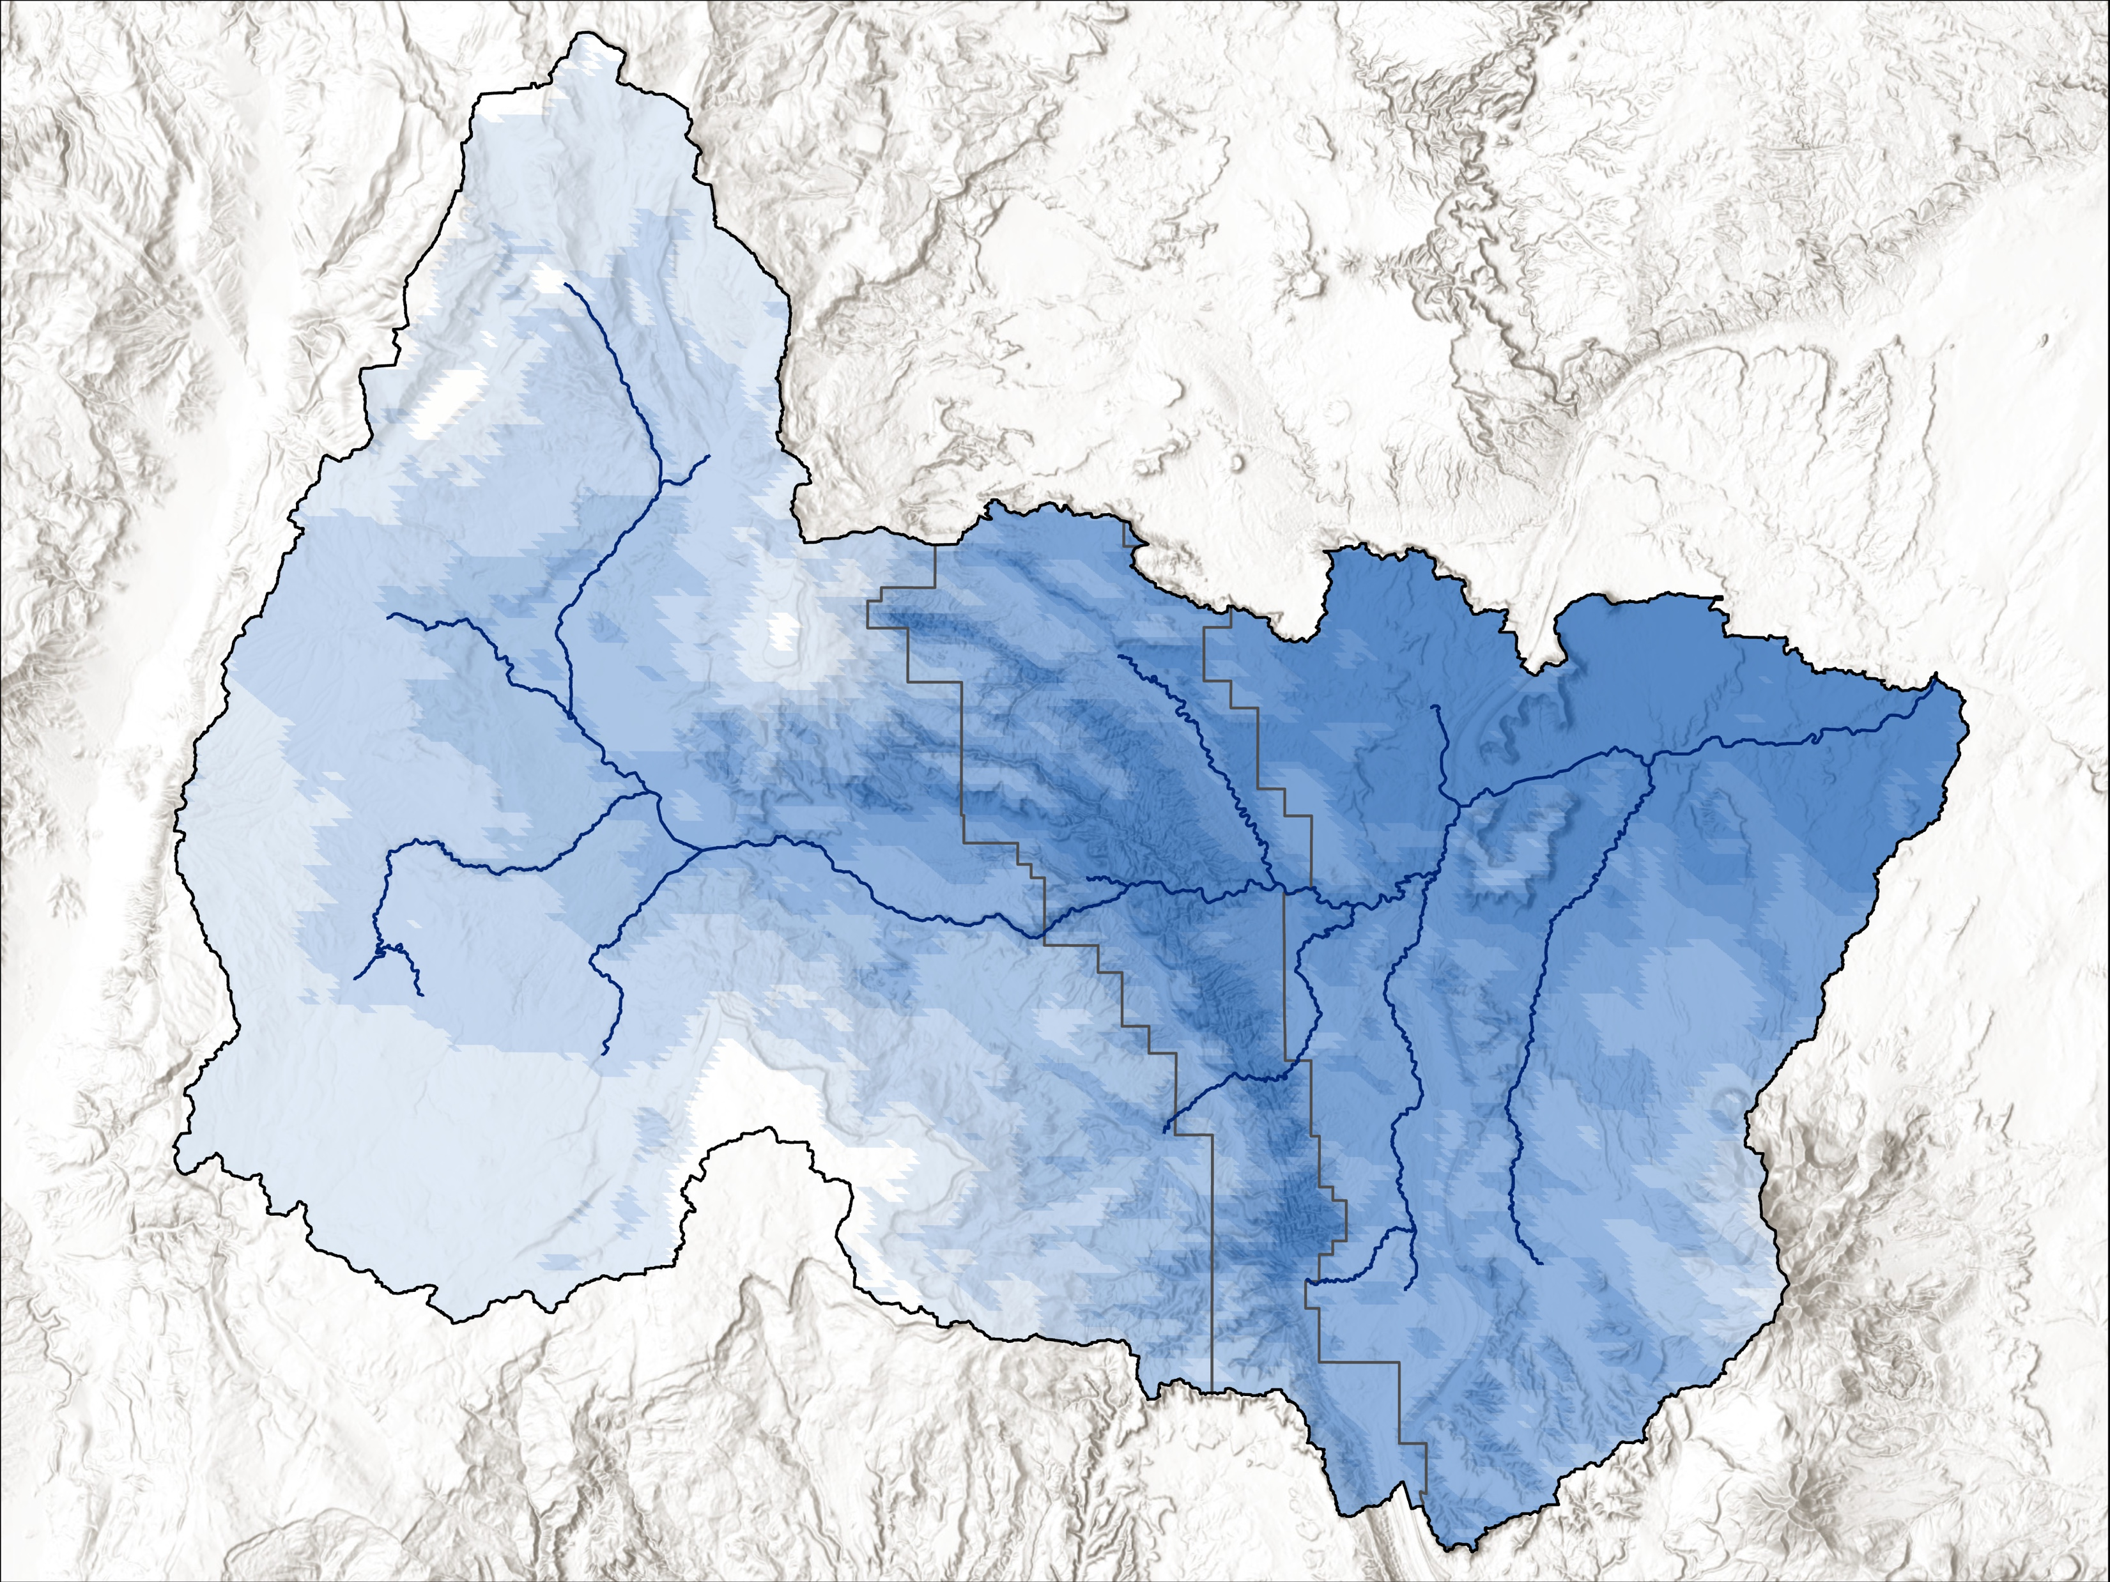
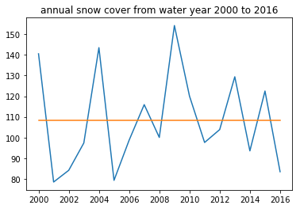
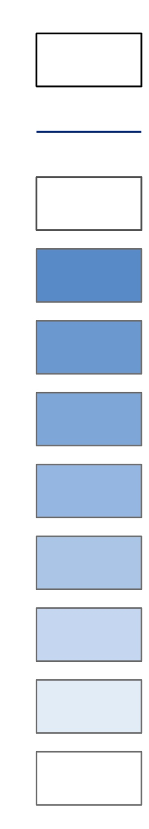
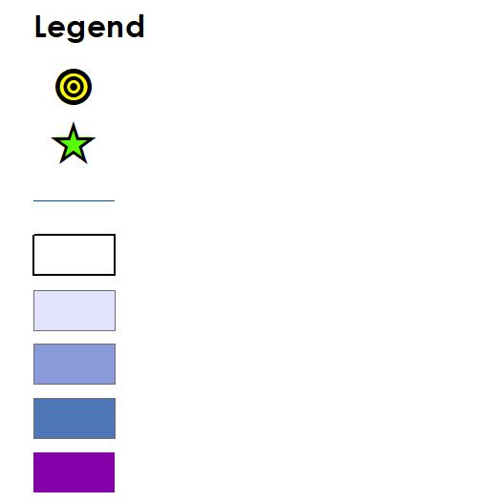
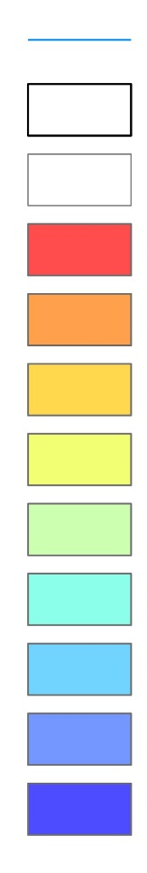
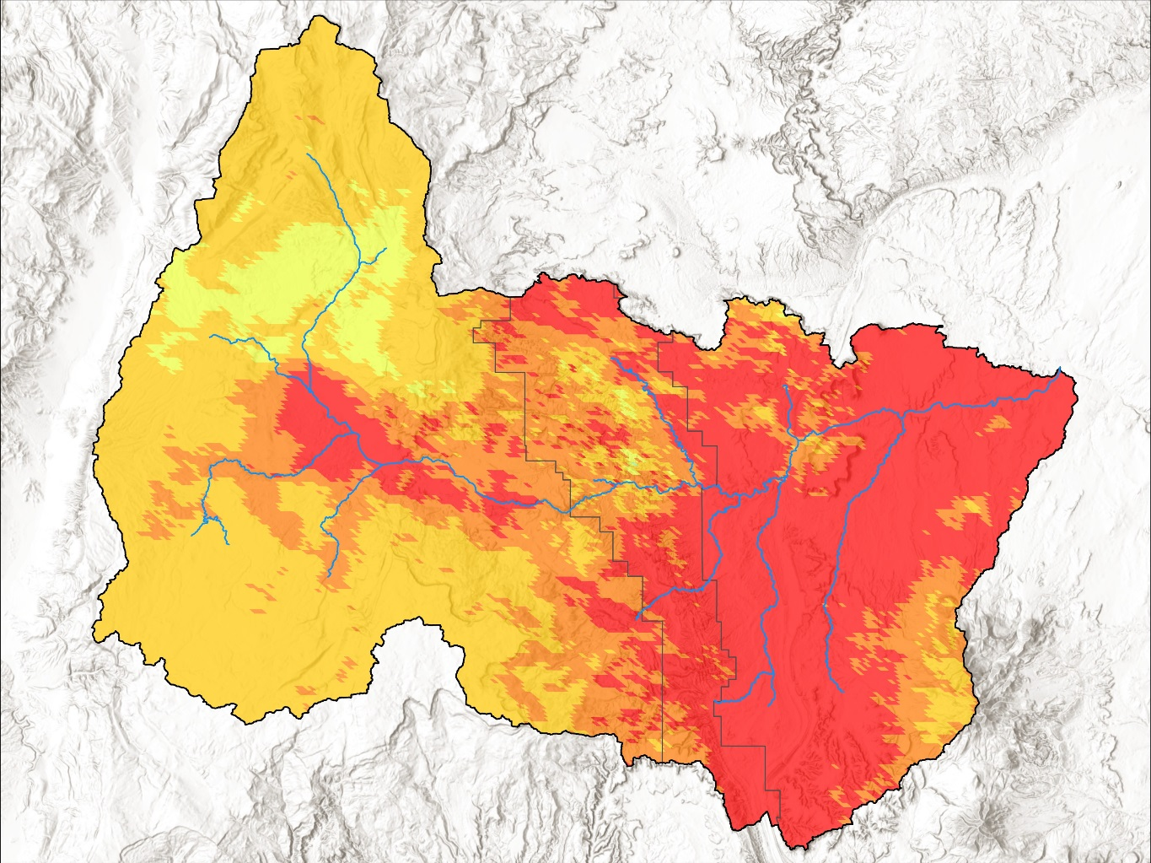
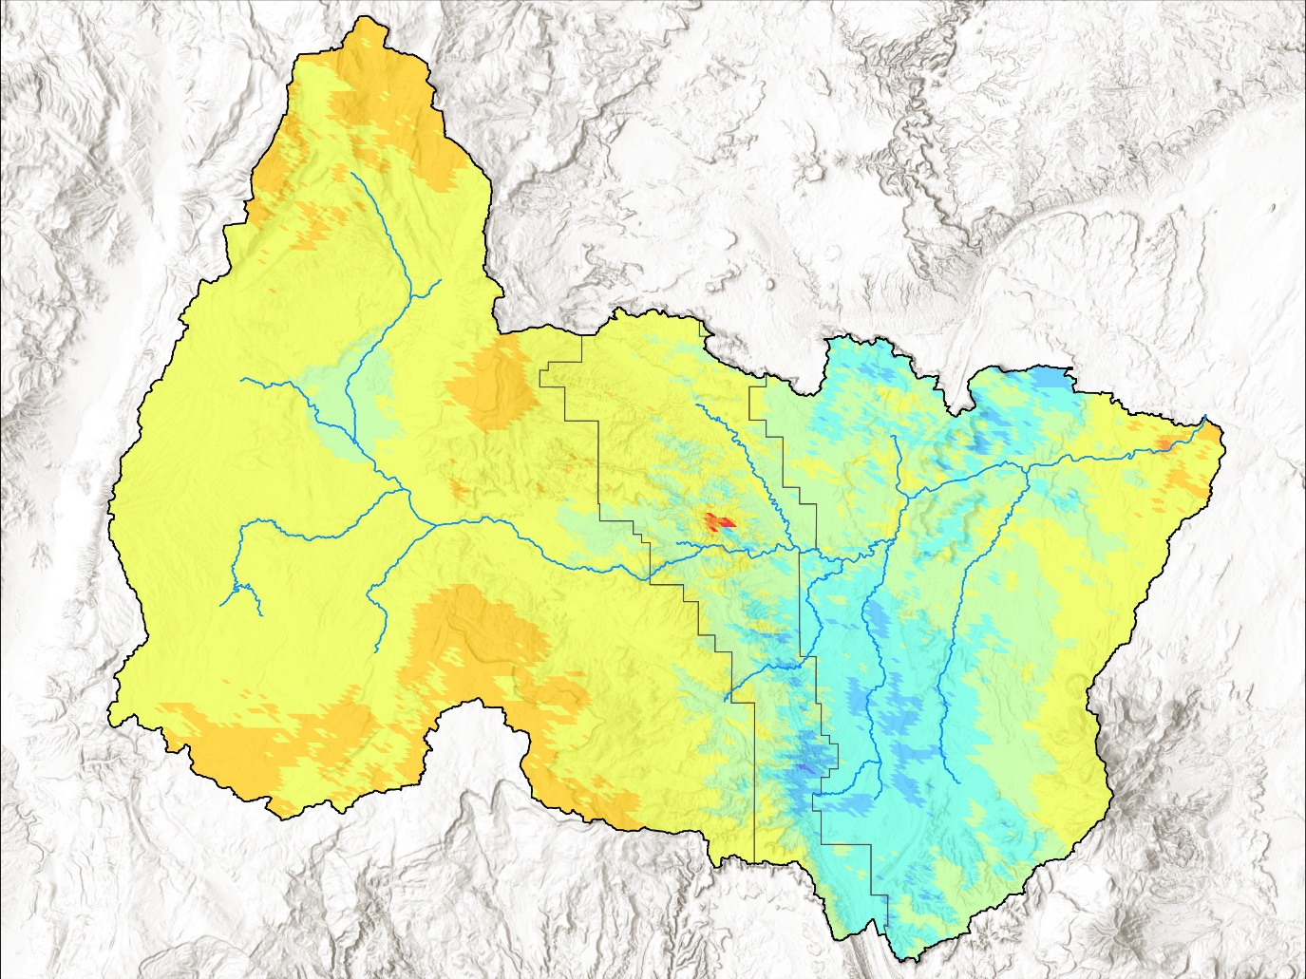
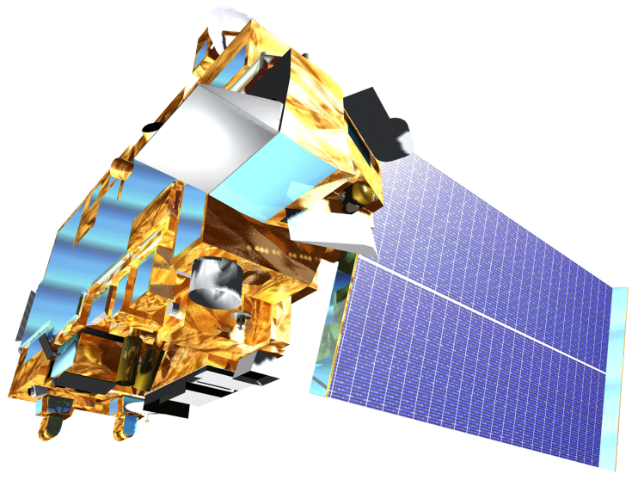
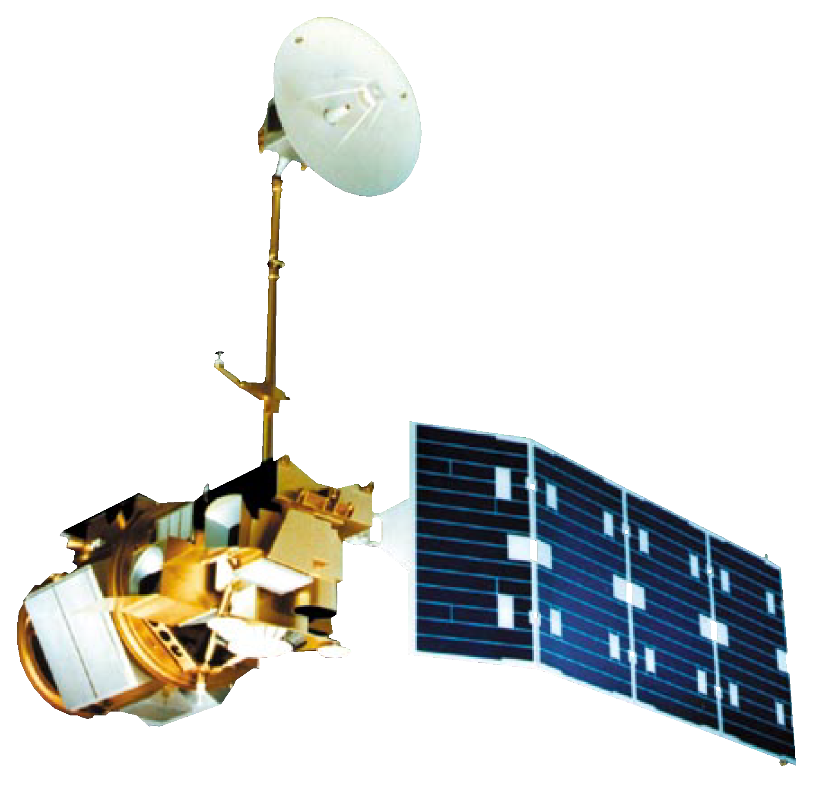

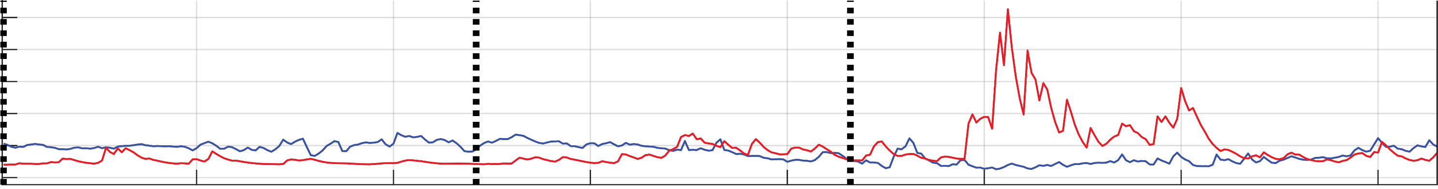
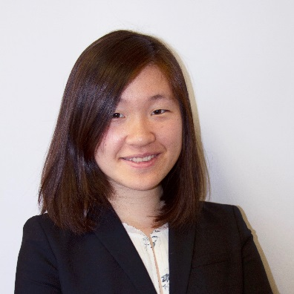
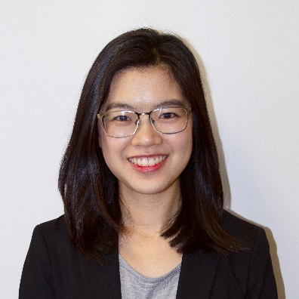
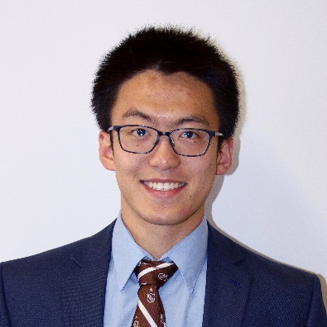

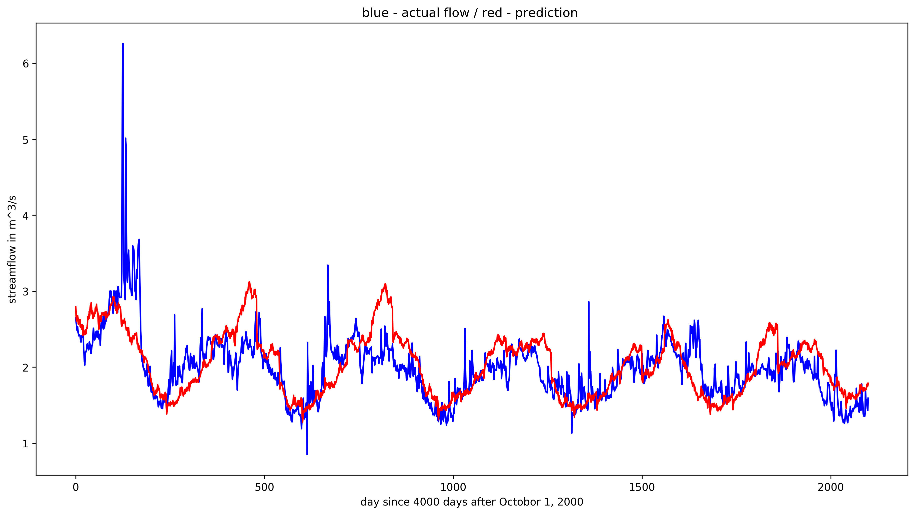
Water Availability Assessment from Annual Snow Cover in the Fremont River Basin Based on NASA Earth Observations and In Situ Data
Abstract
Methodology
As a largely snowmelt-fed watershed, Utah’s Fremont River Basin provides year-round irrigation for approximately 16,000 acres of agricultural areas, including historic orchards and pastures maintained by Capitol Reef National Park (CARE). However, forecasts for seasonal water availability within the basin based on in situ snowpack data have been unreliable compared to water use allocations in the past. For this reason, a more robust method was required to provide accurate water availability assessments that help CARE plan future water allocations more effectively. Multiple NASA Earth observations and in situ data were employed to derive key trends and data insights for snowmelt and relevant climate variables across the watershed. Furthermore, a forecasting tool that predicts seasonal streamflow in the Fremont River Basin was created using machine learning models. The results of the snowmelt and climate analyses along with the forecasting tool will inform water resource management and enhance future irrigation allocation plans at CARE.
DEM
ArcSWAT Watershed Delineation
MODIS NDSI
MODIS
LST
PERSIANN Precipitation
In-situ SNOTEL Data
In-situ Stream Gauge Data
Additional Variables
Elevation Zones
SPAM: Streamflow Prediction & Assessment Model
Comparison
SNOW-M: Snowmelt Observational Watershed Model
Objectives
Devise the most suitable model to forecast streamflow in the Fremont River Basin
Conduct an Exploratory Data Analysis report revealing key snowmelt and climate trends over time
Visualize time series of snow cover changes in the Fremont River Basin
Snow Cover Maps
Confidence Intervals
Predicted Streamflow
GUI Tool
Exploratory Data Analysis
Study Area
Results
ID
WY
Snow Cover
Mean Snow Cover Area (2000-2016)
Annual Snow Cover Area in 2000-2016
UT
Basin
150
NV
CO
River
140
CARE
130
Fremont
0 - 1 %
120
Lyman
1 – 1.5 %
Area(sq. miles)
AZ
NM
Bicknell
Torrey
1.5 – 2.5 %
110
2.5 – 4.5 %
100
Stream gauge
Teasdale
4.5 – 9 %
90
9 – 17 %
SnoTEL station
17 – 34 %
80
River
34 – 68 %
2000
2002
2004
2006
2008
2010
2012
2014
2016
Fremont River Basin
Snow Cover Area for Minimum and Maximum Years vs. Mean Snow Cover Area
Low Elevation Zone
Moderate Elevation Zone
Difference
0
15
30
60
Kilometers
High Elevation Zone
River
Capitol Reef National Park
Basin
Earth Observations
CARE
-100 - -70 %
-70 – -40 %
-40 – 0 %
0 – 150 %
150 – 250 %
250 – 350 %
Terra MODIS
Landsat 5 TM
350 – 550 %
550 – 750 %
2001 (Minimum)
2009 (Maximum)
Team Members
Project Partners
750 – 1,750 %
Actual vs. Predicted Streamflow by SNOW-M
Capitol Reef National Park
6
Actual
5
Predicted
4
National Park Service, Northern Colorado Plateau Network
Streamflow (m³/s)
3
2
1
50
100
150
200
250
300
350
Jessica Li
Project Lead
Zhuoyan He
Chenyu Shi
2016-2017 Water Year
Conclusions
6
Actual vs. Predicted Streamflow by SPAM
In situ and remotely sensed Terra MODIS data are effective inputs for training machine learning algorithms to forecast streamflow.
SPAM exhibited greater accuracy (MAE, RMSE) in modeling streamflow over SNOW-M.
The Streamflow variable was most correlated with Precipitation and Snow Cover Area.
Mean Snow Cover Area data greatly fluctuated year to year from 2000 to 2017, with 203.15 sq. km in 2001 (min. year) and 399.44 sq. km in 2009 (max. year)
Actual
5
Predicted
4
Streamflow (m³/s)
Acknowledgements
3
Joseph Spruce, Lead Science Advisor for NASA DEVELOP VA – Wise County
Dr. L. DeWayne Cecil, Chief Climatologist at NOAA National Centers for Environmental Information and Program Manager of Global Science & Technology, Inc.
Bob VanGundy, Geology Instructor at The University of Virginia’s College at Wise
Brooke Colley, Center Lead at NASA DEVELOP Wise County Clerk of Circuit Court’s Office
Margaret Mulhern, Manda Au, Nolan Barrette, & Austin Counts, NASA DEVELOP VA – Wise County
2
EXAMPLE
1
0
500
1000
1500
2000
Day since September 14, 2011
Fremont River Basin Water Resources II
Virginia – Wise | Summer 2018

