Slide 1
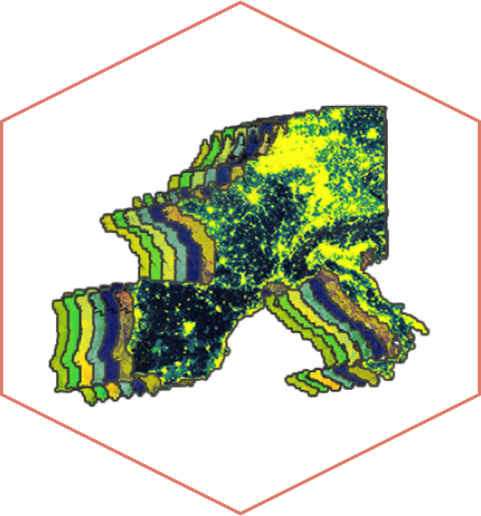
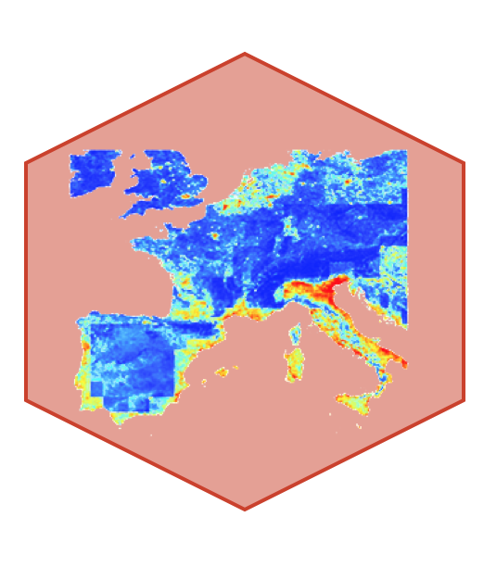
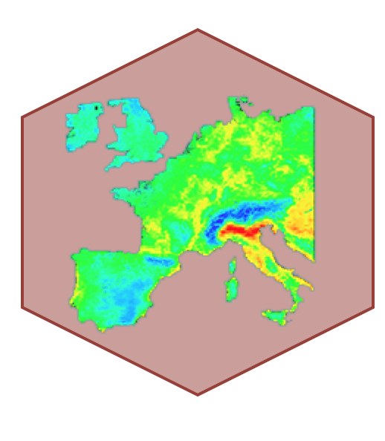
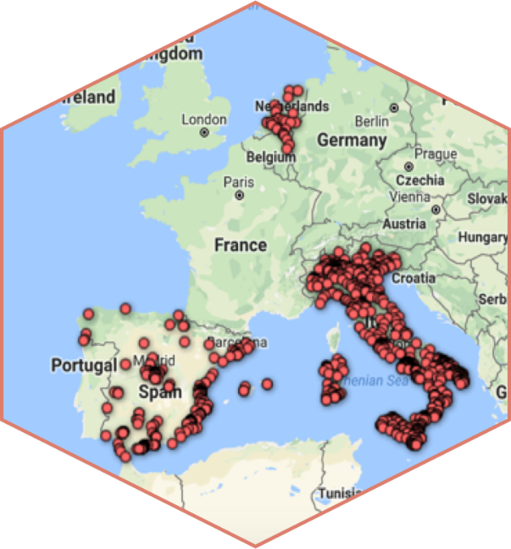
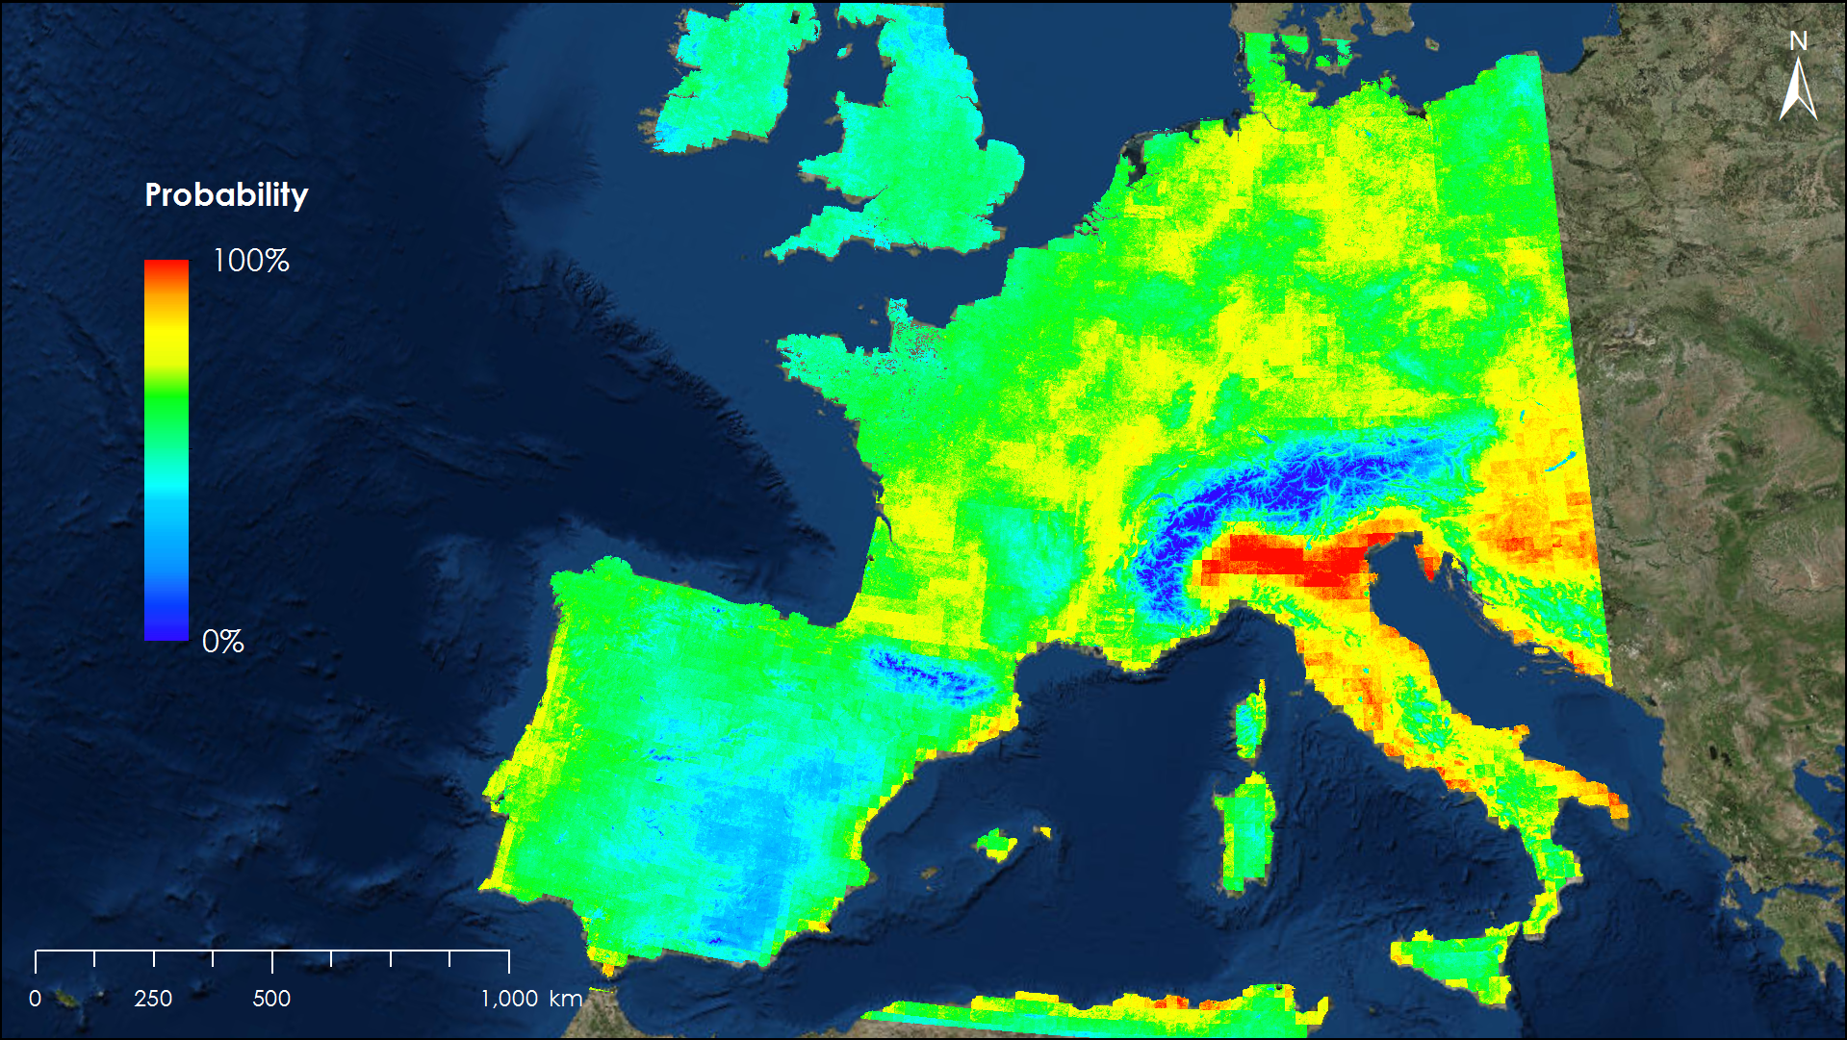
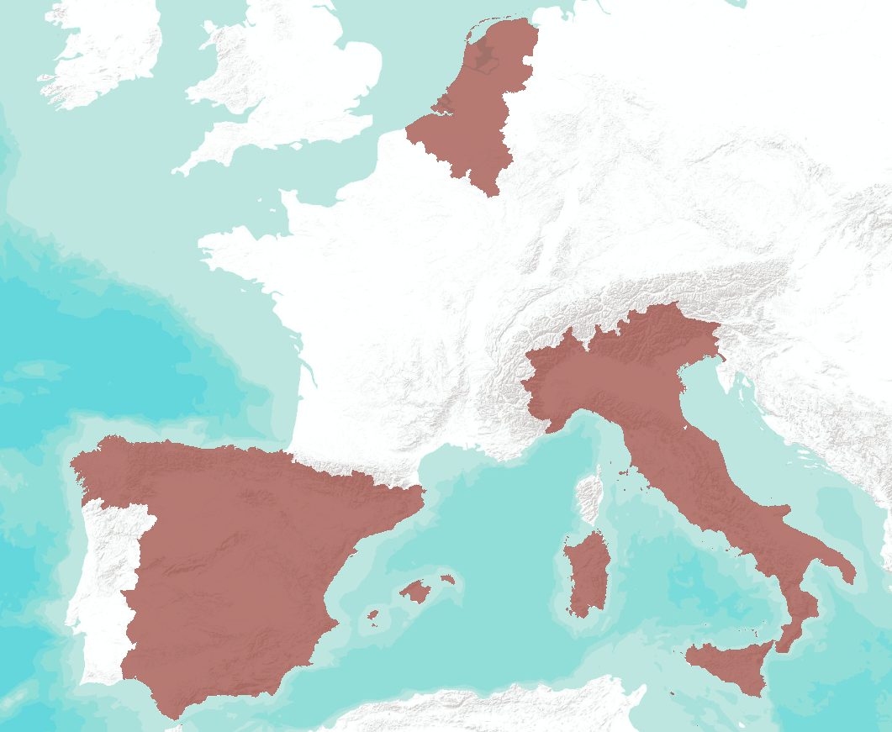
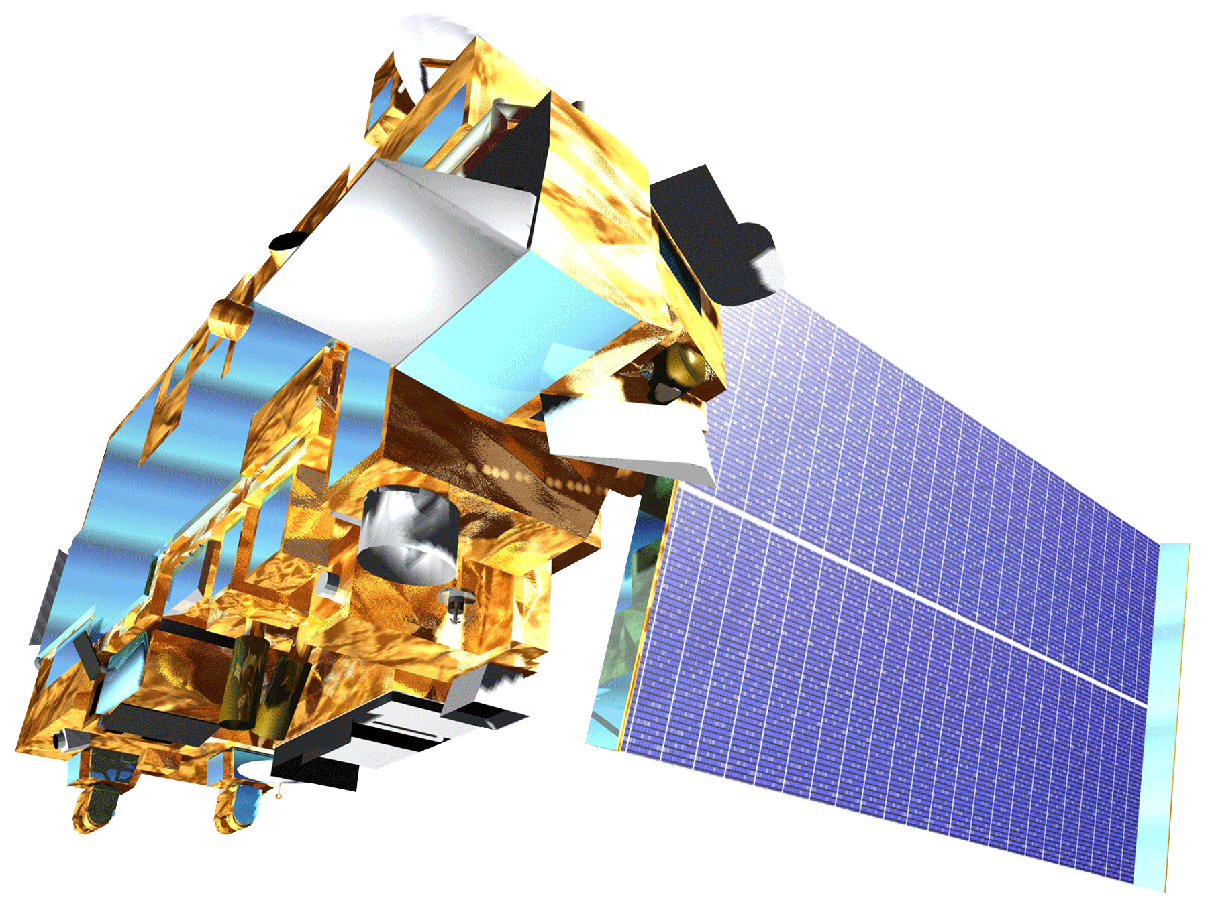
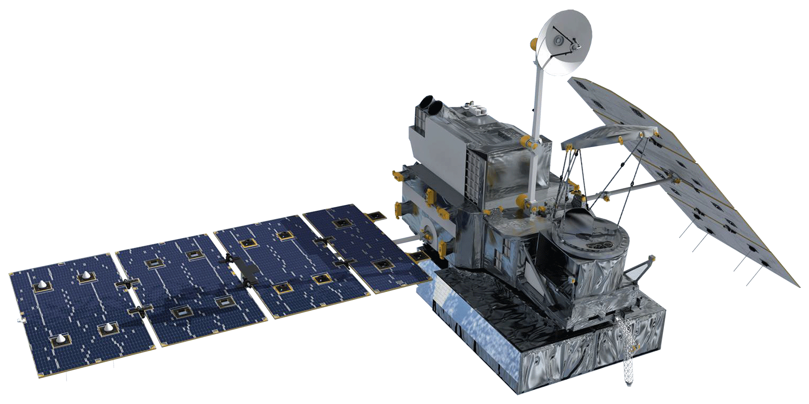
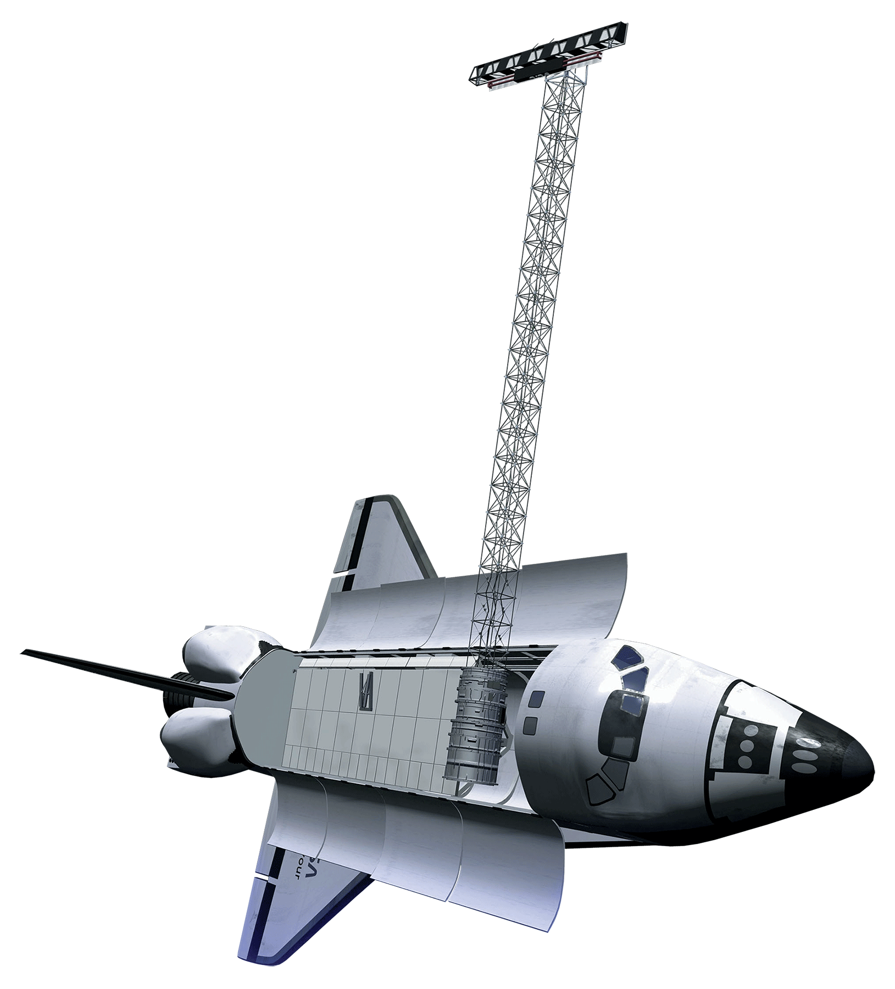
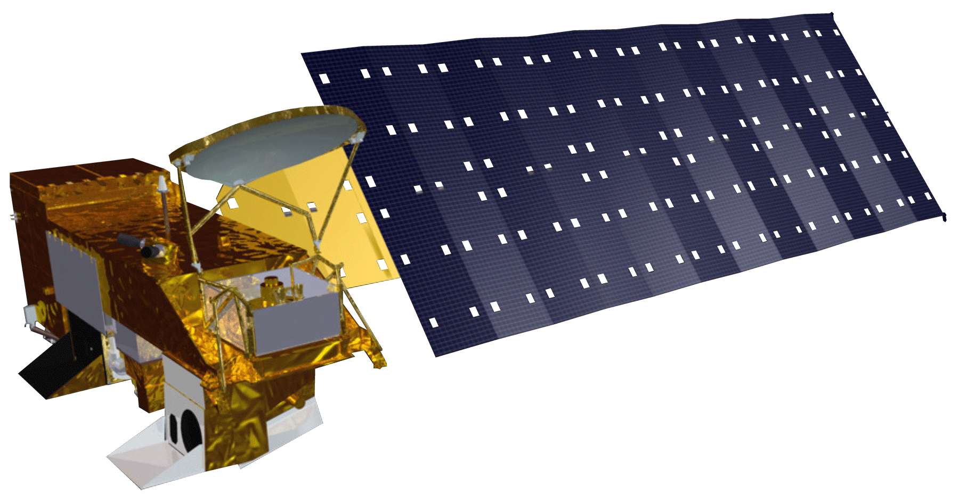
An Interactive Model of Mosquito Presence and Distribution to Assist Vector-Borne Disease Management in Western Europe
Abstract
Methodology
Vector-borne diseases, caused by pathogens and parasites, are transmitted through living organism carriers known as vectors. Mosquitoes are the most common disease vectors and transmit illnesses such as Zika, West Nile, chikungunya, malaria, dengue, and yellow fever. These diseases affect millions of people around the world and kill more than one million people each year. While vector-borne disease outbreaks are difficult to predict, the Global Mosquito Alert Consortium strives to monitor and mitigate outbreaks through research and citizen science. This approach presents several challenges, including a lack of data standardization across different regions. During the first term of this project, the MaxEnt habitat modeling software was used to combine several environmental factors with mosquito presence points extracted from citizen science data to determine which variables are correlated with the presence of mosquitoes. During the second term, the NASA DEVELOP team utilized NASA Earth observations and the Global Mosquito Alert Consortium’s citizen science data to create an interactive, open source map on Google Earth Engine to improve prediction models for vector-borne diseases.
Input
Suitability
GEE
Environmental & Citizen Science Data
Run MaxEnt Model
Interactive Habitat Suitability Model
Objectives
Integrate citizen science data and NASA Earth observations to make them more publicly accessible
Create an interactive map showing mosquito habitat suitability
Overlay results with transportation, public health, and population data
Results
Study Area
Study Area
Belgium
Italy
The Netherlands
Spain
200 miles
Earth Observations
Conclusions
NDVI, temperature, soil moisture, and humidity were positively correlated with mosquito presence.
Elevation was a driving factor and was inversely correlated with mosquito presence.
Homogenous land cover and greenness were associated with mosquito presence.
The distribution of environmental variable importance changed based on the season.
Elevation was the most important variable during the winter months.
During the summer months there was a more even distribution of variable importance.
Terra
Aqua
GPM
SRTM
Team Members
Gia Mancini
(Project Lead)
Julia Heslin
Luisa Silva
Acknowledgements
Assaf Anyamba, PhD, Universities Space Research Association, NASA Goddard Space Flight Center
John Bolten, PhD, NASA Goddard Space Flight Center
John Palmer, PhD, Global Mosquito Alert Consortium
Anne Bowser, PhD, Woodrow Wilson International Center for Scholars
Xhafer Rama, Universities Space Research Association
Russanne Low, PhD, Institute for Global Environmental Strategies
Dorian Janney, ADNET Systems Inc
Greg Newman, PhD, Citizen Science Association
Martin Brocklehurst, European Citizen Science Association
Arnold van Vliet, PhD, and Sander Koenraadt, PhD, Wageningen University
Beniamino Caputo, PhD, and Alessandra Dellatorre, PhD, Sapienza Università Di Roma
Douglas Gardiner, Helen Plattner, Alison Thieme and Aaron Warga, NASA DEVELOP
Victor Lenske
Sara Lubkin, PhD
Project Partners
Global Mosquito Alert Consortium
The Woodrow Wilson International Center for Scholars
Citizen Science Association
European Citizen Science Association
Institute for Global Environmental Strategies
Wageningen University
Sapienza Università Di Roma
Western Europe Health and Air Quality II
Maryland – Goddard | Spring 2018

