Slide 1
El Salvador Ecological Forecasting II
Utilizing NASA Earth Observations to Predict Deforestation and Forest Degradation in El Salvador
Britta Dosch (Project Lead)
Rebekke Muench
Garrett Kidd
Jacob Patrick
Labreshia Mims
Amy Wolfe

Slide 2
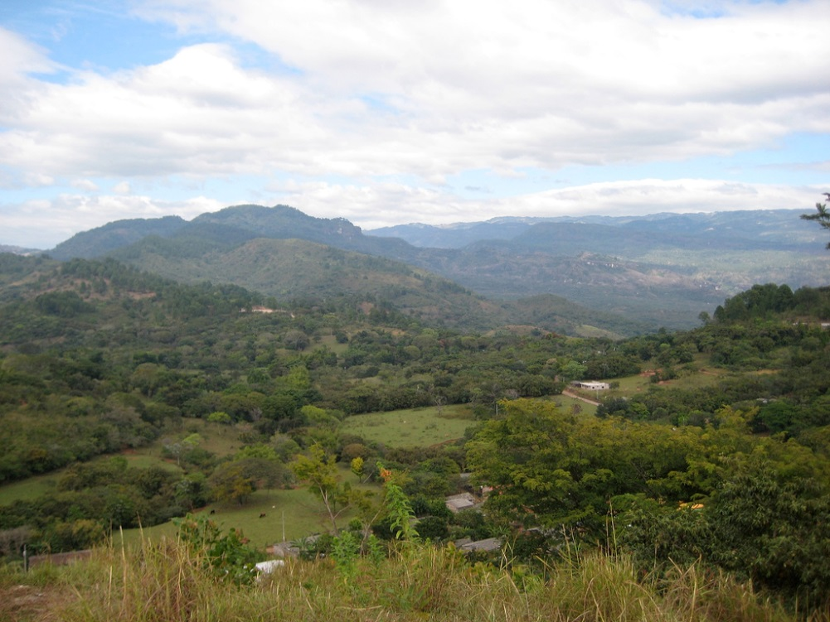
Objectives
Develop methodology for monitoring and forecasting ecological change in study area
Delineate Land Use/Land Cover (LULC) dominate tree species, agriculture and pastoral plots, and urban development
Identify patterns in LULC changes, specifically looking at changes forest cover
Allison Keller

Slide 3
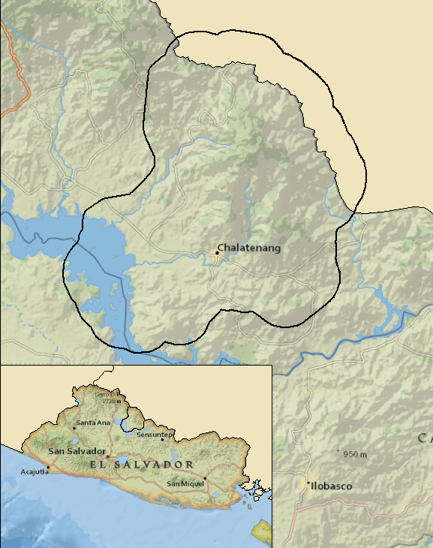
Study Area
La Mancomunidad
La Montañona, Chalatenango, El Salvador
Study Period
1986-2016 dry season (?)

Slide 4
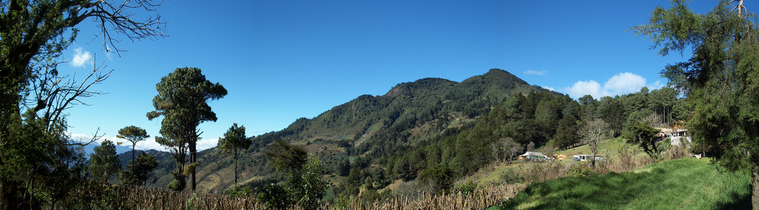
Community Concerns
El Salvador is the second most deforested country in Latin America & has the highest population density in Central America
The pine oak forest is threatened by encroachment by the surrounding agricultural and pastoral activities
Subsistence farmers rely on forests to provide soil stability, prevent mudslides, and reduce nutrient loss
Pine oak forests maintain local stream and river quality
Otto Rodriguez: https://www.flickr.com/photos/otrarove/9596765572

Slide 5
Methodology
Data Acquisition
Data Processing
Data Analysis
End Product

Slide 6


Data Acquisition
Data Processing
Data Analysis
End Product
Landsat CDR 4/5 & 8
ABES Project Field Survey
MARN
USAID GeoCenter
Landsat 8
Landsat 4/5

Slide 7
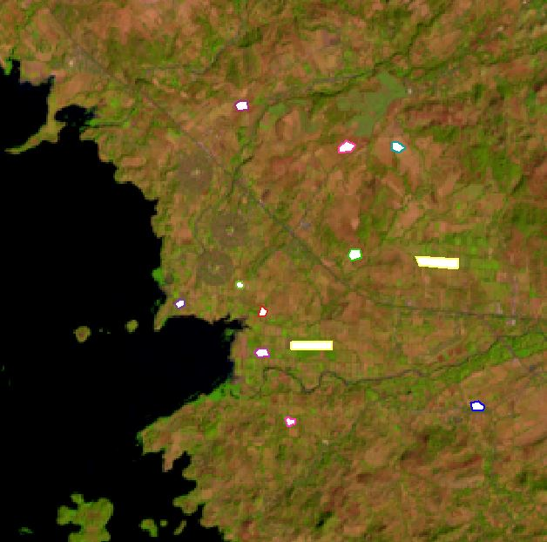
Data Acquisition
Data Processing
Data Analysis
End Product
Landsat Scenes clipped using Google Earth Engine (GEE) Code Editor
QuickBird and RapidEye imagery resampled in ArcGIS to fit resolution of Hansen and Landsat data
Hansen dataset clipped to QuickBird extant
Training sites created in ArcGIS

Slide 8
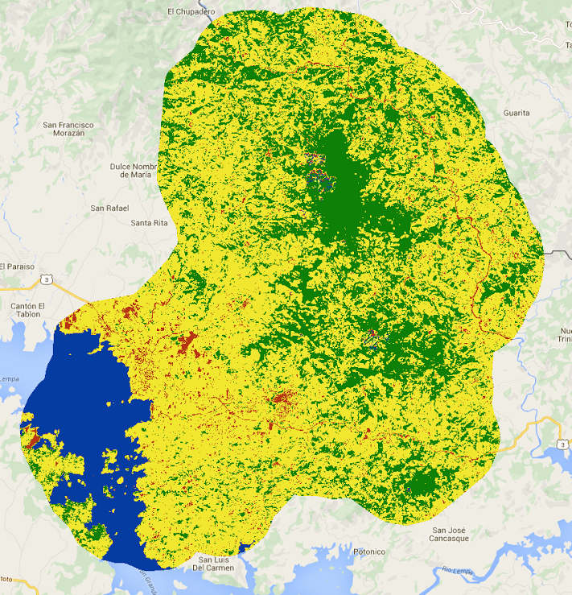
Data Acquisition
Data Processing
Data Analysis
End Product
Maximum entropy and random forest classification
QuickBird imagery utilized to “validate” Hansen data at regional scale
Accuracy assessment preformed using RapidEye imagery and Landsat comparison

Slide 9
Data Acquisition
Data Processing
Data Analysis
End Product
LandTrends historical land change patterns and forecasting model
RFI accuracy checked with field surveys, RapidEye, GeoCenter imagery, and Hansen data

Slide 10
Conclusions

Slide 11
Errors/ Uncertainties

Slide 12
Moving Forward

Slide 13
Advisors
Dr. Kenton Ross, NASA DEVELOP National Program
Emily Adams, NASA DEVELOP National Program
Partners
La Mancomunidad La Montanona, Chalatenango
Ministerio de Medio Ambiente y Recursos Naturales (MARN)
Contributors
The Earth Institute, Columbia University (ABES Project)
Jordan Ped, NASA DEVELOP National Program
Courtney Duquette, NASA DEVELOP National Program
Clarence Kimbrell, NASA DEVELOP National Program
Susannah Miller, NASA DEVELOP National Program
Stephen Zimmerman, NASA DEVELOP National Program

