Slide 1
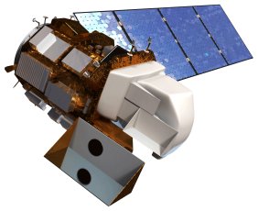
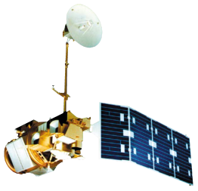
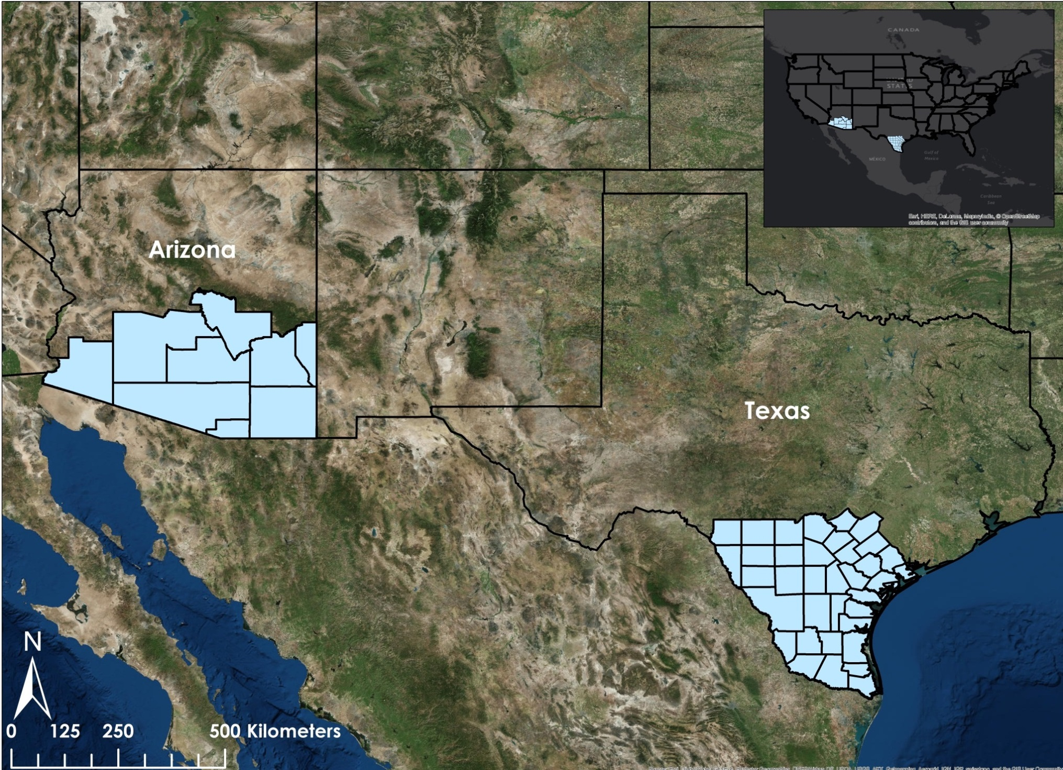
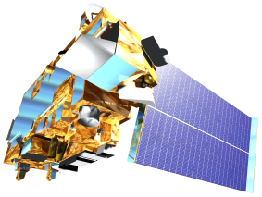
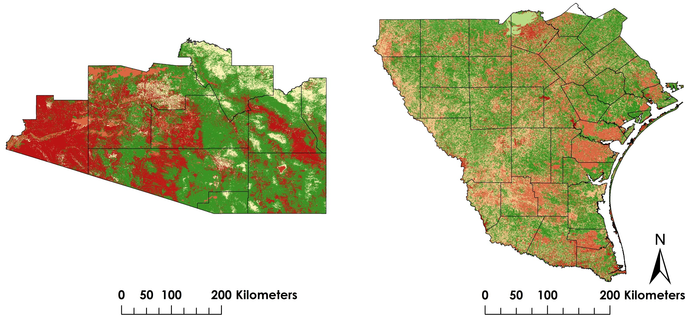
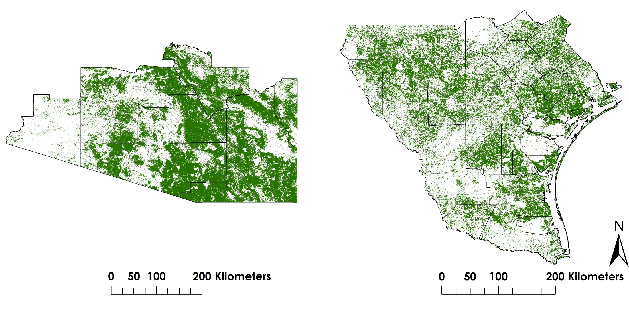
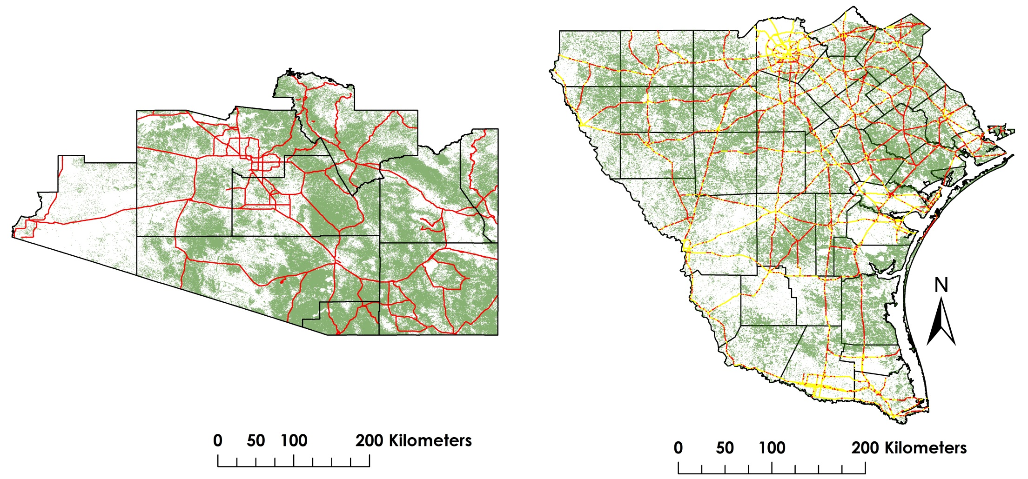
Texas and Arizona Ecological Forecasting
Utilizing NASA earth observations to monitor and manage ocelot habitat loss
Daryl Ann Winstead (Project Lead), Kaushik Narasimhan, Christina Fischer, Amberle Keith
NASA DEVELOP National Program at Marshall Space Flight Center
Abstract
Objectives
Earth Observations
Although ocelot (Leopardus pardalis) habitat is found throughout Central America, portions of South America, and the United States, the species is currently listed as endangered with less than 100 remaining in the United States. This cat requires a minimum home range of 6.5 square kilometers, which aids in deadly interactions with humans on roadways. Many conservation efforts have been attempted, from ocelot translocation to habitat restoration. In this project, a remote sensing approach was developed, using NASA Earth-observing sensors. Landsat 8 Operational Land Imager (OLI) and Landsat 5 Thematic Mapper (TM) imagery were used to create supervised land cover classifications for 1996, 2005, and 2014 during January through March to assess land use and cover over time. Surface reflectance imagery from Terra and Aqua Moderate Resolution Imaging Spectroradiometer (MODIS) were then used to derive Normalized Difference Vegetation Index (NDVI values) to verify the results from the land cover classification layer. The verified land cover classification was then used with in situ data in the Princeton Maximum Entropy model to identify suitable ocelot habitat. A proximity risk map to roads and urban areas was created using multiband buffer zones over this habitat. The products were delivered to the Pittsburgh Zoo & PPG Aquarium, Caesar Kleberg Wildlife Research Institute, Denver Zoo, Texas Department of Transportation, South Texas Refuge Complex, and Secretaria de Medio Ambiente y Rescusos Naturales. The use of GIS and remote sensing will greatly aid the project partner’s decision-making process in directing conservation efforts for this endangered species.
Identify areas of potential ocelot habitat for conservation purposes
Study impact of urban and agricultural growth on ocelot habitat
Study impact of road development on ocelot populations by the Texas Department of Transportation
Landsat 8 OLI
Landsat 5 TM
Study Area
Terra MODIS, ASTER
Results
Suitable Habitat Map
County Border
Most Suitable : 1
Least Suitable : 0
Percent Cover Map
Methodology
NDVI
Streams
Class
Suitable Habitat
Percent Cover
Road Networks
Proximity to Roads
NDVI
Most Suitable Habitat
Landcover Classification
Road Network
Proximity Risk Map
Stream Network
High Risk Roads
Road Network
Team Members
Project Partners
Most Suitable Habitat
Conclusions
Ken Kaemmerer, Pittsburg Zoo & PPG Aquarium
Dr. Joseph Gaspard, Pittsburg Zoo & PPG Aquarium
Dr. Michael Tewes, Caesar Kleberg Wildlife Research Institute at Texas A&M University-Kingsville
Humberto Perotto, Caesar Kleberg Wildlife Research Institute at Texas A&M University-Kingsville
Nanette Bragin, The Denver Zoo
Mitch Sternberg, South Texas Refuge Complex
Dr. John Young Jr., Texas Department of Transportation
Dr. Arturo Caso, SEMARNAT
Dr. Tyler Campbell, East Wildlife Foundation
Percent cover of ocelot habitat has decreased since 1996
Nearly 3,000km in Texas and 11,000km in Arizona of roads intersect with current and potential ocelot habitat
The potential habitat in Arizona is overestimated and requires in situ data to increase accuracy
Acknowledgements
The Texas and Arizona Ecological Forecasting team would like to say thank you to the wide array of partners, mentors and others/participants who provided their time, support, and expertise:
Dr. Jeffrey Luvall, NASA at NSSTC
Dr. Robert Griffin, University of Alabama in Huntsville, Assistant Professor of Atmospheric Science in the Earth System Science Program
Timothy Klug, NASA DEVELOP
Kaushik Narasimhan, Amberle Keith, Daryl Ann Winstead, Christina Fischer
NASA Marshall Space Flight Center

