Slide 1
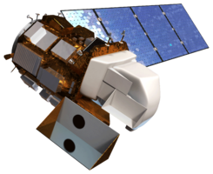
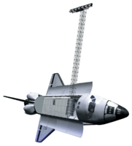
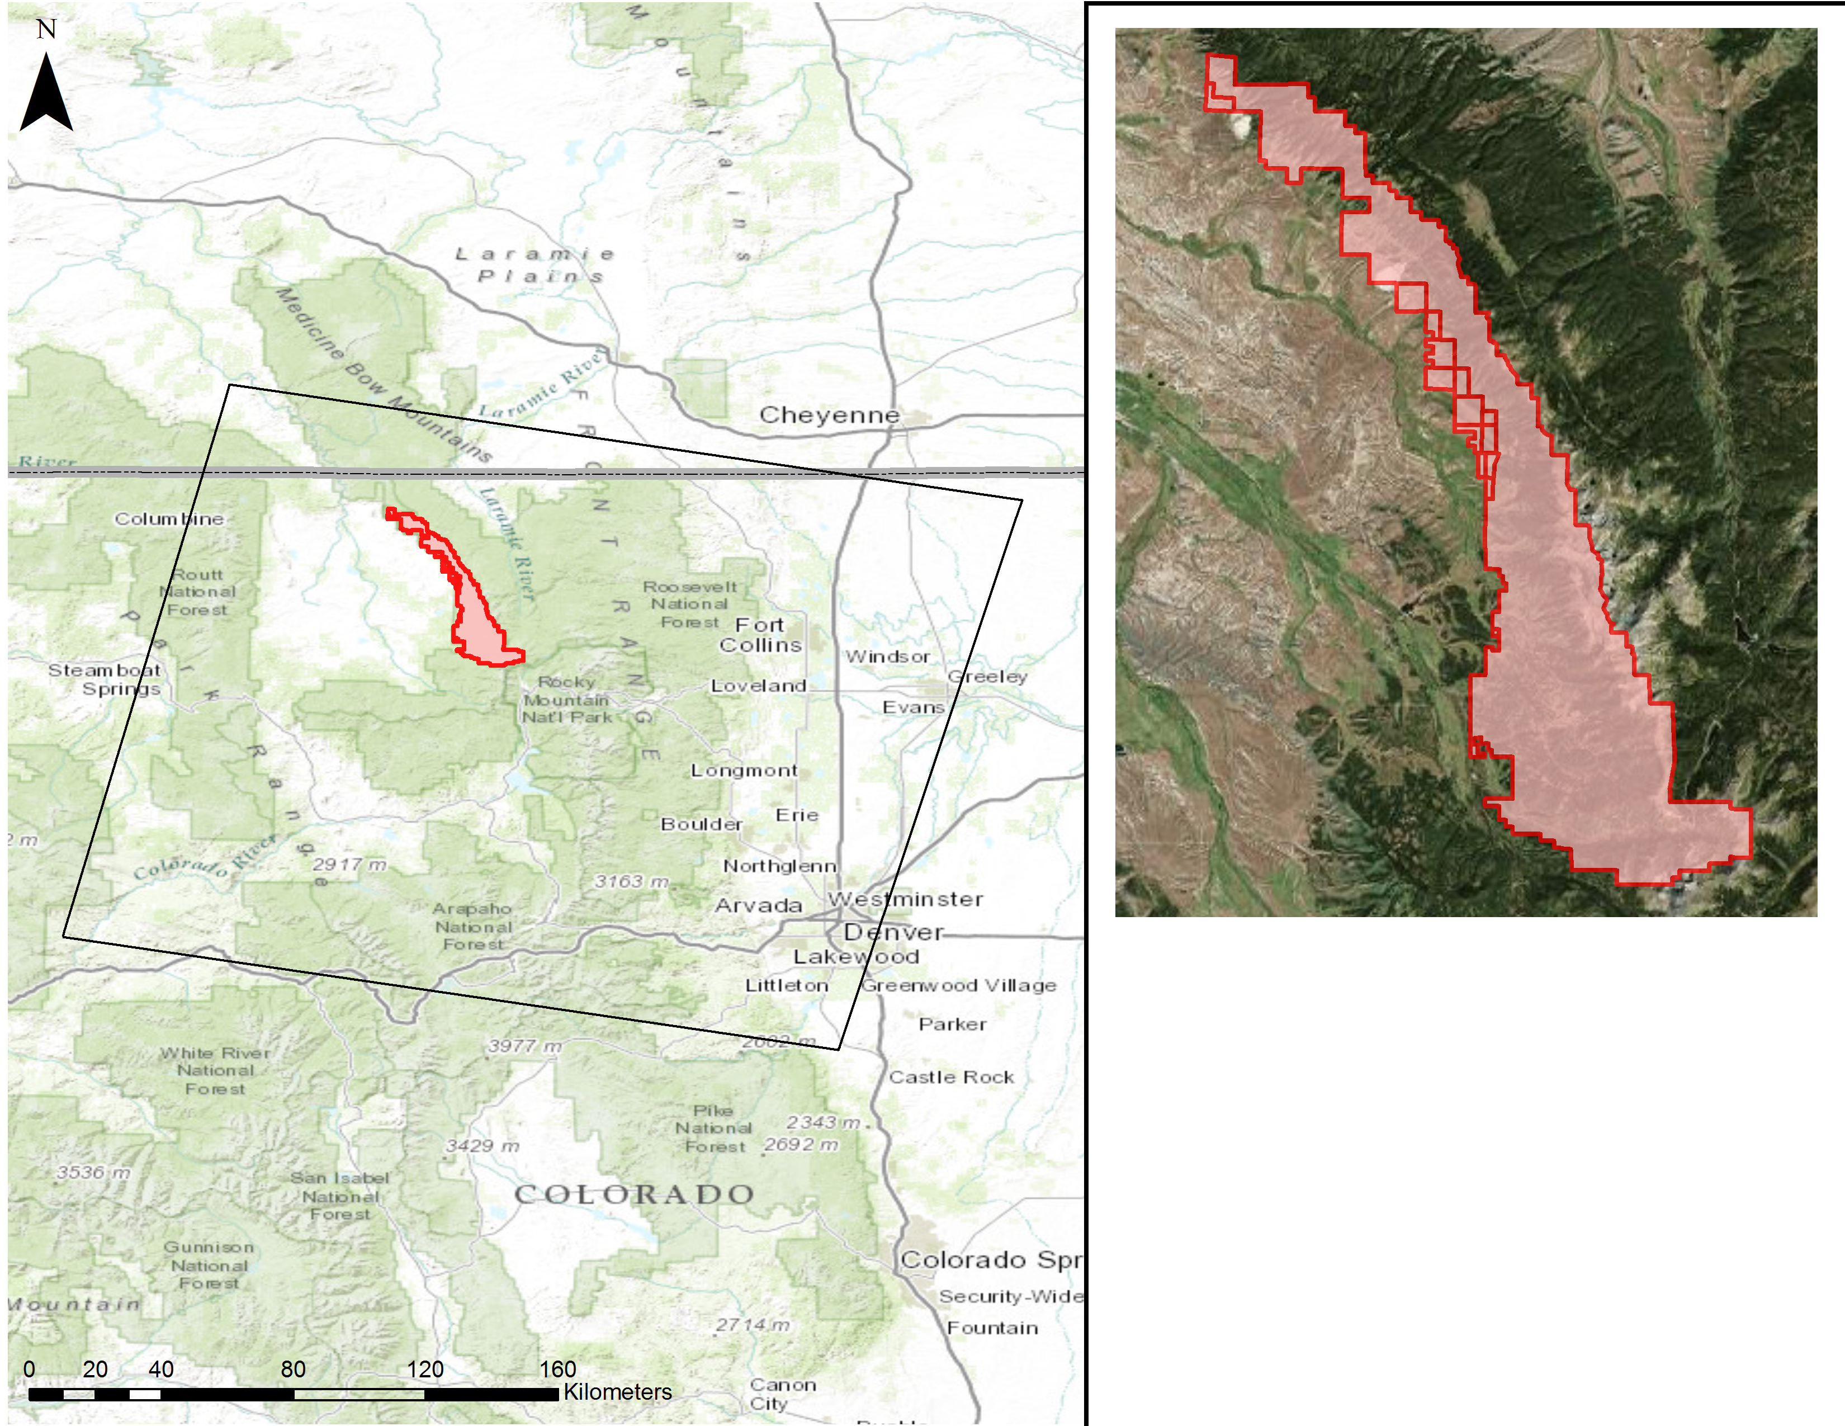
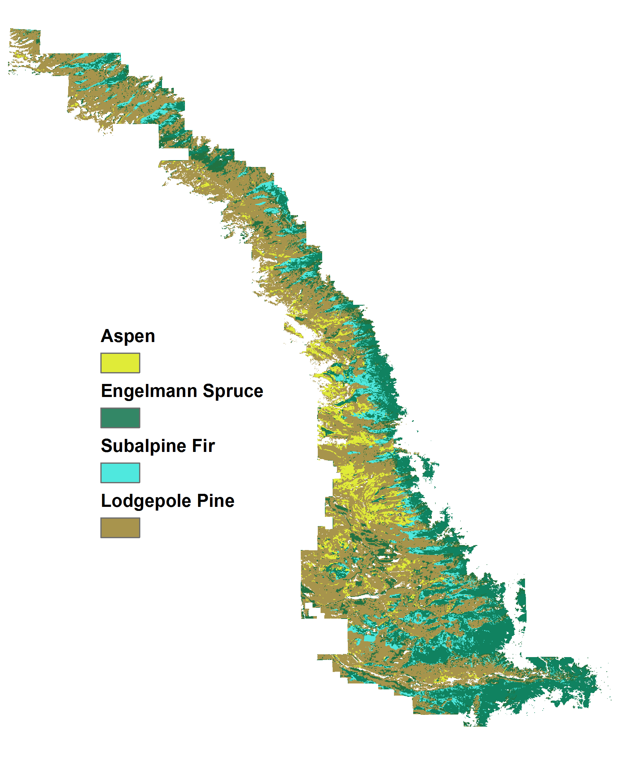
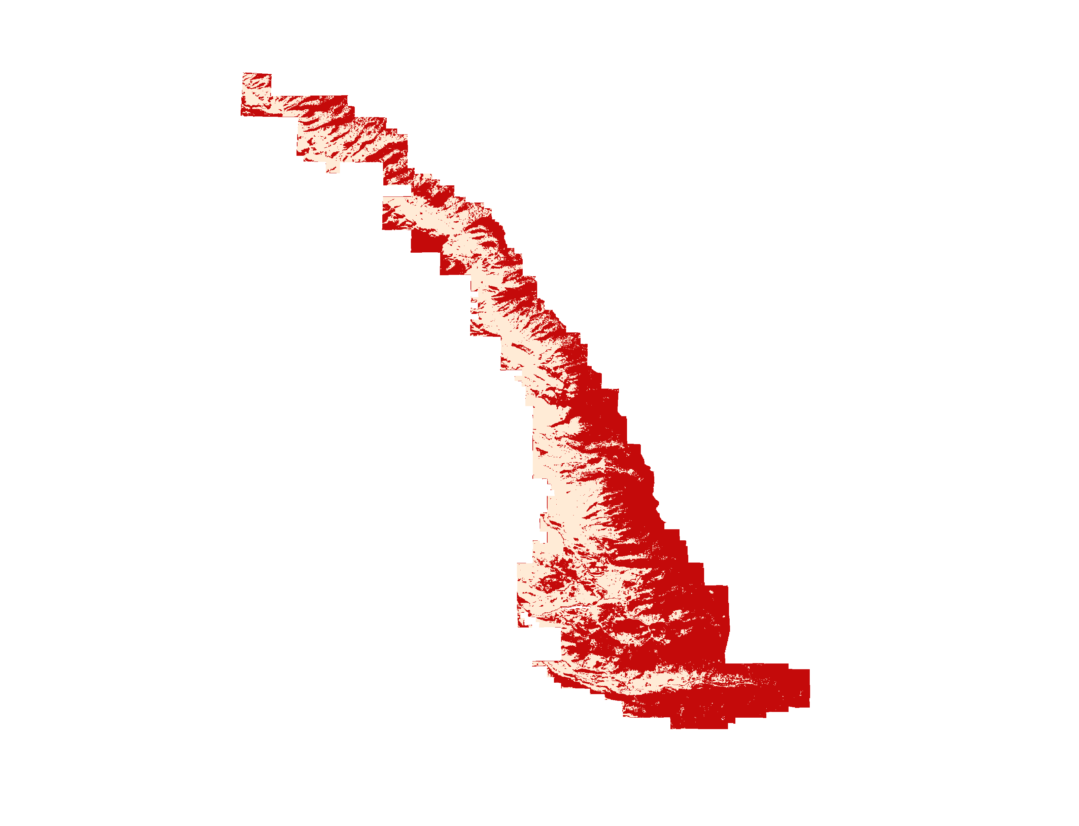
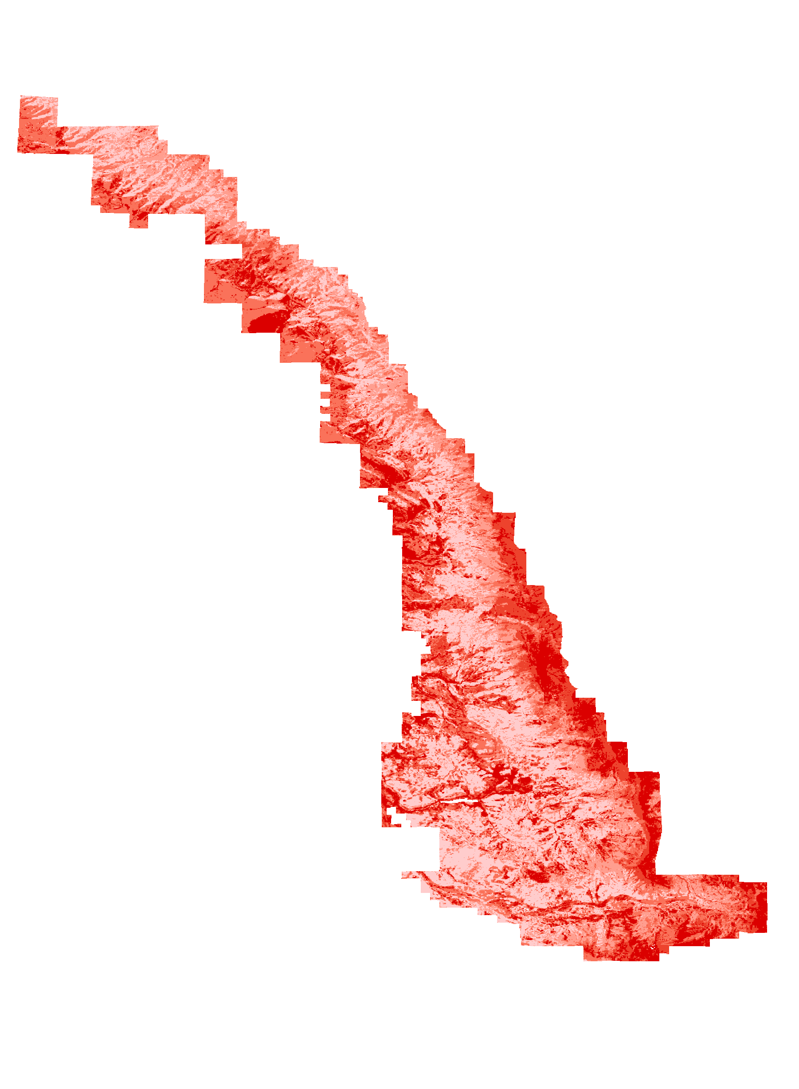
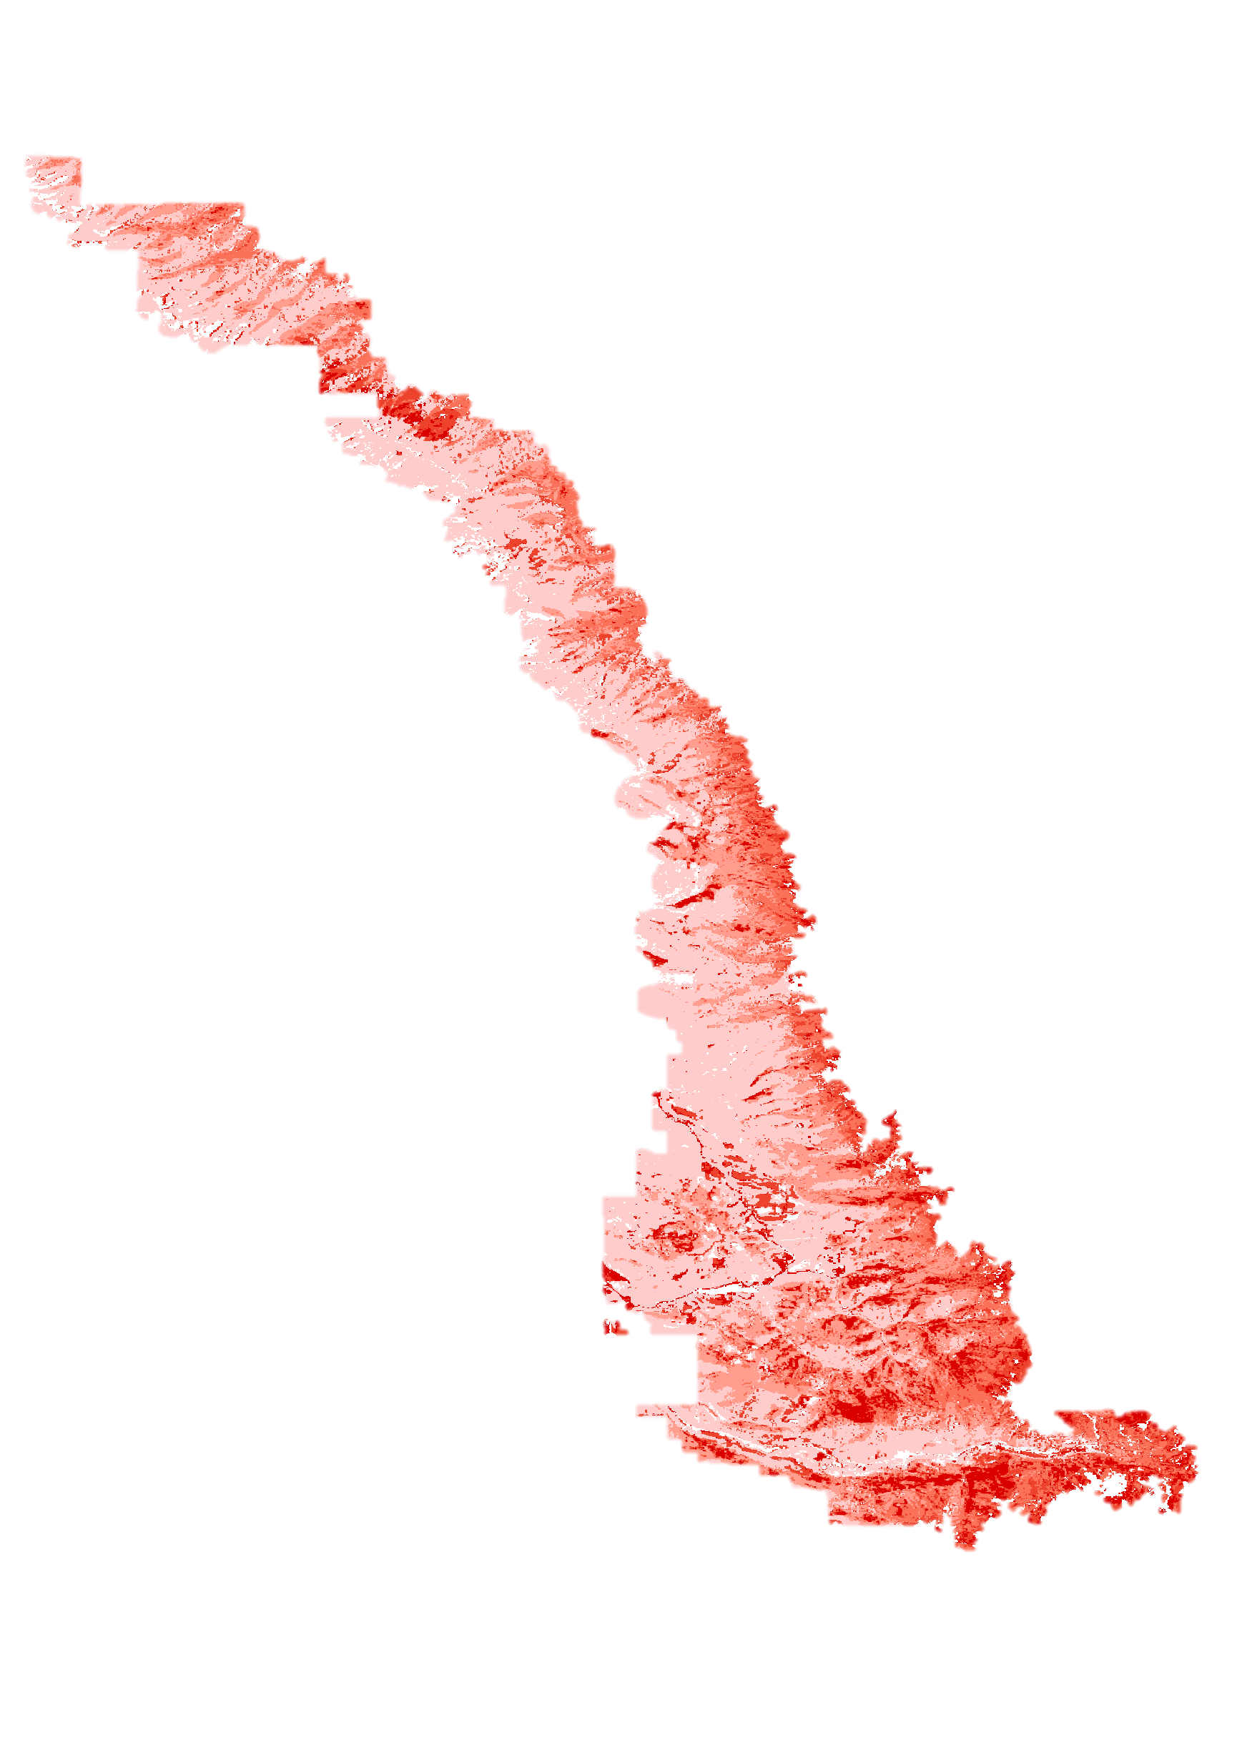
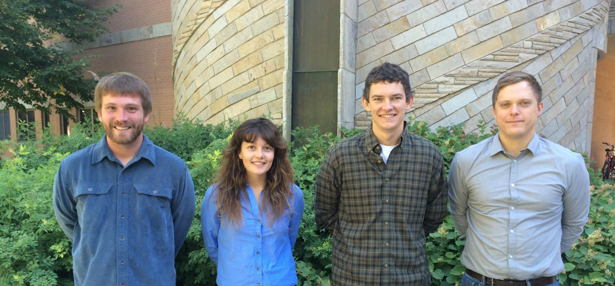
Colorado Agriculture
Mapping Forest Species Composition in the Colorado State Forest
using Landsat 8 with Integrative Spatial Modeling
Brian Woodward (Project Lead), Eric Rounds, Sarah Carroll, and Nicholas Kotlinski
NASA DEVELOP National Program at USGS Colorado State University
Abstract
Objectives
Earth Observations
Keep this blank for now.
Body text point size should be at least 24.
Caption text point size should be at least 16.
Feel free to rename, move, and resize sections as needed.
Employ a novel regression tree model to identify the location and extent of tree species composition within the Colorado State Forest
Validate the location of tree species using high-resolution NAIP imagery
Create accurate species composition maps for the use of our project partners
Landsat 8 OLI
Shuttle Radar Topography Mission (SRTM)
Methodology
Study Area
Reference data: calculate percent canopy cover by species from index of basal area from raw plot data
Imagery: create a 29 band composite image from 3 Landsat 8 scenes, DEM, and NAIP imagery
Preprocessing
Model Processes Inputs
Outputs
Input Reference Data for target Species
Step 1: Model (GLM) binary classification of study area for tree species
Presence = 1
Absence = 0
Output = BIN
(Binary map of study area)
Combine binary map with continuous map
For pixels with a value of 1 , exclude 0 (absence) data
(presence)
Output = Presence Data Only
Step 2: Regression model (SVM) of study areas
with Continuous Response
Output= CON
Continuous Map of Study Area
Final Output: Continuous Map of State Forest for each target species
Results
Step 1: Spruce binary (BIN) output Step 2: Spruce continuous (CON) output Combination of CON Final Map: All Species & BIN outputs
Conclusions
Team Members
Project Partners
Use bullets.
Use complete sentences with periods.
Colorado State Forest Service (CSFS) and Bioenergy Alliance Network of the Rockies
Acknowledgements
Special thanks to our project partners Tony Vorster (BANR, NREL) and John Twitchell (Colorado State Forest Service) for their assistance. We would also like to thank our science advisor Dr. Paul Evangelista (Natural Resource Ecology Lab, CSU) for his continued guidance.
(Left to Right): Brian Woodward, Sarah Carroll, Eric Rounds, and Nicholas Kotlinski
USGS at Colorado State University

