Slide 1
DEVELOP National Program
DEVELOP Logistics:
Guidelines, Rules & Regulations

Slide 2
Participant Reapplication & Eligibility
Fall 2018 Application Window now open! Closing June 29th
DEVELOP Terms: 10 weeks
Classifications:
  Currently Enrolled Student
  Recent Graduate (within 2 years of graduation)
  Early or Transitioning Career Professional (2+ years after graduation from last degree)
Eligibility Requirements:
  18+
  Minimum 3.0 GPA (for paid positions)
  Strong interest in Earth science and remote sensing
  Able to provide personal transportation to and from DEVELOP location
    DEVELOP does not provide transportation to nodes nor can DEVELOP provide a badge to a participant’s driver to gain access to NASA Centers
  U.S. citizenship is required to apply to: ARC, JPL, LaRC, MSFC, GSFC, NCEI
Reapplication:
  Required if you would like to continue with DEVELOP in a future term
  Returning Application is shorter and does not require letters of recommendation

Slide 3

Interacting with the Media
NPO and NASA Public Affairs must be involved with all media interaction from the beginning.
If you are interested in working with the media, contact NPO first.
If someone from the media reaches out to you, contact NPO about a response or connect them with NPO directly.
NPO POC – Lindsay Rogers
Lindsay.M.Rogers@nasa.gov

Slide 4
NASA’s Export Control
What is Export Control?
The NASA Export Control Program is based on the philosophy: “We want to maximize the benefits of our international efforts while ensuring that we comply with U.S. export control laws and regulations”. It is the personal responsibility of each employee or contractor to pursue appropriate international activities involving transfers of technologies, software, and commodities. The Agency’s Export Control Program is the mechanism that provides checks and safeguards at key steps to help manage international activities and ensures that NASA works within Export Administration Regulations (Department of Commerce) and the International Traffic in Arms Regulations (Department of State), which could result in criminal, civil, or administrative enforcement actions against NASA, individual employees, and/or private contractors.
NASA Administrator’s Export Control Policy:
"As a U.S. Government Agency on the forefront of technological development and international cooperation in the fields of space, aeronautics, and science, the National Aeronautics and Space Administration will strive to fulfill its mission for cooperative international research and civil space development in harmony with the export control laws and regulations of the United States. Due to heightened proliferation challenges facing the United States and the world, including risks posed by the spread of missile technologies and weapons of mass destruction, and in view of the significant criminal, civil, and administrative penalties that may affect the Agency and its employees as a result of a failure to comply with U.S. export control laws and regulations, it is the responsibility of every NASA official and employee to ensure that the export control policies of the United States, including nonproliferation objectives, are fully observed in the pursuit of NASA's international mission.“
What does this mean to me?
Before sharing anything outside DEVELOP, check with NPO. Some project materials can be shared without going through export control, others must gain NASA approval first. Email Lauren.M.Childs@nasa.gov with questions.

Slide 5
Designated Countries
What is a ‘Designated Country’?
This list of “Designated Countries” is a compilation of 35 countries with which the United States has no diplomatic relations, countries determined by Department of State to support terrorism, countries under Sanction or Embargo by the United States, and/or countries of Missile Technology Concern.
What does this mean to me?
It means that for any project deliverables, products, decision support tools, etc. to be transferred to any partner (domestic or international), a review must take place first. The NPO ensures that DEVELOP works within NASA Export Control guidelines. The NPO must be made aware of any presentations, publications, or information transfer that take place before they occur. A transfer can be an email, publication, presentation, telecon, webinar, etc. Communication with partners in designated countries has restrictions, so coordinate with NPO ahead of opening communication lines.
But my partner is domestic/not in a designated country?
While your project partner may be in the United States or not on the designated country list, the assumption is that anything that leaves the Agency/DEVELOP could be in turn transferred to any individual or organization anywhere, and thus, we must ensure that all material is appropriate for a global audience.
Questions? Contact Lauren.M.Childs@nasa.gov
NASA Export Control: http://oiir.hq.nasa.gov/nasaecp/index.html

Slide 6
NASA’s Software Release Authority
What is NASA’s Software Release Authority? It is NASA’s process for formally giving approval for software and tools to be released to the public for marketing, distribution, and use. All new “software” developed by NASA-funding must be made available through the Software Release Process, which coordinates export control review, intellectual property review, commercialization assessment, and software release actions, and determines if it meets NASA policies and guidelines.
Process involved:
  Identify which projects are creating the types of tools that must go through SRA by means of the proposal and project summary deliverables.
  To review the full process and steps involved - visit: www.devpedia.developexchange.com/dv/index.php?title=Open_Source_Software_Development_and_Release
Other considerations:
  All software released through NASA DEVELOP will be released open source.
  All software released through NASA DEVELOP will be distributed through the NASA DEVELOP GitHub account after Software Release Approval. Caution partners that this will not occur during the term.
  For questions about this form, refer to DEVELOPedia: Open Source Software Development and Release or contact Jordan Vaa at Jordan.S.Vaa@NASA.gov.
  You cannot handoff any coding tools/short scripts the team created to a partner until the software release process has been completed.
  You cannot include any lines of code in presentations or videos, even after completing SRA.

Slide 7
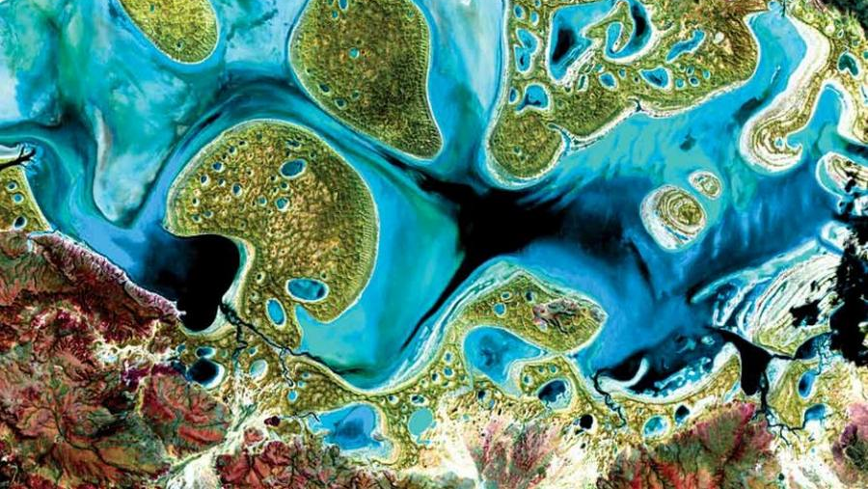
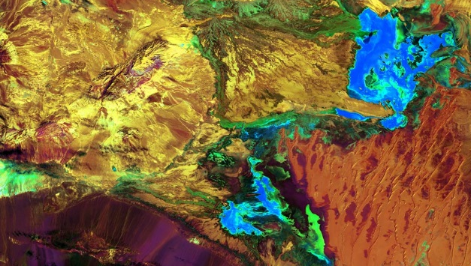

Required Legal Statements
All deliverables/products created by teams need to include this short paragraph of legal statements:
  “This material is based upon work supported by NASA through contract NNL16AA05C and cooperative agreement NNX14AB60A. Any mention of a commercial product, service, or activity in this material does not constitute NASA endorsement. Any opinions, findings, and conclusions or recommendations expressed in this material are those of the author(s) and do not necessarily reflect the views of the National Aeronautics and Space Administration and partner organizations.”

Slide 8
Important Things to Note
Earth observations and Earth science data are objective, transparent, and policy-neutral.
NASA Earth Science doesn’t develop or prescribe policy. Other agencies and organizations use the data and scientific results in their policy analysis and development.
DEVELOP IS part of NASA’s Applied Sciences Program.
DEVELOP is NOT part of NASA’s Office of Education.
DEVELOP is very different from NASA’s internship opportunities in the way we approach projects, focus on teamwork, the level of responsibility and authority given to participants, the opportunities we provide, and the individuals and organizations we network with. Enjoy it while you are here!
NASA has restricted travel under sequestration, meaning that guidelines are in place to gain approval for travel. Travel is a privilege!

Slide 9

THANK YOU!
DEVELOP provides many amazing opportunities. Help ensure that this continues by abiding by regulations!

