Slide 1

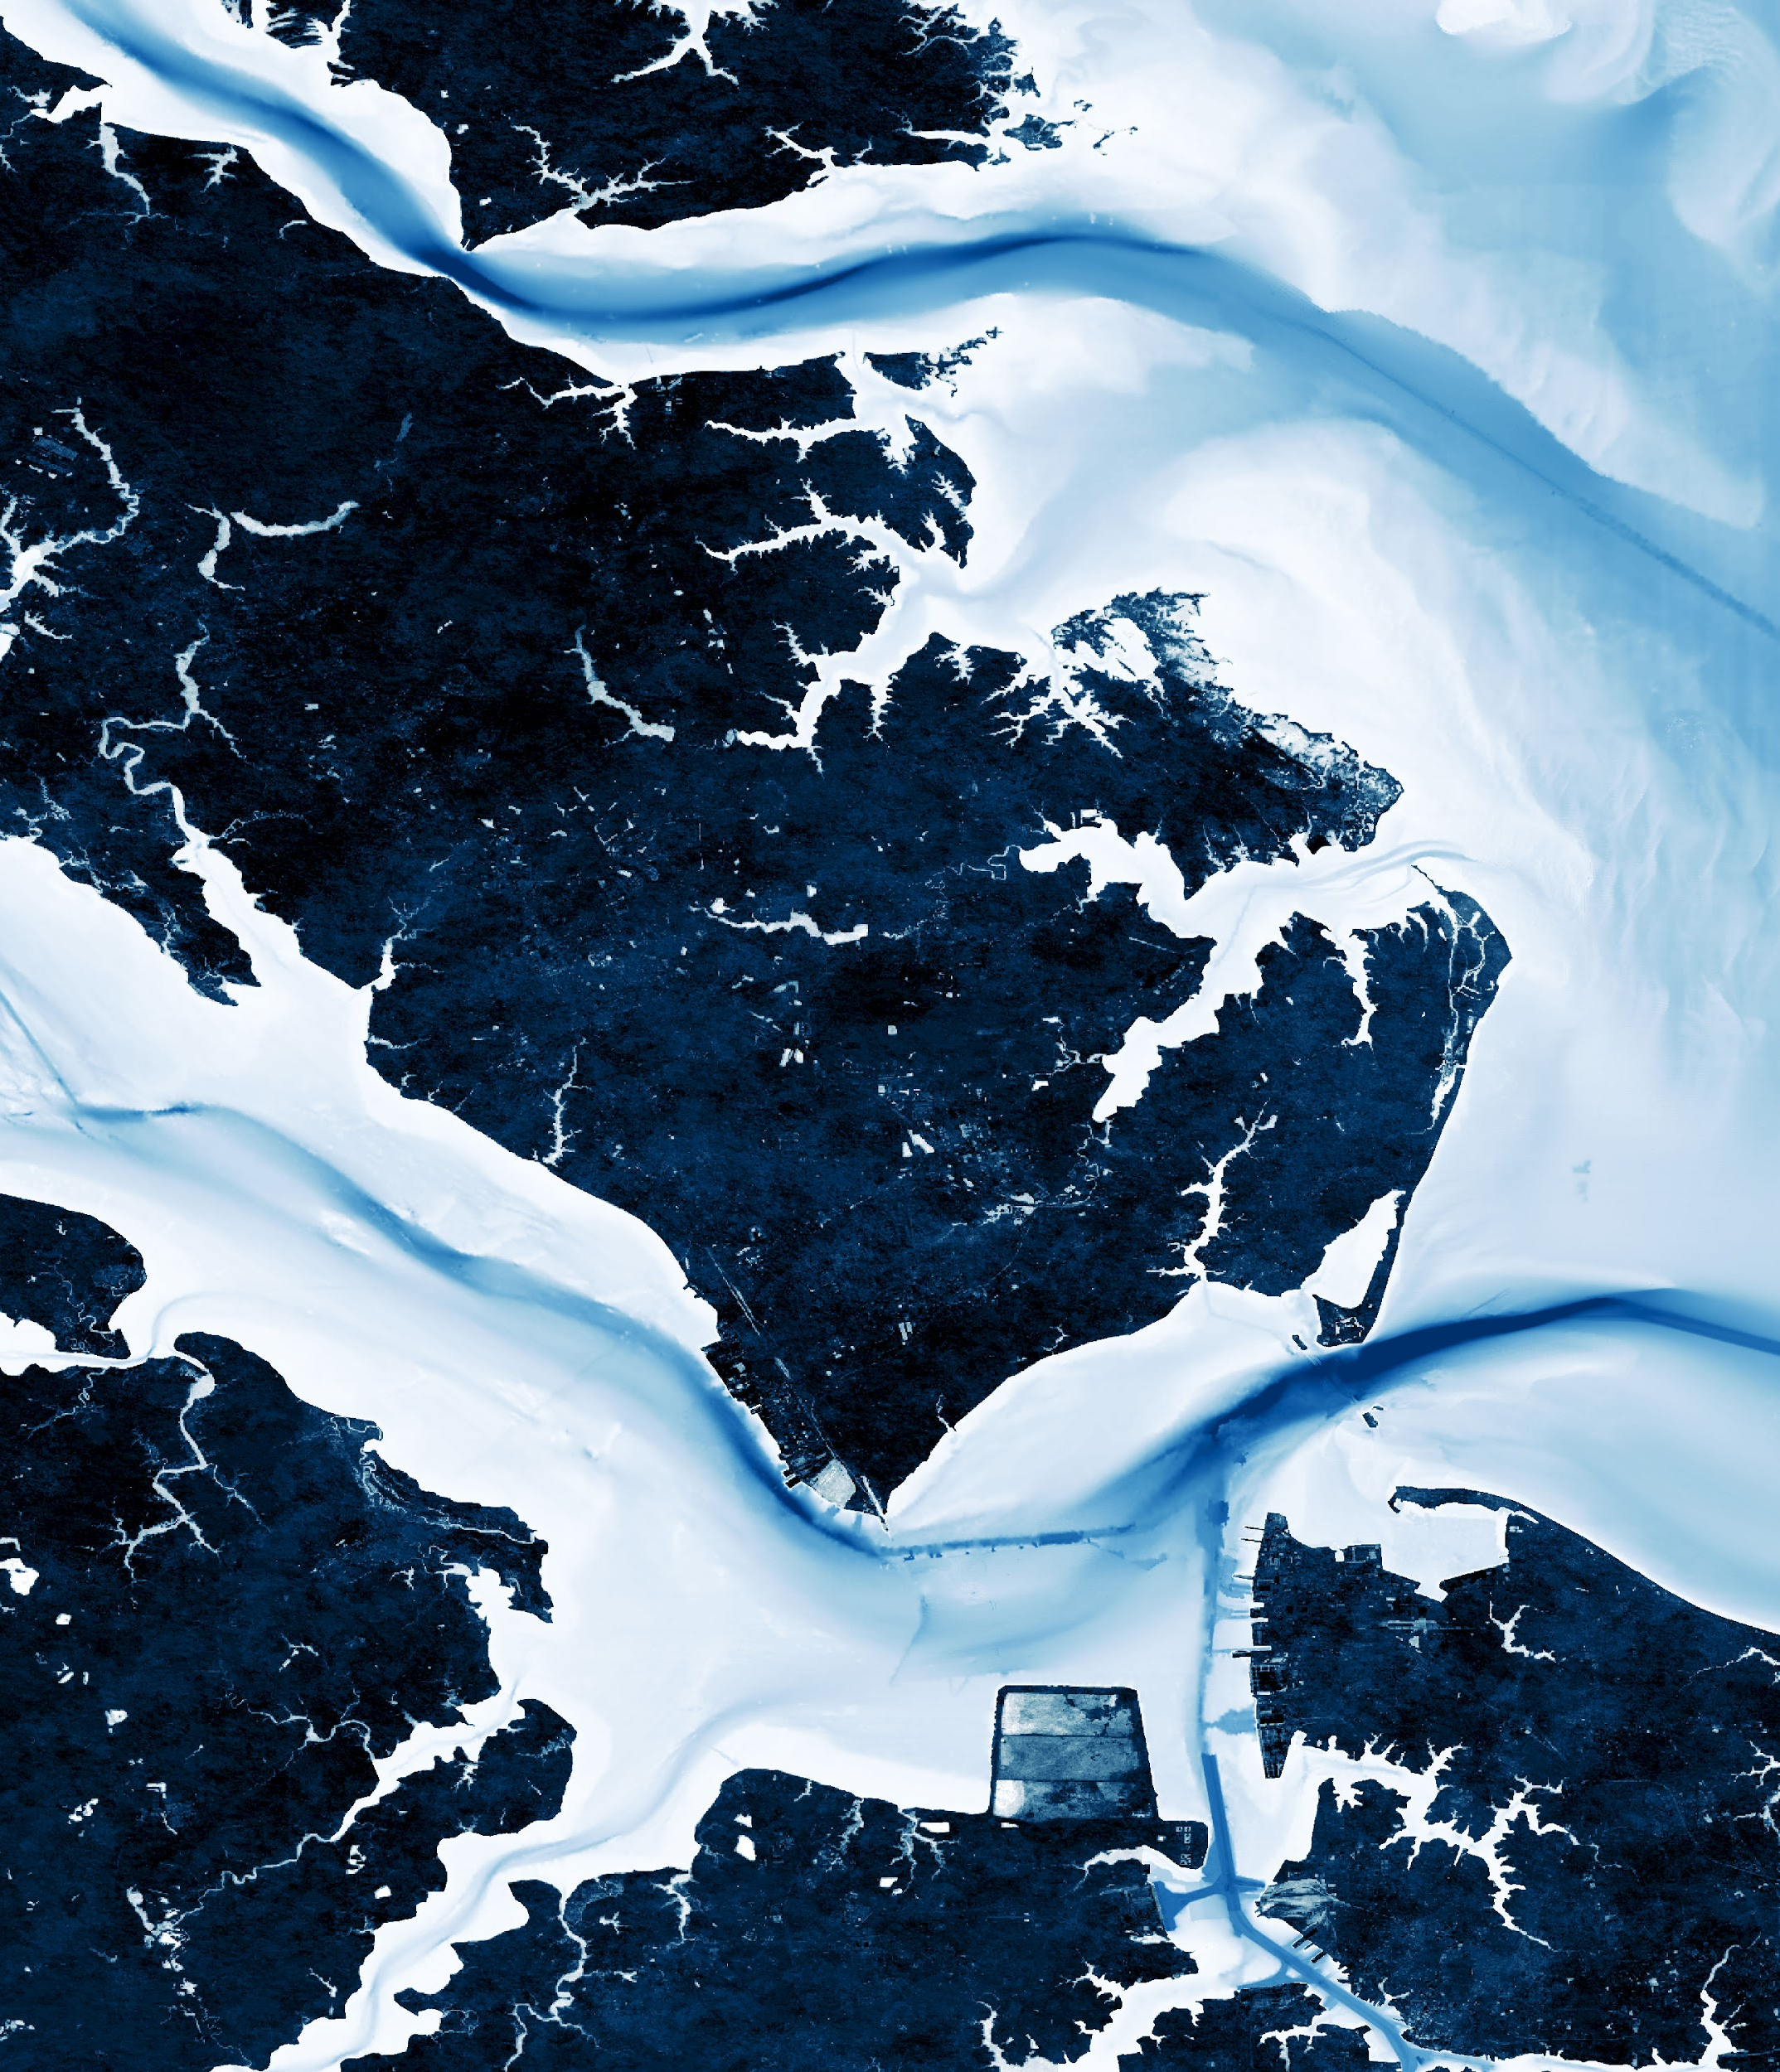


2018 Fall | Virginia – Langley
HAMPTON ROADS URBAN DEVELOPMENT
Enhancing Coastal Management by Monitoring Hampton’s Coastline and Barrier Island Transgression with the Aid of NASA Earth Observations
Danielle Ruffe
Eric Deutsch
Holly Gould
Shaifali Prajapati

Slide 2
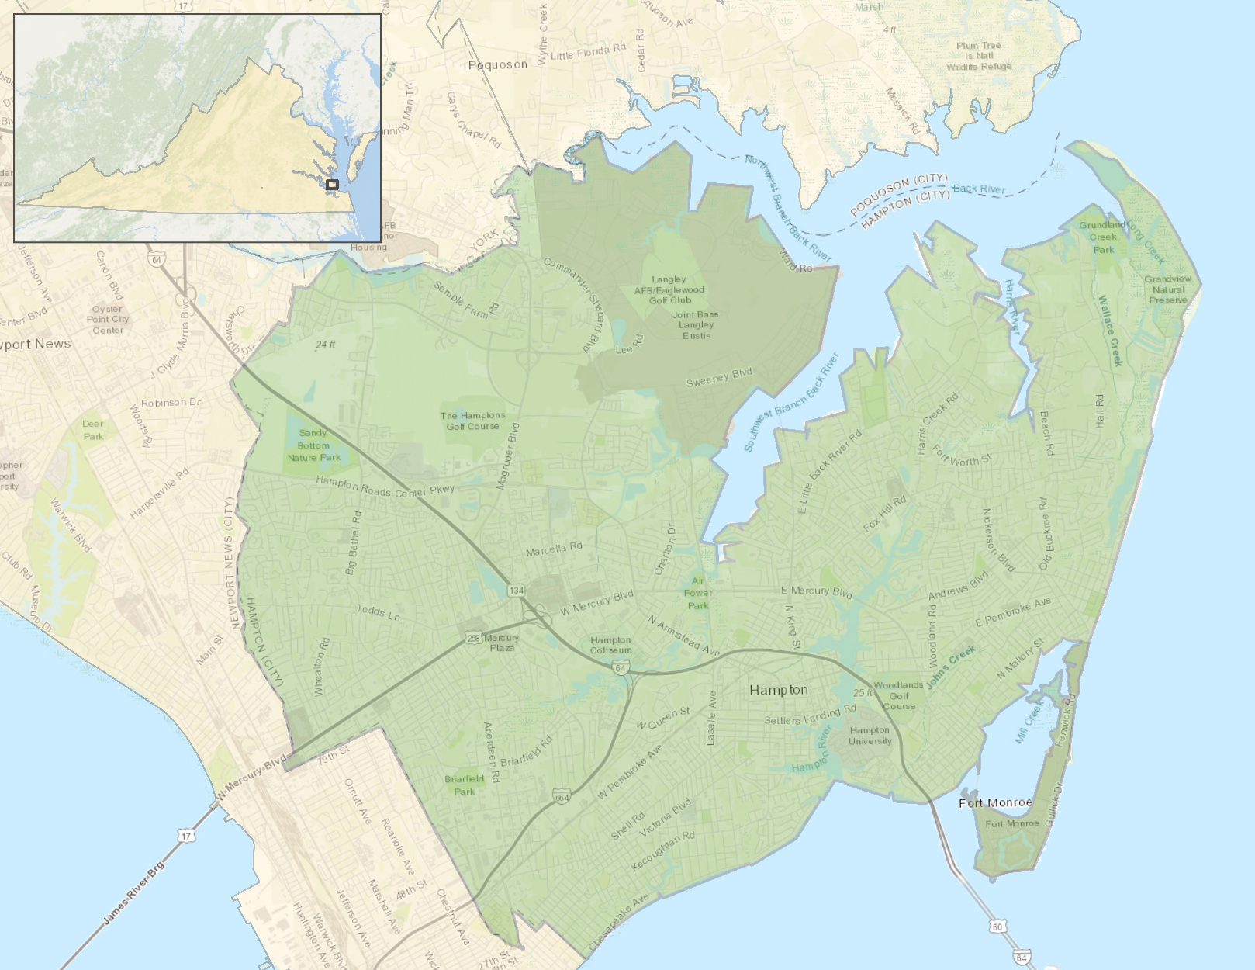



Study Area: Hampton, VA
City of Hampton
Virginia
Chesapeake Bay
James River
Miles
Notes:
The project study area is the city of Hampton, located in the southeast region of Virginia. Situated at the mouth of the Chesapeake Bay, the city’s coastline stretches about 124 miles. This coastal community, founded in 1610, is home to over 137,000 residents. The city is rich in history and natural beauty, drawing in many tourists and residents.

Slide 3
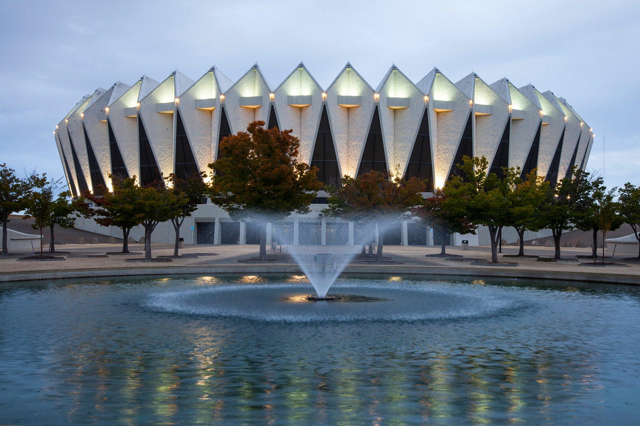
Project Partners
The City of Hampton
Notes:
We partnered with Hampton’s city government to create a useful methodology for future analysis of their coastline and a user friendly platform representing the actions that are being taken to enhance the cities coastal management for community awareness.
Source: The City of Hampton

Slide 4
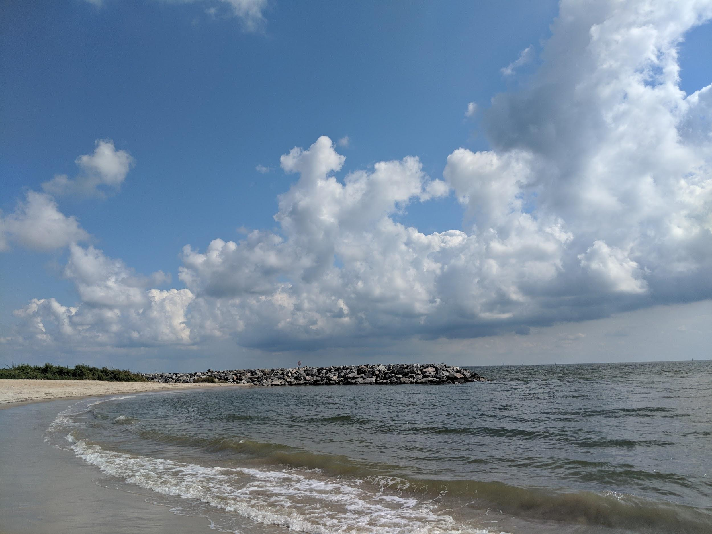
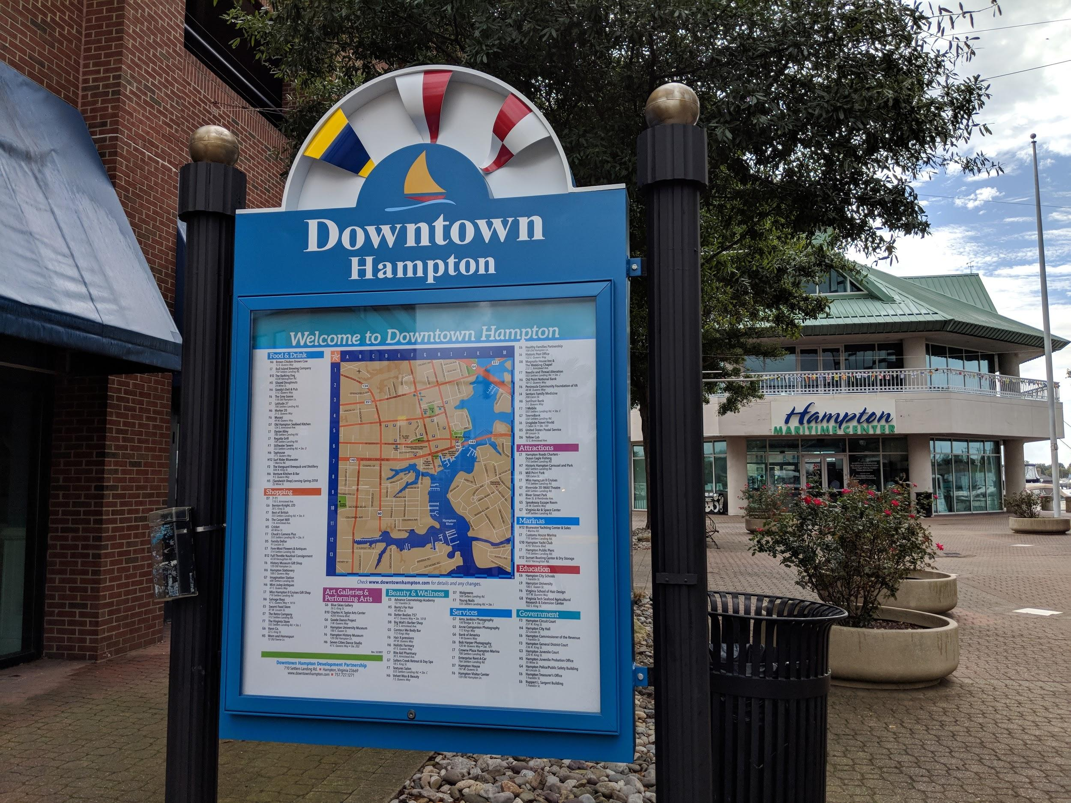
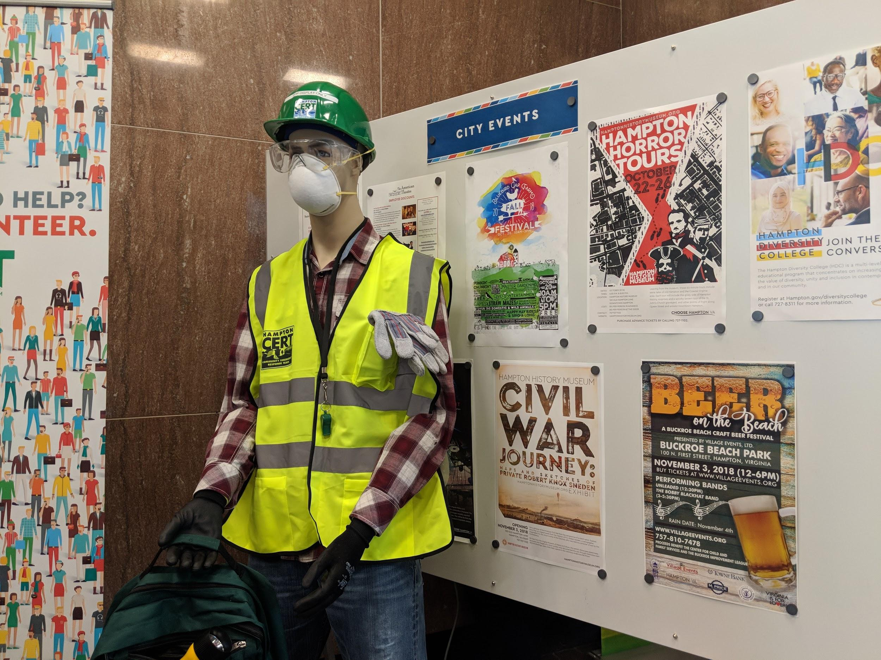
Community Concerns
The shoreline is the city’s first defense against storm events
The damage to developed areas due to flooding and shoreline loss
The need for public awareness on the risk presented by shoreline loss
Notes:
Being a community built along the coast, much of Hampton’s development is associated with water. The city prioritizes its water resources but as there is an increase in flooding and major storm events, Hampton (the city) is experiencing more damage than before. The city and it’s residents are concerned about the future of their coastline, their development, and their resilience. It is very important to the city that they understand the changes of their shoreline systems so they can develop nature based strategies to help adapt to future conditions. The city is hopeful that they will learn about their past and the changes that have occurred with their shoreline to see what areas might be at a higher risk so they can implement new adaptation strategies.
Image Source: All Photos Taken by Team Member Danielle Ruffe

Slide 5
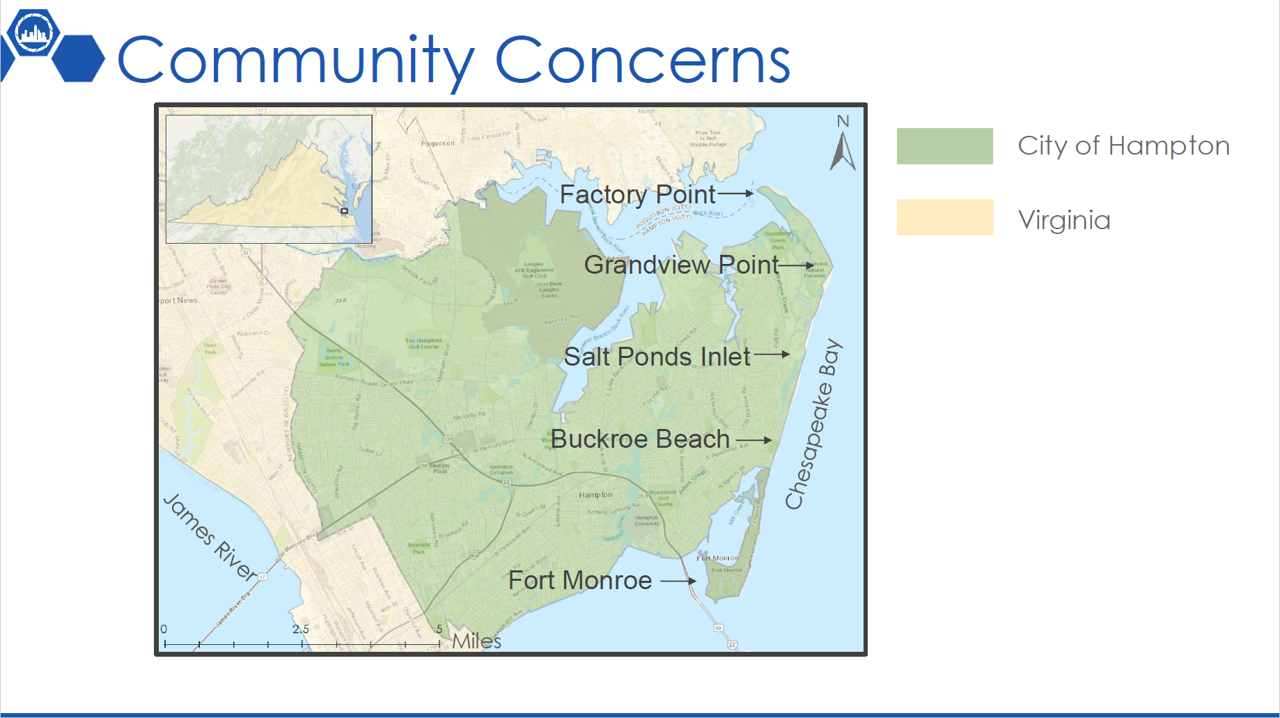
Notes:
These are some specific areas of interest for the city that we mention throughout the presentation.

Slide 6
Objectives
DEVELOP an efficient method for analyzing long-term shoreline changes
IDENTIFY the city’s regions vulnerable to coastal erosion
AID the city’s shoreline conservation efforts through the creation of risk maps
CREATE a GIS Story Map for public awareness addressing the city’s coastal concerns and management efforts
Notes:
We wanted to create a methodology for the city to see the fluctuations of their coastline, allowing them to create adaptation and resilient strategies. We did this by creating an annual shoreline change map that allows for the city to see their coastline alterations over the past 30 years. Also, risk maps were created for the city to identify areas that are at a higher risk and need more protection. Lastly, an ArcGIS Story Map was created for public awareness of the actions that the city is taking for adaptation and resilience.

Slide 7

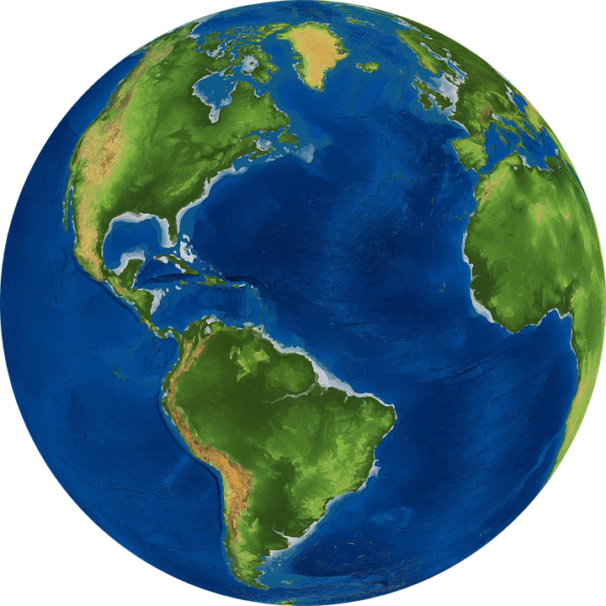

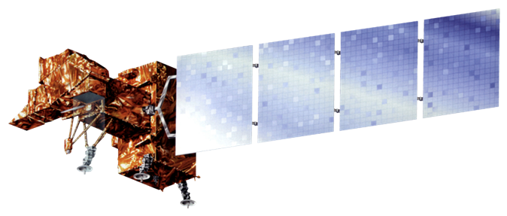
NASA Earth Observations
Landsat 5 TM
Landsat 8 OLI
Landsat 7 ETM+
1988 - 2018
Notes:
We utilized Landsat 5 Thematic Mapper, Landsat 7 Enhanced Thematic Mapper Plus, and Landsat 8 Operational Land Imager imagery to analyze the changes in the shoreline. For the Landsat satellites, the data collections were Surface Reflectance Tier 1.

Slide 8
Methodology: Coastal Change
Google Earth Engine
Landsat 5 TM
Landsat 7 ETM+
Landsat 8 OLI
Average Yearly
Coastline Binary Classification
ESRI ArcMap 10.5
Cloud
Masking
Parse by Year
(1988-2018)
Water Indices
(NDWI and MNDWI)
Annual and Five-Year Difference Rasters
Notes:
For the annual coastline average map, we collected data from NASA Earth observations. Using Google Earth engine, we produced a cloud mask and annual mean NDWI, and MNDWI to generate thresholded water indices where the water threshold equaled zero. Then, we exported the results as GeoTIFFs into ArcGIS Pro to analyze the results and create 1-year, 5-year, and 30-year coastline change maps.

Slide 9
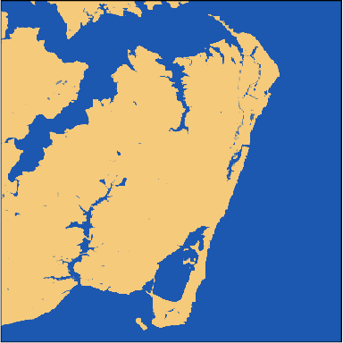


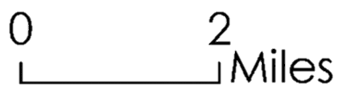
Coastal Evolution
n₂₀₁₃ = 90
n₂₀₁₇ = 117
1 (Water)
1 (Water)
0 1
0 (Land)
0 1
0 (Land)
Miles
Miles
2013
2017
Notes:
These rasters are a mean of the n= ____ images. We chose to show the process of finding the change/evolution between 2013 and 2017 because it is very recent.

Slide 10
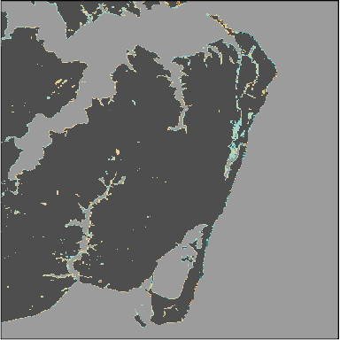
Results
Change in Average Percent of Pixel Covered by Water Over Time
2013 to 2017
-100 to -67
-67 to -33
-33 to -10
-10 to 10
10 to 33
33 to 67
67 to 100
Notes:
The map is turned into various shades of gray to make the pixels that changed pop out. The color of the changed pixels represents the percent chance between the two pixels.

Slide 11
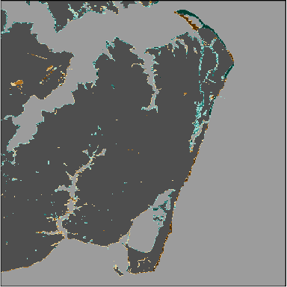
Results
Change in Average Percent of Pixel Covered by Water Over Time
1988 to 2017
-100 to -67
-67 to -33
-33 to -10
-10 to 10
10 to 33
33 to 67
67 to 100
Notes:
The map is turned into various shades of gray to make the pixels that changed pop out. The color of the changed pixels represents the percent chance between the two pixels.

Slide 12
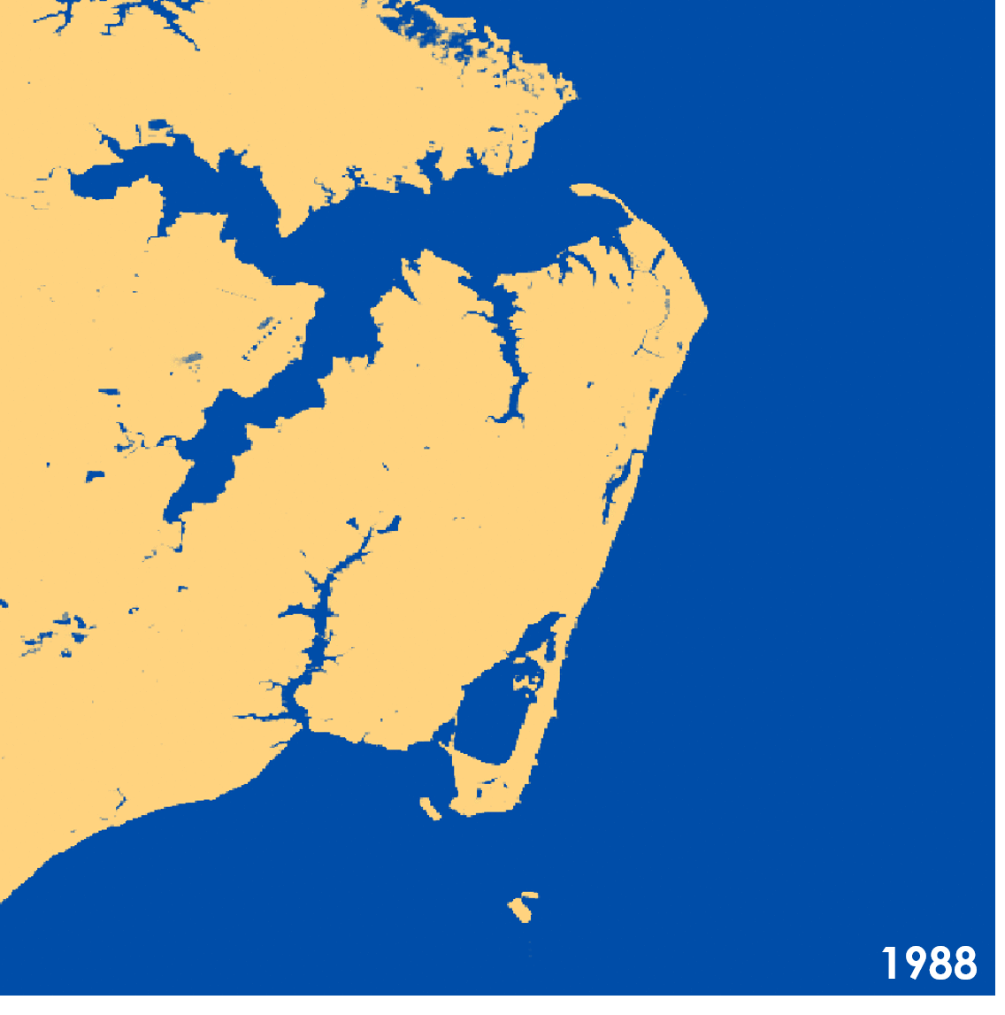
Results
Hampton’s Coastline from 1988 through 2017
1 (Water)
0 (Land)
Notes:
Gif Showing annual change

Slide 13
Errors or Uncertainties
Shoreline Change:
30 m spatial resolution is coarse for purpose of study
Cloud masking algorithm removes pixels from rasters
Threshold values to mitigate hardware degradation are determined through visual inspection
Notes:
These are sources of unavoidable error and uncertainty

Slide 14
Methodology: Risk Map
Acquire land cover, soil, shoreline, elevation
data
Reclassification of layers by risk level
Input datasets into ArcGIS Pro
Weighted Sum
of reclassified risk layers
Calculate slope, distance to shoreline, and soil erodibility
Coastal Erosion
Risk Map
Notes:
For the risk maps, we gathered a variety of datasets including census, land cover, shoreline, soil types, and erosion from multiple government databases. These datasets were imported and analyzed in ArcGIS Pro along with our coastline average maps. With this data, we were able to create and erosion risk map and through cluster analysis, a land value map.

Slide 15
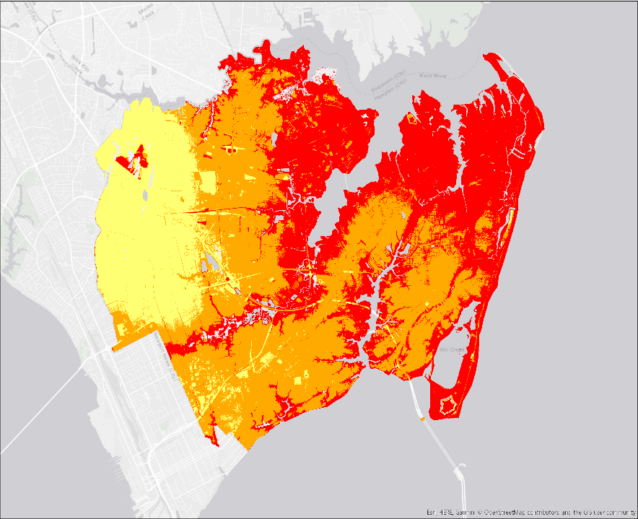
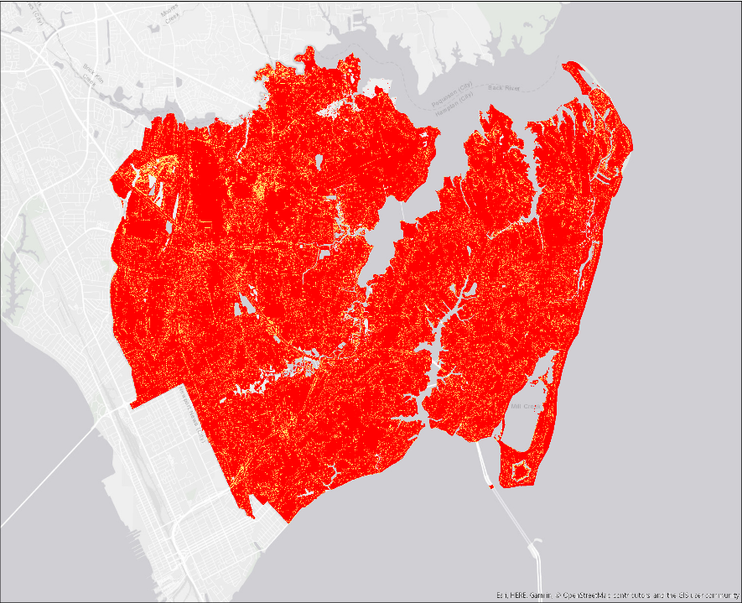
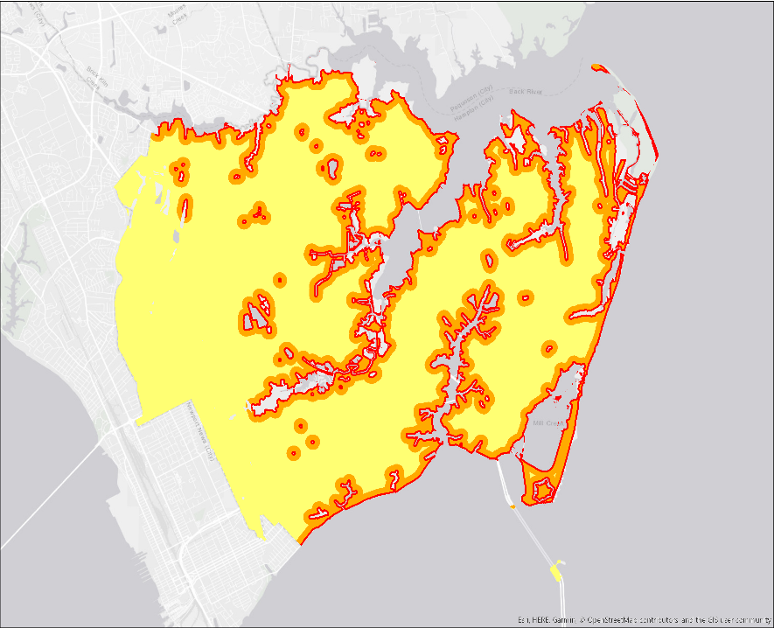

Individual Risk Factors
Elevation:
Slope:
Distance to Water:
Risk Level
Risk Level
Risk Level
Low
High
Low
High
Low
High
Notes:
The risk map is compiled from six main risk factors. While shoreline change comes from average annual coastline change data from the most recent five year intervals, other factors including soil erodibility, slope, elevation, distance to water, and land cover are derived from most recently available national datasets. These national datasets include the United States Geological Survey (USGS), United States Department of Agriculture (USDA), and Natural Resources Conservation Service (NRCS).

Slide 16
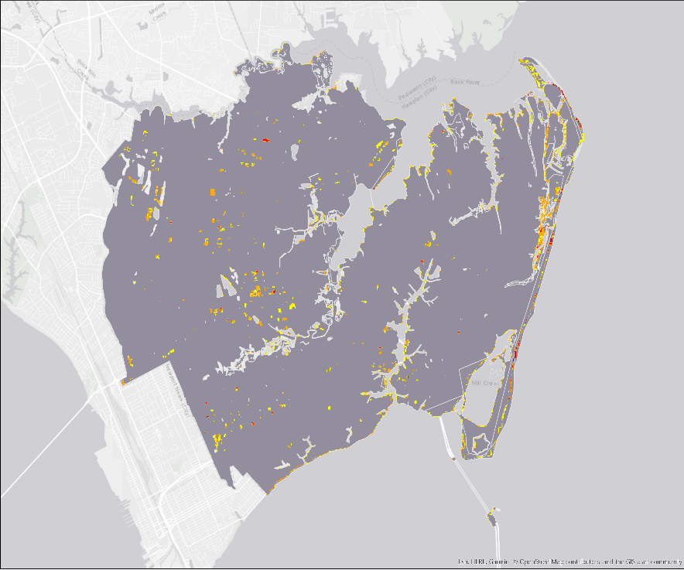
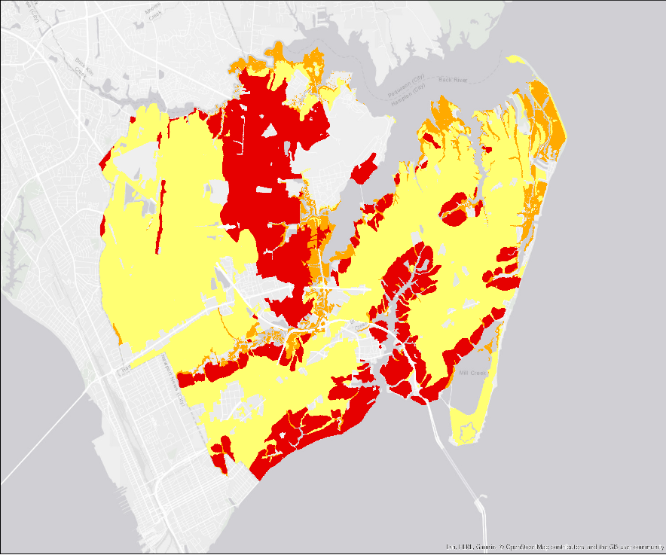
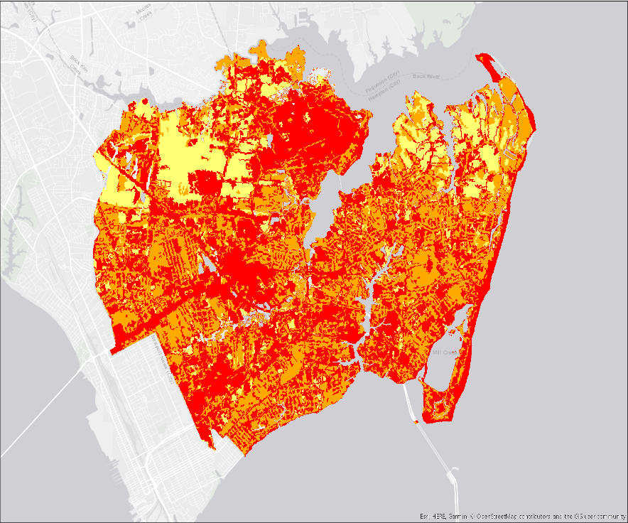
Individual Risk Factors
Shoreline Change:
Soil Erodibility:
Land Cover:
Risk Level
Risk Level
Risk Level
Low
High
Low
High
Low
High
Notes:
The risk map is compiled from six main risk factors. While shoreline change comes from average annual coastline change data from the most recent five year intervals, other factors including soil erodibility, slope, elevation, distance to water, and land cover are derived from most recently available national datasets. These national datasets include the United States Geological Survey (USGS), United States Department of Agriculture (USDA), and Natural Resources Conservation Service (NRCS).

Slide 17
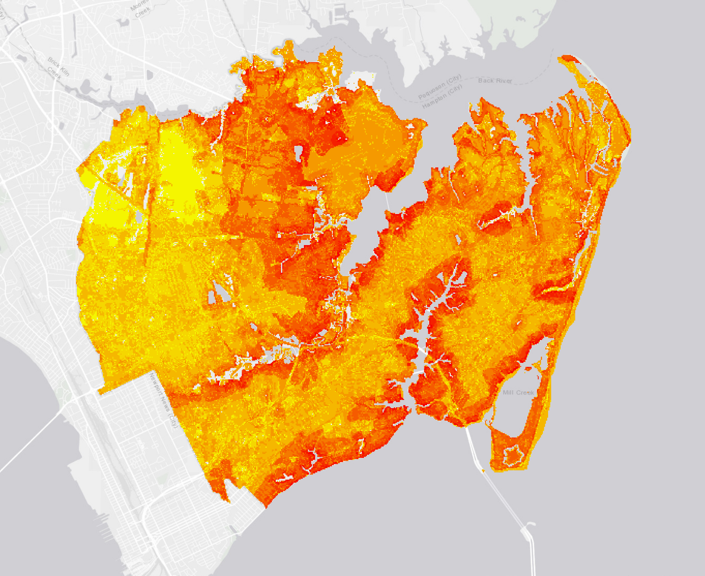
Coastal Erosion Risk Map
Risk Level
High
Low
Notes:
Areas shown in red have higher risk, while areas in yellow demonstrate lower risk.
The higher risk values are in areas along the shoreline and inland water bodies.

Slide 18
Errors or Uncertainties
Map:
Datasets limited to certain time periods and cannot account for most recent changes
No direct scales for coastal erosion risk available
Notes:
These are sources of unavoidable error and uncertainty

Slide 19
GIS Story Map
NASA DEVELOP TEAM
Coastal Average and Risk Maps
ArcGIS Online
City of Hampton
Photographs and Drone Footage
Interactive Web Application Builder
Location Descriptions
GIS Story Map
Notes:
Lastly, the team created a GIS story map in conjunction with the City of Hampton to help teach the public about coastal management concerns and efforts. The coastal average and risk maps, developed by the team, were brought together with photographs and drone footage from the city to create a narrative for public outreach. These background data sources were brought into ArcGIS Online and their interactive Web application builder to produce the GIS Story Map.

Slide 20
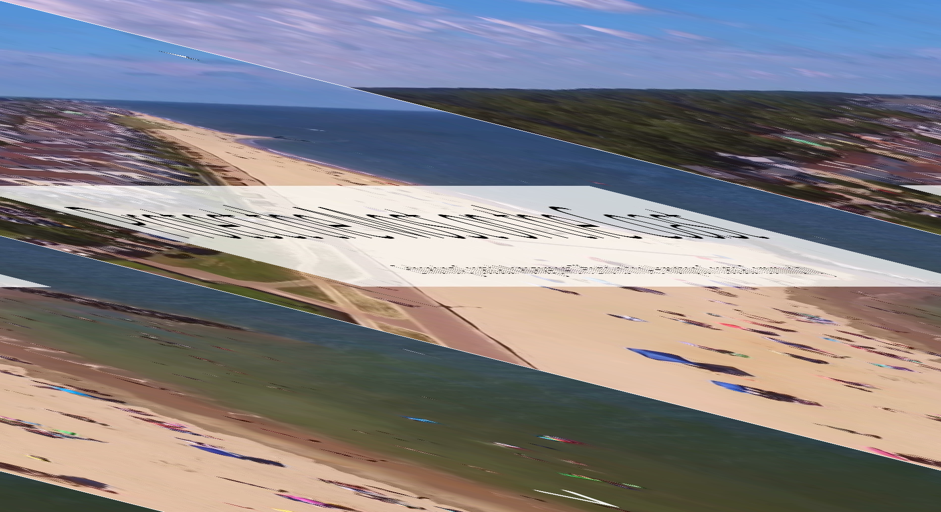
GIS Story Map
Notes:
The annual coastline average locations and the risk map were brought together to create a GIS story map for public outreach. One of the City of Hampton’s concerns was public awareness on their coastal issues and the city sought to find a better way to communicate to the public. With the ability to create an interactive GIS story map in ArcGIS online, the NASA DEVELOP team partnered with the Hampton officials to create a story map that includes a set of interactive web mappers highlighting the 2017-1988 coastline change as well as current areas at shoreline risk in need of mitigation and restoration efforts.

Slide 21
Conclusions
Hampton’s Defined High Risk Areas:
  Factory Point, Grandview Nature Preserve Point, and the Salt Ponds Inlet
Hampton’s Defined Low Risk Area:
  Fort Monroe
Shoreline change maps allows for the city to analyze areas of high coastal erosion after major storm events
  Hurricane Isabel and Hurricane Michael
Notes:
Factory Point: Historically has showed the highest rates of coastline erosion
Artifical riff-raff barrier created to replaced washed-away coast
High Risk
Grandview Point: High levels of coastline erosion: High Risk
Marina inlet: Sediment accumulates north of the entry
Accelerated erosion south of inlet: High Risk
Buckroe Beach: regularly maintenance has made determining trends of this area unreliable: Undetermined
Fort Monroe: Shows slight sediment accumulation: Low Risk

Slide 22
Acknowledgements
The City of Hampton Government Officials:
Bruce Sturk | Director of Federal Facilities
David Imburgia | Environmental and Sustainability Manager
Lucy Stoll | City Planner
Allan Lambert | GIS Manager
Brian Lewis | Water Resources Engineer
Terry O'Neill | Director of Community Development
Matthew Tisdale | NASA Atmospheric Science Data Center
Patrick Frier | Center Lead at DEVELOP Langley
Dr. Kenton Ross | Lead Science Advisor for NASA DEVELOP National Program
Jared Goldbach Ehmer | LaRC DEVELOP Intern on Intermountain US Health & Air Quality II
Notes:
We would like to thank the following members from Hampton City Hall for their help and support for this project. Also, the Matthew Tisdale for his help with the creation of our story map. Finally, Dr. Ross and Patrick Frier for being our advisors throughout the term.

