Slide 1
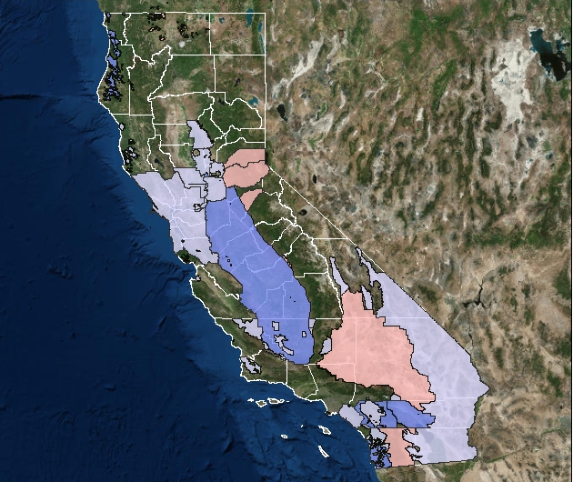
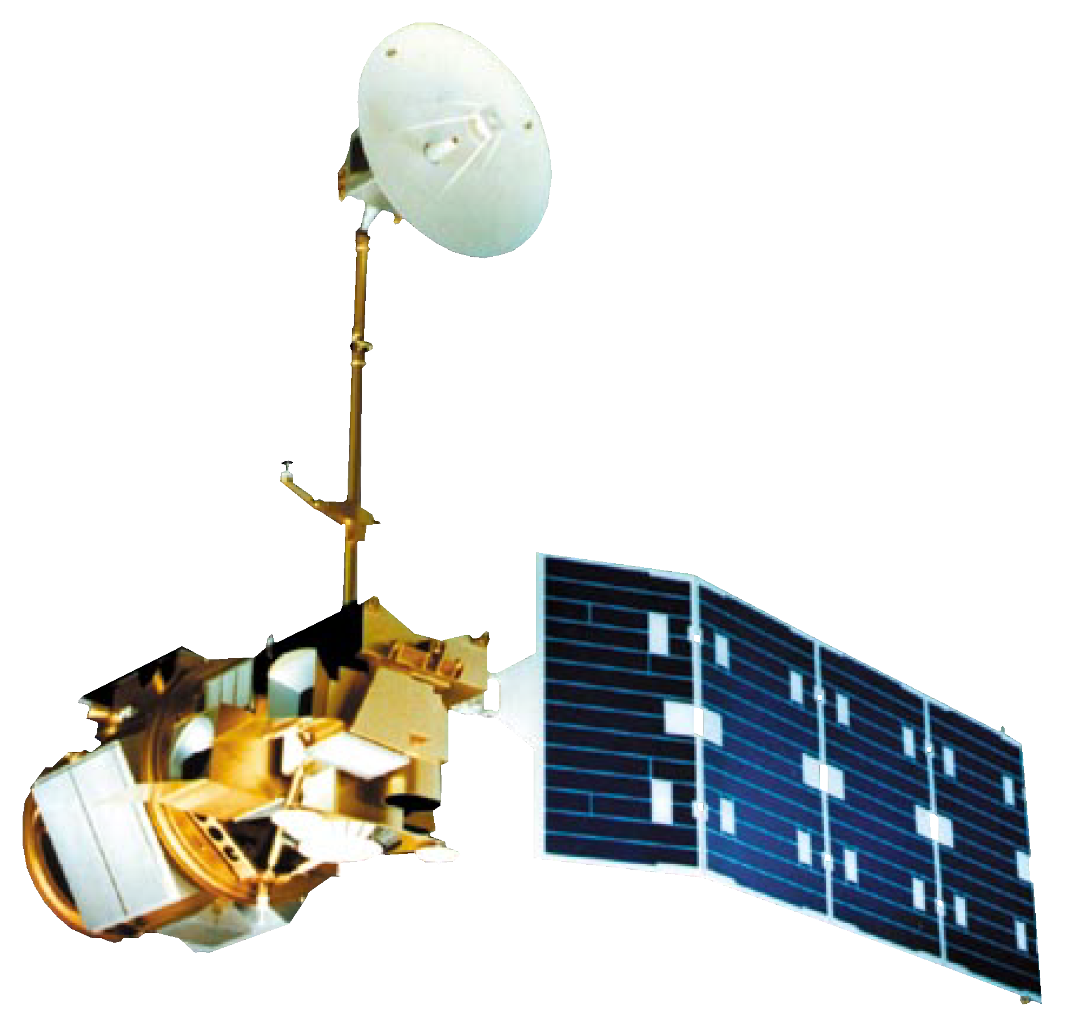

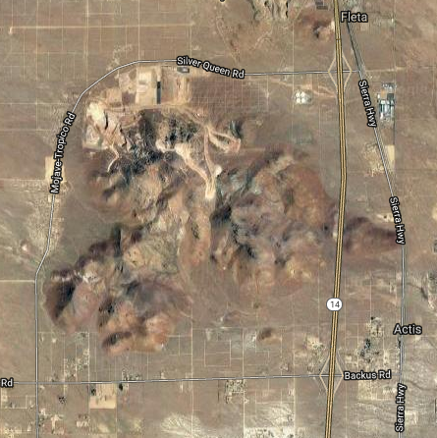
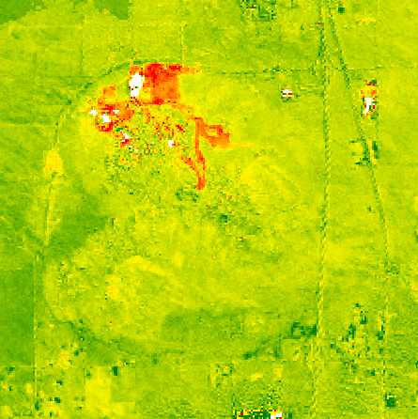
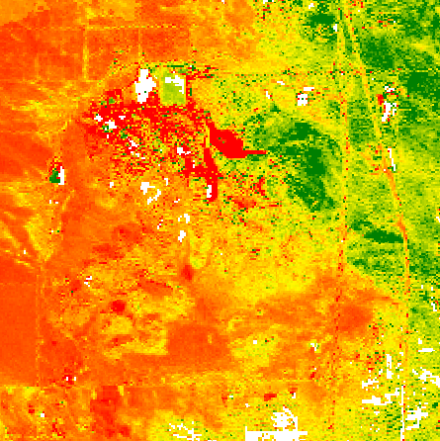
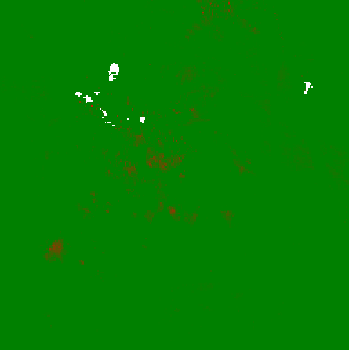
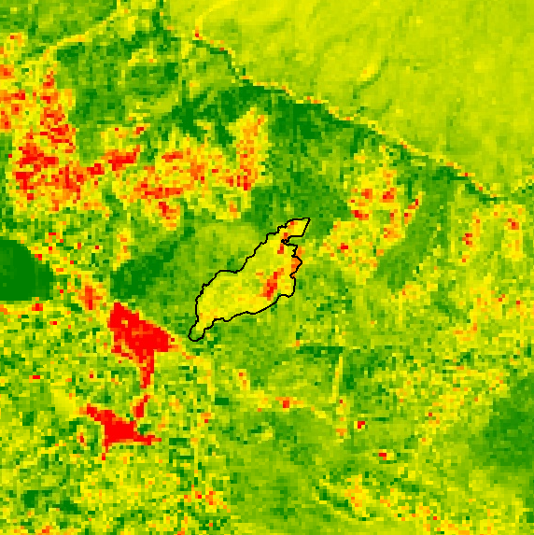
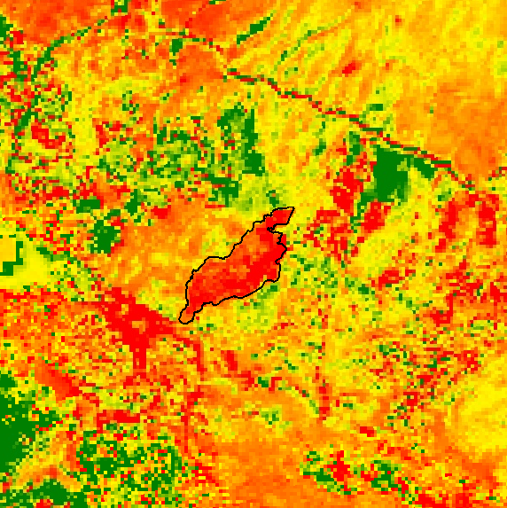
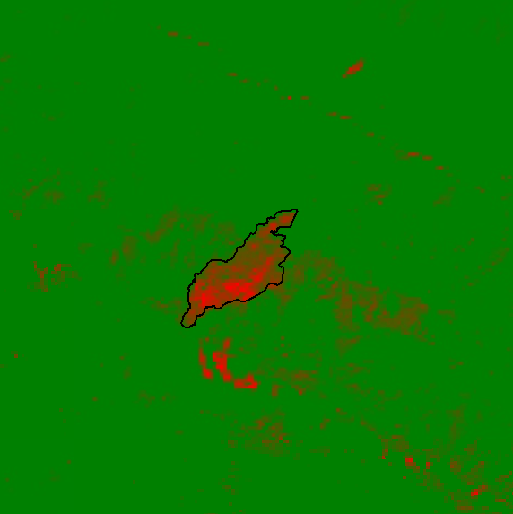





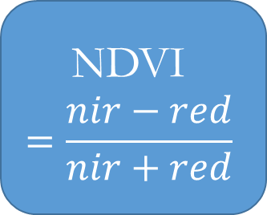
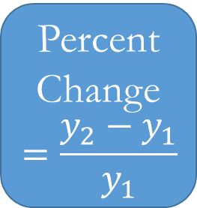
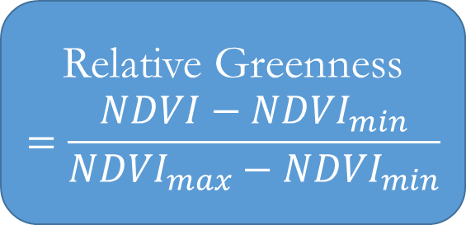
Utilizing NASA Earth Observations to Develop a Land Use Change Detection Tool for Habitat Conservation Plan Areas
Abstract
Objectives
Habitat Conservation Plans (HCPs) were designed to protect and manage areas where desired economic development is in conflict with the needs of threatened and endangered species. Each plan is developed through collaboration between United States Fish and Wildlife Service (USFWS) and a landowner or other project proponent. Regulations restrict activities within HCP boundaries to minimize impacts to listed species while still allowing for land development. The USFWS does not have the capacity to closely monitor and assess the millions of acres of private- and publically-owned lands to ensure compliance with restrictions. In order to assist monitoring efforts by the USFWS, a methodology was constructed that uses remote sensing data and the Normalized Difference Vegetation Index (NDVI) to detect land use change. Past land use change from 1995 to 2017 in the Pacific Southwest HCPs was analyzed. This methodology used publically available satellite data from Landsat 5 and Landsat 8, and was implemented in the open source Google Earth Engine (GEE) API. The USFWS will be able to use this tool on the GEE platform to continue evaluating HPCs for disturbance, saving significant travel time and effort.
Utilize Landsat 5 and Landsat 8 imagery to derive interannual NDVI and relative greenness values for Habitat Conservation Plan areas in California
Identify areas that have undergone significant land cover change between 1995 and 2017 and assess possible causation
Create a tool which assists US Fish and Wildlife Service with monitoring Habitat Conservation Plan areas
Study Area
California Habitat Conservation Plan areas
Legend
HCP Plan Areas
Other
Status
Implementation Phase
Inactive
Plan Development Phase
Post Permit Phase
Methodology
Include a map that has easily readable text and a legend. Including the study period is optional.
For ALL images – make sure all text is legible and add legends separately (so they can be moved or resized). If text is not editable, a team member must be available to make changes with a very short turn-around time (hours, not days) after submission.
Landsat 5
Landsat 8
Baseline Collection
Google Earth Engine
NDVI
$$=\frac{nir−red}{nir+red}$$
Relative Greenness
$$=\frac{NDVI−{NDVI}_{min}}{{NDVI}_{max}−{NDVI}_{min}}$$
Percent Change
$$=\frac{y_{2}−y_{1}}{y_{1}}$$
Identify Cause of Change
Earth Observations
Polygon Study Area
Years of Interest
Landsat 5-
ThematicMapper
Landsat 8- Operational Land Imager
Pacific Southwest Cross-Cutting
Results
a
b
c
d
a
b
c
Relative Green
-1 (Vegetation Loss)
0 (No Change)
1 (Vegetation Gain)
Percent Change Relative Green
-100% (Vegetation Loss)
0 (No Change)
100% (Vegetation Gain)
Normalized Burn Ratio
-0.35 (Fire Likely)
-0.15 (Fire Unlikely)
Relative Green
-1 (Vegetation Loss)
0 (No Change)
1 (Vegetation Gain)
Percent Change Relative Green
-100% (Vegetation Loss)
0 (No Change)
100% (Vegetation Gain)
Normalized Burn Ratio
-0.35 (Fire Likely)
-0.15 (Fire Unlikely)
FIG2 A-D (a) Aerial photography from GEE (b) Relative Green (c) Percent Change in Relative Green (d) Normalized Burn Ratio. This is a Golden Queen Mine in California, also located within the Desert Renewable Energy Conservation Plan HCP. New development occurred in 2016 on the northern part of the mine. Figures 2b and 2c show the vegetation loss that occurred in this area. Fig 2d shows this change was likely not caused by a fire.
FIG 1A-C (a) Relative Green (b) Percent Change in Relative Green (c) Normalized Burn Ratio. These images show part of the Desert Renewable Energy Conservation Plan HCP and contain an outlined area where the Johnson Fire occurred in October, 2016. These results were calculated from Landsat 8 images collected in November of 2016, shortly after the fire. Fig 1a and 1b display the vegetation loss that occurred in the area, and Figure 1c shows it was likely a fire that caused this loss of vegetation.
Conclusions
Recent appreciable land cover change can be detected using Landsat image collections.
Normalized Burn Ratio can help indicate whether the vegetation loss was caused by a fire.
The possible cause of change can be investigated by viewing aerial imagery, ancillary datasets, or conducting a ground survey.
Project Partners
Pacific Southwest Region
Midwest Region
Team Members
Acknowledgements
Dr. Kenton Ross – NASA Langley Research Center
Pat Lineback – Regional GIS Coordinator; USFWS, Pacific Southwest Region
Dan Cox – Regional Habitat Conservation Coordinator; USFWS, Pacific Southwest Region
Brian Huberty – Regional NWI and Remote Sensing Coordinator; USFWS, Midwest Region
Sean Robison
(Project Lead)
Elizabeth Dyer
Katie Thomas
NASA Langley Research Center – Summer 2017

